Slide 1
Applying Learning Theories of Meaningful Reception Learning and Schema in
Identifying Essential Information on the Front, Back and on the Inside of a Sewing Paper Pattern
Instructor: Titilola Obilade
12th December, 2012

Slide 2
OUTLINE
Introduction
Information on the outside of a sewing paper pattern envelope
Information inside a sewing paper pattern envelope; instruction sheet and pattern pieces
Summary
Assessment

Slide 3
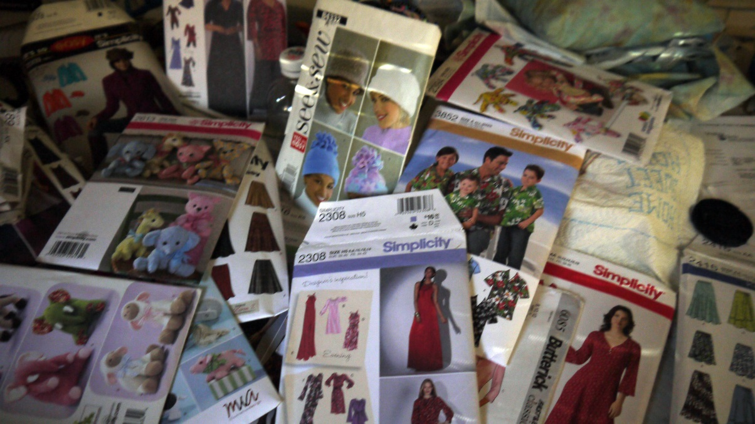
How to Identify Essential Information on a Sewing Paper Pattern
This lesson should take about 20-30 minutes to complete.

Slide 4
Objectives
At the end of this lesson the learner should be able to identify the essential information on the:
1.) Front and Back of a Paper Pattern Envelope
2.) Inside of a Paper Pattern Envelope

Slide 5
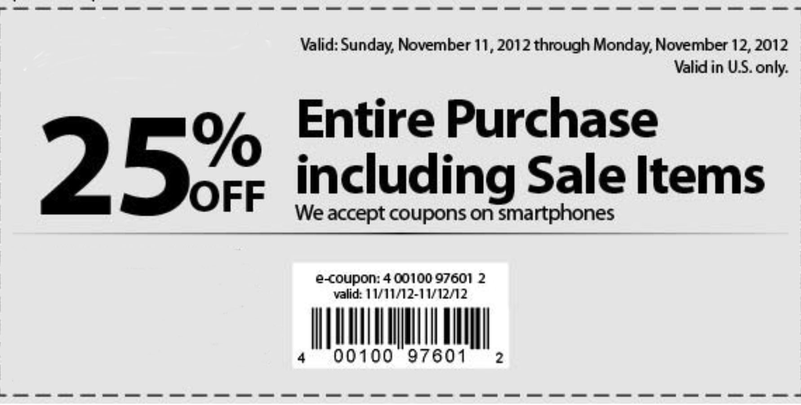
Remember that when you are cutting out a coupon, you have to read the instructions and be careful not to cut the UPC code otherwise, the coupon is no longer useful.
Store Coupon
UPC Code

Slide 6
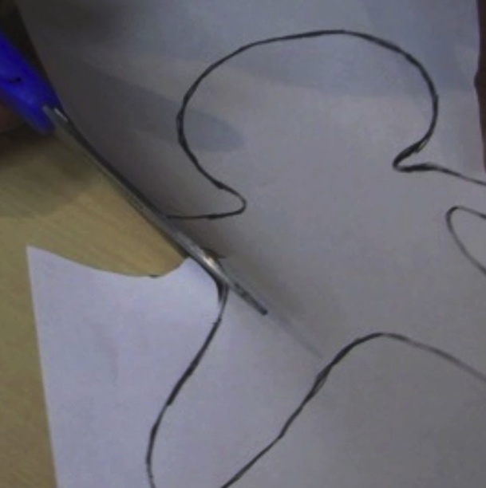
Also, remember that in elementary school, you have cut paper into shapes and we usually follow the directions.
Similarly, when you are cutting a paper pattern, you read the directions but first; you need to identify the essential information on and inside the paper pattern envelope.

Slide 7
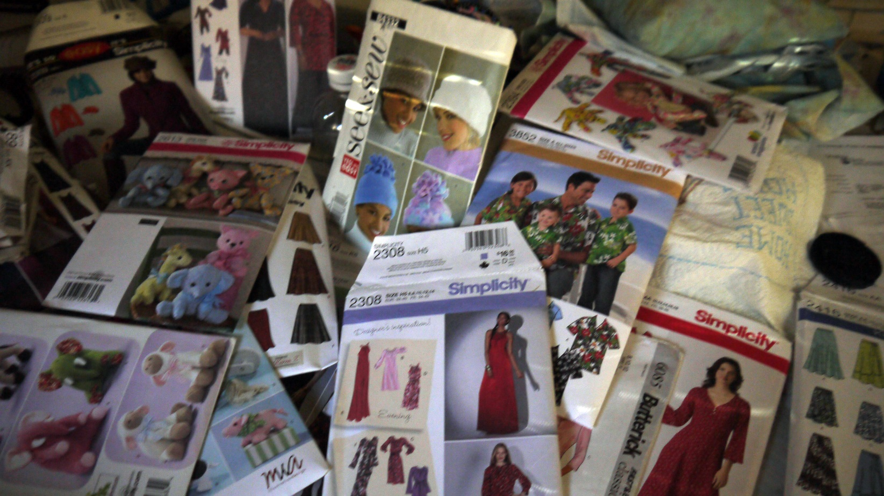
Paper Patterns
Paper patterns are not just for making garments to wear. They can be used to make bags, teddy bears and other stuffed animals.

Slide 8
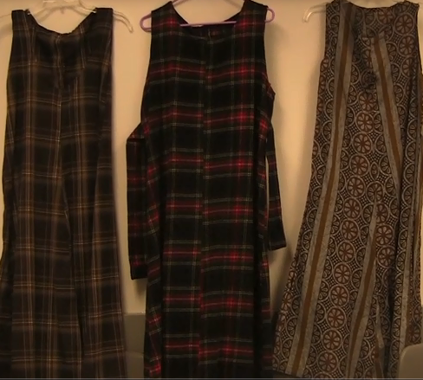
Garments Completed from Paper Patterns

Slide 9
Parts of a Paper Pattern
Inside Paper Pattern Envelope | Outside Paper Pattern Envelope
Instruction Sheet | Front of Paper Pattern Envelope
Tissue Pattern | Back of Paper Pattern Envelope

Slide 10
Outside Paper Pattern Envelope
Front of Paper Pattern Envelope | Back of Paper Pattern Envelope
Pattern Number | Pattern Information
The Price [on the flap of the pattern envelope] | Back views
The Size range of the pattern style | Fabrics that best fit style on pattern envelope
The UPC Code | Notions
Photographs of all the styles possible from the pattern | Body Measurements in inches
The time it would take to complete the style | Sizes in XXS to XL
 | Yardage required for style on pattern envelope
 | Completed garment measurements
 | French and Spanish translation

Slide 11
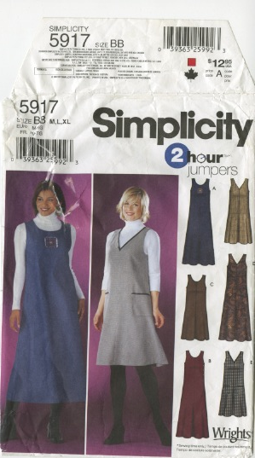
Pattern Number
UPC Code
Price
Front of Pattern Envelope
Sizes
Time taken to complete style
Photos of completed styles

Slide 12
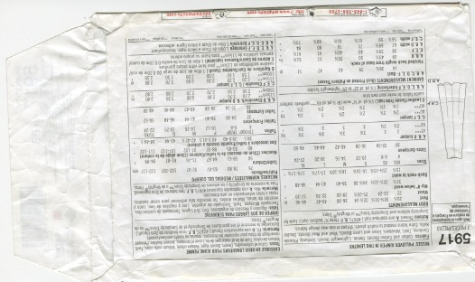
Pattern Information
Fabrics Fitting Style
Body Measurements in Inches
French and Spanish Translation
Notions
Back of Pattern Envelope
Back Views
Sizes
Yardage Required
Completed Garment Measurements

Slide 13
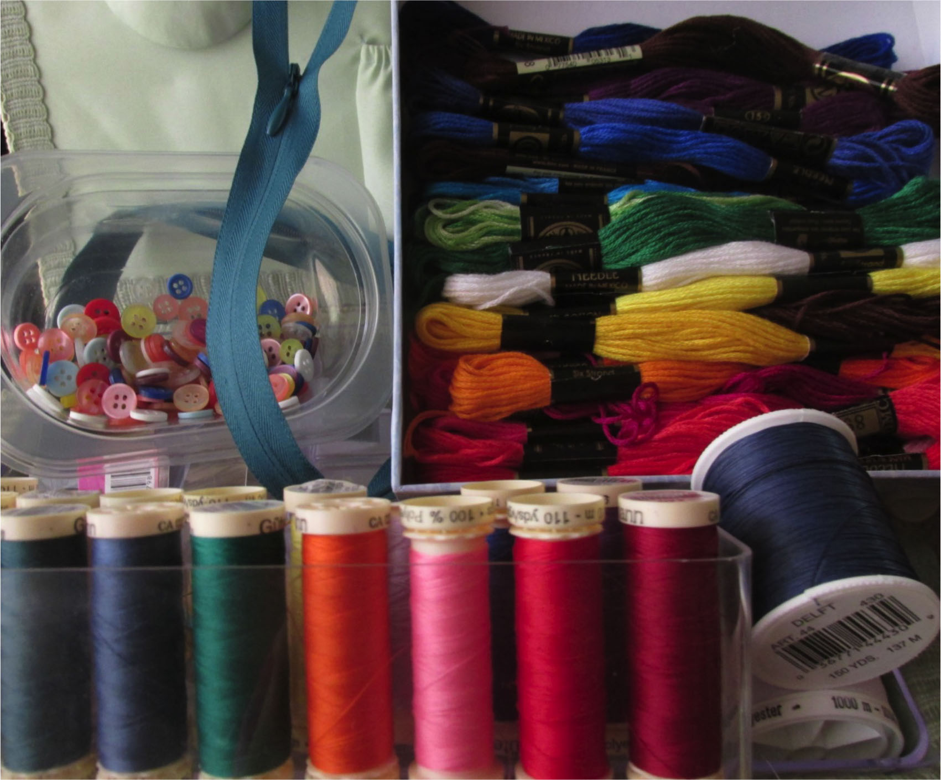
NOTIONS
Notions are items like the threads, buttons, zippers and applique

Slide 14
Inside the Paper Pattern Envelope
Instruction Sheet | Tissue Pattern
Line drawings | General Information
Pattern Pieces | Written Directions
Contact Information | Symbols
General Directions
Cutting Layout
Sewing Directions

Slide 15
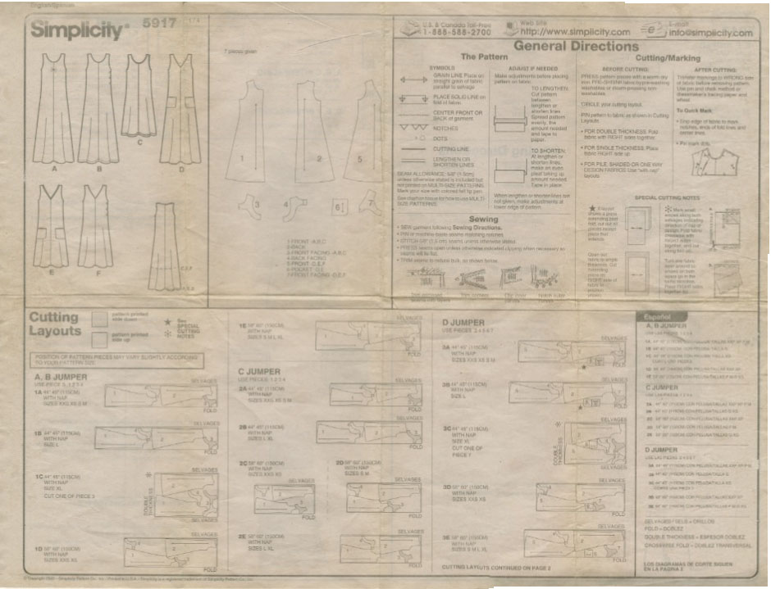
Contact Information
Pattern Pieces
Line drawings
General Directions
Instruction Sheet Page 1
Cutting Layout

Slide 16
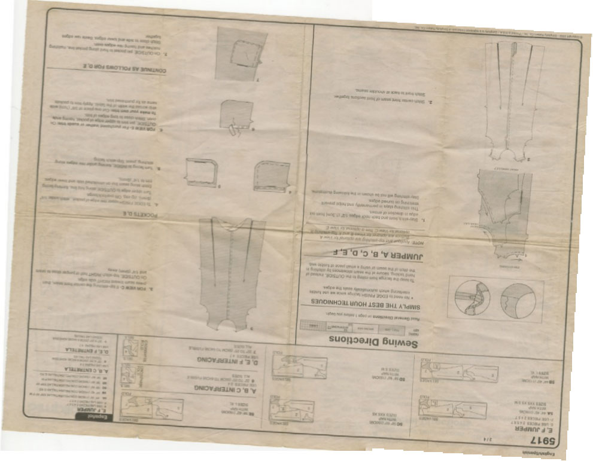
Page 2 of Instruction sheet
Sewing Directions

Slide 17
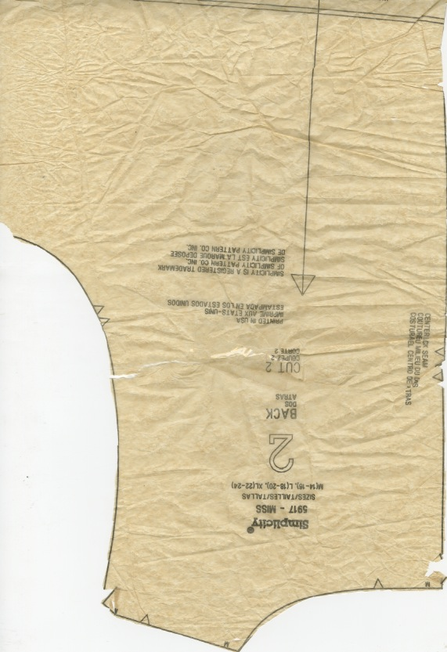
Part of one Tissue Pattern Piece
Pattern Size
Notch
Pattern for back view
Instruction to cut 2 pieces of this pattern
Straight grain

Slide 18
Symbols and Meanings that can be found on the Instruction Sheet and Tissue Pattern
Grain Lines
Fold Line
Dart Line
Center Front or Back of Garment
Matching Edges

Slide 19
RECALL: Parts of a Paper Pattern
Inside Paper Pattern | Outside Paper Pattern
Instruction Sheet | Front of Paper Pattern
Tissue Pattern | Back of Paper Pattern

Slide 20
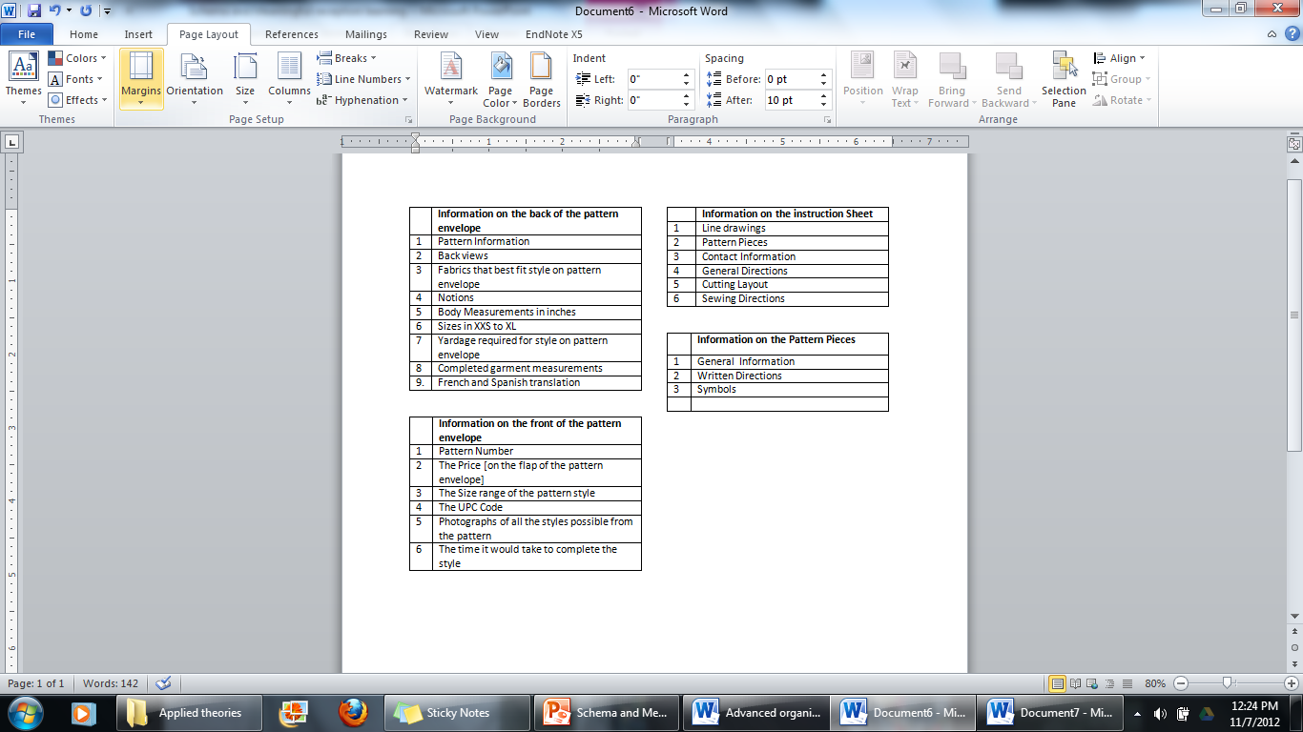

Slide 21
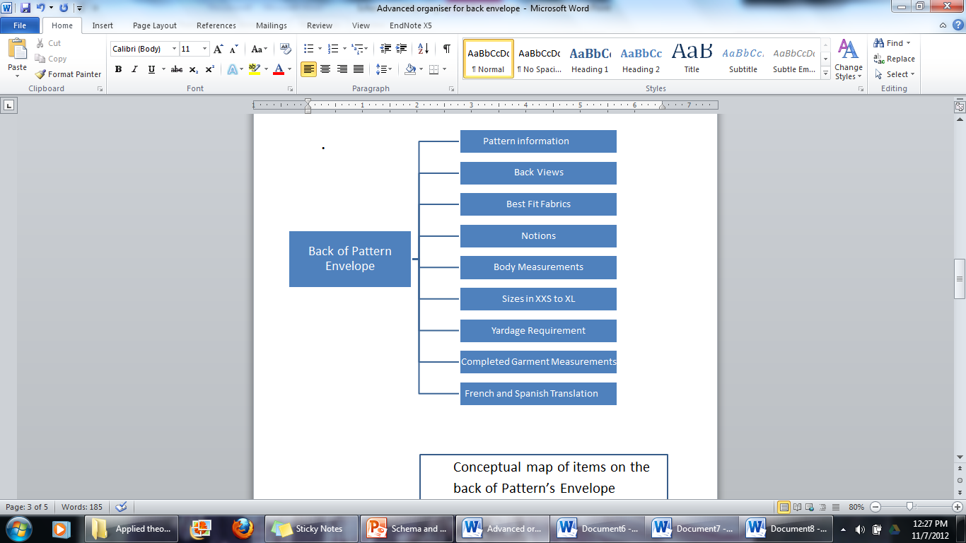

Slide 22
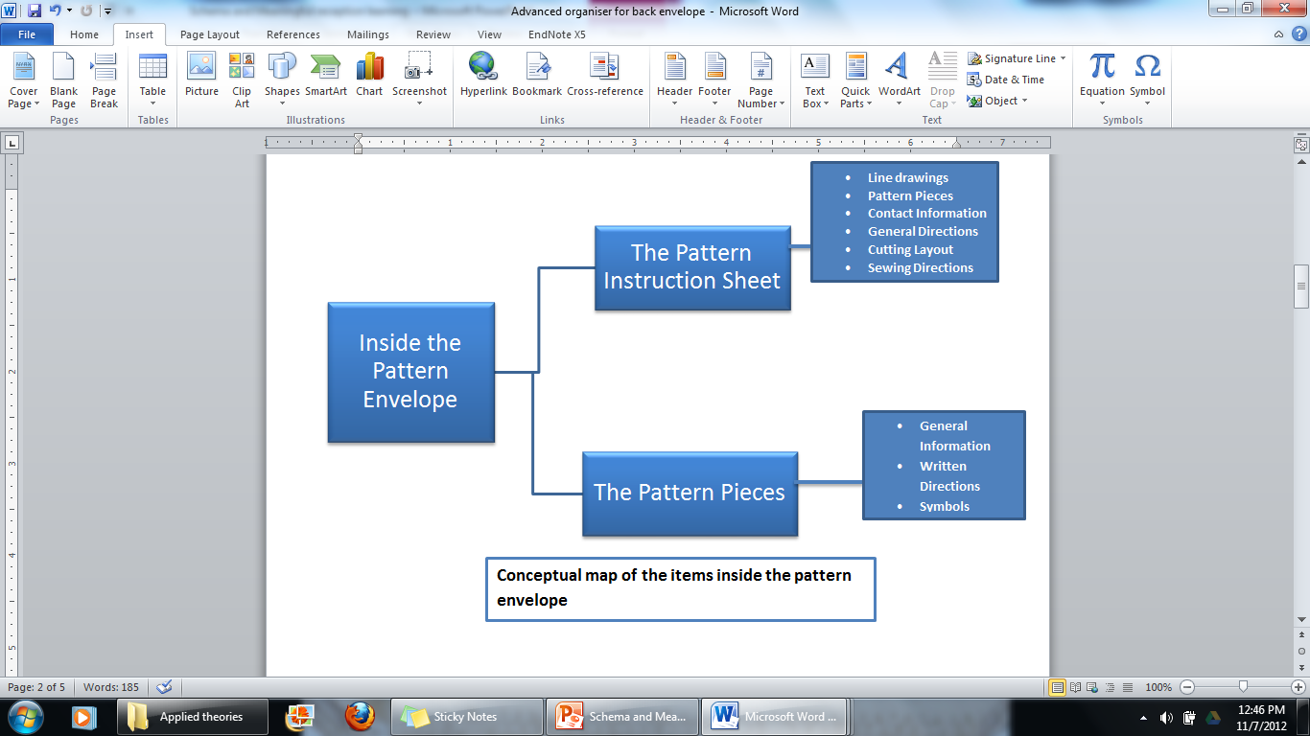

Slide 23
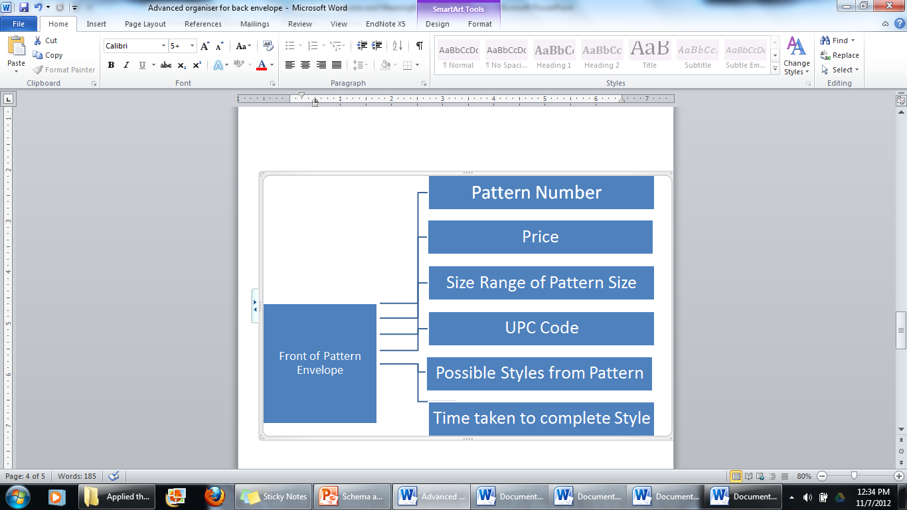
Conceptual Map of Front of Pattern Envelope

Slide 24
PRACTICE: Parts of a Paper Pattern
Fill in the blanks
Inside Paper Pattern | Outside Paper Pattern
1.___________ | 3.______________
2._________________ | 4. _______________

Slide 25
ASSESSMENT
EF= Envelope Front EB=Envelope Back IE= Inside Envelope You can check for the answers in slides 18 and 20.
Place EF beside an item found on the front of the envelope
Place EB beside an item found on the back of the envelope
Place IE beside an item found inside the envelope
Questions:
Fabric types best for style
Cutting Layout
Yardage Chart
Line Drawings
Photos of all the completed styles for pattern
Finished garment measurements
Pattern Number
Pattern Pieces
The Size Range
Standard Body Measurements
The Price of the Pattern
Notions
Clip art of back view of style
Sewing Directions

Slide 26
Meaningful Reception Learning and Schema Theory
Video | Means/Methods
1st 2 minutes | Activates schema
3rd to 12th minute | Advanced organizers, use of verbal and visual information, anchoring of ideas.
Slides | Makes materials meaningful, makes comparative organizers for ease of understanding, organization of materials. The presentation of materials is done through the use of tables, overall layout and hierarchical organization.
Motivation according to Schema and Meaningful Reception Learning | Generates curiosity, Music at the 1st slide, various presentation styles, various pictures, various fonts, Learning goals, vicarious experience {photos of completed jumpers by instructor}, Self-efficacy; Recalls that learners cut coupons, and have cut paper decorations in the past. Satisfies expectations; outcome expectation and efficacy expectations.

Slide 27
SUMMARY
At the end of this presentation, you should be familiar with a sewing paper pattern, the essential information on the front and back of a paper pattern envelope.
You should be familiar with the essential information inside the paper pattern envelope and the meanings of the common symbols found on a sewing paper pattern.

Slide 28
THANK YOU!!!!!

