Slide 1

Tunisia Twitter Data
Ryan Gniadek, Victoria Hardy, Sraavya Gudavalli, Steven Ruckert
CS 4624: Multimedia, Hypertext, and Information Access Capstone
Dr. Edward Fox
Virginia Tech, Blacksburg VA 24061
May 11, 2023

Slide 2
Outline
Motivation
Project Plan
OKRs and Approach
Data Filtering and Sentiment Analysis
Visualizations
Acknowledgements
References
Notes:
The second slide should be Outline, with a list of key headings of the sections of the presentation that follow.
Client, Problem, Motivation, Deliverables, Approach, Plan, Timeline/Milestones, OKRs, Acknowledgements (covering the client, any grants or sponsor details), References (books, papers, URLs with associated title/author/year information, other resources)

Slide 3
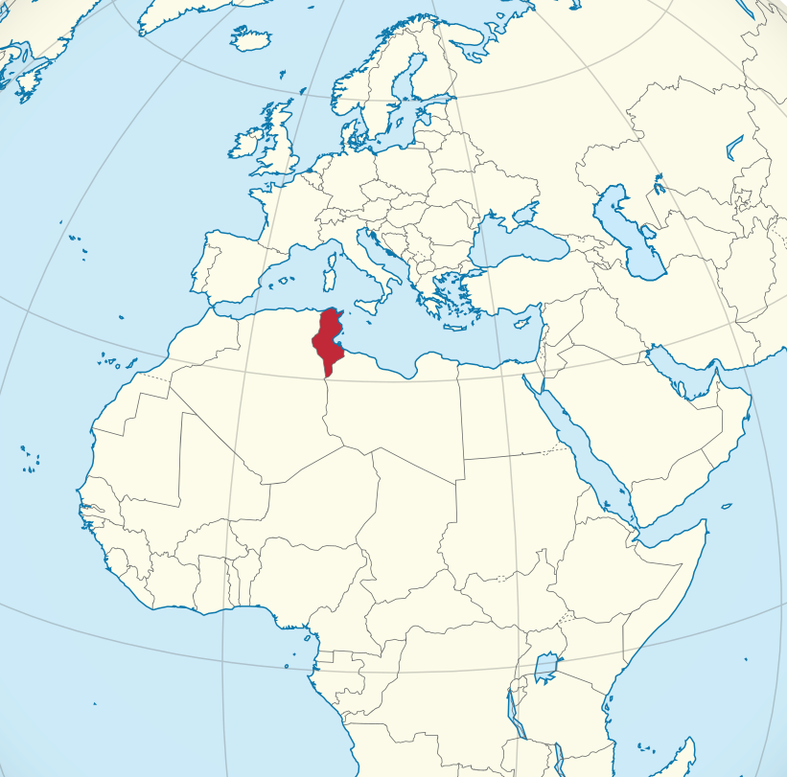
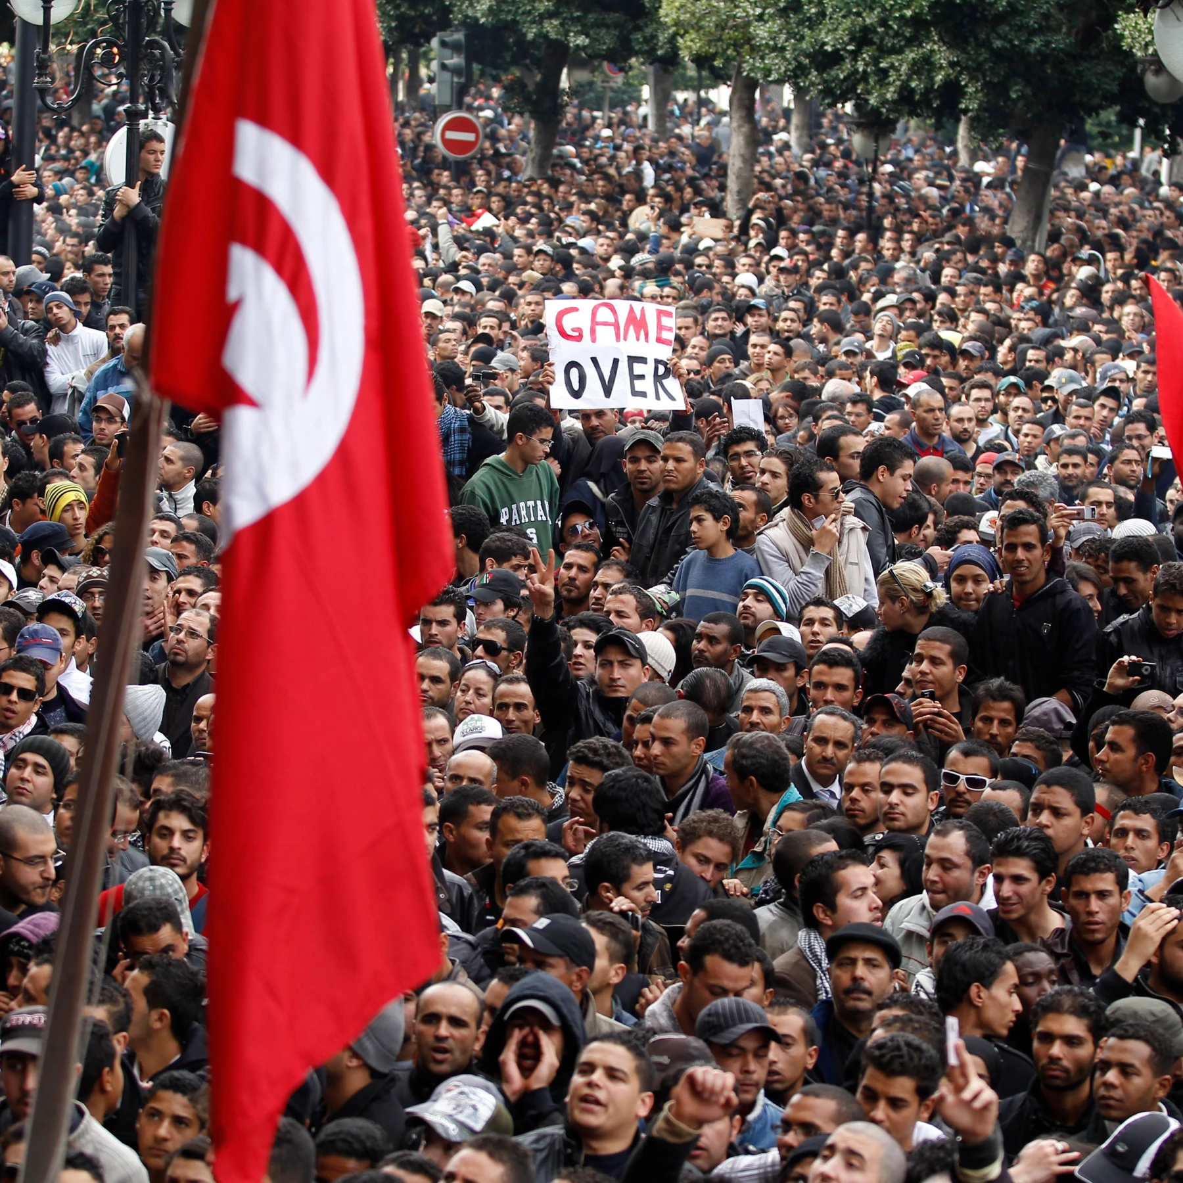

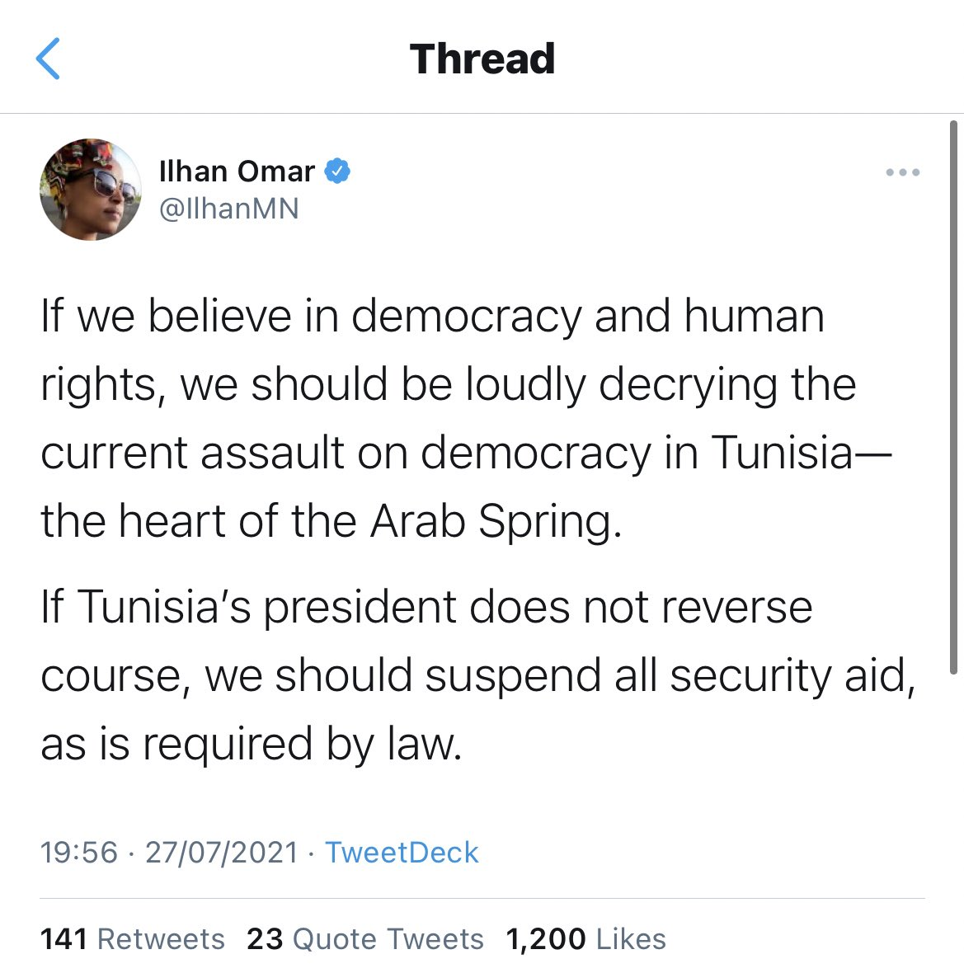
Motivation
After the 2011 Arab Spring, Tunisia underwent a democratic revolution.
Political Twitter usage increased as the population exercised freedom of expression.
Notes:
Tory

Slide 4


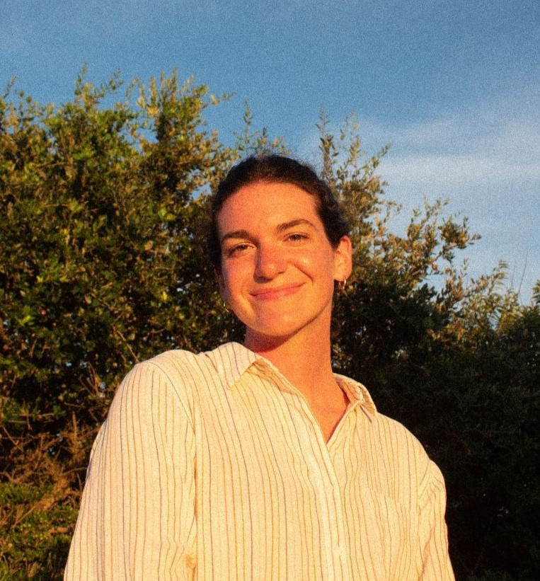

Project Plan
Ryan Gniadek
Back-End & Data Management
Sraavya Gudavalli
Documentation & Visualizations
Victoria Hardy
Documentation & Visualizations
Steven Ruckert
Back-End & Data Management
Subtasks based on each team member’s skill set/ background
Collaboration on all aspects of the project
One team member heads one aspect

Slide 5
OKRs
Archive of Previous Twitter Data
Consolidate data into one library
Coordination with previous researchers/contributors
Import of Live Twitter Data *
Utilize SFM framework for incoming data
Standardize format of imported twitter data
Improvement of Data Filtering Methods
Reduce collection of short, uninformative tweets
Reduce collection of spam Twitter data

Slide 6
OKRs
Analysis of Tunisia Twitter Data
Produce new data trends
Add trends to existing research
Visualization of Analysis
Single platform to view data trends
Compare the old and new data
Development and Demonstration of Professional Work Skills
High attendance
Fair work distribution

Slide 7
OKR Overview: Progress
Archive of Previous Twitter Data
Real-Time Import of New Twitter Data
Improvement of Data Filtering Methods
Analysis of Tunisia Twitter Data
Visualization of Analysis
100%
100%
100%
100%
100%
Notes:
Archive of Previous Twitter Data
Consolidate data into one library
Coordination with previous researchers/contributors
Analysis of Tunisia Twitter Data
Produce new data trends
Add trends to existing research
Real-Time Import of New Twitter Data
Utilize SFM framework for incoming data
Standardize format of imported twitter data
Visualization of Analysis
Single platform to view data trends
Compare the old and new data
Improvement of Data Filtering Methods
Reduce collection of short, uninformative tweets
Reduce collection of spam twitter data

Slide 8
OKR Project Approach
Collect Twitter Data
(Archived and Real-Time)
Social Feed Manager
February 17, 2023
Analyze Twitter Data
Political Events and Protests
March 24, 2023
Filter Twitter Data
Sentiment, Keyword, and Language
March 3, 2023
Visualize Data
Trends in keyword frequency and sentiment
April 12, 2023

Slide 9
Approach
Using the Social Feed Manager system, Twitter data was collected
Due to uncertainty around Twitter API access, ongoing collection was not possible. Tweets were added through February 2023
Format of existing tweet archive needs to be standardized and consolidated
Language and sentiment analysis determined for tweet contents
Interactive visualizations of Twitter data using modern web technologies
Notes:
The second slide should be Outline, with a list of key headings of the sections of the presentation that follow.
Client, Problem, Motivation, Deliverables, Approach, Plan, Timeline/Milestones, OKRs, Acknowledgements (covering the client, any grants or sponsor details), References (books, papers, URLs with associated title/author/year information, other resources)

Slide 10
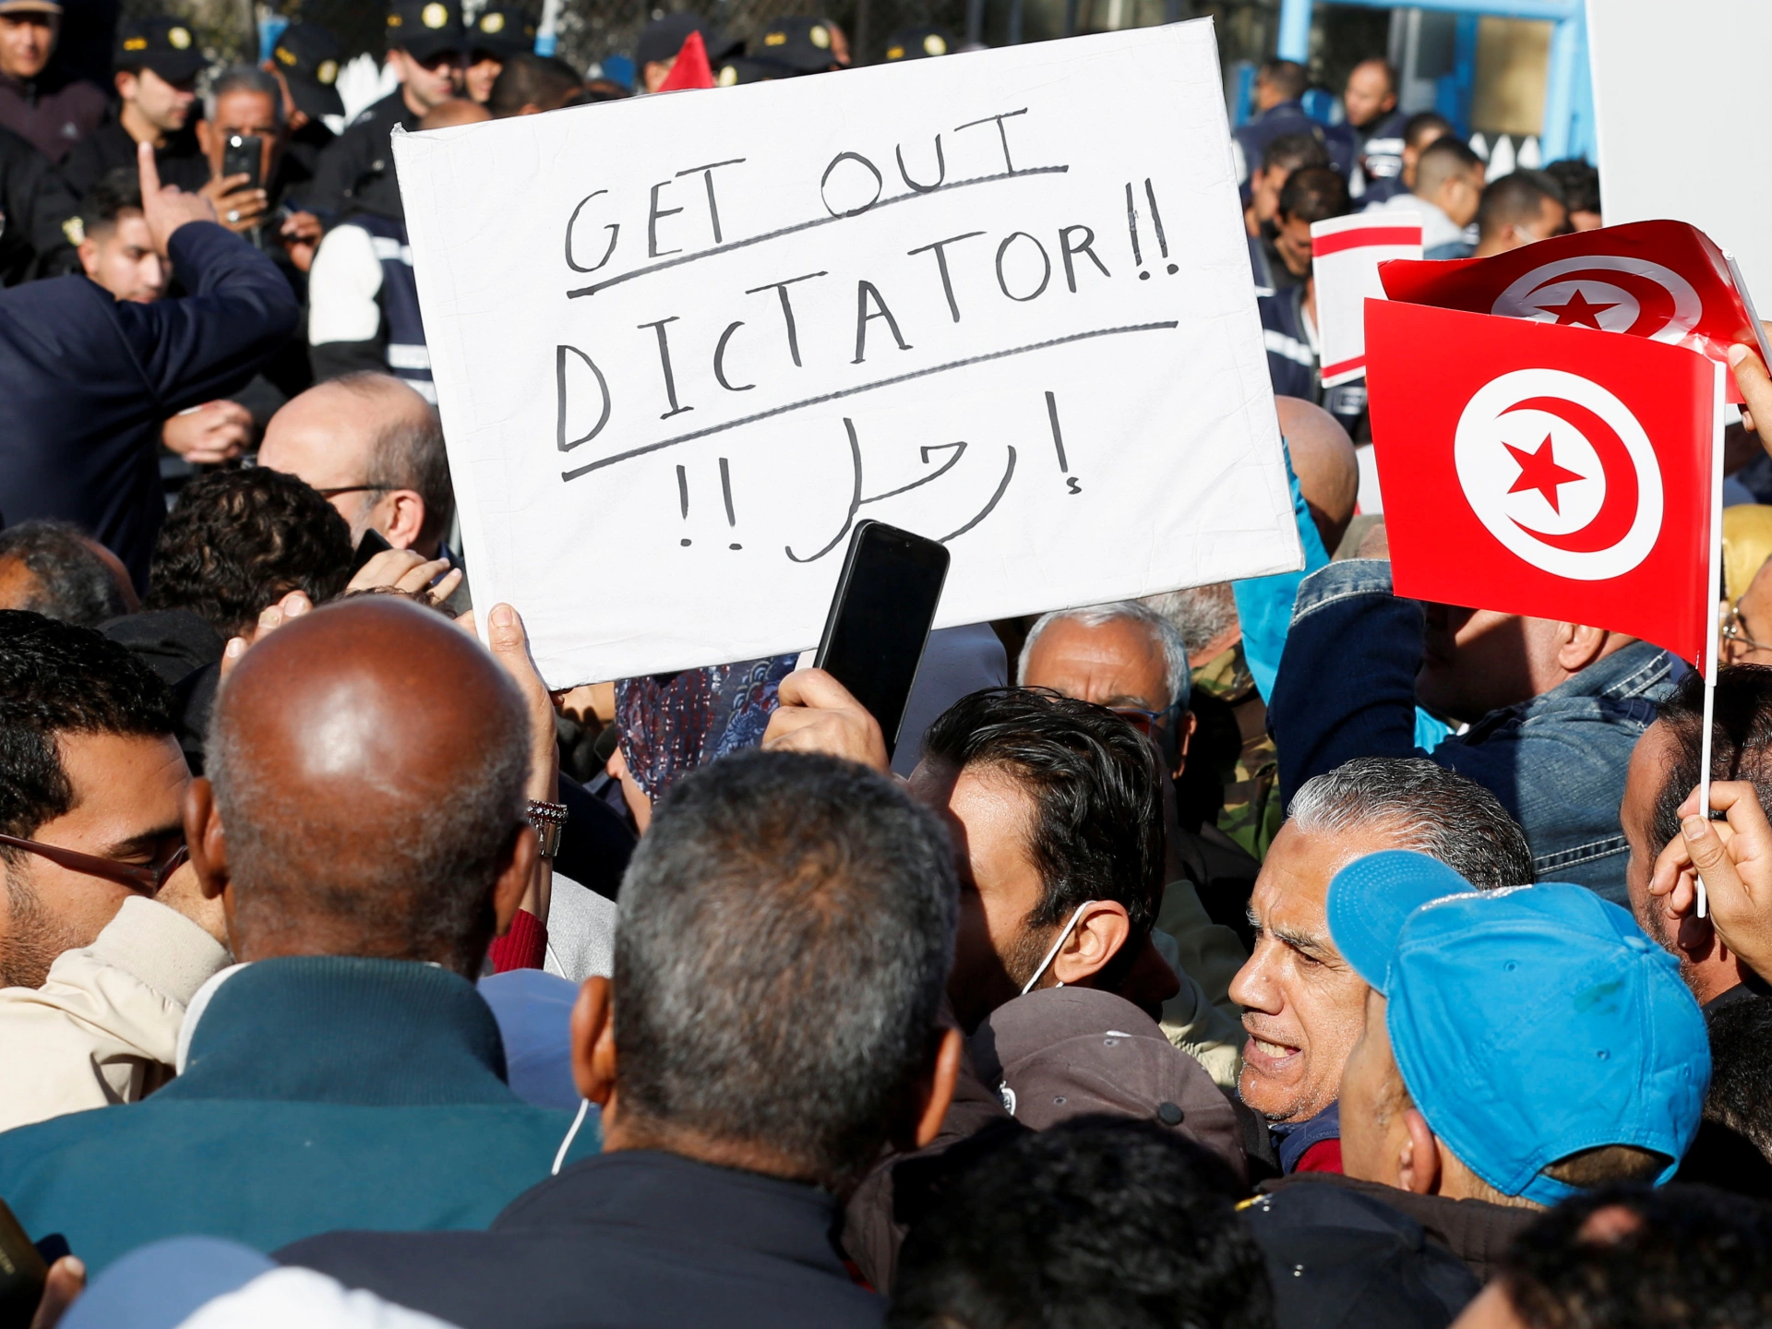
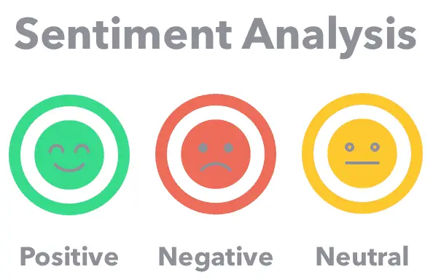
Data Filtering and Sentiment Analysis
#Tunisia
#Saied
#25juillet
#July25
#Referendum
#TnElec2019
#TnElection
#TunisiaVotes
#TunisiaDecides
#Tunisie
#kaisSaid
#constitutionélections
#législatives
Filtering
Sentiment Analysis
Notes:
List of keywords – filter tweets that contain keywords. Get sentiment score of those tweets

Slide 11
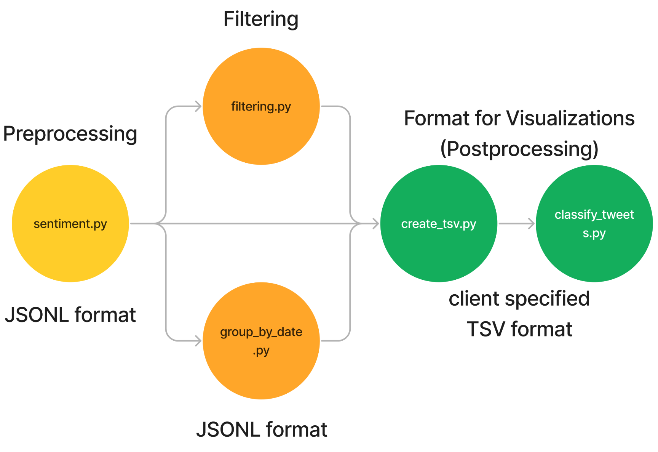
Data Filtering and Sentiment Analysis
Notes:
We have created a script to preview subsets of data that we have filtered

Slide 12
Data Filtering and Sentiment Analysis
FOR each line of tweets in JSONL file
TRY:
FOR each tweet in the line
Get the language of the tweet as ‘lang’
IF: Lang is 'en':
TRY:
Calculate sentiment of tweet's text & add to ‘sentiment’ attribute
Write tweet as JSON string to output_filename
EXCEPT: Print "Skipped tweet - No Sentiment Score"
ELSE: Print "Skipped tweet - Not in English"
EXCEPT: Print "Skipped line"
Notes:
We have created a script to preview subsets of data that we have filtered

Slide 13
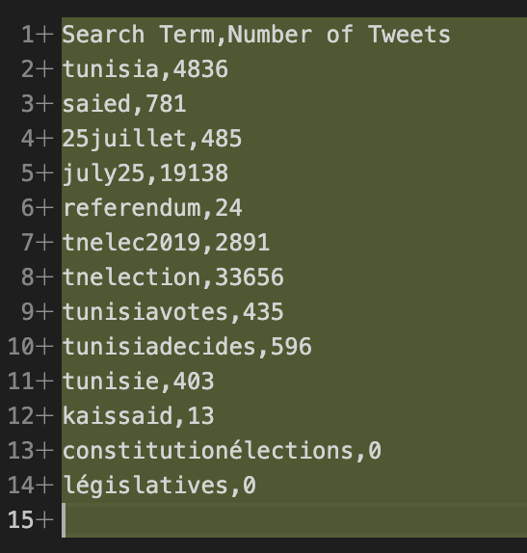
Visualizations
Created for tweet data filtered by keyword
Keyword-in-tweet volume
Tweet sentiment trend
Analysed with respect to Tunisian political events between 2019-2023
Notes:
Perform sentiment analysis
Geoplot lib - geog data, location of tweeters
Plotly - interactive, web-compatible
Topic modeling: analyzes text data to determine cluster words for a set of documents
Topic modeling is something they emphasized we really needed compared to other type of visualizations

Slide 14
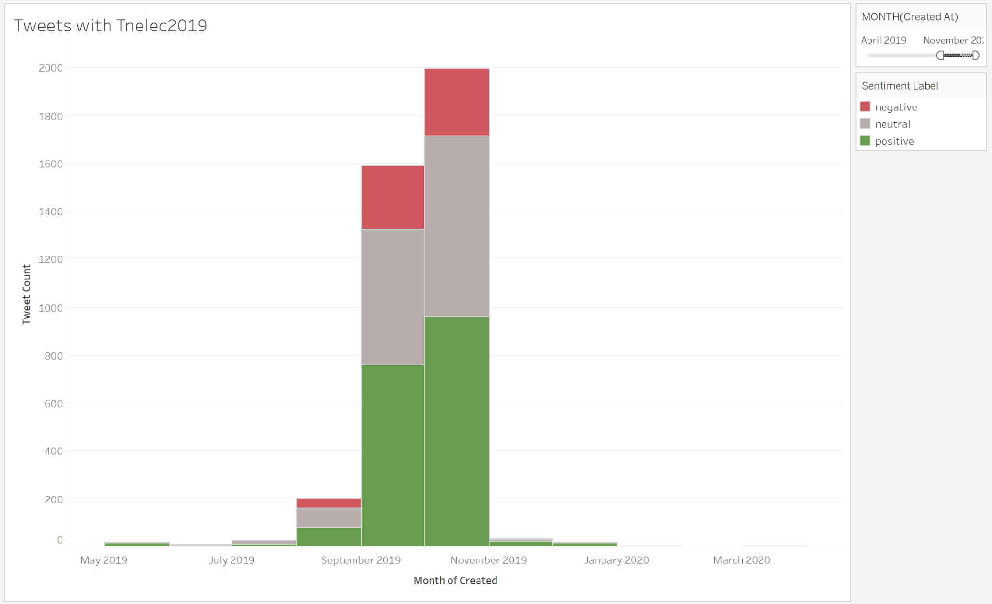
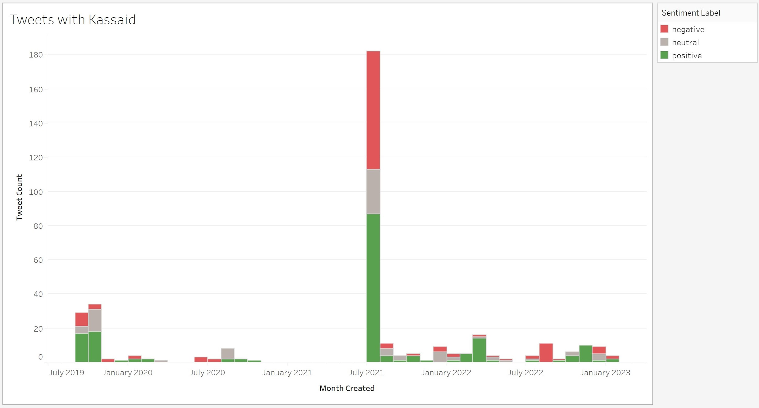
“Tnelec2019” Keyword Visualization
September 15, 2019
Presidential elections
October 6, 2019
Parliamentary elections
October 13, 2019
Presidential run-off
“Tunisiavotes”, “tunisiadecides”, & “tnelec2019” have the most tweets in 2019.

Slide 15
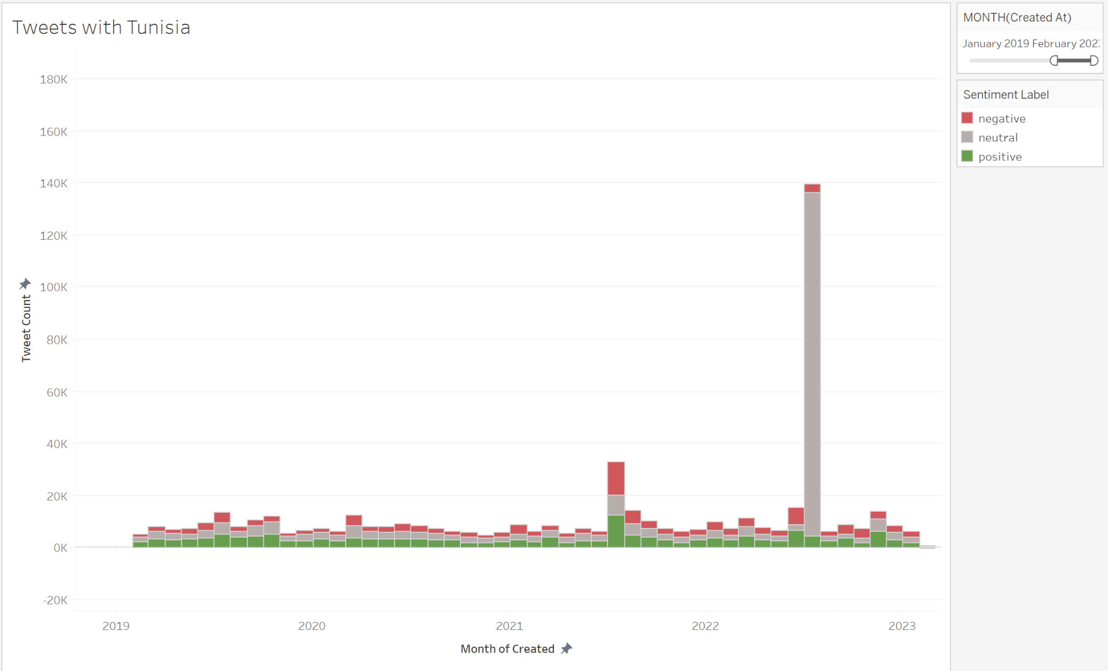
“Tunisia” Keyword Visualization
July 25, 2021
President Saied coup
July 25, 2022
Tunisians go to polls to vote on a referendum on a new constitution.

Slide 16
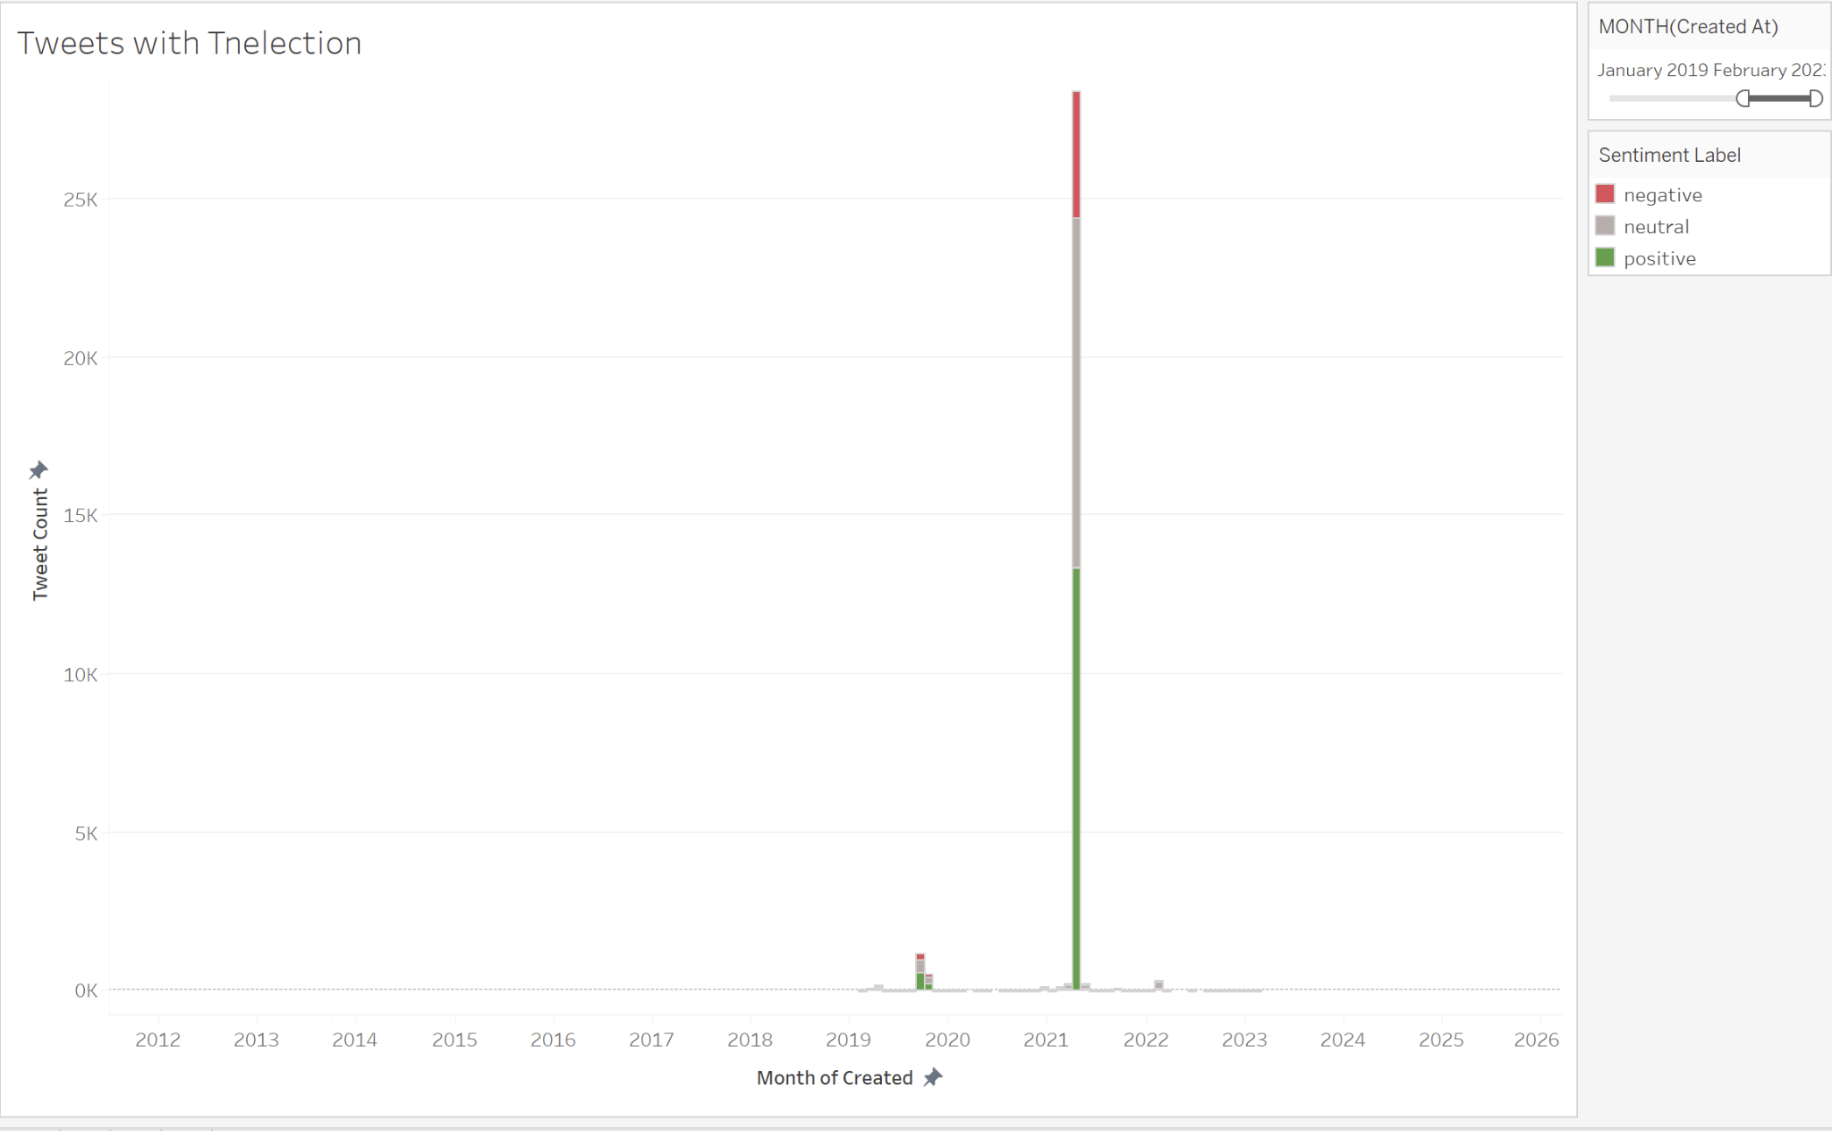
“Tnelection” Keyword Visualization
July 25, 2021
President Saied coup

Slide 17
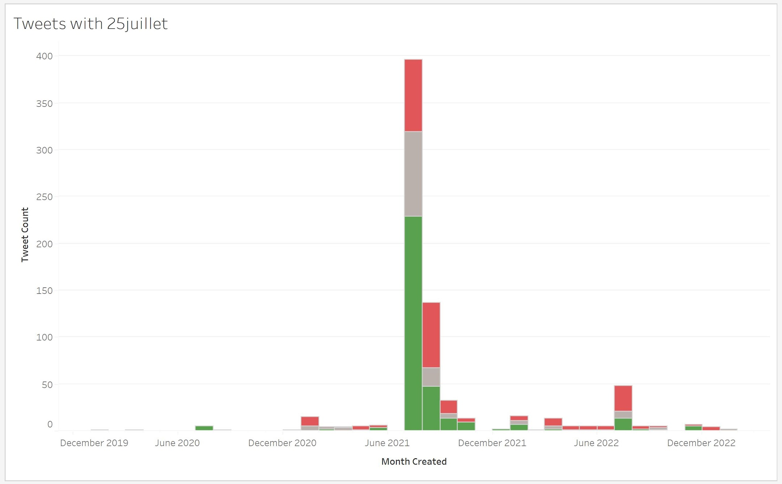
“Kassaid” & “25juillet” Keyword Visualizations
July 25, 2021
President Saied coup

Slide 18
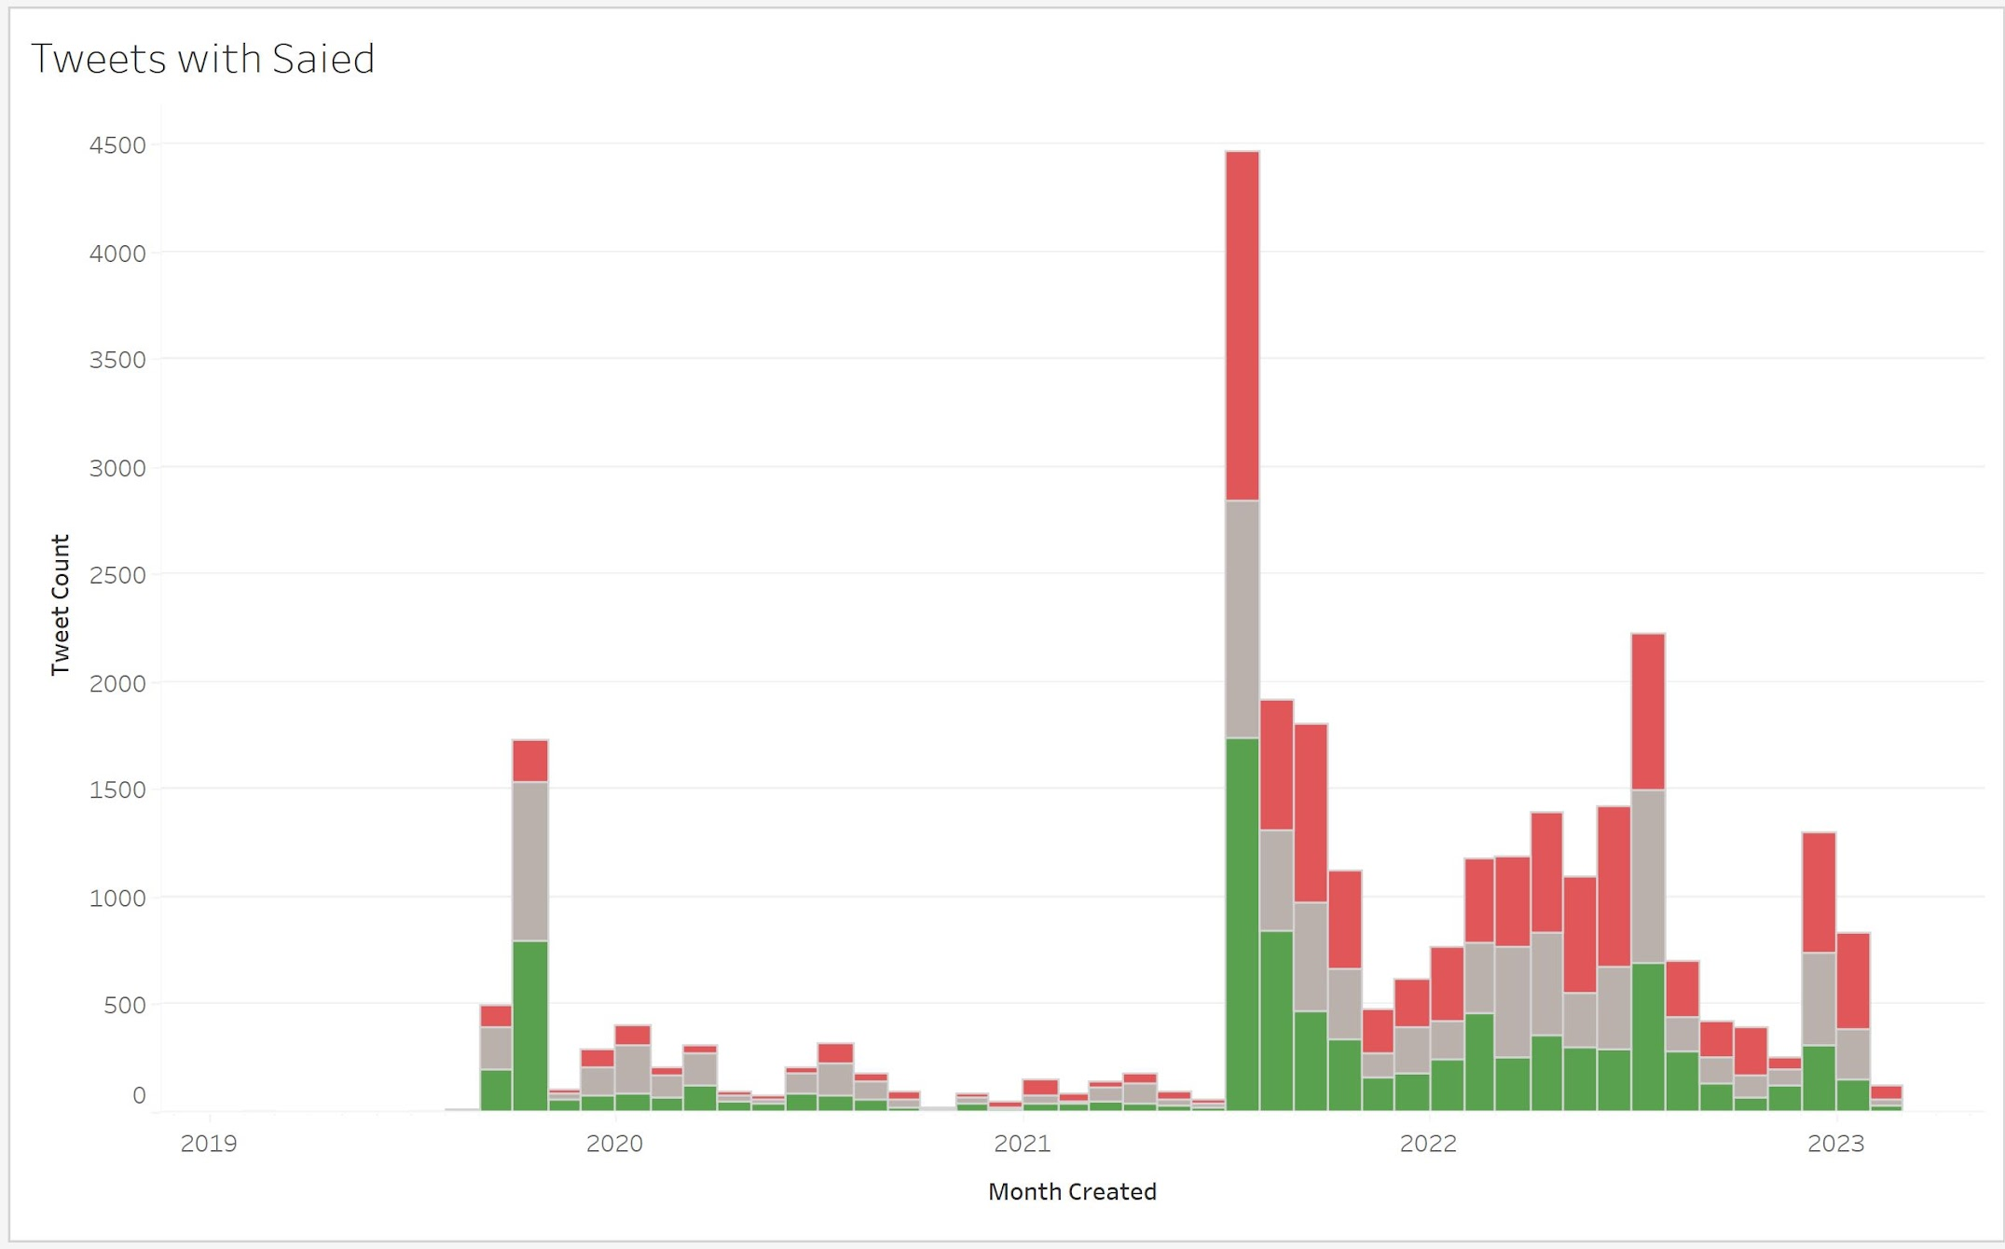
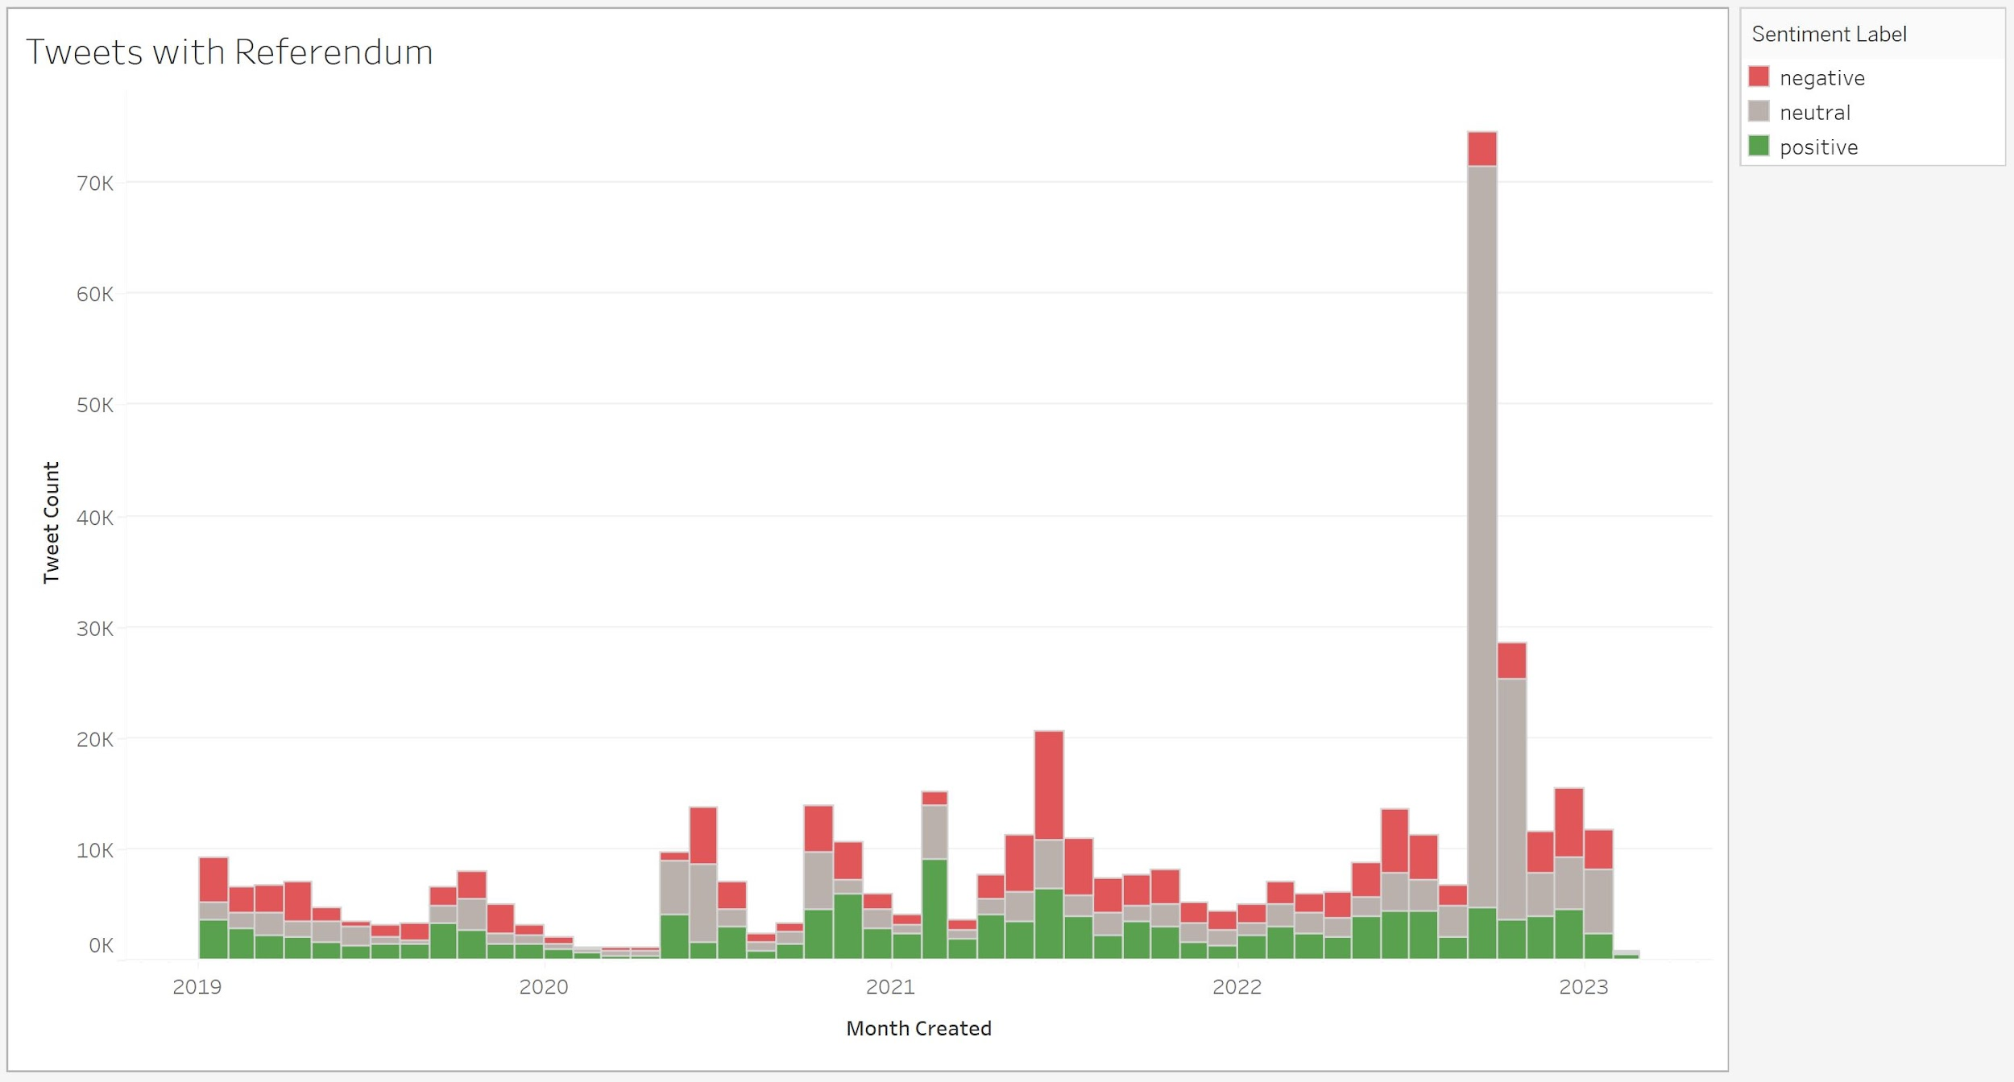
“Saied” & “Referendum” Keyword Visualizations
October 15, 2022
Islamist Ennahda and Free Constitutional Parties held parallel rallies against Saied
December 17, 2022
Lower Parliament elections are held

Slide 19
Visualization Analysis Takeaways
Tweet sentiment was always more negative than positive
Spikes frequently occurred around major elections and protest dates
September 2019: Presidential elections
October 2019: Parliamentary elections and Saied’s presidential run-offs
July 2021: President Saied’s coup, dismissal of parliament, enforced curfew
July 2022: Tunisians vote for a referendum
October 2022: Major anti-Saied protests
December 2022: Lower Parliament elections
Notes:
Perform sentiment analysis
Geoplot lib - geog data, location of tweeters
Plotly - interactive, web-compatible
Topic modeling: analyzes text data to determine cluster words for a set of documents
Topic modeling is something they emphasized we really needed compared to other type of visualizations

Slide 20
Project Takeaways
Challenges
Successes
Future Work
Bias from English-only tweets
Use of sentiment analysis
Learned Tableau for visualizations
Added as authors to research paper
Create sentiment algorithm for non-English tweets
Create visualizations for non-English tweets
Notes:
Perform sentiment analysis
Geoplot lib - geog data, location of tweeters
Plotly - interactive, web-compatible
Topic modeling: analyzes text data to determine cluster words for a set of documents
Topic modeling is something they emphasized we really needed compared to other type of visualizations

Slide 21
Acknowledgements
We’d like to thank Dr. Fox and the CS 4624 Teaching Team for supporting us throughout our Capstone project.
We’d also like to thank our clients Dr. Kavanaugh, Dr. Sheets, the Data Collection team, and VT University Libraries for advising our Tunisia Twitter Data project.

Slide 22
References
Sun, A. (2023, February 15). “What happened at the second round of Tunisian parliamentary elections?” The Boar. https://theboar.org/2023/02/what-happened-at-the-second-round-of-tunisian-parliamentary-elections/
Roth, K. (2022, January 13). “World Report 2022: Rights Trends in Tunisia.” Human Rights Watch, https://www.hrw.org/world-report/2022/country-chapters/tunisia.
Yerkes, S.; Alhomoud, M. (2022, July 22). “One Year Later, Tunisia’s President Has Reversed Nearly a Decade of Democratic Gains.” Carnegie Endownent For International Peace. https://carnegieendowment.org/2022/07/22/one-year-later-tunisia-s-president-has-reversed-nearly-decade-of-democratic-gains-pub-87555
Amara, T. (2022, October 15). “Thousands from Rival Tunisian Parties Protest against President.” Reuters. https://www.reuters.com/world/africa/thousands-rival-tunisian-parties-protest-against-president-2022-10-15/
Chrisafis, A., Black, I. (2011, January 15). “Zine al-Abidine Ben Ali forced to flee Tunisia as protesters claim victory.” The Guardian. https://www.theguardian.com/world/2011/jan/14/tunisian-president-flees-country-protests
Domingues, D., Rosatzin, M. (2013, January 6). “Tweeting the Revolution: Egypt in the Arab Spring. Kantonsschule Zürcher Unterland.” Cultural Diplomacy. https://www.culturaldiplomacy.org/pdf/case-studies/daniel_domingues_-_tweeting_the_revolution.pdf
Kavanaugh, A.; Song, Z.; Li, L.; Fox, E. (2019, June). “Communication Behavior in an Emerging Democracy.” Association for Computing Machinery. https://doi.org/10.1145/3325112.3325263
Tsotsis, A. (2011, January 17). “A Twitter snapshot of the Tunisian Revolution: Over 196K mentions of Tunisia, reaching over 26m users.” TechCrunch. https://techcrunch.com/2011/01/16/tunisia-2/

