Slide 1

Bingeable Archives: Licensing Content for TV and film
Alan Munshower
DLF Baltimore
October 10, 2022
Notes:
Good morning, my name is Alan Munshower, I’m the Digital Collections Archivist at Virginia Tech University Libraries, and I’ll be speaking about how to add moving image licensing to your archives’ services. This session was originally scheduled to have multiple speakers but an unforeseen change in plans means that only I will be sharing a presentation this morning. I aim to provide a high-level view of an archival moving image licensing program, and considerations for starting a program. With only one presentation as a part of the session this morning, there will be plenty of time for questions. Our moderator, Heather Heckman, also has experience overseeing a moving image licensing program and will be able to participate in the Q&A. I hope that many of you attending will also share your experiences with licensing.

Slide 2
Benefits of Licensing
Money for your organization
  Can be designated for care of collections, future digitization of time-based media, or any other specific use that helps the patron understand how this fee supports the archives
Publicity / Raise awareness of organization
Licensing and associated documentation controls the paper trail and allows control of organization’s intellectual property
Notes:
Money for your organization is likely the benefit of licensing that has your interest in the subject. It’s important though to consider where this money will go, and how it will be used. It benefits the patron to understand how this fee can directly support the research and access they are engaged in. As with any fee associated with a Library, it’s important to understand and articulate how this supports the institutional mission and is not an obstacle to access and research.
The publicity and awareness of the archives that comes from a prominent licensing deal is a major benefit. Having your material featured in the latest Netflix hit is great exposure, and helps show the variety of services and material that is served by an archives.
Lastly, licensing controls the paper trail and helps manage the organization’s IP. Educational and research related use is always welcome and encouraged, but licensing helps control widespread commercial overuse or abuse of materials.

Slide 3
Components of a licensing program
Staffing
Access to Materials
  Digital Collections Platform
  Finding Aids
  Physical access / Reading Room
Patrons / Identified users of material
Use Agreement / Terms
Clear record of copyright and ownership of materials
  Compatible donor agreement
Notes:
Imagine you are starting a licensing program from the ground up. What do you need?
The big one first off is staffing. Who will be doing this work? As far as workflow, it’s not unlike reference work, but licensing can be more labor intensive. There is more paperwork for one, AV material often has added challenges related to digitization and access, and production studios tend to work on a tighter deadline than many archives patrons. How much staffing time to devote to a new program will probably undergo trial and error, but 5-10 hours/week may be a good starting point.
Access to materials is probably an area that is well addressed already. Discovery will be facilitated by a robust digital collections platform, detailed finding aids, and physical access to the materials. In my experience, most all licensing requests are done remotely, so these first two components are key to reaching patrons. Though reading room access to AV materials may be important for some patrons who are focused on a very specific subject.
A use agreement that reflects the terms of the copyright, being a document separate from a fair use/research purposes form will need to be developed.
A challenge is that many archives have “interesting” or non existent donor agreements, but licensed material should have a clear chain of custody and ownership. Revising existing agreements for new accessions would be a proactive step.

Slide 4
Components of a licensing program (cont.)
Fee Schedule / Rate Card
Marketing
Payment system
Secure file transferring system
Access to legal review
Notes:
The place where many feel like they are starting from scratch is the fee schedule or rate card. This should outline the exact fees to charge, and can be based on amount of footage licensed and/or type of use and distribution. There is a lot of flexibility in designing this best to suit your organization. More on this in a bit.
Will you market the program? Maybe not in a traditional sense, but getting attention to the material is important. Though there is a lot to be said for building a program organically through solid relationships and service.
We’re not used to handling money, and organizations tend to make this nearly impossible. This might be the first thing you look into. How to invoice and receive payment online.
A secure file transferring system that you already subscribe to such as Google Drive or Dropbox will probably be adequate for this, barring any institutional IT concerns over transferring large files outside your organization.
Lastly, access to legal review is important for both the development of new forms, and for review when inevitably you will receive revisions or an additional contract back from a patron, outlining their preferred terms.

Slide 5
Identifying Material and Patrons
Collecting areas and licensing potential
  What collecting areas have AV representation?
  Strengthening local and regional holdings / geographic representation
  Identify collections from underrepresented groups
Who are your identified user personas?
  Academic researcher, student, genealogist, etc
  Now includes documentary producers, commercial film producers, and most commonly organizations doing archival footage research of behalf of content producers
Notes:
Among the first things to consider are: which collecting areas have good AV licensing potential. Raw numbers of time-based media, and knowing what percentage has been digitized is important, but also knowing which materials are unique and have the copyright retained by the archives. The importance of strengthening and promoting your local and regional AV holdings can not be understated. Researchers are inclined to contact institutions local to their subject matter, assuming they are the best starting place for regional material. Also, take the time to identify AV collections that are underrepresented both in your institution and more broadly.
If you are starting a moving image licensing practice, you will likely be adding a new user persona to your regular patrons. Read types of personas

Slide 6
Use agreements, contracts, and riders
Will you license for a specified time, use, media or program?
  Changing media landscape - streaming now ubiquitous
  Not getting ‘ in perpetuity’ may be a dealbreaker for some
    Excluding advertising uses is a common exception to in perpetuity agreements
  Patrons are often dealing with multiple archives, different terms, and different lengths of contract
Publish your agreement on the Archives website
  Include documents, FAQ, turnaround times, etc.
Riders and involving legal department
  Make clear to patrons that this will slow down the process
  Who is signing agreements and rider? Department Head? Dean?
Notes:
What should be spelled out in the use agreement? The duration of the contract, exact use and distribution.
When constructing a movie image use agreement, consider that the publishing model is very different from traditional physical books. The media landscape is continuously evolving, and streaming is now ubiquitous. While platforms, formats, and producers change, the work or program rarely changes from it’s form. Use should be for a single, specific program or edition.
Not getting an in perpetuity deal may be a dealbreaker. Keep in mind, if you in the archives are negotiating five-year licensing terms, what will be the process for identifying use renewals for content still available online after five years?
Make your use agreements public and be transparent about the process, including turnaround times.
Some organizations may want to add their own terms, which will mandate more legal review. This can be a very slow process, especially at academic institutions where there is not a designated attorney for Library matters. Also be mindful that even with approved forms, who is the signee?

Slide 7
Considering a Fee Schedule / Rate Card
To charge or not?
  Some institutions may purposely not charge or not have a set fee schedule
  Do you currently charge for digitization, photocopying, or other regular patron services?
There is a calculable cost to use of time and resources
Have ability to explain to patron that it’s not an arbitrary fee
  Clear costs and targeted support of program included on schedule
Notes:
Licensing may not be the right choice for your archives. You may decide that licensing will not work for a number of reasons, including legacy donor agreements, collecting areas, lack of AV formats, or general attitude among institutional stakeholders. Are there currently services that carry a cost for patrons, such as digitization or photocopying? You will want to consider the organization’s history regarding fees. Not having a stated policy, but operating on a case-by-case basis may be possible to start, but could present issues of equity in your licensing structure.
That being said, there is a calculable cost to staff time and resources. An estimate of these costs will be helpful in creating your rates and/or seeking approval for a new licensing policy. Once the fee is determined, buy-in from the patron base is helped by clear explanation of how the funds support this program.

Slide 8
Other Fee Schedule Considerations
Rates can vary based on any equitable scale you design.
Commercial use vs non-profit or small press
Scale of distribution
Discount for length of material
Minimum fee
Beware interchangeable terms (TV, video)
Would you consider one-off digitization? In house equipment may be adequate. Additional fees for this?
Strive for equitable fees to encourage wide use of materials in a variety of productions
Notes:
I recommend an equitable, tiered scale, for licensing rates. The scale is best if customized to the needs of the institution. The variety of uses that become evident during the first years of a licensing program will help shape adjustments and future design of this scale. Some example tiers or delineated rates may include one for commercial use and one for non-profit or small press publication. You may consider the scale of the distribution in determining the rate. Depending on the nature of the moving image material and frequency of use, a minimum fee or discount for length of licenced material may also make sense. Your fee schedule should be aware of the changing media landscape and interchangeable terms. The tiers and categories of fees should be clear to the licensor to avoid unnecessary negotiation. Inevitably you will get a request to digitize a video for potential licensing patron based off basic description in the finding aid. Have a plan for how you will address this. And, again a reminder to strive for equitable fees to encourage wide use of materials.

Slide 9
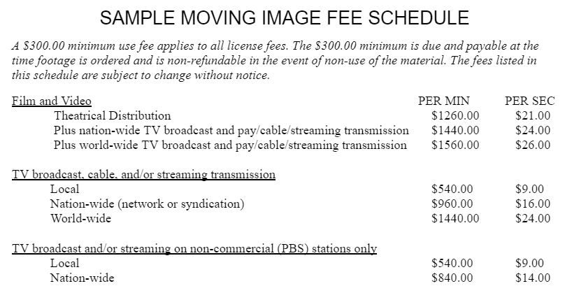
Notes:
Sample fee schedule
Notice the minimum use fee is clearly at the top
Fees per minute and per second are included. Another consideration may be a rate per frame depending on the content you have. It’s not uncommon for producers to have the exact frames identified. This fee schedule delineates type of medium, commercial vs non-profit, and level of distribution. As the media landscape evolves, there may be a logical reason to have separate fees for cable and streaming services, but in this example they are grouped together.

Slide 10
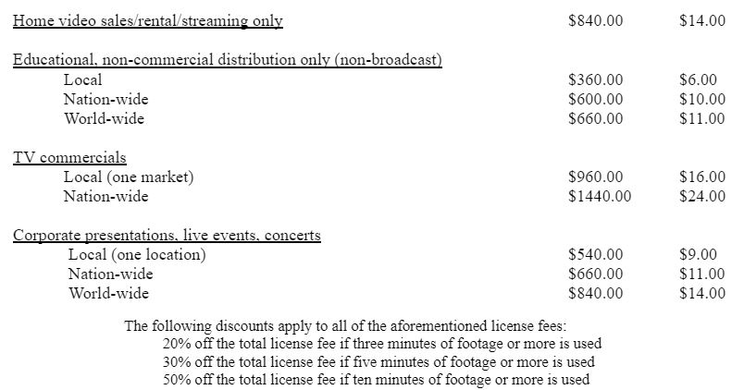
Per Minute Per Second
Notes:
Part two of the sample fee schedule has categories for home/streaming distribution only, Educational uses by region, Use in commercials and advertising, and use live events. Volume discounts are also included.

Slide 11
Access Lifecycle Considerations
Initial discovery and access of AV
  Moving image digital collections described well, chaptered, transcribed
  Reading room access for analog materials
Ability to deliver a screener (access) copy so studios are able to determine exact length of licensed footage
Use existing system (Google Drive, Dropbox)
  Larger AV files may require other solutions such as an FTP
Always on a deadline - much more so than archivists are used to
  Design the agreement to be clear legally
  Establish a timeline and expectations for delivery of content
Notes:
Moving image file management comes with additional challenges that may be familiar to many of you. The importance of a digital content platform that has discoverability and ease of access is key in building your moving image licensing practice. Detailed description will go far, and any chaptering or ways to expedite web playback and searching will be appreciated by researchers. Ultimately there may be a need for an offline or downloadable access copy for studios to edit content into their video production.
Common tools such as google drive and dropbox will work for many transfer applications, but when working with hi-resolution or larger videos, you may need to explore other methods.
And I’ll say from experience that movie image researchers are almost always on a deadline. With so many moving parts in a film production, timelines can be accelerated beyond what archivists might be used to. Ways to mitigate this include having a clear use agreement from the start, as legal review can often be the biggest hurdle. And also establishing a timeline and expectations when the initial request is made.

Slide 12
Common Obstacles
There is an assumption if you pay for something, you’re getting the copyright.
Education is needed, especially for those used to everything being free on internet.
Be aware of stockpiling of footage.
Rights
  Know rights issues among archival collections
  Is approval needed from a third party?
  For unknown rights, orphan works
    Charge for digitization or ‘access fee’
    Complete use agreement charging patron with seeking permission from rights holder
Notes:
Some other obstacles discovered through years of practice…
There is an assumption that if you pay for something, you’re getting the copyright. Educate your patrons on this, just as you would for reading room procedures, or fair use of materials. On the flip side, many patrons are used to everything being free on the internet, or are coming from a digital culture where reuse is common, such as tik tok. There is some excellent recent scholar on this in the edited volume by Sara R. Benson, “Copyright Conversations: Rights Literacy in a Digital World.”
Be aware of third party vendor stockpiling your footage. You will get regular researchers who are contracted with major studios. In the best cases, you’ll develop a great working relationship with them, and they will come to really know the collections. However, you should pay attention to third parties that request large amounts of screeners, or who may be harvesting material from you digital platform, without any other discussion about processes, policies or procedures. Rights are always a huge concern. Know the rights issues associated with the collections and items. Old donor agreements don’t always have the clearest language, if there is even paperwork! Maybe you need to contact the donor or a family member for verbal permission. If copyright is not known, you could still pass responsibility for seeking publication rights onto the patron. In this case, there is still potential to recoup costs in the form of an ‘access’ fee or digitization fee.

Slide 13
Consulting Resources
Existing Internal Archives Agreements
  MOUs from Publishing and Special Collections, Digitization MOA
  Project proposal forms
  Donor agreements
  Ad-hoc agreements based on stakeholder needs
Professional literature
Other libraries’ forms, including digitization and licensing rates
Anecdotal experiences with existing projects and patrons
Notes:
In building your moving image licensing program, here are are few other resources to consider.
If you organization has existing agreements, that is a great place to start, assuming that these existing agreements have made it through some amount of legal scrutiny. These could include use agreement, publishing permission, and digitization requests.
Project proposal forms and donor agreements will inform what language needs to be included, such as attribution and what exact rights are conveyed.
Professional literature is always a valuable resource, and other libraries typically have use agreements online for download. I have not typically seen fee schedules posted publicly. It may be would considering for transparency, but it could also become challenging if/when those rates need to be updated.
Lastly, anecdotal experience is very important. You may there is a targeted interest in a specific collection or reel of film. Understanding how it is being used will inform descriptive practices and help refine workflows in getting material to the patrons quicker.

Slide 14
Where to Start
Have you licensed photographs or images?
Are there existing use agreements?
Digital Collections platform
  What technical features or level of support exists for AV Collections?
Identify how to staff this new program
Collaborate with others who have copyright and open access interests in your organization
Notes:
Again, important places to start:
Have you licensed any material before, such as photographs. This will be a natural starting place.
Use your existing user agreements to create a material-in-copyright use agreement.
What sort of technical features are enabled and supported on your digital collections platform?
Where will you find the staffing hours for this? The program is not likely to pay for itself immediately.
Also, find other in your organization who are interested in copyright and open access, such as a working group. A support system will be helpful in hashing out more complications as they arise.

Slide 15
Conclusion / Major Decisions
Who are you serving?
To charge or not to charge?
Have a fixed fee schedule or a flexible one?
Duration and limitations present in the use agreement?
Do you have the capacity to license analog material?
How will your digital collections and discovery systems support access for a new group of researchers?
Notes:
After asking the simple questions to start off, finally here are some of the challenging ones.
Who are you serving? Identifying materials and researchers that would be likely new users.
To charge or not? Consideration for institutional culture are important.
Fixed or flexible fee schedule? How can you curated the rates to be equitable?
Duration and limitations? How will your use agreement help to manage rights and IP in perpetuity.
Do you have the capacity to license analog materials? Can you digitize on-site? Are you able to help facilitate access to these materials, or have them digitizes through a vendor?
How will your existing system support this new group of researchers?

Slide 16
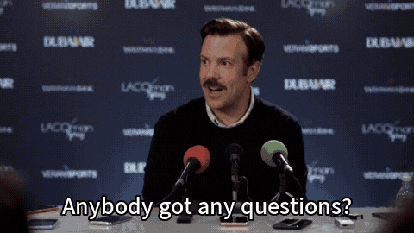
Thank you!
Contact:
Alan Munshower
Digital Collections Archivist
alanmun@vt.edu
Notes:
Questions for myself or Heather Heckman.

