Slide 1
ETDs (Electronic Theses and Dissertations) Recommendation System
Talia Blakemore and Long Phan
CS 4624, Professor Edward A. Fox, Virginia Tech, Blacksburg VA 24061 5/17/2023

Slide 2
Outline
Overview of Project
Timeline
General Approach
Deliverables
Testing & Evaluation
Acknowledgements
References

Slide 3
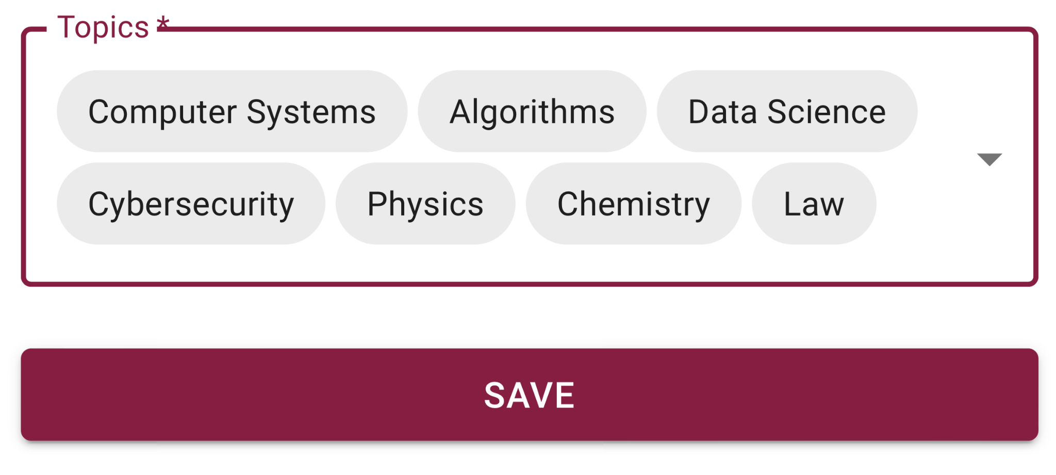
Overview
Client: Satvik Chekuri
Current System:
  Recommendation system is built upon interests supplied by the user
  Uses document titles and abstracts to evaluate similarity between documents
Notes:
Our client for this project is Satvik Chekuri, a PHD candidate working directly with Professor Fox. Chekuri has guided many of the previous teams who have worked with ETDs.
Our project expands upon a previous recommendation system built by a CS 5604 Team last fall. They polled users on their interests, as shown on the right, then were able to recommend documents that matched those terms by using document abstracts.

Slide 4
Overview
We want to use chapter summaries to evaluate similarity
  More efficient and accurate
  Summaries are based on narrower topics
Previous capstone group has created chapter summaries for over 5000 ETDS, resulting in over ~20,000 chapter summaries
  We are using 5000 summaries
Notes:
Our project proposes using chapter summaries rather than document abstracts for our recommendation system. Since we are narrowing down our results to be specific chapters within the ETDs, we found that these results were more efficient and accurate than recommending documents as a whole.
A previous team used a chapter summarization tool to generate summaries for over 5000 ETDs, resulting in over 20000 chapter summaries. For proof of concept for our project, we are only using 5000 chapter summaries.

Slide 5
Timeline
Research recommendation systems and Python libraries
Run clustering algorithms & perform data analysis
Integrate with front-end
February
March
April
2023
2023
2023
Collect chapter summaries & create embeddings
Prepare for integration with front-end
Conclude front-end/back-end work

Slide 6
Preprocessing
BERT
UMAP
Search query
Clustering Algorithm
Sorting Algorithm
Front-end
General Approach
Notes:
This graphic outlines our general approach to accomplishing our proposed recommendation system

Slide 7
Retrieve chapter summaries from summarization API
Preprocessing
BERT
UMAP
Search query
Clustering Algorithm
Sorting Algorithm
Front-end
General Approach
Notes:
The first step is to retrieve the chapter summaries from the chapter summarization API

Slide 8
Create embeddings using Sentence-Transformers Package
Preprocessing
BERT
UMAP
Search query
Clustering Algorithm
Sorting Algorithm
Front-end
General Approach
Notes:
Next, to be able to use textual data in our clustering algorithms, we must create embeddings of the data. This is performed using the sentence-transformers package

Slide 9
Perform dimensionality reduction
Preprocessing
BERT
UMAP
Search query
Clustering Algorithm
Sorting Algorithm
Front-end
General Approach
Notes:
Using UMAP, we can perform dimensionality reduction — WHY DO WE INCLUDE THIS (FROM REPORT)

Slide 10
Clustering algorithm
Number of documents to cluster, n
Number of clusters/Minimum Cluster size
Whether to use PCA
User performs a search, specifying
Preprocessing
BERT
UMAP
Search query
Clustering Algorithm
Sorting Algorithm
Front-end
General Approach
Notes:
On the front end, the user performs a search, then specifies

Slide 11
KMeans, DBScan or HDBScan using user specifications
Preprocessing
BERT
UMAP
Search query
Clustering Algorithm
Sorting Algorithm
Front-end
General Approach
Notes:
The form results are sent to the backend, where our clustering algorithm is run

Slide 12
Sort output of each cluster to retrieve two nearest results to first n chapters
Preprocessing
BERT
UMAP
Search query
Clustering Algorithm
Sorting Algorithm
Front-end
General Approach
Notes:
After the clusters have been output, we sort each one to retrieve the two nearest documents

Slide 13
Append two nearest documents to search results
Preprocessing
BERT
UMAP
Search query
Clustering Algorithm
Sorting Algorithm
Front-end
General Approach
Notes:
Using UMAP, we can perform dimensionality reduction — UMAP helps keep the clustering algorithm from overlooking minor aspects of the vectors and boosts performance. We can improve the accuracy and speed of the system by running UMAP prior to clustering.

Slide 14
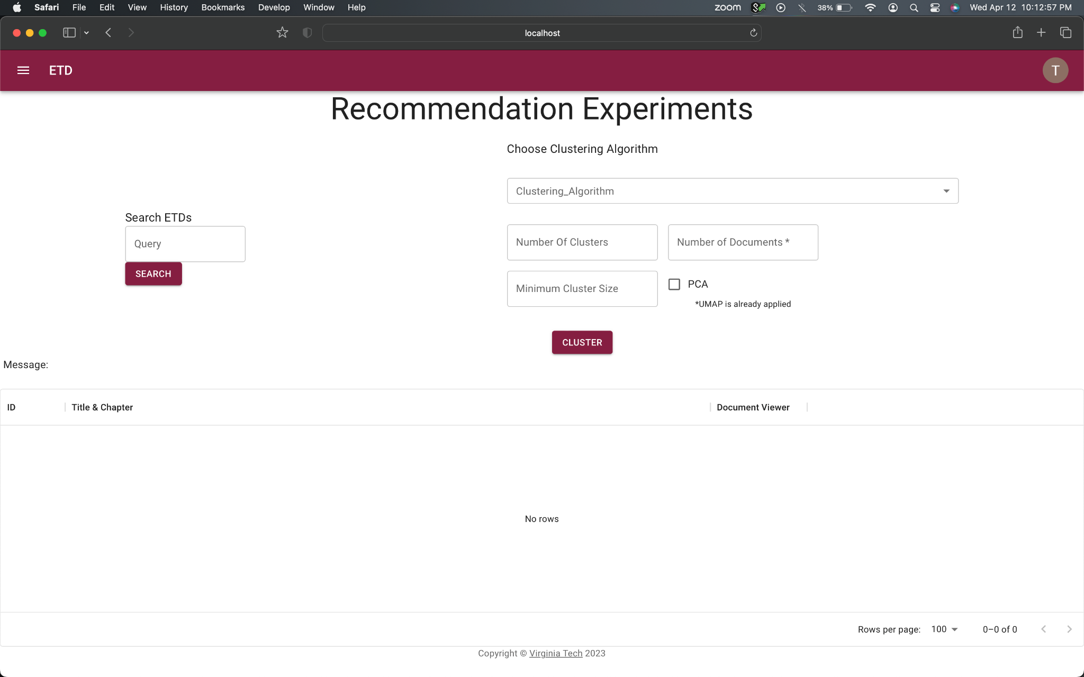
Deliverables

Slide 15
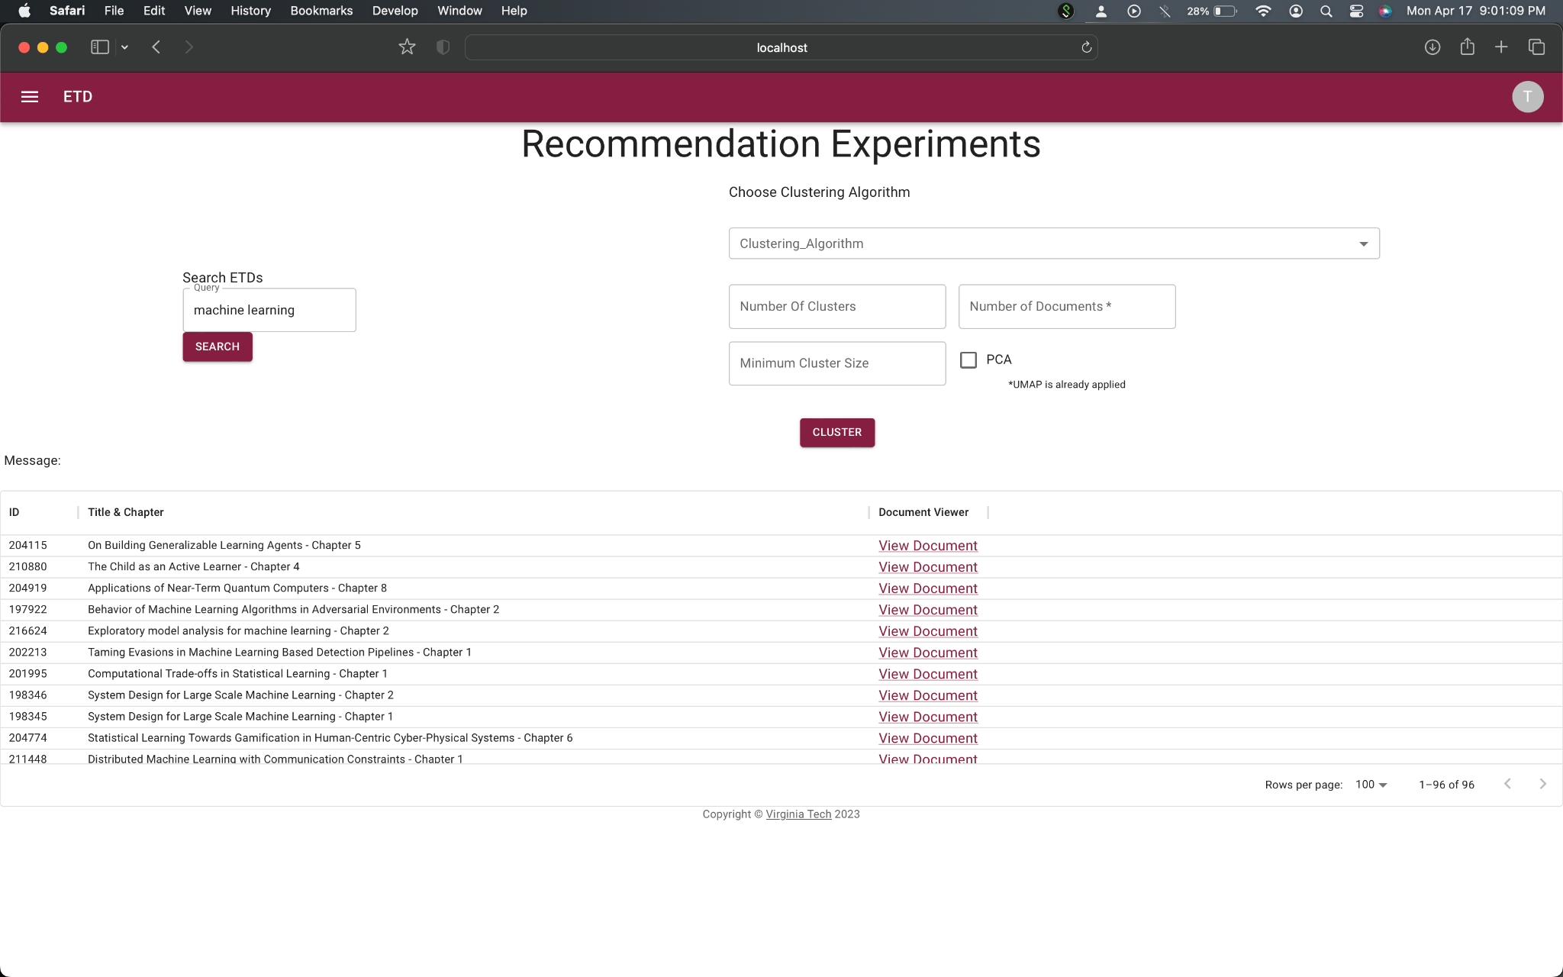
Deliverables
Deliverables

Slide 16
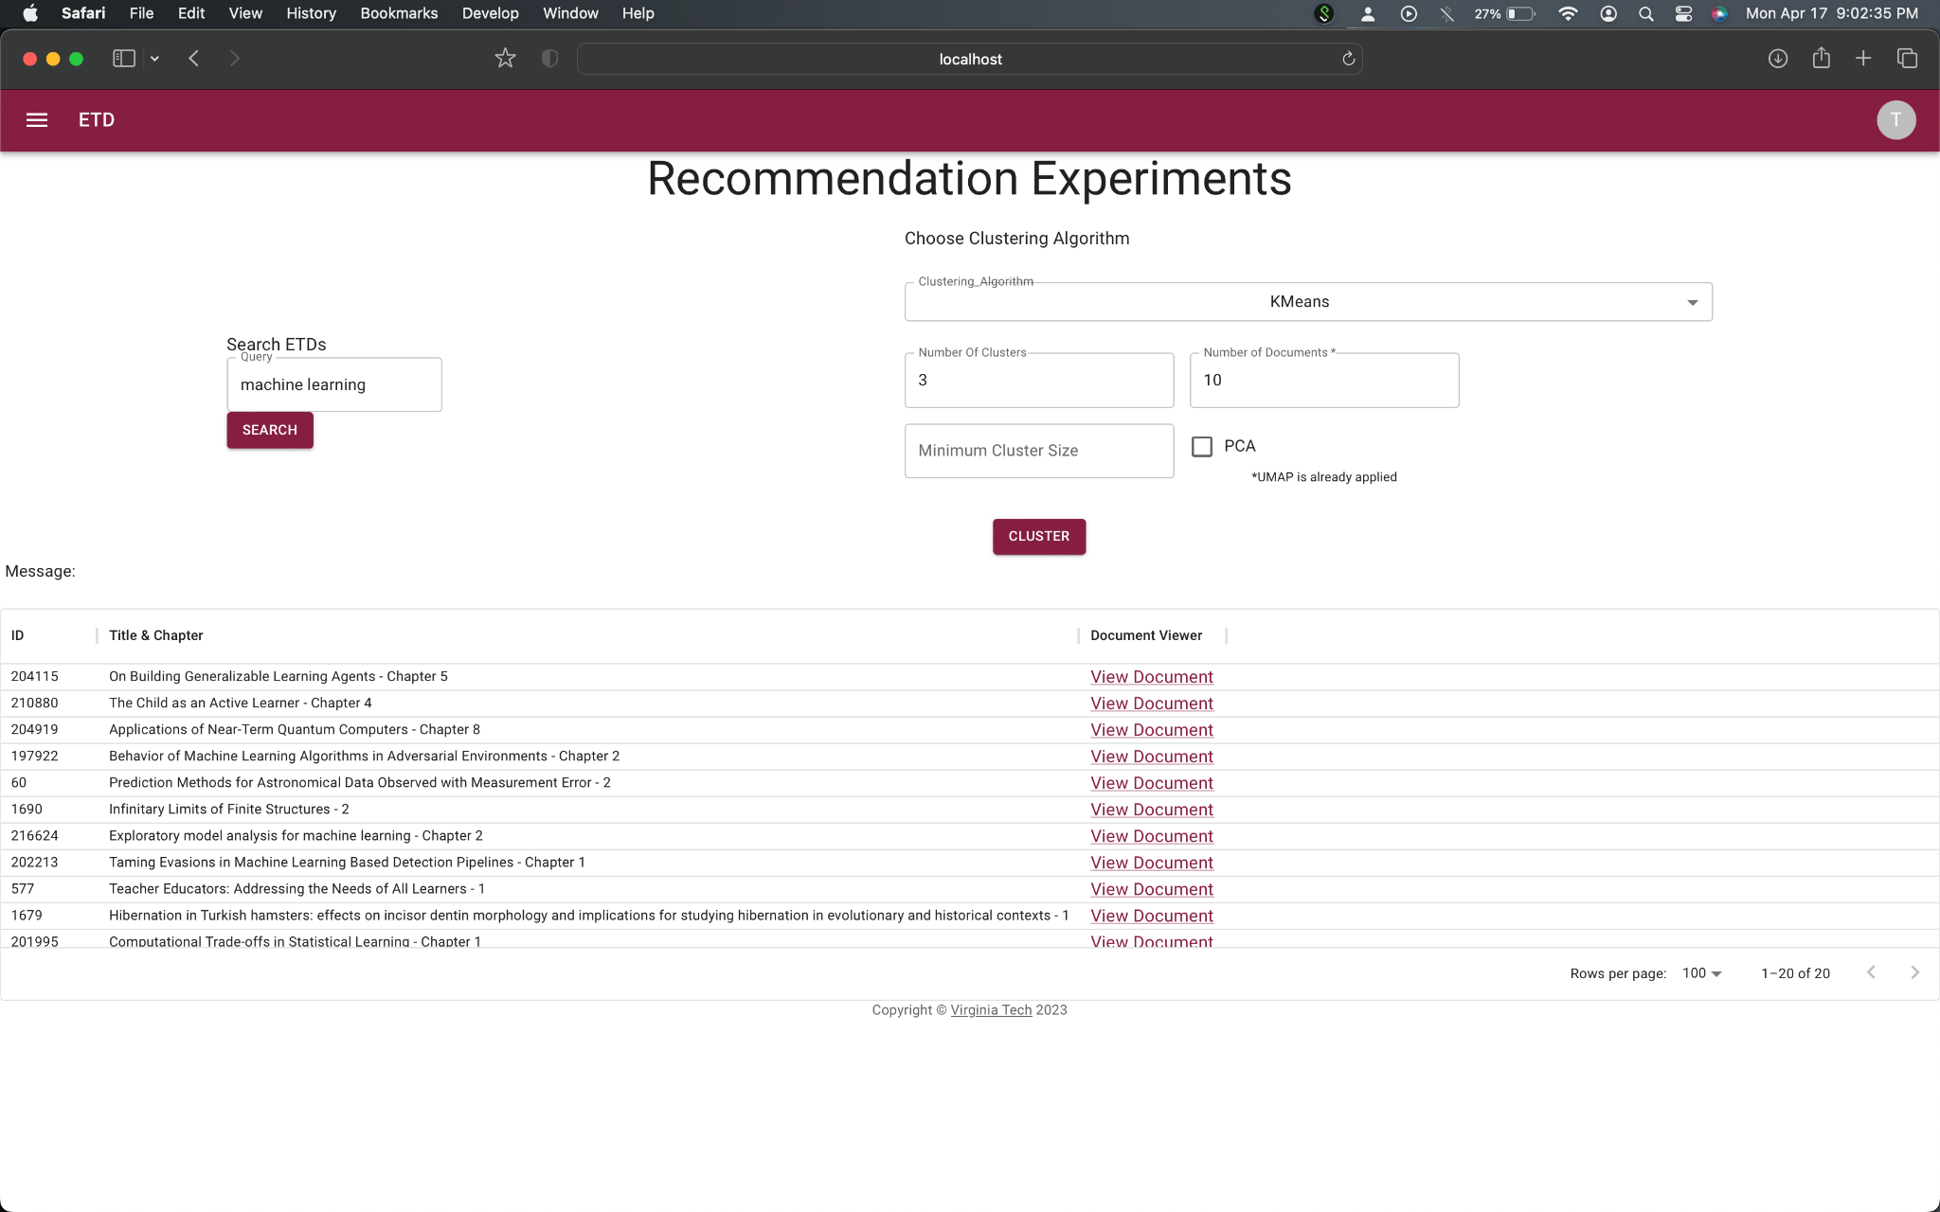
Deliverables
Deliverables - KMeans

Slide 17

Deliverables
Deliverables - DBScan
Notes:
With the current output, we actually didn’t see a difference between KMeans and DBScan, but honestly that is to be expected since the two nearest chapters are more than likely expected to be in the same cluster. As we add on more chapters, this means there is more of a chance that two documents might be in separate clusters, but even then it is pretty unlikely.

Slide 18
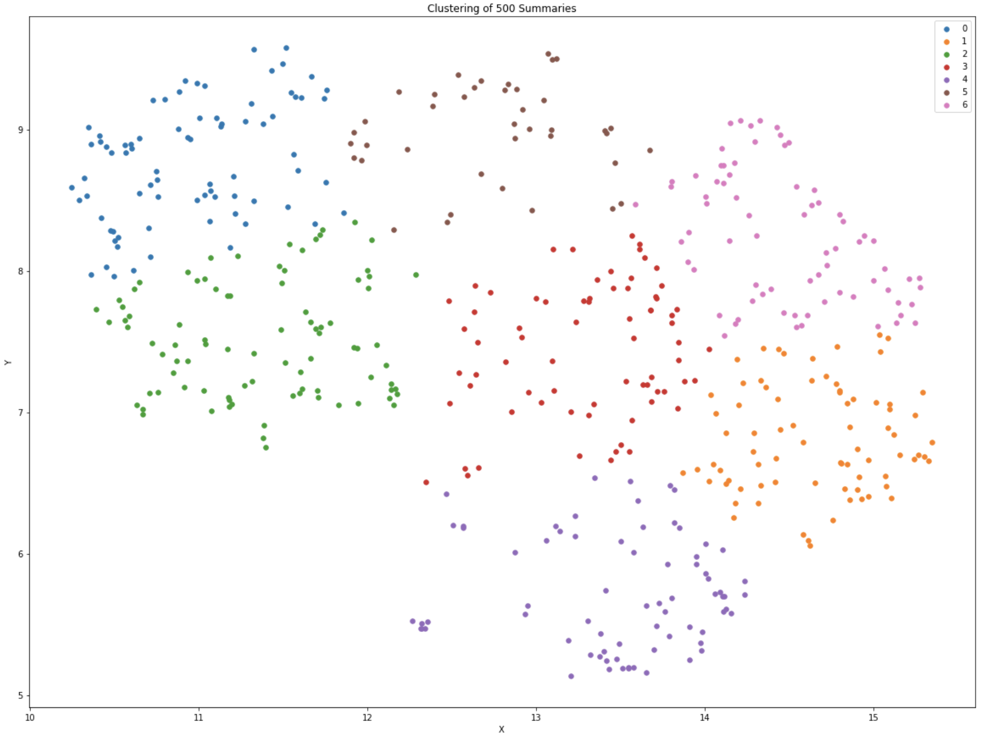
Testing & Evaluation - KMeans

Slide 19
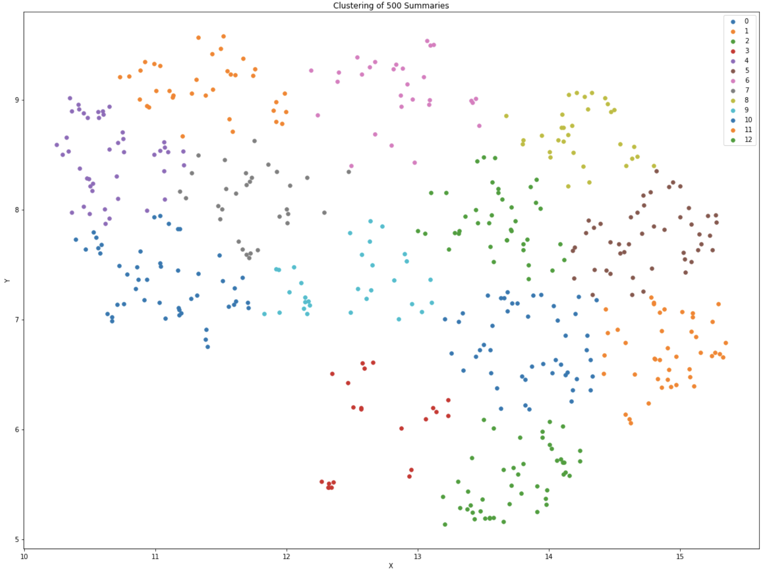
Testing & Evaluation - KMeans

Slide 20
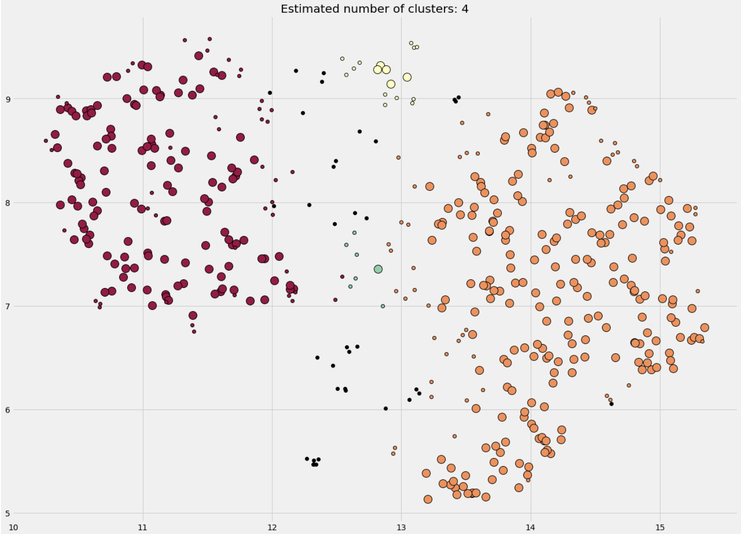
Testing & Evaluation - DBScan

Slide 21
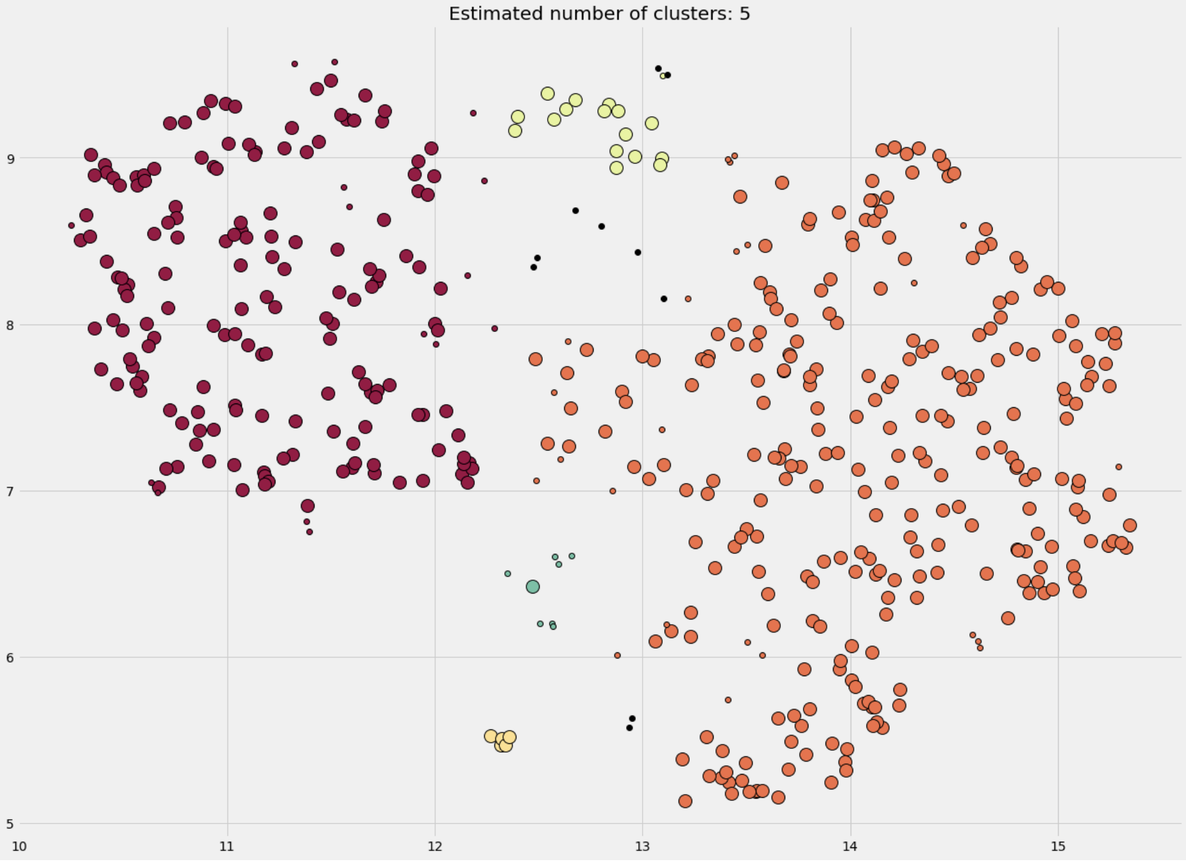
Testing & Evaluation - DBScan

Slide 22
Acknowledgements
Satvik Chekuri
Dr. Fox
Previous CS 5604 teams
  Chapter Summarization Model
  Information Retrieval
Notes:
long

Slide 23
References
[1] Bhanja, Satyanarayan. “How to Cluster Text Documents Using BERT.” Theaidigest.in, 29 Sept. 2020, https://theaidigest.in/how-to-cluster-text-documents-using-bert/. Accessed 3 Mar. 2023.
[2] Caboom.ai. “Speeding up Similarity Search in Recommender Systems Using FAISS.” Medium, Artificial Intelligence in Plain English, 13 Aug. 2020, https://ai.plainenglish.io/speeding-up-similarity-search-in-recommender-systems-using-faiss-basics-part-i-ec1b5e92c92d. Accessed 14 Feb. 2023.
[3] Erik Bernhardsson. “Nearest Neighbors and Vector Models – Part 2 – Algorithms and Data Structures.” Erik Bernhardsson, Erik Bernhardsson, 19 Apr. 2020, https://erikbern.com/2015/10/01/nearest-neighbors-and-vector-models-part-2-how-to-search-in-high-dimensional-spaces.html. Accessed 14 Feb. 2023.
[4] Frederickson, Ben. “Approximate Nearest Neighbours for Recommender Systems.” Ben Frederickson, 11 Oct. 2017, https://www.benfrederickson.com/approximate-nearest-neighbours-for-recommender-systems/. Accessed 14 Feb. 2023.
[5] Ramachandran, Aiswarya. “Building a Movie Recommendation Using FAISS.” Medium, Analytics Vidhya, 29 Jan. 2021, https://medium.com/analytics-vidhya/building-a-movie-recommendation-using-faiss-60d65b104dda. Accessed 14 Feb. 2023.
[6] Trabelsi, Eyal. “Comprehensive Guide to Approximate Nearest Neighbors Algorithms.” Medium, Towards Data Science, 8 Sept. 2021, https://towardsdatascience.com/comprehensive-guide-to-approximate-nearest-neighbors-algorithms-8b94f057d6b6. Accessed 14 Feb. 2023.

Slide 24
References
[7] Paidiparthy, Manoj Prabhakar. Ramanujan, Ramaraja. Teegalapally, Akshita. Muralikrishnan, Madhuvanti. Balar, Romil Khimraj. Juvekar, Shaunak. Murali, Vivek. 11 Jan. 2023, CS5604 (Information Retrieval) F2022 End User (EU) Team Project, http://hdl.handle.net/10919/114080. Accessed 6 Apr. 2023.
[8] Ganesan, Kaushik. Nanjundan, Deepak. Srivastava, Deval. Neog, Abhilash. Jayaprakash, Dharneeshkar. Shah, Aditya. 11 Jan. 2023, CS5604 (Information Retrieval) Language Models, Classification, Summarization & Segmentation, http://hdl.handle.net/10919/114077. Accessed 6 Apr. 2023.
[9] Devlin, Jacob, et al. ‘BERT: Pre-Training of Deep Bidirectional Transformers for Language Understanding’. CoRR, vol. abs/1810.04805, 2018, http://arxiv.org/abs/1810.04805. arXiv. Accessed 6 Apr. 2023.
[10] McInnes, Leland, et al. ‘UMAP: Uniform Manifold Approximation and Projection’. Journal of Open Source Software, vol. 3, no. 29, The Open Journal, 2018, p. 861, https://doi.org10.21105/joss.00861. Accessed 6 Apr. 2023.
[11] Meta, Inc. “Welcome to FAISS Documentation.” Welcome to Faiss Documentation - Faiss Documentation, Meta, Inc, 2015, https://faiss.ai/. Accessed 6 Apr. 2023.
[12] Spotify USA, Inc.ANNOY Library. 2015, https://github.com/spotify/annoy. Accessed 6 Apr. 2023.
[13] Pearson, Karl. ‘LIII. On Lines and Planes of Closest Fit to Systems of Points in Space’. The London, Edinburgh, and Dublin Philosophical Magazine and Journal of Science, vol. 2, no. 11, Taylor & Francis, 1901, pp. 559–572, https://doi.org10.1080/14786440109462720. Accessed 8 Apr. 2023.

Slide 25
References
[14] Elastic, “Elasticsearch”. 2015, https://github.com/elasticsearch/elasticsearch. Accessed 8 Apr. 2023.
[15] Dorfer, Thomas A. “Density-Based Clustering: DBSCAN vs. HDBSCAN.” Medium, Towards Data Science, 6 Dec. 2022, https://towardsdatascience.com/density-based-clustering-dbscan-vs-hdbscan-39e02af990c7. Accessed 8 Apr. 2023.
[16] Ginni. “What Is the Difference between K-Means and DBSCAN.” Tutorials Point, 14 Feb 2022, https://www.tutorialspoint.com/what-is-the-difference-between-k-means-and-dbscan. Accessed 8 Apr. 2023.
[17] McInnes, Leland. Healy, John. Astels, Steve. “Comparing Python Clustering Algorithms.” Comparing Python Clustering Algorithms - Hdbscan 0.8.1 Documentation, 2016, https://hdbscan.readthedocs.io/en/latest/comparing_clustering_algorithms.html. Accessed 8 Apr. 2023.
[18] Trivedi, Aashka. Trivedi, Anya. Varshney, Sourabh. Joshipura, Vidhey. Mehta, Rupa. Dhanani, Jenish. IEEE, 2020, Extracted Summary Based Recommendation System for Indian Legal Documents, ieeexplore.ieee.org/abstract/document/9225290. Accessed 10 Apr. 2023.
[19] Radev, Dragomir R. Fan, Weiguo. Zhang, Zhu. WebInEssence: A Personalized Web-Based Multi-Document Summarization and Recommendation System, Sept. 2001, citeseerx.ist.psu.edu/document?repid=rep1&type=pdf&doi=40fccfffe550e84797d146f856e5d437f52ed422. Accessed 10 Apr. 2023.

Slide 26
References
[20] Trabelsi, Eyal. “Comprehensive Guide to Approximate Nearest Neighbors Algorithms.” Medium, Towards Data Science, 8 Sept. 2021, https://towardsdatascience.com/comprehensive-guide-to-approximate-nearest-neighbors-algorithms-8b94f057d6b6. Accessed 10 Apr. 2023.
[21] Real Python. “K-Means Clustering in Python: A Practical Guide.” Real Python, Real Python, 30 Jan. 2023, https://realpython.com/k-means-clustering-python/#choosing-the-appropriate-number-of-clusters. Accessed 12 Apr. 2023.
[22] Arvai, Kevin. Kneed Package, kneed. 0.7.0, 8 2020, https://doi.org10.5281/zenodo.6496267. Accessed 12 Apr. 2023.
[23] Frenzel, Charles. “Tuning with HDBSCAN.” Medium, Towards Data Science, 11 Sept. 2021, towardsdatascience.com/tuning-with-hdbscan-149865ac2970.

