Slide 1
Did you really get the message? Using text reminders to stimulate adoption of agricultural technologies
Jeffrey Alwang (with Catherine Larochelle)
Presentation at SCAU, 28 February 2017
Notes:
Study was conducted as part of IPM crps project in Ecuador
Randomized farmers into T& C. Treated received text messages about IPM
We found that text messages increase adoption of and knowledge about IPM
We investigate channels using the psychology literature through which SMS can induce behavior change

Slide 2
Objectives
Discuss use of randomized control trials to investigate behavioral phenomena
Specific case of use of information and communications technology to induce change in agricultural practices
Present a simple RCT
Discuss broader use of such research techniques

Slide 3
Introduction
Need to identify cost-effective means of stimulating adoption of agricultural technologies
Integrated Pest Management (IPM)
  Set of practices that limit use of harmful chemicals to manage pests and diseases
Diffusion methods for IPM
  Farmer Field Schools (FFS), farmer field days, mass media, farm visits, etc.
Previous studies find mixed results on impact of FFS on IPM adoption and diffusion
  Issue of selectivity bias
Notes:
1- need to increase ag productivity – with spike in food price
2. IPM information ranges from simple messages to complex management practices
IPM is often information intensive and frequently includes a combination of practices.
3. Many diffusion methods, some better for certain types of information
More intensive training methods cost more but budgets are limited

Slide 4
Information & Communication Technology (ICT)
Capable of delivering information at low cost
Previous studies find that increased in cellular coverage increases producer and consumer welfare (Jensen, 2007; Aker, 2011; Aker and Fafchamps, 2014)
Cell phone ownership
Cost of SMS
Makes using SMS to deliver info appealing
Easy to randomize
Notes:
Rapid changes in ICT
IN developing countries

Slide 5
Previous RCTs on impact of SMS
In agricultural sector
  In India, not effective in increasing prices received in markets (Fafchamps and Minten, 2012).
  In India, increased use of appropriate and less hazardous pesticides but no impact on knowledge (Cole and Fernando, 2012)
  Treated farmers in Peru received higher market prices, especially for perishable crops (Nakasone, 2013)
In other sectors
  SMS increase savings in a 3-country study (Karlan et al. 2016)
  Used in the health sector for adherence to drug regimens, smoking cessation, increased physical activity, dengue prevention, etc. (e.g. Rodgers et al. 2005; Da Costa et al. 2010; Dammert et al. 2014)
  Often used as reminders
Notes:
RCT to determine the effective of text message to effect behavior changes

Slide 6
Objectives of study
Determine if text messages affect adoption of IPM practices among potato farmers in Carchi, Ecuador
Determine if text messages affect knowledge about IPM
Identify mechanisms by which text messages induce behavior changes
  Reminder effect?
  Knowledge building effect?
Notes:
limited evidence about SMS to increase adoption of IPM
Not reminder effects => need to tailor message to correct timing
Knowledge building effects => substitute or complement extension services and message content could be adapt to farmers skills/knowledge to max impact.

Slide 7
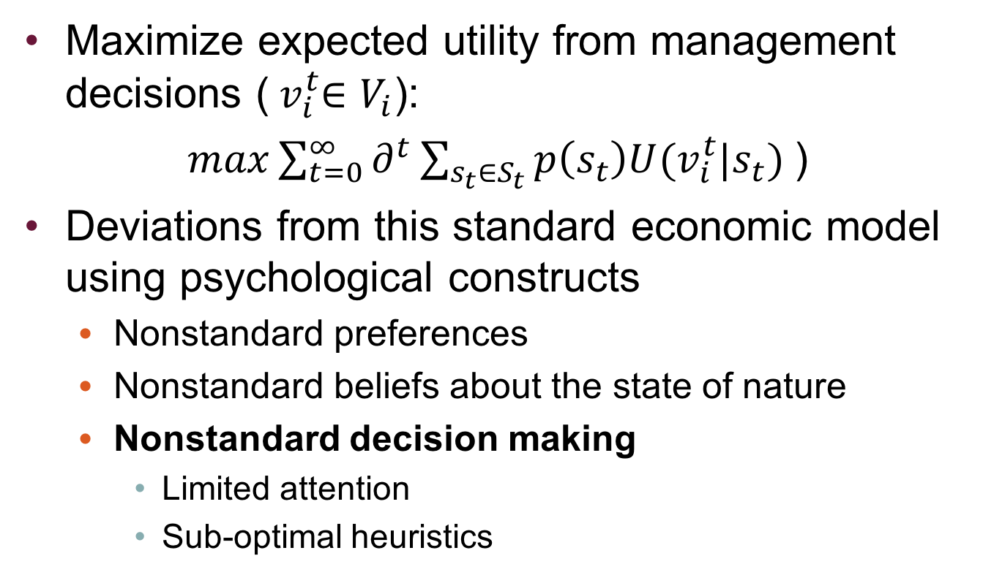
Conceptual framework
Maximize expected utility from management decisions (${ v}_{i}^{t}∈V_{i}$):
$max\sum_{t=0}^{∞}{∂^{t}\sum_{s_{t}∈S_{t}}{p\left(s_{t}\right)U(v_{i}^{t}|s_{t}}) }$)
Deviations from this standard economic model using psychological constructs
  Nonstandard preferences
  Nonstandard beliefs about the state of nature
  Nonstandard decision making
    Limited attention
    Sub-optimal heuristics
Notes:
-We follow DellaVigna, who uses the psychology literature to explain not standard decision making
IPM practices have low adoption rates despite benefits, economic, health, environment, well demonstrated

Slide 8
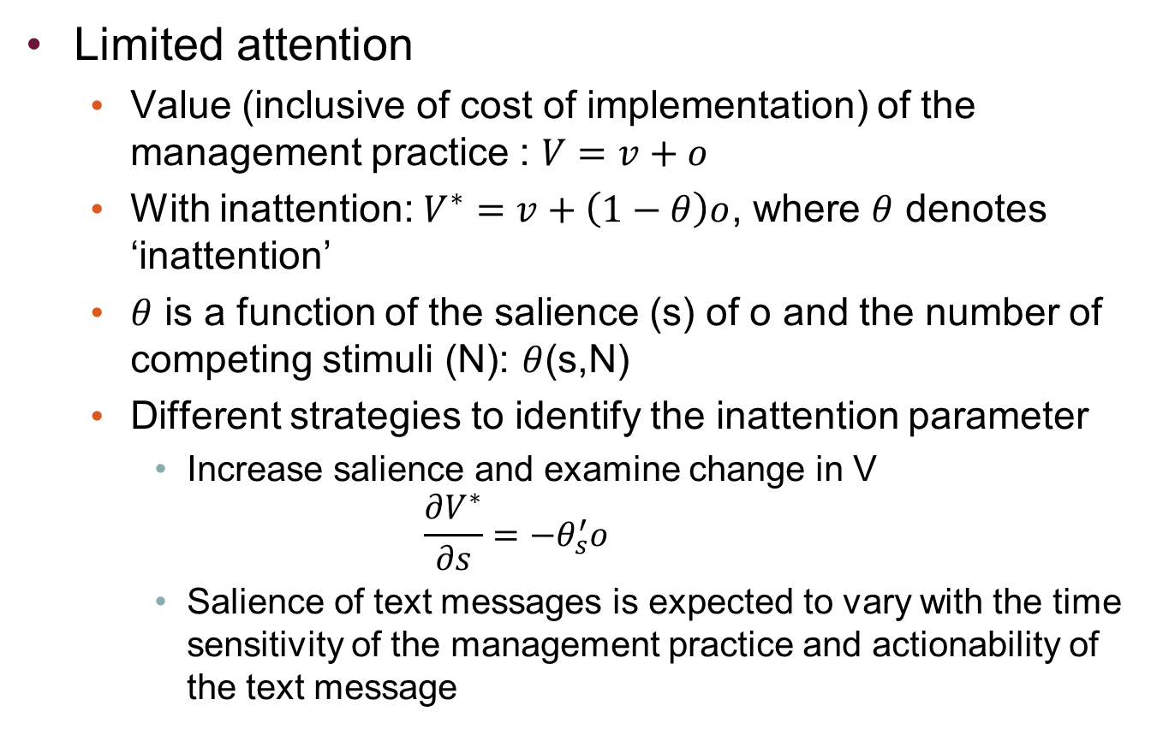
Conceptual framework
Limited attention
  Value (inclusive of cost of implementation) of the management practice : $V=v+o$
  With inattention: $V^{∗}=v+\left(1−θ\right)o$, where $θ$ denotes ‘inattention’
  $θ$ is a function of the salience (s) of o and the number of competing stimuli (N): $θ$(s,N)
  Different strategies to identify the inattention parameter
    Increase salience and examine change in V
    $$\frac{∂V^{∗}}{∂s}=−θ_{s}^{′}o$$
    Salience of text messages is expected to vary with the time sensitivity of the management practice and actionability of the text message
Notes:
V = visible, known and remember by decision maker
O more opaque component, require more effort and attention to process
Attention is a scare resource and due to inattention
O some of the benefits of IPM are harder to perceive-not a direct increase in yield– like positive impact on health and environment, might take time to occur, and might be disperse.
texts messages might have greater impact on the inattention parameter than others.

Slide 9
Conceptual framework
Sub-optimal heuristics
  Situation where the decision maker faces a large menu of options
    Preference for the familiar to sort out complexities
  The IPM package includes numerous and complex choices
    Knowledgeable farmers are less likely to be overwhelmed by the complex choice sets and less likely to choose the default option
    Impact of text messages:
      Greater for complex compared to simple IPM practices
      Smaller for already knowledgeable farmers
Notes:
sub-optimal decision

Slide 10
Background
Carchi is the largest potato producing region in Ecuador
  90,000 potato producers
  Heavy use of pesticides-health, environment, and cost of production issues
IPM program (INIAP/CIP/IPM CRSP—supported by USAID) since 1999
  Late blight, Andean potato weevil, tuber moth, leaf miner, and rhizoctonia are the major pests and diseases
IPM diffusion methods under IPM CRSP
    FFS (1998-2003)
    Farmer field days
    Written materials & mass media
    Farmer-to-Farmer transfer

Slide 11
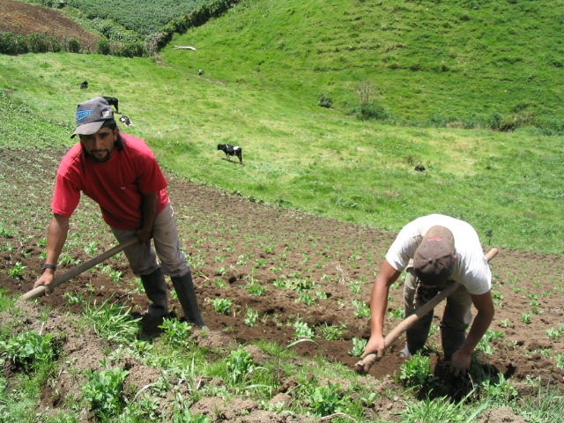

Slide 12
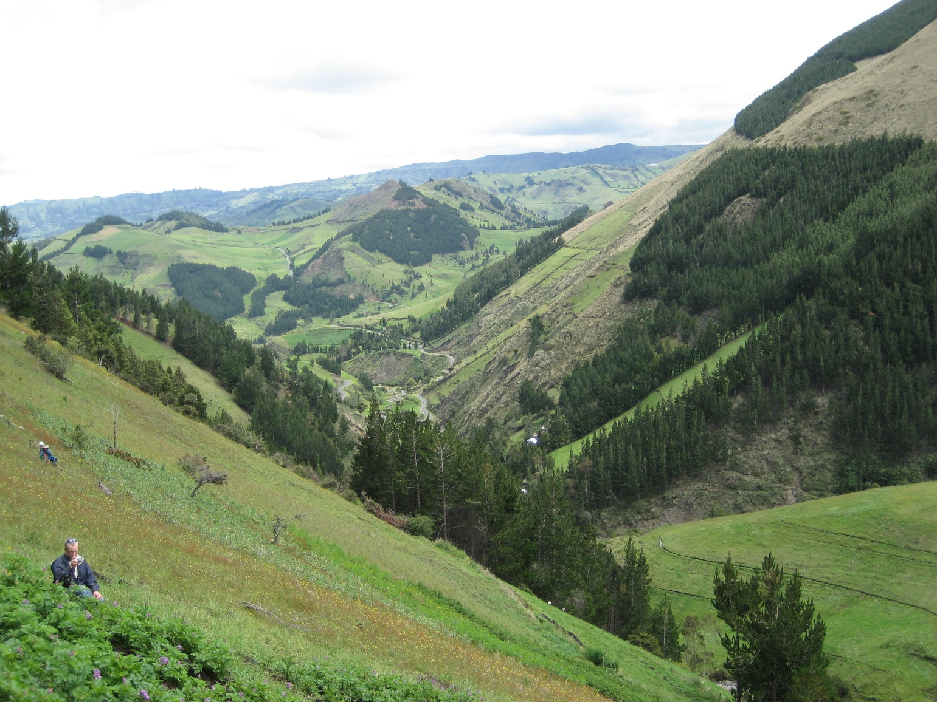

Slide 13
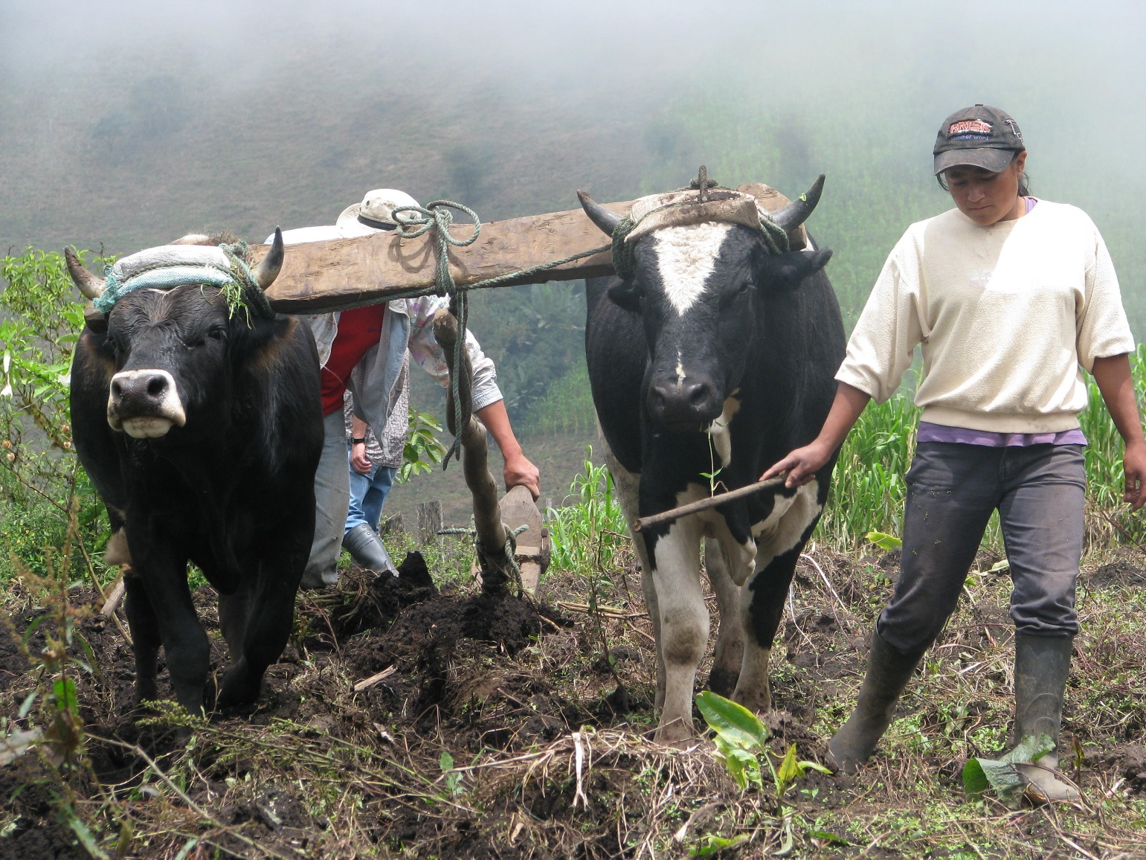

Slide 14
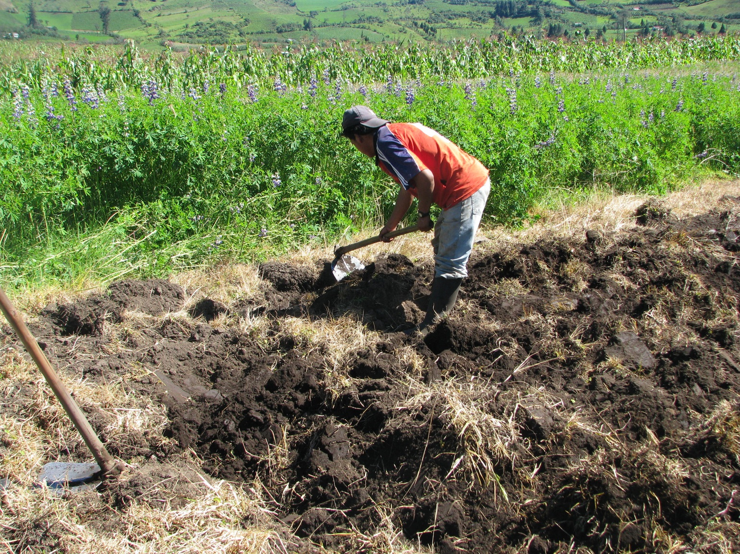

Slide 15
Experiment
Invitation for potato producers to attend a day-long farmer field day (FFD) on IPM training
FFDs were conducted in 3 locations:
  Teaching stations on IPM practices
  Booklet
  Informed about experiment
  Gathered basic household demographics for eligible participants
  Also information on stage of the potato plant
Randomization of participants into control and treatment groups
Notes:
Advertised my employees ministry of agriculture, local government, NGOS
Eligibility: own cell phone, can read, and interested in participating in the experiment
RCT at village level

Slide 16
Experiment
Treatment group
  Received 2-3 text messages per week over 10 weeks for free
  Texts tailored towards stage of production cycle
  Texts could be reminders, informative, or both
Follow-up questionnaire
  Adoption of and knowledge about IPM practices
  353 farmers (196 treated and 157 control)

Slide 17
Data
12 IPM practices, grouped into 7 adoption scores:
  All 12 IPM practices
  Simple vs. complex IPM practices
  Purchase vs. non-purchase reliant IPM practices
  Time sensitive vs. insensitive IPM practices
23 IPM knowledge questions and 8 knowledge scores
  Overall knowledge
  Knowledge related to each of the 7 adoption scores
Notes:
All expressed in %

Slide 18
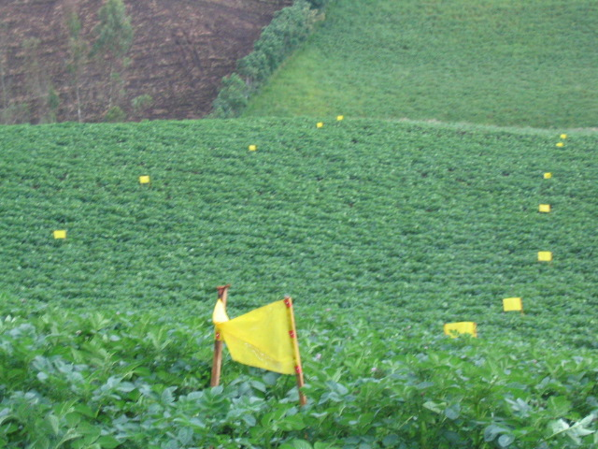

Slide 19
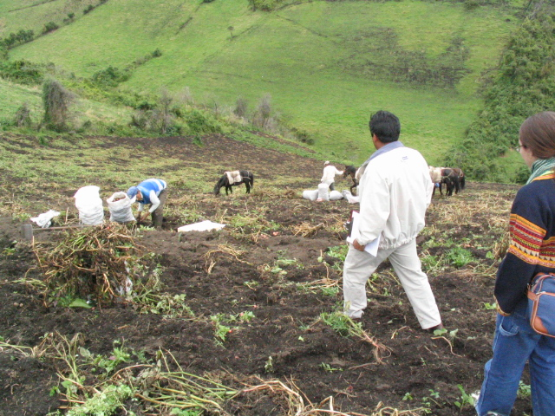

Slide 20
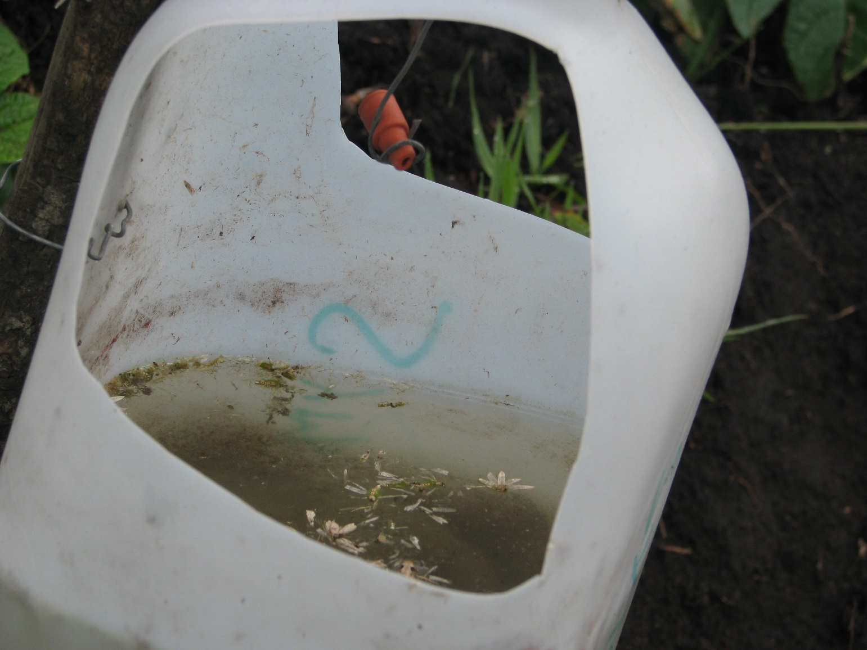

Slide 21
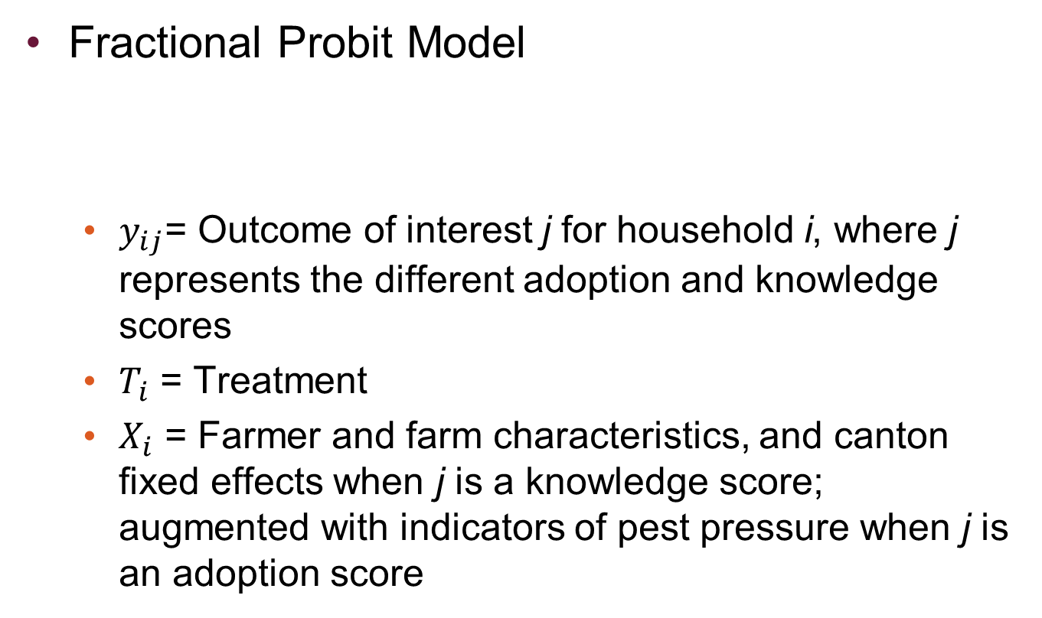

Empirical model
Fractional Probit Model
  $y_{ij}$= Outcome of interest j for household i, where j represents the different adoption and knowledge scores
  $T_{i}$ = Treatment
  $X_{i}$ = Farmer and farm characteristics, and canton fixed effects when j is a knowledge score; augmented with indicators of pest pressure when j is an adoption score
$$y_{ij}=α_{j}+β_{j}T_{i}+γ_{j}X_{i}+ε_{ij}$$

Slide 22
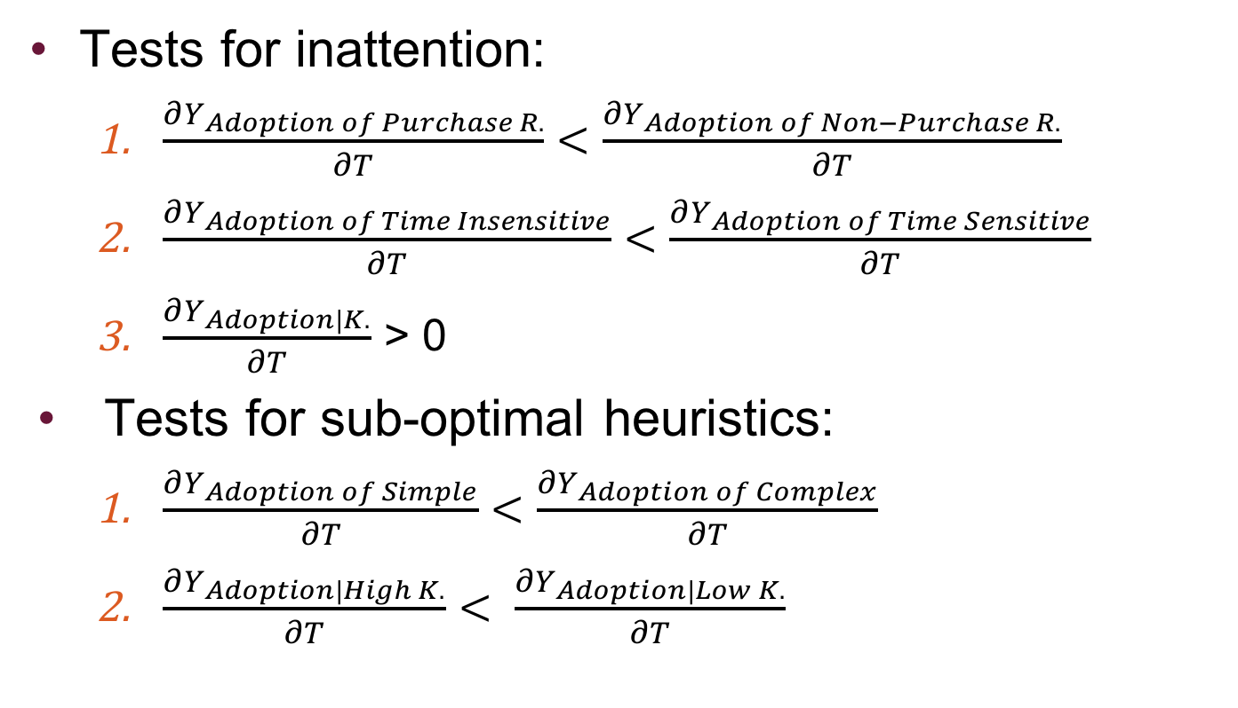
Testing the theories
Tests for inattention:
  $\frac{∂Y_{Adoption of Purchase R.}}{∂T}<\frac{∂Y_{Adoption of Non−Purchase R.}}{∂T}$
  $\frac{∂Y_{Adoption of Time Insensitive}}{∂T}<\frac{∂Y_{Adoption of Time Sensitive}}{∂T}$
  $\frac{∂Y_{Adoption|K.}}{∂T}$ > 0
Tests for sub-optimal heuristics:
  $\frac{∂Y_{Adoption of Simple}}{∂T}<\frac{∂Y_{Adoption of Complex}}{∂T}$
  $\frac{∂Y_{Adoption|High K.}}{∂T}$ $< \frac{∂Y_{Adoption|Low K.}}{∂T}$
Predict Pre-Treatment Knowledge (PTK)
Interaction term between T and PTK
Compute marginal effect of T at different values of PTK

Slide 23
Table 1: Descriptive statistics of IPM adoption practices and scores
 | Sample |  | Control | Treatment | ∆ C & T
Description |  | Mean (%) | Mean (%) | Mean (%) | p-value
Adoption of IPM practices
Use of traps for weevil |  | 16.71 | 12.74 | 19.90 | 0.068
Use of bait plants for weevil |  | 17.56 | 8.28 | 25.00 | 0.000
Use of IPM chemical control for weevil |  | 48.71 | 52.94 | 45.41 | 0.163
Solarize seeds to prevent tuber moth |  | 62.04 | 49.04 | 72.45 | 0.000
Apply Bacu-Turin to prevent tuber moth |  | 10.76 | 10.19 | 11.22 | 0.755
Hilling to prevent tuber moth |  | 86.97 | 81.53 | 91.33 | 0.009
Use of IPM chemical control for tuber moth |  | 65.71 | 63.40 | 67.53 | 0.424
Use of fixed traps for leaf miner |  | 8.50 | 8.92 | 8.16 | 0.802
Use of mobile traps for leaf miner |  | 6.23 | 6.37 | 6.12 | 0.924
Disinfect seeds to prevent rhizoctonia |  | 61.47 | 54.14 | 67.35 | 0.012
Use of IPM chemical to control for rhizoctonia |  | 38.81 | 31.85 | 44.39 | 0.015
Remove yellow plants to maintain seed quality |  | 52.97 | 50.32 | 55.10 | 0.373
Adoption scores (see table A1 for definition of adoption scores)
Overall |  | 39.60 | 35.61 | 42.79 | 0.000
Simple practices |  | 59.04 | 54.55 | 62.64 | 0.001
Complex practices |  | 20.21 | 16.77 | 22.96 | 0.004
Purchase-reliant practices |  | 32.03 | 29.16 | 34.32 | 0.011
Non-purchase reliant practices |  | 54.67 | 48.41 | 59.69 | 0.000
Time sensitive practices |  | 36.20 | 31.34 | 40.10 | 0.000
Non-time sensitive practices |  | 56.68 | 57.37 | 56.12 | 0.759
Number of observations | 353 |  | 157 | 196
Note: ∆ C & T means difference between control and treatment group.

Slide 24
Descriptive analysis
Table 2: Descriptive statistics of IPM adoption scores
 | Sample |  | Control | Treatment | ∆ C & T
Description | Mean (%) |  | Mean (%) | Mean (%) | p-value
Adoption scores in percentage of IPM practices adopted
All practices (12) |  | 39.6 | 35.61 | 42.79 | 0
Simple practices (6) |  | 59.04 | 54.55 | 62.64 | 0.001
Complex practices (6) |  | 20.21 | 16.77 | 22.96 | 0.004
Purchase-reliant practices (8) |  | 32.03 | 29.16 | 34.32 | 0.011
Non-purchase reliant practices (4) |  | 54.67 | 48.41 | 59.69 | 0
Time sensitive practices (10) |  | 36.2 | 31.34 | 40.1 | 0
Time insensitive practices (2) |  | 56.68 | 57.37 | 56.12 | 0.759
Number of observations |  | 353 | 157 | 196

Slide 25
Descriptive analysis
Table 3: Descriptive statistics for IPM knowledge scores
 | Sample | Control | Treatment | ∆
Description | Mean (%) | Mean (%) | Mean (%) | p-value
IPM knowledge scores in percentage of correctly answered questions
Overall Knowledge (23) | 40.34 | 31.27 | 47.6 | 0
Knowledge w.r.t. all 12 practices (15) | 38.04 | 28.2 | 45.92 | 0
Knowledge w.r.t. simple practices (7) | 46.22 | 38.22 | 52.62 | 0
Knowledge w.r.t. complex practices (8) | 30.88 | 19.43 | 40.05 | 0
Knowledge w.r.t. purchase reliant practices (10) | 32.01 | 21.91 | 40.1 | 0
Knowledge w.r.t. non-purchase reliant practices (5) | 50.08 | 40.76 | 57.55 | 0
Knowledge w.r.t. time sensitive practices (13) | 36.67 | 26.85 | 44.54 | 0
Knowledge w.r.t. time insensitive practices (2) | 46.88 | 36.94 | 54.85 | 0
Number of observations | 353 | 157 | 196

Slide 26
Balance of covariates
Table 4: Balance of covariates
 | Sample | Control | Treatment | ∆ C & T
Description | Mean | Mean | Mean | p-value
Socio-economic characteristics
Age of the respondent | 42.31 | 42.59 | 42.08 | 0.686
Education of the respondent (years) | 8.82 | 8.52 | 9.06 | 0.187
Household size | 4.37 | 4.6 | 4.19 | 0.004
Nb of HH members 15 years old and above | 3.05 | 3.24 | 2.9 | 0.007
Land owned (ha) | 10.44 | 11.25 | 9.79 | 0.062
Land devoted to potato production (ha) | 2.79 | 2.81 | 2.77 | 0.879
Number of cows owned | 5 | 3.66 | 6.08 | 0.001
Altitude (meters) | 2942.48 | 2899.19 | 2977.15 | 0.000
Pest pressure
Observed weevil (1=yes) | 0.85 | 0.83 | 0.87 | 0.392
Observed tuber moth (1=yes) | 0.8 | 0.78 | 0.83 | 0.250
Observed leaf miner p (1=yes) | 0.85 | 0.8 | 0.89 | 0.030
Observed late (1=yes) | 0.89 | 0.87 | 0.9 | 0.462
Observed rhizoctonia (1=yes) | 0.5 | 0.44 | 0.54 | 0.059
Number of observations | 353 | 157 | 196

Slide 27
Regression results
Table 5: impact of treatment on knowledge and adoption
 | Overall Knowledge |  | Overall adoption
 | dy/dx | z | dy/dx | z
Treatment | 0.184*** | 5.33 | 0.063*** | 2.62
Secondary education (1=Yes) | 0.073** | 2.14 | 0.031 | 1.52
Age | -0.001 | -0.99 | 0 | -0.41
Nb of HH members 15 years & + | 0.023*** | 2.68 | -0.003 | -0.51
Land owned (ha) | 0 | -0.03 | -0.002* | -1.7
Nb of cows owned | 0.004** | 1.97 | 0.002* | 1.68
Altitude (m) |  |  | 0.000** | 2.07
Observed weevil (1=Yes) |  |  | 0.064** | 2.15
Observed tuber moth (1=Yes) |  |  | 0.082 | 1.62
Observed leaf miner (1=Yes) |  |  | -0.012 | -0.26
Observed late blight (1=Yes) |  |  | 0.063 | 1.58
Observed Rhizoctonia (1=Yes) |  |  | 0.070*** | 3.54
Notes:
Impact of treatment on knowledge = between 18 to 23 percentage points-depending on the knowledge score

Slide 28
Regression results
Theory of limited attention is supported
 | Adoption of purchase reliant practices |  | Adoption of non-purchase reliant practices
 | dy/dT | z | dy/dT | z
Treatment | 0.053** | 2.07 | 0.086*** | 2.97
<
 | Adoption of time sensitive practices |  | Adoption of time insensitive practices
 | dy/dT | z | dy/dT | z
Treatment | 0.071*** | 3.08 | 0.022 | 0.5
>

Slide 29
Regression results
But not fully… suggestions/thoughts ??
Overall Adoption | dy/dx | z
Treatment | -0.001 | -0.05
Knowledge | 0.330*** | 11.15
Secondary education (1=Yes) | 0.004 | 0.23
Age | 0 | 0.12
Nb of HH members 15 years old & + | -0.011** | -2.19
Land owned (ha) | -0.002* | -1.69
Nb of cows owned | 0.001 | 0.92
Altitude (m) | 0.000** | 2.44
Observed weevil (1=Yes) | 0.068*** | 3
Observed tuber moth (1=Yes) | 0.092*** | 3.2
Observed leaf miner (1=Yes) | -0.019 | -0.62
Observed late blight (1=Yes) | 0.006 | 0.19
Observed Rhizoctonia (1=Yes) | 0.065*** | 3.67

Slide 30
Regression results
Theory of sub-optimal heuristics is supported
 | Adoption of simple practices |  | Adoption of complex practices
 | dy/dT | z | dy/dT | z
Treatment | 0.047* | 1.83 | 0.075*** | 2.71
<
Overall adoption | dy/dx | z
Treatment
@
PTK p10 | 0.073*** | 2.92
PTK p25 | 0.068*** | 2.99
PTK p50 | 0.061*** | 2.58
PTK p75 | 0.054*** | 2.02
PTK p90 | 0.043 | 1.26

Slide 31
Conclusions
Use of ICT to promote technology adoption lags behind its potential
Findings from our study are promising
Timing, message content, farmer ability are important determinants of its effectiveness
Limitations to external validity of the study
  RCT preceded with formal training session
  IPM training has occurred for several years in Carchi

Slide 32
Extensions: RCTs in Agriculture
Agricultural inputs
  Fertilizer application (Duflo, Kremer & Robinson, AER, 2008)
  Fertilizer in Mali (Beaman et al. NBER, 2013)
Testing the value of information provision
  Milk in Vietnam (Sanger, Torero, Qaim, AJAE, 2014)
Insurance & finance
  Investment and risk: returns to insurance in Ghana (Karlan, Osei, Osei-Akoto & Udry, QJE, 2014)
  Social networks and insurance in China (Cai, de Janvry & Sadoulet, AER: Applied Economics, 2015)
  Social networks linked with micro finance (Atkinson, de Janvry, Macintosh, Sadoulet, EDCC, 2013)
Notes:
CJS: Networks are effective at disseminating information

Slide 33
Questions?
Thank you

