Slide 1

To Boldly Go:
First-year exploration of
OER Initiatives
Virginia
Virginia Libraries Association Annual Conference
Williamsburg, VA - October 23, 2014
Anita Walz
Assessment, Open Education & Online Learning Environments Librarian
University Libraries, Virginia Tech
arwalz@vt.edu

Slide 2
My charge (25%)
  Explore and disseminate information regarding Open Educational Resources (OER) (to include digital textbooks and multimedia) to the library community and interested faculty at Virginia Tech.
Identify current faculty practices
Survey peer institutions for:
  Ways that librarians are providing support and services in this space;
  Ways that instructors are currently using open educational resources and
  Uncover any advocacy for OER and their impact on teaching/ learning
Identify opportunities for the Libraries to lead or partner in initiatives regarding OERs at VT.

Slide 3
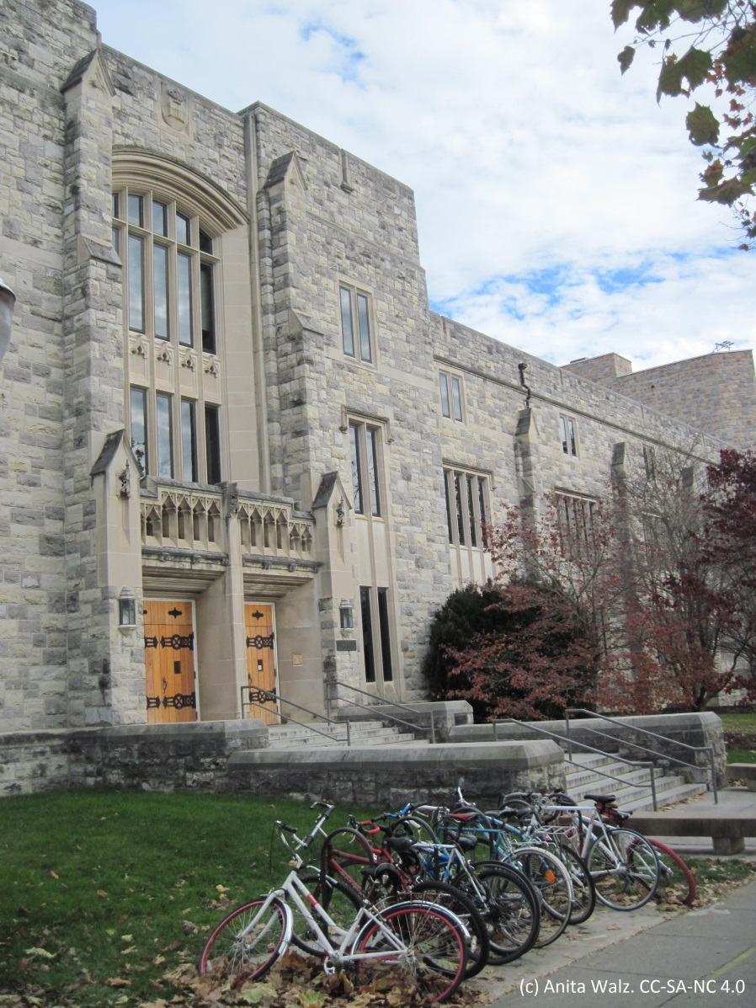
Virginia Tech
~ 3,700+ faculty
29,000 students on campus + some off campus
“Residential Undergraduate Experience”
+ plus online options
Tenure, academic freedom and faculty choice
= Decentralized faculty decision-making

Slide 4
Session Objectives
By the end of this presentation you should be able to:
Describe the concept of Open Educational Resources
Articulate rationale for OER
Summarize existing & potential contributions by libraries

Slide 5

Why Open Educational Resources?
OER have the potential to . . .
reduce the cost of education for students
increase student retention (saving institutions $)
allow innovative pedagogy (which may increase student achievement)

Slide 6
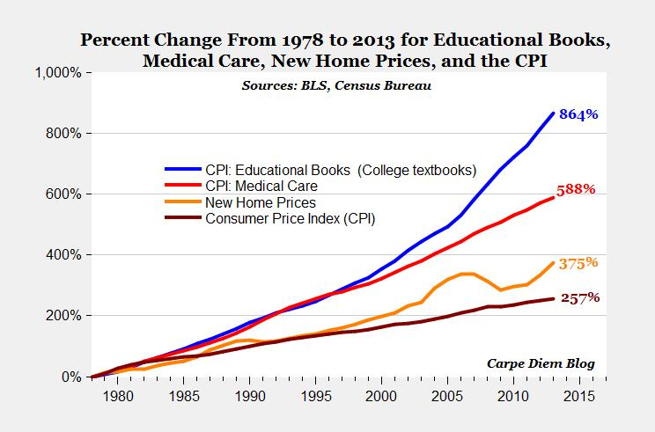
Why Open Educational Resources?
© 2014, Mark Perry, Scholar at American Enterprise Institute for Public Policy Research. All Rights Reserved. Used with permission. https://twitter.com/Mark_J_Perry/status/459395162032988160/photo/1
http://www.aei-ideas.org/2012/12/the-college-textbook-bubble-and-how-the-open-educational-resources-movement-is-going-up-against-the-textbook-cartel

Slide 7
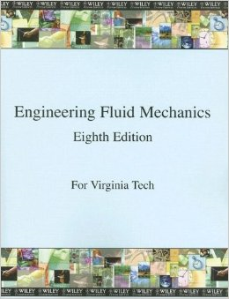
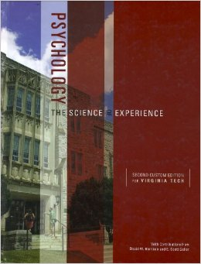
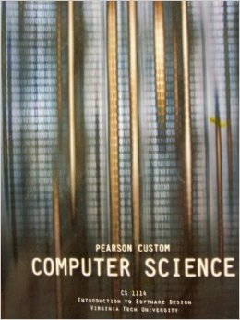
Rental options and Custom textbooks
Publishers respond with
Custom Editions $$ from Wiley, Pearson & McGraw Hill
Software access codes continue to be bundled.
All images are property of their respective owners and may be subject to copyright. Used under “fair use.”

Slide 8
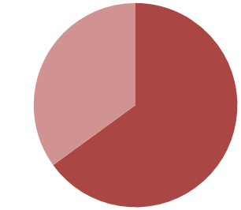
Why Open Educational Resources?
65% of [college] students
surveyed said that they had
decided against buying a
textbook because it was
too expensive.
94% of students who had foregone purchasing a textbook were concerned that doing so would hurt their grade in a course.
U.S. PIRG (2014) “Fixing the Broken Textbook Market: How Students Respond to High Textbook Costs and Demand Alternatives ” http://www.uspirg.org/reports/usp/fixing-broken-textbook-market

Slide 9
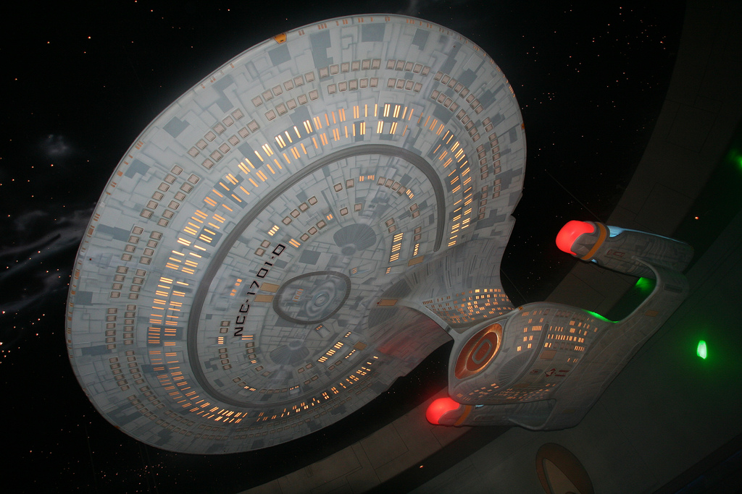
© Ezra S F “NCC-1701-D” CC BY

Slide 10
What are
Open Educational
Resources
anyway?

Slide 11
Open Educational Resources . . .
- are teaching, learning, and research resources
- that reside in the public domain or have been released under an intellectual property license that permits their free use and re-purposing by others.
- include full courses, course materials, modules, textbooks, streaming videos, tests, software, and any other tools, materials, or techniques used to support access to knowledge."
- Hewlett Foundation

Slide 12



What kind of “open” did you mean?
  Free (Open Access)
  Free (Openly licensed)
  redistribute, edit, remix/tweak, build upon;
  no need to navigate fair use & copyright exemptions
See also: 4Rs http://opencontent.org/blog/archives/1123 and the 5th R http://opencontent.org/blog/archives/3251

Slide 13
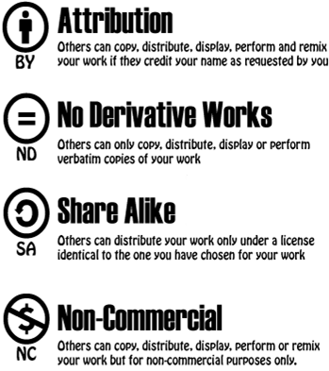
Creative Commons License Symbols

Slide 14
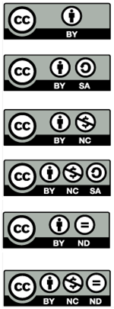
6 Creative Commons Licenses
Attribution “CC-BY”
Attribution ShareAlike “CC BY-SA”
Attribution Noncommercial “CC BY-NC”
Attribution NonCommercial ShareAlike “CC BY-NC-SA”
Attribution NoDerivatives “CC BY-ND”
Attribution NonCommercial NoDerivatives “CC BY-NC-ND”

Slide 15
6 Creative Commons Licenses
Attribution “CC-BY”
This license lets others distribute, remix, tweak, and build upon a work, even commercially, as long as they credit the original author for the original creation. This is the most accommodating of licenses offered, in terms of what others can do with a work licensed under Attribution.
Notes:
© University of Michigan CC BY
http://www.lib.umich.edu/copyright/using-cc-licensed-material
http://creativecommons.org/licenses/by/4.0

Slide 16
6 Creative Commons Licenses
Attribution “CC-BY”
This license lets others distribute, remix, tweak, and build upon a work, even commercially, as long as they credit the original author for the original creation. This is the most accommodating of licenses offered, in terms of what others can do with a work licensed under Attribution.
Attribution ShareAlike “CC BY-SA”
This license lets others remix, tweak, and build upon a work even for commercial reasons, as long as they credit the original author and license their new creations under the identical terms. This license is often compared to open source software licenses. All new works based on a work licensed this way will carry the same license, so any derivatives will also allow commercial use.
Notes:
© University of Michigan CC BY
http://www.lib.umich.edu/copyright/using-cc-licensed-material
http://creativecommons.org/licenses/by/4.0

Slide 17
6 Creative Commons Licenses
Attribution “CC-BY”
This license lets others distribute, remix, tweak, and build upon a work, even commercially, as long as they credit the original author for the original creation. This is the most accommodating of licenses offered, in terms of what others can do with a work licensed under Attribution.
Attribution ShareAlike “CC BY-SA”
This license lets others remix, tweak, and build upon a work even for commercial reasons, as long as they credit the original author and license their new creations under the identical terms. This license is often compared to open source software licenses. All new works based on a work licensed this way will carry the same license, so any derivatives will also allow commercial use.
Attribution Noncommercial “CC BY-NC”
This license lets others remix, tweak, and build upon a work non-commercially, and although their new works must also acknowledge the original author and be non-commercial, they don’t have to license their derivative works on the same terms.
Notes:
© University of Michigan CC BY
http://www.lib.umich.edu/copyright/using-cc-licensed-material
http://creativecommons.org/licenses/by/4.0

Slide 18
6 Creative Commons Licenses
Attribution “CC-BY”
This license lets others distribute, remix, tweak, and build upon a work, even commercially, as long as they credit the original author for the original creation. This is the most accommodating of licenses offered, in terms of what others can do with a work licensed under Attribution.
Attribution ShareAlike “CC BY-SA”
This license lets others remix, tweak, and build upon a work even for commercial reasons, as long as they credit the original author and license their new creations under the identical terms. This license is often compared to open source software licenses. All new works based on a work licensed this way will carry the same license, so any derivatives will also allow commercial use.
Attribution Noncommercial “CC BY-NC”
This license lets others remix, tweak, and build upon a work non-commercially, and although their new works must also acknowledge the original author and be non-commercial, they don’t have to license their derivative works on the same terms.
Attribution NonCommercial ShareAlike “CC BY-NC-SA”
This license lets others remix, tweak, and build upon a work non-commercially, as long as they credit the original author and license their new creations under the identical terms. Others can download and redistribute this work just like the by-nc-nd license, but they can also translate, make remixes, and produce new stories based on the work. All new work based on the original will carry the same license, so any derivatives will also be non-commercial in nature.
Notes:
© University of Michigan CC BY
http://www.lib.umich.edu/copyright/using-cc-licensed-material
http://creativecommons.org/licenses/by/4.0

Slide 19
6 Creative Commons Licenses
Attribution “CC-BY”
This license lets others distribute, remix, tweak, and build upon a work, even commercially, as long as they credit the original author for the original creation. This is the most accommodating of licenses offered, in terms of what others can do with a work licensed under Attribution.
Attribution ShareAlike “CC BY-SA”
This license lets others remix, tweak, and build upon a work even for commercial reasons, as long as they credit the original author and license their new creations under the identical terms. This license is often compared to open source software licenses. All new works based on a work licensed this way will carry the same license, so any derivatives will also allow commercial use.
Attribution Noncommercial “CC BY-NC”
This license lets others remix, tweak, and build upon a work non-commercially, and although their new works must also acknowledge the original author and be non-commercial, they don’t have to license their derivative works on the same terms.
Attribution NonCommercial ShareAlike “CC BY-NC-SA”
This license lets others remix, tweak, and build upon a work non-commercially, as long as they credit the original author and license their new creations under the identical terms. Others can download and redistribute this work just like the by-nc-nd license, but they can also translate, make remixes, and produce new stories based on the work. All new work based on the original will carry the same license, so any derivatives will also be non-commercial in nature.
Attribution NoDerivatives “CC BY-ND”
This license allows for redistribution, commercial and non-commercial, as long as it is passed along unchanged and in whole, with credit to the original author.
Notes:
© University of Michigan CC BY
http://www.lib.umich.edu/copyright/using-cc-licensed-material
http://creativecommons.org/licenses/by/4.0

Slide 20
6 Creative Commons Licenses
Attribution “CC-BY”
This license lets others distribute, remix, tweak, and build upon a work, even commercially, as long as they credit the original author for the original creation. This is the most accommodating of licenses offered, in terms of what others can do with a work licensed under Attribution.
Attribution ShareAlike “CC BY-SA”
This license lets others remix, tweak, and build upon a work even for commercial reasons, as long as they credit the original author and license their new creations under the identical terms. This license is often compared to open source software licenses. All new works based on a work licensed this way will carry the same license, so any derivatives will also allow commercial use.
Attribution Noncommercial “CC BY-NC”
This license lets others remix, tweak, and build upon a work non-commercially, and although their new works must also acknowledge the original author and be non-commercial, they don’t have to license their derivative works on the same terms.
Attribution NonCommercial ShareAlike “CC BY-NC-SA”
This license lets others remix, tweak, and build upon a work non-commercially, as long as they credit the original author and license their new creations under the identical terms. Others can download and redistribute this work just like the by-nc-nd license, but they can also translate, make remixes, and produce new stories based on the work. All new work based on the original will carry the same license, so any derivatives will also be non-commercial in nature.
Attribution NoDerivatives “CC BY-ND”
This license allows for redistribution, commercial and non-commercial, as long as it is passed along unchanged and in whole, with credit to the original author.
Attribution NonCommercial NoDerivatives “CC BY-NC-ND”
This license is the most restrictive of the six main licenses, allowing redistribution. This license is often called the “free advertising” license because it allows others to download works and share them with others as long as they mention the original author and link back to them, but they can’t change them in any way or use them commercially.
© University of Michigan CC BY
Notes:
© University of Michigan CC BY
http://www.lib.umich.edu/copyright/using-cc-licensed-material
http://creativecommons.org/licenses/by/4.0

Slide 21
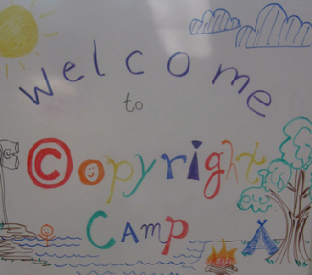
How to attribute openly licensed works
  Credit the author or other parties (as they specify)
  List the title & URL of the work (if available)
  Identify the license & URL of the license
  "Copyright Camp" by Greg Grossmeier from http://www.flickr.com/photos/grggrssmr/4846187035, used under a Creative Commons Attribution-ShareAlike license: http://creativecommons.org/licenses/by-sa/3.0
  OR
  "Copyright Camp" by Greg Grossmeier CC BY-SA
  (See also https://wiki.creativecommons.org/Best_practices_for_attribution and making notices machine readable: https://wiki.creativecommons.org/Marking_Works_Technical
Notes:
© University of Michigan CC BY http://www.lib.umich.edu/copyright/using-cc-licensed-material http://creativecommons.org/licenses/by/4.0
See also: http://wiki.creativecommons.org/Best_practices_for_attribution

Slide 22
Adopt, Adapt, Build & Share
Find, review, adopt,
customize, use
& share
Find, review, adopt
customize, use
& share
Find, review, adopt
customize, use
& share
Create, use
& share
Find, review, adopt,
customize, use
& share

Slide 23

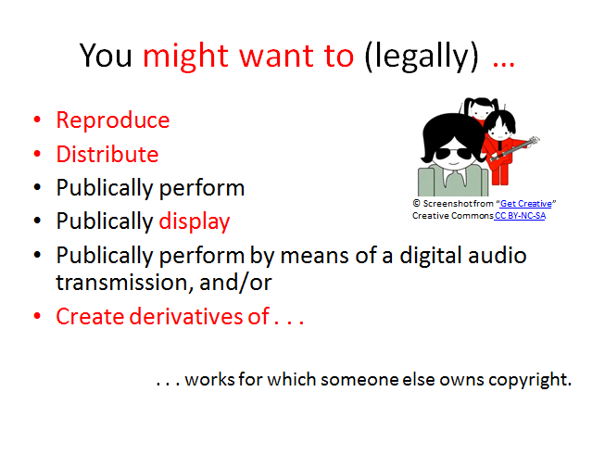
An alternative to navigating copyright
© "Copyright- all rights reserved" by MikeBlogs - http://www.flickr.com/photos/mikeblogs/3020966268/sizes/o/in/photostream Licensed under Public domain via Wikimedia Commons - http://commons.wikimedia.org/wiki/File:Copyright-_all_rights_reserved.png#mediaviewer/File:Copyright-_all_rights_reserved.png

Slide 24
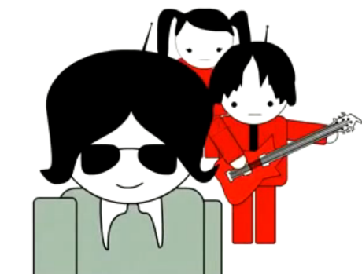
You might want to (legally) …
Reproduce
Distribute
Publically perform
Publically display
Publically perform by means of a digital audio transmission, and/or
Create derivatives of . . .
. . . works for which someone else owns copyright.
© Screenshot from “Get Creative” Creative Commons CC BY-NC-SA
Notes:
Copying is not flattery. It is illegal.

Slide 25
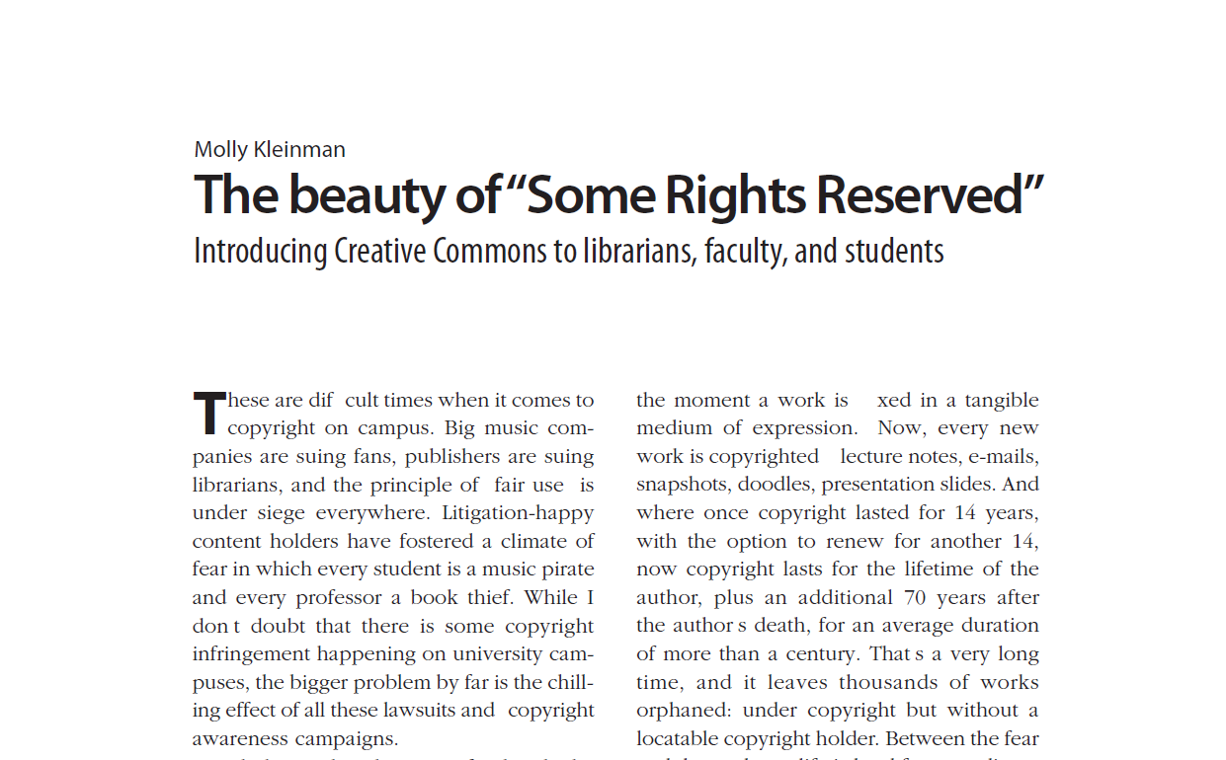


© Screenshot from “Get Creative”
Creative Commons CC BY-NC-SA
Kleinman, Molly (2008) “The Beauty of ‘Some Rights Reserved’: Introducing Creative Commons to Librarians, Faculty, and Students” College & Research Libraries News 69(10): 594-597 http://crln.acrl.org/content/69/10/594.full.pdf

Slide 26
Open Educational Resources . . .
- are teaching, learning, and research resources
- that reside in the public domain or have been released under an intellectual property license that permits their free use and re-purposing by others.
- include full courses, course materials, modules, textbooks, streaming videos, tests, software, and any other tools, materials, or techniques used to support access to knowledge."
- Hewlett Foundation

Slide 27
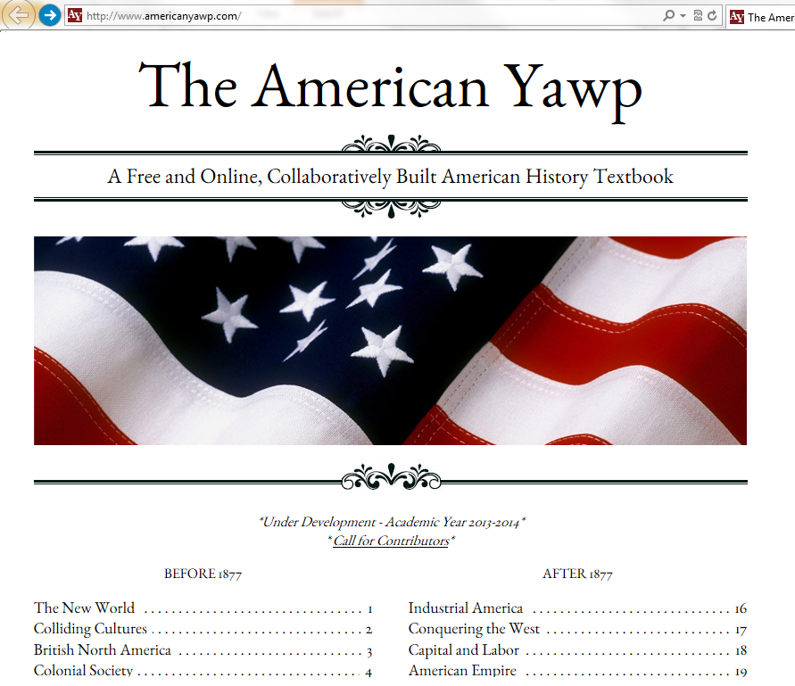
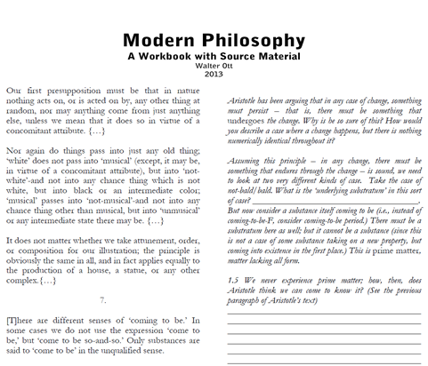
. . . (nearly) any type of resource imaginable

Slide 28

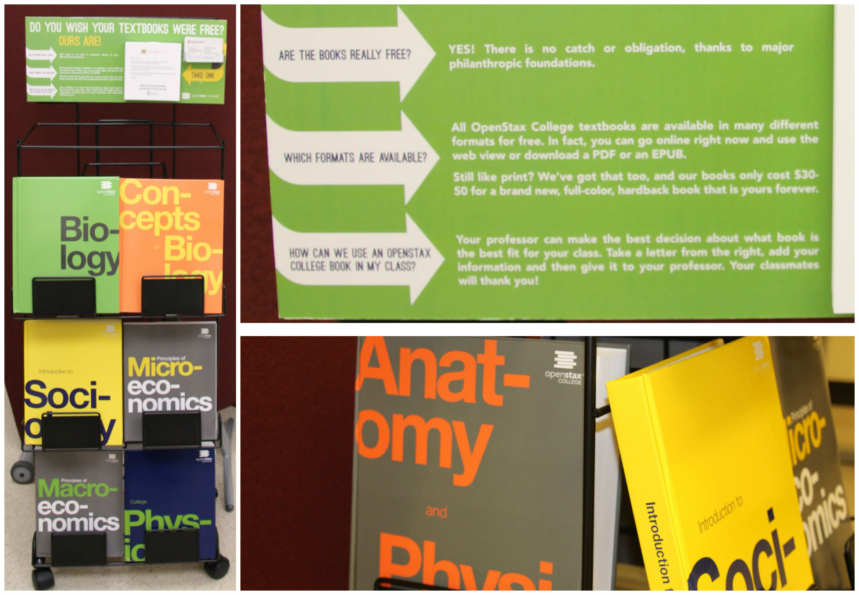
. . . (nearly) any type of resource imaginable

Slide 29
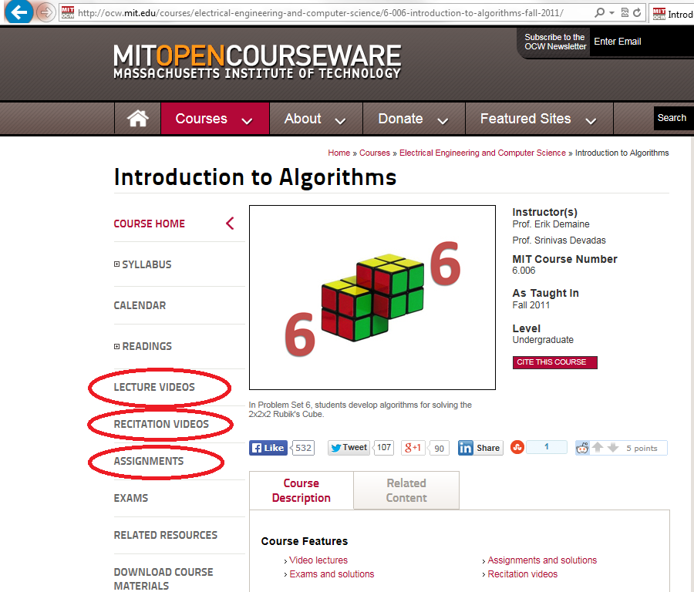
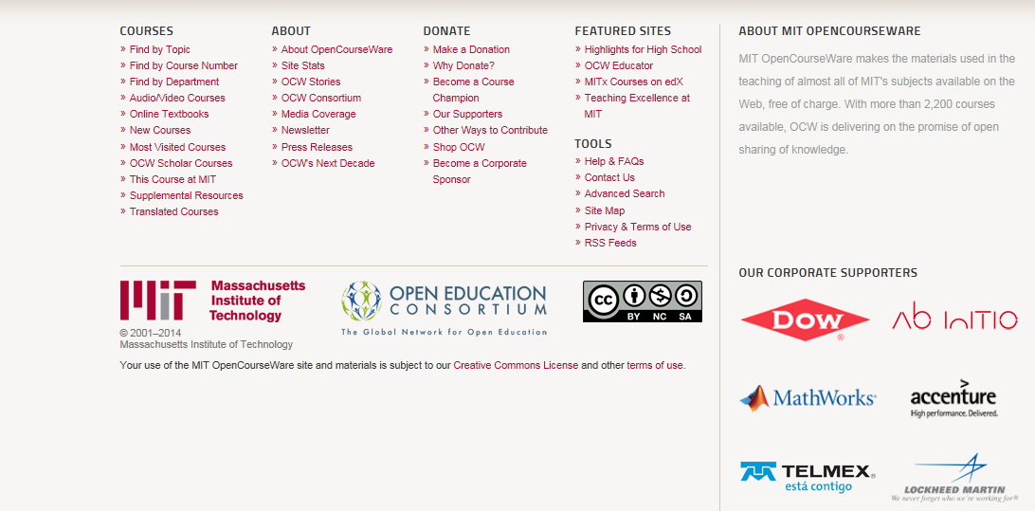
. . . (nearly) any type of resource imaginable
“Introduction to Algorithms” © MIT CC BY-NC-SA

Slide 30
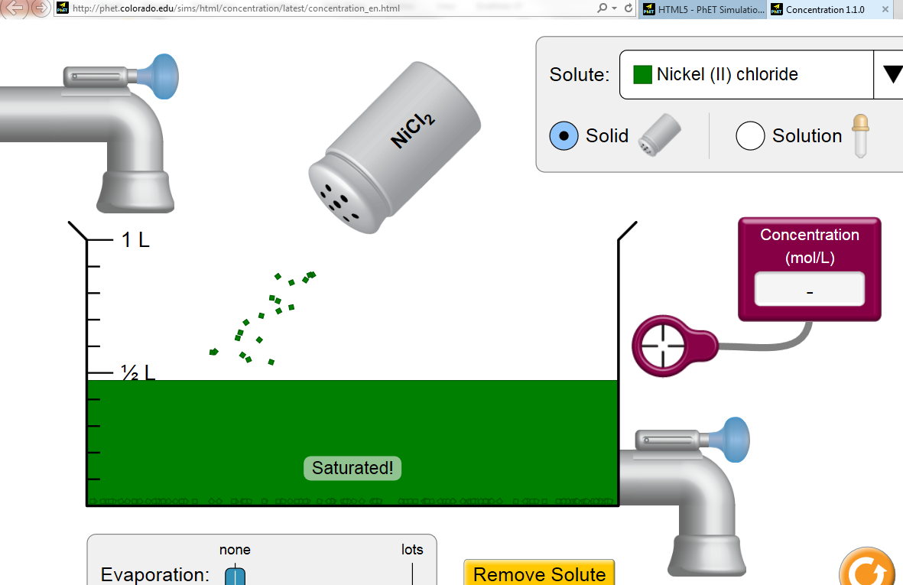
. . . (nearly) any type of resource imaginable
“Concentration” ©University of Colorado CC BY

Slide 31
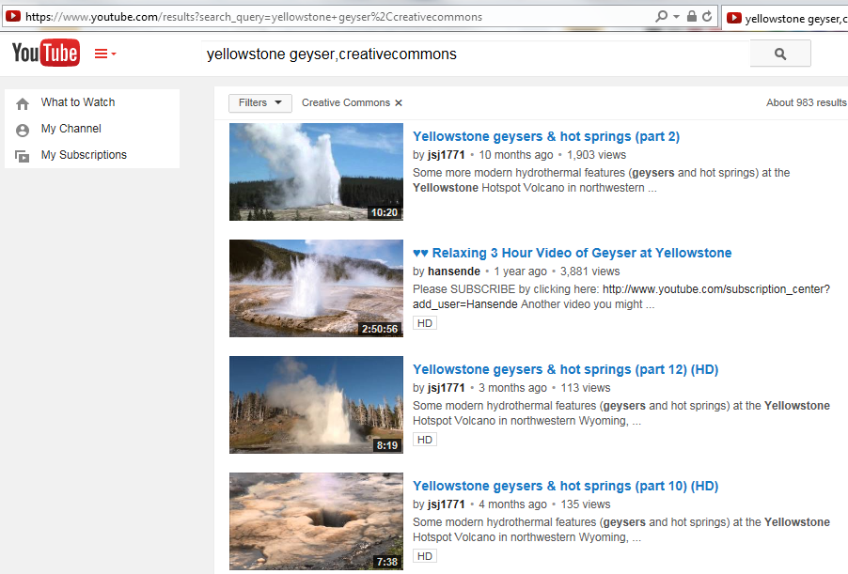
. . . (nearly) any type of resource imaginable

Slide 32
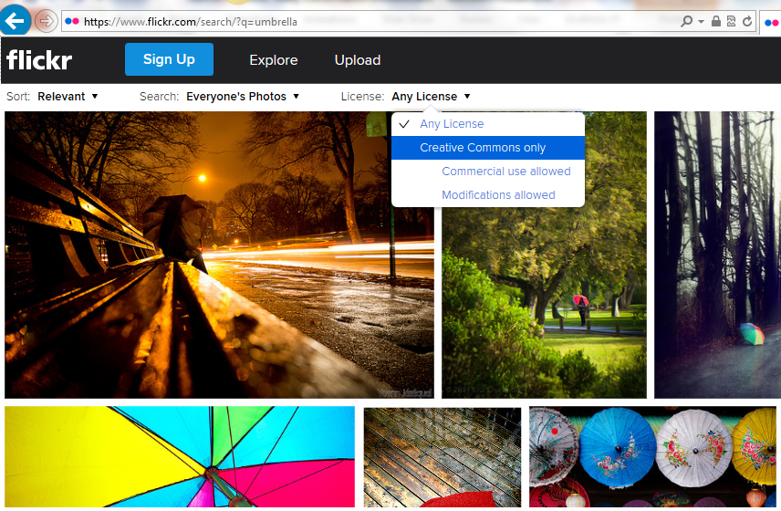
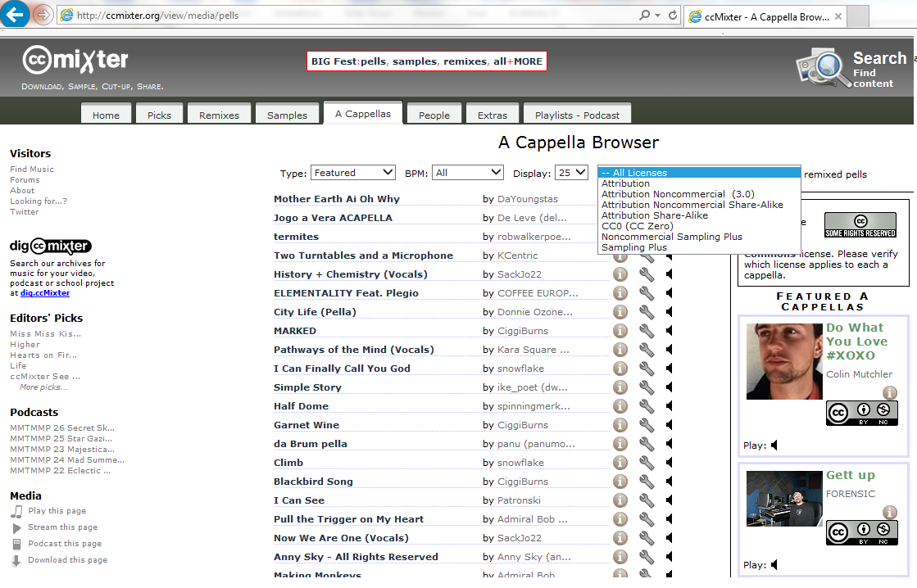
. . . (nearly) any type of resource imaginable
http://www.flickr.com
http://ccmixter.org

Slide 33
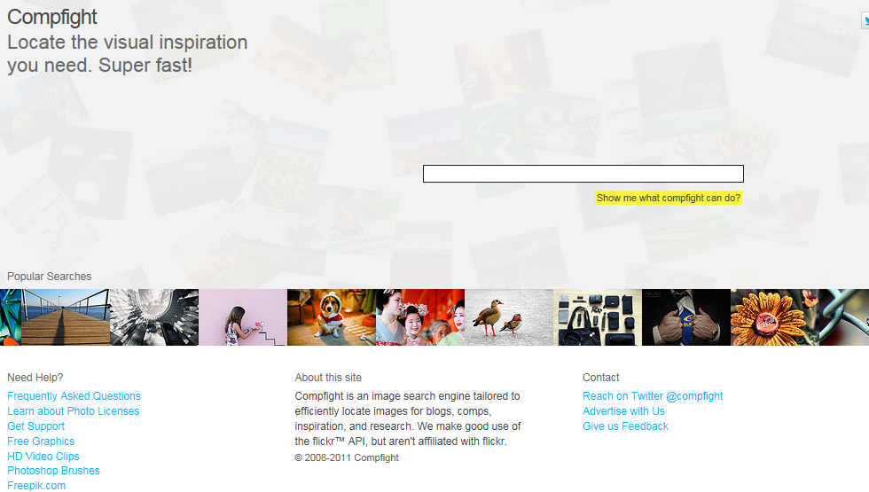
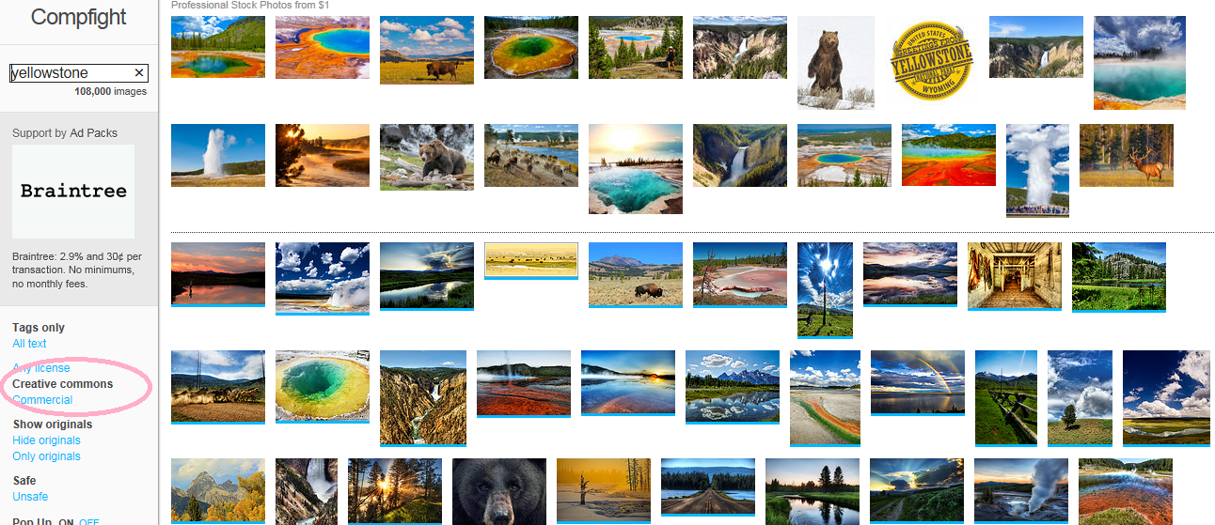
. . . (nearly) any type of resource imaginable
http://compfight.com

Slide 34
Open Educational Resources . . .
- are teaching, learning, and research resources
- that reside in the public domain or have been released under an intellectual property license that permits their free use and re-purposing by others.
- include full courses, course materials, modules, textbooks, streaming videos, tests, software, and any other tools, materials, or techniques used to support access to knowledge."
- Hewlett Foundation

Slide 35
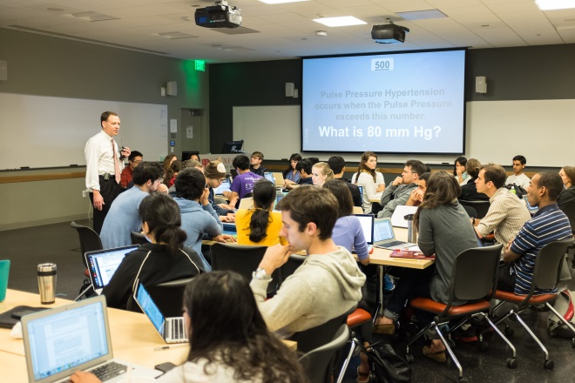
Teaching, Learning & Instructional Design
Environments/Pedagogies/Resources
Mobile
Classroom – face to face
Online
Flipped/hybrid classes
Personalized-learning models
Independent/hobby/supplemental learning
Resources, pedagogies and environments require adaptation.
© EdTech Stanford University “HHD Flipped Classroom Session” CC BY-NC-ND

Slide 36
Roles for Libraries?
Beyond raising awareness . . .

Slide 37

Libraries are . . .
Intellectually curious, service-oriented information problem solvers
Already working on information access issues
Have trusted relationships with constituents
Expert searchers with subject expertise
Hubs for teaching, pedagogy & instructional design
Repository infrastructure experts (for access, retrieval, retention)
Copyright knowledgable
Curators (identify, evaluate, and curate collections)
Already engaged in open initiatives

Slide 38

Virginia Tech Libraries
Collaboration
Copyright instruction and consultation (See also: https://www.youtube.com/watch?v=io3BrAQl3so )
Faculty author IT hosting needs
OER development planning collaboration
Student engagement
  VT Libraries Student Advisory Board
  Student Government
Modeling open licensing
“Finding OER” resources for instructional designers
Textbook adoption workshop (upcoming)
Exploring open publishing initiatives (upcoming)

Slide 39
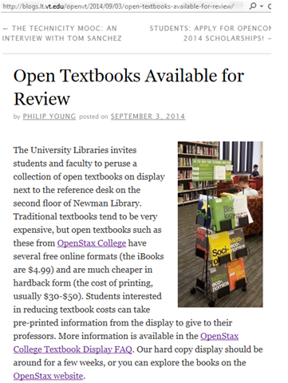
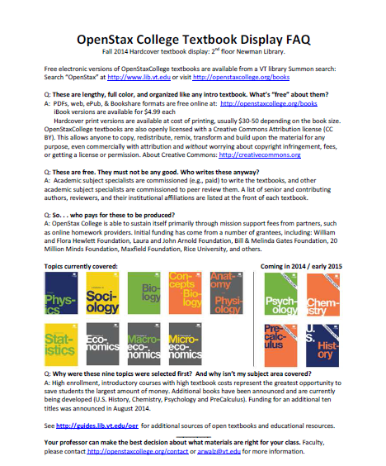
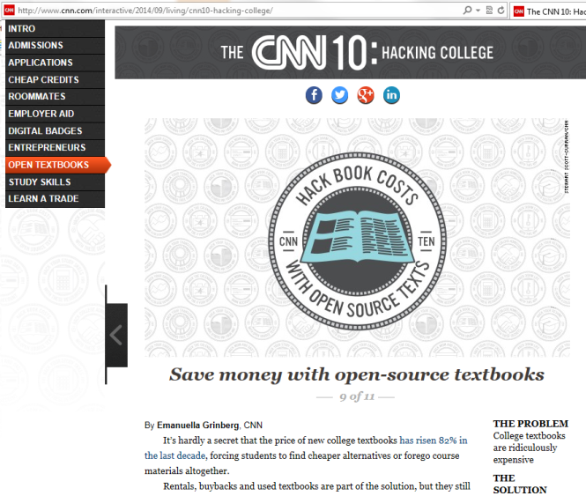
Virginia Tech Libraries

Slide 40
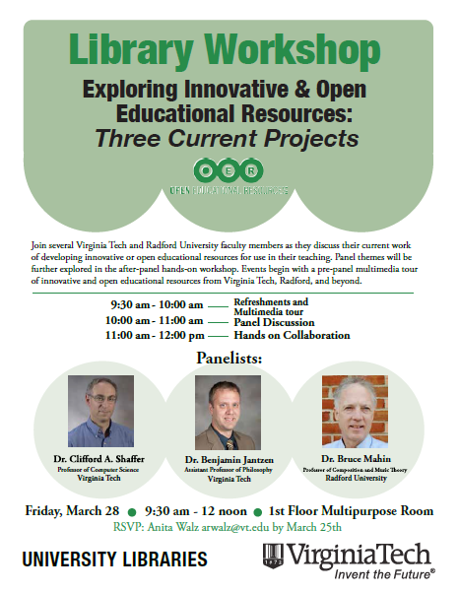
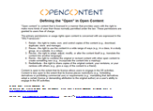
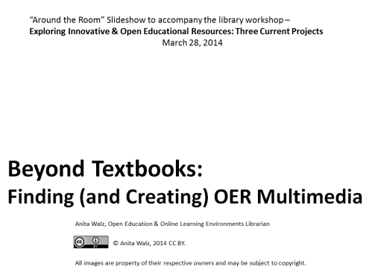
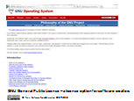
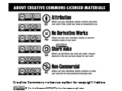
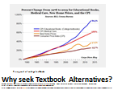
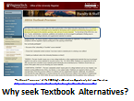
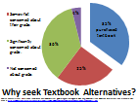
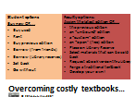
Virginia Tech Libraries
http://vtechworks.lib.vt.edu/handle/10919/46998

Slide 41
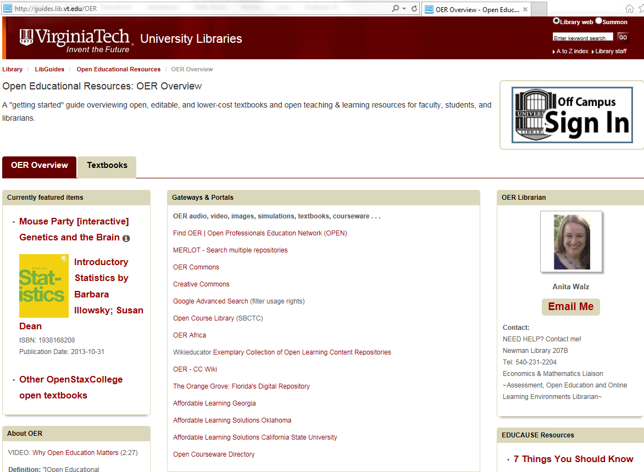
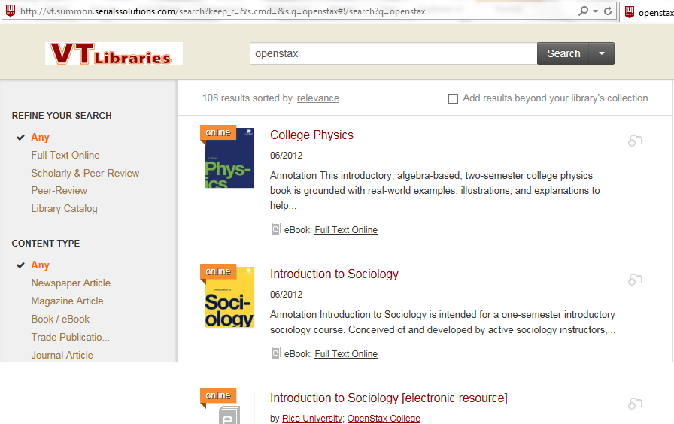
Virginia Tech Libraries
http://guides.lib.vt.edu/OER
Surfacing OER via Summon library catalog

Slide 42
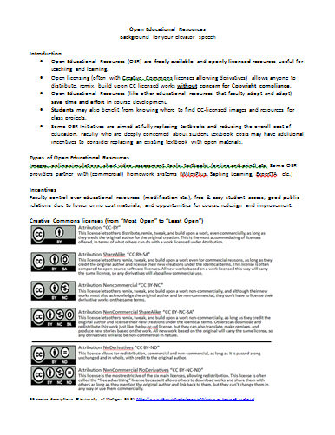
Virginia Tech Libraries
“Elevator Speech” background
for Library subject liaisons

Slide 43
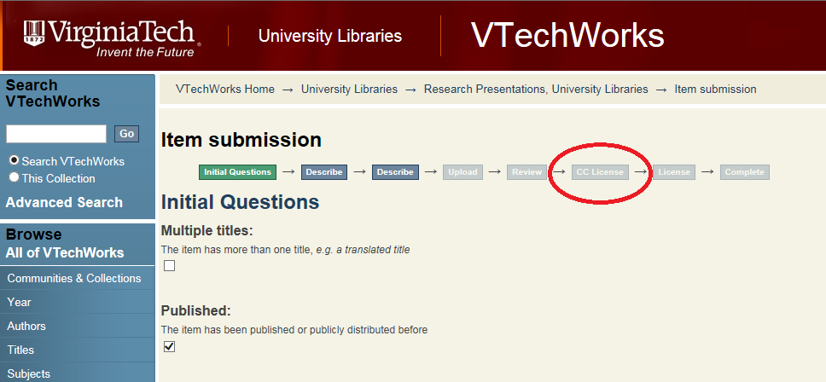
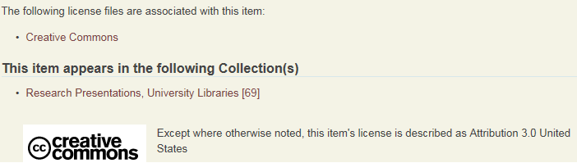
Virginia Tech Libraries
Integrating and Creative Commons licenses in VTechWorks institutional repository

Slide 44
Current Challenges at VT
Understanding the current landscape
Find, learn from, and support faculty OER champions
Make it easier for faculty to find, adopt, adapt, build & share openly licensed resources (possibly incentivize)
Identify and integrate support into faculty workflows
Encourage student-led engagement
Measure our impact

Slide 45
Issues and constraints
How (and by whom) is the cost of OER development, support, findability etc. shared?
OER development is time and likely cost intensive
Course redesign is effortful and time consuming
Institutional support has financial costs
Need for greater awareness of accessibility (508 compliance) and quality criteria

Slide 46
Key questions we’re asking
Do faculty use open resources?
What do they use?
How did they learn about these?
If they are not using open resources, why not?
Are faculty creating open resources?
Are they sharing them? How?
Do faculty openly license their work?

Slide 47






What other libraries are doing
Incentivizing $ OER adoption and authoring
Instructional design / course redesign (Integrating OER and subscribed library resources)
Curating local and subject collections of OER
Open textbook development & publishing
Faculty instruction “OER Pathways”(TCC)

Slide 48
What other libraries are doing
Temple University Library’s Alternative Textbook Project assists faculty in developing and adopting alternatives to textbooks http://sites.temple.edu/alttextbook/photos
Kansas State Libraries allocates funds from the Kansas State Student Governing Association for development of Open/Alternative Textbooks http://www.k-state.edu/today/announcement.php?id=13575&category=news&referredBy=todayRSSFeed
Emory University’s Emory Open Education Initiative trains faculty to create and use OER and library materials in lieu textbooks in support of student learning. https://scholarblogs.emory.edu/eoei/about/
The UCLA Library Affordable Course Materials Initiative incentivizes “instructors to use low-cost or free alternatives to expensive course materials” http://www.library.ucla.edu/libraries/affordable-course-materials-initiative-description
Open SUNY Textbooks is a State University of New York wide open textbook publishing initiative http://opensuny.org/omp/index.php/SUNYOpenTextbooks/about/description

Slide 49
Other major OER initiatives (non-library)
BCCampus http://open.bccampus.ca
OpenStax http://openstaxcollege.org
Lumen Learning http://lumenlearning.com
MIT Open CourseWare http://ocw.mit.edu
Saylor Foundation http://www.saylor.org

Slide 50
Tools for your OER tool box

Slide 51
Suggested Reading
The roles of libraries and information professionals in Open Educational Resources (OER) initiatives (JISC CETIS) August 2012 http://publications.cetis.ac.uk/wp-content/uploads/2012/08/OER-Libraries-Survey-Report.pdf
Environmental Scan and Assessment of OERs, MOOCs and Libraries: What Effectiveness and Sustainability Means for Libraries' Impact on Open Education (ACRL 2014) http://www.ala.org/acrl/sites/ala.org.acrl/files/content/publications/whitepapers/Environmental%20Scan%20and%20Assessment.pdf
  John Shank (2014) Interactive Open Educational Resources: A Guide to Finding, Choosing, and Using What’s Out There to Transform College Teaching (Jossey-Bass/ACRL)

Slide 52
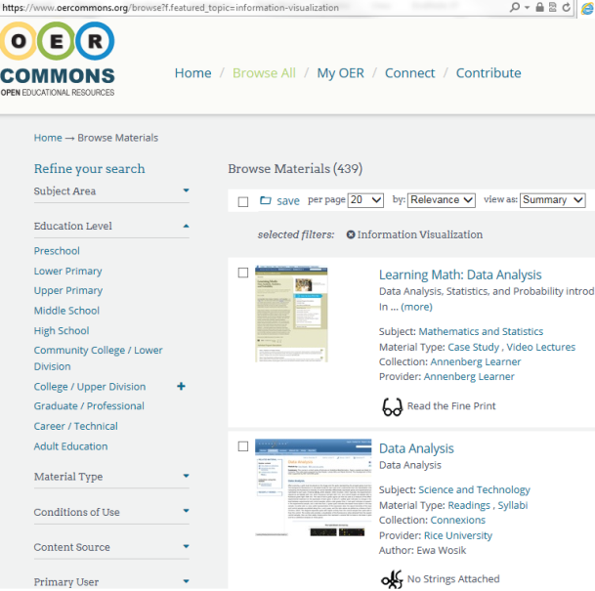
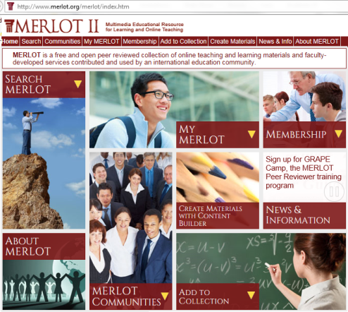
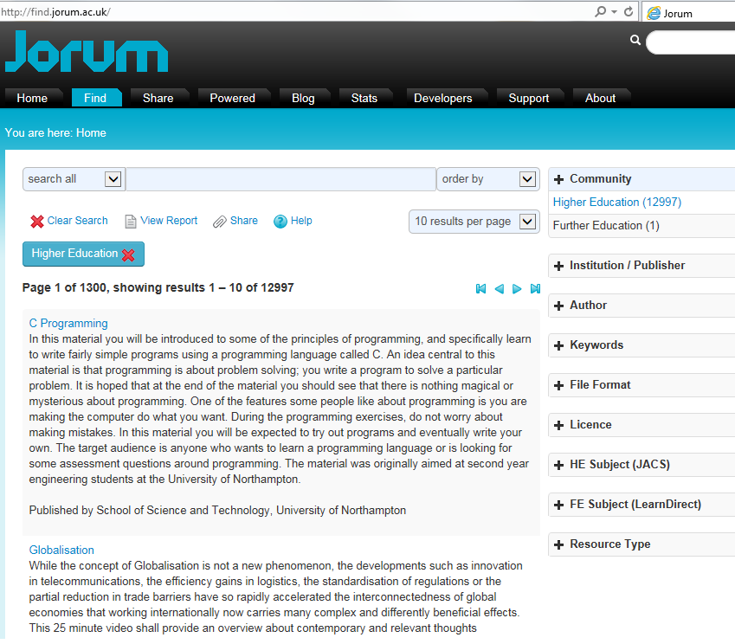
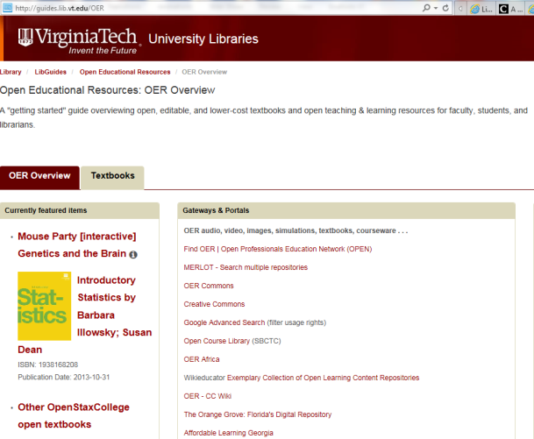
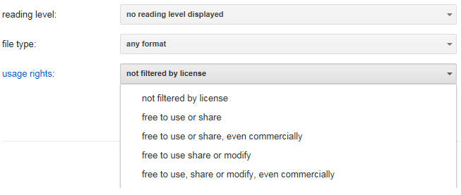
Finding openly-licensed works
http://www.merlot.org
http://oercommons.org
http://www.jorum.ac.uk
http://guides.lib.vt.edu/OER
Also: http://guides.ou.edu/oer/open_textbook_collections
http://guides.library.umass.edu/oer
http://open.umn.edu/opentextbooks
https://www.google.com/advanced_search or advanced image search (scroll down to “usage rights”)

Slide 53
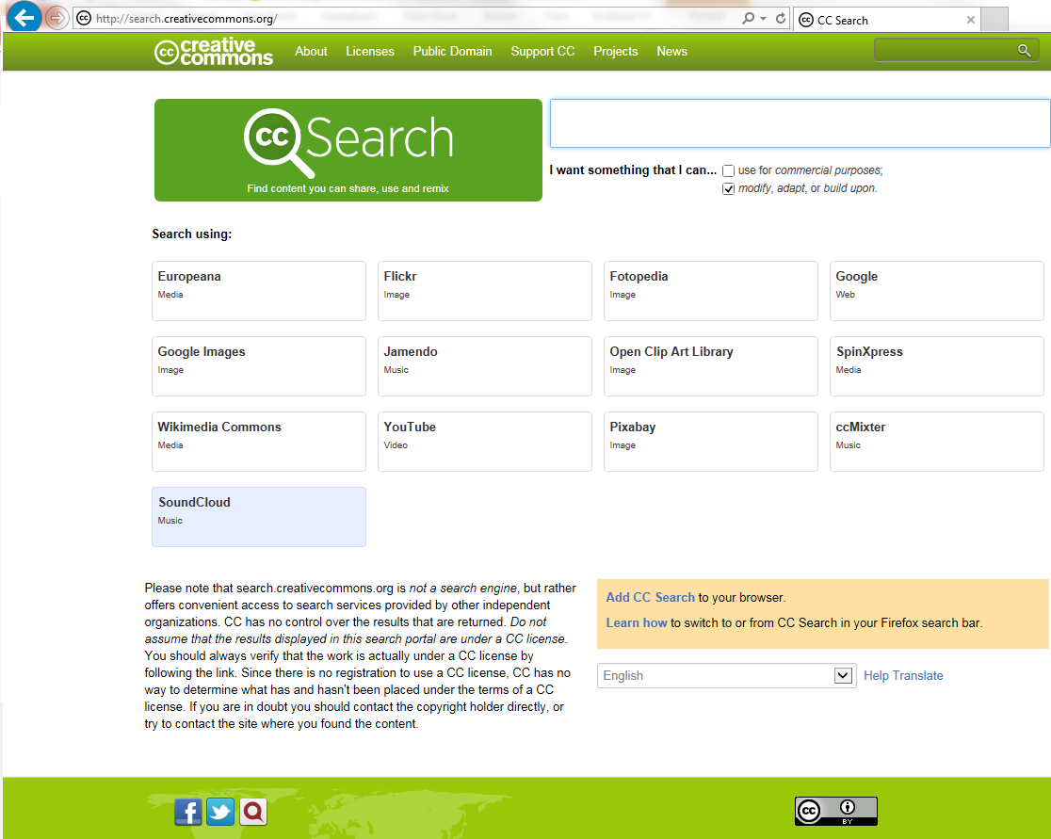
Finding openly-licensed works
[Search screen] © Creative Commons http://search.creativecommons.org CC BY

Slide 54
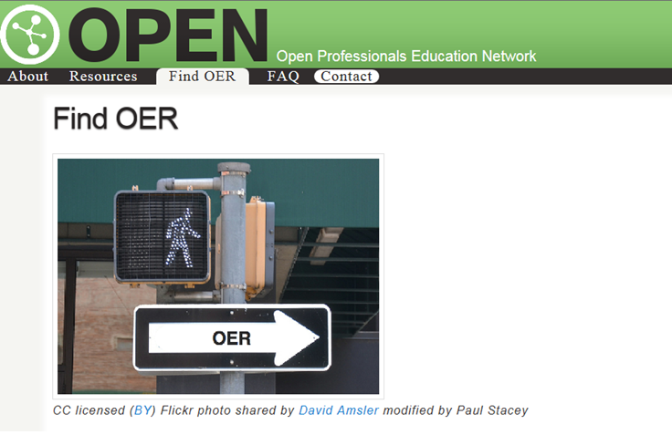
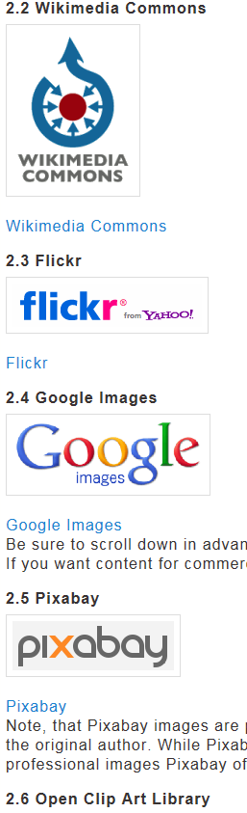

Finding openly-licensed works
http://open4us.org/find-oer

Slide 55

OER Support by & for Librarians
SPARC Libraries & OER Forum
http://www.sparc.arl.org/resource/sparc-libraries-oer-forum
Monthly topical teleconference
Listserv
Blended Librarian Community
https://www.facebook.com/BlendedLibrarians
http://www.scoop.it/t/blended-librarianship
Free webcasts/webinars
Community College Consortium for Open Educational Resources https://groups.google.com/forum/#!forum/cccoer-advisory
Focused on Community Colleges
Monthly webinars
Listserv

Slide 56

Idea: Virginia libraries OER group?
For example: BC OER Librarians
  http://bcoerguides.wikispaces.com
  http://open.bccampus.ca/2014/05/20/one-heck-of-a-hackfest-id-say
Idea

Slide 57
Want to talk more?
VLA “UnConference” on OER
Friday 1-1:45pm
Conference Center Atrium, 1st Floor
Idea

Slide 58

Thanks for your time!
Questions?
Anita Walz
University Libraries, Virginia Tech
arwalz@vt.edu
Twitter: @arwalz
540-231-2204
© Screenshot from “Get Creative” Creative Commons CC BY-NC-SA

