Slide 1

Classification and extraction of information from ETD Documents
CS 6604: DIGITAL LIBRARIES — FINAL PRESENTATION
DEPT. OF COMPUTER SCIENCE, VIRGINIA TECH
BY JOHN AROMANDO, BIPASHA BANERJEE, BILL INGRAM,
PALAKH MIGNONNE JUDE, AND SAMPANNA KAHU
{JAROMANDO, BIPASHABANERJEE, WAINGRAM,
JPALAKHMIGNONNE, SAMPANNA}@VT.EDU
DECEMBER 5, 2020

Slide 2




Acknowledgements
Dr. Edward A. Fox for his instruction and mentorship
Dr. Jian Wu at Old Dominion University for his guidance and advice on parsing and classification, and for providing us with annotated gold standard reference strings for us to use for testing and evaluating NeuralParsCit
Web Information Retrieval/Natural Language Processing Group (WING) at the National University of Singapore, for their work on Neural ParsCit and SciWING, and for sharing their processing scripts and training data
This project was made possible in part by the Institute of Museum and Library Services LG-37-19-0078-19

Slide 3
Introduction

Slide 4

Introduction
Millions of Electronic Theses and Dissertations (ETDs) are openly available online.
University Libraries VTechWorks repository holds over 30,000 ETDs, dating back to 1903
https://vtechworks.lib.vt.edu/.
The collection contains a mixture of born-digital and scanned documents.
Items contain PDF, Dublin Core metadata, and various supplementary files.

Slide 5





Outline
INTRODUCTION, ETDS, UNIVERSITY LIBRARIES VTECHWORKS
CLASSIFICATION
REFERENCE PARSING
FIGURE EXTRACTION
CONCLUSIONS AND FUTURE WORK

Slide 6
Classification

Slide 7
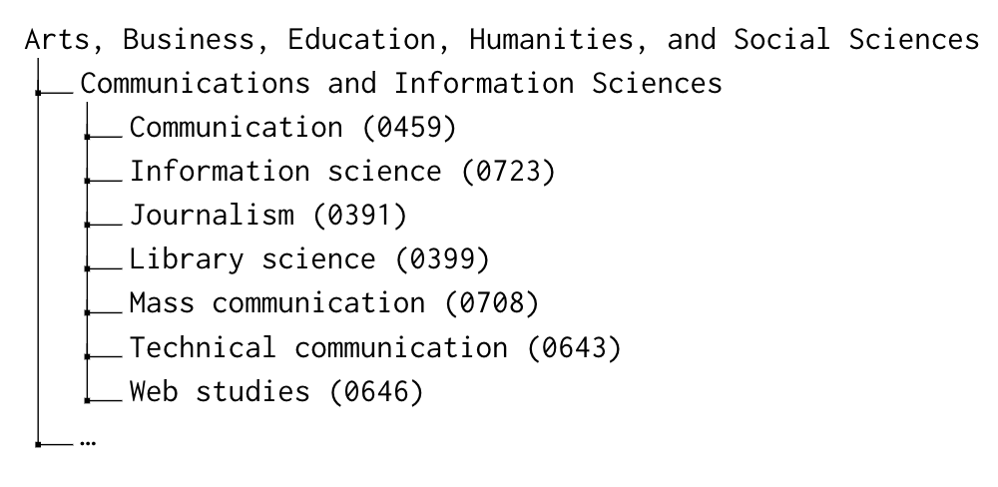
ETD Subject Classification
The ProQuest Subject Categories for the 2018--2019 Academic Year contain
  2 primary headings
  21 secondary headings
  432 subject categories
Subsection of ProQuest Subject Categories

Slide 8
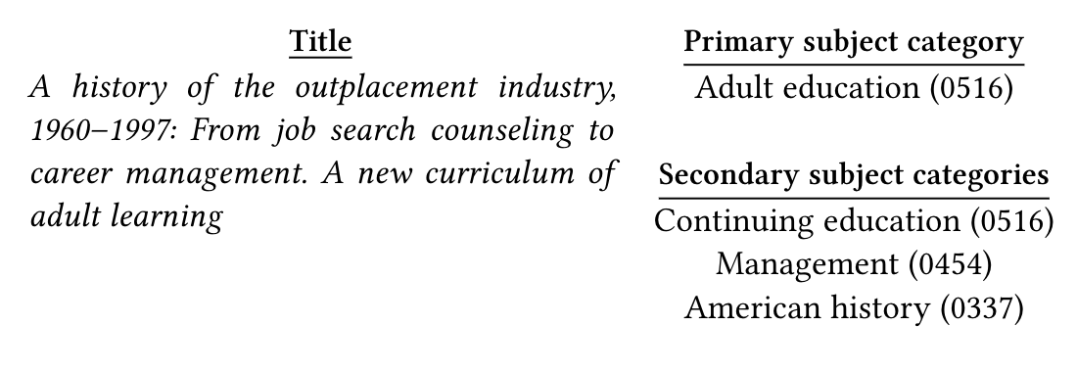
Multi-label Classification
Authors are asked to pick one subject category that best describes their field of research or creative work and may choose additional categories as secondary subjects.
Example ETD with multiple subject categories

Slide 9
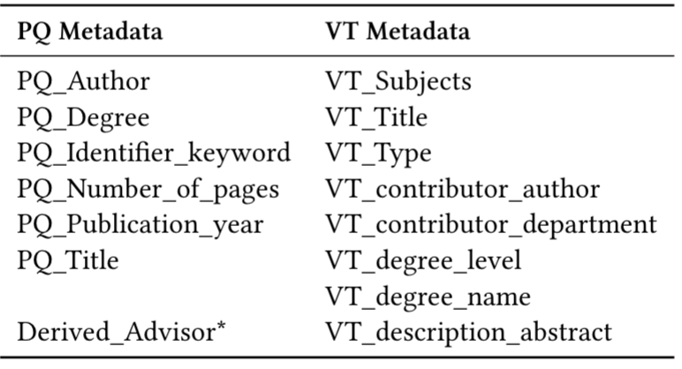
Data Pre-processing
Formatting Classification Labels
Splitting Data
Data Cleaning
Dealing With Missing Values
Feature Selection
Evaluation Metrics
Set of features used to train the model

Slide 10
Methods
Multi-Label Classification
  BinaryRelevance
  LabelPowerset
  Formatting class labels for the classification task
Machine Learning Algorithms
  Logistic Regression
  Support Vector Machine
  Random Forest

Slide 11
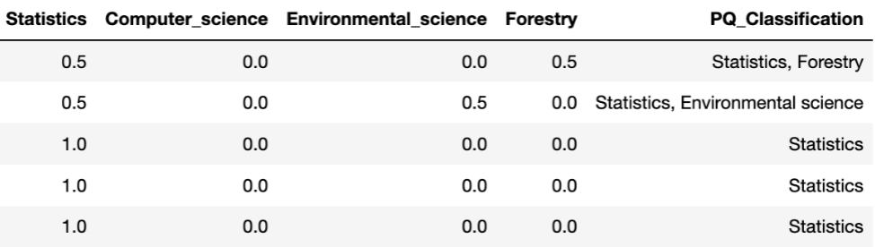
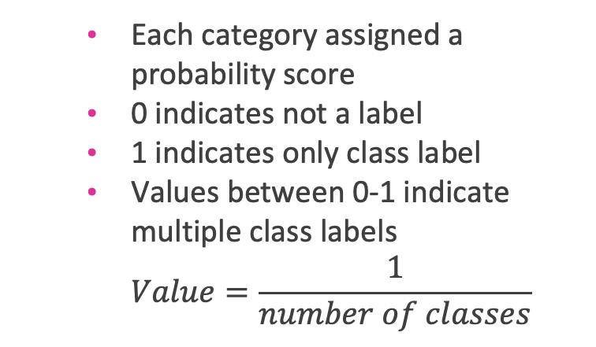
Methods
Each category assigned a probability score
0 indicates not a label
1 indicates only class label
Values between 0-1 indicate multiple class labels
$Value=\frac{1}{number of classes}$
Sample ETD records with transformed class labels (with probability scores)

Slide 12
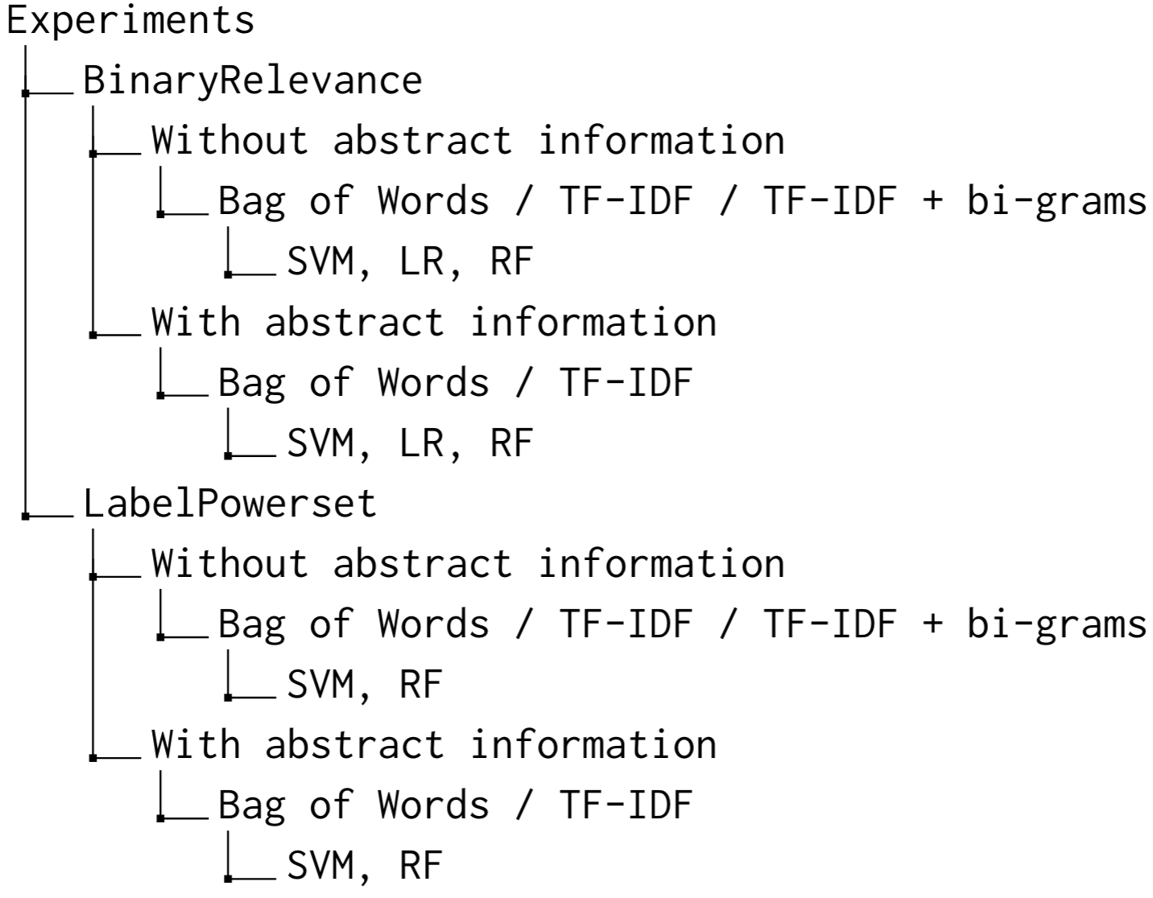
Experiments
Various experimental setups

Slide 13
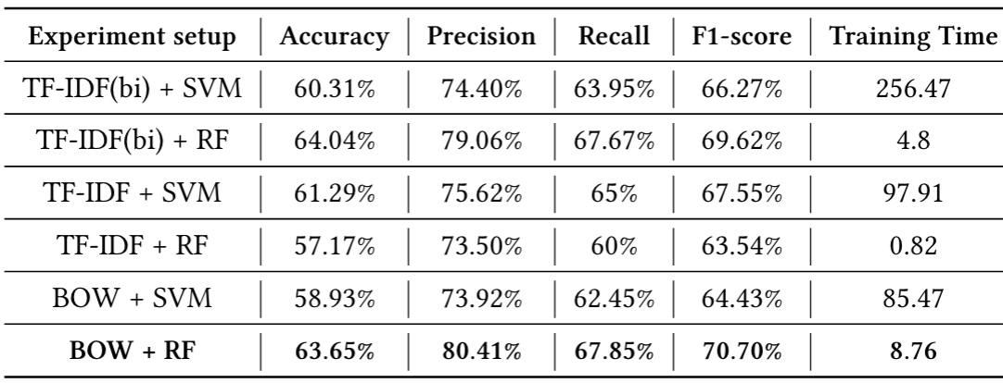
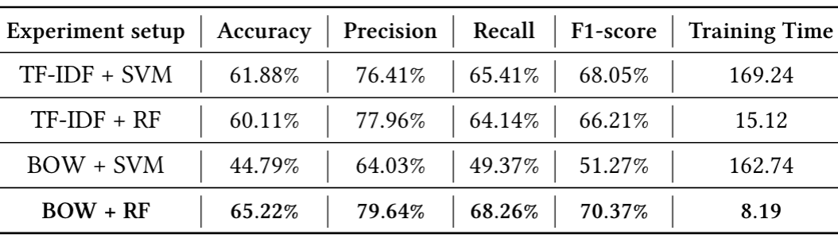
Results and Discussion
Performance of various experimental setups using LabelPowerset with presence-absence labels (without abstract)
Performance of various experimental setups using LabelPowerset with presence-absence labels (with abstract)

Slide 14
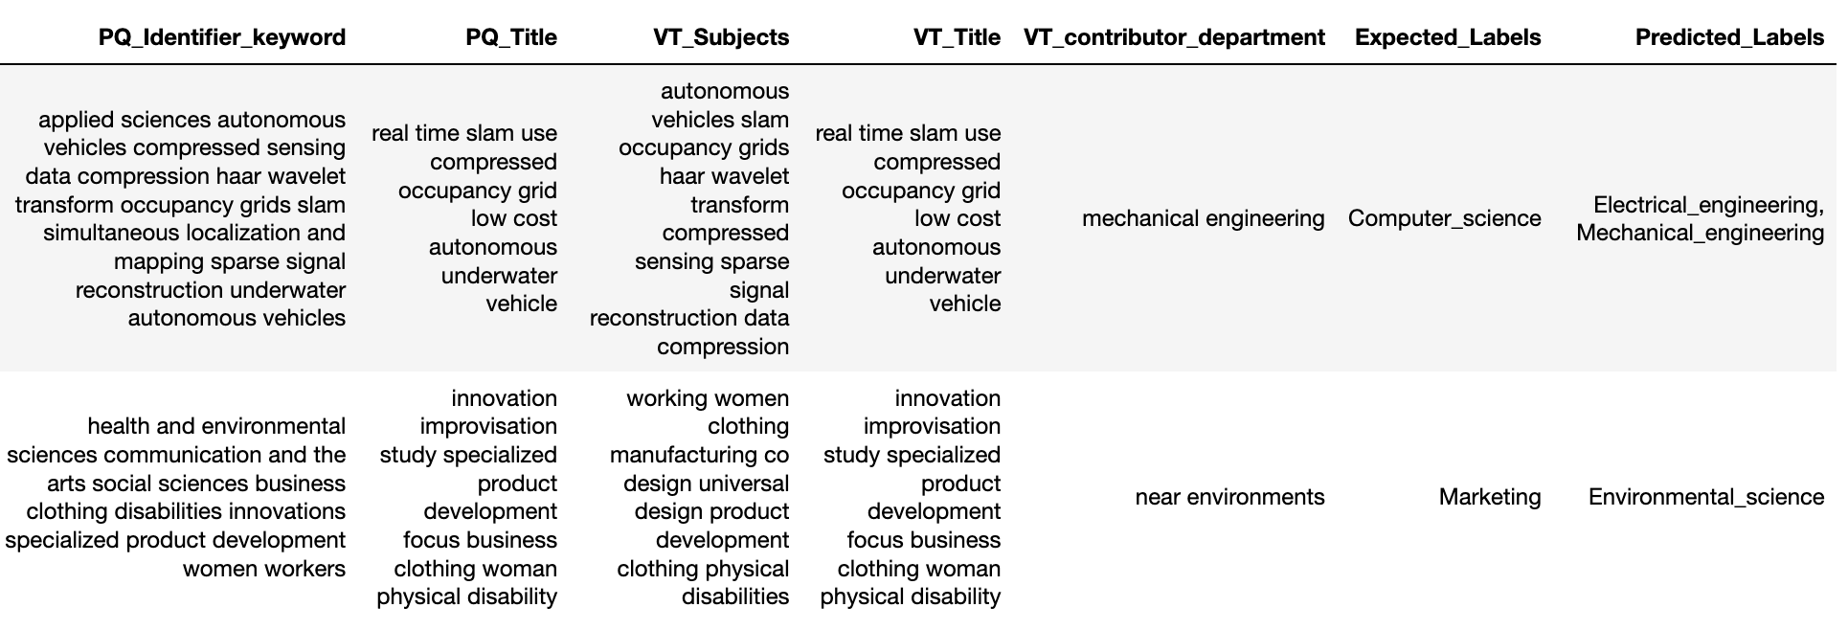

Slide 15
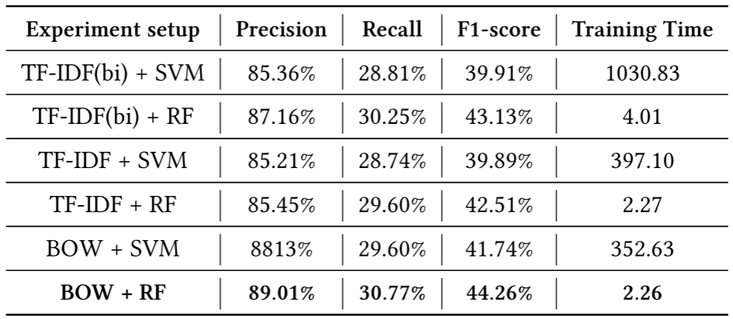
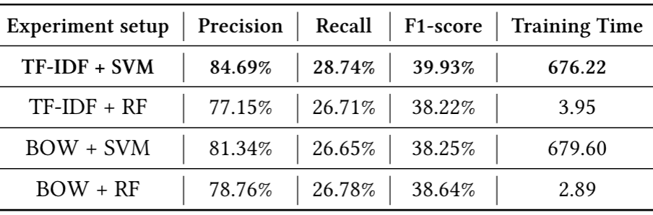
Results and Discussion
Performance of various experimental setups using LabelPowerset with probability scores (without abstract)
Performance of various experimental setups using LabelPowerset with probability scores (with abstract)

Slide 16
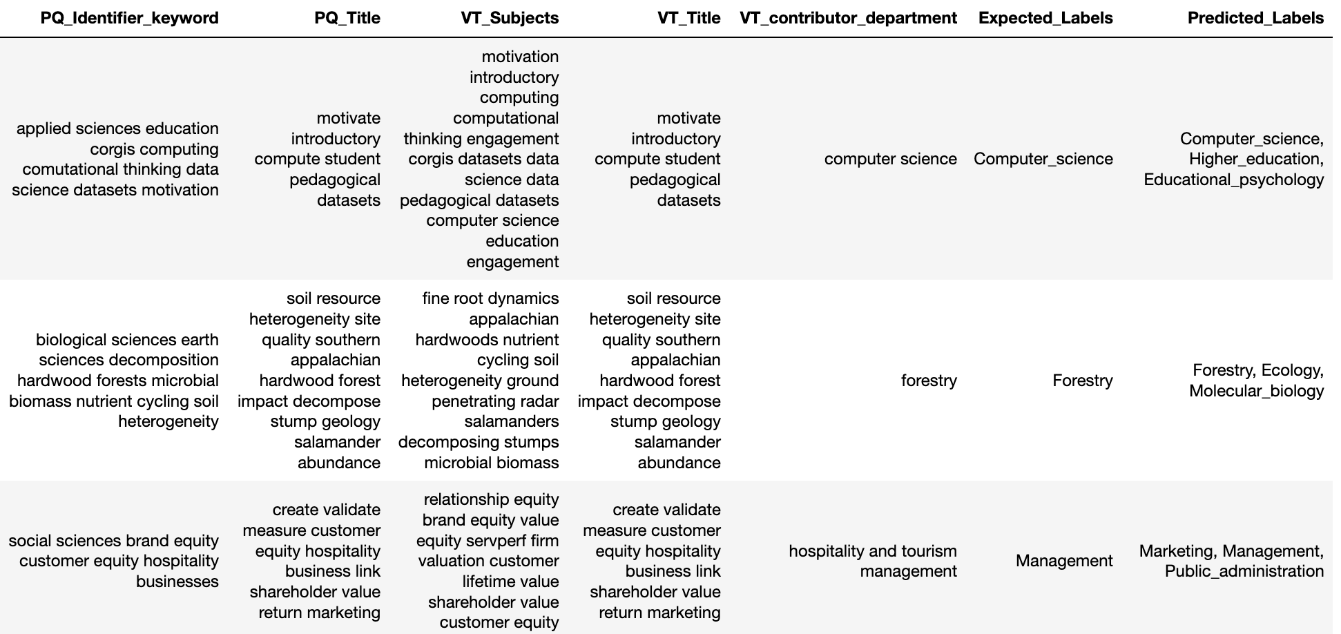

Slide 17
Reference Parsing

Slide 18
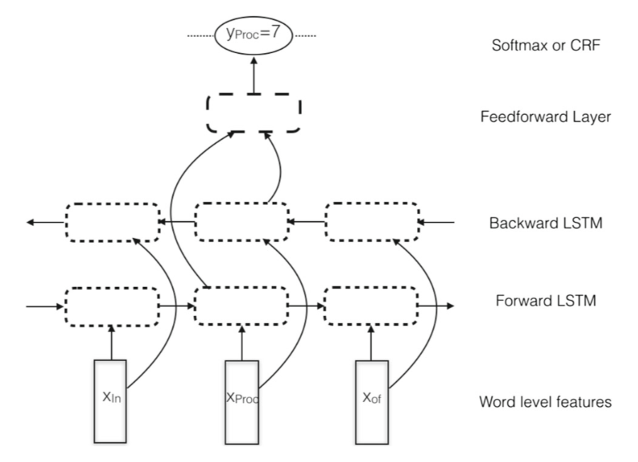
Neural ParsCit
Deep learning-based reference string parser
Developed by the Web Information Retrieval/Natural Language Processing Group (WING) at the National University of Singapore
Bidirectional LSTM
Neural ParsCit Model Architecture
Animesh Prasad, Manpreet Kaur, and Min-Yen Kan. 2018. Neural ParsCit: a deep learning-based reference string parser. International Journal on Digital Libraries 19, 4 (01 Nov 2018), 323–337. https://doi.org/10.1007/s00799-018-0242-1

Slide 19
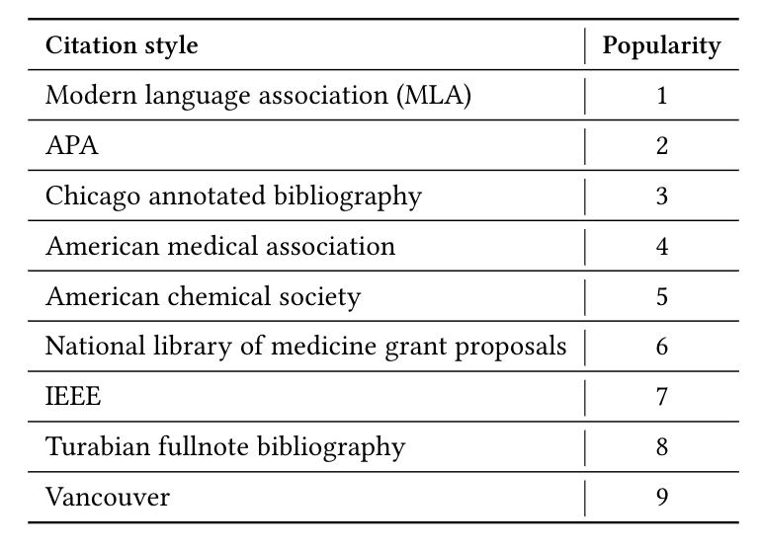
Methods
Download thousands of BibTex references from CrossRef REST API for multiple reference types (e.g., journal, book, conference paper)
Use Cite-Proc, a Citation Style Language (CSL) processor for Java, to generate multiple versions of each citation in 9 different citation types
Retrain Neural ParsCit with this data
2015. Citation Styles Guide | Which Citation Style Should You Use? Scribbr. Retrieved December 3, 2019 from https://www.scribbr.com/citing-sources/citation-styles/

Slide 20
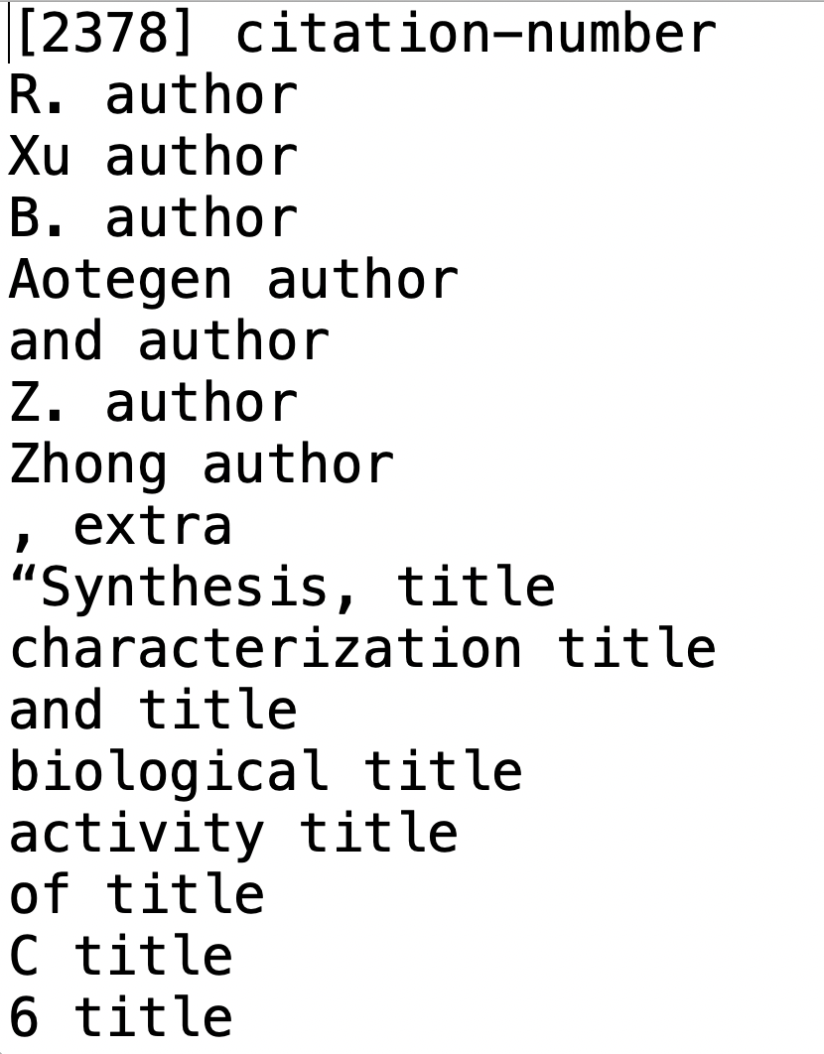
Creating the training data
Only conference proceeding and journal citations considered
Splitting data for each citation style
Combining data from each styles into one train, val
and test sets
Shuffling the data
Create folds for cross-validation
Script to convert into the required format
Training data format

Slide 21
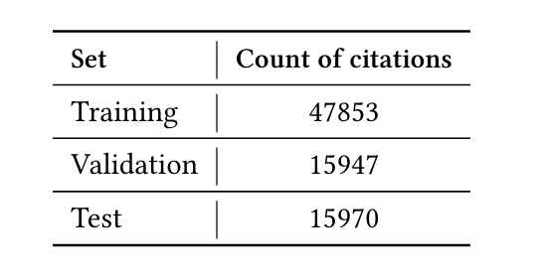
Training Process
Trained on ARC’s Cascades cluster
Took approximately 8 hours per fold
Results computed after each fold
Input data statistics

Slide 22
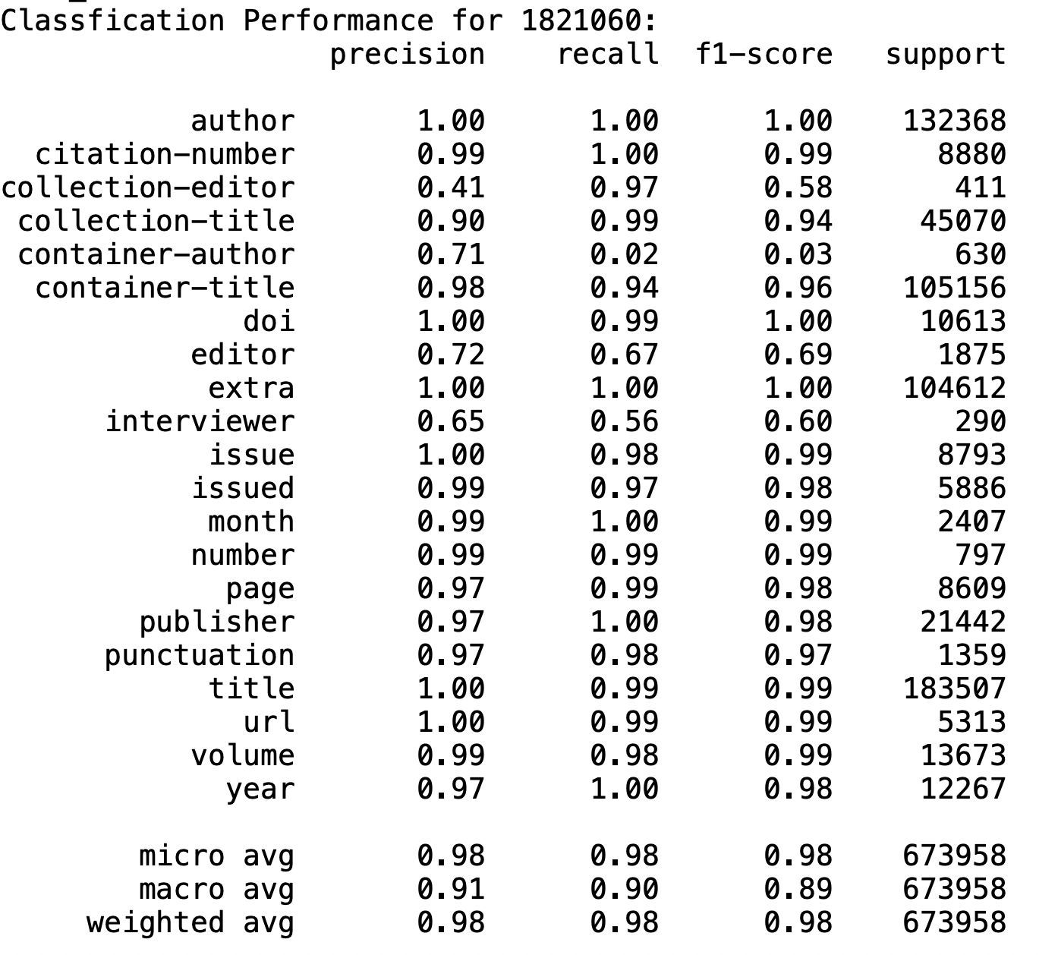

Slide 23
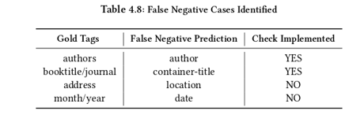
Evaluation
Gold Tag Discussion
  Multi-correct labels?
  Gold set not so gold
  Different but equal tags
Formatting For Evaluation
  Tokenization/parsing, labels
  Binary, strings
  Label match ups

Slide 24
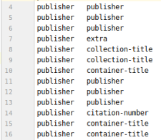
Evaluation
Input: Per Gold Tag, Cumulative
  Per tag affected scores when using sklearn
21 categories, 8 gold
  F1, Precision, and Recall calculated for each

Slide 25
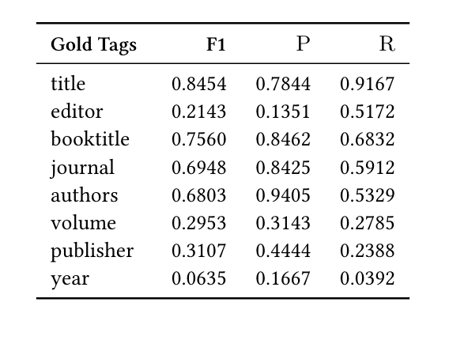
Discussion
Tags like “title” and “booktitle” perform decently
“Author” and “editor” are performing poorly
Publisher is also classified as “collection-title” and “container-title”
“Year” performs poorly
Evaluation against gold standard

Slide 26
Examples
<author>Abate, Alessandro, et al.</author>. <title>“Box Invariance for Biologically-Inspired Dynamical Systems.”</title> <container-title>2007 46th IEEE Conference on Decision and Control</container-title>, <publisher>IEEE</publisher>, <issued>2007</issued>, <DOI>doi:10.1109/cdc.2007.4434569</DOI>.
<author>A.M. Lätti and H. Koskela and J. Pekkanen</author>. <title>“Prolongation of Recent-Onset Cough: A Prospective Follow-Up Study Among Finnish Adult Employee Population.”</title> <container-title>C37. SYMPTOMS, PLEURAL DISEASE, BEHAVIORAL SCIENCE, AND OTHER TOPICS</container-title>, <publisher>American Thoracic Society</publisher>, <issued>2019</issued>, <DOI>doi:10.1164/ajrccm-conference.2019.199.1_meetingabstracts.a4699</DOI>.

Slide 27
Figure Extraction

Slide 28
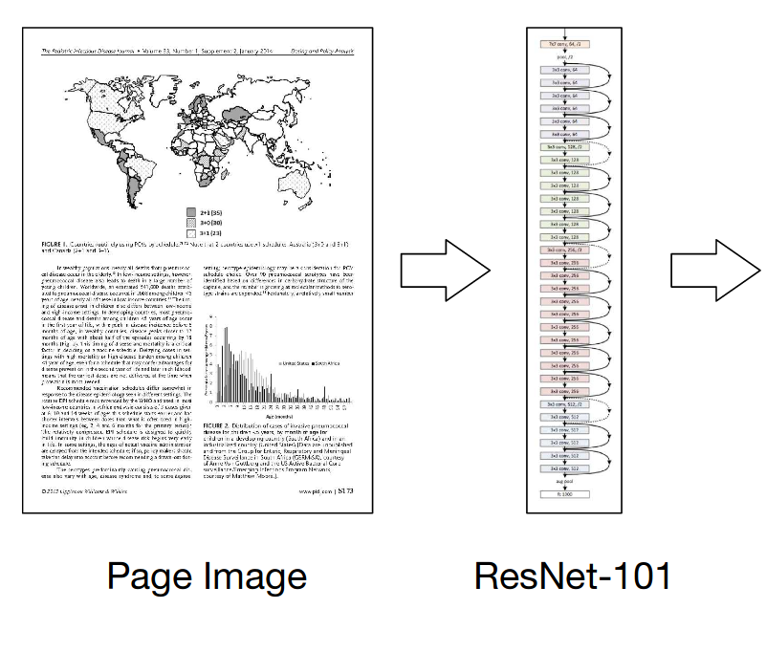
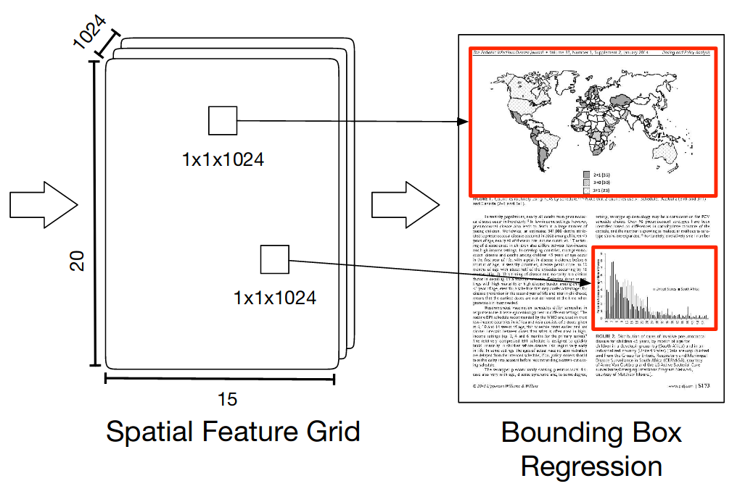
DeepFigures
Novel method to extract non-textual components (figures and tables) from PDF
Two datasets were used for training—arXiv and PubMed
For arXiv, authors modified the original LaTeX source code of the PDFs such that it rendered bounding boxes around the figures and captions
For PubMed, the figures were already present in parsed format
These induced labels were then used to train a deep learning model to predict the coordinates of the bounding boxes around figures
Noah Siegel, Nicholas Lourie, Russell Power, and Waleed Ammar. 2018. Extracting Scientific Figures with Distantly Supervised Neural Networks. CoRRabs/1804.02445 (2018). arXiv:1804.02445 Retrieved October 9, 2019 from http://arxiv.org/abs/1804.02445

Slide 29
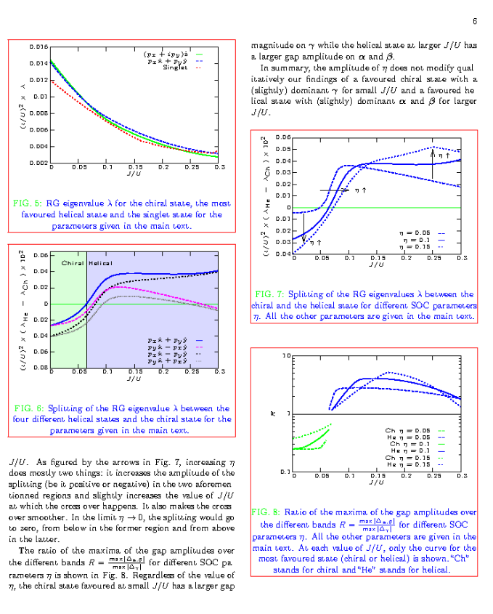
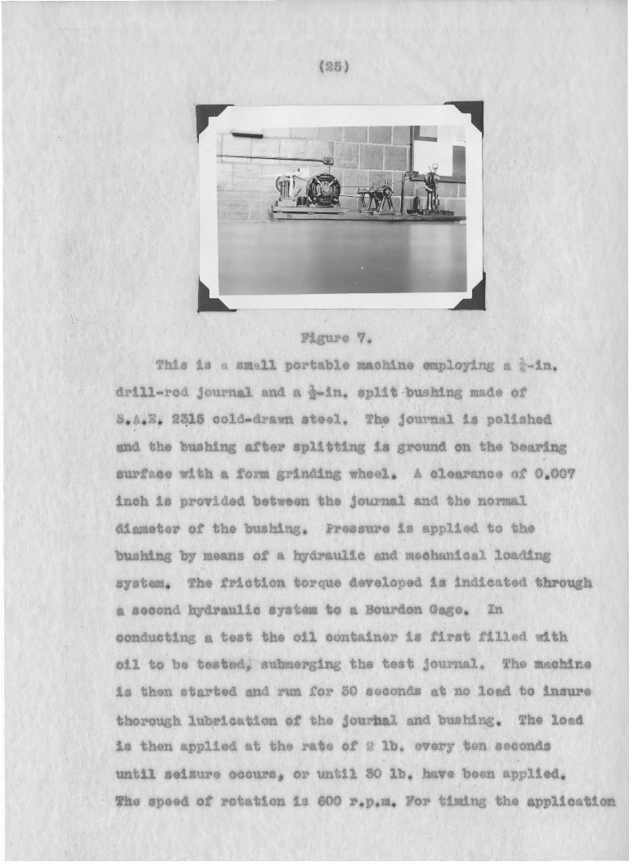
Figure Extraction:
Born Digital vs. Scanned
Image 1 src: https://arxiv.org/pdf/1804.02445.pdf
Image 2 src: https://vtechworks.lib.vt.edu/handle/10919/56159
Noah Siegel, Nicholas Lourie, Russell Power, and Waleed Ammar. 2018. Extracting Scientific Figures with Distantly Supervised Neural Networks. CoRRabs/1804.02445 (2018). arXiv:1804.02445 Retrieved October 9, 2019 from http://arxiv.org/abs/1804.02445

Slide 30
Methods
Alter a born-digital PDF to make it more like a scanned document. Then train the model on the altered PDF.
Image-based data augmentation
  We use the popular ImgAug tool to apply a list of image-based augmentations to each page of the born-digital ETD
Latex-based data augmentation
  Change the inherent structure of the text within the page by altering the LaTeX source code of the PDFs
Alexander B. Jung, Kentaro Wada, Jon Crall, Satoshi Tanaka, Jake Graving, Sarthak Yadav, Joy Banerjee, Gábor Vecsei, Adam Kraft, Jirka Borovec, Christian Vallentin, Semen Zhydenko, Kilian Pfeiffer, Ben Cook, Ismael Fernández, Weng Chi-Hung, Abner Ayala-Acevedo, Raphael Meudec, Matias Laporte, et al. 2019. imgaug GitHub Repository. Retrieved September 25, 2019 from https://github.com/aleju/imgaug

Slide 31



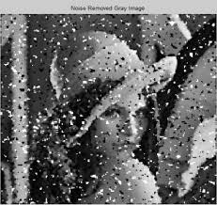
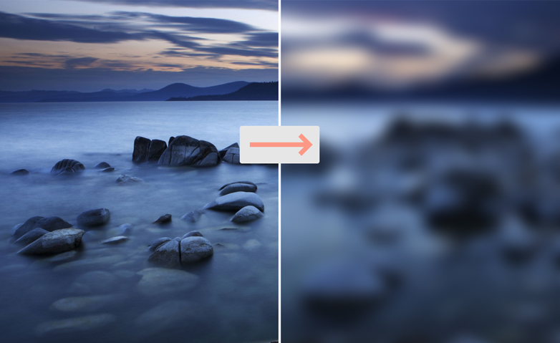
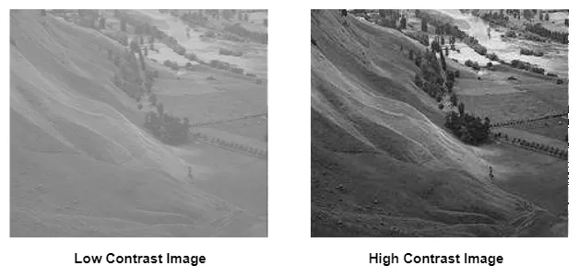
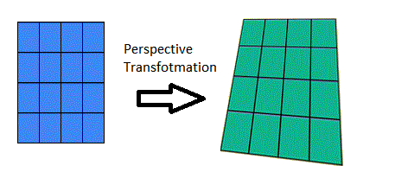
Methods
Image-based data augmentations
  Random affine rotation (limited to +/- 5 degrees)
  Additive Gaussian noise
  Salt-and-pepper noise
  Gaussian blur
  Linear contrast
  Perspective transform
Latex-based data augmentations
  \documentclass[sigconf]{acmart}
  \documentclass[sigconf,12pt]{acmart}
  Following code added at the beginning:
  \renewcommand\ttdefault{cmvtt}
  \renewcommand{\familydefault}{\ttdefault}
  \linespread{1.5}

Slide 32
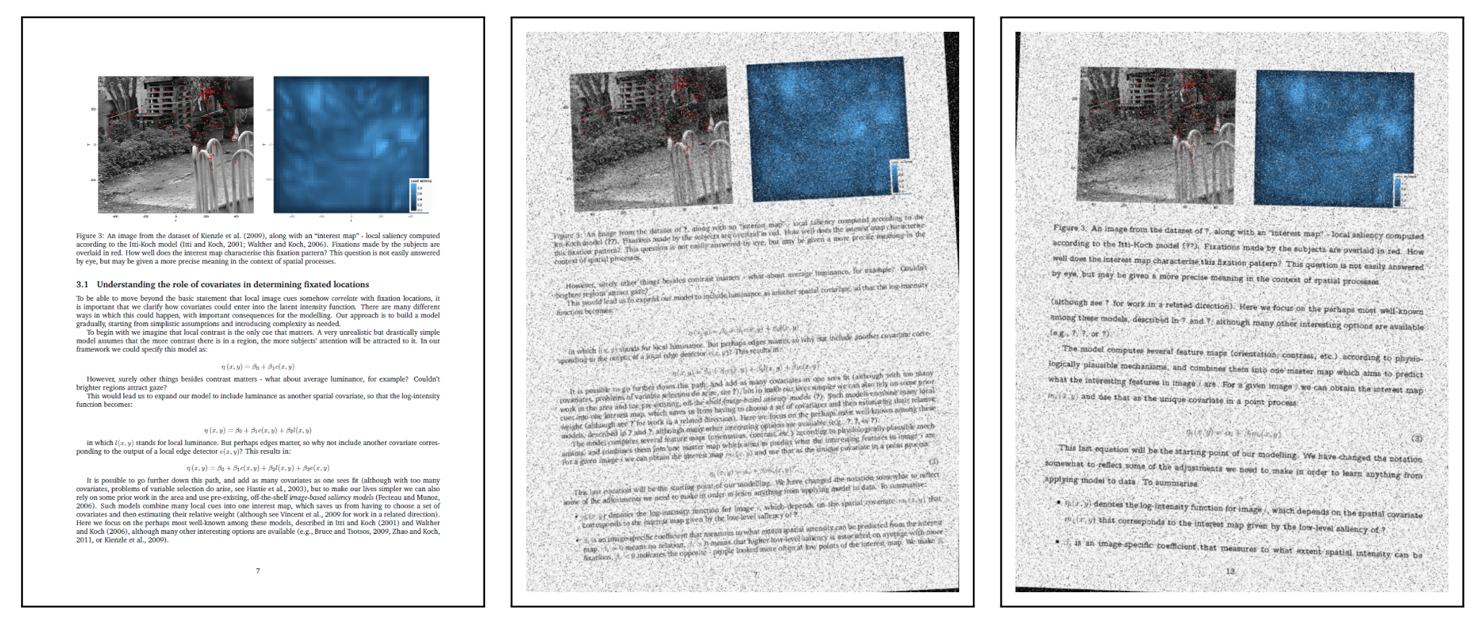
Experiments
Train the DeepFigures model on our augmented data set
Simon Barthelmé, Hans Trukenbrod, Ralf Engbert, and Felix Wichmann. 2012. Modelling fixation locations using spatial point processes. arXiv:stat.AP/1207.2370

Slide 33
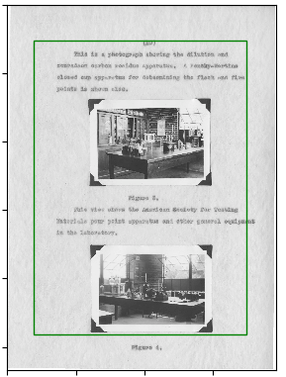
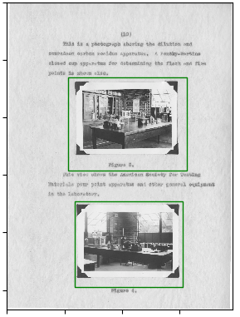

Results and Discussion
Original model
(Ours) Model trained on image-based transformations
(Ours) Model trained on all transformations
ETD source: Walter Douglas Chiles. 1935. Effect of service on automobile crankcase oils. Ph.D. Dissertation. Virginia Agricultural and Mechanical College and Polytechnic Institute. http://hdl.handle.net/10919/56159

Slide 34
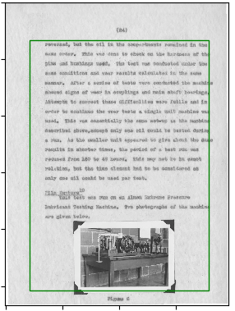
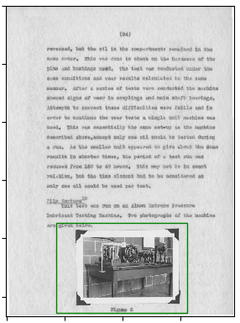
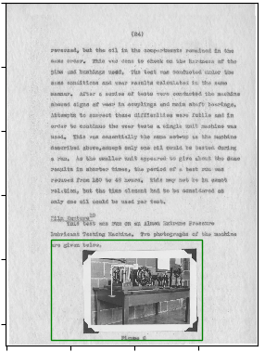
Results and Discussion
Original model
(Ours) Model trained on image-based transformations
(Ours) Model trained on all transformations
ETD source: Walter Douglas Chiles. 1935. Effect of service on automobile crankcase oils. Ph.D. Dissertation. Virginia Agricultural and Mechanical College and Polytechnic Institute. http://hdl.handle.net/10919/56159

Slide 35
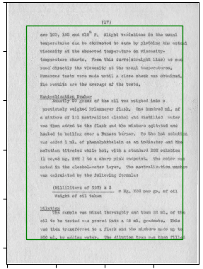
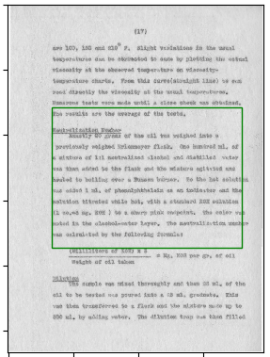
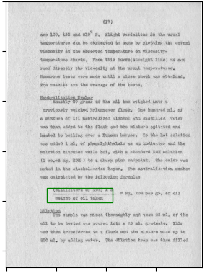
Results and Discussion
Original model
(Ours) Model trained on image-based transformations
(Ours) Model trained on all transformations
ETD source: Walter Douglas Chiles. 1935. Effect of service on automobile crankcase oils. Ph.D. Dissertation. Virginia Agricultural and Mechanical College and Polytechnic Institute. http://hdl.handle.net/10919/56159

Slide 36
Evaluation
Evaluated the model on a single ETD from VTechWorks.
Number of actual images: 26 (ground truth)
 | Original model (DeepFigures) | Model trained on image-based transformations | Model trained on all transformations
True Positives (correct predictions) (Higher is better) | 0 | 7 | 10
False positives (incorrect predictions) (Lower is better) | 29 | 16 | 15
False negatives (missed predictions) (Lower is better) | 26 | 21 | 16
ETD source: Walter Douglas Chiles. 1935. Effect of service on automobile crankcase oils. Ph.D. Dissertation. Virginia Agricultural and Mechanical College and Polytechnic Institute. http://hdl.handle.net/10919/56159

Slide 37
Future Work

Slide 38
Future Work
Classification
Use Word Embeddings like GloVe, BERT along with Deep Learning models
Extend the work to include full-text data
Extend these methods to classify ETD chapters
Parsing
Pre-processing of data to be done carefully
Train on more data and types of documents
How golden are the gold tags?
Figure Extraction
Train on more augmented data.
Try more augmentations.
Try more architectures (YOLOv3, SSD, etc)

Slide 39
Thank you
©2019 by John Aromando, Bipasha Banerjee, Bill Ingram, Palakh Mignonne Jude, and Sampanna Kahu
This work is licensed under a Creative Commons Attribution-ShareAlike 4.0 International License.
This research was done under the supervision of Dr. Edward A. Fox
as part of the course
CS6604: Digital Libraries at Virginia Tech, Fall 2019.
https://github.com/waingram/CS6604-ETD/

