Slide 1

Publishing Services from the Center for Digital Research and Scholarship
Gail McMillan
Director, Digital Research and Scholarship Services
Anne Lawrence
DRSS Online Editor
University Libraries, Virginia Tech

Slide 2
Journal Publishing at VT since 1989
ALAN Review
Electronic Antiquity
International Colloquium on Communication
Journal of Career and Technical Education
Journal of Research in Music Performance
Journal of Technology Education
Journal of Technology Studies
Reports from the National Surface Transportation Safety Center for Excellence
Virginia Libraries
WILLA: Women in Literacy and Life Assembly
Notes:
40 serials on our publications list, 34 of which we continue to host. These 10 are currently publishing issues, usually quarterly
9 our of these 10 are hosted by DRSS.
#5 is taking advantage of our new publishing system OJS, which Anne will demonstrate for you.

Slide 3
Publishing Services
Journals and Conference Proceedings
OJS: open journals systems
OCS: open conference systems
Editorial workflow
Solicitation, submission, peer review, editing, access
Long-term preservation and access
VTechWorks
Distributed digital preservation network strategy
Notes:
Digital Research and Scholarship Services, previously known as the Digital Library and Archives and the Scholarly Communications Project, is here to help anyone in the university community with the editorial workflow, hosting journals and conference proceedings, and their long-term preservation.
OJS’s open source software is implemented, hosted, and maintained locally. OCS, also open source software is implemented locally, but hosted and maintained through a library contractual agreement with PKP/PS (Public Knowledge Project Publishing Services).
Conference proceedings publishing Services provides web hosting for symposia and conferences hosted by Virginia Tech. We work with conference organizers from the university community. Like all DRSS Services, we are most anxious to support Open Access content and we have a strong preservation strategy, which is enabled by our partnership in a distributed digital preservation network of other research libraries.

Slide 4
Open Access
Immediately or delayed
You decide.
Benefits of OA
Increased citations (reputation)
Research widely available increases rate of progress in academic fields
Fulfilling the mission of our land grant university

Slide 5
Additional Publishing Services
Persistent identifiers
Handles
DOIs
Listing in Directory of Open Access Journals
Indexing by Google and Google Scholar

Slide 6
This Memorandum of Understanding expresses the interest of the [journal] and Virginia Tech’s University Libraries to ensure long-term public access to the journal. At the request of the [journal], the Digital Research and Scholarship Services (DRSS) agrees to host the [journal] and to provide online public access to its past, current, and future issues under the following terms:
The editors of [journal] agree to have their journal on the library’s web domain.
DRSS agrees to maintain online public access to the [journal] on the library web domain at a stable web address (URL) and to preserve the JRMP for the indefinite future.
DRSS will provide the editors with the stable URL so that they may make use of the links and identifiers for citations and other purposes.
Once available on the library domain, [journal] transfers responsibility for the journal’s files to the University Libraries to preserve and provide online public access to the journal.
It is understood that this joint effort is to ensure that the [journal] is available for public access as long as is practicable. Either party may terminate the agreement after giving one year’s notice to the other party, though it is assumed that such action would only be taken after mutual consultation in order to avoid any possible inconvenience to the other organization.
The agreement shall become effective on the day representatives of both organizations affix their signatures and is subject to revision or modification by mutual agreement.
Notes:
Sometimes Formal Agreements

Slide 7
https://pkp.sfu.ca/ojs/
Notes:
Open Journal Systems or OJS is free a open source journal management system. On the first page of the brochure is the URL for the Libraries OJS service, ejournals.lib.vt.edu. Inside the brochure on thr right just above “Benefits” is the URL for the Open Journal Systems site. This site has a variety of introductory information about OJS including documentation, video tutorials, FAQs, demonstration websites, and screenshots of various journals using OJS.

Slide 8
https://pkp.sfu.ca/https://pkp.sfu.ca/development-partners/
Notes:
OJS was developed by the Public Knowledge Project, which is a partnership among Simon Fraser University, Stanford University, University of British Columbia, University of Pittsburgh, the Ontario Council of University Libraries, and the California Digital Library.
The Public Knowledge Project was founded in 1998 by John Willinsky of the University of British Columbia.
The Public Knowledge Project also developed Open Conference Systems, Open Monograph Press, and Open Harvester system. http://pkp.sfu.ca/?q=ojs

Slide 9
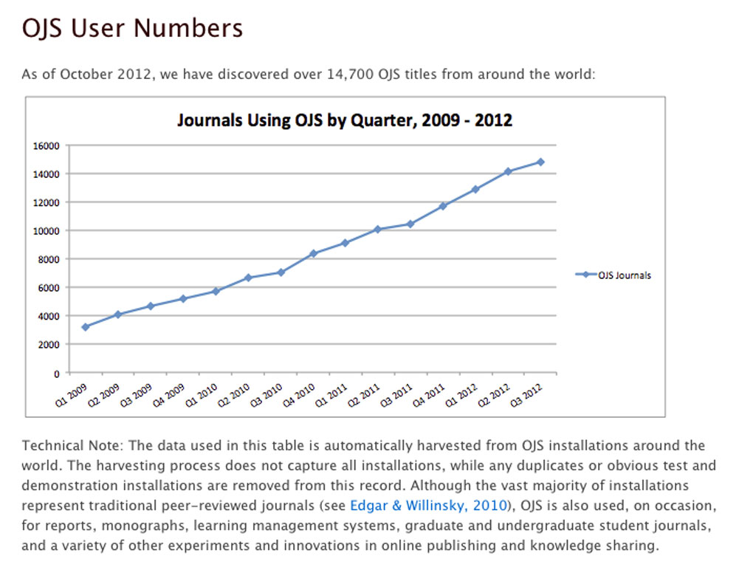
Notes:
It claims 15,000 titles in OJS in 2012. Usage has increased 500% in the past four years.

Slide 10
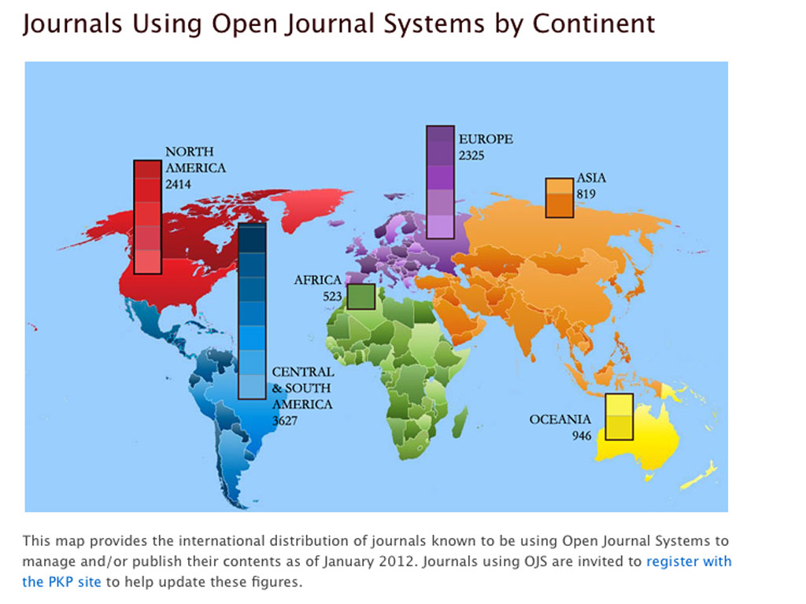
Notes:
OJS is used for over 14,000 journals on six continents.

Slide 11
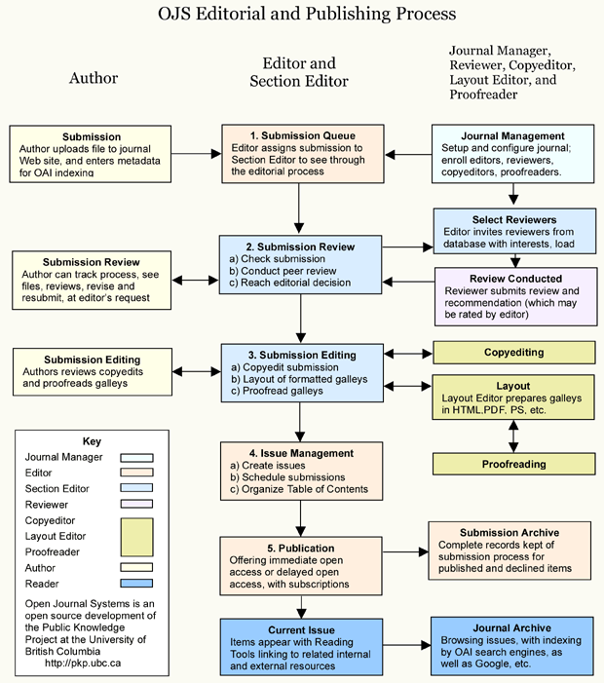
Notes:
The software is based on the editorial and publishing processes. Users have privileges based on roles such as journal manager, editor, reviewer, author, and reader. The software tracks each article through the steps from submission to publication.

Slide 12
http://pkpschool.sfu.ca/
Notes:
PKP also has an OJS school site with numerous short videos about OJS and editing journals, in general.

Slide 13
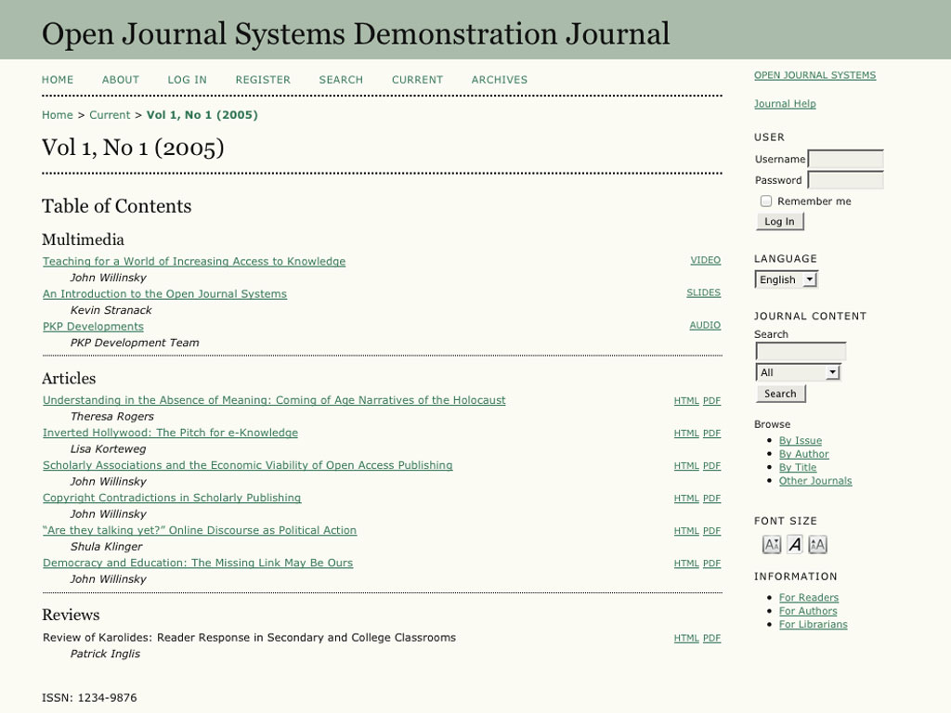
http://journals.sfu.ca/present/index.php/demojournal/issue/current
Notes:
OJS is ready to go “out of the box” and can be used without knowledge of HTML, web design, etc. via its many simple forms and a host of plugins. This is the default reader interface. OJS support a variety of file formats, including, HTML, PDF, mp3, and video.

Slide 14
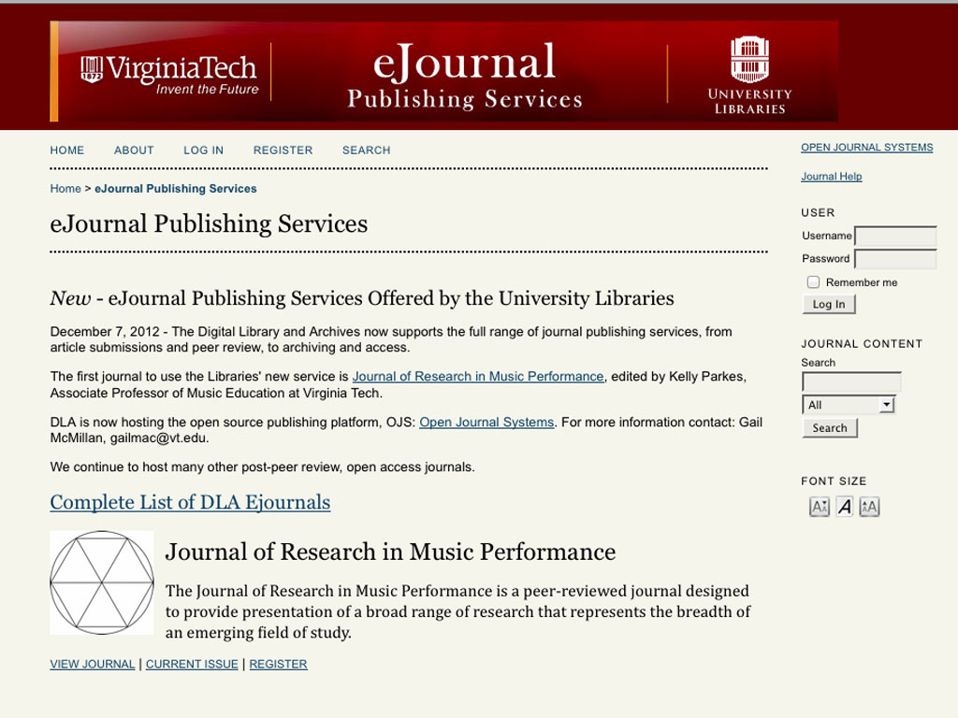
http://ejournals.lib.vt.edu/
Notes:
Our installation has been modestly customized.

Slide 15
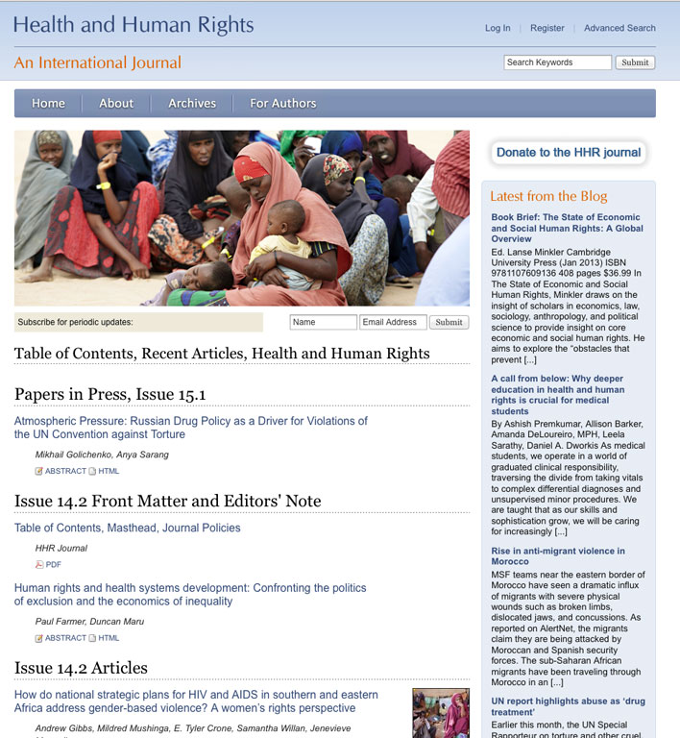
http://www.hhrjournalarchive.org/index.php/hhr
Notes:
However it can be more dramatically customized as seen in Health and Human Rights, http://www.hhrjournalarchive.org/index.php/hhr

Slide 16
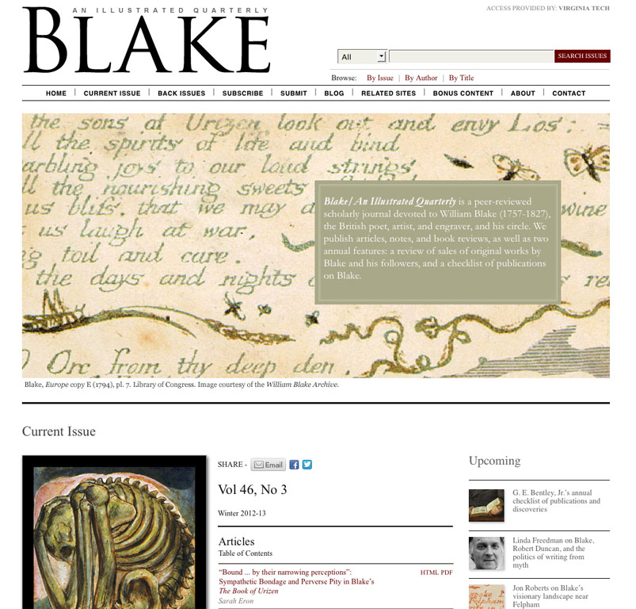
http://blake.lib.rochester.edu/blakeojs/index.php/blake
Notes:
And Blake, http://blake.lib.rochester.edu/blakeojs/index.php/blake http://pkp.sfu.ca/ojs-customization

Slide 17
http://ejournalsdev.lib.vt.edu/JEMTJ/article/view/1
Notes:
Reading tools, shown on the left, can be enabled. They allows readers to export citations, email articles, browse and search.

Slide 18
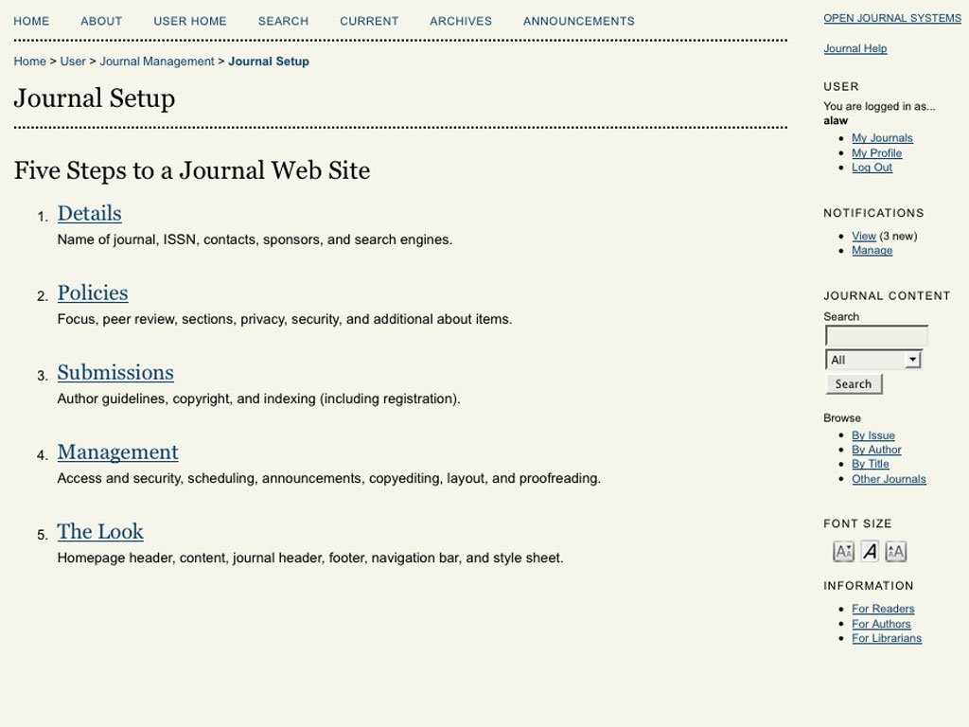
Notes:
The journal setup is fairly straight forward but detailed. This includes information about the journal, a detailed set of policies, submission guidelines, management settings (assigning roles, etc.), and customizing the look of the ejournal.

Slide 19
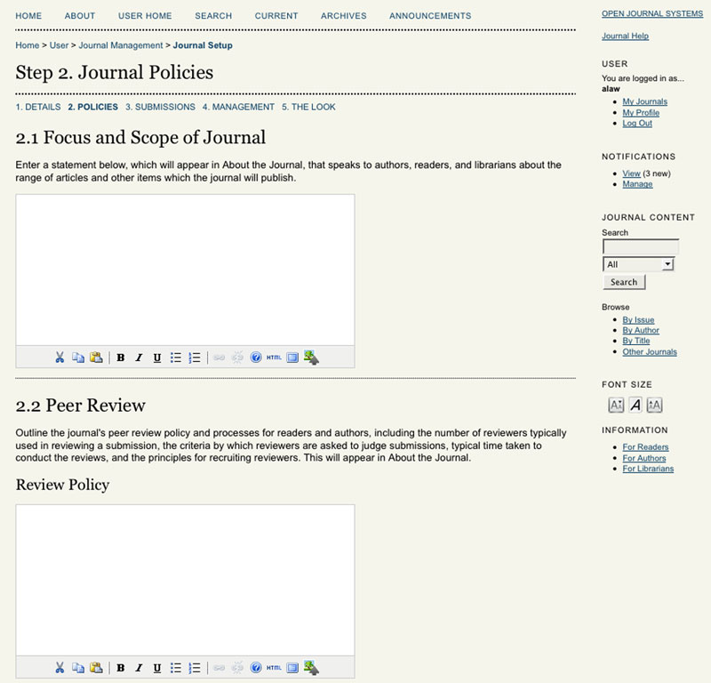
Notes:
There are many forms to fill out. Some come with default text. This detail can help editors to realize the many policy decisions they face and provide the opportunity to make their choices explicit.

Slide 20
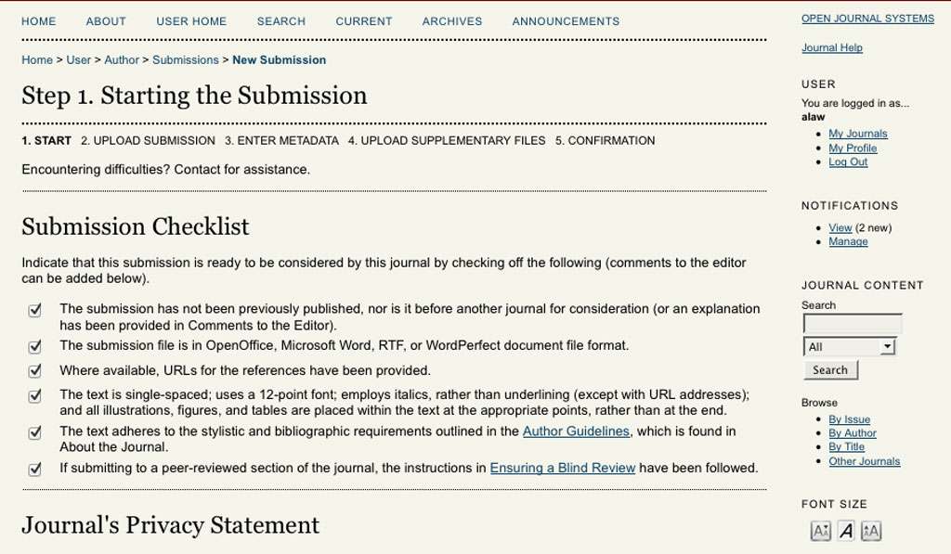
Notes:
Authors can submit articles online. OJS offers secure registration for readers, editors, authors, and reviewers.

Slide 21
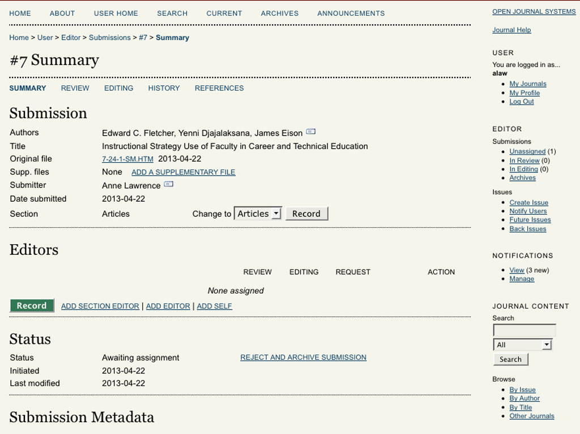
Notes:
Editors can assign reviewers to the articles and track the double blind peer review process. The system generates notices to editors, reviewers, and editors. Reviewers can reply in the peer review form. OJS helps organize the other steps of publishing such as copyediting and layout.

Slide 22
Notes:
OJS supports subscriptions. Content can be made available immediately or with an embargo period. Content can be made open access or restricted to registered users, incoming IP addresses, or subscribers. Blake, shown earlier, is available via the Libraries' subscription to this journal.
It also supports online advertisement and online collection of subscription and author fees, print on demand fees via Lulu, and donations via plugins for Paypal and others.

Slide 23
http://pkp.sfu.ca/ocs/
Notes:
PKP also produces Open Conference Systems, which we have begun to offer. This service provides a peer review process to prepare and publish conference proceedings. With it you can prepare a website, send a call for papers, register participants.

Slide 24
http://econferencesdev.lib.vt.edu/
Notes:
This is a screenshot of our development server with Open Conferernce Systems. Again, it has been just modestly customized.

Slide 25
http://ocs.sfu.ca/mets/index.php/mets/mets
Notes:
We are hosting our first conference with this service. It it is the Marine Energy Technology Symposium , which will be held in Seattle next April.

Slide 26
http://iti.srce.unizg.hr/index.php/ITI/index/pages/view/homepage
Notes:
This conference, Information Technology Interfaces, has used OCS for several years and has a very customized interface with an archive of past conferences.

Slide 27
Open Journal Systems and Open Conference Systems Offer
low technical and financial hurdles for publishing
scholarly publishing online workflow assistance
long-term stability – fixed URLs, DOIs, preservation
“out of the box” or customization
reading tools
metadata for search engines and export tools
statistics

Slide 28
Library Publishing Services Are Free!
Gail McMillan
gailmac@vt.edu
540-231-9252
Anne Lawrence
alaw@vt.edu
540-231-9320

