Slide 1



Doing the Work:
Developing a DEI Toolkit to Center Equity in Textbook Creation
OE Global Conference
Edmonton, Alberta, Canada
October 16, 2023
Slidedeck: https://bit.ly/doingthework_oeglobal
Doing the Work: Developing a DEI Toolkit to Center Equity in Textbook Creation by Heather Blicher and Veronica Vold is licensed under a CC BY 4.0 international license.
Notes:
Heather slides 1-4 (2 min)
Hi everyone! Welcome to our presentation, Doing the Work: Developing a DEI Toolkit to Center Equity in Textbook Creation.

Slide 2
1. Agenda
Introduction
Background
Toolkit
Notes:
Heather slides 1-4 (2 min)
In the next 25 minutes, we’ll offer an overview of our OER development project, Targeted Pathways, explain key leadership roles in this project, and offer an in-depth look at a toolkit that we developed to on-board new and revising authors to the project’s equity framework.

Slide 3
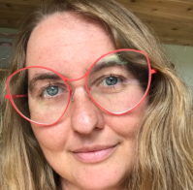
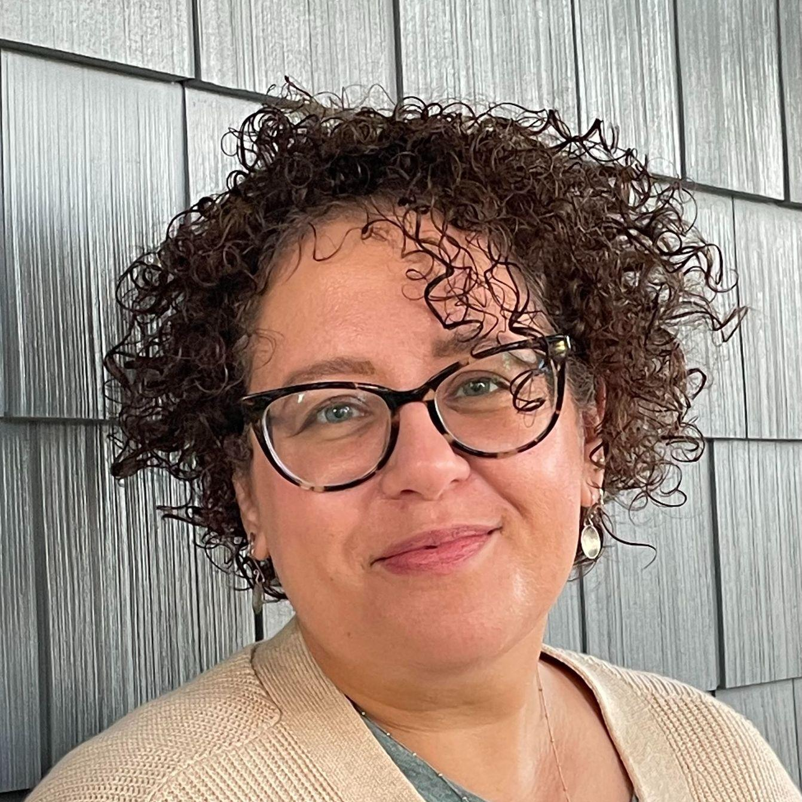
Who We Are
Veronica Vold (she/her)
Open Education Instructional Designer
Open Oregon Educational Resources
Heather Blicher (she/her)
Equity Consultant and Instructional Designer
Open Oregon Educational Resources
Notes:
Both introduce ourselves
I am Heather Blicher, an Open Education librarian with Virginia Tech and I’ve worked on the Targeted Pathways project as both an equity consultant and instructional designer.
I am Veronica Vold, I’m the Open Education Instructional Designer with Open Oregon Educational Resources. I provide consultation to our authors and pilot instructors on alignment, engagement, and meaningful learning design.

Slide 4
Goals
Recommend tools to promote equity in textbook and course design.
Examine instructional design choices that center equity as a throughline in OER development.
Explain the importance of engaging equity consultants as leaders in OER development.
Develop realistic strategies to manage barriers to faculty participation in equity-minded OER creation.
Notes:
Heather slides 1-4 (2 min)
We have four goals for this session:
Recommend tools to promote equity in textbook and course design, focusing on theDoing the Work Toolkit.
Examine instructional design choices that center equity as a throughline in OER development. Offering examples in our Toolkit that model the kind of engagement with authors that we hope to create for students.
Explain the importance of engaging equity consultants as leaders in OER development.
Develop realistic strategies to manage barriers to faculty participation in equity-minded OER creation, highlighting what worked and what didn’t in our own implementation.
We hope that this time will be a catalyst for your own planning about how to integrate equity into your OER development programs.

Slide 5

Overview of Targeted Pathways Project
“Photo” by Olia 💙💛 Gozha on Unsplash/cropped from original.
Notes:
Veronica slides 1-5 (3 min)
I want to offer a brief overview of Targeted Pathways project: Our project redesigns high-enrollment courses in disciplines that lead to in-demand occupations in Oregon.
Our disciplines include Human Development & Family Studies, Sociology, Criminal Justice.
Our leadership team supports authors and instructors in creating high quality openly licensed course materials with an equity lens that are not otherwise available
We explicitly focus on equity-minded outputs for student learning: we aim to share course materials that directly address and interrogate systems of oppression, equipping students and educators with the knowledge to do the same.
This is especially urgent as we work with public universities and community colleges in a predominantly white state. Portland State University professor Walidah Imarisha reminds us that Oregon was founded as a racist white utopia. In this historical context, Oregon students have different advantages and opportunities to learn based on a constellation of identity factors and broader social systems. We know that as a statewide program, we must attend to the impact our design choices have on Oregon students.
https://openoregon.org/targeted-open-pathways-for-hdfs-and-soc/
https://openoregon.org/update-targeted-open-pathway-for-criminal-justice/

Slide 6
2. Background
Notes:
Heather slides 6-11 (3-4 min)
Working with a decentralized team from all over Oregon (and in some cases outside of Oregon), we needed to find a way to support the team, especially for authors new to an ongoing project. We asked ourselves:
How do we organize all of this information in one place for easy access and future reference?
And how do we make sure authors get the information they need to be successful in the project?
Because we had access to Pressbooks, we decided to put this tool to use in developing a toolkit of sorts to introduce important concepts and topics.
We’ll go over two of the key roles in the project, and this will emphasize the challenge of:
Building foundational modules that center equity
And the challenge of how much is too much content? Because we had plenty to share :).

Slide 7
58 Authors
38 Pilot instructors
13 Team leads & support staff (grown over time)
Notes:
Heather slides 6-11 (3-4 min)
Our project team has grown over the past 2+ years and we now have 58 authors, 38 pilot instructors, and 13 team leads and support staff, including a project manager, open educational instructional designer (with part time instructional designers), 2 equity consultants, and open education researchers.
This creates a number of challenges.
We don’t have all of the answers and we’re still figuring things out as we go along. This is a pilot and as we’ve progressed through the project, we’ve made adjustments as needed.

Slide 8
Challenges -
Decentralized Teams
Calendar availability for live sessions
How to support team integration?
Accommodate learner variability?
Ensure active participation?
Organize information in one place
Notes:
Heather slides 6-11 (3-4 min)
This section should introduce the questions we answer in the implementation section
In our first semester working with authors, we scheduled and held two 4 hour synchronous training sessions. The leadership team’s goals were to onboard as many authors together so that we could hold mini intensive sessions to discuss the project and create a community of practice for all to take part in.
The meetings included highlights on the work with Chemeketa Press personnel, accessibility topics, support available to participants and self-reflective activities introducing the concept of DEI and the equity lens in relation to the project.
While we had active participation from a core group of attendees, with such a large group we began to question how we could improve these sessions in onboarding future authors. The obvious answer was to switch from synchronous to asynchronous to solve the issues of calendar availability, but we found ourselves discussing how could we support team integration? Accommodate learner variability? Ensure participation? And organize information all in one place.

Slide 9
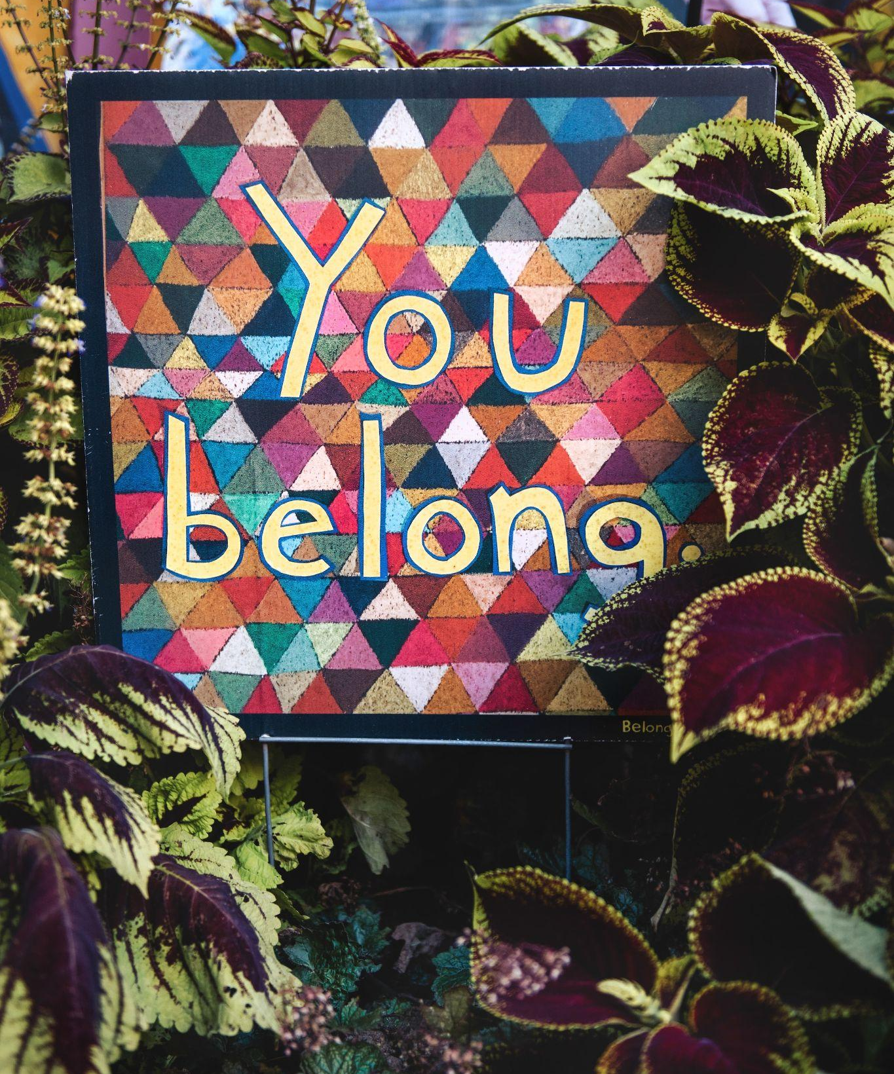
Equity Consultants
Providing an “equity lens”
“Photo”by Tim Mossholder on Unsplash/ cropped from original
Notes:
Heather slides 6-11 (3-4 min)
My role as an equity consultant is to work with the leadership team, instructors, and authors to ensure considerations of diversity, equity, and inclusion are built into the development process from the very beginning of the project and to keep it a priority. This includes being a part of leadership team meeting discussions, a part of onboarding new authors, providing recommendations on how to address and solve inequities as they arise, and one on one and group support to authors, and being an advocate.
The role grew beyond our original focus as we progressed and secured more funding. We started with subject areas that included HDFS (or Human Development and Family Services) and Sociology, and then eventually added Criminal Justice. A second equity consultant was then added to the team. Together we developed a DEI-focused module for the project’s toolkit to try to center the majority of what we wanted to express to authors coming on board to the project. I say “the majority of what we wanted to express” instead of all that we wanted to express because even though this is a recent project, I already have thoughts on what I’d like to add and revise the next time we get the chance.

Slide 10
The way to right wrongs is to turn the light of truth upon them.
-Ida B. Wells
Notes:
Heather slides 6-11 (3-4 min)
Why are equity consultants important to the project?
Ida B. Wells, a Black journalist, activist, and researcher in the late 19th and early 20th centuries, said, “The way to right wrongs is to turn the light of truth upon them.” For the purposes of our project, using an equity lens means shining a light on the nuances of language, content, and design that can intentionally or unintentionally promote inaccurate information that leads to more oppression, social injustice, and disparities we live with today.
With so much happening all at once on a large-scale project like this, we have to stay focused on providing the equity lens to ensure we don’t lose sight of it as the center of the project.

Slide 11
Challenges
Underrepresentation
Exaggerated negative associations
Limited positive associations
Missing stories
Notes:
Heather slides 6-11 (3-4 min)
Championing education and the knowledge that results can contribute (even in small ways) to the dismantling of systemic barriers and prejudices, the amplification of marginalized voices, and reach towards an overarching goal to create a more inclusive and equitable society.
More well-known challenges include faculty awareness and the need for diverse content creators. I’ve listed challenges that I’m not sure we talk about enough.
Underrepresentation- think twice about what is considered “normal” and question your choices on the people and perspectives you automatically think to include in your writing or course
Exaggerated negative associations- the content inadvertently reinforces stereotypes based on an individual or structural bias- like highlighting crimes by People of Color in a criminal justice textbook
Limited positive associations are done with good intent but perpetuate marginalization, like reinforcing popular depictions of Black people being successful in sports
And missing stories (In history, the focus tends to be on contributions by white men; BIPOC people (that is Black, Indigenous, and People of Color) made important contributions, but they were less visible or intentionally ignored in history books

Slide 12

Instructional Designers
Guiding the way through
“Photo”by Muhammad Haikal Sjukri on Unsplash/ cropped from original
Notes:
Veronica slides 10-12 (2 min)
Following the lead of our equity consultants, our instructional design team collaborates with authors and instructors, coming alongside them to help create an aligned and responsive learning pathway for students. We help to make all the parts of a book or a course work together in support of specific learning outcomes. Our instructional design team also looks for opportunities to center student knowledge and meaning-making. We advance the project’s equity framework in interactives and activities.
Instructional designers help solve this question: How do you help busy and overworked authors not simply skim or skip content, but practice applying it and get feedback on their work? Especially when they are exhausted and overextended? In the design of this toolkit, we drew on inclusive instructional design frameworks to help authors assess their DEI practice in meaningful and attainable ways.

Slide 13
Inclusive Design Practices
T Transparency
in Learning
and Teaching
(TILT)
Universal Design for Learning
(UDL)
Culturally
Responsive
Teaching
(CRT)
Accessibility
Notes:
Veronica slides 10-12 (2 min)
Some of the inclusive design frameworks that show up in our tool kit include transparency in learning and teaching (TILT), universal design for learning (UDL), culturally responsive teaching (CRT), and accessibility. These frameworks are reinforced in design consultations with our OER development consultants and instructional designers.
Transparency in Learning and Teaching (TILT) is a design practice that aims to strip out any hidden curriculum and make the unwritten rules of academic work legible for students and fellow educators.
Universal Design for Learning (UDL) is a set of 3 design principles that focus on learner variability as its starting point. Essentially, UDL recognizes that students possess different strengths and challenges as learners, and designs for flexibility and student agency, rather than assuming one size fits all.
Culturally Responsive Teaching means that educators value diverse cultural backgrounds and diverse student experiences as assets rather than deficits. Culturally Responsive Teaching strives to help students to see diversity as strength, to respond directly to inequities in existing social systems, and to help students to build and express critical thinking skills. From a design perspective, it means examining how our books encourage students to connect their lived experiences to content, where students see themselves in content, and how students connect course content to their own lived knowledge.
In designing for Accessibility, authors and instructors anticipate common barriers for screen reader software. They also design the scope and length of chapters to ease cognitive load for students, maximizing student engagement with actual questions and content. In our tool kit, Accessibility focused on the challenge of creating alt text and image descriptions, as well as descriptive links.

Slide 14
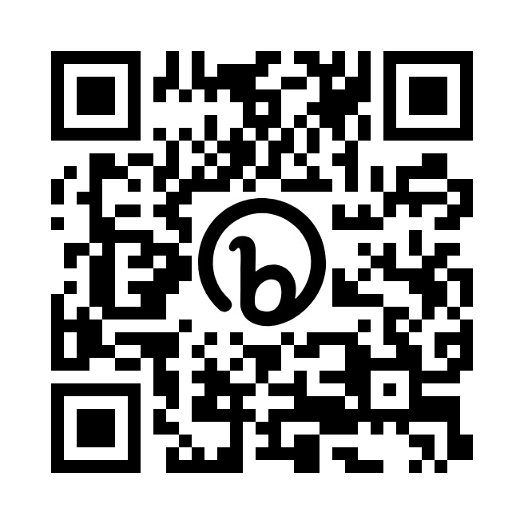
3. The Toolkit
https://openoregon.pressbooks.pub/dothework/
Notes:
Veronica slides 15-16 (5 min)
In our remaining time today, we’ll showcase the toolkit itself, offering you a quick tour, before closing with a summary of what worked and what didn’t for us.

Slide 15
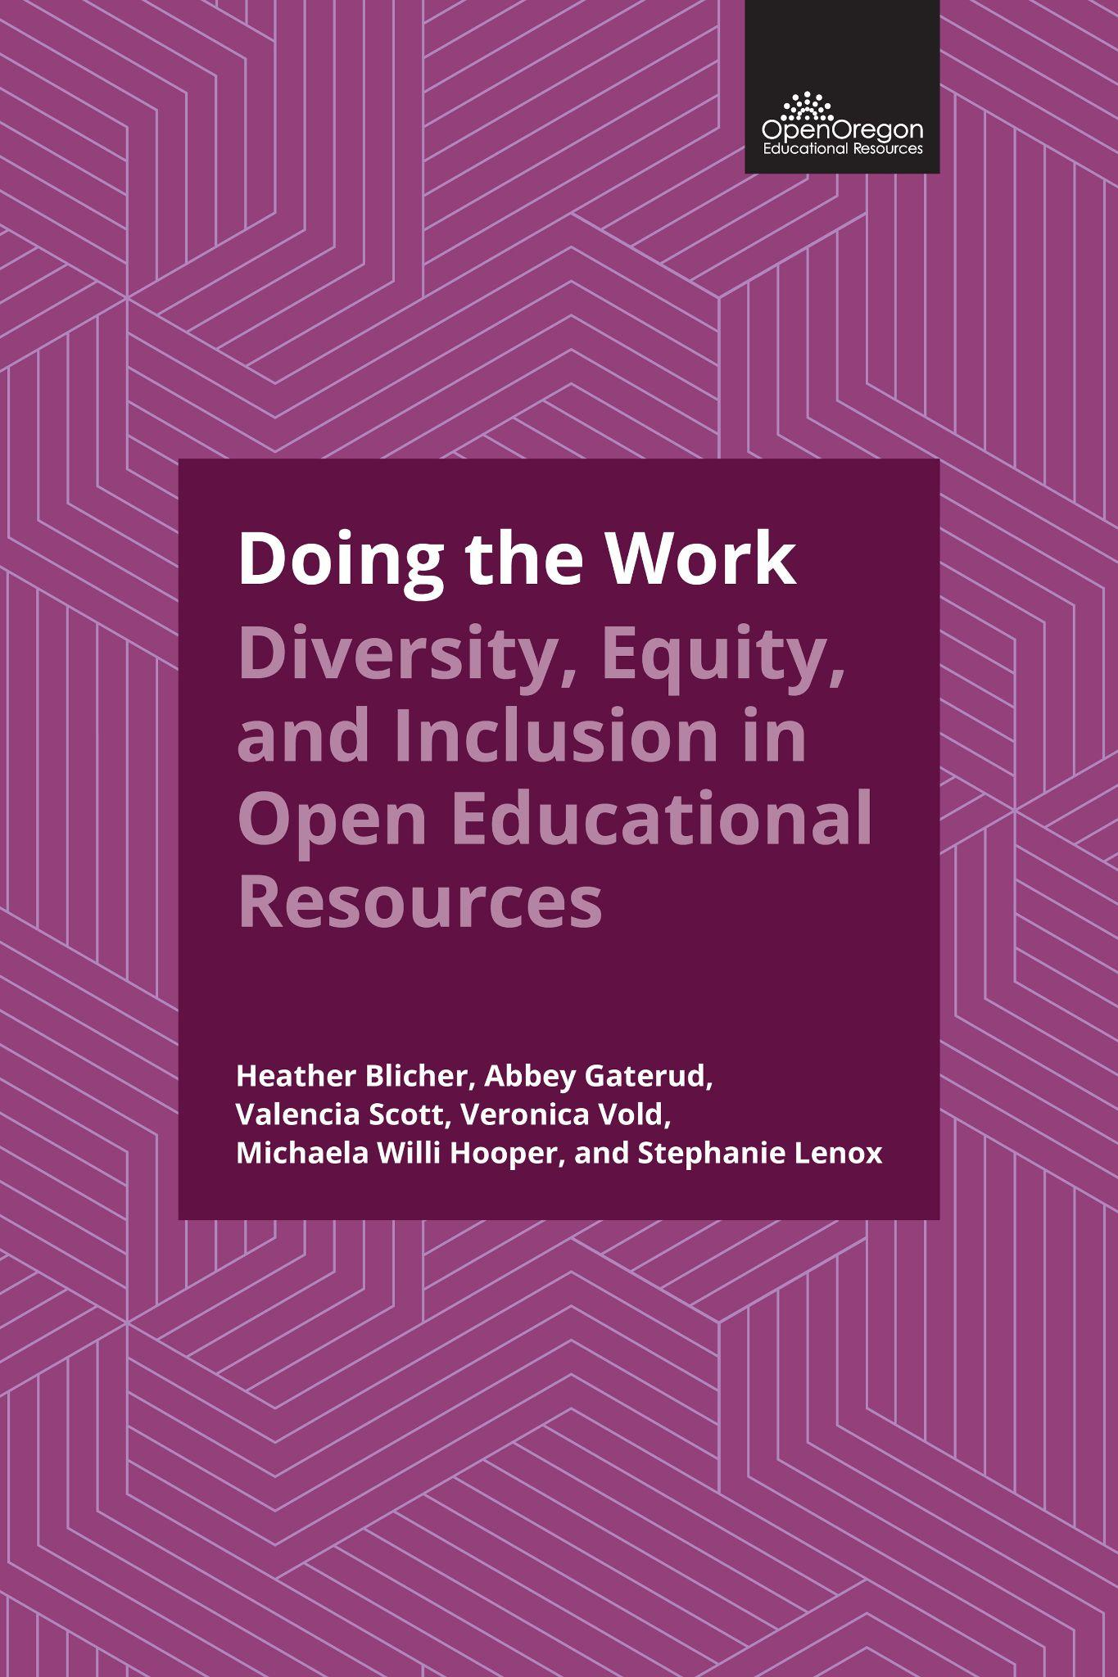
Purpose and Objectives of the Toolkit
Orient authors to strategies necessary to meet equity-minded outputs: Student-centered textbooks that fully integrate with dynamic courses.
Each of the 5 module builds toward a synchronous learning opportunity to join with fellow authors to assess skills and knowledge of concepts.
Openly licensed and shareable (once copyediting is complete!)
Notes:
Veronica slides 15-16 (5 min)
Doing the Work is designed to orient authors to the skills and strategies necessary to meet equity-minded outputs: Student-centered textbooks that fully integrate with dynamic courses.
We wanted to find a way to offer regular and sustained interaction with equity consultants and curriculum designers for authors who are overextended and exhausted. We also wanted to create a learning pathway for new team members that oriented them to what DEI means to us and explained key concepts through this lens.
The toolkit includes five modules of asynchronous content: We worked with our project team to identify four content areas in addition to the DEI anchor module that give team members what they need to integrate and apply equity-minded strategies in content creation.
Each module builds toward a synchronous learning opportunity to join with fellow authors to assess skills and knowledge of concepts. However, the synchronous meeting was optional! If you couldn’t come, that’s okay. You can still complete the asynchronous “apply and submit” activity to receive direct and meaningful feedback related to content development, where our leadership team will comment on your content and redirect you to parts of the module. We wanted to model in this toolkit the kind of flexibility that instructors offer students, facilitating learning and understanding through interactive engagement with the author’s choice of interaction.
Openly licensed and shareable (once copyediting is complete!)
https://openoregon.pressbooks.pub/dothework/

Slide 16
Toolkit Components
Module 1: Introduction to DEI in Targeted Pathways
Module 2: Inclusive Textbook Revision
Module 3: Working Toward Accessibility: Expanding Your Universe of Learners
Module 4: Building OER Together for All: Attributions, Access, and Authorship
Module 5: Equity-Minded Alignment for Course Packs + H5P
https://openoregon.pressbooks.pub/dothework/
Notes:
Veronica plays screenshare recording
Notes below just in case:
Heather slides 17 + Screen share (5 min)
And now I have the pleasure to share the components of our toolkit. You can see from our slide that we have 5 modules of asynchronous content:
An introduction to DEI in Targeted Pathways
Inclusive Textbook revision
Working Toward Accessibility
Building OER Together for All (focuses on Copyright)
Equity-minded alignment for coursepacks and H5P
I’ll share my screen and highlight specific sections within the modules.
This is Doing the Work: Diversity, Equity, and Inclusion in Open Educational Resources.
Starting with the table of contents, you can see we have an introduction and our 6 modules.
In the introduction, we orient the authors by including course outcomes, a description of the revising author role and their responsibilities, an equity statement, and a course timeline and activities.
Let’s start with module 1, which is what we refer to as our “anchor module” because it introduces the user to DEI and how we define it within the project.
In each module, we provide learning objectives and for the anchor module, this includes:
Identifying the importance of DEI
Defining DEI and describing the difference between equity and equality
Analyzing the impact of language and word choice in your textbook
Applying an equity lens to your writing
And recognizing that writing textbooks with an equity lens is labor intensive work
We want our authors to know what is expected of them and reviewers have shared with us that including learning objectives for each module has a greater impact.
As I scroll through, you can see we’re tackling some intriguing topics.
Then we come to the Apply and Submit section. There is an apply and submit section at the end of each module that provides an activity to complete. We ask users to read the activity prompt and then complete the activity either by joining us in the optional Zoom workshop, or on their own. Once they’ve completed a particular activity, the responsible person or persons is notified to review and give feedback. In this case it is the equity consultants that follow-up. This is how we engage with the authors in an asynchronous format.
Now let’s go to the module 4 which focuses on copyright.
4.2 There is a great read on copyright as a colonial endeavor. This is one of the sections that I think is unique to our project, that you wouldn’t stumble across in other guidelines focused on how to write or revise a textbook.
Throughout the different modules, we’ve included H5P activities to provide a place for interactive self-checks as you’re reading through the content.
For example in Module 3, I’m taking us to the accessibility module (3.2) on figure captions, alt text, and image descriptions. And if you’re familiar with these, you might counter that these definitions are pretty straight forward. I’ve found they’re not, especially for authors who are new to the process of writing or adapting textbook content.
If we look at the self-comprehension check here, you’ll find the wheel of power and privilege with four hot spot icons describing parts of the figure. (Click on each hot spot icon)
Another example activity that is not an H5P is in Module 1 in the section on language (1.3). Using these call-out boxes to highlight this activity- looking for problematic elements within a passage, gives the user an opportunity to see what they’ve read explained through a specific example.

Slide 17
Implementation:
Realistic Strategies
Scope the training content to be short and manageable
Spread modules out over time (give time to complete, but also maintain momentum)
Be flexible and accommodating; gentle reminders are critical
When you have a sequence of actions (ex: Pressbook to Google Doc to Google Form), keep the actions consistent and predictable
Notes:
Veronica Slide 18-20 (5 min)
Now that you’ve had a chance to look at the “Doing the Work” toolkit, we invite you to consider some realistic strategies for implementing this toolkit your author teams.
We recommend keeping equity-minded training content short and manageable. What is most important for your author teams to apply in their projects? Chunking content into sections, incorporating media and images to honor learner variability, and offering interactives gives authors multiple ways to engage without overloading them with the perceived workload.
We recommend that you spread modules out over time to allow them to complete activities and build momentum. At the same time, we encourage you to be flexible and accommodating. While we envisioned our training as week by week collaboration to manage workload and give our leadership team time for interaction, some authors just completed it in the span of a weekend. We didn’t anticipate that! Accept that some authors will go through quickly while others need more support to complete it. Gentle, personal reminders are critical.
While our synchronous sessions were not very well attended, they were transformational for those who came. Having this option alongside the apply and submit activity made a dramatic difference in the writing and thinking of our teams.
While we wanted everything to be in one place, we used a sequence of actions for authors to complete each activity and alert our team that it was ready for feedback. We kept this sequence predictable to minimize confusion and included instructions and links in the Pressbook for ease of use.

Slide 18
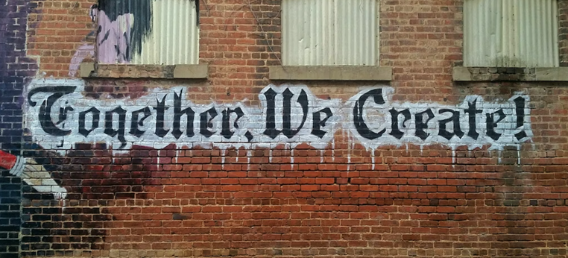
“white and black Together We Create graffiti wall decor” by “My Life Through A Lens” on Unsplash/cropped from original
Notes:
Veronica Slide 18-20 (5 min)
This project was a collaboration between many members of our leadership team as well as our authors and instructors. We look forward to learning how you adapt it and make use of it in your own OER development program to advance equity in the open movement.

Slide 19
Thanks!
Any questions?
Veronica Vold
voldv@linnbenton.edu
Heather Blicher
heatherblicher@gmail.com
Notes:
Veronica Slide 18-20 (5 min)
Thanks so much! Please reach out to us with questions or to continue the conversation.

Slide 20
References
Blicher, H., Gaterud, A., Scott, V., Vold, V., Hooper, M.W., & Lenox, S. (2023). Doing the work: Diversity, equity, and inclusion in open educational resources. Open Oregon Educational Resources. https://openoregon.pressbooks.pub/dothework/
Hofer, A. (2021, November 19). Targeted open pathways for HDFS and SOC. Open Oregon Educational Resources. https://openoregon.org/targeted-open-pathways-for-hdfs-and-soc/
Hofer, A., Blicher, H., Ford, E., Jones, T., Pearce, E., & Puttman, K. (2022, March 10). We’re On Our Way: Targeted open pathways for HDFS and SOC. Open Oregon Educational Resources. https://openoregon.org/were-on-our-way-targeted-open-pathways-for-hdfs-and-soc/
Hofer, A. (2022, March 11). Update: Targeted open pathway for criminal justice. Open Oregon Educational Resources. https://openoregon.org/update-targeted-open-pathway-for-criminal-justice/
Wells-Barnett I. B., Bay M. & Gates H. L. (2014). The light of truth: writings of an anti-lynching crusader. Penguin Books.

Slide 21
Credits
Special thanks to all the people who made and released these awesome resources for free:
Presentation template by SlidesCarnival
Titles: Kulim Park Bold
Body copy: Kulim Park Light
Download for free at:
https://github.com/noponies/Kulim-Park

