Slide 1

Final Project Presentation
Team 3- Object Detection and Topic Modeling
Pradyumna Upendra Dasu, Amr Ahmed Aboelnaga , Anushka Sivakumar, Jayanth Narla,
Ragul Seetharaman, Sahana Bhaskar, Shankar Srinidhi Srinivas
Under the guidance of Dr. Edward Fox
SME: Chenyu Mao
30 November 2023
CS5604, Virginia Tech, Blacksburg, VA 24061

Slide 2
Sections Covered
Team
Deliverables and responsibility
Project management
Object detection
Tasks completed
Tasks in progress
Future work
Chapter segmentation
Methodology
Tasks completed
Tasks in progress
Future work
Topic modeling
Tasks completed
Future work

Slide 3
TEAM
Subject Matter Expert - Chenyu Mao (mchenyu@vt.edu)
Email (for team): team3_CS5604-g@vt.edu Slack
Name | Email | Responsibility
Anushka Sivakumar | anushkas01@vt.edu | Object detection: XML generation with IDs, API integration, multiprocessing
Amr Ahmed Aboelnaga | amraboelnaga@vt.edu | Image generation, object detection, image classification, chapter segmentation using table of contents.
Jayanth Narla | jnarla@vt.edu | Topic modeling API integration
Pradyumna Upendra Dasu | pradyumnaupendra@vt.edu | Topic modeling experimentation and data cleaning
Ragul Seetharaman | ragul@vt.edu | Object detection and documentation
Sahana Bhaskar | sahanab@vt.edu | XML generation, API integration, experimentation with multiprocessing
Shankar Srinidhi Srinivas | shankarsrinidhi@vt.edu | Topic modeling and documentation

Slide 4
DELIVERABLE
A system supporting searching etc. using topics, where users can search on derived digital objects, and where experimenters can further research about objects and topics.

Slide 5
RESPONSIBILITIES
Responsibility 1:
Analyzing documents, considering object detection and topic models.
Improving the current methods and deploying them widely.
Responsibility 2:
Building on the existing system working with object detection and topic analysis.
Help Team 1 so object detection results will be represented in the KG.
Help Team 2 so detected objects and topics can be integrated into indexing.
Help Team 4 so classification and summarization can be over chapters.
Help Team 6 for integration with the UI.

Slide 6
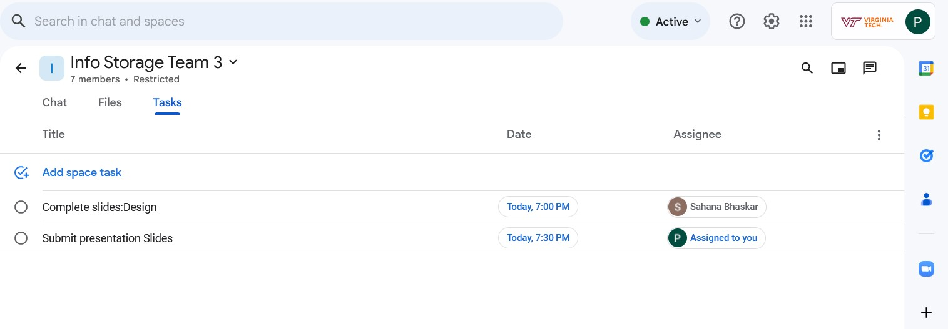
PROJECT MANAGEMENT
Weekly meeting on Wednesdays via Zoom.
Using Google Tasks for collaboration and task management.
Slack for sharing resources and links.

Slide 7
Object detection

Slide 8
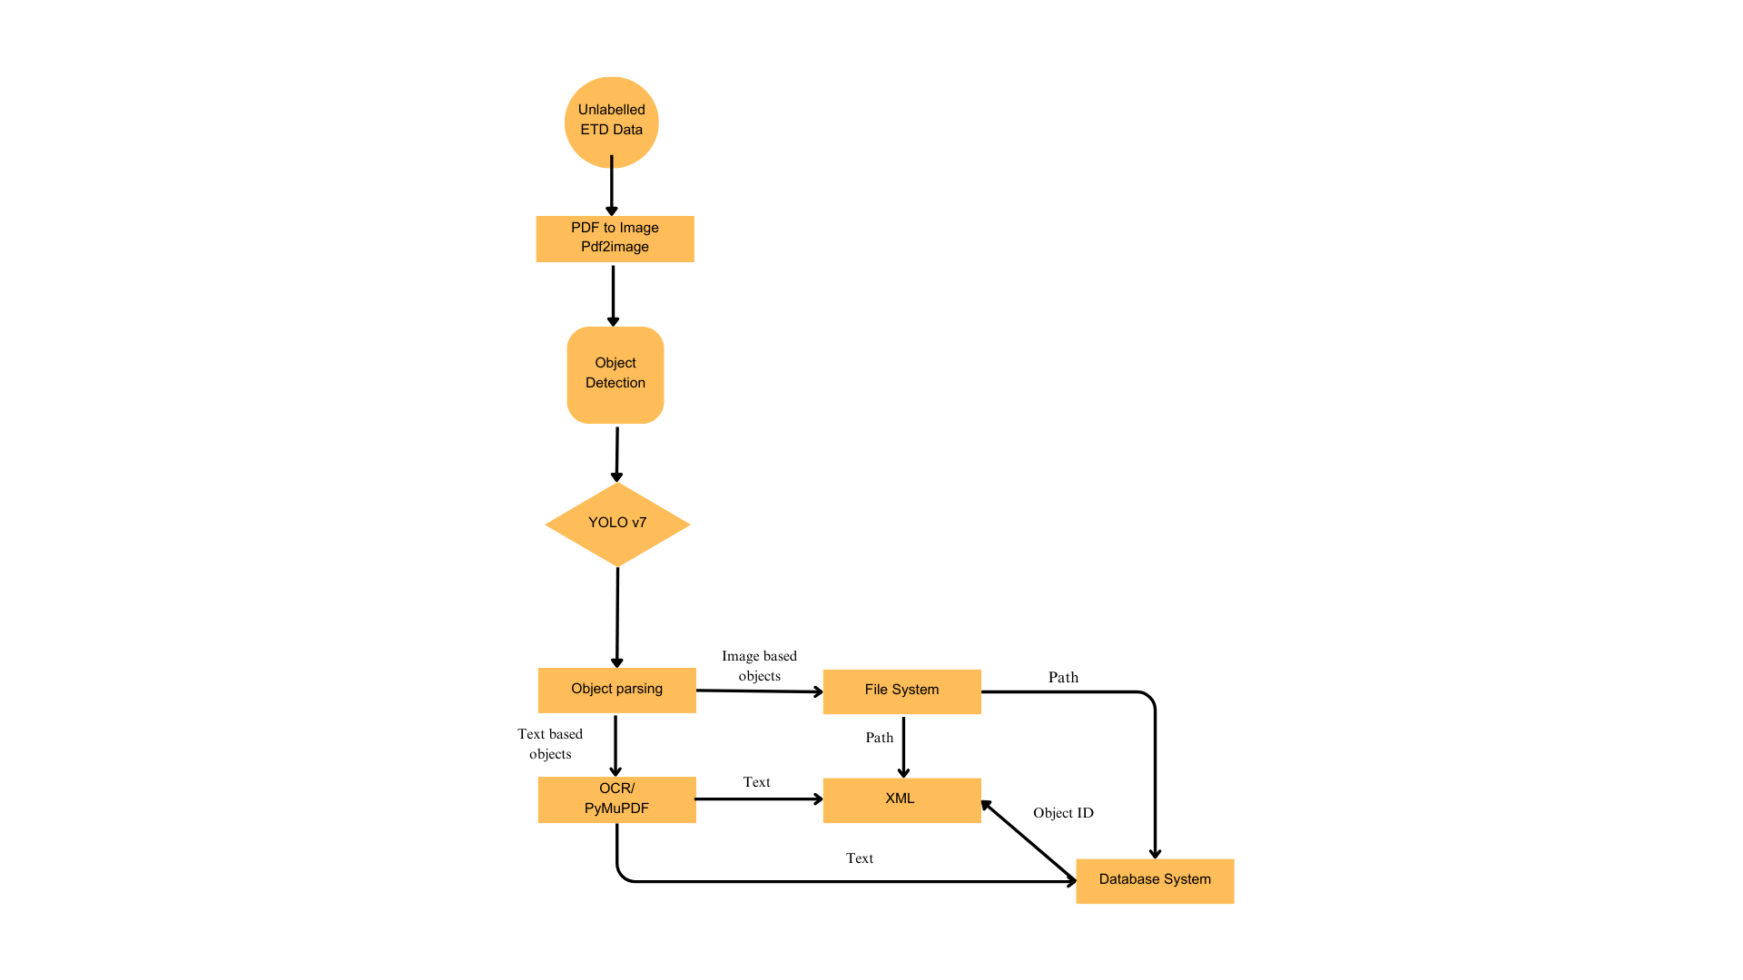
DESIGN

Slide 9
TASKS COMPLETED
Object detection setup in Endeavour.
Modified the object detection pipeline to save the page images as well as objects detected.
Object detection run on 200 ETDs that has already been segmented in past work.
Updated the XML generation code to include unique object IDs that Team 1 needs for recording structural connections and reran the object detection code on the 200 ETDs.
Defined and integrated the required APIs to populate the database and save the files corresponding to the ETD.

Slide 10
TASKS COMPLETED
Example results of an ETD through the object detection pipeline

Slide 11
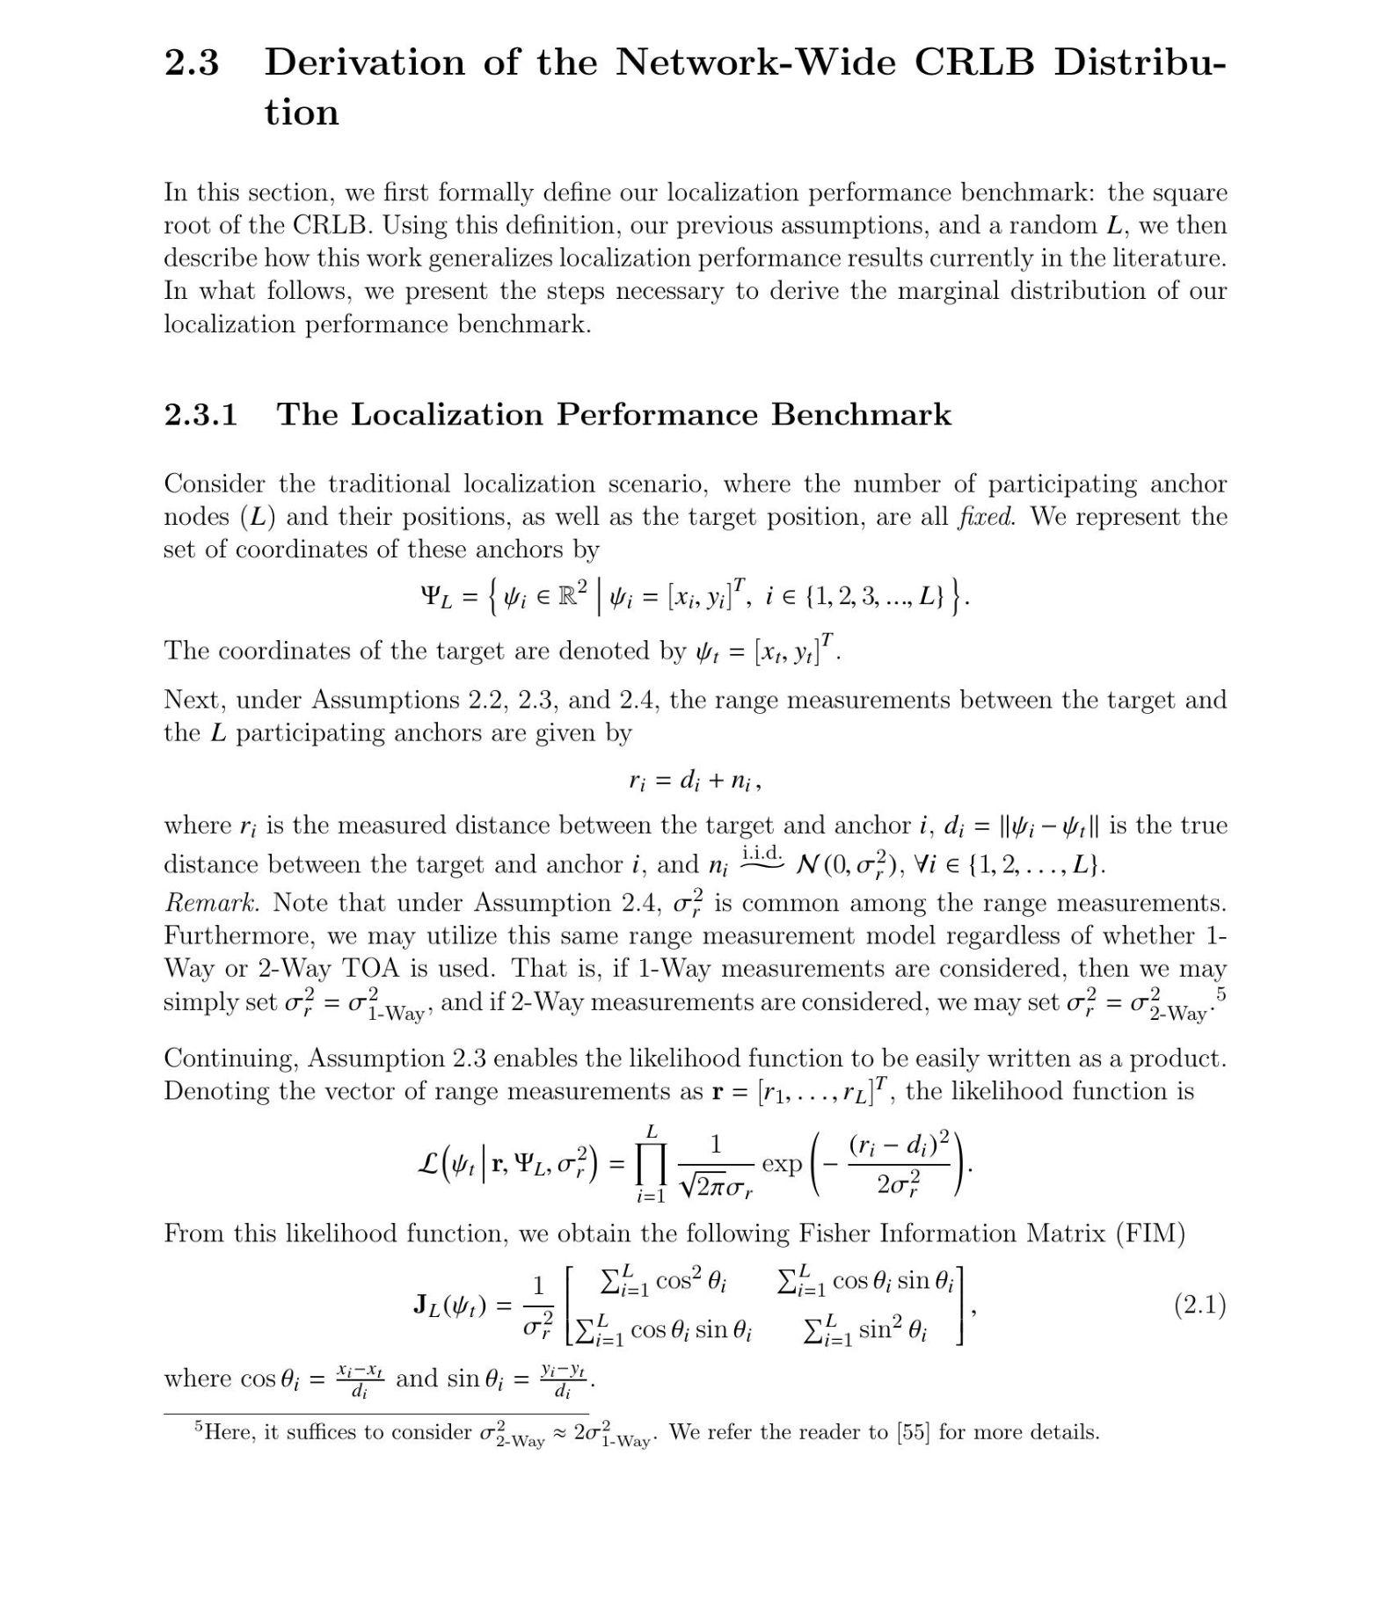
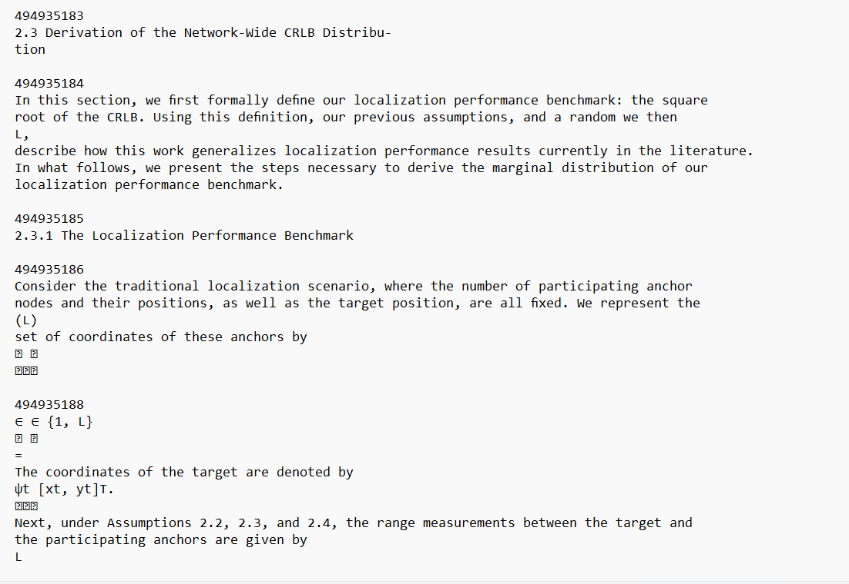
TASKS COMPLETED
Objects Detected from Page Image
Image of the page
Text detected from the page

Slide 12


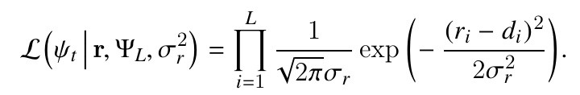
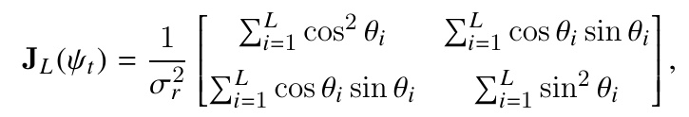
TASKS COMPLETED
Images detected

Slide 13
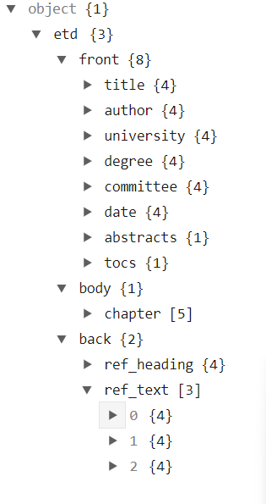
TASKS COMPLETED
XML Generated
XML Schema:
The XML schema contains the ETD ID as the root element and 3 subsections:-
Front
Body
Back

Slide 14
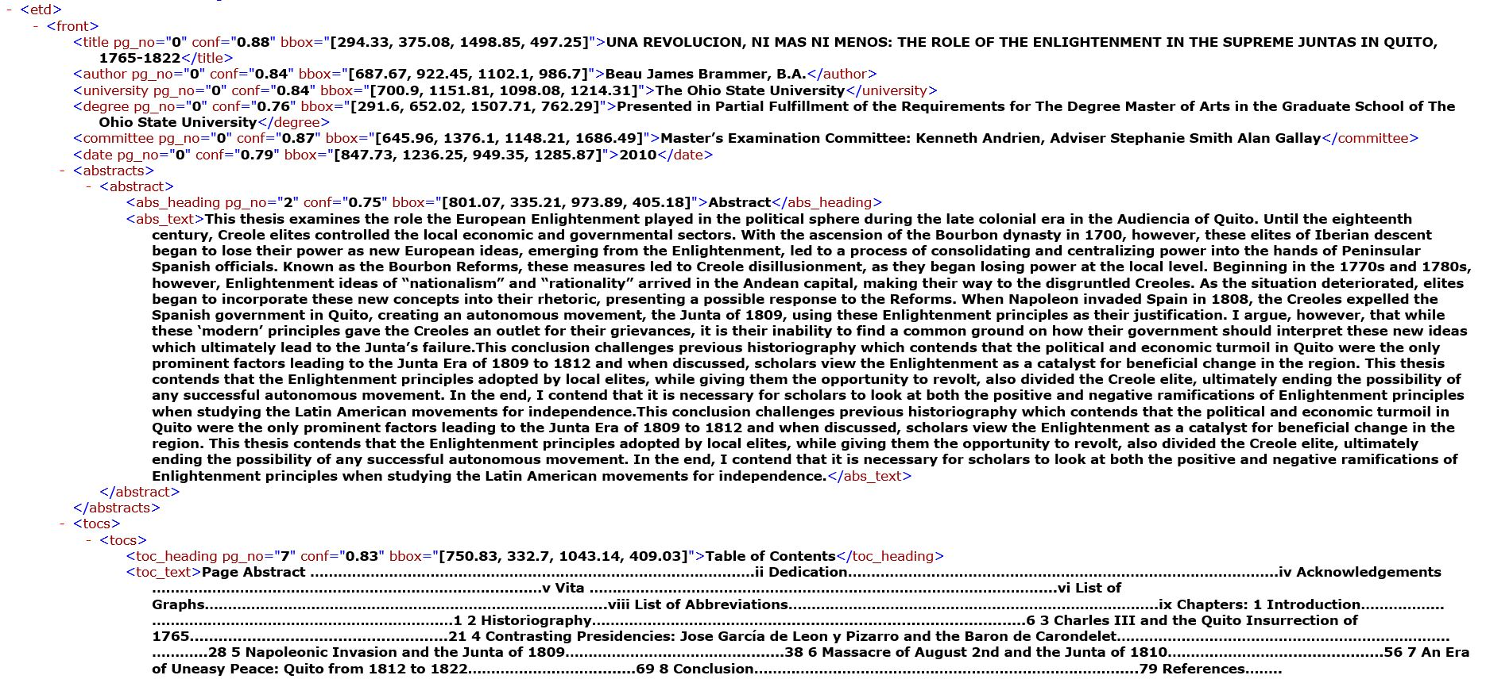
TASKS COMPLETED
XML Generated Front Section

Slide 15
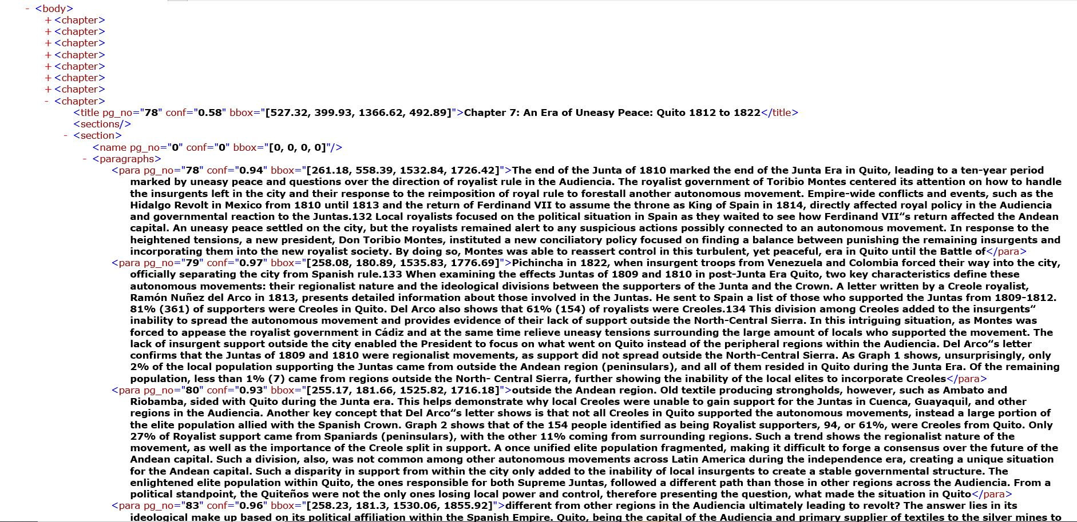
TASKS COMPLETED
Body Section

Slide 16
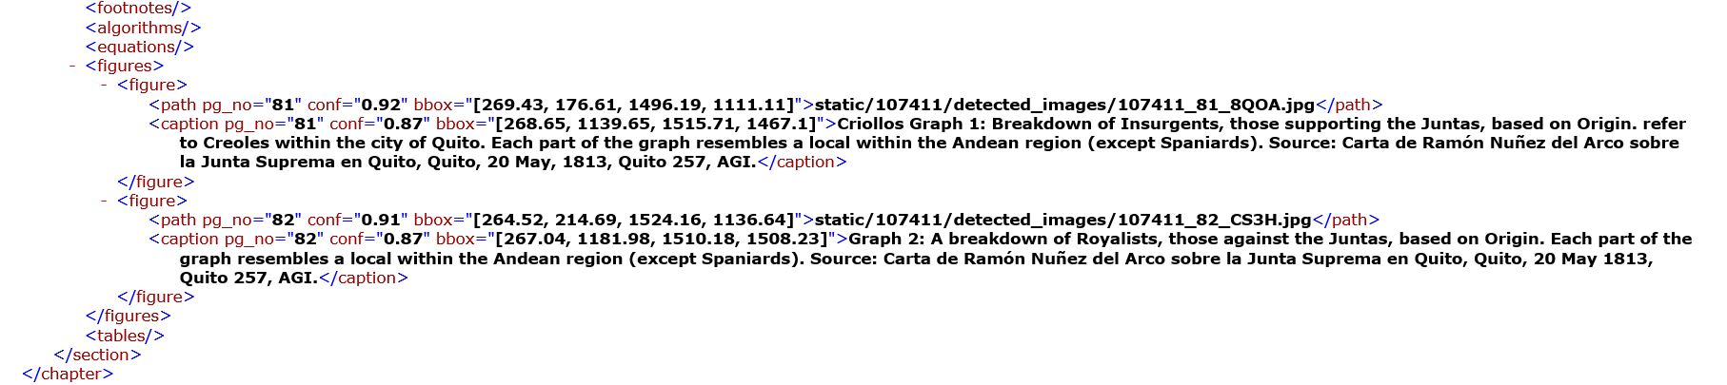
TASKS COMPLETED
Body Section

Slide 17
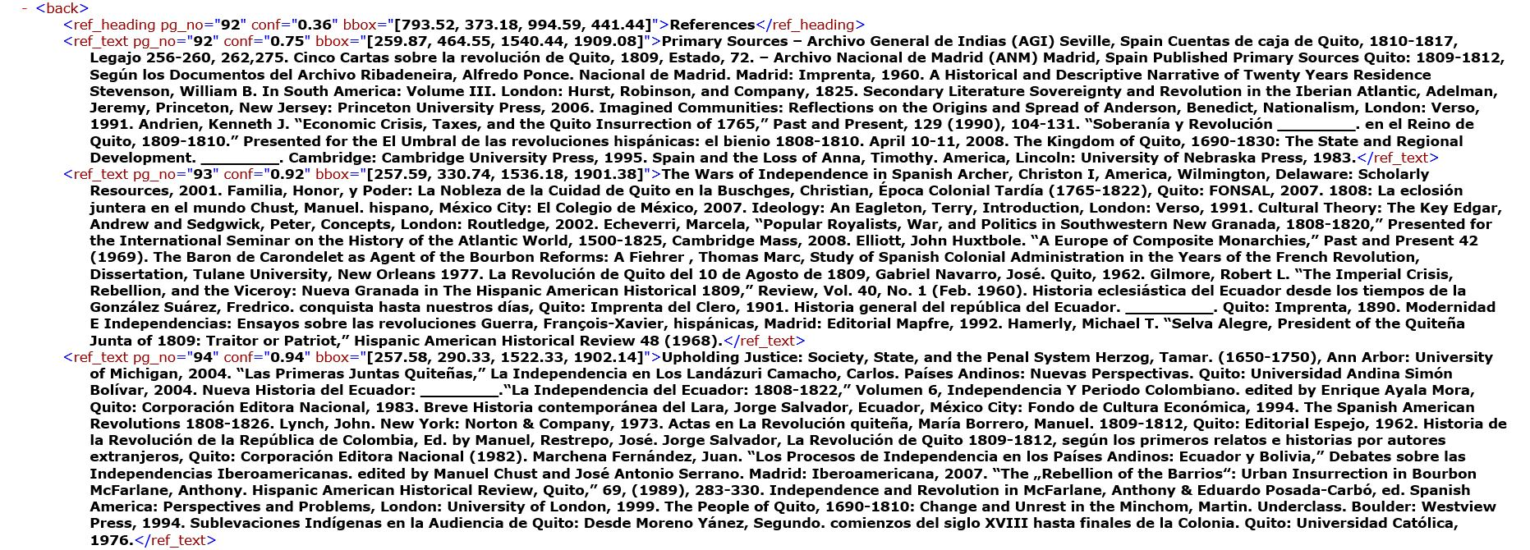
TASKS COMPLETED
Back Section

Slide 18
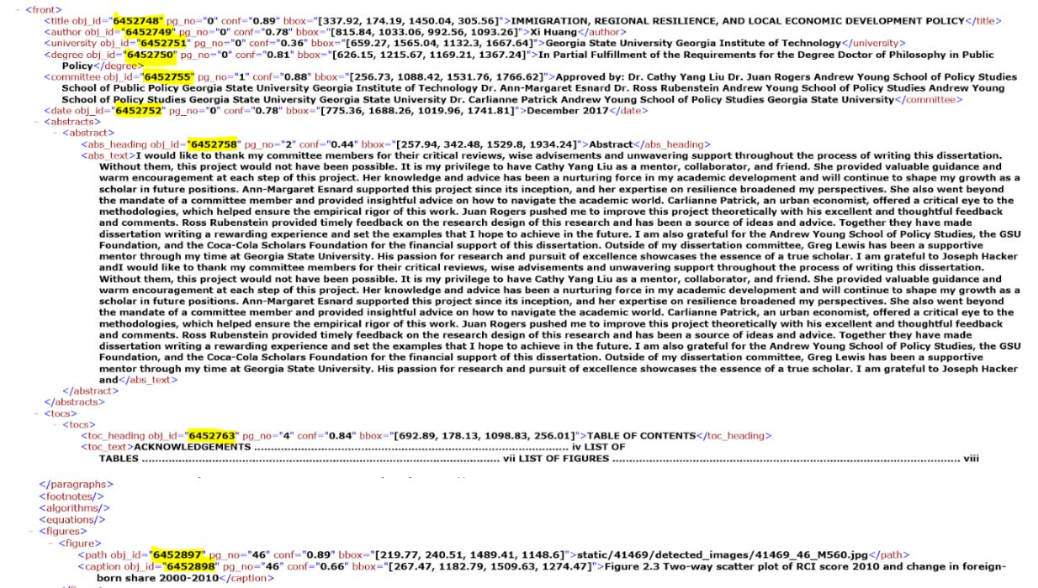
TASKS COMPLETED
XML with object ID

Slide 19
TASKS COMPLETED
API integration

Slide 20
TASKS COMPLETED
Team 3 APIs
Request Method | Description | Request parameters | Database/File System and Response (if any)
GET | Get ETD ID of the PDF file | - | Database Table: etds
GET | GET ETD with ETD ID | - | File System
POST | Save page image (page of PDF) | data = { etds_id = ETD ID, page_no = page number of the page, page_image = .jpg image, } | Table: etd_pages and File System. Responds with pageID
GET | Retrieve page image with pageID | data = { pageID = page ID received after saving the page. } | File System

Slide 21
TASKS COMPLETED
Request Method | Description | Request parameters | Database/File System and Response (if any)
POST | Populate the ETD_metadata table with the ETD metadata extracted | data = { etds_id = ETD ID, title = Title of the ETD, author = Author of the ETD, institution = Institution Name extracted , department = , committee = List of committee members, year = Extracted from the date ETD was published, degree = Degree , degree_level = Degree level, rights = List of Rights (eg:"Open Access", "Attribution required"), keywords = List of keywords extracted from text,, abstract = abstract text, abstract_additions = ["Additional note 1", "Additional note 2"] } | Database Table: ETD metadata

Slide 22
TASKS COMPLETED
Request method | Description | Request Parameters | Database/File System and Response (if any)
POST | Store the detected objects | data = { etd_id = ETD ID of the ETD, object_type = Text category (paragraph, abstract, etc.) or Image category (figure, equation, etc), object_format = Text or Image object_text = Text extracted from text based objects (null if storing image) object_image = .jpg of image-based object (null if storing text) } | Database Table: objects and File System. Responds with objectID
POST | Store the generated XML file | data = { File = .xml file generated for the ETD etds_id = ETD ID landing = provide landing/url } | Filesystem

Slide 23
TASKS COMPLETED
Image generation for 450,000 ETDs, turning each page into an image.

Slide 24
FUTURE OBJECTIVES
Improve the object detection model and experiment with models such as YOLO v8.
Running object detection algorithm on the images generated by the image generation algorithm for the 500,000 ETDs.
Improve the object detection pipeline to use Kafka so it can speedily handle batches.
Populate both the database and the file system with the extracted data and files generated by passing the ETD through the object detection pipeline using the integrated APIs.

Slide 25
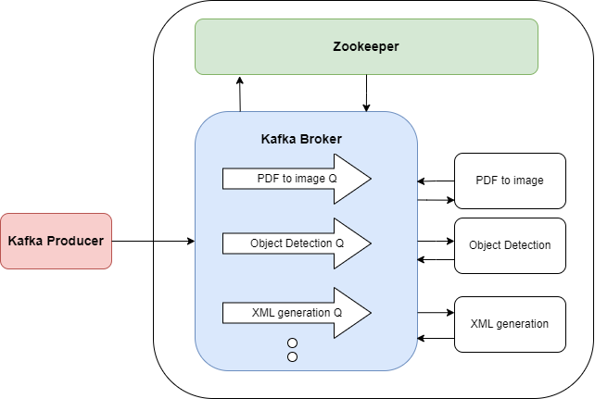
Architecture for bulk processing ETDs

Slide 26
Chapter Segmentation

Slide 27
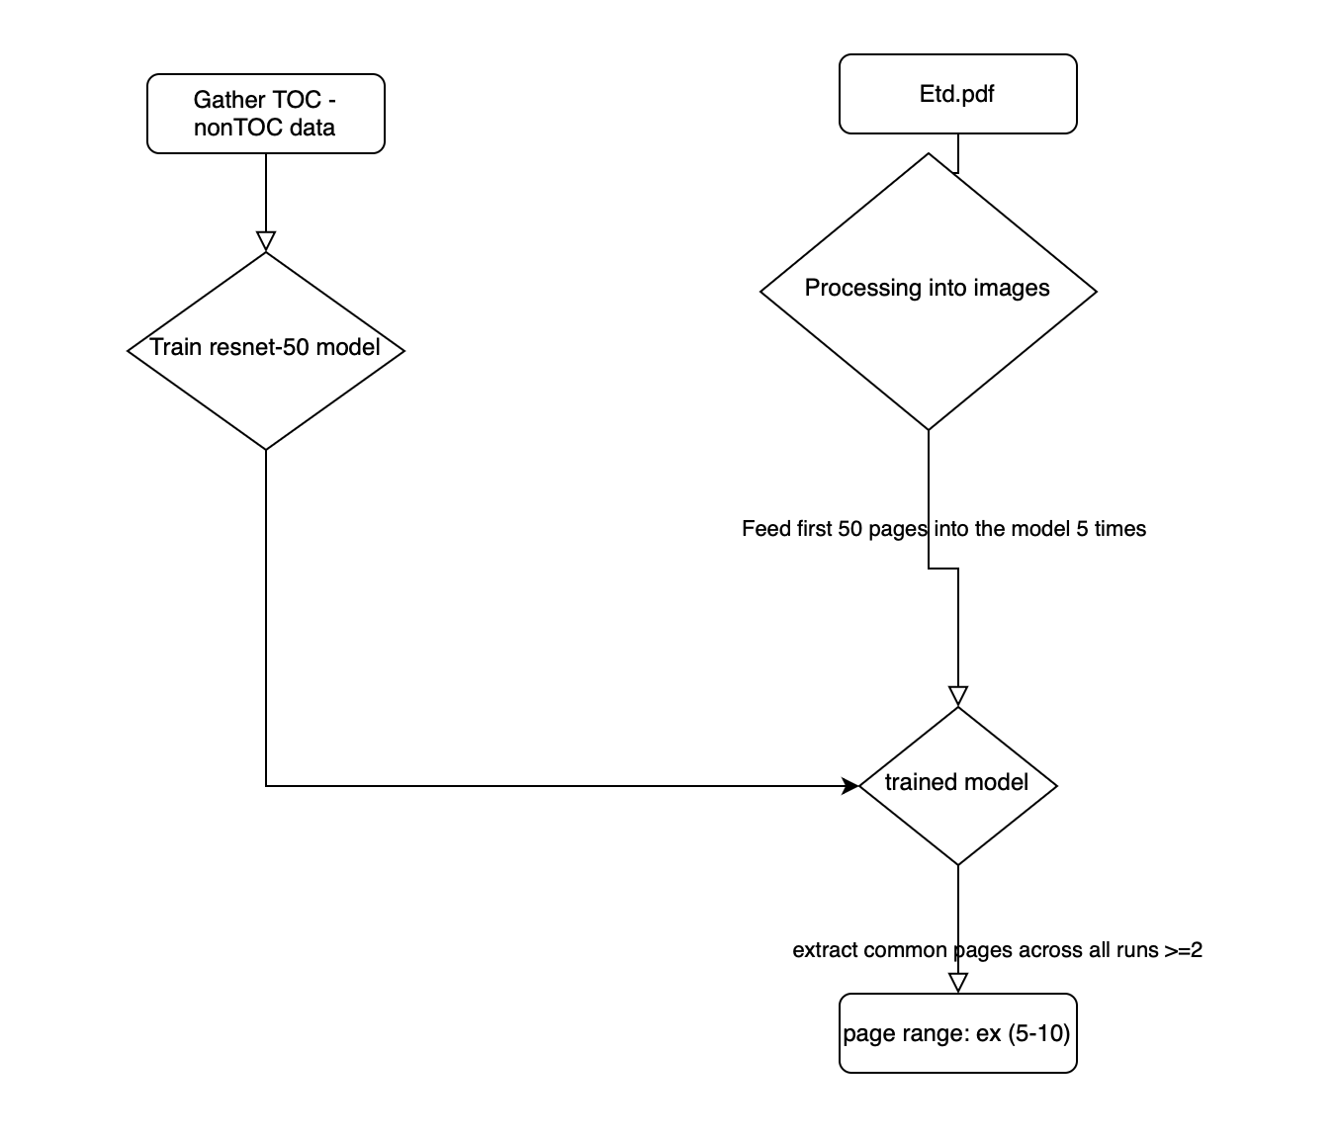
METHODOLOGY: EXTRACTING TOC PAGES

Slide 28
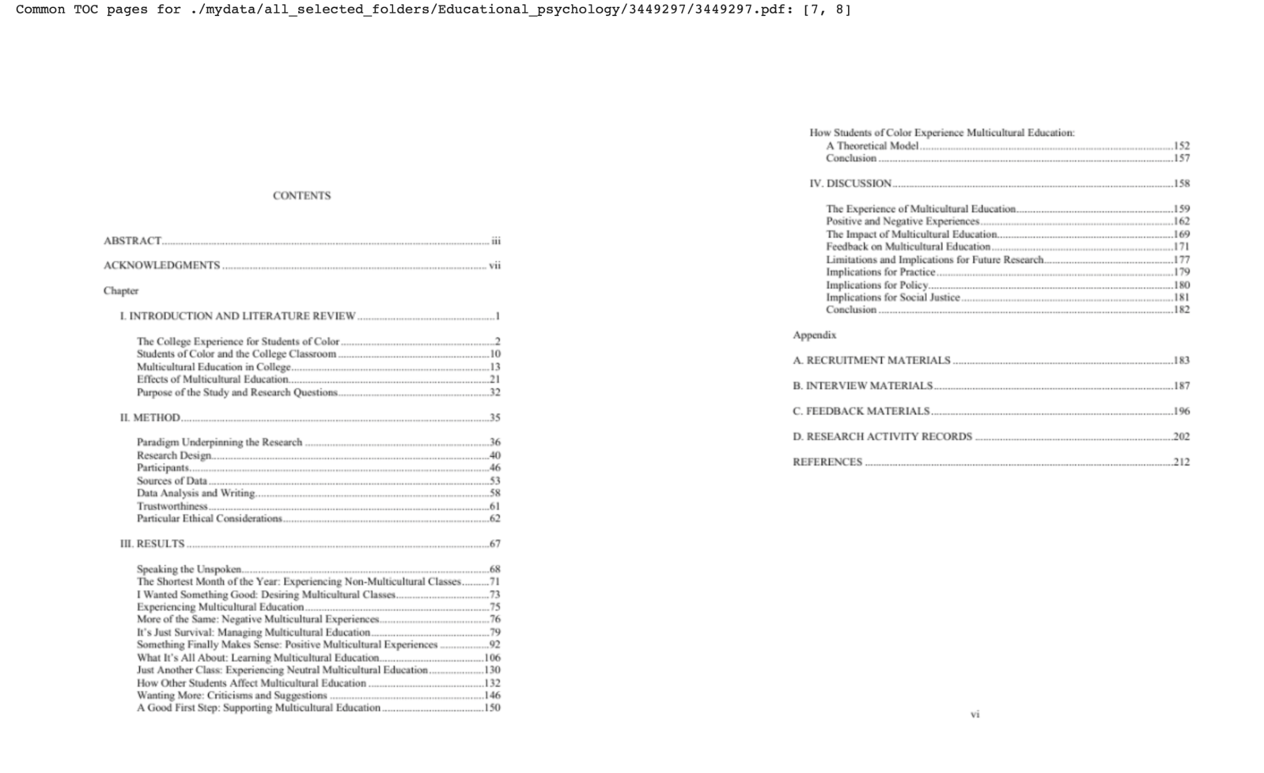
METHODOLOGY: EXTRACTING TOC PAGES

Slide 29
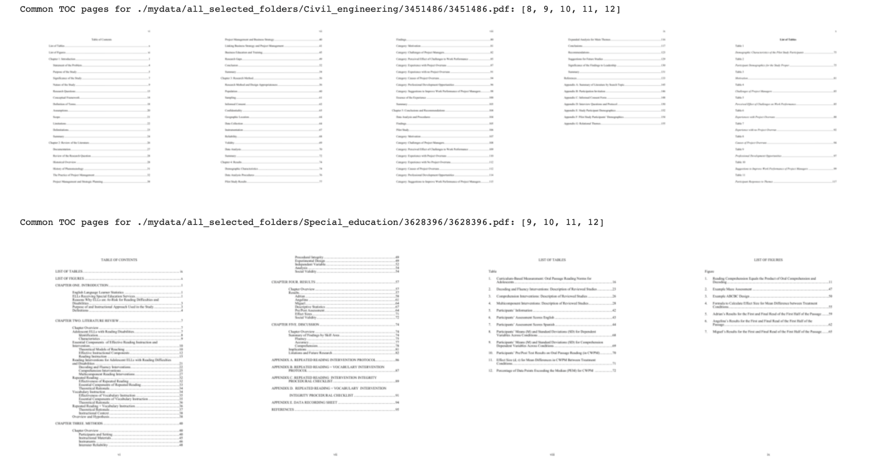
METHODOLOGY: EXTRACTING TOC PAGES

Slide 30
METHODOLOGY: LLM APPOACH
Parse each of the table of contents pages by blocks (the basic parsing unit of most parsing libraries).
Extract lines from blocks.
Construct similarly structured text with similar indentation to the PDF text version.
Pass in a prompt “turn this table of contents page into a hierarchical JSON object that has each chapter title and starting page: [text] ”
Feed the prompt to LLaMA 2 13B model with long context such as the together-api LLaMA 2 model version.

Slide 31
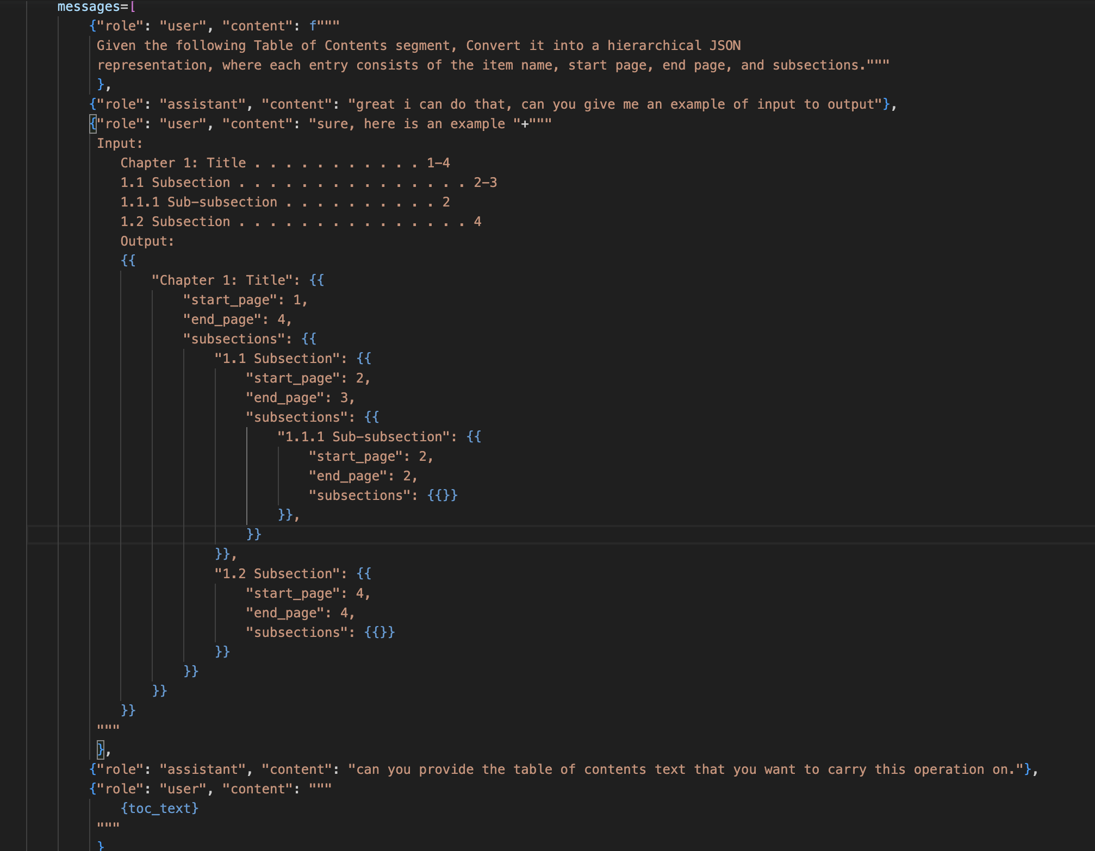
METHODOLOGY: Using ChatGPT

Slide 32
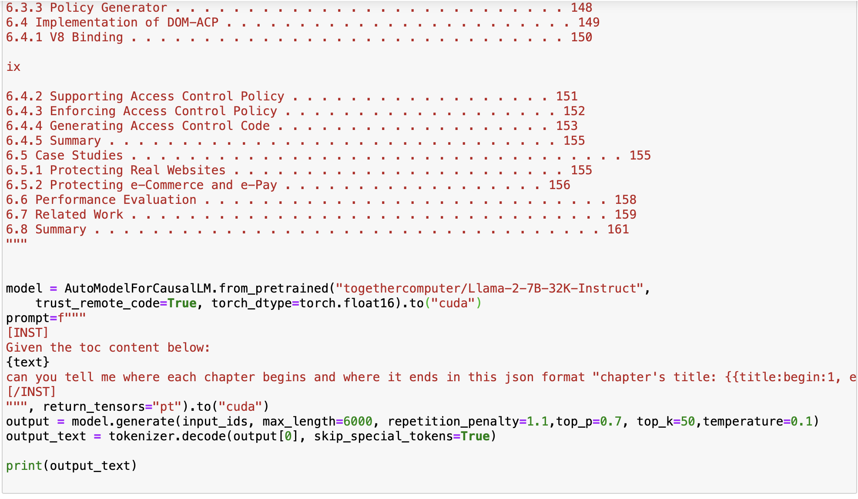
METHODOLOGY: Using LLaMA 2-7b-32k

Slide 33
METHODOLOGY: HEURISTIC APPOACH #1
Parse each of the table of contents pages by blocks (the basic parsing unit of most parsing libraries).
Extract lines from blocks.
Extract spans from lines.
Align all the spans horizontally, keeping track of indentation level to construct functional lines.
Extract page numbers at the end of each line.
Construct JSON object based on the indentation level recursively.

Slide 34
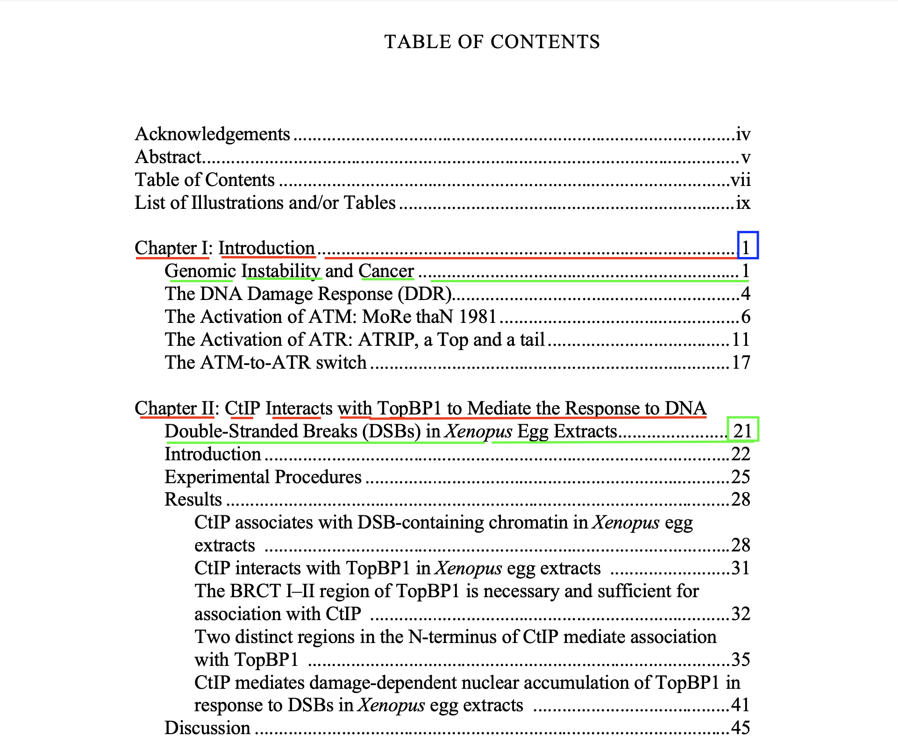
METHODOLOGY: HEURISTIC APPOACH #1

Slide 35
METHODOLOGY: HEURISTIC APPOACH #2
Parse each of the table of contents pages by blocks (the basic parsing unit of most parsing libraries).
Extract lines from blocks.
Extract spans from lines.
Group by clustering column-wise numbers detected from the spans.
Take the right-most column to be the page numbers detected for chapters/subchapters.

Slide 36
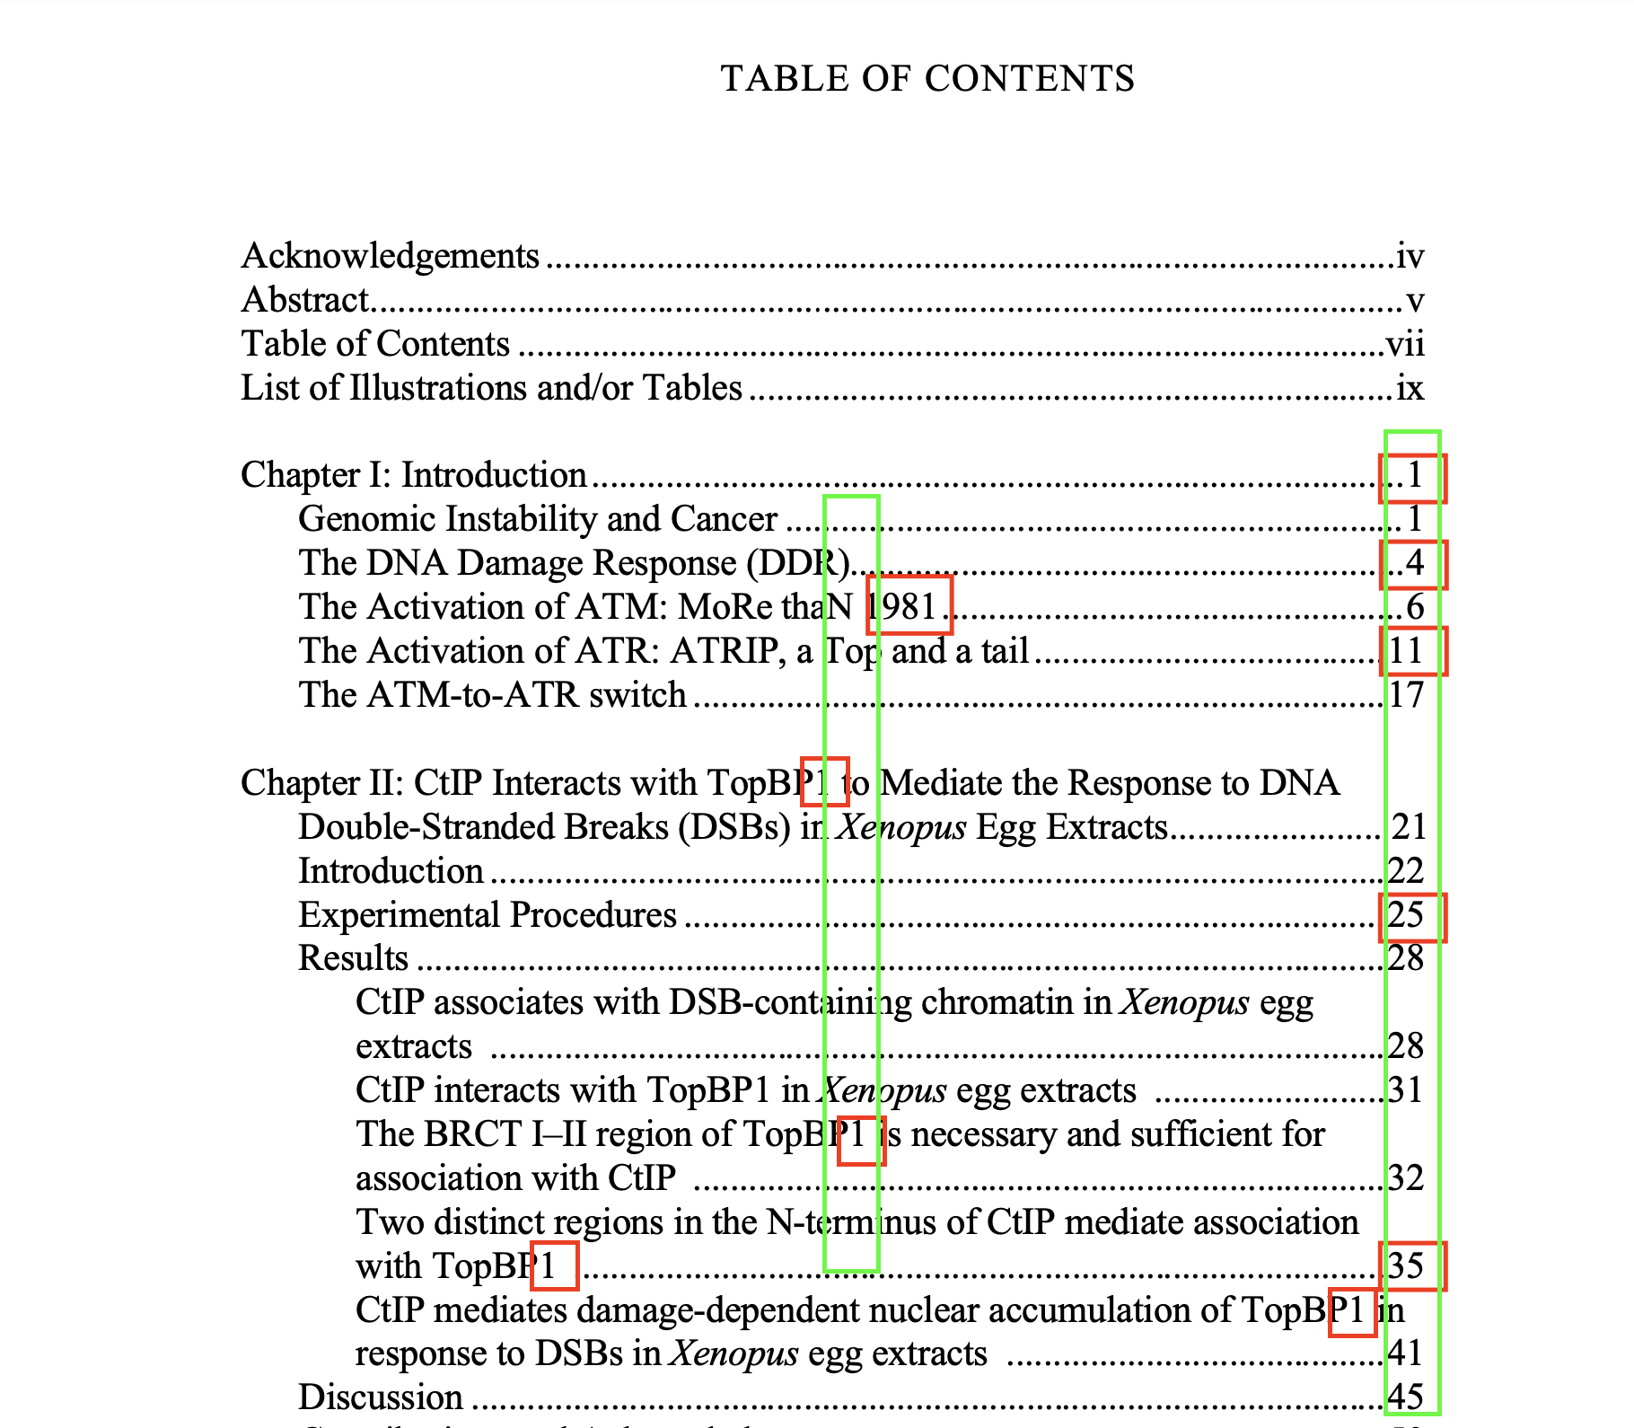
METHODOLOGY: HEURISTIC APPOACH #2

Slide 37
FUTURE WORK
Merge heuristic approach 1, 2 in order to get a hierarchical JSON object.
Run the merged algorithm on both OCR and digital data.
Generate training data for LLaMA 2-7b fine tuning.
Fine tune LLaMA 2-7b to generate JSON object dependently.

Slide 38
Topic Modeling

Slide 39
TASKS COMPLETED
Topic modeling setup in Endeavour.
Topic modeling run on cleaned dataset of ~334k ETDs.
Updated the LDA code to generate JSON, CSV and TSV formats of topic modeling results to be used by Team 2 and Team 6.
Defined the required APIs to populate the database with topic modeling data corresponding to the ETD.

Slide 40
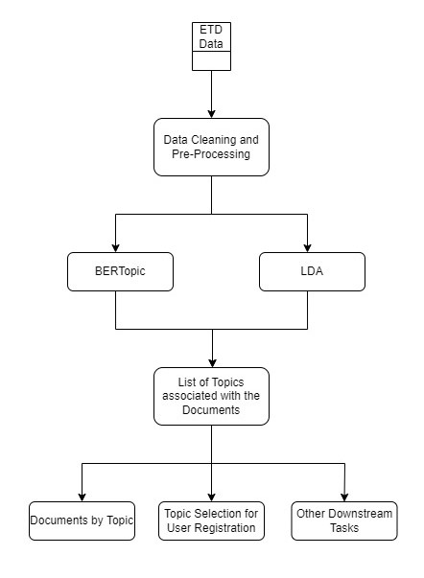

Slide 41
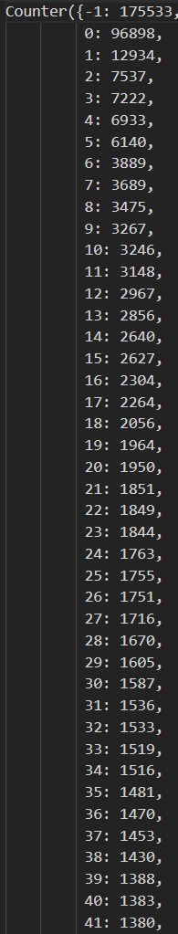
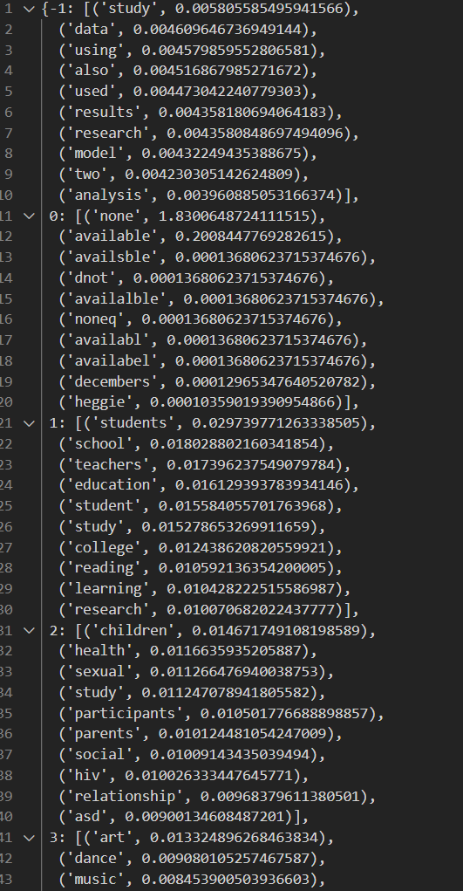
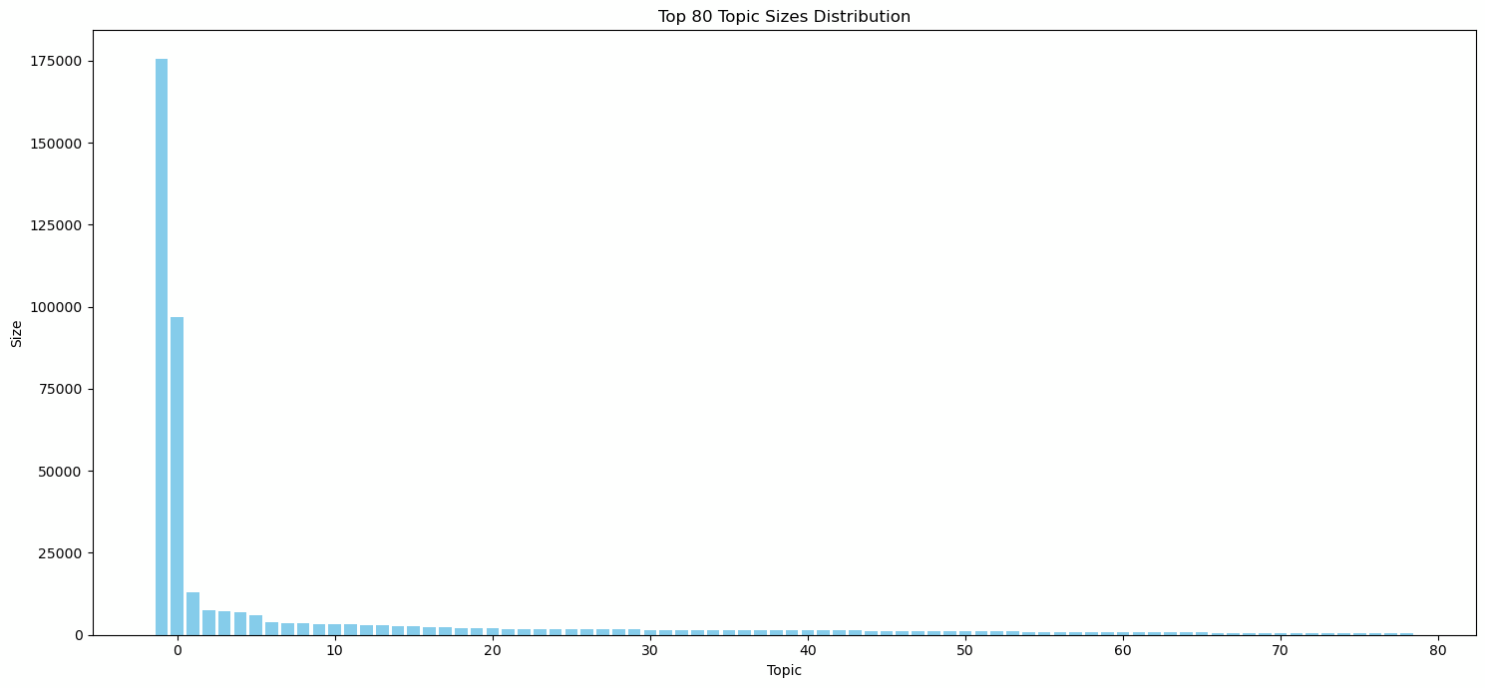
BERTopic
Topic modeling:
BERTopic (Bidirectional Encoder Representations from Transformers) was the topic modeling technique used
100 topics were found among 423589 ETDs.
Each topic is a set of 10 words.
53 topics have more than 1000 ETDs.
Topic 0 has ETDs with incomplete data: 96898 ETDs. .

Slide 42
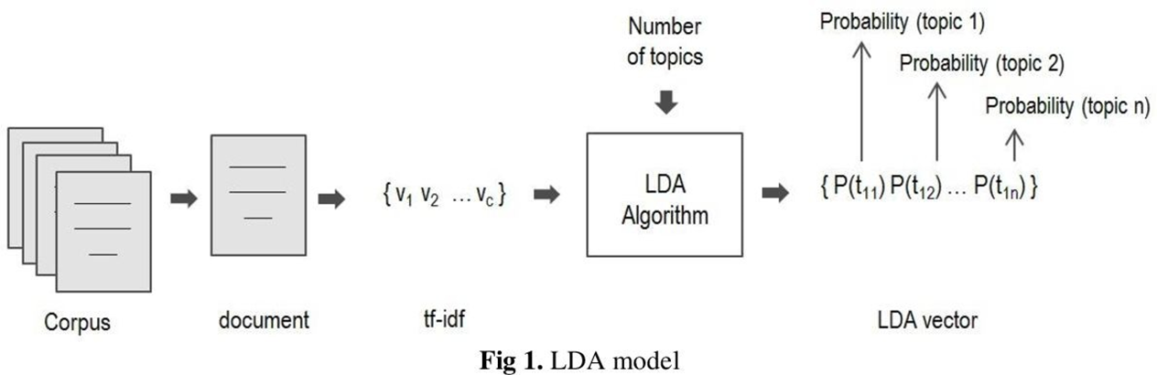
LDA

Slide 43
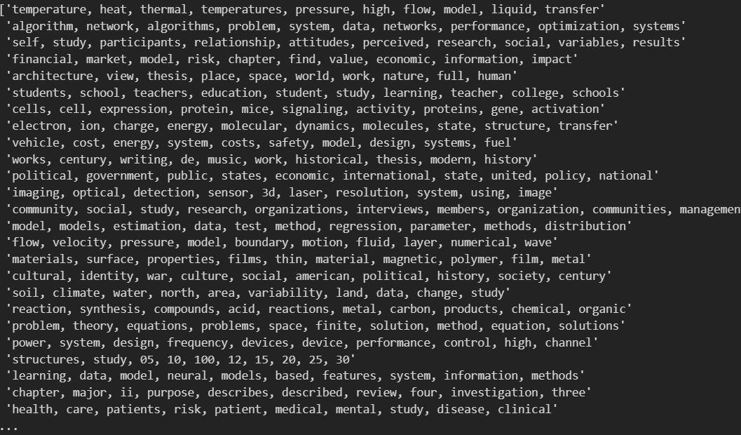
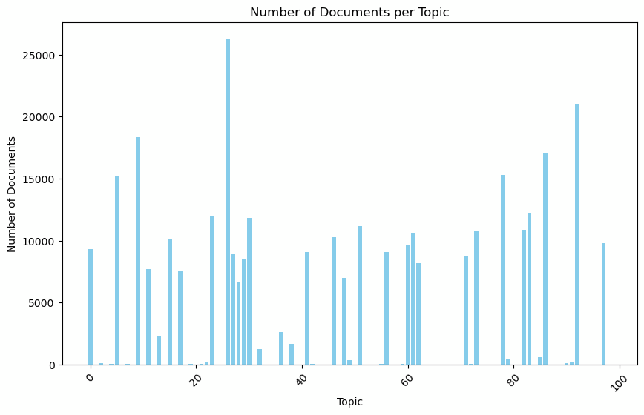
LDA
Topic modeling:
LDA (latent Dirichlet allocation) was the algorithm used.
73 topics were found among ~334k ETDs.
Each topic is a set of 10 keywords.
List of topics passed to team 2 and team 6.

Slide 44
FUTURE WORK
Populate tables using API :
“Add to Topic_models” to add one row for a topic modeler.
“Add to Collection_topics” to store the set of topics from that modeler.
“Add to ETD_topics” to store its topic modeling results for the ETDs.
“Add to Object_topics” to store the topic modeling results using the topic model build on the ETD metadata, applied to chapter summaries, which are obtained using the API “Get from Object_summaries”.

Slide 45
FUTURE WORK
Analyze and implement the LDA model on chapter summaries and try to improve results by running more experiments.
Analyze BERTopic results and run experiments to improve the model to get better outputs.
Explore and compare more topic models like ProdLda and NeurLDA with BERTopic and LDA.
Integrating Kafka for Bulk processing ETDs to assign topics.

Slide 46
Thank You!

Slide 47

Large Image

