Slide 1
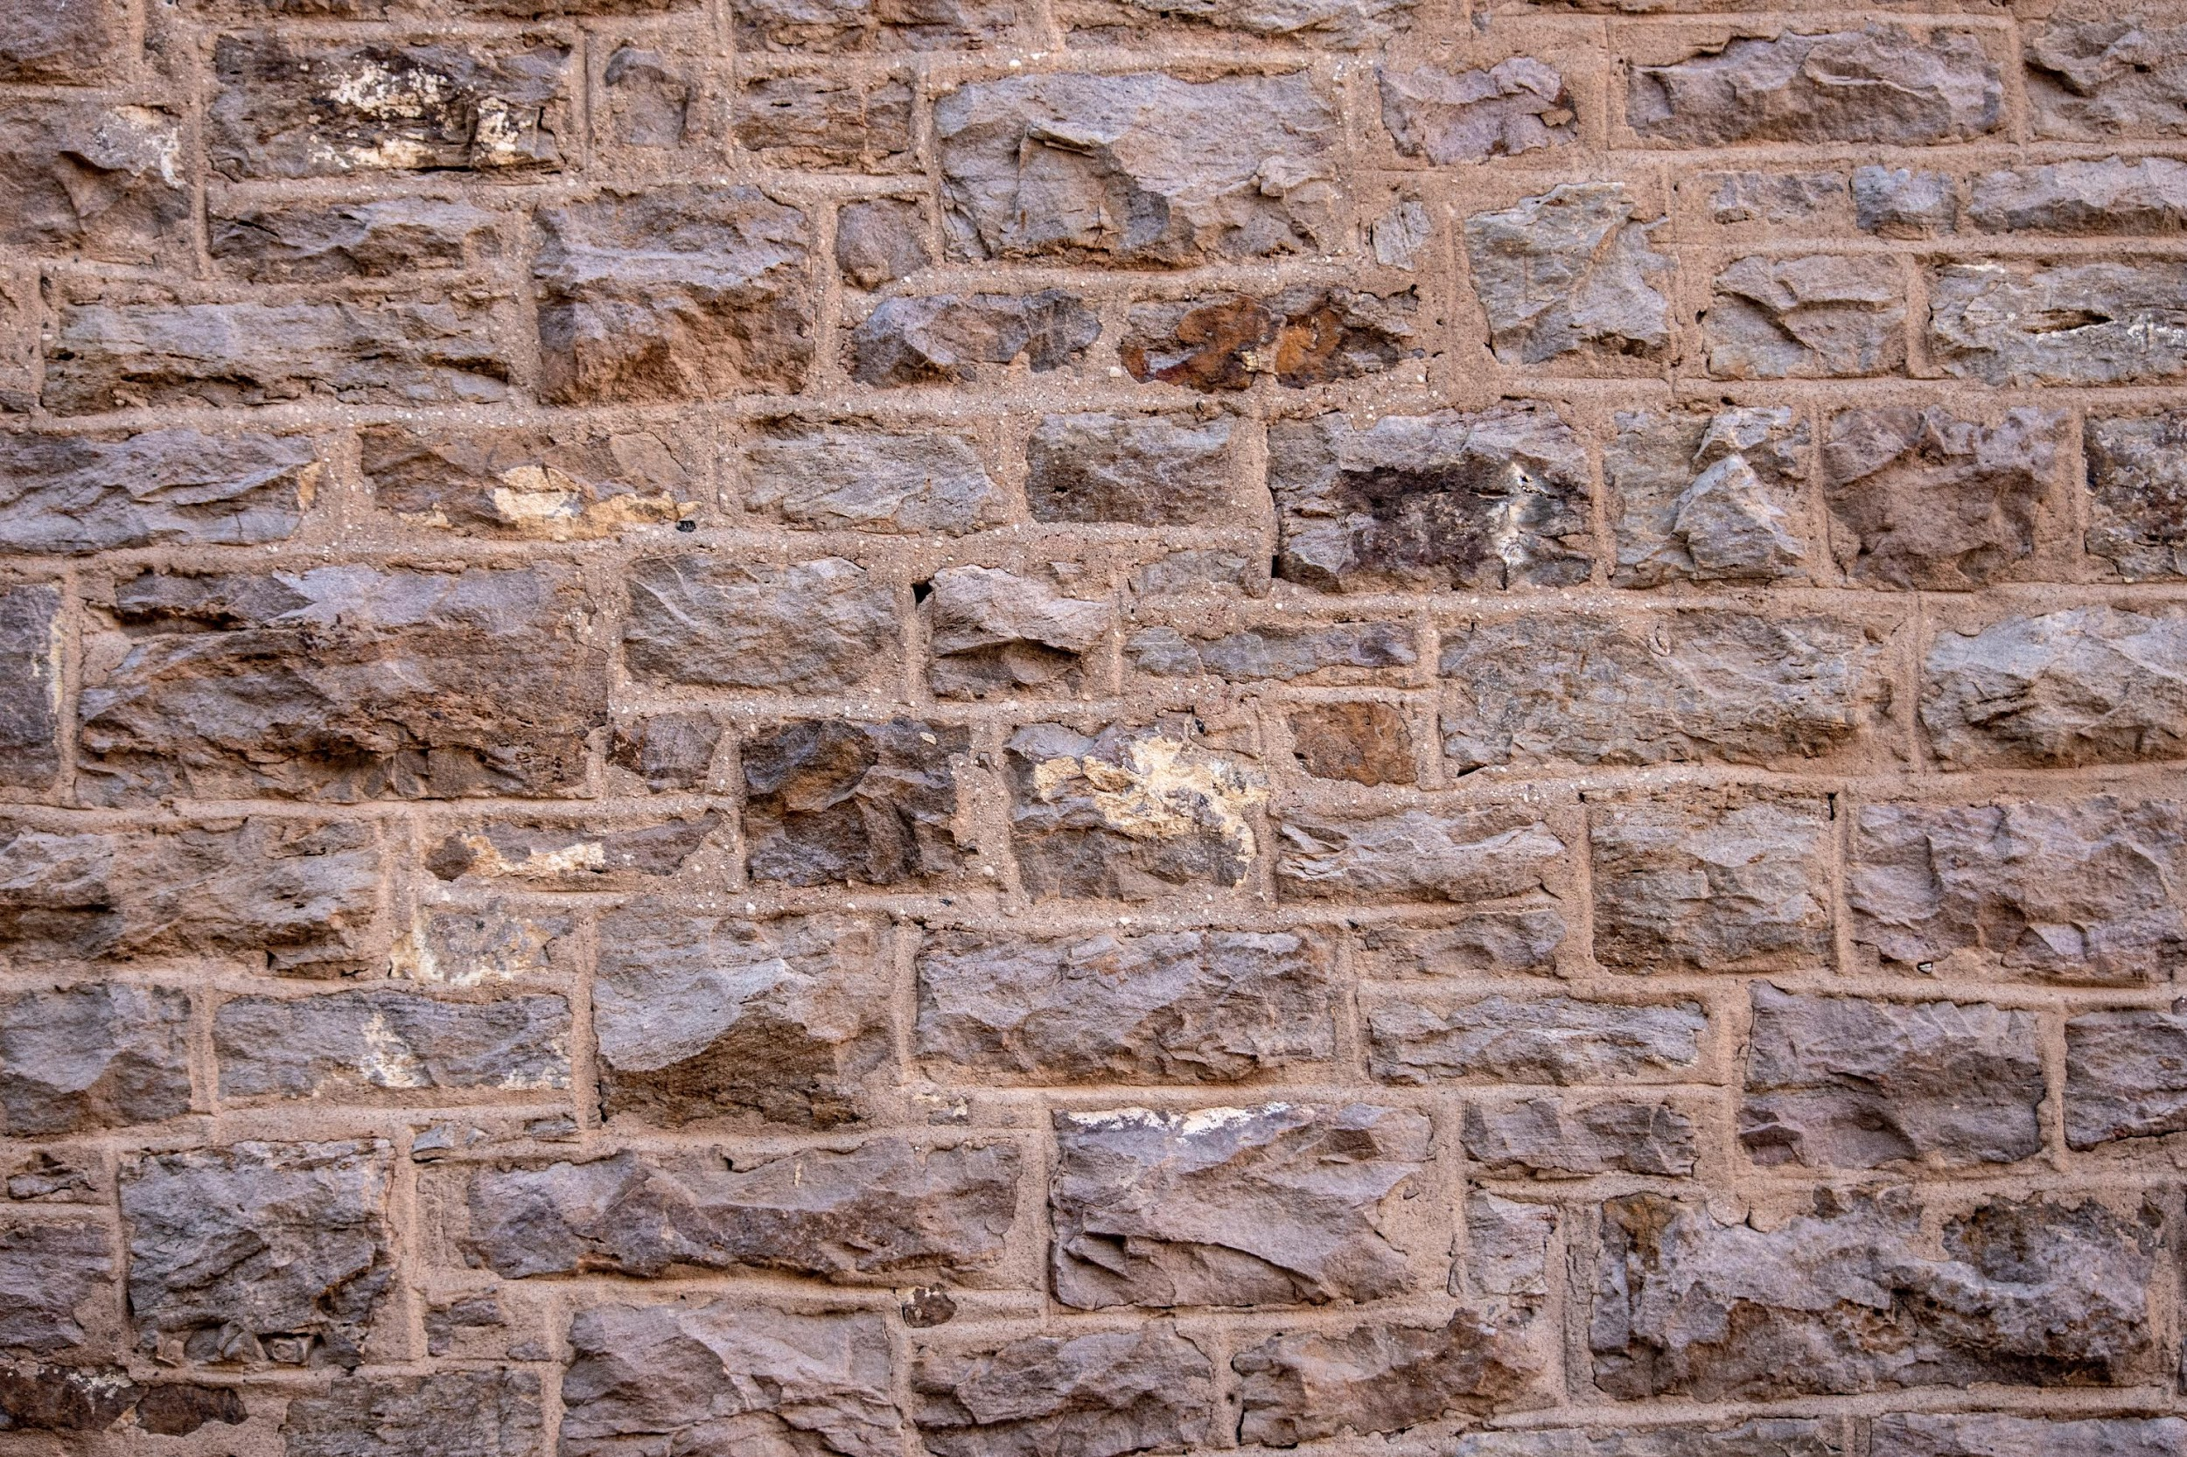

Strategic Management
External Analysis
Case: Hotel Industry
Unless otherwise noted, this slide deck is (c) Virginia Polytechnic Institute and State University. It is released under a Creative Commons Attribution NonCommercial ShareAlike 3.0 license (CC BY NC-SA 3.0)
Instructor Name | Name of Institution
http://hdl.handle.net/10919/102735
Photo by Jon Sailer on Unsplash

Slide 2
The Hotel Industry
Review the following focus questions
http://hdl.handle.net/10919/102735

Slide 3
PESTEL – First…What Industry are we in?
1. Conduct a PESTEL analysis of the Hotel industry. Following your analysis, list the top three factors causing change (positive or negative) using the PESTEL framework.
Factor 1:
Factor 2:
Factor 3:
http://hdl.handle.net/10919/102735

Slide 4
Porter’s 5 Forces
2. Conduct a five forces analysis placing hotels as the rivals. Identify the players, the factors that drive the strength of each force and the strength of each force:
Rivalry:
Threat of Entry:
Suppliers:
Buyers:
Substitutes:
http://hdl.handle.net/10919/102735

Slide 5
External Analysis
3. How are your top 3 factors impacting the five forces model—either negatively or positively?
4. Which of the five competitive forces is strongest? Which is weakest? What competitive forces seem to have the greatest effect on industry attractiveness and the potential profitability of new entrants?
http://hdl.handle.net/10919/102735

Slide 6
Strategic Group Map
What does your strategic group map of the hotel industry look like? Which strategic groups do you think are in the best positions? The worst positions?
High
$ Price On Board
Low
Low ???? High
http://hdl.handle.net/10919/102735

Slide 7
Conclusions and Recommendations
6. What key factors may determine the success of a start-up hotel?
7. What recommendations would you make to a smaller, start-up hotel company to improve its competitiveness in the market while mitigating any current and future risks?
http://hdl.handle.net/10919/102735

