Slide 1

Poison Ivy Appalachian Trail
Mega-Transect Data Collection Application
Presenters:
Anthony Barbee
Qi Bing
Alisher Pazylbekov
Nathan Rosa
Virginia Polytechnic Institute and State University, Blacksburg, VA, 24061
CS 4624
April 28, 2016

Slide 2
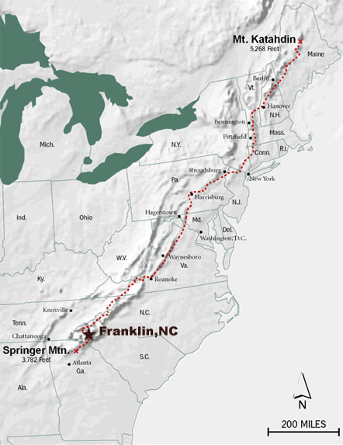
Purpose/ Background
Client: Dr. John G. Jelesko
Research program to study molecular biology and the evolution of plant metabolism
Record current poison ivy trends along the AT
Notes:
His research program seeks to understand the molecular biology and evolution of plant metabolism responsible for making valuable chemicals.
In recent years, there has been a higher demand for chemical feed stocks to supply the manufacturing of economically important medicines and materials due to a decline in synthetic reserves
“Identification of Poison Ivy Urushiol Biosynthetic Genes Using RNAseq” - aimed at developing informatic resources enabling the identification of urushiol biosynthetic genes
Urushiol is the oily allergen found in poison ivy that causes the reaction of a skin rash in some individuals

Slide 3
Requirements
Android application (stored on external SD)
Record GPS coordinates, growth habit, and plant id
Sync to remote database when reconnected
External Controller (e.g., headphones)
Documented and available code
Tutorials

Slide 4
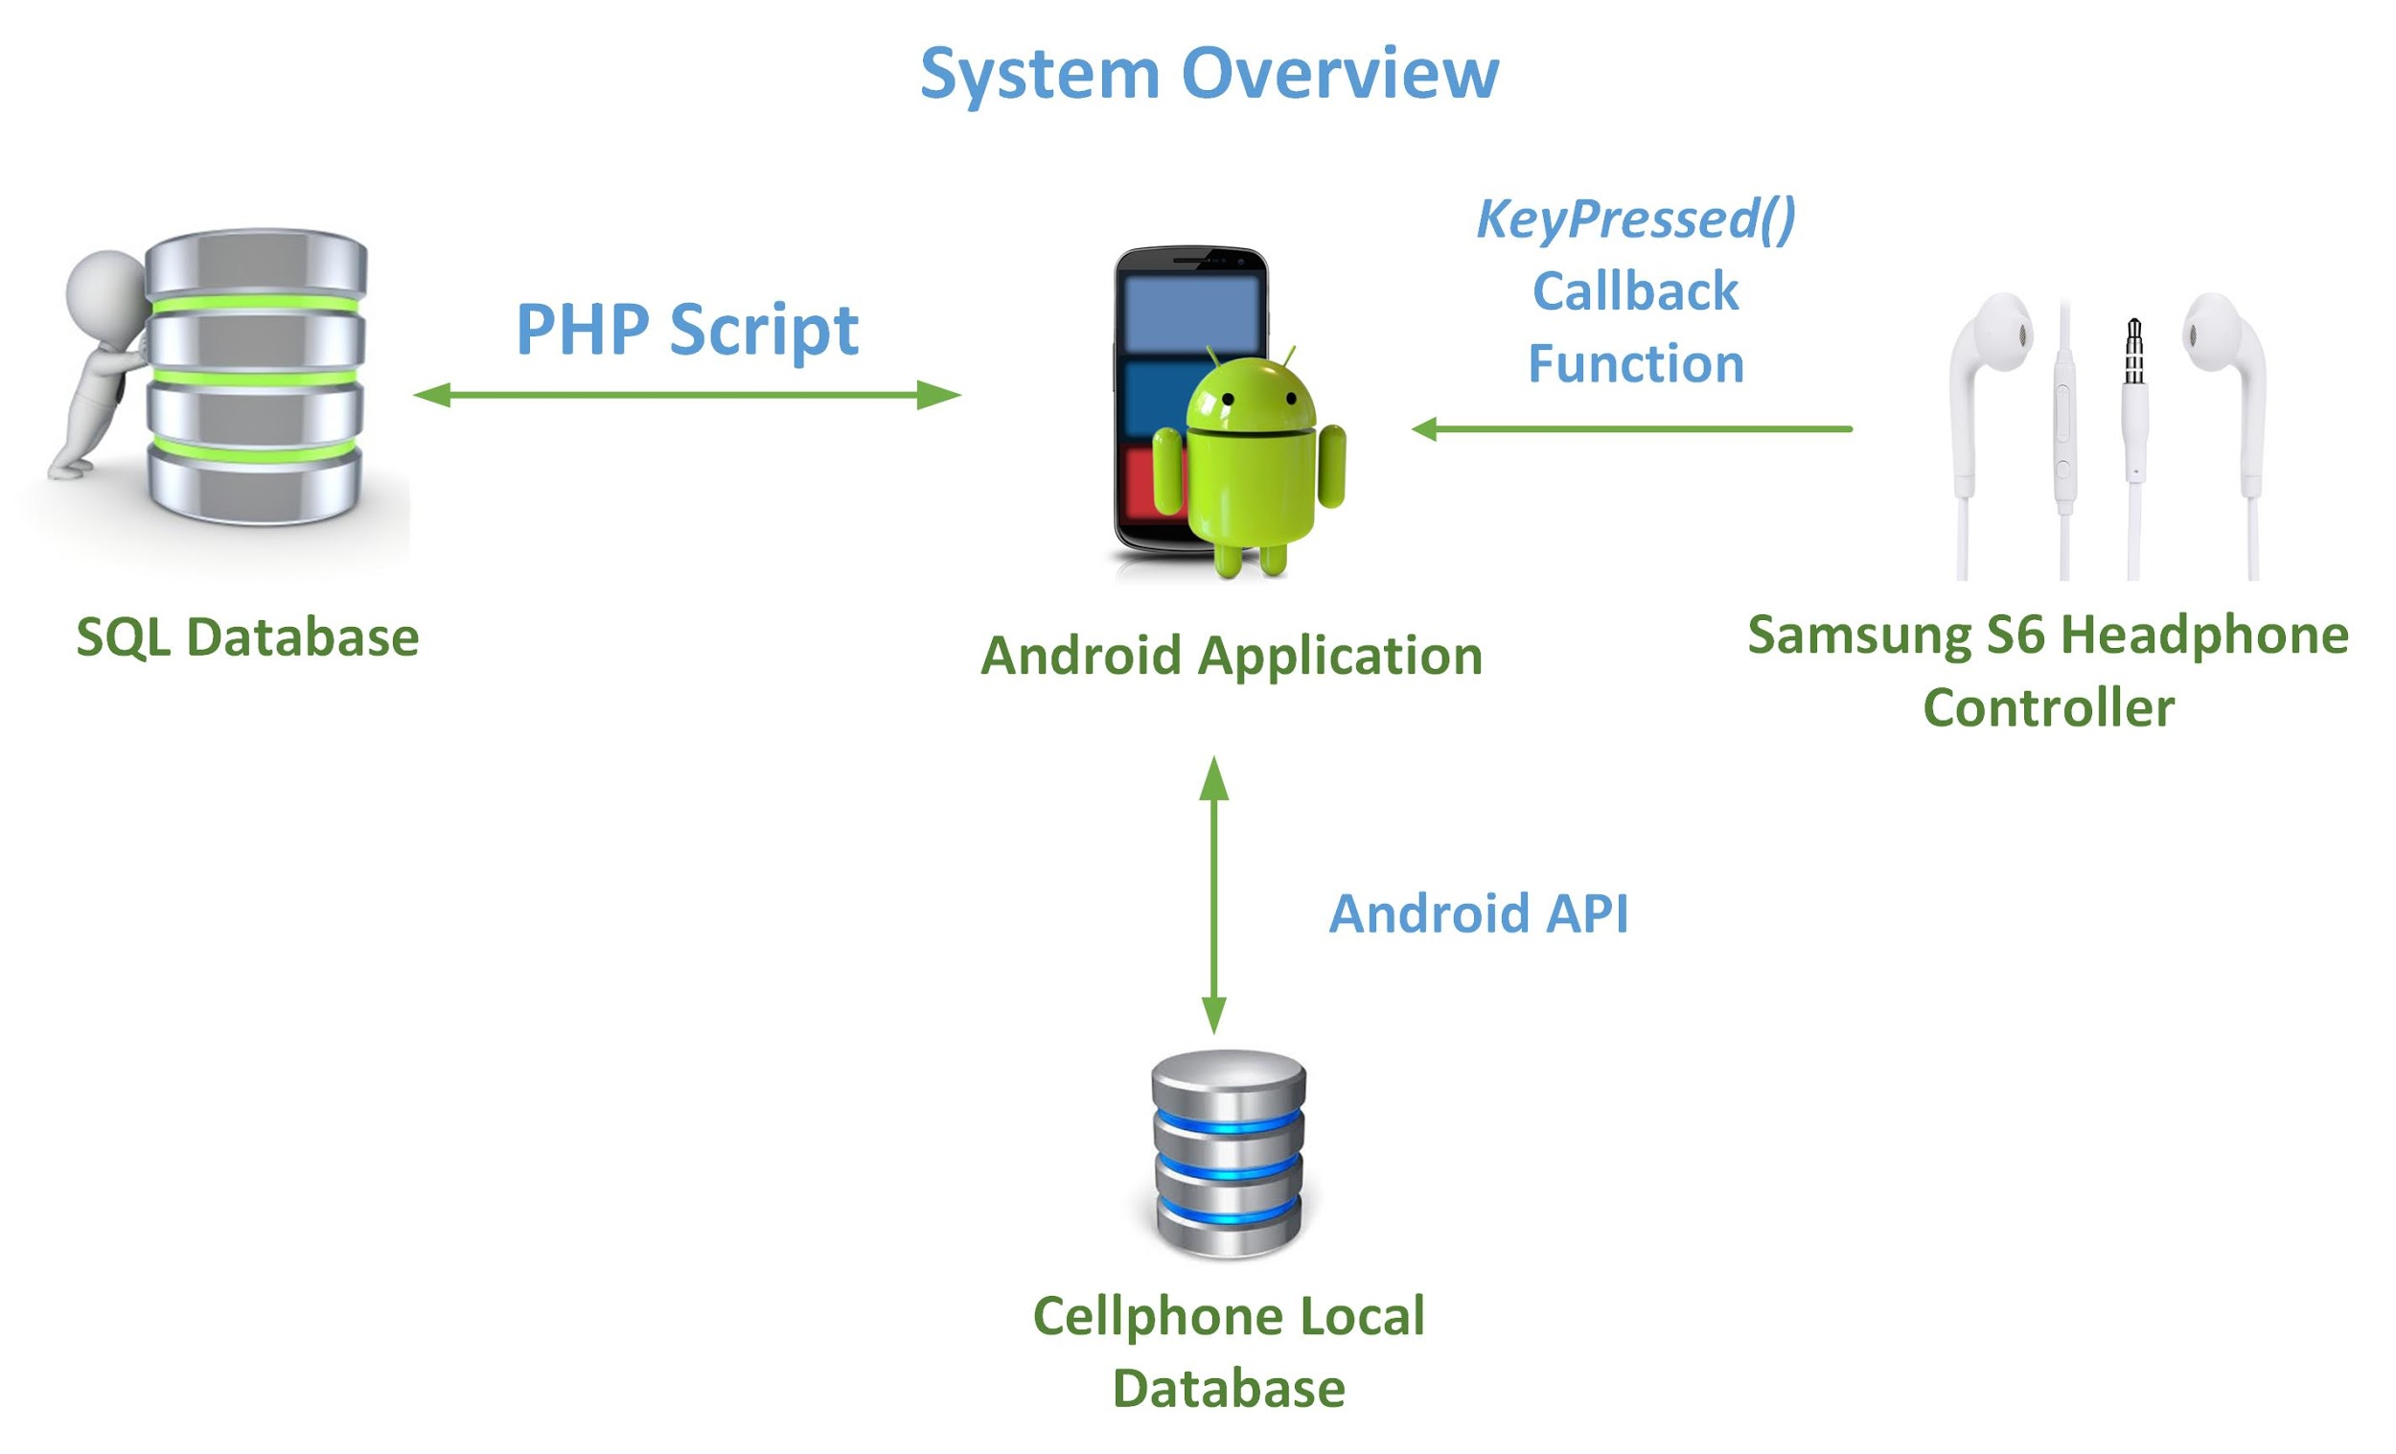
Application Overview

Slide 5
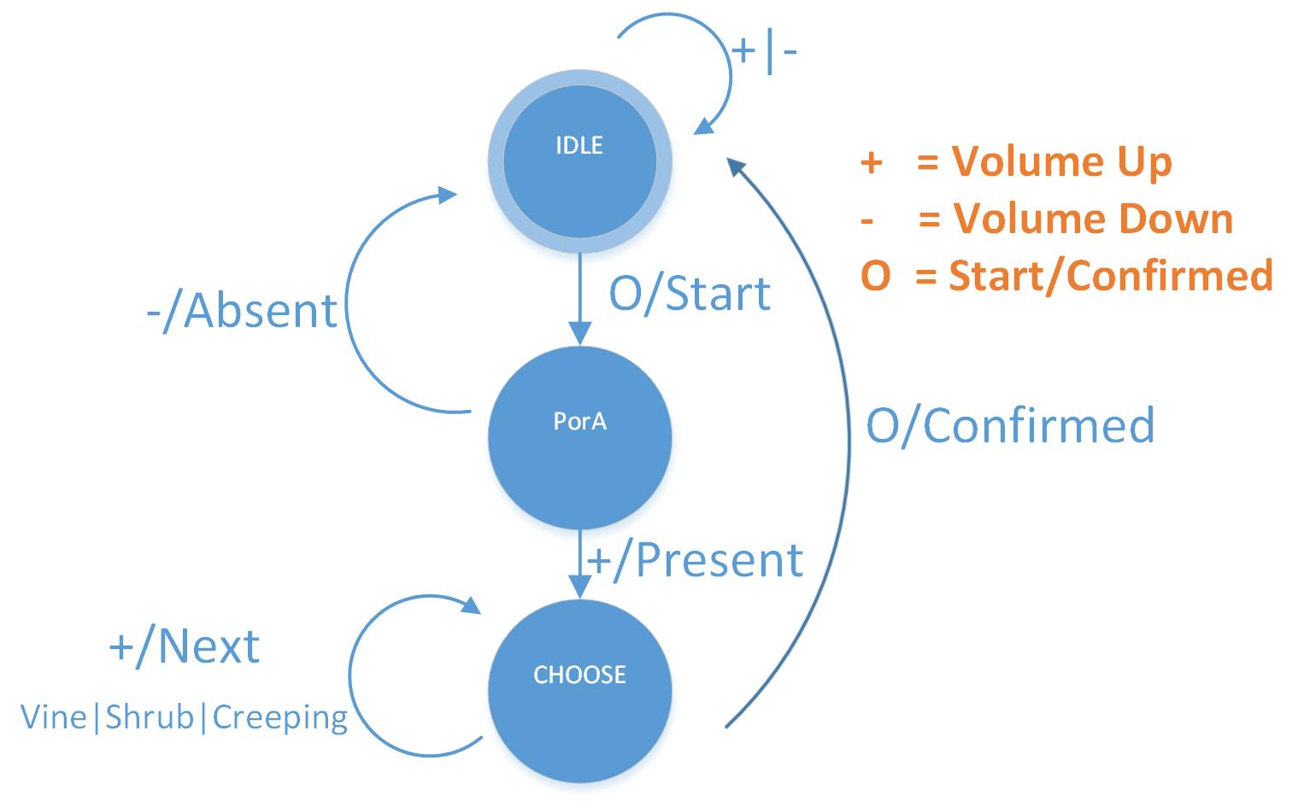

External Hardware

Slide 6
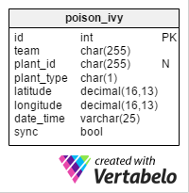
Databases
Local (SQLite)
Server (MySQL and PHP)

Slide 7
Problems Faced and Lessons Learned
Problems | Solutions/Lessons Learned
Connectivity | GPS connectivity dependent on service provider
GPS Location Service | Choose best known location or last known
External Headphone to Software Connection | Make best use of build-in functions
VT Server Configuration | Just because it work on one system it won’t always work on another
Pronunciation | It’s pronounced “Appa-LATCH-uh”
External SD Card Migration | Manually move the PIAT app to SD card

Slide 8
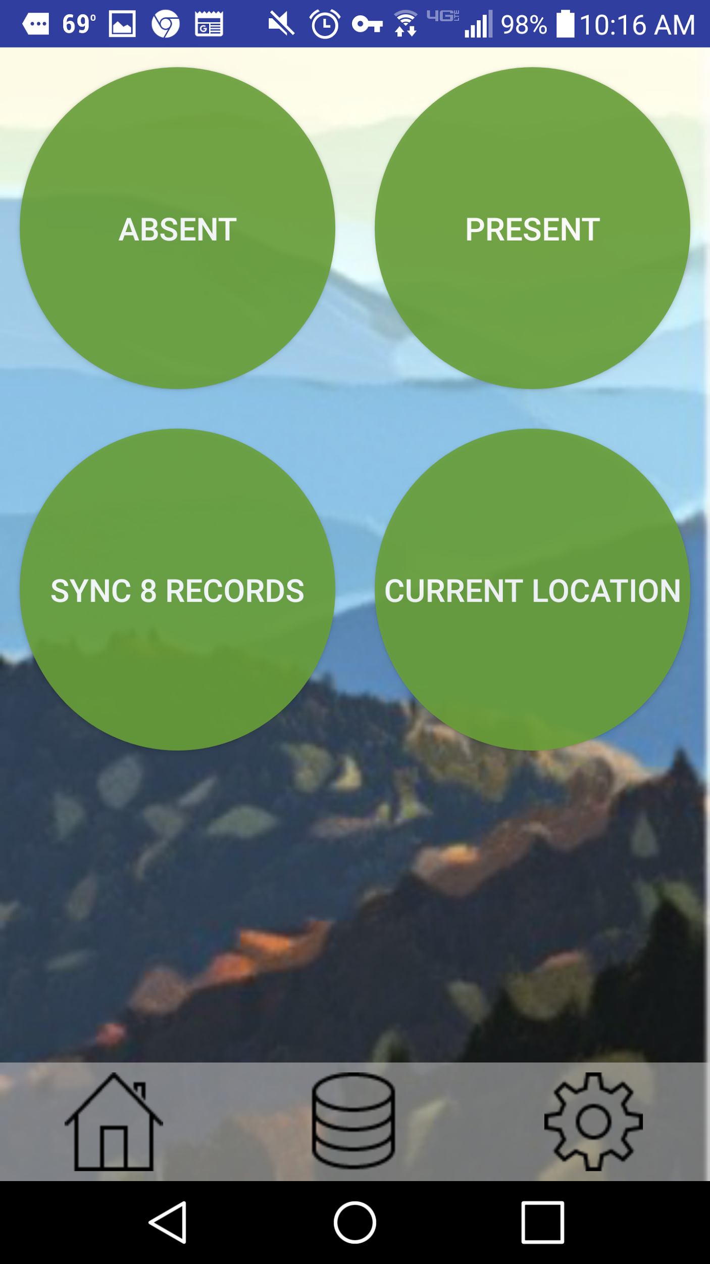
Demo

Slide 9



The home button brings you to the homepage
The local database button displays in a table format the current records and their respective properties.
The settings button displays the input fields for the user to input their respective teams, MySQL username, and password.

Slide 10
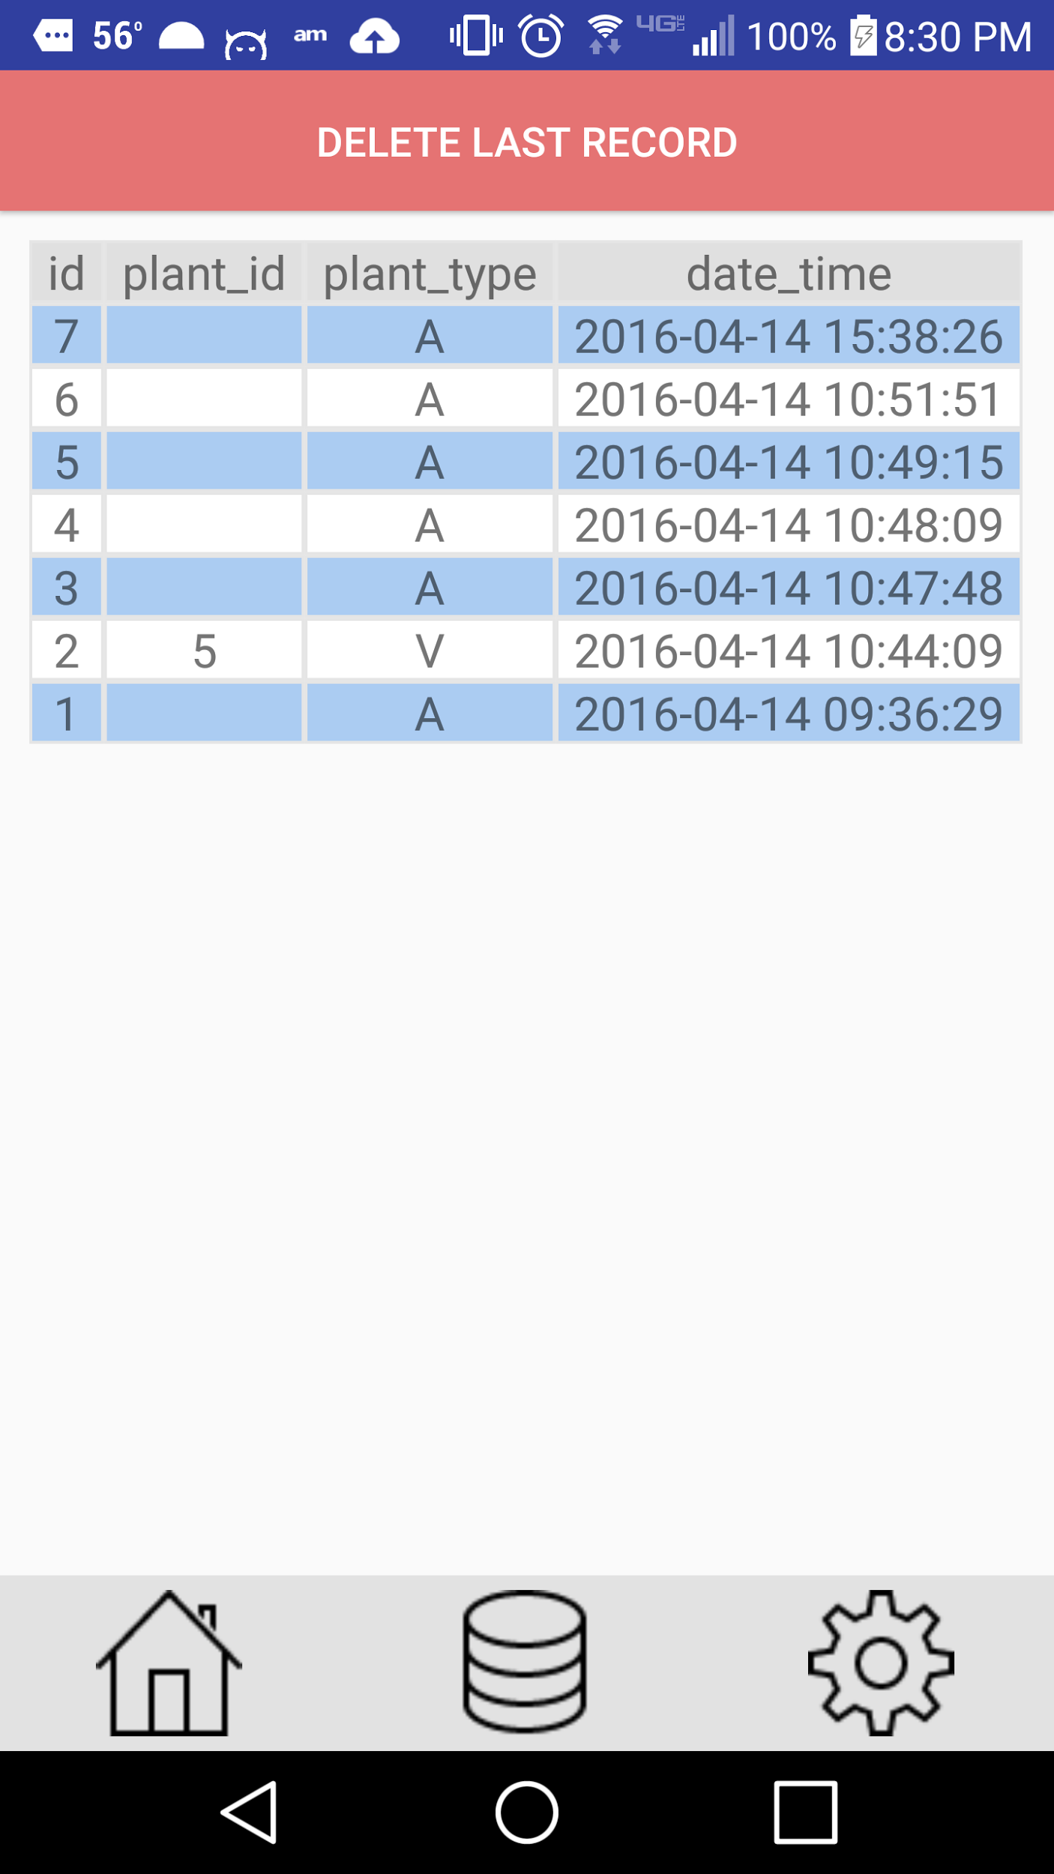
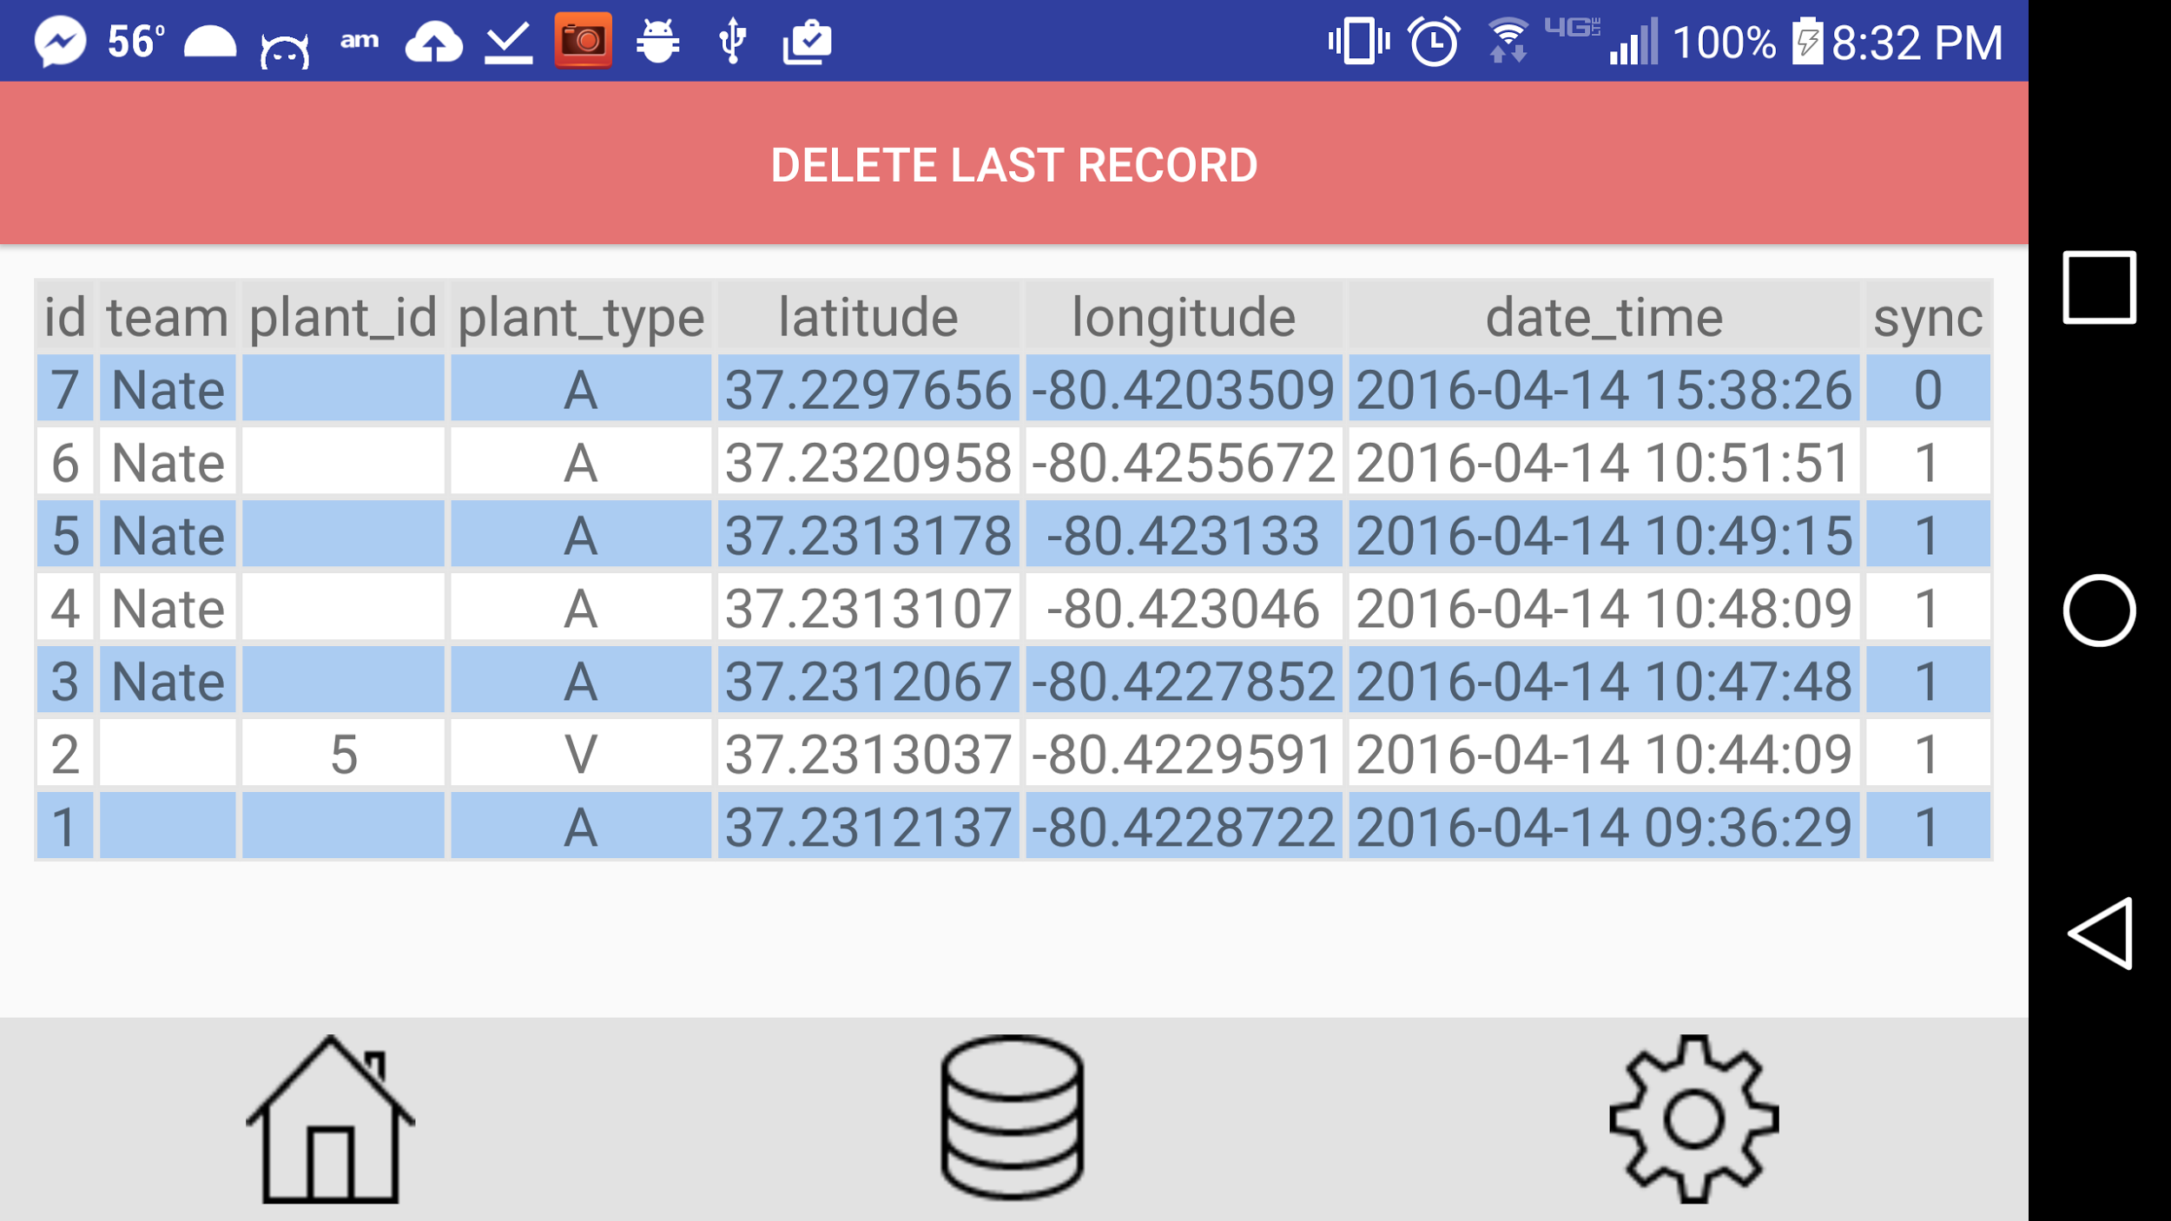

Slide 11
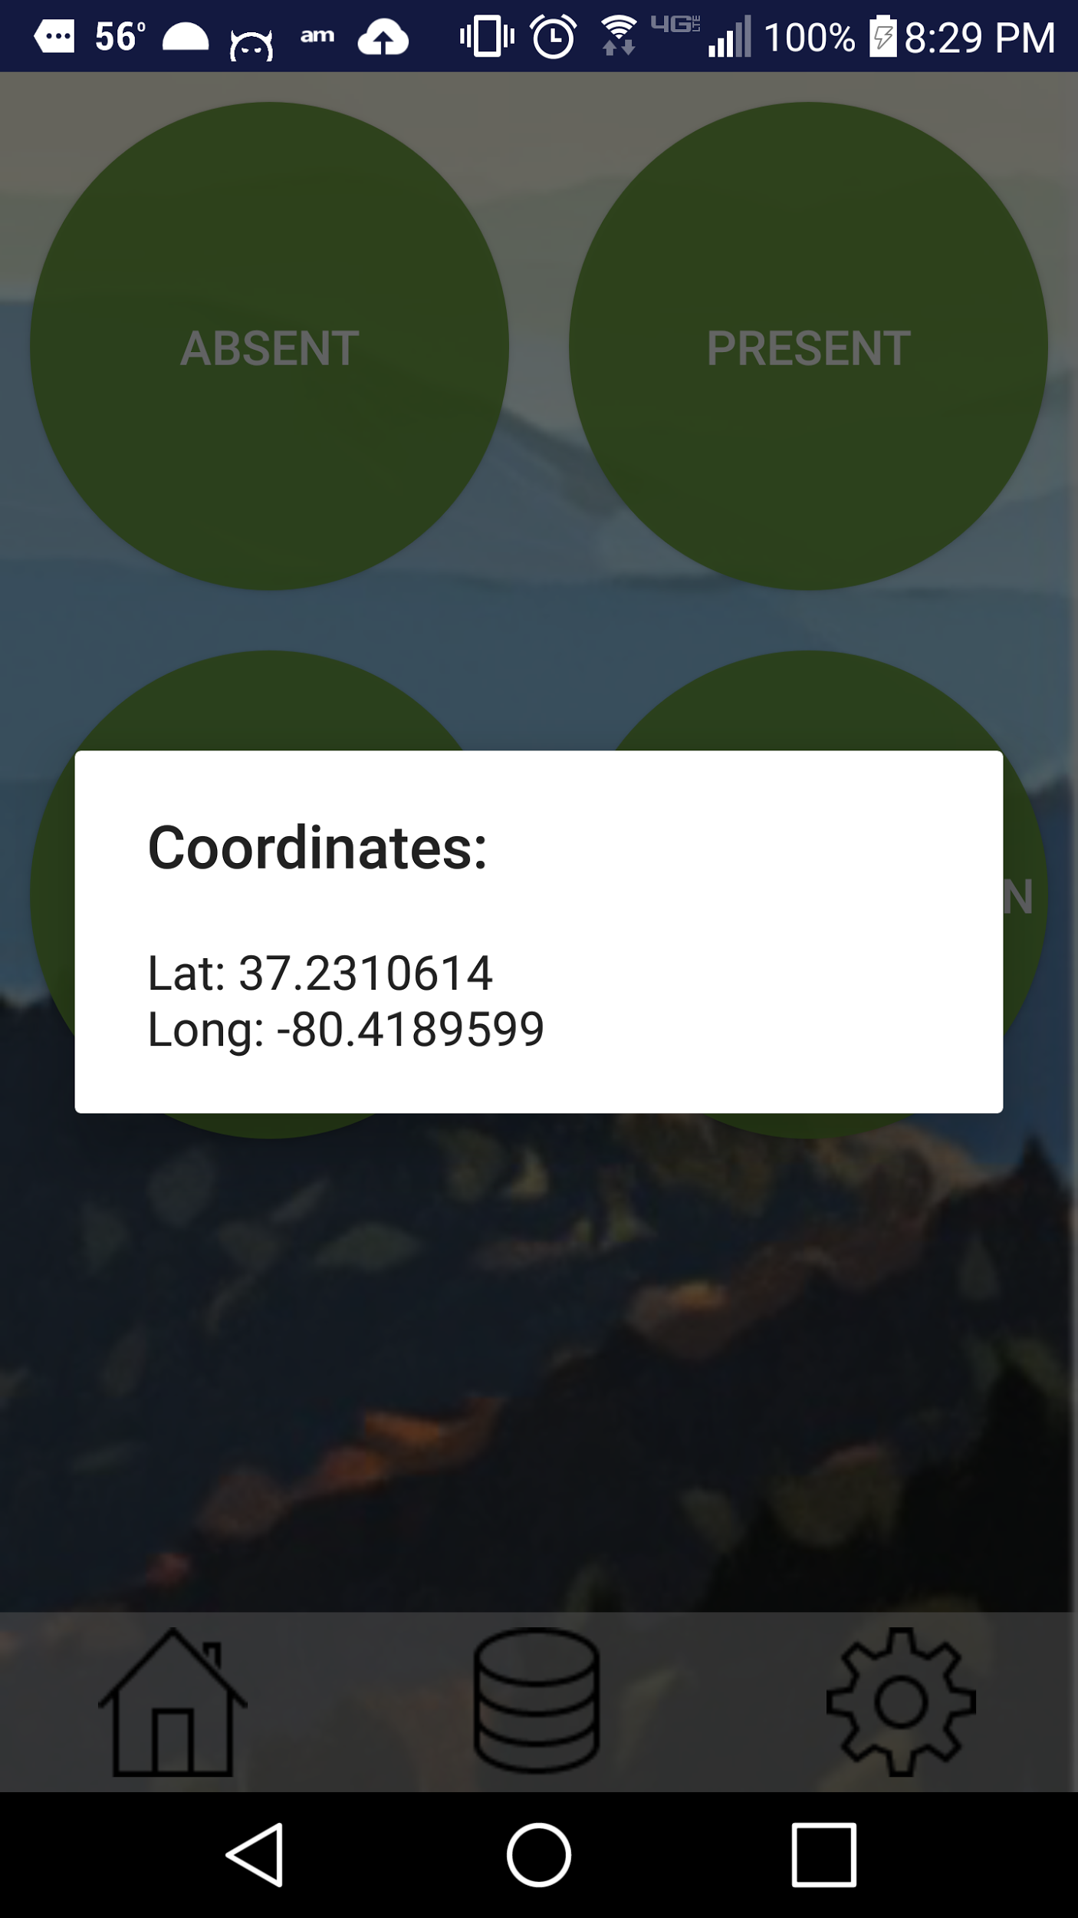
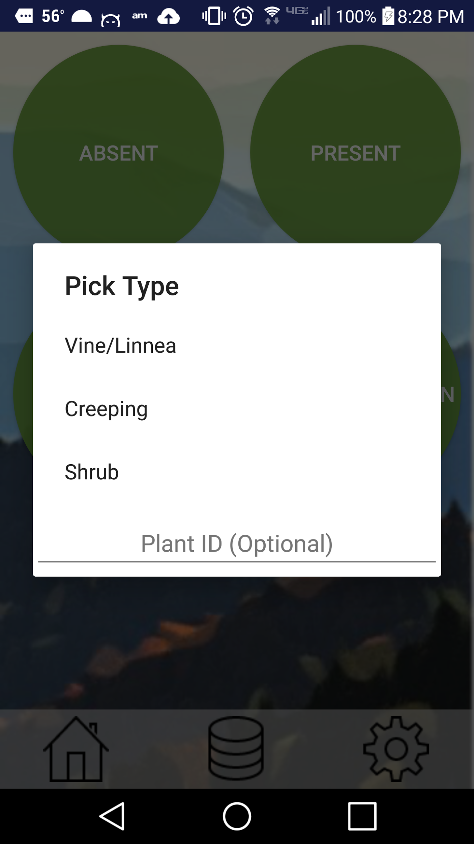

Slide 12
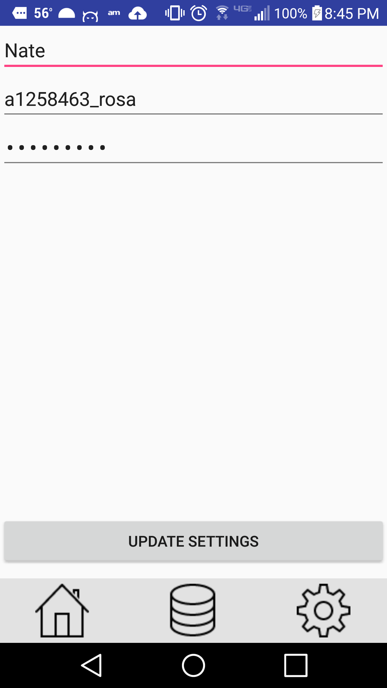

Slide 13
QUESTIONS?

