Slide 1
WildLife Tracker App
Ziwei (James) Kou, Boshen Zhang, Muyang Wang, Kevin Zhang
CS 4624 - Multimedia, Hypertext, and Information Access
Professor Edward Fox
Virginia Tech, Blacksburg VA 24061
11.30.21

Slide 2
Presentation Outline
Project Overview
Timeline
Deliverables
  iOS App
  Website
  Report
Testing
Ideas for future
Lessons learned
Acknowledgement
Notes:
Project Overview - James
Timeline - James
Deliverables
iOS App - Boshen
Website - Muyang
Report - James
Testing - Kevin
Ideas for future - Boshen and Muyang
Lessons learned - Kevin
Acknowledgement - Kevin

Slide 3
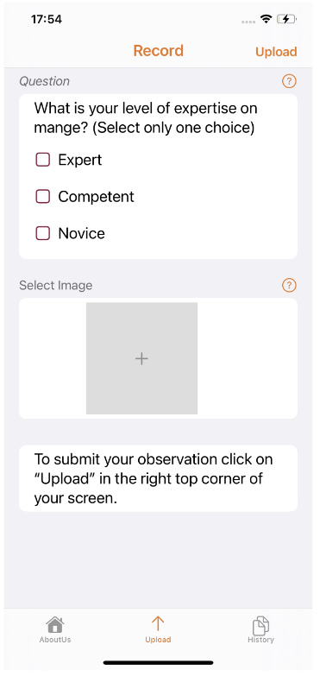
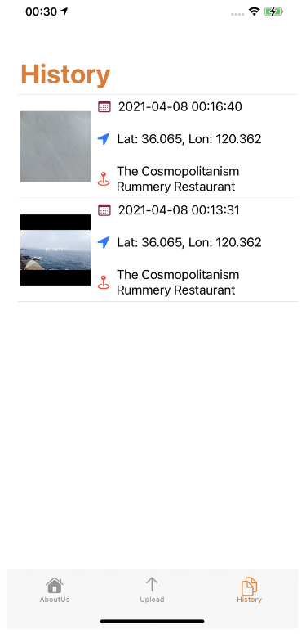
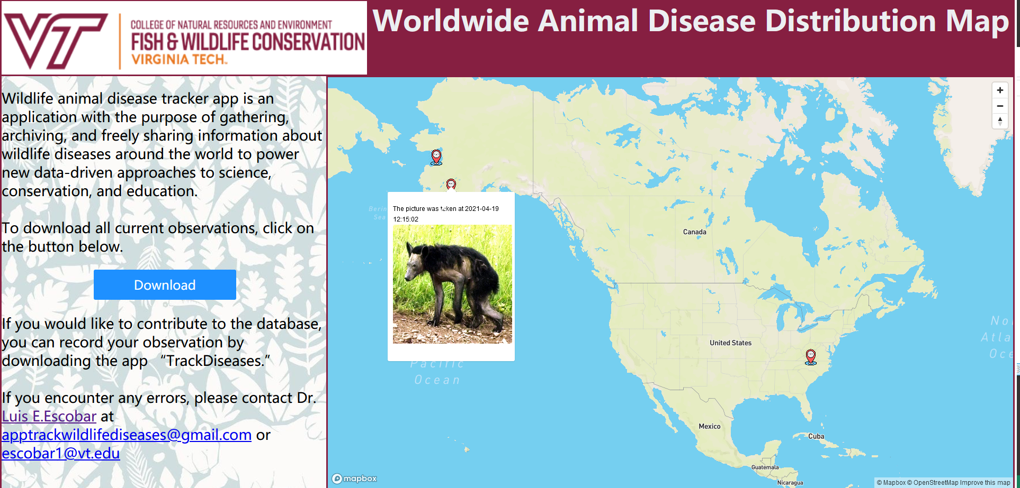
Project Overview Recap
Problem: monitor wildlife diseases
Goal: develop supportive tools
Project division:
  iOS app
  Website
Version II: update and finalize

Slide 4
Timeline
October
10.3 - 10.9: 40% of designs complete
10.10 - 10.16: 60% of designs complete
10.17 - 10.23: 80% of designs complete
10.30: App & Website complete
November
11.11: Begin Testing / Interim Report Complete
11.20: Final Project complete & creation of final presentation
11.30: Finish presentation & Report
September
9.20: Reviewing current app / website models
9.30: Have the first 20% of idea designs and new features complete

Slide 5
iOS Development
General improvement in goals of aesthetically pleasing
Login credentials
Map display view
History detail view
Notes:
Client wants: login credentials and map functionality. We have implemented 3 features including …

Slide 6
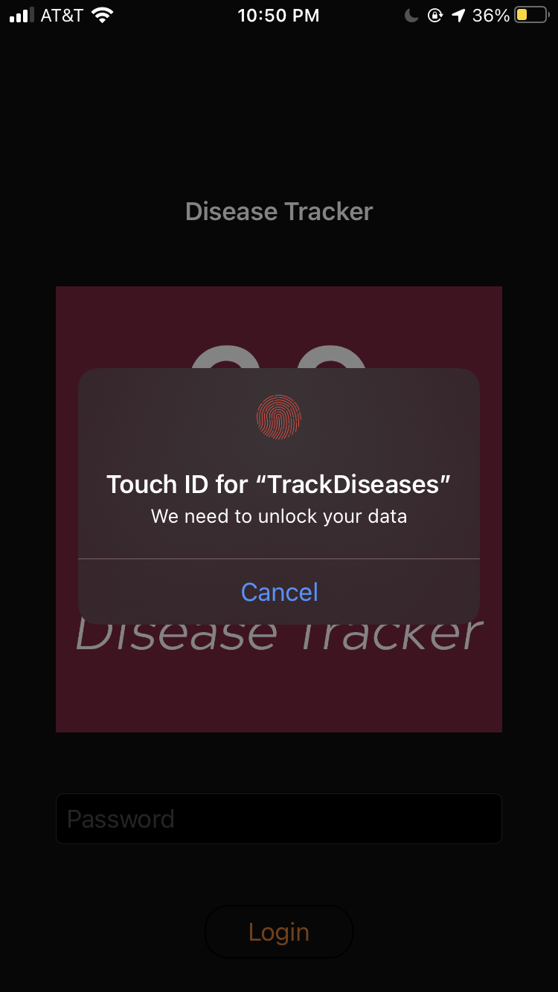
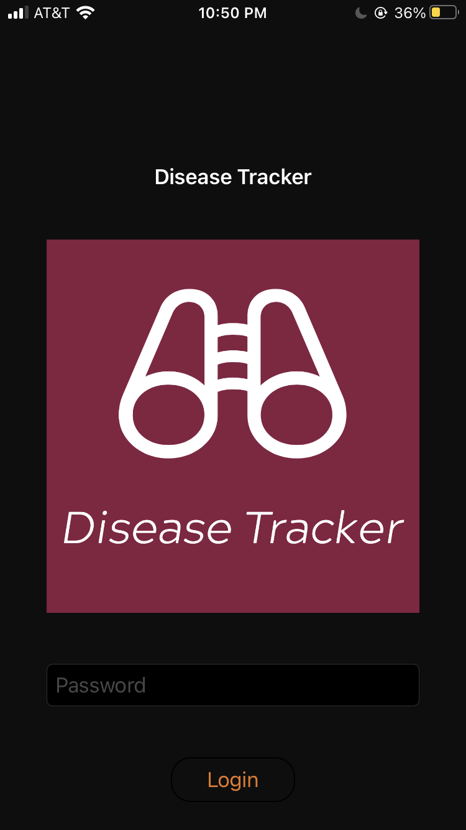
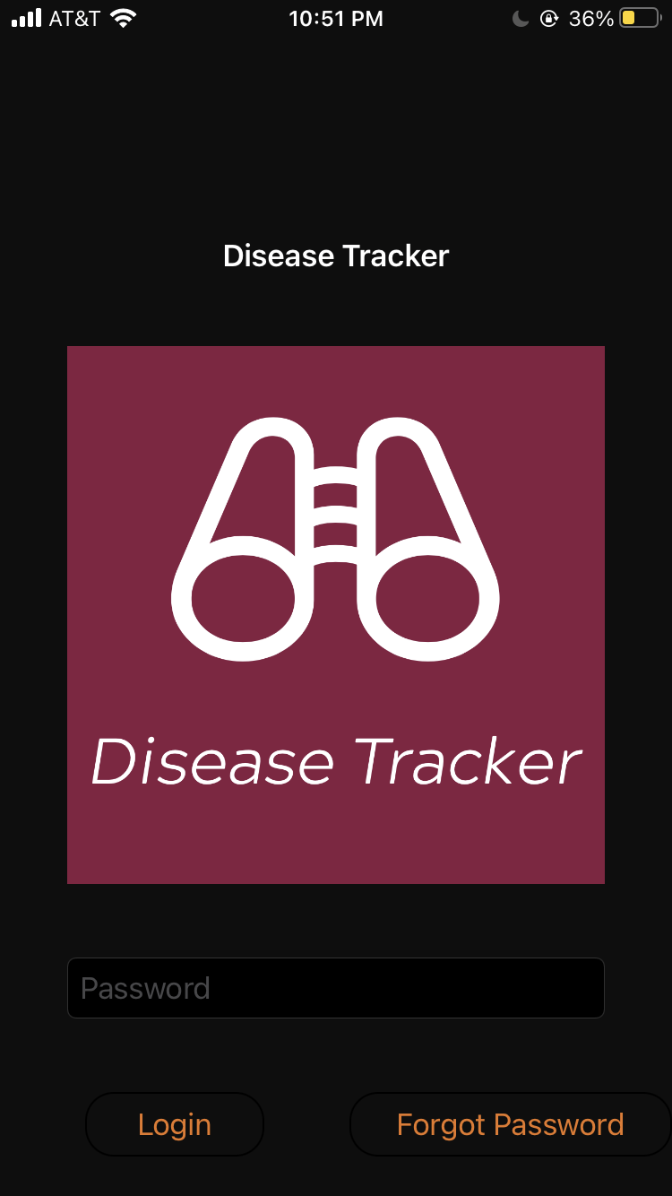
iOS Login Function
or

Slide 7
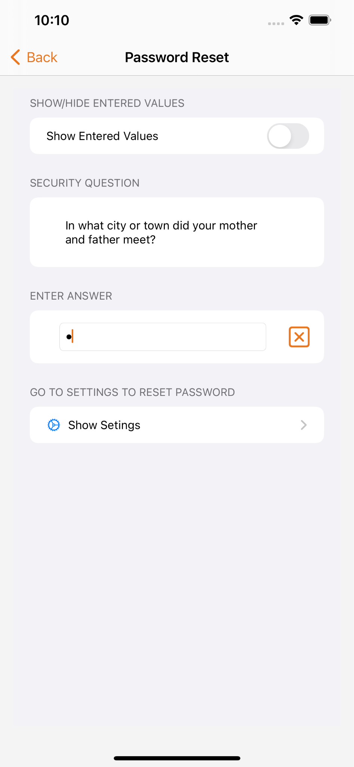
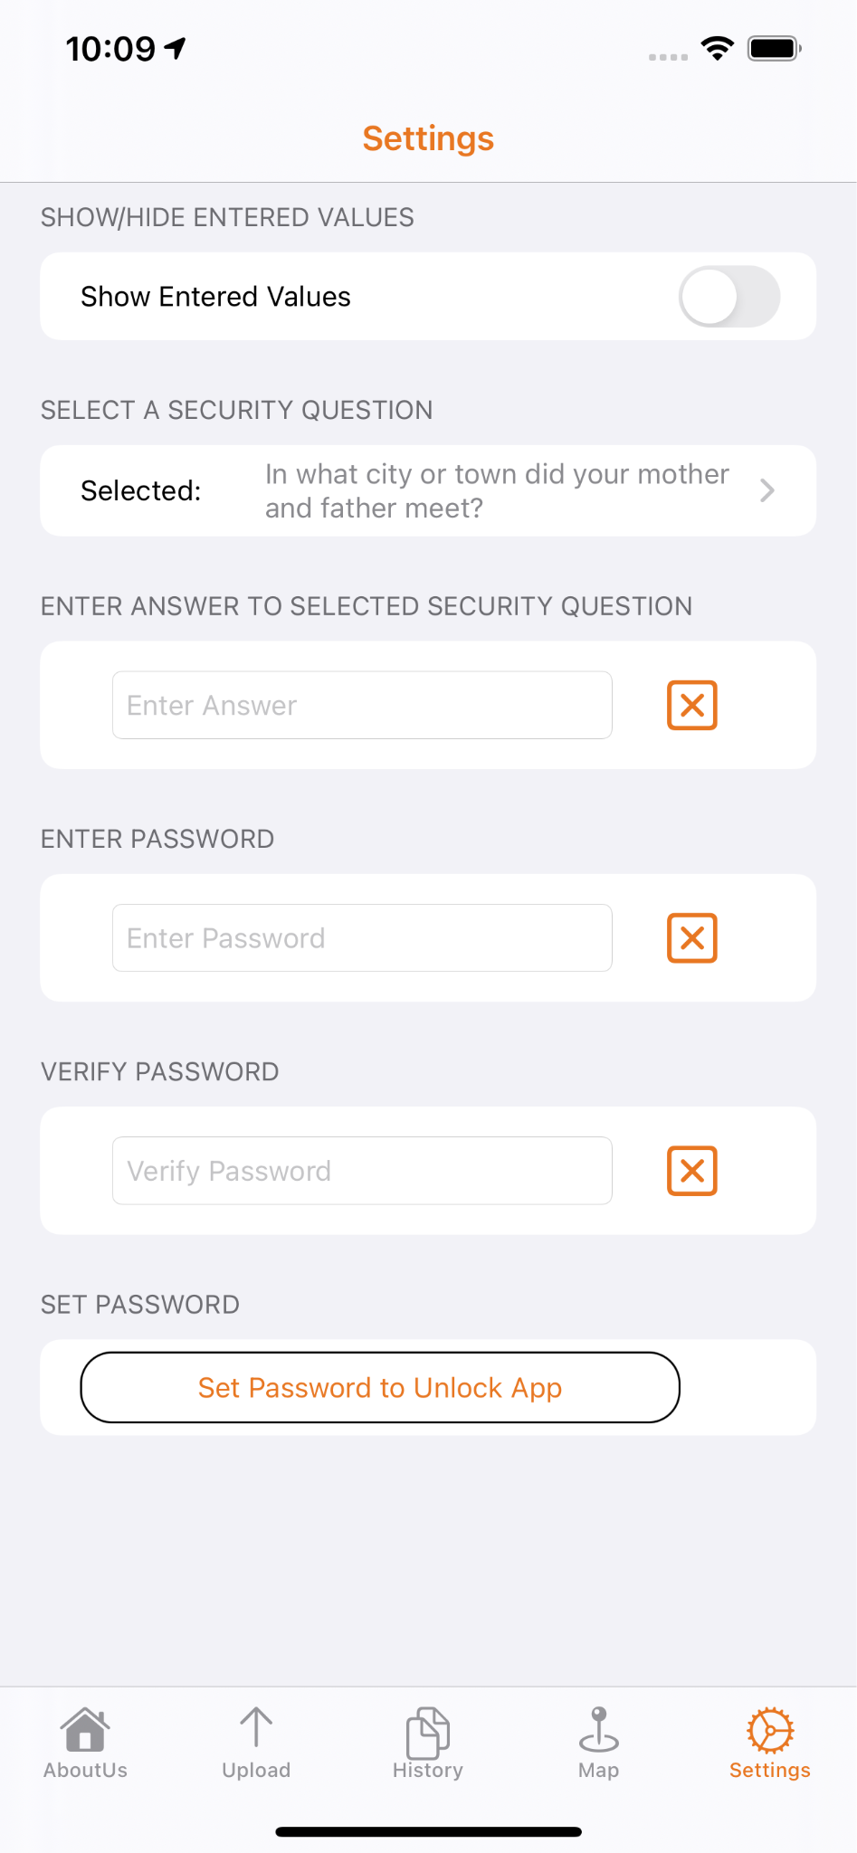
iOS Login Function (continued)
Forget password:

Slide 8
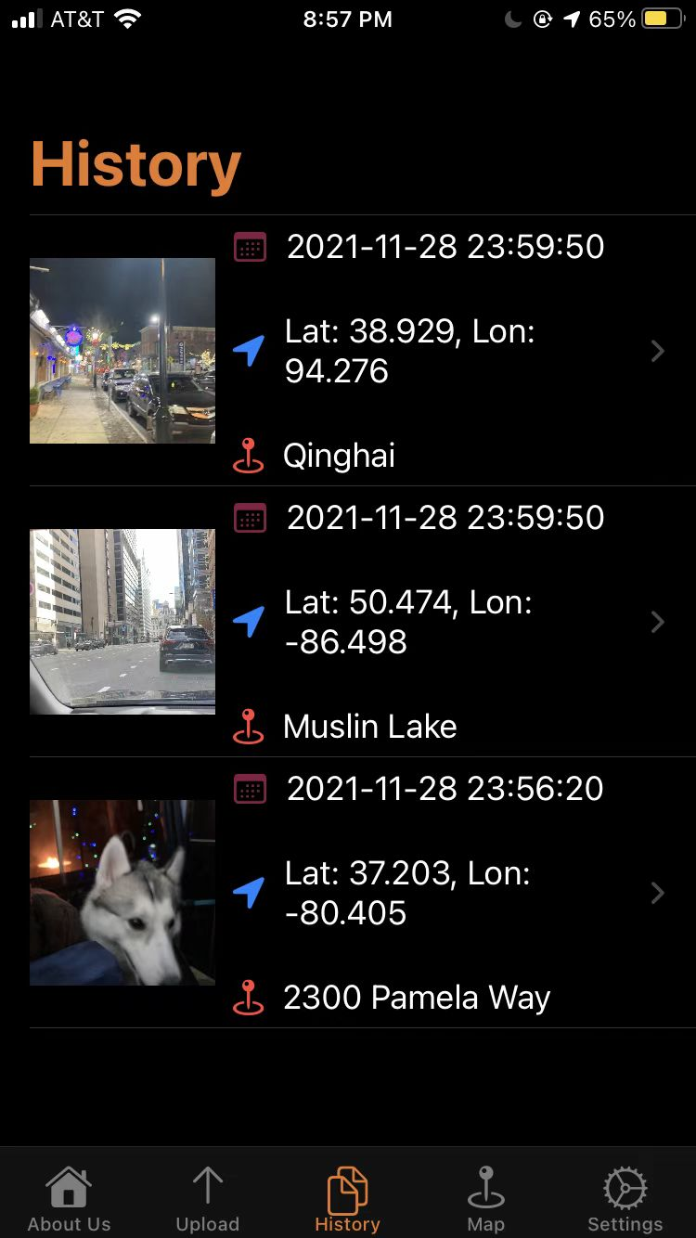
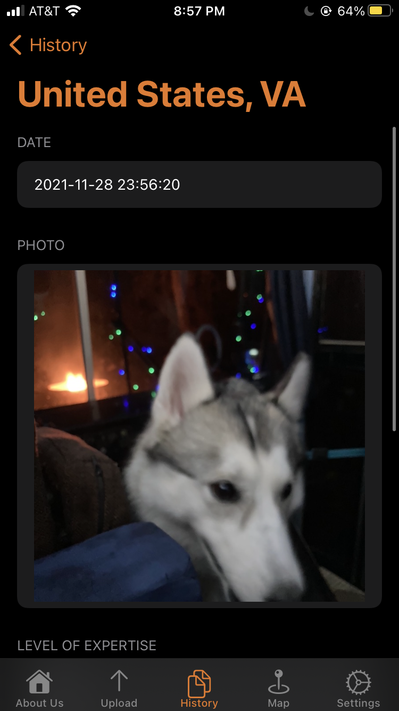
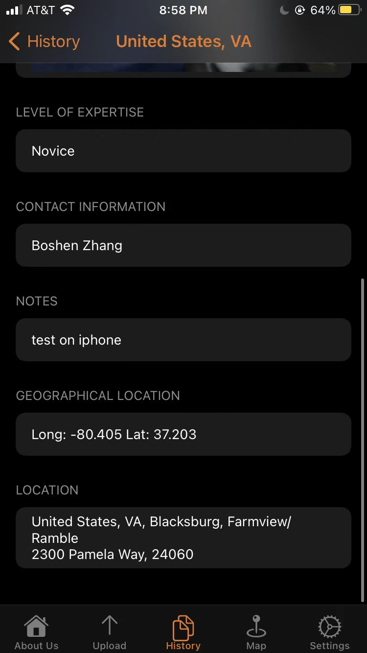
History Detail View
Notes:
After some test on the app from previous group, we found that user are not able to see the details of the history such as contact information, geographical location, notes. We have added a detail view that enables user to further investigate the data they uploaded.
Moreover, we have implemented the specific location converted from the longitude and latitude to be more user friendly and human readable.

Slide 9
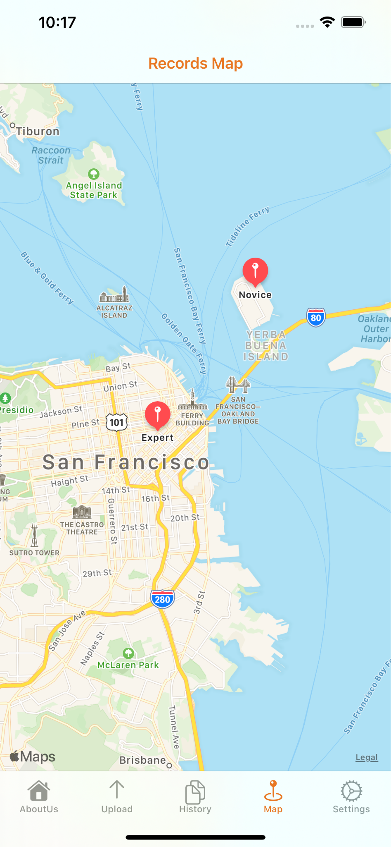
Map Function
Displays markers generated from Firebase
Displays time and experience level when clicks on markers
Update when user uploads new diseases
Notes:
Map view. Much like the history list. Display list item in a map as markers

Slide 10
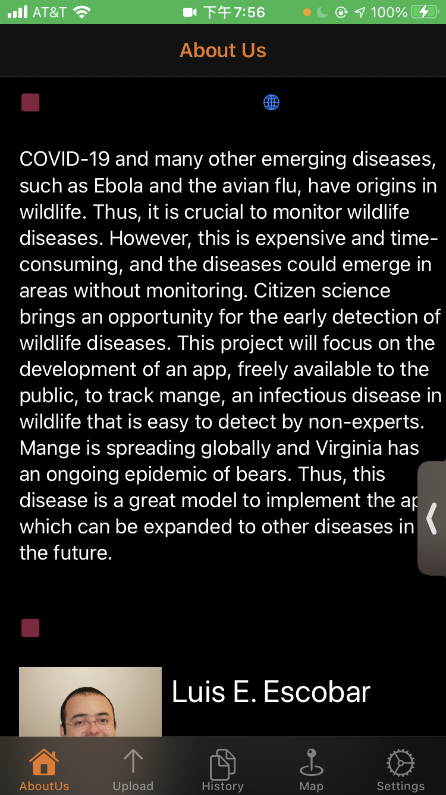
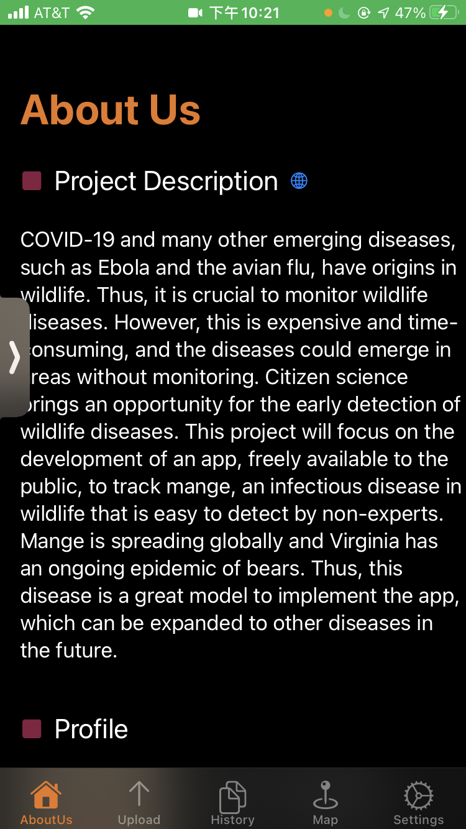
Minor Fixes
Dark Mode display problem
Notes:
We also tested the app in the dark mode. Some of the content were not displayed correctly under black background. Therefore we made some small changes. This is an example of what we did.

Slide 11
Website
Home page
Map page
Spreadsheet page
App download instruction page
Admin login page

Slide 12
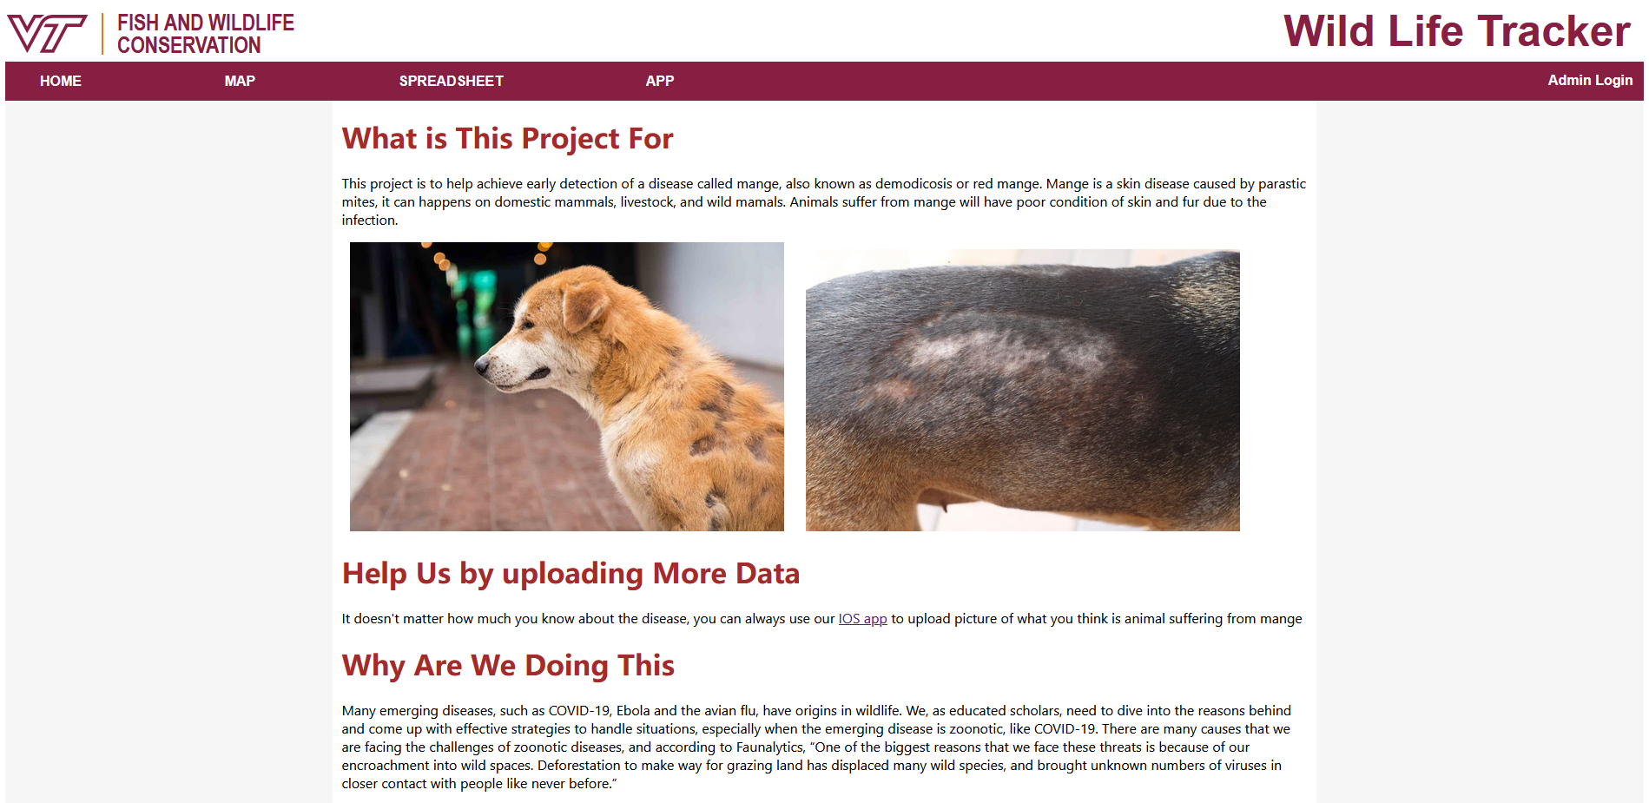
Home Page

Slide 13
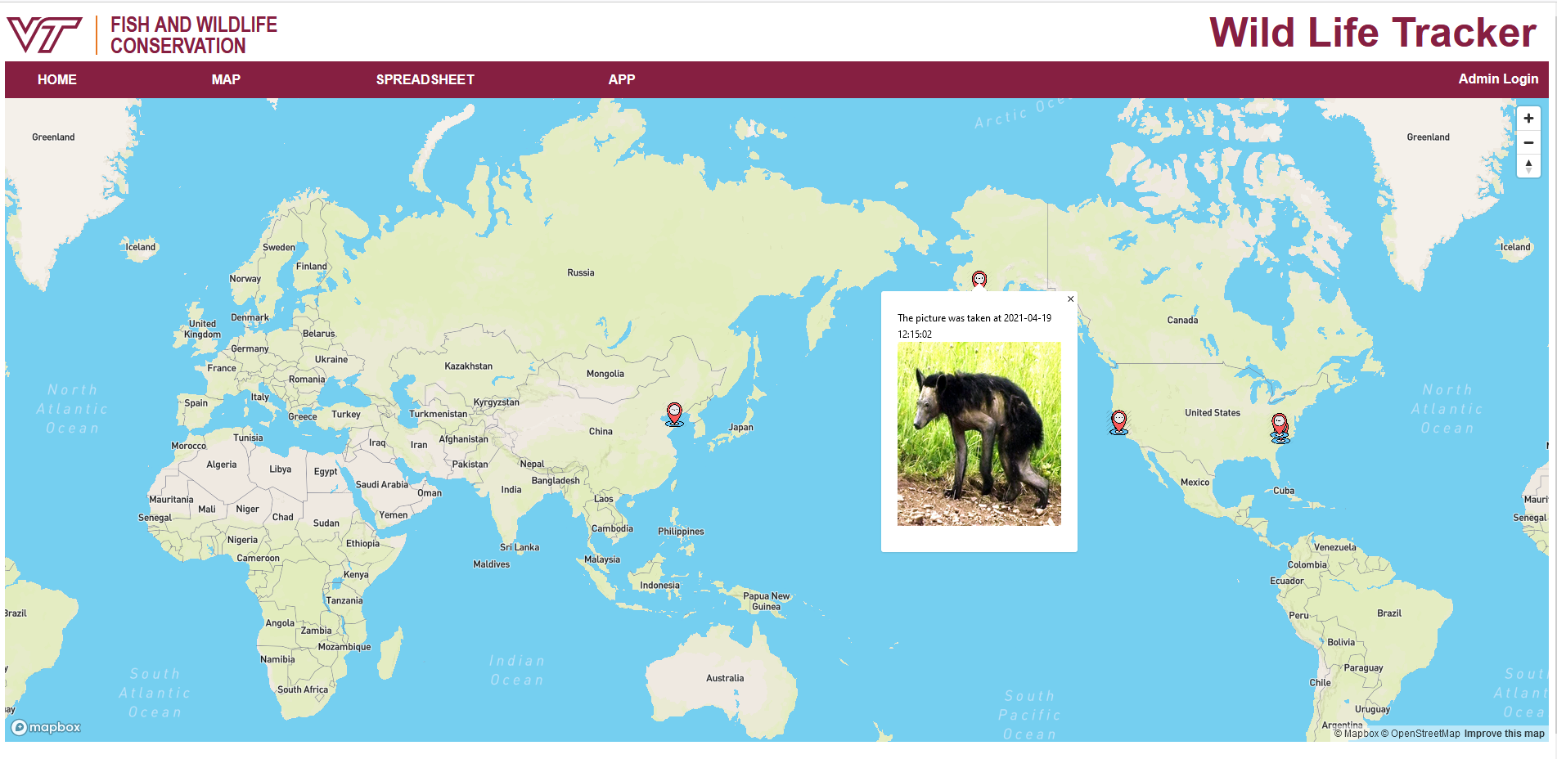
Map

Slide 14
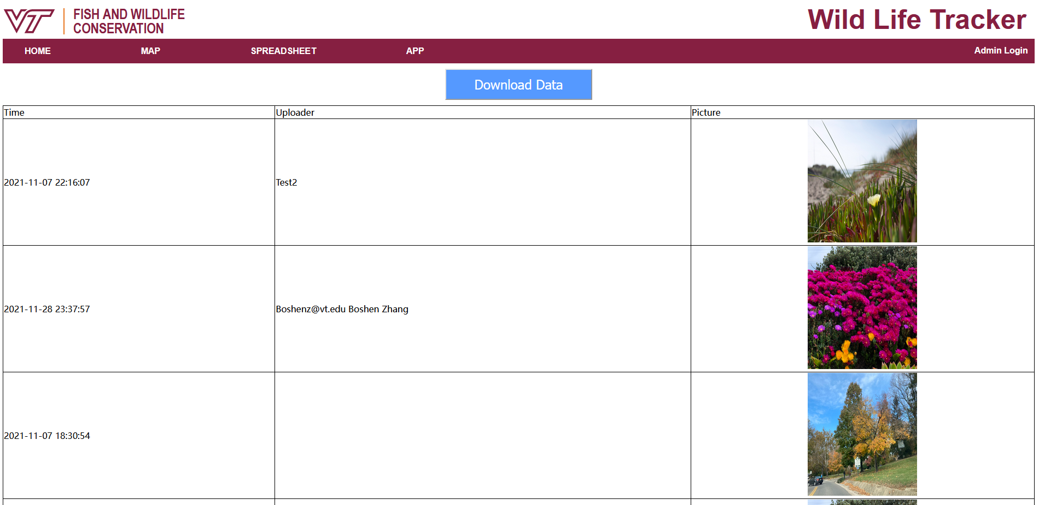
Spreadsheet

Slide 15
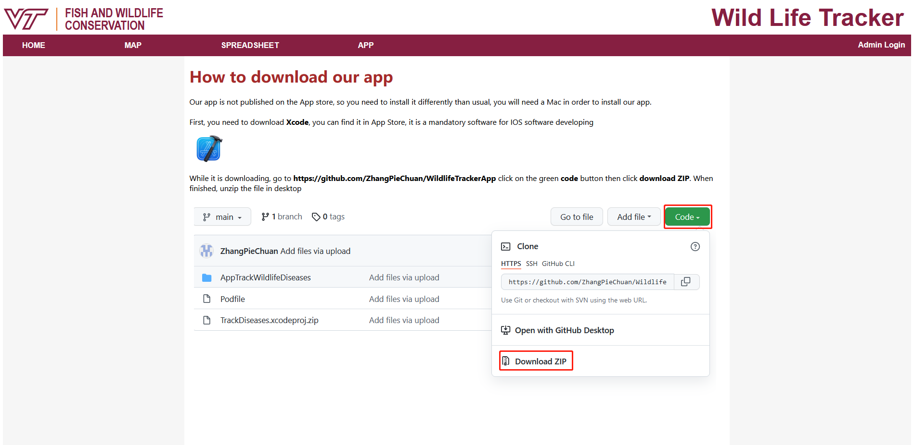
App

Slide 16
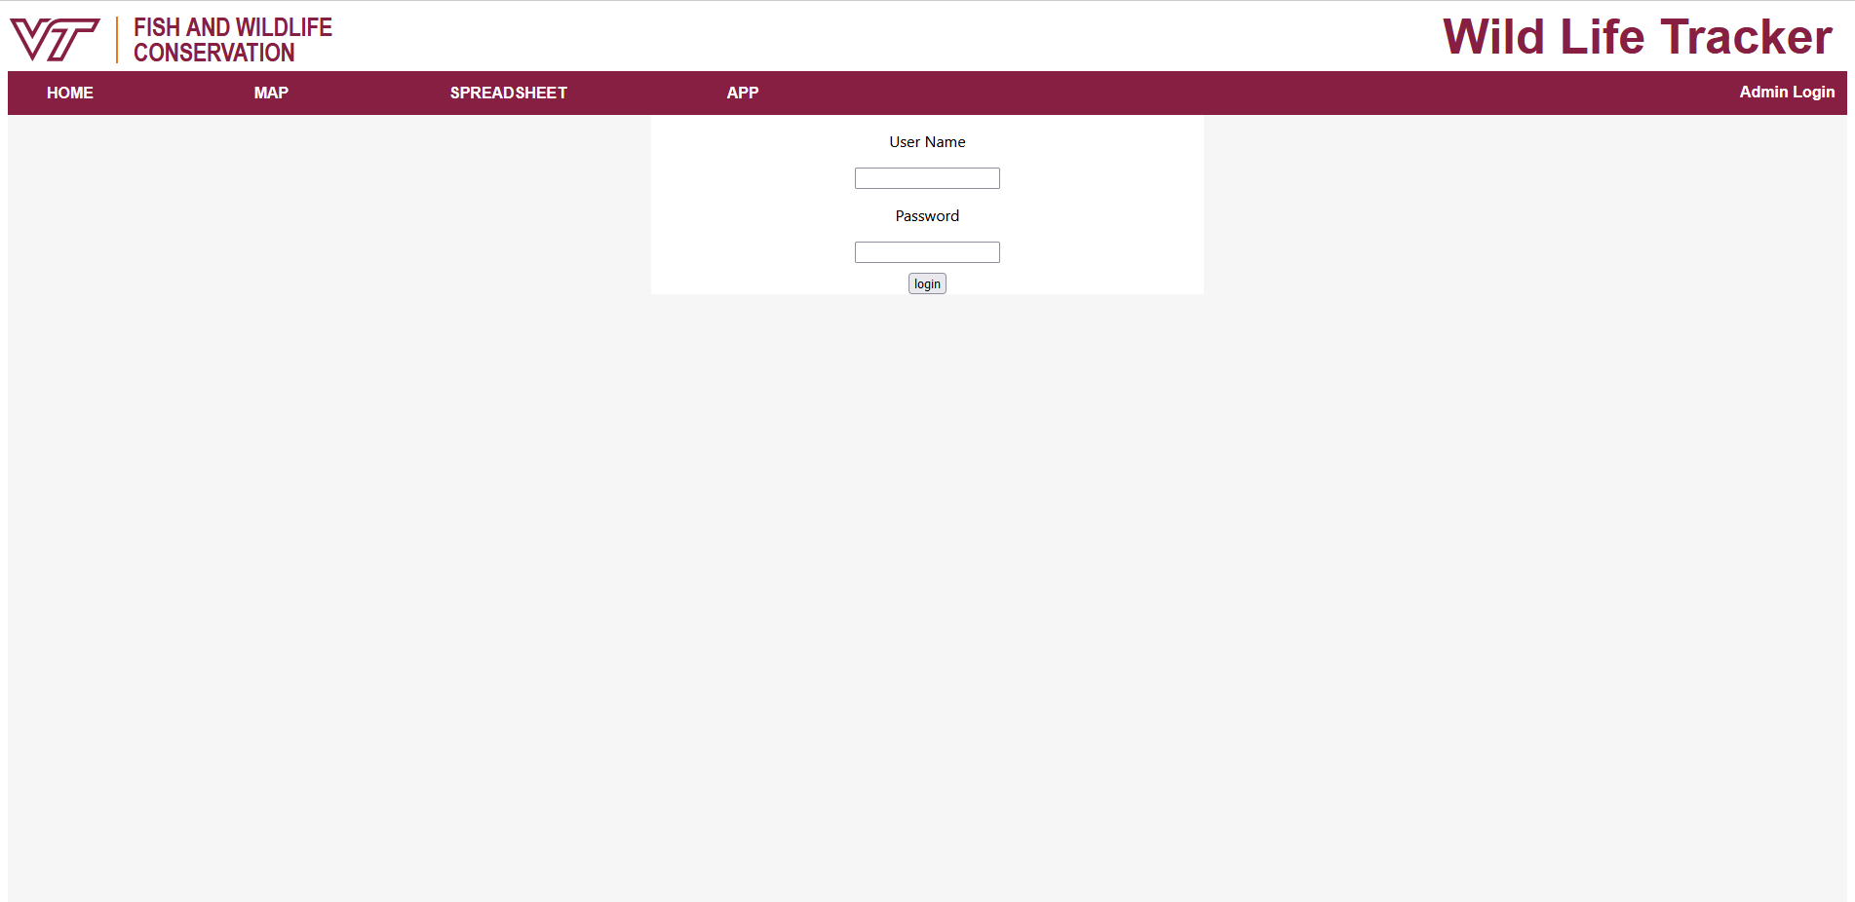
Admin Login

Slide 17
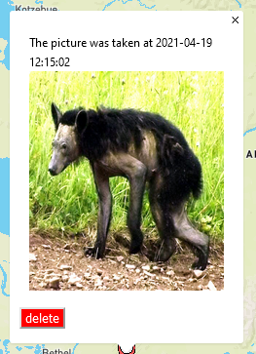
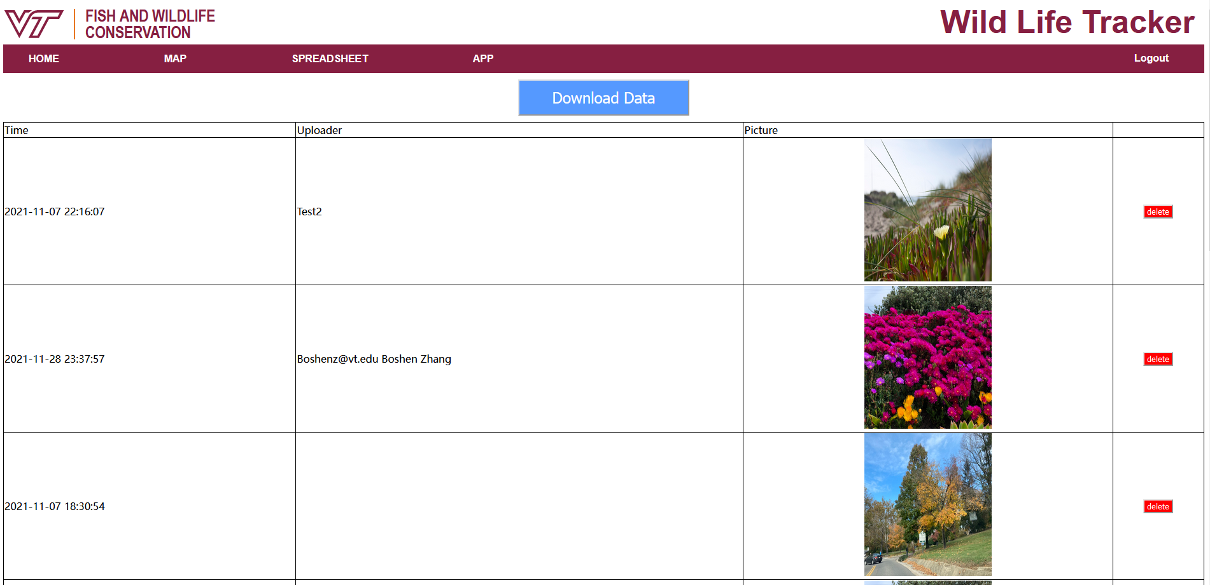
Delete Function

Slide 18
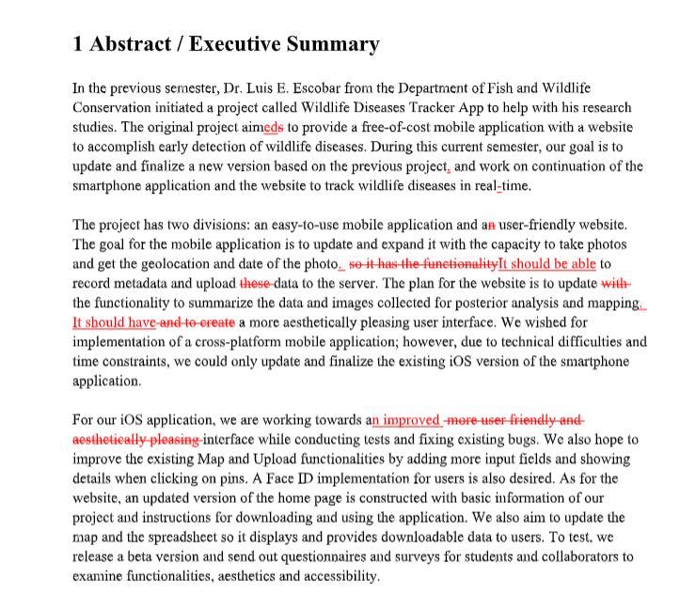
Report
Interim Report
  Feedback
    Testing
    Documentation for
      Users
      Future developers
  Revision
Final Report

Slide 19
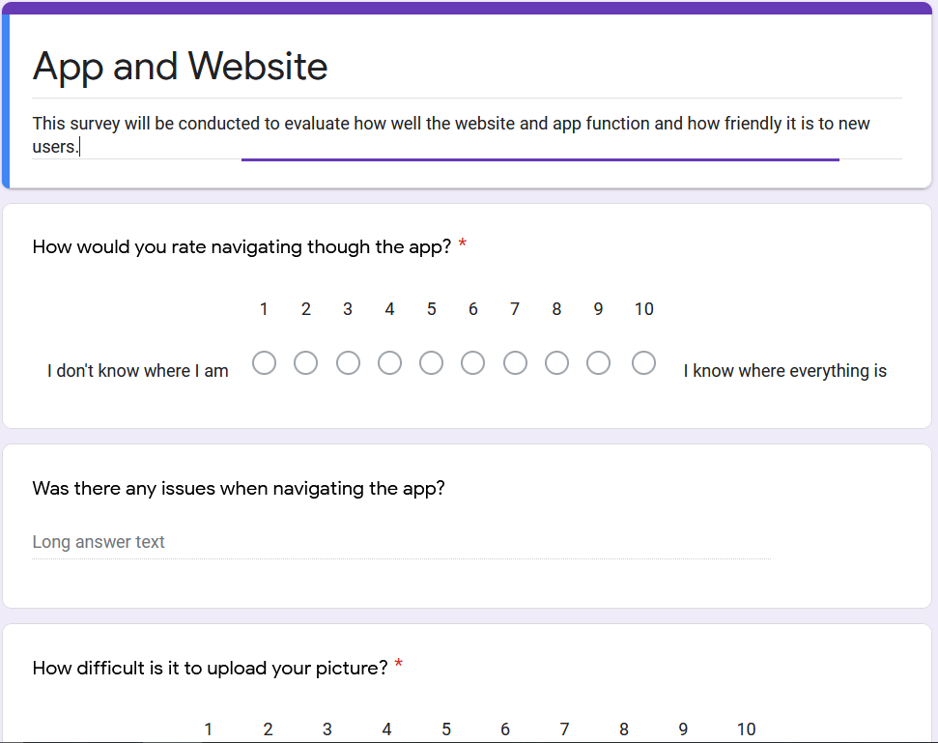
Testing
We’ve updated the test to
be a number based system.
We can find the average
of each user.
Additionally adding comments
for each section.
Notes:
So we changed how we change some interface option. Instead of having multiple choice questions with written out answers, it’s more easier to evaluate and score if we use a metric from one to ten. We can calculate the averages of all the users to determine scores of each function and see if it reaches our target value in our UX table. Additionally, we want to have a guided and unguided test, meaning we will have some function for each user to do, versus giving vague instructions to users to see if they can figure out how to do it without any prior knowledge.

Slide 20
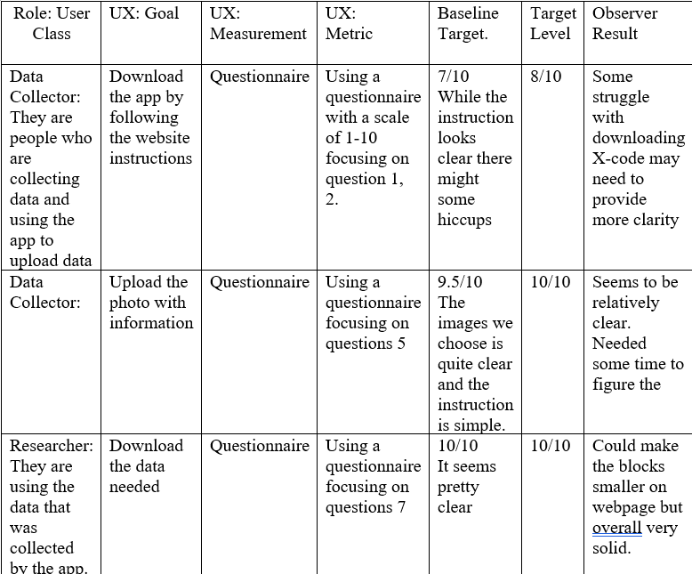
Assessment: UX Target Table
We create scores and see if the test
reaches those scores.
Identify different roles of people who might
use the website and app.
Note any additional observations that
might occur during testing.
Notes:
We would like to make a target table where we can can use to evaluate what scores we want to be seeing from users interaction with the website and app and also evaluate any possible roles of people who might want to use the app or

Slide 21
Future Ideas
iOS
  Publish the app on testflight (require Apple developer program, 99$）
  Enable modification of records
  Immigrate from IOS to Android
Website
  Provide link in spreadsheet page that can jump to the corresponding post on map
  Provide sorting option for spreadsheet
General
  Provide services for other diseases
Notes:
In order to test the app in a larger group of user and easier installment, next group may need to publish the app on testflight which may require 99 dollar registration fee.

Slide 22

Lessons Learned
Handle pressure & unforeseen factors
Accessibility
Team collaboration
Clarity issues
Thinking way too large
Notes:
While working on our project, we had some slight hiccups that affected performance and completion of the project. One of the biggest is that our group do have priorities on other classes. We do have other classes and projects that need our attention and having that affected some completion time. Additionally, we lost a group member causing us to reevaluate our teams role and feasibility on deliverables. Accessibility is another issue, we have a hard time making sure that we had access to all the data and information of previous groups work as well as code from other older members. We also had clarity issues where we might not be clear on an objective, or might be overthinking a situation as well, which leads me to the last point where we are thinking a little bit too much when it comes some things such as trying to get the app on the app store.

Slide 23

Acknowledgements
Thank you to:
Client | Professor Luis Escobar | Department of Fish and Wildlife Conservation | escobar1@vt.edu
Second Contact / Client | Mariana Castaneda Guzman | marianacg@vt.edu
Professor | Professor Edward Fox | Department of Computer Science | fox@vt.edu

Slide 24
Reference
Previous Website:
https://trackwildlifeanimaladmin-58tz.web.app/
Previous App:
https://github.com/Shangzheng98/Track_WildlifeDiseases
Previous Report:
http://hdl.handle.net/10919/103257
Notes:
Paste to report：https://www.twilio.com/blog/2018/07/how-to-test-your-ios-application-on-a-real-device.html

