Slide 1
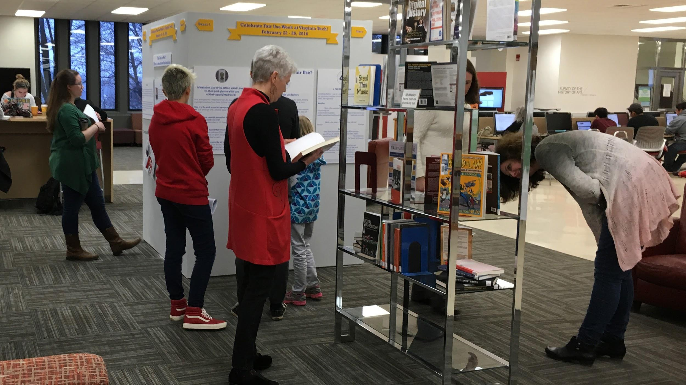
"Is It a Fair Use?"
Celebrating Fair Use Week to Promote
Critical Thinking about Copyrights
Authors: Virginia Pannabecker, Anita Walz, Robert Sebek, Scott Fralin, Keith Gilbertson
This presentation is licensed
for reuse: CC BY 4.0
University Libraries, Virginia Tech
February 22-March 4 2016

Slide 2
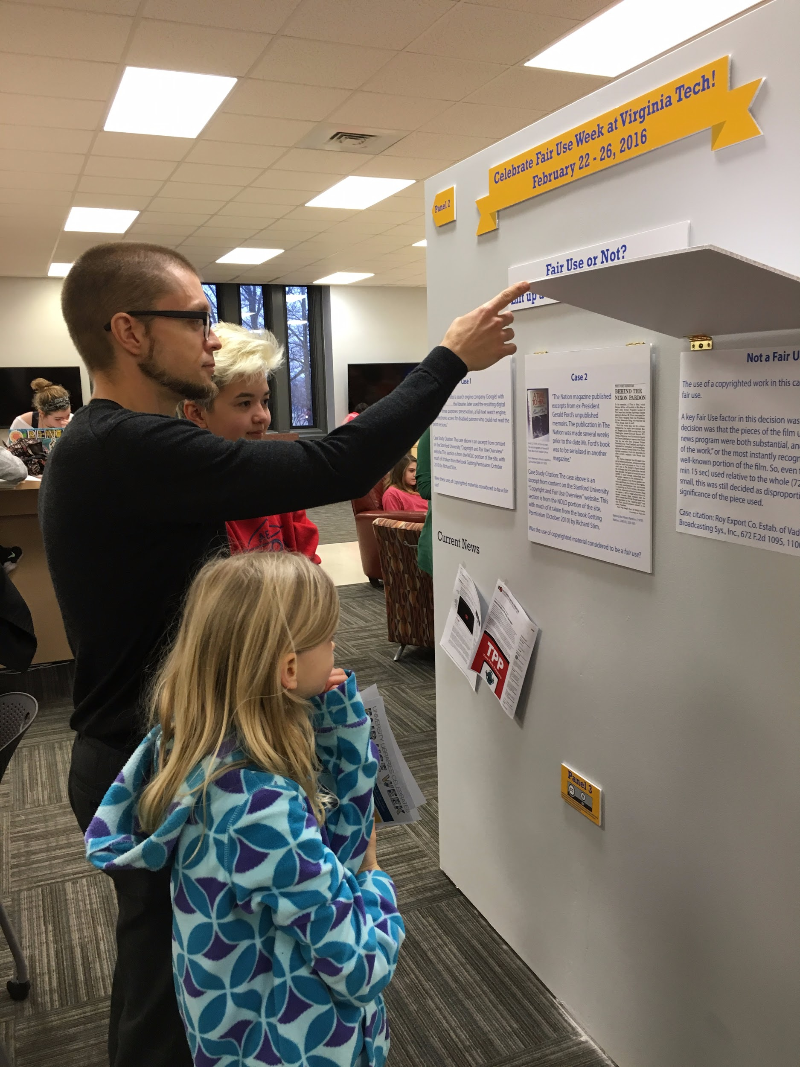
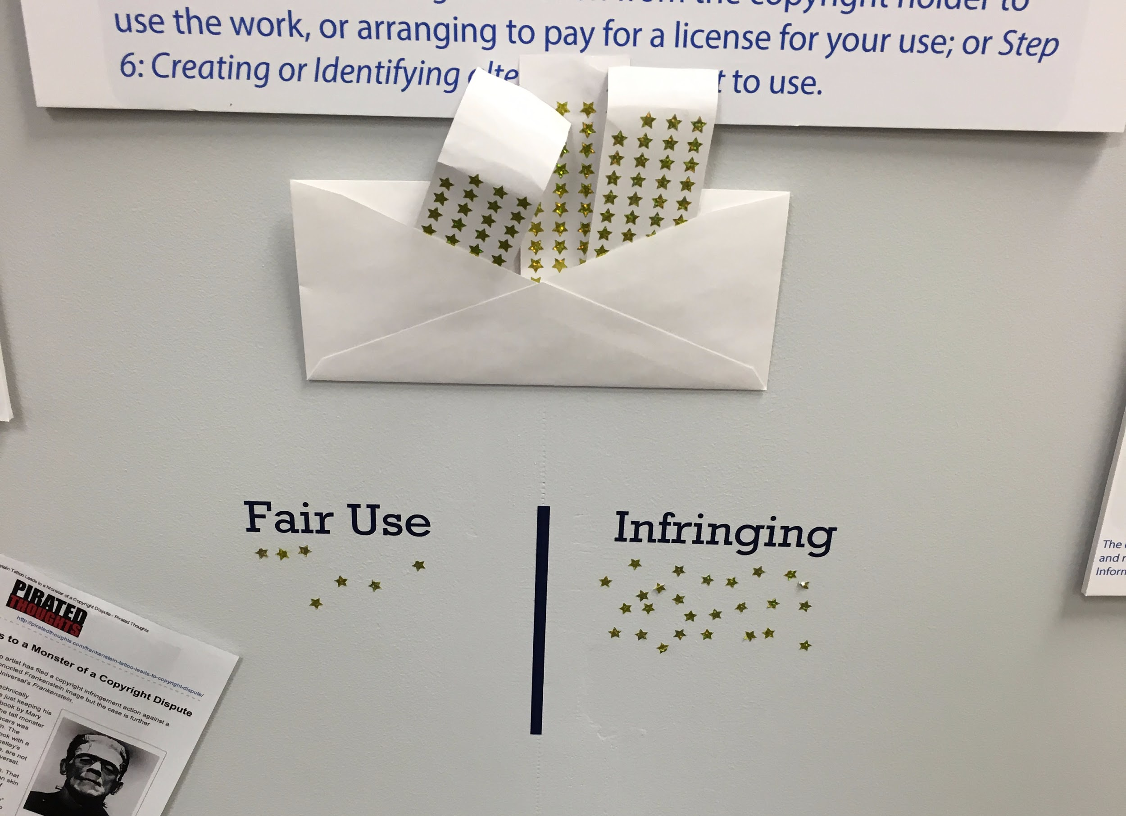

Fair Use Week 2016 at Virginia Tech, University Libraries
Context: a large, public, research university
Goals
  Raise awareness
  Emphasize interactivity
Components
  Exhibit
  Programming: Exhibit Opening; Workshops
  Website
  Blog Post

Slide 3
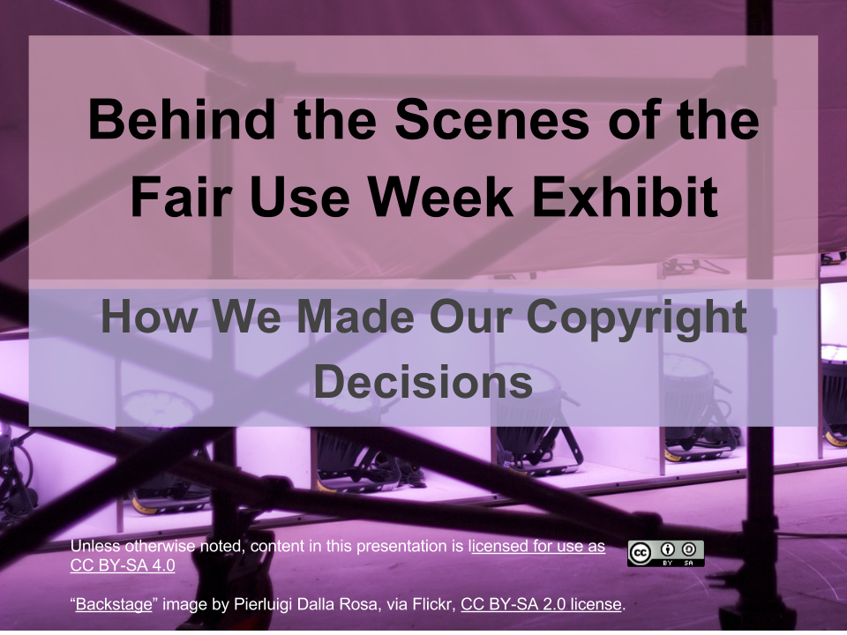
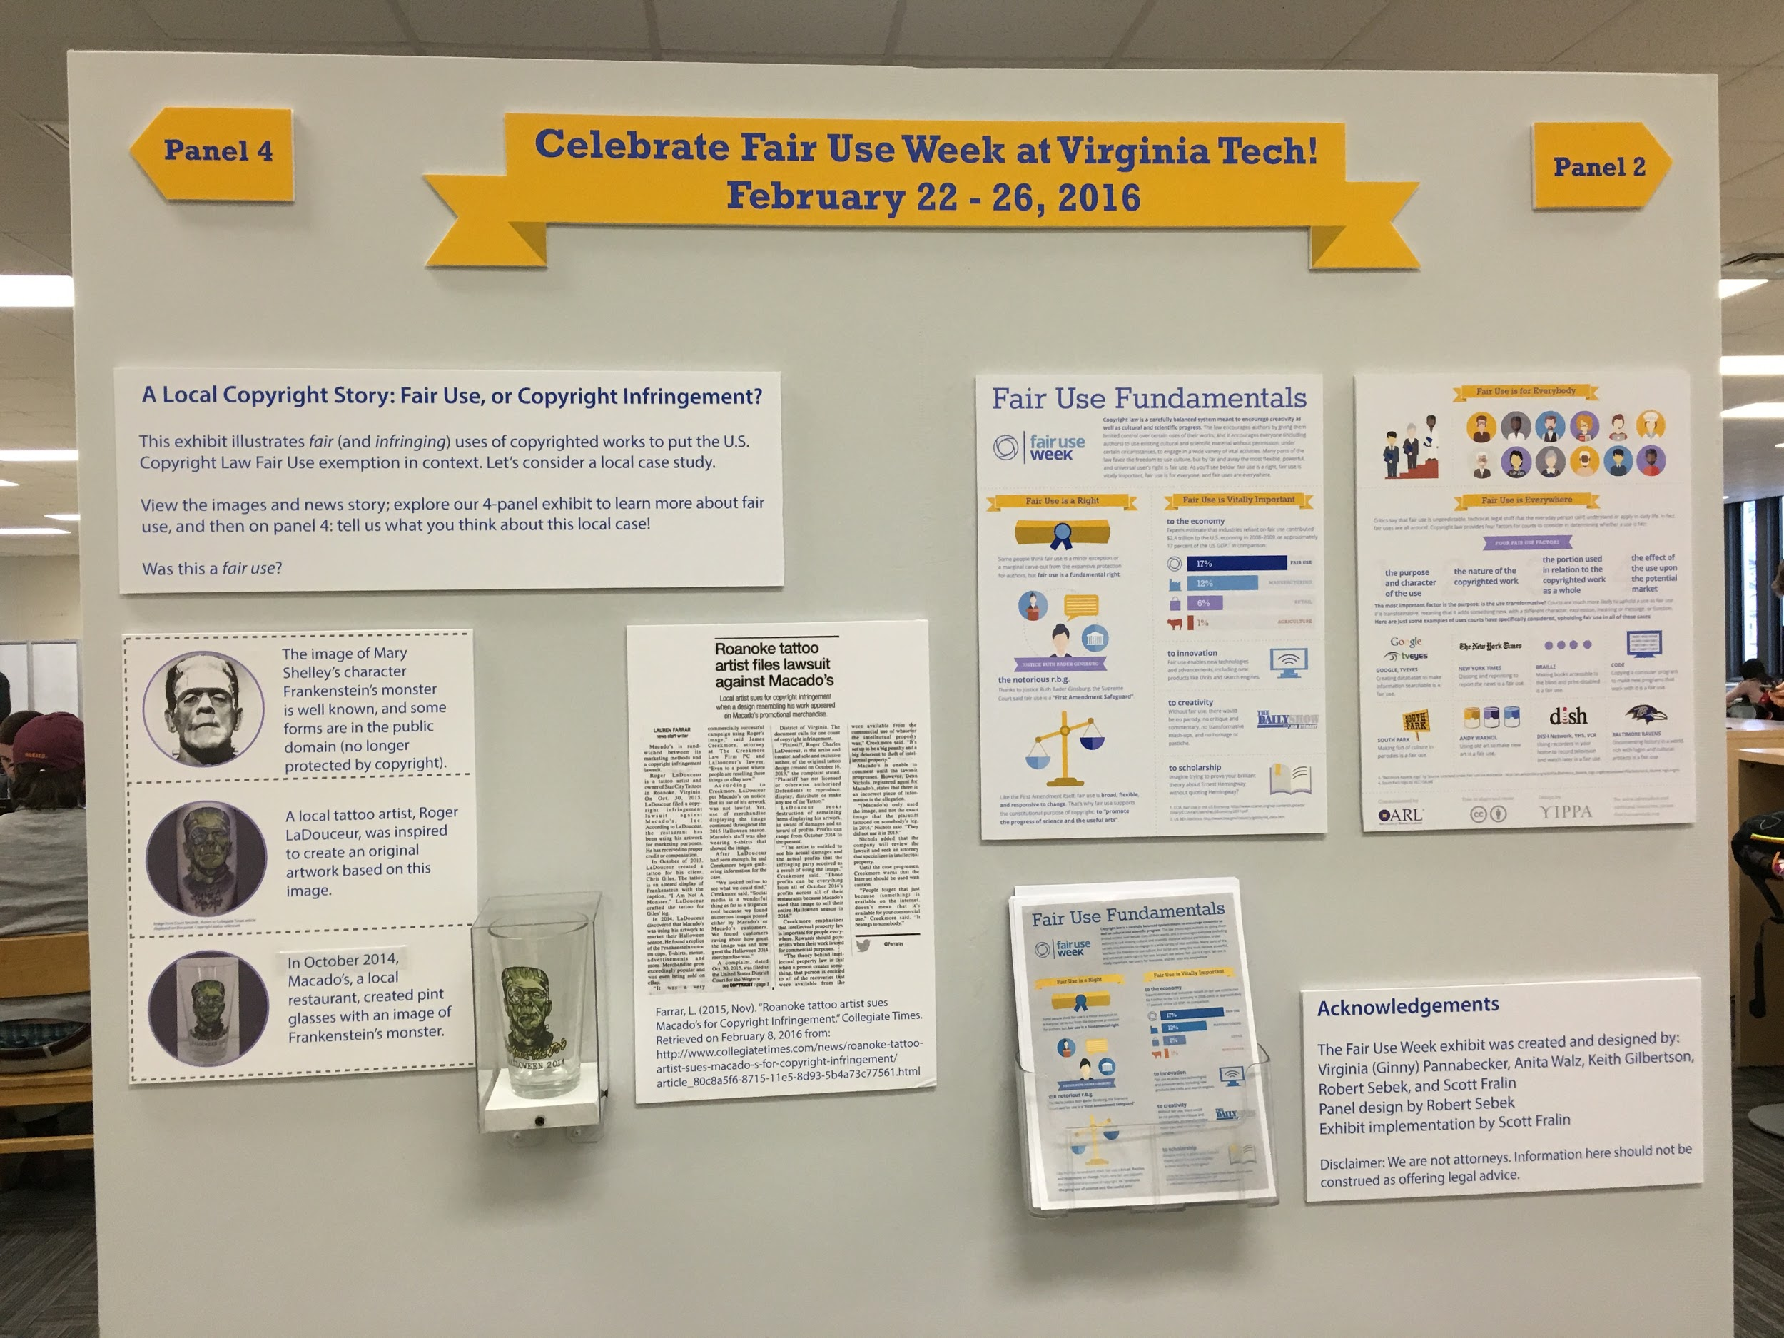
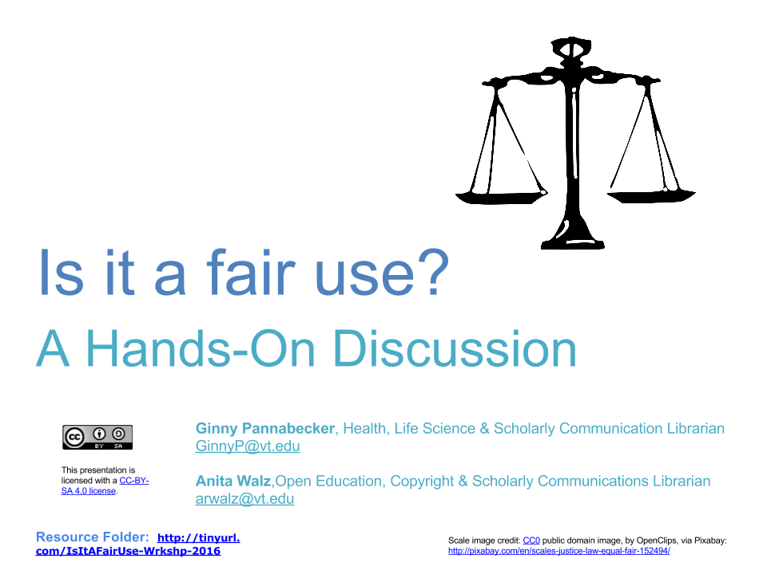

Fair Use Week 2016 at Virginia Tech, University Libraries
Resources
Event Toolkit: http://hdl.handle.net/10919/70924
Event Website: lib.vt.edu/copyright/fair-use-week/index.html
Contact for Questions: vpannabe@vt.edu
Future Plans
Speaker
International copyright info
Student, faculty collaboration

