Slide 1
VertMapViz
Courtney Duncan, Christian Garcia, Wasay Mehdi, Andre Urcia
CS 4624 Multimedia, Hypertext, and Information Access
Instructor: Dr. Fox
Virginia Tech, Blacksburg VA 24061, 05/12/19

Slide 2
Outline
Project Description
Work Completed
User Testing
Future Work
Lessons Learned
Acknowledgements

Slide 3
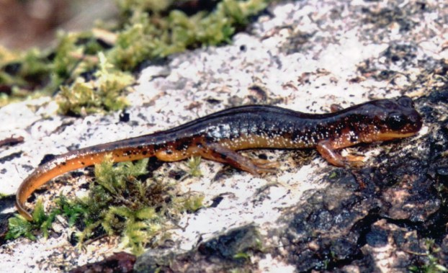
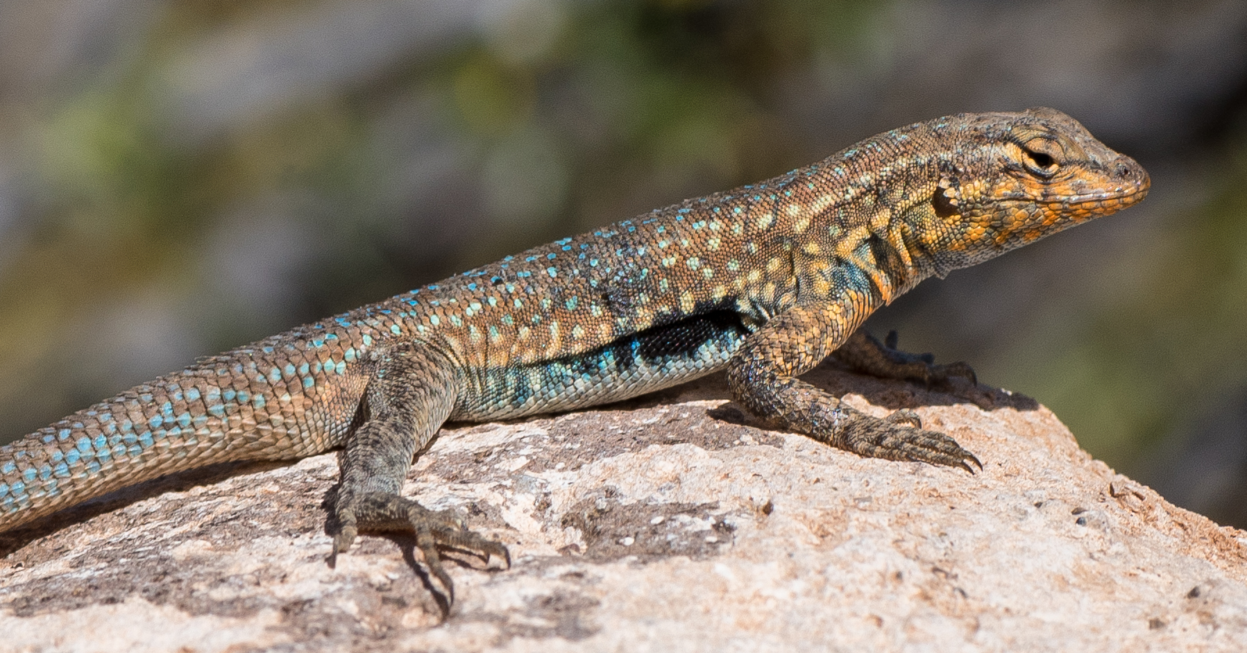
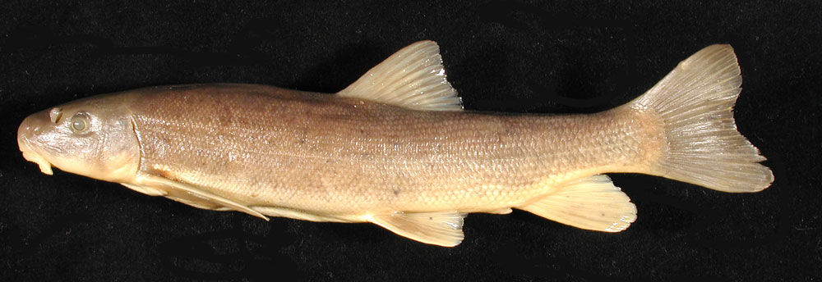
Project Description
Creating a website that displays data on 114 vertebrates native to the Pacific Northwest
Data displayed will be in both list and map form
Data separated into Amphibians, Fish, and Reptiles
Displaying major research findings related to the 114 species
https://i0.wp.com/gonefroggin.com/wp-content/uploads/2018/02/0188.jpeg?resize=622%2C379&ssl=1
https://idfg.idaho.gov/species/sites/default/files/taxa/11547_orig.jpg
https://static.inaturalist.org/photos/6972589/original.jpg?1491821005

Slide 4
Work Completed
Filled lists and map with species entries
Added species Shape files to the map
Added personal modals with pictures and detailed info
Improved website aesthetics
Separated filtering functionality from table and map
Giving all entries pictures
Made About section with map user guide

Slide 5
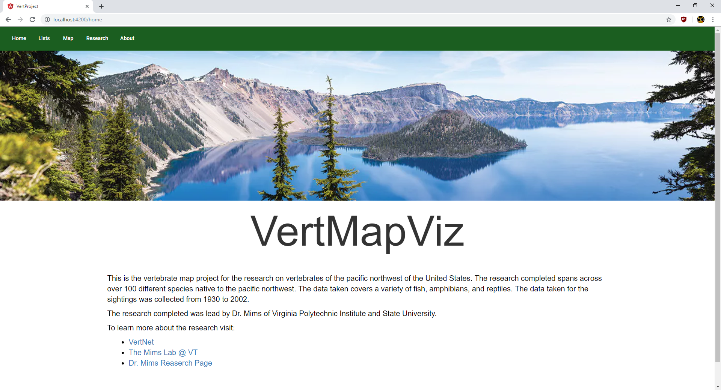

Slide 6
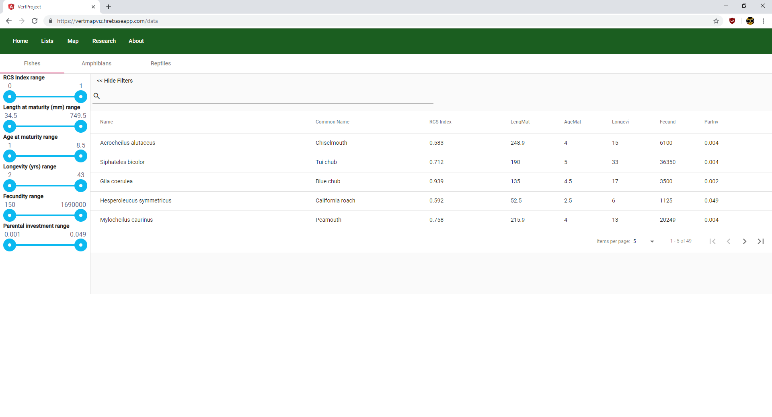

Slide 7
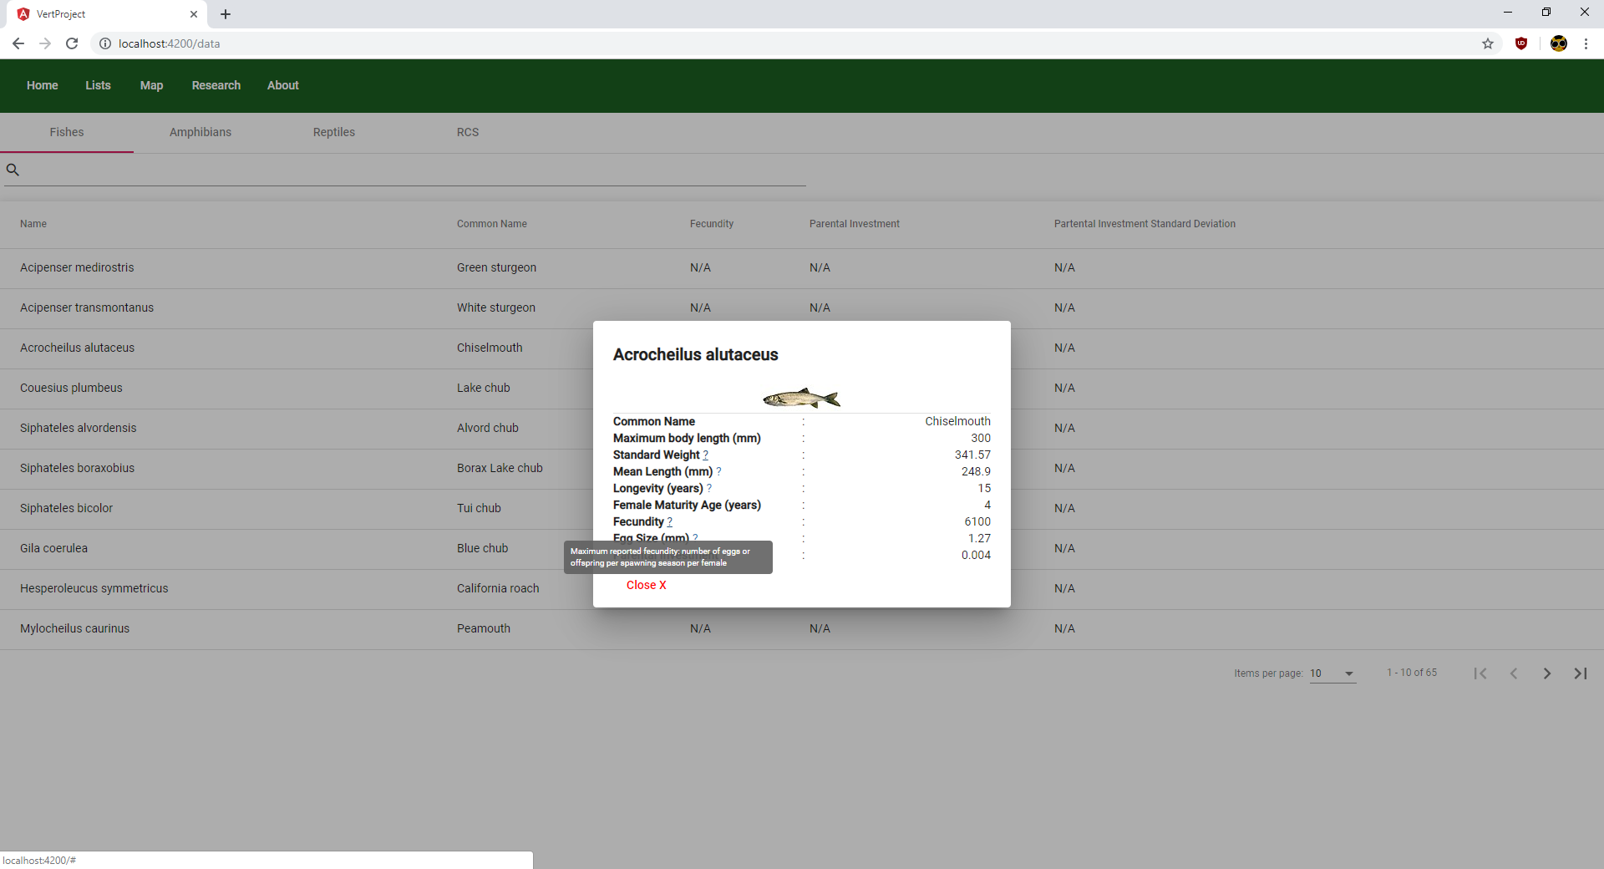

Slide 8
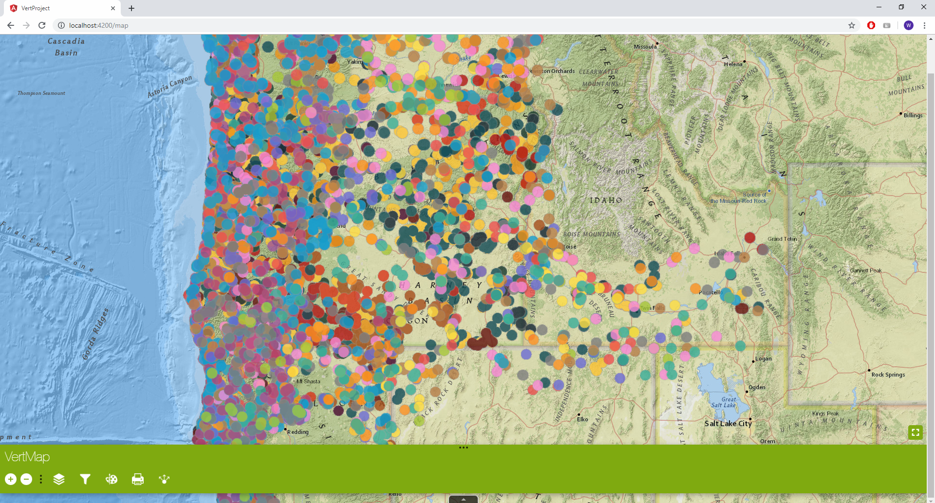

Slide 9
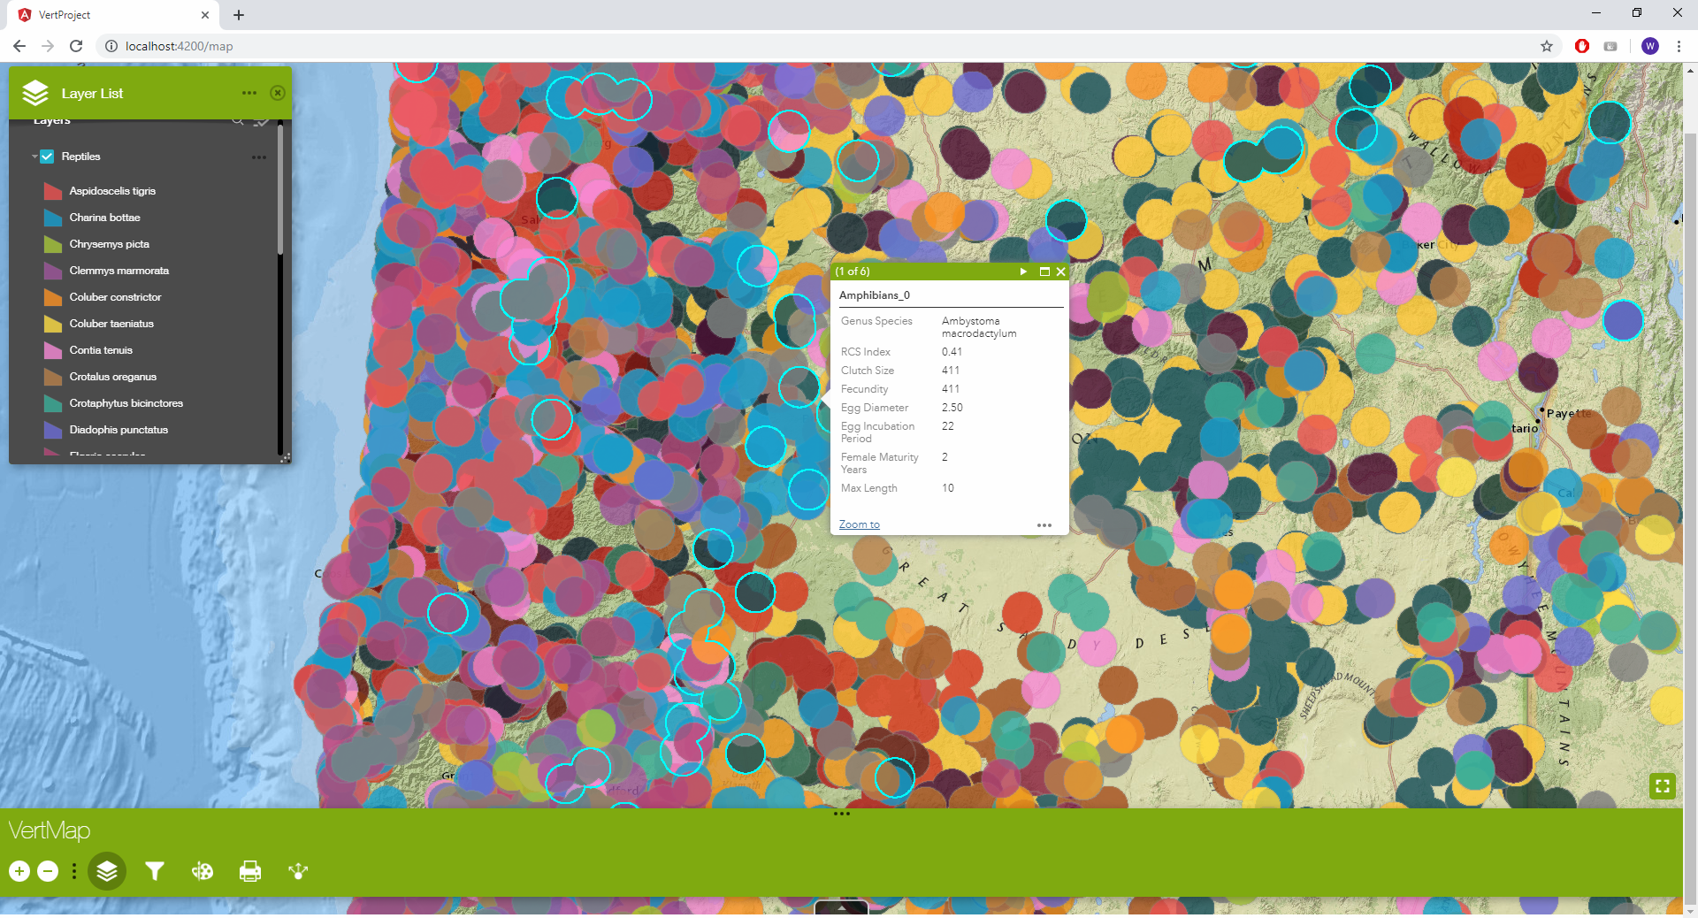

Slide 10
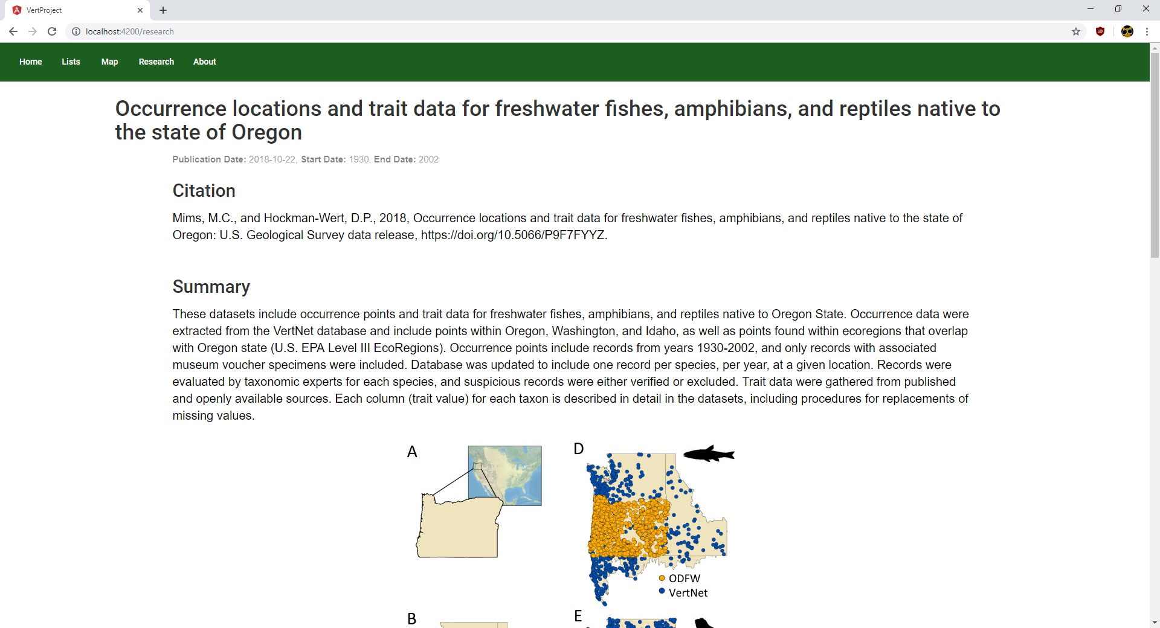

Slide 11
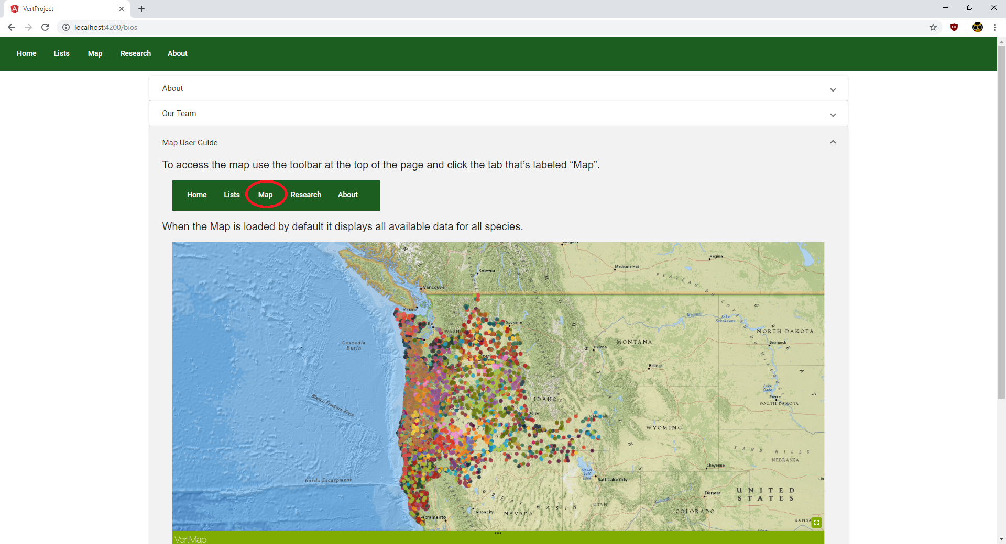

Slide 12
User Testing
Work Role: User Class | UX Goal | UX Measure | Measuring Instrument | UX Metric | Baseline Level | Target Level | Avg. Observed Results (sec)
Someone interested in biology: Using Design for the first time | Ease of Use | Initial User Performance | Access the map page of the website | Average tIme on Task | 10 seconds | 5 seconds | 3
Someone interested in biology: Using Design for the first time | Ease of Use | Initial User Performance | Set the layer to be a certain species | Average tIme on Task | 45 seconds | 30 seconds | 5
Someone interested in biology: Using Design for the first time | Ease of Use | Initial User Performance | Access the list Page | Average tIme on Task | 10 seconds | 5 seconds | 2
Someone interested in biology: Using Design for the first time | Ease of Use | Initial User Performance | Find detailed information on a select species | Average tIme on Task | 10 seconds | 5 seconds | 12
Someone interested in biology: Using Design for the first time | Ease of Use | Initial User Performance | Access the Reptiles List | Average time on task | 5 seconds | 3 seconds | 3
Testing Pool:
15 people
Backgrounds:
  Students of multiple majors
  Technologically savvy/illiterate

Slide 13
Future Work
Add login feature to easily change dataset
Have more integration across the list and the map
Separate the species into their own layers on the map
Let users create their own filters
Improving UX (Design Patterns)

Slide 14
Lessons Learned
Angular Material is a good framework for a professional website
Get into contact VT early for website hosting
Esri has a steep learning curve, but is versatile
Using 3rd party libraries can make it difficult to customize
Weekly meeting and defined schedules makes for a well structured project

Slide 15
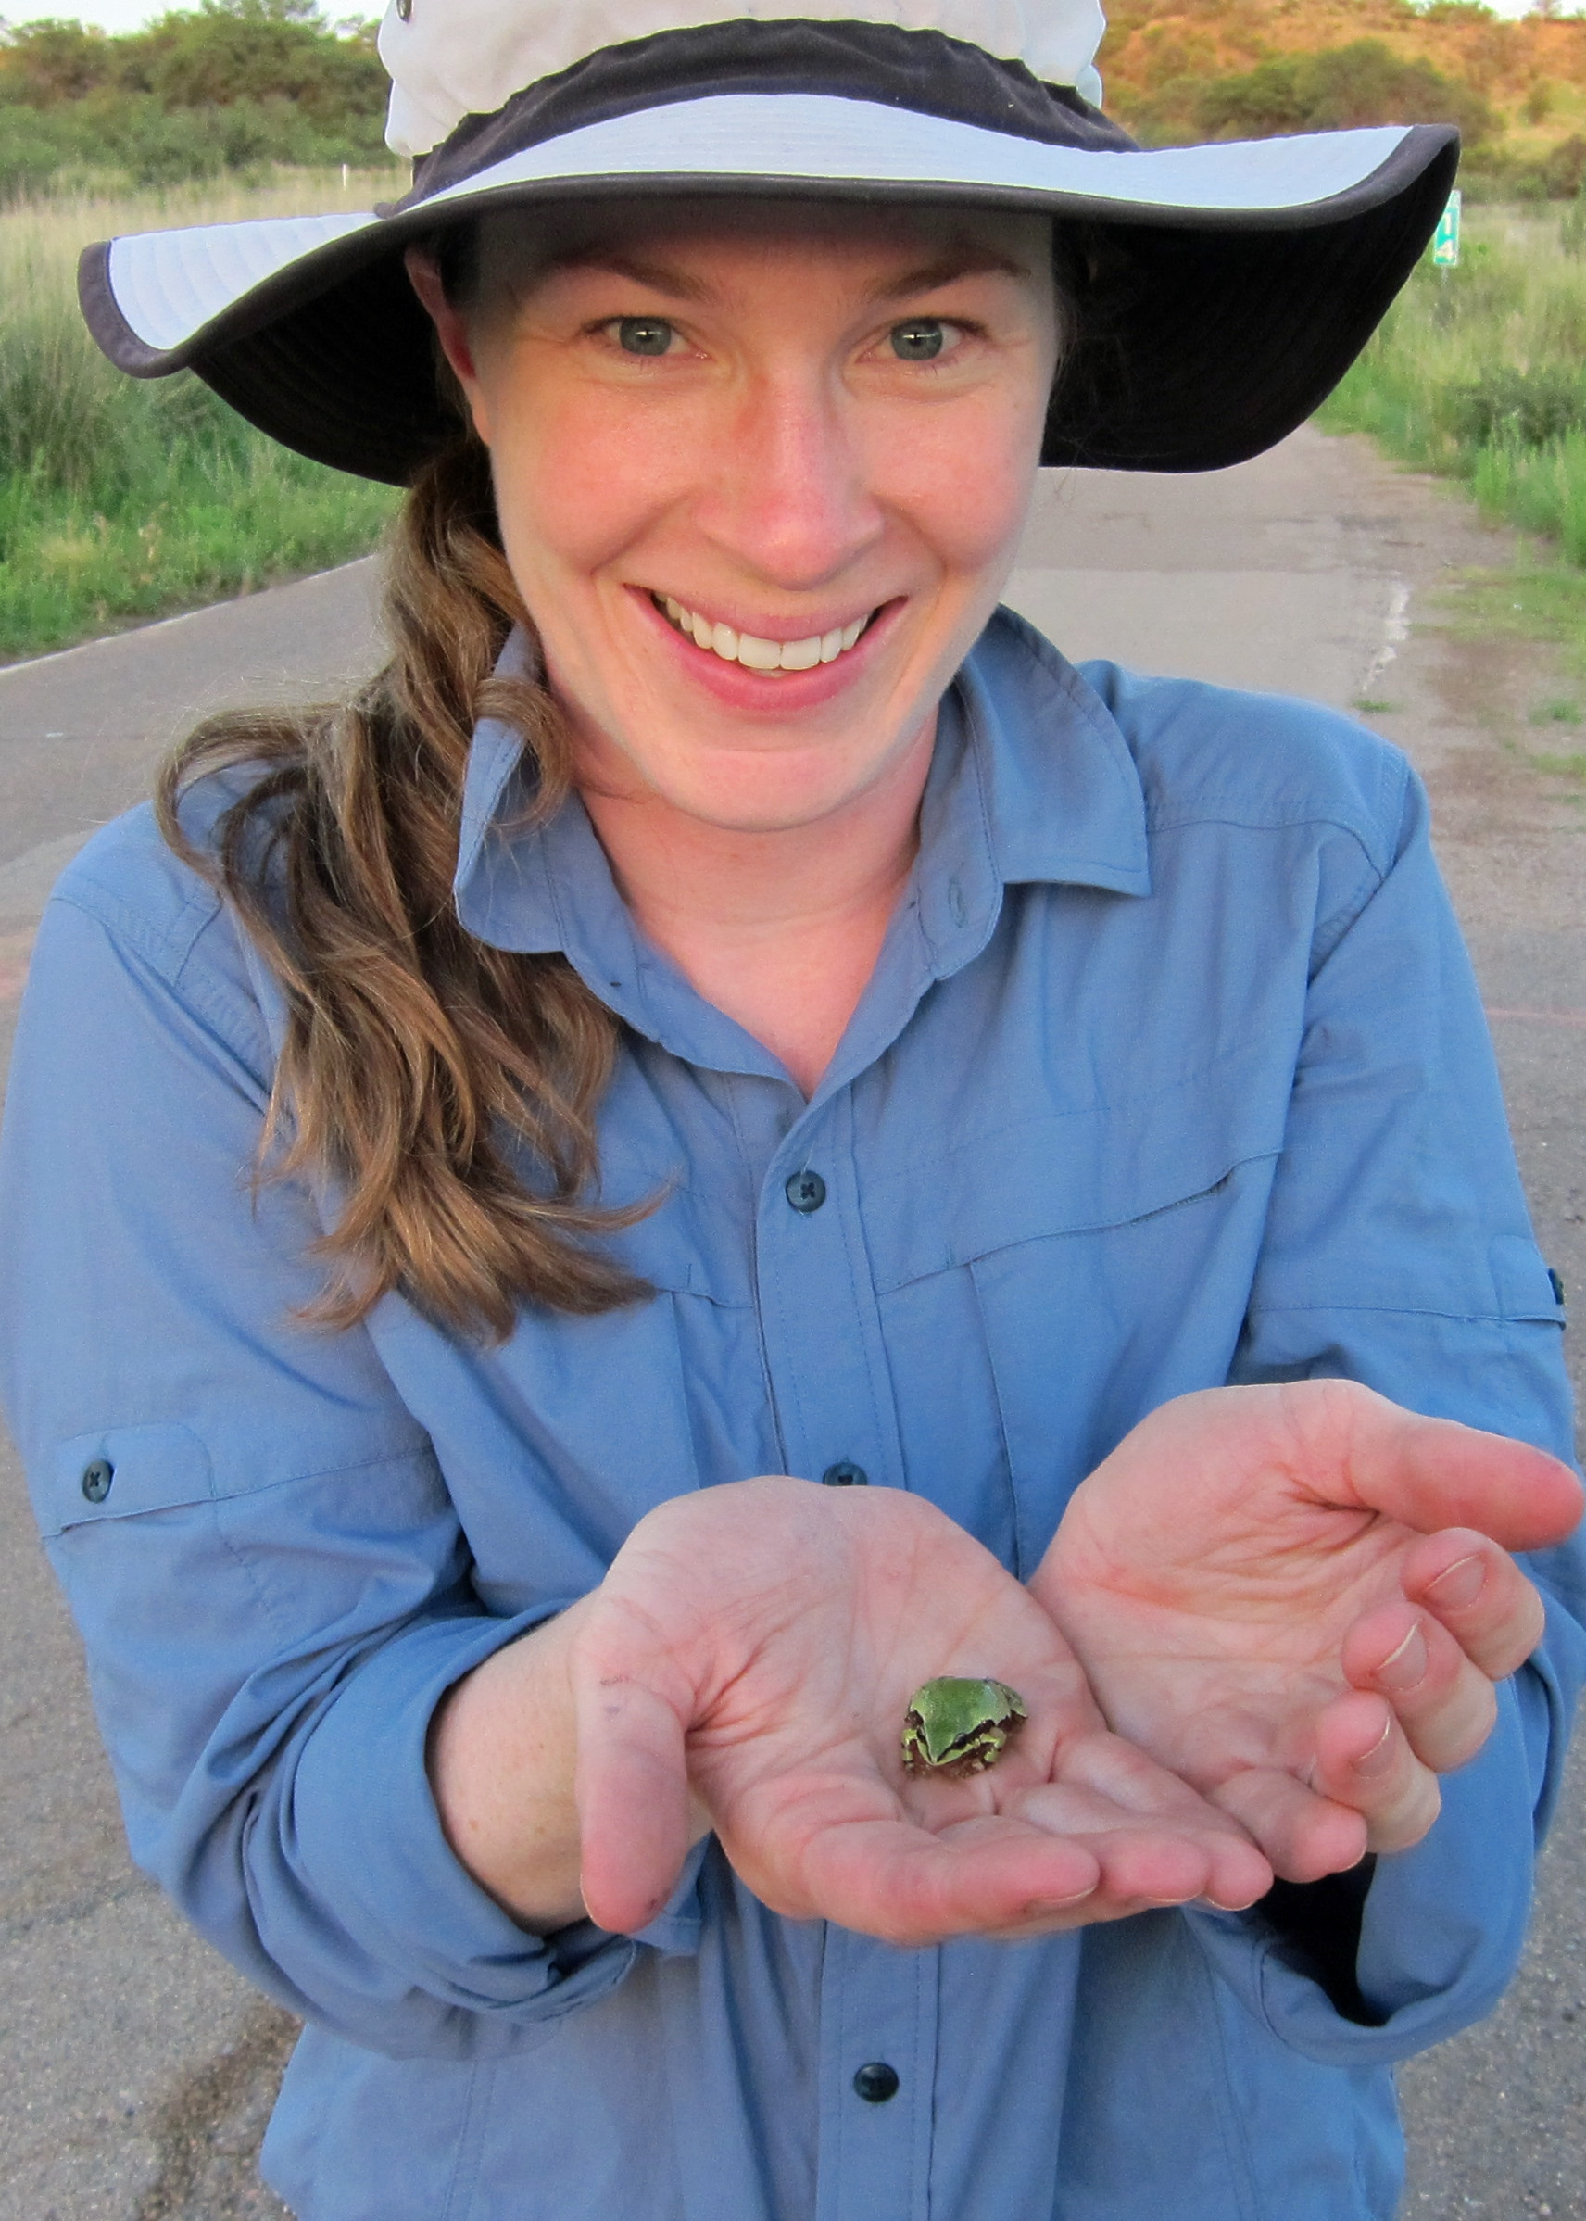
Acknowledgements
Client: Dr. Mims
References:
Functional and geographic components of risk for climate sensitive vertebrates in the Pacific Northwest, USA; Meryl C.Mims, Deanna H.Olson, David S.Pilliod, Jason B.Dunham; December 2018.
https://www.biol.vt.edu/content/biol_vt_edu/en/faculty/Mims/_jcr_content/bio-image.img.jpg/1487105648189.jpg

