Slide 1
5 P’s of DH:
Project Management, Preservation, Policies, Procedures, and Prosopographies
Corinne Guimont
Alex Kinnaman
Virginia Tech University Libraries

Slide 2

Lord Byron and His Times
Lordbyron.org
Developed by David Radcliffe of the Virginia Tech English Department
Began with TEI markup of Byron works and letters and led to a collection of individuals and connections between English society active between 1780 and 1830 containing linked data for persons in literature, politics, and high society
The XML exists in one large file to power the site which frequently breaks down
Notes:
Lord Byron and His Times was Developed by David Radcliffe in the English at Virginia Tech. It is a digital archive of Byron works and letters marked up in TEI. Individuals named in these works were then used to create a prosopography of people active between 1780 and 1830. Radcliffe has since built this prosopography up nearly 30,000 individual records that exist in one very large XML file that is stored on a desktop computer in the professor’s home. The site frequently breaks down because of the size of this file, and it no longer validates in oXygen.

Slide 3
SNiGB: Social Networks in Georgian Britain
The person data from Lord Byron and His Times has led to SNiGB, an English society digital prosopography
Prosopography: a description of a person's social and family connections, career, etc., or a collection of such descriptions
Now managed jointly by the researcher and the University Libraries
Goal to transition project data into a more user-friendly tool for data mining, querying, visualizing, and general exploration of this collection
Notes:
This prosopography has evolved to be a separate project that we are now calling SNiGB, meaning Social Networks in Georgian Britain. SNiGB will be website and database, and serve as a way for researchers to find connections among people based on their family, career, organizations, etc.
As mentioned, the entire work currently exists solely in its XML/TEI format on Radcliffe’s individual computer. Our goals are to migrate the data to a public git repo containing individual XML files for each record and then build an interactive user interface for data mining, querying, visualizations, and general exploration. To do so, I have gathered a team from the library with people of different areas of expertise to assist in reaching this goal.

Slide 4
Project Background
This is the 4th iteration of collaboration with the University Libraries
Project Goals:
Transition management to the Library
Split the XML file and develop a database
Develop the components for a public website, individual profiles, and interactive social networking tools
Develop and implement relevant sustainability policy and plans
Notes:
However, while this is our first time working with this project, this is the fourth time Radcliffe has worked with someone in the Library on both SNiGB and Lord Byron with no permanent solution or outcome. So our personal goals for us in the library are to:
Transition management to the Library: Radcliffe plans to retire in the near future so to ensure long-term success we will need a long-term management plan.
Split the XML and develop a database: ultimately, we need to make this data available to other researchers in its XML form for re-use and (leading to our next goal)
Develop the interactive user interface: to make it user-friendly for exploration
And last and probably most importantly, develop and implement relevant sustainability policy and plans

Slide 5
Challenges in DH
DH projects are complex and dynamic
May often have limited funding and/or supporting personnel
Lack of sustainability planning or general maintenance, especially with class projects
Lack of dedicated support after project completion or grant completion
Notes:
So in looking at this project as a case study, we can identify some common challenges with supporting DH projets.
They’re often very complex and dynamic (especially these larger projects), meaning we can’t always have a set workflow or tool for dealing with them.
A lot of the time, they lack funding and/or support outside of the main researcher, who most likely does not have experience in every aspect of the project lifecycle, leading to ...
They often lack sustainability planning or general maintenance. In my experience working in publishing, a lot of researchers write a book and when its done its done and they don’t have to worry about it, and that carries over to DH projects, where researchers are simply looking for that completion point.
Which means, there’s usually no dedicated support after project completion (or whatever is seen as project completion).

Slide 6
Additional SNiGB Challenges
Researcher depends on the Library for tech support, but also micromanages decision-making
We have space, but no Library-supported funding for DH at this time
No dedicated project manager
How to communicate with the researcher about succession planning and “the death of the project”
Notes:
In addition to the usual challenges of DH, with SNiGB, we are running into a few specific issues
Radcliffe understands the need for the library to take over this project and often says that its a library project, however, he is unable to actually do this which leads to some micromanaging
We have a DH space to support Digital Humanities, but no funding for the development
There is no dedicated project manager - outside of the time that I am able to give it, which is not enough to take on a project of this size
Radcliffe has been working with this data for over 20 years and is unable to consider what we’ve referred to as “the death of the project” or what to do when the interactive user interface is no longer live

Slide 7
Purpose
Create a model for managing DH projects
Create basic templates for future projects to make this more scalable
Actively document decisions
MOUs, finding funding
Develop a reasonable preservation plan for a DH project
Preservation profile, succession plan
Notes:
The purpose in documenting how we go about taking ownership of this project and seeing it through is to create a model that we can use to manage future DH projects. This might include creating templates for preservation planning and policy, data management, and others for a more scalable use; we also want to actively document not just our decisions, but our rationale for those decisions; and developing methods for finding funding and developing Memorandum’s of Understanding.
The second purpose is to develop a reasonable preservation plan for a DH project. DH projects are complex, multimodal, and we are in the process of developing a preservation profile and a succession plan.

Slide 8
Strategies
The 5 P’s
Project Management
Policy Development
Procedure & Documentation
Preservation Planning
Prosopographies
Notes:
We’ve condensed our strategies for handling this DH project into these 5 P’s; project management, policy development, procedure and documentation, preservation planning, and prosopographies, all of which we will discuss further.

Slide 9
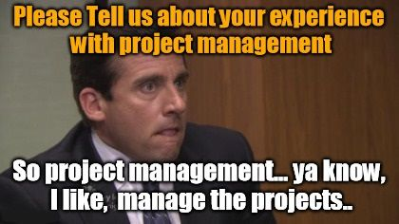
Project Management
Building the team
Regular meeting times
Identifying documentation needs early on
Developing benchmarks with deadlines
Notes:
Our first strategy (and perhaps our greatest challenge) is project management. As we mentioned, this project is in its fourth iteration of collaboration between the researcher and a Library group and the researcher will retire sooner rather than later, so it’s critical that we bring this project to completion.
First, we built a diverse team, which will be described in the next slide.
Second, and I know it’s obvious, but we established regular bi-weekly meeting times with the researcher and the project group, which has kept us more on track than anything.
Third, we identified certain documentation needs early on by looking at general grant guidelines, other project management resources in our Library, and some homegrown tools that we developed.
Finally, we developed benchmarks with hard and soft deadlines.
We know that all of these things will evolve and need to be adapted to any changes, so it’s important to not get hung up on not meeting a specific self-imposed deadline.

Slide 10
Project Management - Building the Team
Project team consists of a publishing specialist, an archivist, 2 digital preservationists, and the researcher
IT and data services are available as consultants
Outsourcing database components to Performant
Building an Advisory board
Notes:
Building the volunteer project team has been the key to sustaining this project. The project team consists of a digital scholarship coordinator, an archivist, two digital preservationists with different backgrounds, and the researcher. We also looped in IT and data services early on and they are available as consultants.
We also realized that our project group and our LIbrary ITS couldn’t reasonably handle some of the technical work in the first phase of this project, so we have outsourced the database components to Performant Software. We are in regular communication with them and have already hosted an all-day, in-person retreat to hammer out the details. Finally, we are in the process of building an advisory board consisting of individuals outside of Virginia Tech.

Slide 11
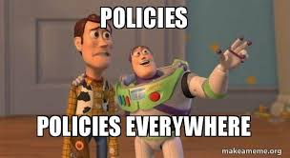
Policy & Plan Development
MOU to distinguish roles and to determine who retains responsibility for the project during and after completion
  Don’t bite of more than you can chew
Data Management Plan
  Grant requirements; data handling
Preservation Policy
  Sustainability
Succession Plan
  What happens if….
Notes:
As we’ve built our team and have developed our individual roles, our next steps are to document those roles in some form of MOU or agreement, so that it is clear to Radcliffe and others (including ourselves!) who has committed what to this project.
For the Data Management plan, we have met with our Data Management Consultant and began developing a plan that meet grant requirements, but also includes steps that are possible to actually carry out so it will be clear to us and whoever else may be working on this in the future what needs to be done.
We are using a preservation profile to develop a preservation policy that will be tied to the University LIbraries’ preservation policy.
We will also be developing a succession plan, which the researcher is less willing to discuss because it implies that the project will end. We are trying to organize the data using archival strategies from the beginning and provide relevant READ ME files and other documentation then this should be less of an issue, but we still need to find a way to approach our researcher about this topic.

Slide 12
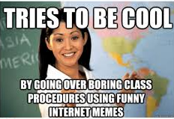
Procedure & Documentation: Procedure
Transitioning management from the researcher to the project team
Determining responsibilities
Notes:
While Radcliffe is extremely knowledgeable on his research, he will completely admit that he doesn’t understand the needs of the full project life cycle and for that reason he wants the project to be managed by a whole team rather than just himself and with that we have determined responsibilities between who is working on schemas, documentation, grant writing, etc.

Slide 13
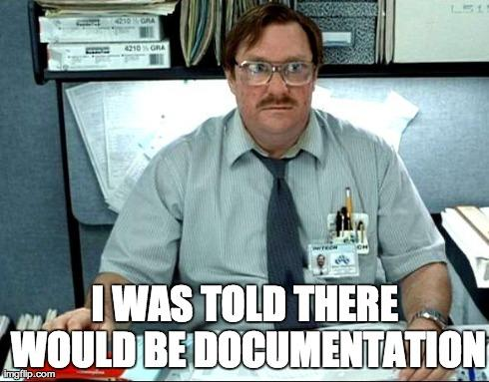
Procedure & Documentation: Documentation
Develop phases with steps for each phase
Planning & splitting XML file, developing the
Database in GIT
Public interface, design and testing
Outlining the process and needs before development begins
Gantt chart, schedule of completion
Continuously adding to and appraising documentation
Decision records, use cases, environmental scan
Notes:
In terms of documentation that is not a policy or plan or preparation for a policy or a plan, we first outlined two phases and developed potential steps for each. In our case we have two major phases, the first being a planning phase and also when we get the XML file split and ingested into a Git database; and the second phase is developing and designing the public interface and conducting user and accessibility tests.
We also wanted to outline the needs and the potential process for these phases, and at this point we have developed a gantt chart and schedule of completion that we are constantly adapting.
Finally, we are generally trying to keep up with our documentation by tracking our decisions and accomplishments (which is also useful as we work on several grants), developing use cases and user stories, and conducting an environmental scan of other similar projects that are publicly accessible.

Slide 14
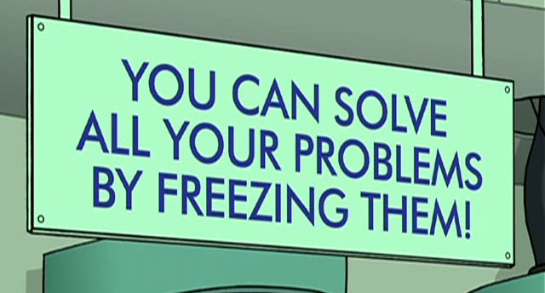
Preservation Profile
10 components:
Basic Info
Responsible Parties
Content Type profile
Preservation Storage
Preservation Activities
Access, Search, & Retrieval
7. Usage and Impact
8. Metadata and
Controlled Vocabularies
9. Government or Other
Funding Reqs
10. Intellectual Property
Rights, Rights, PII, and other Sensitive Content
Notes:
The preservation profile is something that we adapted from a rubric used at Indiana University by our digital preservation technologist. We modified it, adding fields relevant to VTUL and adding more components from ISO 16363, the trusted digital repository standards. We have provided it to the content managers of our institutional repositories for feedback, and they have filled them out. As we preserve each institutional repository collection, the profile serves two purposes; to identify any needs that may prioritize one collection over another to be preserved or addressed first; and two be preserved along with the collection as a general overview.
It’s composed of 10 sections, collected in a spreadsheet, that provide information on various aspects that may require special consideration.

Slide 15
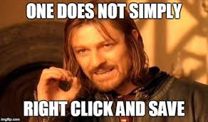
Preservation Plan
Profile to identify all aspects of a project and its data
  File types/formats; special software; grant requirements; other special considerations
Fill out the profile as we develop
Helps to guide decision-making
Tracks progress
Final preservation plan is based on the profile
Notes:
The profile is made for “collection-level” appraisal (“collection referring to a general group of content, not necessarily any one specific definition of collection), but we thought we could use SNiGB to adapt the profile to a project. The primary difference between the collections in our institutional repositories and projects like SNiGB is that there is a combination of datasets, scripts, HTML and CSS, individual profiles in RDF/XML, and so on, and all of these components will continue to be updated for several more years at minimum, meaning ongoing harvesting will be necessary for a longer period of time. The profile helps us to identify these components, determine the best strategies to preserve them, and decide how we are combining those strategies into a single workflow.
This profile will then be translated to a formal preservation plan (hopefully one that can be applied to other future DH projects).

Slide 16
Preservation Plan
Packaging and workflow: TBD!
Include metadata, paradata, READ ME files, and other relevant documentation
Ingest into VTechData, our data repository → Automatic ingest into our preservation system
Web Archiving in the VTWA
Current in-progress strategy is this, but will be adapting as we go forward
Notes:
The packaging and workflow specifics are still a bit elusive since we are in the process of building the database. However, we know that we will be including relevant metadata, paradata and decision documentation, and all other relevant documentation. We also know that we will be bagging and ingesting the data into VTechData, our data repository, which in a few years will also mean automatic ingest into our preservation system. We also use Archive-It for web archiving for the current website and will also add the new website when it is live.
As our Library preservation program evolves, so will the details of the components that we preserve in this and other DH projects. This is just where we are now.

Slide 17
Moving Forward
Scalability: this project is hands-on, but how can our process scale to support multiple projects
  Different levels of support provided
  Different project sizes
Outreach: How do we encourage other project managers to plan early on
  Any templates we can provide to ease the process (DMP questionnaire, preservation profile), and provide additional resources in a centralized location
Notes:
So everything we’ve presented so far shows how hands-on we’ve been with this project, but that obviously isn’t scalable. As much as I know many would love it, we can’t bring in four librarians to support every DH project at this level. So our hope is to develop templates and workflows that can be shared with future project teams to encourage early planning.

Slide 18
Limitations in applicability
Our situation doesn’t apply well to people/institutions with limited technical expertise or highly limited technology
We also have a DH community and space within the Library and University
Our tools are customized for VTUL policy and procedure, but they could be adapted
Notes:
For the sake of transparency, we wanted to acknowledge that our strategies have their limitations in applicability for other projects. We do have a significant number of people with technical expertise, ontology development, and we have access to several on-site consultants. We also have a Library and University DH communities, and a physical space within the library. Finally, our tools are customized for VTUL policy and procedure, but once we release our templates for public access, they could be adapted.

Slide 19
Takeaways
Plan for sustainability early, even before you have to deal with grant requirements
  Preservation profile, plan, data management
With preservation, doing anything is better than nothing
Break up your project into phases with their own benchmarks
Be prepared to not have complete success
Produce deliverables - make the data and content accessible somewhere, even if it isn’t in it’s ideal format
Notes:
In summary, our strategy has been to plan for sustainability early, even before your have other pressure from external sources like grant requirements or potential deliverables from administration.
With DH projects like this where sustainability is not always the first priority and you have to come into the middle of it and try to adapt it, taking any preventative preservation strategies is better than taking none.
We’ve also planned to break the project into phases with each phase having some sort of outcome (e.g., white paper, shared data, grant proposal, etc.), this is uplifting for the team to feel like they’ve accomplished something, it’s also helpful for promotion and tenure.
It also helps with the idea that there might not be complete success, but some smaller outcomes will still show some success.

Slide 20
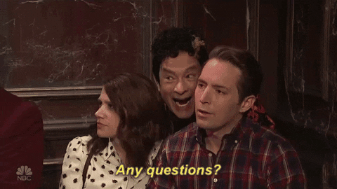
Thank you!
Corinne Guimont
Digital Scholarship Coordinator
gcorinne@vt.edu
Alex Kinnaman
Digital Preservation Coordinator
alexk93@vt.edu
Notes:
Thank you for your time and please feel free to contact us!

