Slide 1
CS 5604: Information Storage and Retrieval
ProjCINETViz
by
Maksudul Alam,
S M Arifuzzaman, and
Md Hasanuzzaman Bhuiyan

Slide 2
Overview
Recap
Features
Demonstration
Technical Challenges
Future work

Slide 3
Project Description
Developed a visualization module
  Visualize graphs using Gephi
  Integrate this visualization module with CINET
Supports large network graphs

Slide 4
Gephi
Java based visualization and exploration platform
Interactive
Visualize all kinds of networks
Compatible with Windows, Linux and Mac OS X
Open-source and free

Slide 5
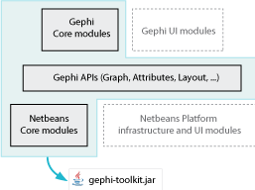
How to use Gephi?
Stand-alone desktop application
Java based Gephi Toolkit library
We will use Gephi Toolkit library

Slide 6
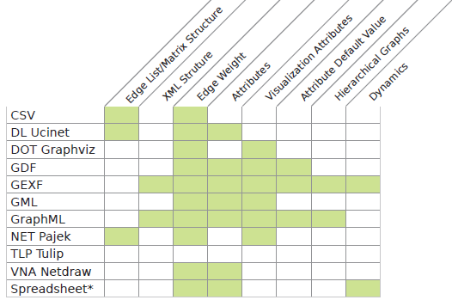
Network Representation

Slide 7
Network Visualization
Typical steps to visualize a network:
1. Layout
  Random
  Force Atlas
  Yifan Hu’s
2. Feature based organization
  Degree
  Betweenness centrality
  Closeness centrality
  Modularity
3. Visualization in Web Browser
  Java Applet
  Javascript
  Flash
  WebGL

Slide 8
CINET
Cyber-Infrastructure for NETwork Science
Easy-to-use cyber-environment
Provides computational and analytic environment for network analysis
Developed in NDSSL lab
Funded by NSF

Slide 9
Integration of Visualization to CINET
Preprocessed viz. data
Viz. Interface

Slide 10
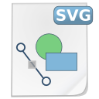






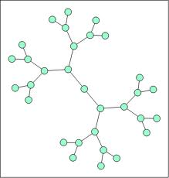

Typical Visualization Workflow
Process Data for Web Browser
Color, Size, Label
Display Network in Web Browser
Web Rendering
Script
Store Rendered Graph
Visualization
Core
Generate Gexf from CINET Graphs
CINET Server
Network Analysis Core
User
Network Analysis
User Parameters
Apply Layout
Gexf Generation
Core
Layout Core
CINETViz

Slide 11
CINETViz – Features
Mimic the core functionalities of Gephi Desktop Application into web interface:
  Layout
  Ranking based on parameters
  Partitioning
Dynamic range of visualization
  User can pick how the node color, size would vary and by how much
Store rendered networks into organized structure

Slide 12
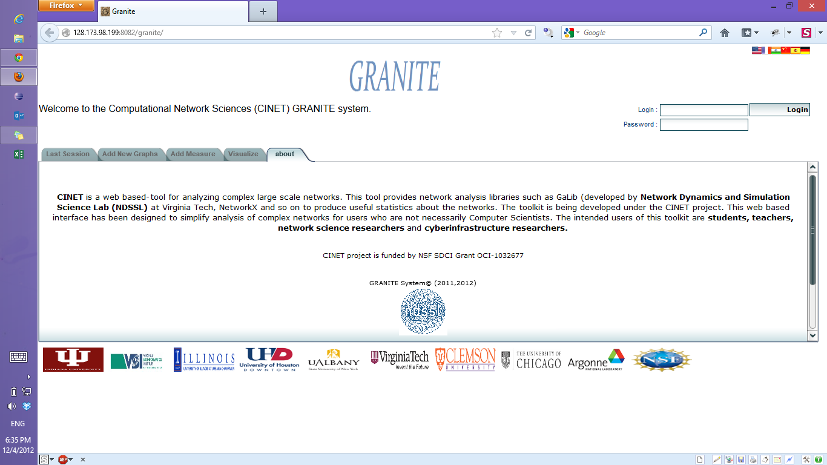
CINETViz-DEMO
Main Screen
http://128.173.98.199:8082/granite

Slide 13
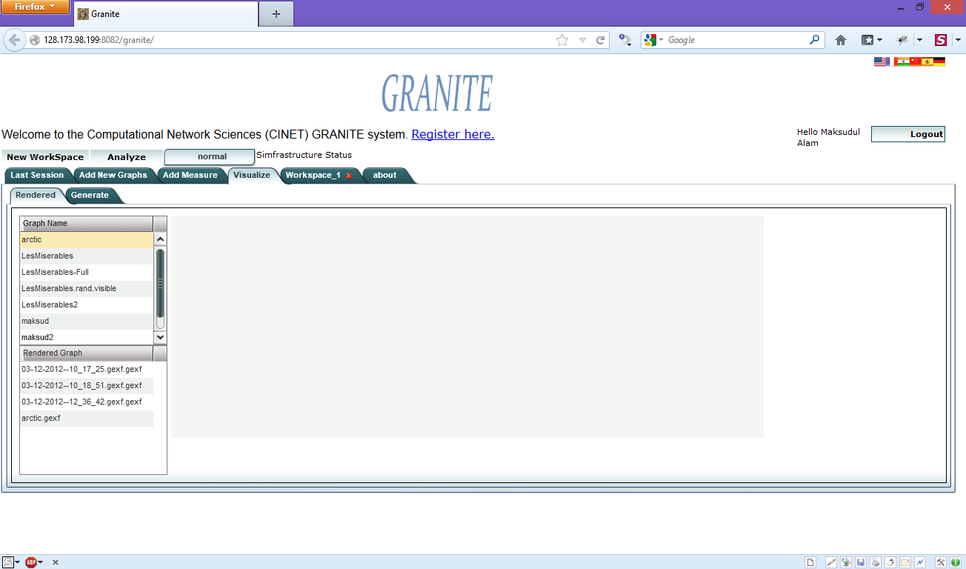
CINETViz-DEMO
Visualization integrated as a Tab into CINET interface

Slide 14
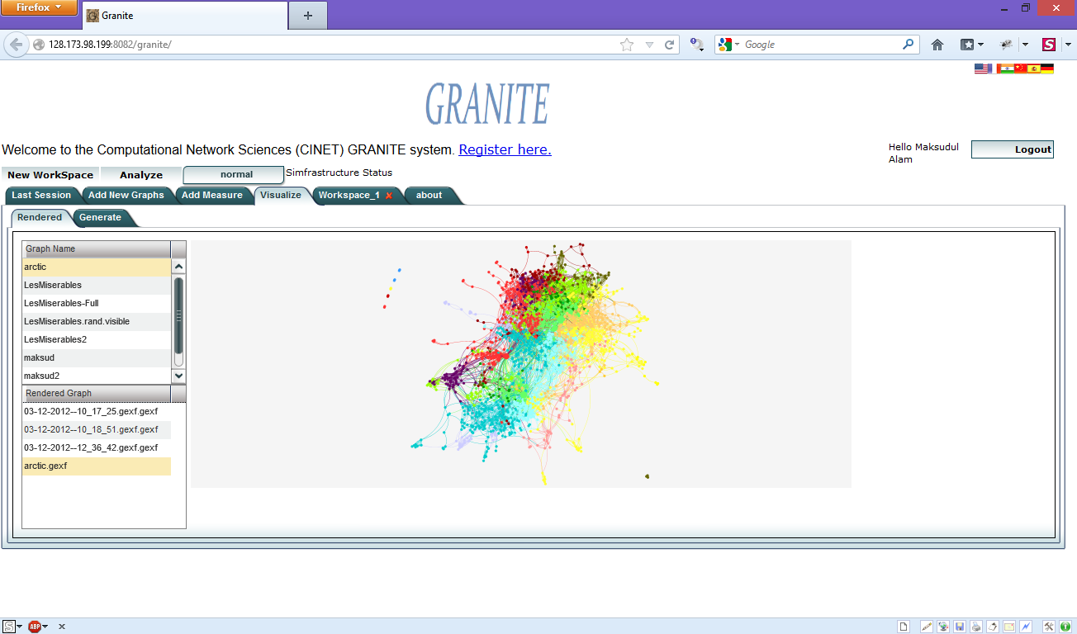
CINETViz-DEMO
User can visualize pre-rendered network or submit new network visualization.

Slide 15
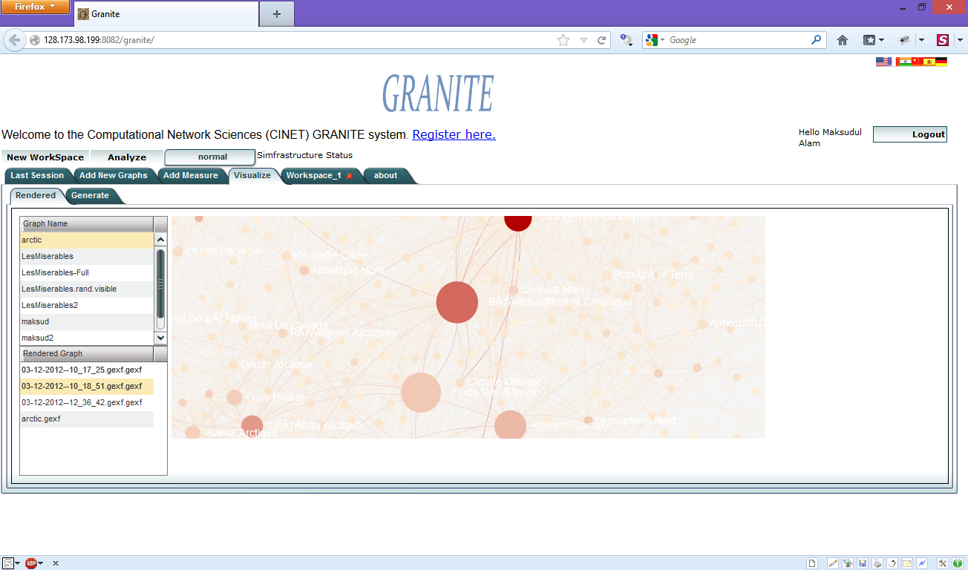
CINETViz-DEMO
User can visualize pre-rendered network or submit new network visualization.

Slide 16
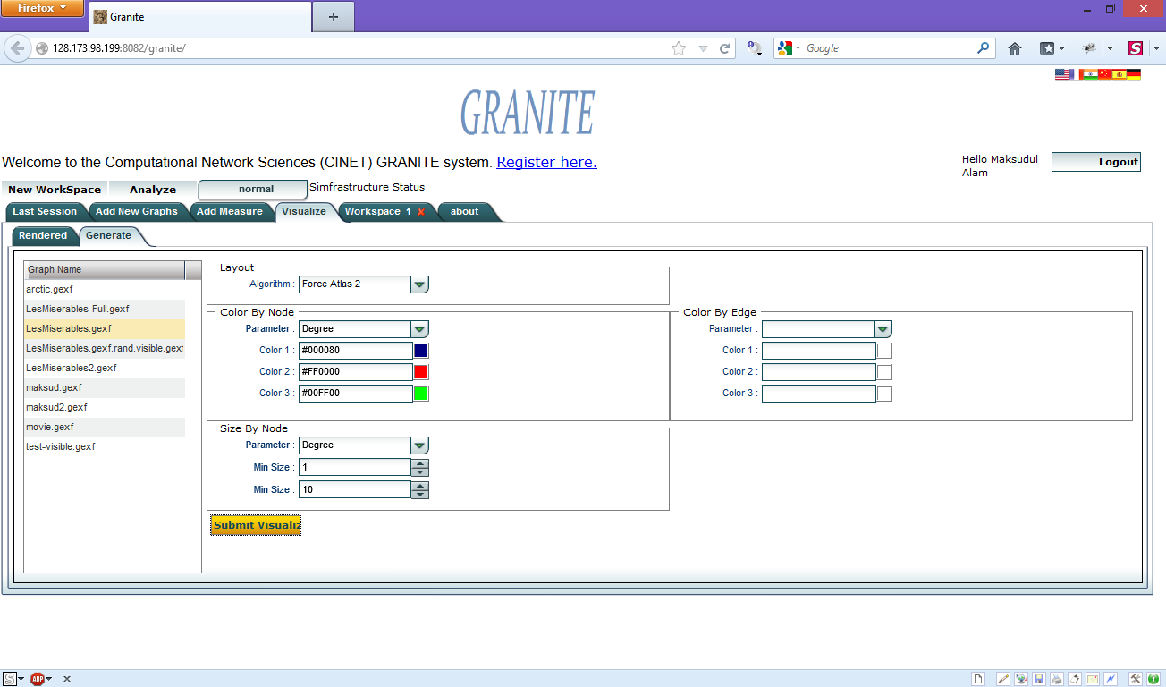
CINETViz-DEMO
To generate new network visualization user can pick a network and select appropriate visualization parameters

Slide 17
Difficulties
Graph format
  Diverse
  Conversion
Data transfer from server to web app
  Latency, bandwidth, browser compatibility and support
Integration with CINET
  Compatibility with existing architecture
  Issues with smart-gwt etc.

Slide 18
CINETViz Implementation Challenges
Study of CINET GRANITE framework
Integration of visualization toolkit into web browser
  Communicate between GWT and sigmajs visualization library using native javascript
Communication between web server and high performance cluster
Implementation of visualization methods (coloring, sizing, layouting) using gephi-toolkit programmatically

Slide 19
Visualizing Large Networks
Large network if |V| >= 10,000 or |E| >= 50,000
Choose a root node
  Randomly
  User defined
Using BFS, explore from root up to:
  Pre-specified depth (i.e., 4 or 5)
  Pre-specified number of nodes (i.e., 200 nodes)

Slide 20
Future Work
Workflow
  Visualizing the output
Providing more information
  Showing node label, id, edge weight and etc.
Filtering
  Visualize small part of graph
Graph organization by applying multiple algorithms
  For example, we want to apply both page rank and betweenness centrality
Comparison of the different visualization
  Using different measures

Slide 21

Questions and Comments

