Slide 1
Reducing Noise
CS5604: Final Presentation
Xiangwen Wang, Prashant Chandrasekar

Slide 2
Acknowledgements
Integrated Digital Event Archiving and Library (IDEAL)
Digital Libraries Research Laboratory (DLRL)
Dr. Fox, IDEAL GRA’s (Sunshin & Mohamed)
All of the teams especially the Hadoop & Solr team

Slide 3
Goal
Providing “quality” data
Identify and remove “noisy” data
Process and clean “sound” data
Extract and organize data

Slide 4
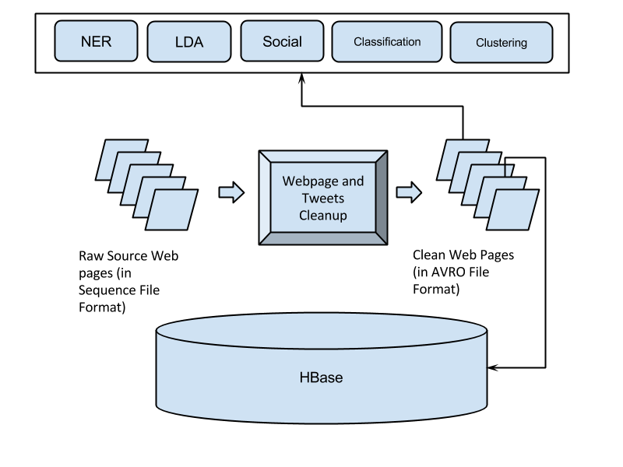
Reducing Noise in IR System

Slide 5
Cleanup Process
Raw Tweets Collections in Avro Format on HDFS
Lists of URLs
Nutch
Raw Files & Metadata in SequenceFile Format
Clean Tweets in Avro Format
Clean web pages in Avro Format

Slide 6
Libraries/Packages
BeautifulSoup4:
Parse text out of HTML and XML files.
Readability:
Pull out the title and main body text from a webpage.
Langdetect:
Detect language of a text using naive Bayesian filter.
Re:
Provide regular expression matching operations.
NLTK:
Natural language processing (stemming, stopwords removal).

Slide 7
Cleaning Rules
Remove Emoticons
Remove Non-ASCII Characters
Filter english text only
Extract URLs, (Tweets) Hashtags, (Tweets) User Handles
Stopwords removal, Stemming
Remove invalid URLs
Remove profane words
Implemented with regular expressions, e.g.

Slide 8
Tweets cleaning process
Tweets collections in AVRO Format
ASCII characters only
English only Tweets
Matching regular
expressions
Stop words and profane
words removal
Clean Tweets
Clean Tweets
in AVRO format
with pre-setted schema
URLs, Hashtags,
User Handles, etc.
Stemming
Clean Tweets 2

Slide 9
{
'lang': 'English',
'user_id': '81703236',
'text_clean': 'News Ebola in Canada Suspected patient returns from Nigeria to Ontario with symptoms',
'text_clean2': 'new ebol canad suspect paty return niger ontario symptom ',
'created_at': '1407706831',
'hashtags': 'CharlieHebdo|Shooting’,
'user_mentions_id': 'CharlieHebdo',
'tweet_id': '498584703352320001',
'urls': 'http://t.co/KoOD8yweJd',
'collection': 'charlie_hebdo_S',
'doc_id': 'charlie_hebdo_S--8515a3c7-1d97-3bfa-a264-93ddb159e58e',
'user_screen_name': 'toyeenb',
. . .
}
{
'iso_language_code': 'en',
'text': u"News: Ebola in Canada?: @CharlieHebdo #CharlieHebdo #Shooting Suspected patient returns from Nigeria to Ontario with symptoms http://t.co/KoOD8yweJd",
'time': 1407706831,
'from_user': 'toyeenb',
'from_user_id': '81703236',
'to_user_id': '',
'id': '498584703352320001’
. . .
}
Original Tweet Example
Clean Tweet Example

Slide 10
Web pages cleaning process
Raw Files & metadata in Sequence File format
Raw consolidated files & metadata in Text format
Re
Titles & “Useful” HTML
HTML only (raw)
Identified individual files with corresponding URLs
Readability
Beautifulsoup
Content only
English only Text
ASCII only Text
Langdetect
Re
Clean web pages
in AVRO format
with pre-setted schema
Clean Text and Extract URLs

Slide 11
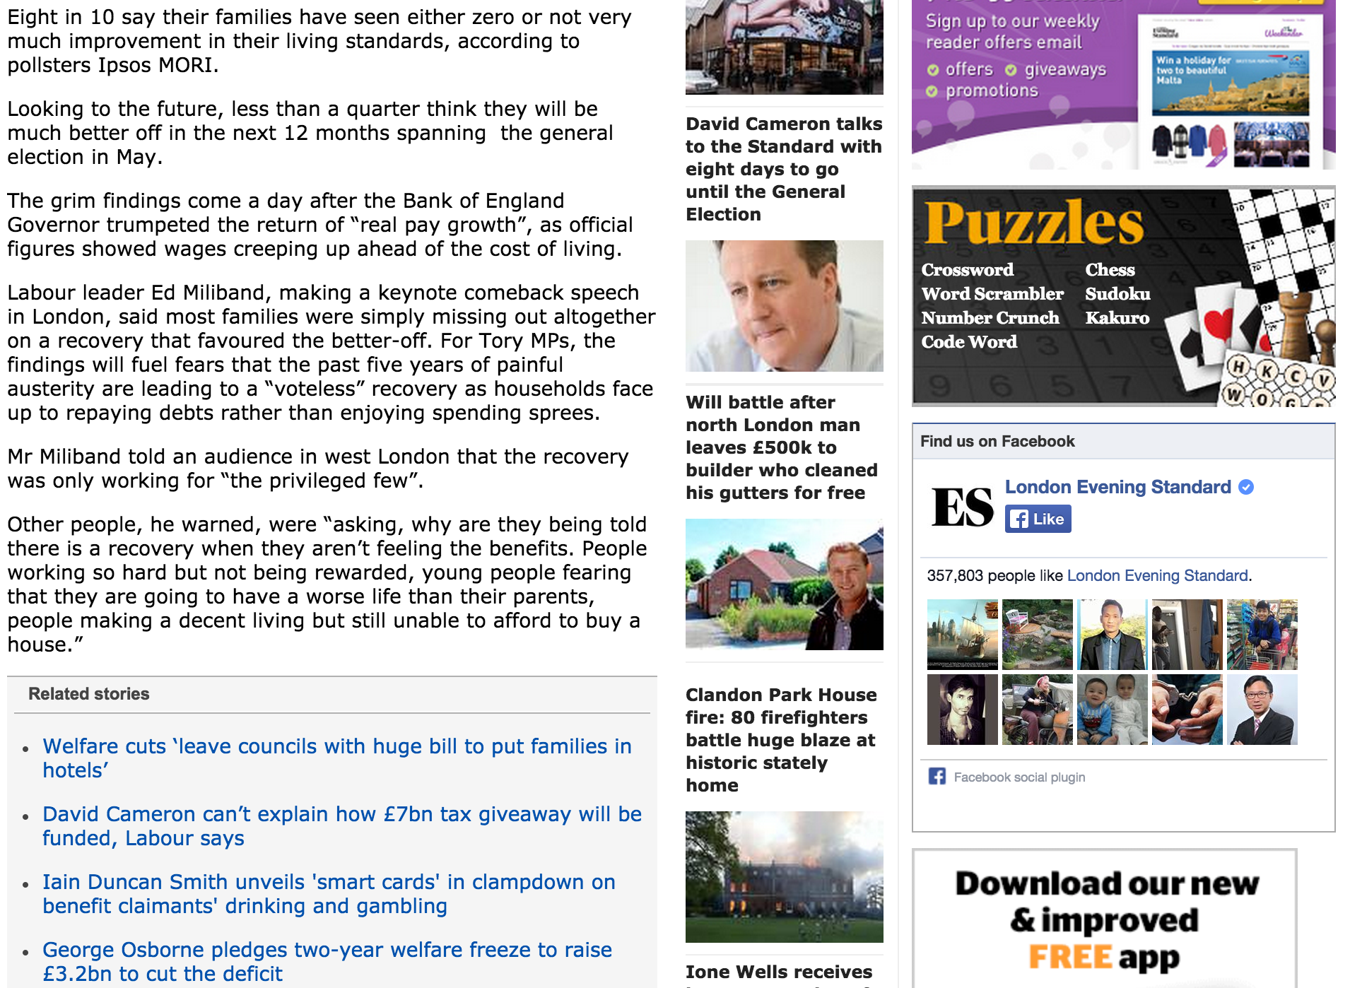
Web Page Cleaning: Original Page

Slide 12
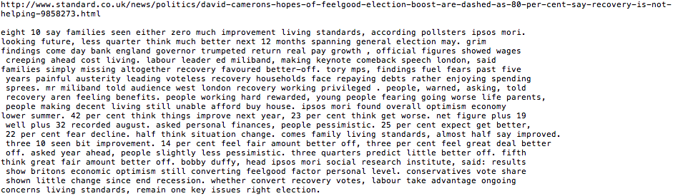
Web Page Cleaning: Clean Text

Slide 13
Output Statistics: Tweets
Collection Name | Number of Tweets | Number of Non-English Tweets | Percent of Tweets cleaned | Execution Time (seconds) | Size of Output File (MB)
suicide_bomb_attack_S | 39258 | 2083 | 95% (37175) | 32.18 | 15.8
Jan_25 | 911684 | 415873 | 55% (495811) | 475.18 | 210.2
charlie_hebdo_S | 520211 | 346989 | 34% (173222) | 85.46 | 70.1
ebola_S | 621099 | 240655 | 62% (380444) | 422.66 | 136.3
election_S | 931436 | 101659 | 90% (829777) | 823.77 | 323.5
plane_crash_S | 273595 | 7561 | 98% (266034) | 237.96 | 100.0
winter_storm_S | 493812 | 7772 | 99% (486040) | 444.90 | 192.9
egypt_B | 11747983 | 3797211 | 68% (7950772) | 7271.36 | 3313.2
Malaysia_Airlines_B | 1239606 | 462651 | 63% (776955) | 769.62 | 305.3
bomb_B | 24676569 | 3955957 | 84% (20720612) | 16506.19 | 6537.7
diabetes_B | 8382585 | 2845395 | 67% (5537190) | 5452.62 | 2073.2
shooting_B | 26381867 | 3535187 | 87% (22846680) | 19377.55 | 8403.2
storm_B | 27286337 | 4949268 | 82% (22337069) | 18649.99 | 7591.7
tunisia_B | 6061926 | 3322288 | 46% (2739638) | 3265.69 | 1004.4

Slide 14
Output Statistics: Web pages
Collection Name | Number of web pages | Percent of web pages cleaned | Execution Time (seconds) | Size of Output File (MB)
ebola_S | 1279 | 36% | 64.51 | 28.58
election_S | 266 | 72% | 16.15 | 11.44
charlie_hebdo_S | 339 | 87% | 21.54 | 17.02
winter_storm_S | 1726 | 66% | 79.93 | 65.06
egypt_B | 6,844 | 45% | 330.12 | 143.42
shooting_B | 10843 | 81% | 524.49 | 462.11

Slide 15
Challenges
Non-ASCII characters
Language of document
AVRO with Hadoop Streaming
Notes:
Garbled

Slide 16
Next Steps and Future Work
Next Steps
Clean big collection
Reducing Noise using MR
Future Work
Cleaning Document with multiple languages
Cleaning different document formats

Slide 17
References
- Steven Bird, Ewan Klein, and Edward Loper, Natural language processing with Python. O'Reilly Media, 2009.
- NLTK project, NLTK 3.0 documentation. http://www.nltk.org, accessed on 02/05/2015.
- The Apache Software Foundation, Solr Download. http://lucene.apache.org/solr/mirrors-solr-latest-redir.html, accessed on 02/05/2015.
- Leonard Richardson, Beautiful Soup Documentation. http://www.crummy.com/software/BeautifulSoup/bs4/doc/, accessed on 02/05/2015.
- Christopher Manning, Prabhakar Raghavan, and Hinrich Schütze, Introduction to information retrieval. Vol. 1. Cambridge: Cambridge University Press, 2008.
- Alex J. Champandard, The Easy Way to Extract Useful Text from Arbitrary HTML. http://ai-depot.com/articles/the-easy-way-to-extract-useful-text-from-arbitrary-html/, accessed on 02/05/2015
- Joseph Acanfora, Stanislaw Antol, Souleiman Ayoub, et al. Vtechworks: CS4984 Computational Linguistics. https://vtechworks.lib.vt.edu/handle/10919/50956 accessed on 02/05/2015.
- Ari Pollak, Include OutputFormat for a specified Avro schema that works with Streaming.
https://issues.apache.org/jira/browse/AVRO-1067, accessed on 03/29/2015.
- Michael G. Noll, Using Avro in MapReduce Jobs With Hadoop, Pig, Hive.
http://www.michael-noll.com/blog/2013/07/04/using-avro-in-mapreduce-jobs-with-hadoop-pig-hive/, accessed on 03/29/2015.
- Leonard Richardson, BeautifulSoup, http://www.crummy.com/software/BeautifulSoup/, accessed on 04/30/2015.
- Yuri Baburov, python-readability, https://github.com/buriy/python-readability, accessed on 04/30/2015.
- Michal Danilák, langdetect, https://github.com/Mimino666/langdetect, accessed on 04/30/2015.
- Python Software Foundation, Regular expression operations, https://docs.python.org/2/library/re.html, accessed on 04/30/2015.

Slide 18
Thank you
{wxw, peecee}@vt.edu

