Slide 1



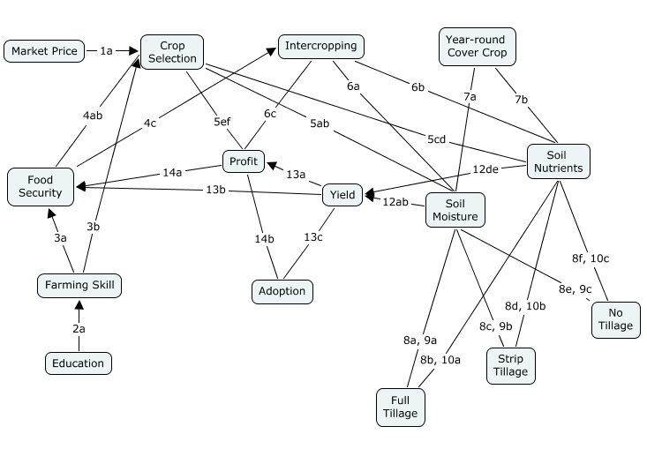
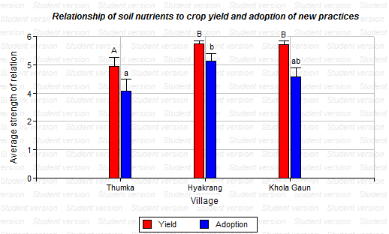
Using Fuzzy Cognitive Mapping to Understand Farmer's Perception of Sustainable Agricultural Practices for Enhanced Food Security in Nepal
J. Halbrendt¹, S. Gray¹, S. Crow¹, L. Shariq¹, and B.B. Tamang²
¹University of Hawaii Dept. of Natural Resources & Environmental Management, ²Local Initiatives for Biodiversity Research & Development (Li-Bird)
Introduction
Agricultural production in the central mid-hill region of Nepal supports 44% of the nation’s population of 29.8 million
Populations in this region are predominantly smallholder subsistence farmers with less than 2 hectares of cultivated land
This area is a prime focus for NGO and researcher groups to introduce conservation agricultural practices; however, long-term adoption of such technologies remain a challenge
Fuzzy Cognitive Mapping (FCM) is a method to understand values and perceptions involved in farmer decision-making of new agricultural technologies
Methods
Surveys were conducted with smallholder, subsistence farmers from three central mid-hill villages in Nepal
Initial surveys compiled a list of factors important to farmer decision-making regarding new agricultural practices, August 2011
A mental model was developed using data from the initial surveys, combined with causal relationships and agricultural knowledge
A second survey used a Likert scale to determine the strength of the relationship between the factors identified in the initial survey, January 2012
Soil samples were collected from each village to measure macro and micro nutrient status, texture, and organic matter
An analysis of variance was used to assess significant differences in the data (α=0.05, Infostat 2011)
Figure 1. Community mental model
Soil nutrients were viewed as having a stronger relationship with crop yield and long-term adoption in Hyakrang and Khola Gaun villages
Thumka soils were found to have higher silt and clay sized particles, and were associated with higher micronutrient content (Fe, Cu, Mn), as compared with the other villages
Fertile soils, such as in Thumka, may be associated with a reduced farmer perception of the causal relationship between soil and yield, and soil and the likelihood of adoption
Objectives
To develop community mental maps representing the relevant factors and relative importance of such factors in the decision-making processes for agricultural practices in farmer groups
To use the mental maps to determine the differences in values and perception between the stakeholder groups, as they relate to understanding the components and connection between components of an agricultural production system
To explain the differences in perceptions among farm communities relating to relevant decision-making factors for adopting new practices based on local ecological conditions
Table 1. Survey respondent demographics
Figure 2. Perception of relation between soil nutrients with crop yield & adoption
Results and Discussion
Survey respondent demographics (Table 1) show that average farmer age ranged from 33-40 years, while education was relatively low, with primary school being the highest level attained
The community mental model (Figure 1) developed from the initial survey shows the causal relationships between the factors relevant to farmer decision-making
Statistical analysis showed similarities in the perception of many of the causal relationships
Differences were observed in the perception of the relationship between soil nutrients with crop yield and long-term adoption (Figure 2)
Mental Models
Internal constructs that provide interpretation and structure of an external environment
Constructed as an individual navigates time and space and becomes exposed to culture, environment, and experience
Shared mental models in communities are essential to the way societies structure their environments and build expectations
Community mental models are developed from individual surveys and identify relevant factors and causal relationship between such factors
Conclusions
Farmer perception of the agricultural system is based on experience farming, as well as the ecological environment
It is vital in planning for agricultural development projects to understand both the cognitive processes and environmental factors which may influence farmer decision-making with regards to conservation practices
Project funded by: USAID SANREM-CRSP
Additional support provided by: Institute of Agriculture & Animal Sciences, Tribhuvan University , Nepal

