Slide 1
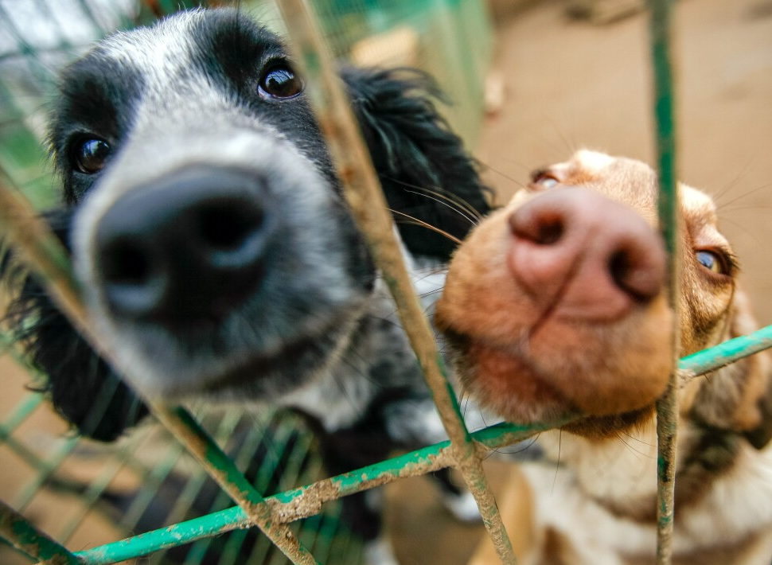
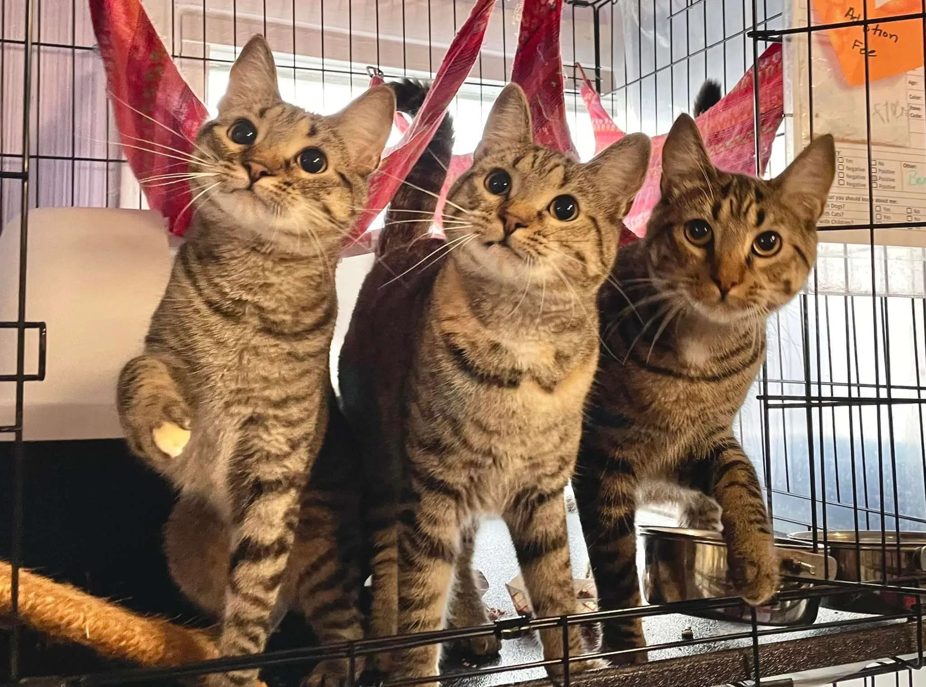
Sterilization Timing Effects on Lengths of Stay in Shelter Dogs and Cats
https://www.wmar2news.com/list-of-no-kill-animal-shelters-in-maryland
  FINAL PROJECT SUBMITTED BY: AMITA MCDONALD
VIRGINIA TECH, APPLIED ANIMAL BEHAVIOR AND WELFARE
COMMITTEE CHAIR: DR. LISA GUNTER, PHD, CAAB, CBCC-KA
AUG 9, 2024
https://woodstockcats.org/
Notes:
Thank you all for being here. My project is on sterilization timing and how it effects the lengths of stay in shelter dogs and cats.

Slide 2
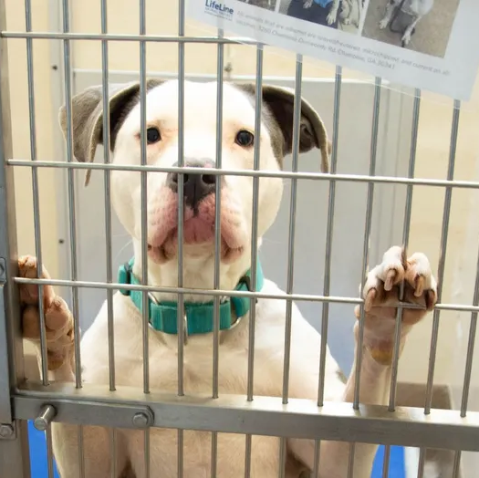
Overview
Introduction
Study Overview and Methods
Results and Discussion
Limitations and Opportunities
Questions
https://www.fox5atlanta.com/news/dekalb-animal-shelter-dog-adoptions-overcrowding-fears
Notes:
So first, a brief overview of the presentation today. We will start with an introduction, which is a literature review pertaining to our main research question. Then we will move to a study overview and the methods we used. Finally, we will cover the results, discussion, limitations, and further research opportunities.

Slide 3
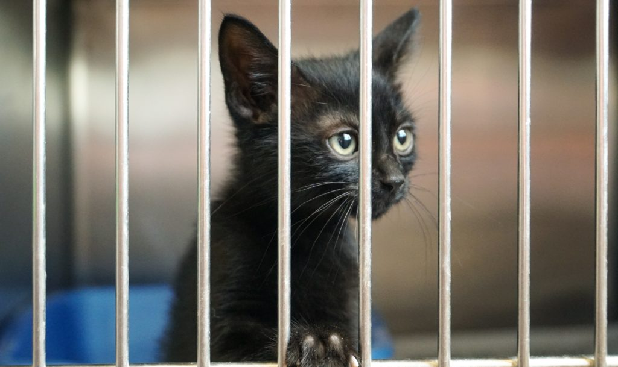
Introduction
https://avsab.org/does-behavior-affect-how-long-cats-stay-in-shelters/
Notes:
Now onto our literature introduction.

Slide 4
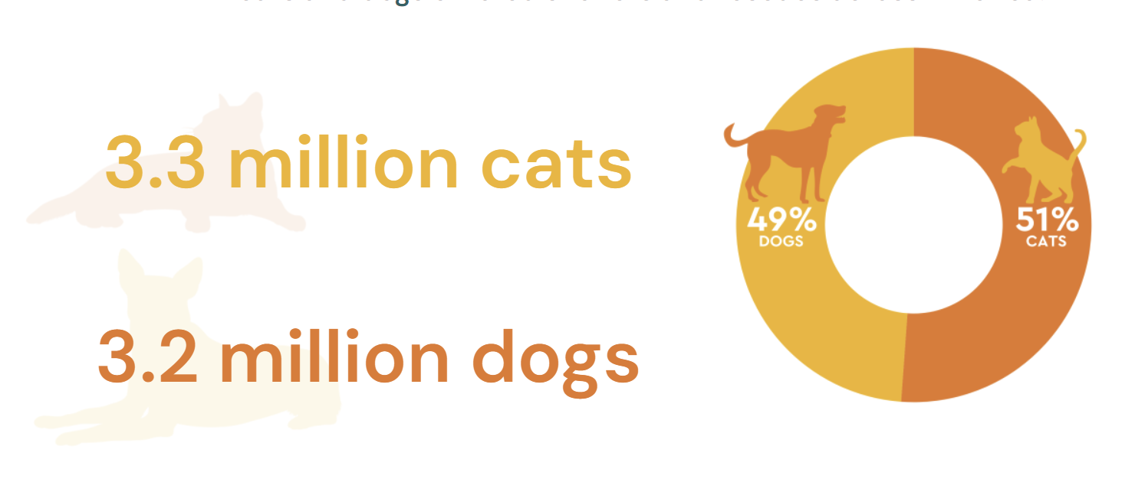
Current Statistics on Animal Sheltering
6.5 million pets entered animal shelters and rescues last year (2023 Statistics, 2024)
https://www.shelteranimalscount.org/stats
1.3 million shelter pets are euthanized annually in US (Haworth, 2019)
There is a capacity crisis in US animal sheltering (2023 Statistics, 2024)
Notes:
The most recent data from 2023 presented by Shelter Animals Count, which is a nonprofit organization that maintains a centralized database of animal sheltering data for the United States, estimated that 6.5 million pets entered an animal sheltering organization. Previously, in a survey in 1973, the Humane Society of the United States estimated that more than 20 million animals entered the shelters and 13.5 million were ultimately euthanized. More recent figures indicated that 1.3 million pets were euthanized in US shelters. This equates to an over 90% reduction.
Nevertheless, these improvements are being threatened by the COVID-19 pandemic. . For 2023, Shelter Animals Count reported an 8% increase in non-live outcomes for cats. Similar data post-pandemic emerged for dogs. Since 2022 there has been a 24% increase in shelter dog euthanasia, and a 64% increase from 2021. A capacity crisis is being faced by sheltering organizations, brought about by an additional 900,000 animals entering shelters and lingering in the care. This strain is more often felt by animal welfare facilities, as opposed to rescues (which are often foster-based and do not have physical locations), as shelters account for 85% of total animal intakes in the US.

Slide 5
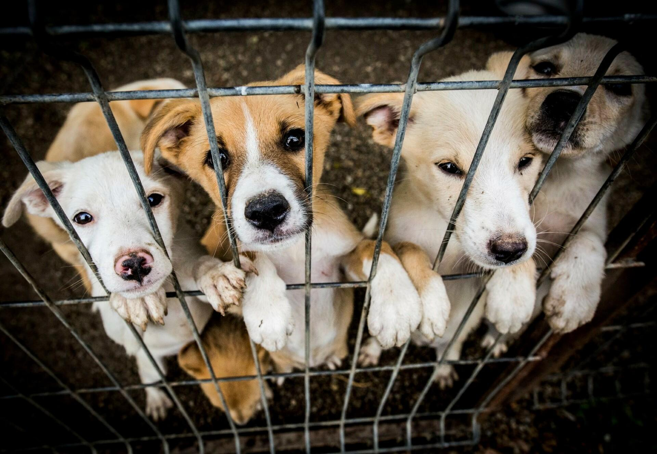
Welfare Associated Concerns in Animal Sheltering
Longer dog stays increase dogs’ likelihood of euthanasia (Clevenger & Kass, 2003)
Stressors include excessive noise, lack of routine, and social isolation
https://www.four-paws.org/campaigns-topics/topics/companion-animals/adoption/what-makes-a-good-shelter
Notes:
In a study by Clevenger and Kass, it was found that the longer a dog remains in shelter care than more their chances of being euthanized increase. The researchers posited that space limitations may explain this relationship. In addition to this increased risk, there is also the fact that animal shelters are an immensely stressful environment for dogs and cats, which negatively affects their welfare. The high levels of stress have been contributed to by excessive noise in kennels, a lack of routine and predictability, and social isolation. In the shelter, cats struggle with lack of caretaker familiarity, stressors due to veterinary care and increased handling, disease transmission, unfamiliar conspecifics, lack of human interaction, and inadequacies in space and control. Ultimately, animal shelters are designed for short term stays and are not comparable to a home environment.

Slide 6
Welfare Associated Concerns (Con’t)
Animal shelter is stressful, negatively impacting physical and mental health (Levy et al., 2020)
82% of cats lost weight during their first week in shelter care (Tanaka et al., 2012)
  25% lost over 10% of body weight during LOS
https://www.four-paws.org/campaigns-topics/topics/companion-animals/adoption/what-makes-a-good-shelter
Stressed animals are more likely to become ill, especially with upper respiratory infections
Notes:
The stress the animals face in the shelter environment can affect their adoptability, as it impacts their physical and mental health. Researchers have found that some animals refuse to eat or move in response to the environment, leading to weight loss. Tanaka and colleagues (2012) discovered that 82% of cats lost weight during their first week in the shelter’s care, and 25% of the cats lost over 10% of their body weight while at the shelter. Furthermore, stressed animals are more likely to become ill and contract upper respiratory infections, which are common in the shelter. Tanaka and colleagues (2012) found that cats with high stress scores during their first week in shelter care were five times more likely to develop upper respiratory infections than cats with low stress. During their stay at the shelter, 58% of cats developed an upper respiratory infection before leaving the facility.

Slide 7
Welfare Associated Concerns (Con’t)
Cats & dogs exhibit behavioral changes after shelter stays (Gouveia et al., 2011; Wells et al., 2002; Raudies et al., 2021)
Cats with longer LOS were less active and involved in more conflict with conspecifics (Gouveia et al., 2011)
https://www.four-paws.org/campaigns-topics/topics/companion-animals/adoption/what-makes-a-good-shelter
Abnormal behaviors in dogs were seen to increase with prolonged LOS (Raudies et al., 2021)
Notes:
Animals are also affected behaviorally by prolonged stays in the shelter environment. In a study by Gouveia et al. (2011), researchers found that shelter cats with longer length of stays were less active and were more often involved in conflicts with conspecifics than cats with shorter length of stays, although this could be due to the increased observation time. Gouveia and colleagues observed that long-stay cats had reduced food and water intake, decreased litter box activity, inadequate coat care and engaged in overgrooming, performed less playful behaviors, were excessively vigilant, urine sprayed, hid more often, and displayed more agonistic behavior towards humans. Long lengths of stay in the shelter also negatively affect dogs’ behavior. Wells and colleagues (2002) found that dogs that had resided in the shelter for over five years spent more time in the back of their kennels, likely making it more difficult for potential adopters to view these dogs Other dog behaviors, such as paw lifting, vocalizing, repetitive behaviors, circling, self-licking, panting, and the inability to rest, have also been associated with more days awaiting adoption in the animal shelter (Raudies et al., 2021).

Slide 8
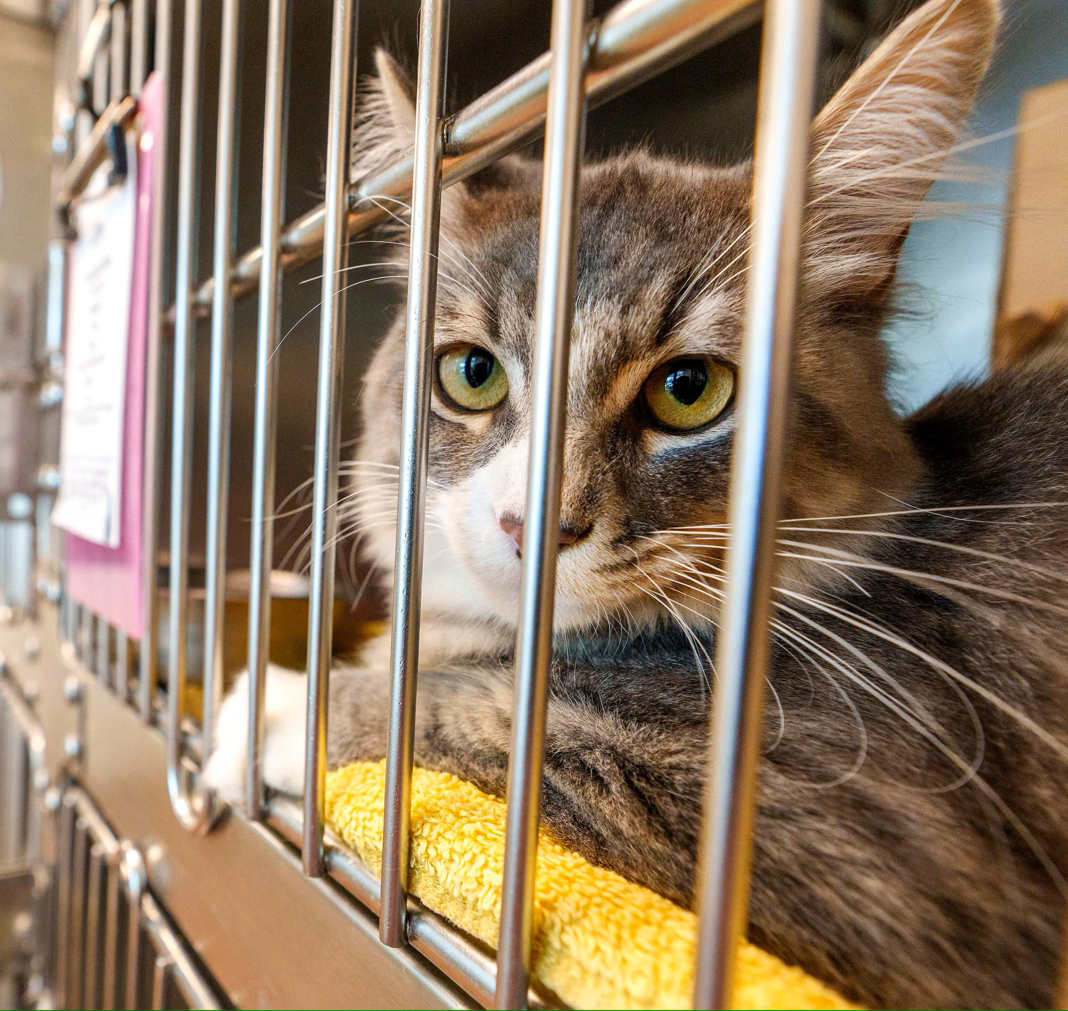
Economic Effects of Prolonged Lengths of Stay
https://www.sltrib.com/news/2022/08/31/utah-animal-shelter-cats-face/
Median cost of care cats: $12.26/day (Hawes et al., 2018)
  Cost for 0-9 days in care: $46.08
  Cost for 130-160 days in care: $1,831.68
Median cost of care dogs: $13.57/day (Hawes et al., 2018)
  Cost for 0-9 days in care: $56.49
  Cost for 140-149 days in care: $2,356.04
Notes:
Along with the effects of long stays on animal welfare, there are also effects on the sheltering organization themselves. Prolonged lengths of stay can drain a shelter’s already limited resources. In a study by Hawes and colleagues, researchers found that the median cost of care for cats in an Austin animal shelter was approximately $12.26 a day. The median amount spent for cats who were in shelter care for zero to nine days was only $46.08, while cats who stayed 130-160 days cost the shelter an median of $1,831.68. In the same study, it was found that dogs’ median cost of shelter care was approximately $13.57 per day. Dogs who spent zero to nine days in the shelter had an average median cost of care of $56.49, while dogs sheltered for 140-149 days had an median cost of care of $2,356.04.

Slide 9
Economic Effects (Con’t)
https://www.sltrib.com/news/2022/08/31/utah-animal-shelter-cats-face/
Average cost of care per animal has doubled over the past decade (Dakin Humane Society, 2024)
  2015-2018: $513 per animal
  2024: $950 per animal
Longer lengths of stay drain shelter resources
Notes:
Along with the effects of long stays on animal welfare, there are also effects on the sheltering organization themselves. Prolonged lengths of stay can drain a shelter’s already limited resources. In a study by Hawes and colleagues, researchers found that the median cost of care for cats in an Austin animal shelter was approximately $12.26 a day. The median amount spent for cats who were in shelter care for zero to nine days was only $46.08, while cats who stayed 130-160 days cost the shelter an median of $1,831.68. In the same study, it was found that dogs’ median cost of shelter care was approximately $13.57 per day. Dogs who spent zero to nine days in the shelter had an average median cost of care of $56.49, while dogs sheltered for 140-149 days had an median cost of care of $2,356.04. . In a self-reported financial disclosure, the Dakin Humane Society in Springfield, Massachusetts, revealed that the average cost of care per animal had nearly doubled over the past decade. From 2015-2018, the cost was approximately $513 per animal; comparatively in 2024, the cost was $950 per animal. The shelter cited that increase was due to longer lengths of stay for animals and rising supply and care costs.
Longer stays and higher associated costs can negatively impact resource-limited shelters. Organizational budgets depend on the amount of money received from municipal contracts and private funding, which limits the resources and supplies available to shelters. When animals reside longer in the shelter, the number of new animals admitted into the shelter’s care is affected.

Slide 10
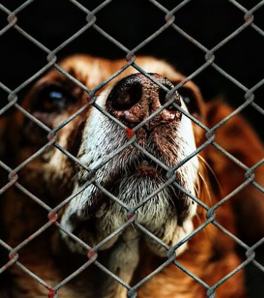
Policies that Lengthen Animals’ Stays in Shelters
Stray Hold Policies
  3-10 days
Medical Quarantines and Procedures
Behavioral Evaluations
https://startupjungle.com/start-animal-rescue-business/
Notes:
A variety of shelter policies and procedures can impact an animal’s stay in the organization’s care, such as stray hold policies, medical procedures, and behavioral evaluations. Stray hold policies provide owners the opportunity to reclaim their pet if it has arrived at the shelter as a stray before the organization assumes ownership of the animal. Most states require shelters to hold pets for three to five days; but in some jurisdictions these periods can last as long as 10 days. Shelters often place new animals in quarantine areas, away from other pets to limit the spread of diseases and monitor their health, further lengthening an animal’s time in care. Shelters may also evaluate an animal’s behavioral suitability for adoption or complete medical or surgical procedures that can add additional days to an animal’s length of stay.

Slide 11

Surgical Sterilization May Affect Length of Stay
Dogs that had arrived at shelter sterilized had shortest length of stay (Gunter et al., 2022)
Puppies had shortest lengths of stay when altered after adoption & longest when altered in foster care (Gunter et al., 2022)
Sterilization surgeries must be appropriately timed to ensure lengths of stay aren’t extended (Levy et al., 2020)
https://medium.com/@vosd1218/the-importance-of-dog-sterilization-understanding-the-benefits-a241504e3021
Notes:
Previous research has shown that the timing of surgical sterilization might have an affect on the animal’s length of stay. Gunter and colleagues (2022) found that dogs that had already arrived at the shelter sterilized had the shortest length of stay. Puppies had the shortest lengths of stay when altered after adoption; and conversely, had the longest lengths of stay when their sterilization procedure occurred during foster care. Researchers have also suggested that sterilization surgeries must be appropriately timed to avoid extending the animal’s length of stay unnecessarily.
Which brings us to our research question

Slide 12
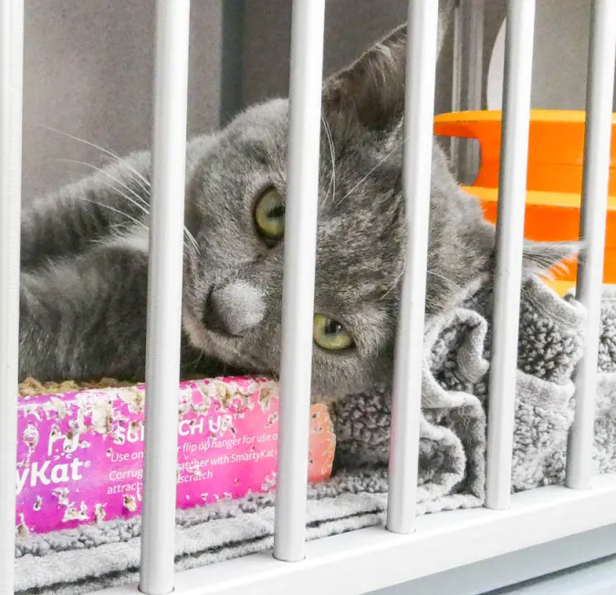
Research Question
Does the timing of sterilization effect the length of stay of shelter animals? If so, how?
https://voiceofoc.org/2023/05/are-appointment-only-policies-in-animal-shelters-across-america-driving-up-kill-rates/
Notes:
The purpose of this study is to investigate whether sterilization that has occurred prior to an animal’s intake, during its time in the shelter, or after adoption is associated with the number of days it resides in care. We hypothesize that animals altered prior to admission or following adoption will have shorter lengths of stay than dogs and cats altered during their stay. Additionally, we will explore if variables about the shelter, including its location or type, and the animal, such as its intake type, sex, age, size, and positive outcome, are correlated with length of stay.

Slide 13

Study Overview & Methods
https://kcpetproject.org/
Notes:
Now onto the overview of the present study and our methodology

Slide 14
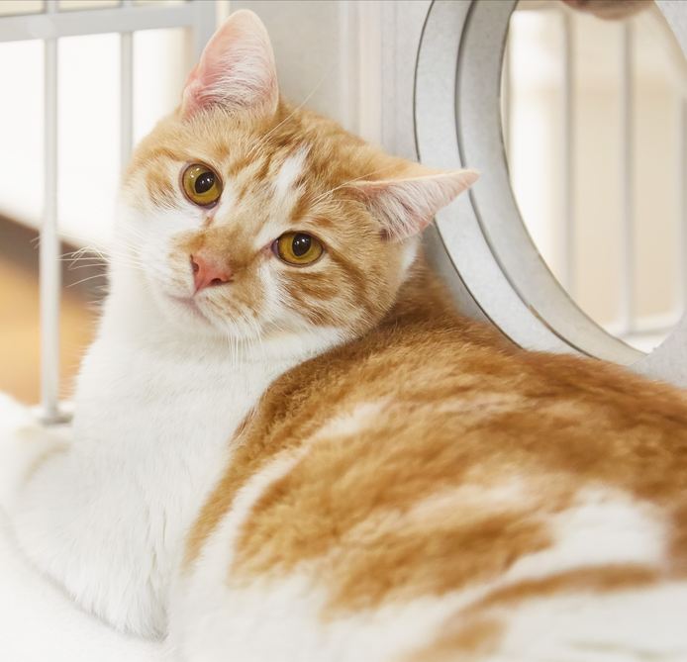
Dataset Acquisition
https://fearfreepets.com/reduce-stress-in-shelter-cats/
Final dataset after exclusions included 400,108 animal records
Organizations utilizing PetPoint were selected for inclusion
Represents records of dogs and cats residing at these shelters between January 1 and December 31, 2023
Notes:
Shelter Animals Count, a nonprofit organization based in Atlanta, Georgia, maintains a centralized database of animal sheltering data and provided this dataset for analysis. After necessary exclusions, the final dataset was comprised of 400,108 animal records. Organizations utilizing PetPoint, a cloud-based data management system were selected for inclusion in this study. This dataset represents records of dogs and cats residing at these shelters between January 1 and December 31, 2023.

Slide 15

Key Data Variables
https://www.123rf.com/stock-photo/cats_and_dogs.html
Species: dogs, cats
Intake Types: owner/guardian surrender and return, seized custody, stray, transport in
Outcome Types: adopted, transfer out
Organization Type: nonprofit with a government contract, government animal services, nonprofit (without a government contract)
US Region: Northeast, Southeast, Midwest, Southwest, West
Length of Stay: measure of time elapsed between the animal’s intake and outcome from the shelter, described in days
Age: described in months
Sterilization Surgery Timing: before intake, during shelter care, after outcome
Notes:
The key variables for this dataset were the species of animal, its intake type, age (in months), timing of sterilization surgery,, length of stay (in days), live outcome type, US region, and organization type.
The only species included in the final dataset were dogs and cats.
Intake types describes how the animal arrived at the animal shelter and the relevant types for the final dataset were determined to be owner surrender, which includes animals that were returned, seized or custody case animals, stray, and transfer in. Owner surrender is defined as the relinquishment of a pet by its owner to the animal shelter. Seized or custody case is defined as when an animal welfare agent believes an animal is not receiving humane care and is removed from the owner’s care after confirmation from a veterinarian that it is in the animal’s best interest. Stray animals are either born in the community, abandoned, or lost without identification when brought into the shelter for rehoming. transport in is defined as an animal who has been admitted from another animal sheltering organization.
Outcome types that were included in the final dataset were adopted and transfer out. Adopted indicates the animal was placed with an owner that assumed all responsibility for their care. An animal was categorized as transfer out when it was moved to another animal welfare agency for placement.
Organization type describes the animal welfare organization in which the animal resided. For the final dataset we only included animal shelters, meaning the relevant types were animal shelters with a government contract, government animal services, and shelter without a government contract. An animal shelters are physical sheltering locations that the public can visit and adopt pets. Shelters with government contracts receive funding from municipalities to carry out animal care services but are not operated by a municipality. Government animal shelters are animal care services directly managed by the municipality.
US region indicates the physical location of the animal welfare organization and includes 45 states and Washington D.C. For the purposes of our study, US states were grouped into regional categories as described by the United States Census Bureau (2021) with a further division of the South as reported by National Geographic. In total, the regions of Northeast, Southeast, Midwest, Southwest, and West were used.
Length of Stay is the measure of time elapsed between the animal’s intake and outcome from the shelter. LOS was calculated by subtracting the intake date from the outcome date. These values are described in days.
Age is calculated at time of intake. This value, described in months, was calculated by subtracting the estimated or provided birth date from the intake date at the shelter.
Sterilization surgery timing depicts when the animal’s alteration occurred and was determined based on two alteration statuses: at the time of intake and when the animal left the shelter’s care. Before intake indicates that the animal received surgical sterilization before entering the shelter’s care. During Shelter Care indicates that the animal was sterilized while under the care of the shelter and before an outcome was completed. After outcome indicates that the animal was not sterilized before it left the shelter’s care.

Slide 16
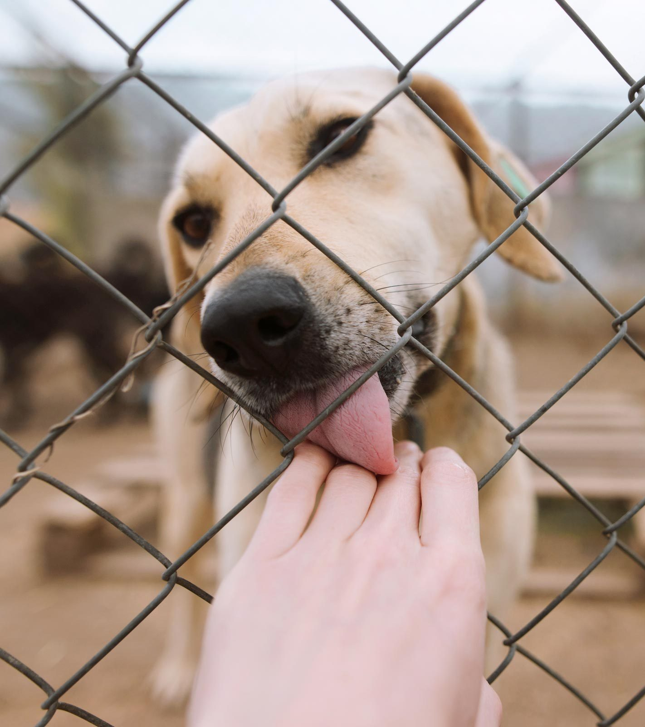
Statistical Analysis
Preliminary data coding and cleaning conducted in Microsoft Excel
Utilized IBM SPSS Statistics (Version 27)
Generalized linear mixed model utilized
All independent variables and covariate, age, were entered as fixed effects
2- & 3-way interactions were retained based on model fit with the dependent variable of length of stay
To determine which model was a better fit for the data in each analysis, Bayesian Information Criterion (BIC) was used
https://www.rd.com/list/dogs-need-a-home/
Notes:
The dataset was provided by Shelter Animals Count as a Microsoft Excel file and preliminary coding and cleaning was carried out in this program. However, data analyses was completed utilizing IBM SPSS Statistics (Version 27). To better understand the amount of time that animals resided in the shelter and its relationship with sterilization surgery timing, a generalized linear model was utilized. This count model included a negative binomial distribution with a log link function. In addition to sterilization timing, all other independent variables and one covariate, age, were entered in the models as fixed effects. Two- and three-way interactions were retained based on model fit with the dependent variable of length of stay. To determine which model was a better fit for the data in each analysis, Bayesian Information Criterion (BIC) was used.

Slide 17
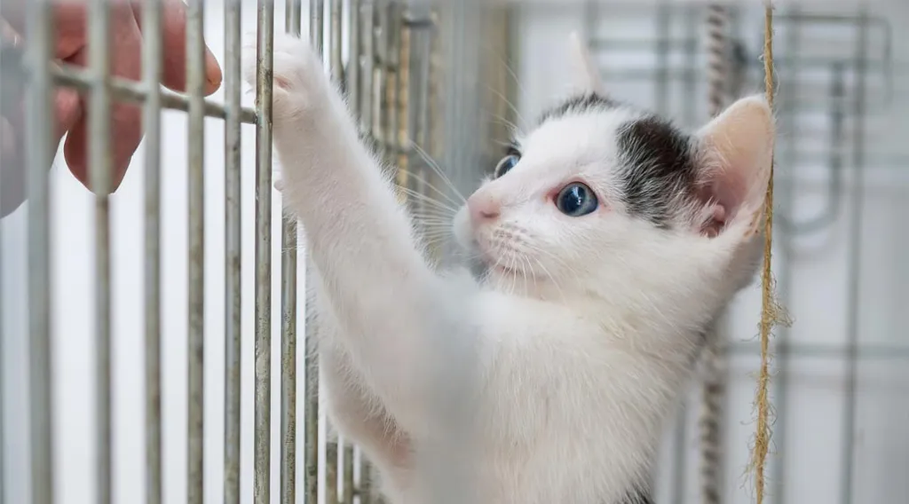
Results
https://brownsburganimalclinic.com/a-county-shelter-we-can-be-proud-of/
Notes:
Now that we have a solid background and know how the data was analyzed, we can move to the results

Slide 18
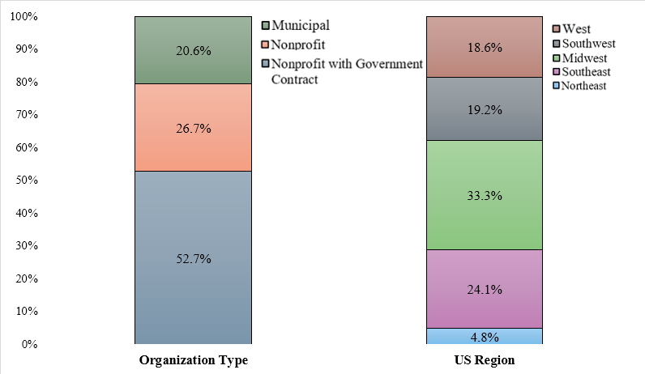
Descriptive Statistics: Shelter Demographics
Notes:
This slide breaks down the shelter demographics of those included in our dataset. Nonprofit animal shelters with government contracts comprised a majority of records in our dataset with 52.7%. This was followed by nonprofit organizations and then municipality run shelter. In terms of geographic location, most records were from animal shelters in the Midwest region of the United States, with a third of the records coming from this region. The Southeast was next most populous, followed by Southwest and West regions having similar representation. A very small number of records were from shelters in the Northeast.

Slide 19
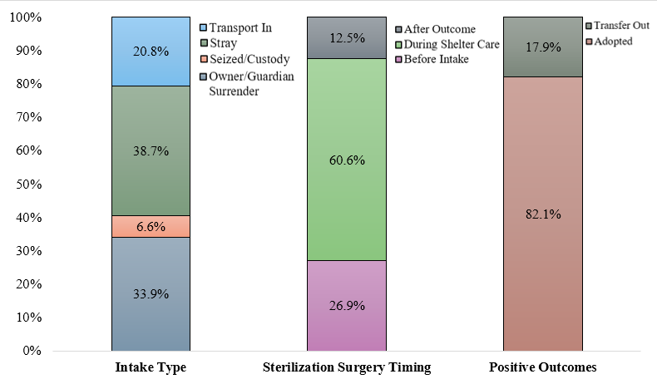
Descriptive Statistics: Animal Demographics
Notes:
Now we move onto the descriptive statistics of the animal records included in the final dataset. Cats were more represented in our dataset than dogs, with 55.7%. The most common intake type for our final dataset was stray with 38.7% which was followed by owner surrender at 33.9%. The mean age of animals entering shelters was 1.6 years old with a median age of 8 months old. However, there was a wide range of ages represented in our dataset. The youngest animals were born in shelter care, and the oldest was 22.9 years old. Most often, animals were sterilized during their time in the animal shelter’s care, with 60.6% falling into this category. Slightly over one-quarter of the animals arrived pre-altered, and 12.5% left the shelter’s care unsterilized. A vast majority of animals in our dataset experienced the positive outcome of adoption with only 17.9% of animals being transferred out. The mean number of days the animals spent in shelter care was 28.4 days with a range of 0 days spent in the shelter, for animals who exited shelter care the same day as their intake, and a maximum of 387 days spent in the shelter. The median length of stay of the animals in our dataset was 16 days.

Slide 20
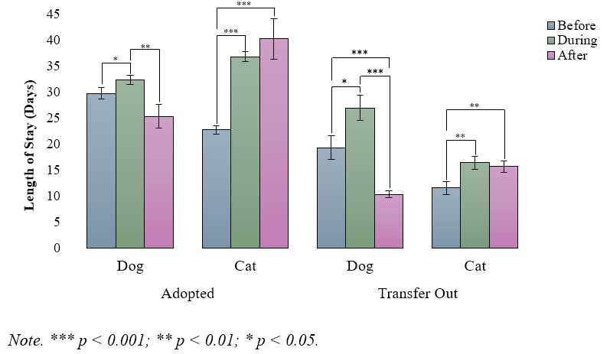
Predictors of Length of Stay
Estimated Marginal Means of Length of Stay (in days) for Dogs and Cats by Positive Outcome, and Sterilization Surgery Timing
Notes:
Figure 4 describes the three-way interaction between animal type, sterilization timing, and positive outcome. For adopted dogs, we found that their lengths of stay were significantly shorter when they were sterilized following adoption as compared to being sterilized during their time in care. Sterilization prior to entering the shelter was also associated with shorter lengths of stay for adopted dogs than sterilization that occurred at the shelter. Adopted dogs had shorter lengths of stay, which were approaching significance, when altered after their time in care versus arriving already altered.
*CLICK*
Dogs that were transferred out of their shelters for placement had much shorter length of stays when they were sterilized after transfer as compared to arriving to the shelter spayed or neutered or being sterilized during their time in care. Conversely, transferred dogs had the longest length of stays when altered during care.
*CLICK*
In comparison, adopted cats experienced significantly longer lengths of stay when they were altered after adoption as compared to before. Additionally, we found no difference between these cats’ time in the shelter when they were sterilized after or during their shelter stay. Adopted cats that arrived at the shelter altered had significantly shorter length of stays than those altered during care or after adoption.
*CLICK*
For transferred cats, being altered before intake resulted in the shortest length of stay as compared to during or after their time in care. We found no difference between transferred cats that were altered during as compared to after their stay in the shelter.

Slide 21
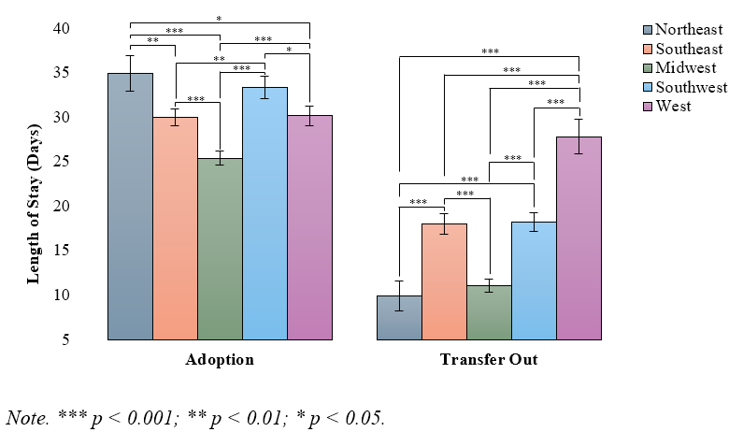
Predictors of Length of Stay
Estimated Marginal Means of Length of Stay (in days) by Positive Outcomes & US Region
Notes:
Figure 5 describes the two-way interaction between positive outcomes from the shelter and the US region. We found adopted animals’ lengths of stay at Midwest shelters were significantly shorter than animals that were adopted from any other region. Conversely, adopted animals from Northeast shelters had significantly longer lengths of stay than those from Southeast, Midwest, and West shelters; however, we found no difference in the lengths of stay between adopted animals in Northeast and Southwest shelters. Adopted animals in Southeast shelters had significantly shorter lengths of stay than those in Southwest shelters, but no difference was found between animals’ lengths of stay that were adopted from Southeast and West shelters. Adopted animals in Southwest had significantly longer lengths of stay than those in West shelters.
*CLICK*
The lengths of stay for transferred animals at Northeast shelters was significantly shorter as compared to all other regions except transferred animals from the Midwest. We found that animals that were transferred out of Southeast shelters had longer lengths of stay than those animals at Midwest shelters and shorter lengths of stay than transferred animals from West shelters but there was no difference between transferred animals at Southeast and Southwest shelter. The length of stay of transferred animals at Midwest shelters was shorter than those animals at Southwest and West shelters. Animals that were transferred out of Southwest shelters for placement had shorter lengths of stay than those animals from shelters in the West.

Slide 22
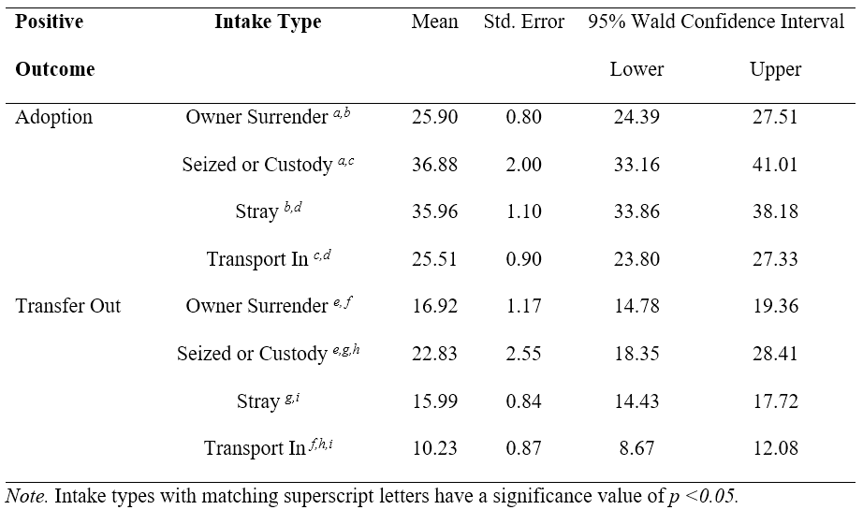
Predictors of Length of Stay
Estimated Marginal Means of Animal Length of Stay (in days) by Positive Outcome Type & Intake Type
Notes:
Table 4 describes the two-way interaction between positive outcomes and intake type.
*CLICK*
When animals were adopted, they had the longest length of stay when they arrived as part of a seizure or custody case, which was not significantly different from stray animals.
*CLICK*
This indicates that animals who were adopted, the longest lengths of stay were intake types seized or custody case animals and stray animals.
The other two tested intake types*CLICK* owner surrenders and *CLICK* transfer ins were significantly shorter lengths of stay for adopted animals.
Similarly, for animals that were ultimately transferred out of the shelter, the longest length of stay was found to be *CLICK* seized or custody case animals. The shortest lengths of stay for transferred out animals was *CLICK* animals that were transferred into the shelter organization to begin with. *CLICK* Animals that were surrendered by their owners and *CLICK* strays did not have differ in their lengths of stay when transfer out was their outcome, having them fall in the middle of the pack.

Slide 23

Discussion
https://www.cityofames.org/government/departments-divisions-a-h/ames-animal-shelter-animal-control /
Notes:
Now how does our study connect to previous literature.

Slide 24
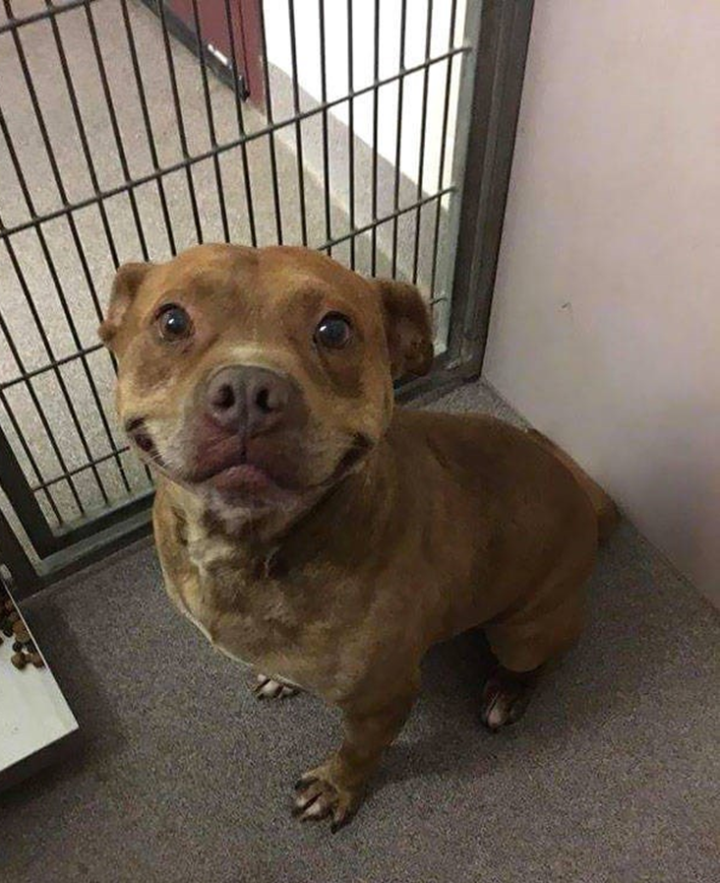
Dogs & Sterilization Timing
Our findings agree & contradict previous literature (Gunter et al., 2022)
  Puppies had shorter LOS when sterilized after outcome
  Dogs had longer LOS when altered after
Pre-altered dogs (& cats) had shorter LOS, likely due to less medical procedures
Why? Possible backlog
  Deficit of more than 2.7 million sterilization surgeries (Guerios et al., 2022)
  91% of shelters surveyed faced a backlog of procedures (Kogut et al., 2024)
  Totaled 18,648 animals waiting to be altered
https://amp.cheezburger.com/7977989/26-images-of-animals-in-shelters-that-will-win-your-hearts-over
Notes:
Our findings both agree with and contradict the previous literature, with Gunter et al. 2022 being one. *CLICK* As mentioned before Gunter and colleagues determined that puppies had shorter lengths of stay when sterilized after outcome, but they established that dogs over 8 weeks old had longer lengths of stay when altered after their outcome. It is possible that the discrepancy in our findings may be related to our much larger dataset of 177,056 canine records, which only included dogs that had positive outcomes from their shelters, whereas Gunter and colleagues utilized a smaller sample of puppies and dogs, 2,225, that had both positive and negative outcomes from the participating shelters. Taken together, our findings seem to suggest that sterilization can shorten the length of stay for young dogs in the shelter if it occurs after their shelter stay, as found by Gunter et al., but it can also lead to shorter stays for adult dogs that have positive outcomes from the animal shelter as well.
Both adopted dogs and cats that entered the animal shelter already altered had shorter lengths of stay, regardless of their positive outcome. It is likely that when animals arrive at the shelter sterilized, the time required for their medical procedures prior to adoption availability shortens, reducing their lengths of stay. Guerios and colleagues (2022) found that following the pandemic, there was a deficit of more than 2.7 million sterilization surgeries at U.S. veterinary clinics. Of 140 animal shelters surveyed by Kogut and colleagues (2024), 91% faced this backlog of procedures, with a total of 18,648 animals waiting for sterilization. In general, client wait times for veterinary services have been reported to be anywhere from two to six weeks to over two months. It is possible that the sterilization procedure itself and recovery as well as the time waiting to receive this veterinary care in the shelter contributed to the longer lengths of stays for dogs and cats that we observed in our study.

Slide 25
Sterilization After Adoption for Dogs
Dogs who were altered after their positive outcome had similar benefits to LOS to those who were prealtered
Why?
  Bypass wait time for medical procedures
  Can be placed utilizing post-adoption spay/neuter contract
https://amp.cheezburger.com/7977989/26-images-of-animals-in-shelters-that-will-win-your-hearts-over
Notes:
Our findings both agree with and contradict the previous literature, with Gunter et al. 2022 being one. *CLICK* As mentioned before Gunter and colleagues determined that puppies had shorter lengths of stay when sterilized after outcome, but they established that dogs over 8 weeks old had longer lengths of stay when altered after their outcome. It is possible that the discrepancy in our findings may be related to our much larger dataset of 177,056 canine records, which only included dogs that had positive outcomes from their shelters, whereas Gunter and colleagues utilized a smaller sample of puppies and dogs, 2,225, that had both positive and negative outcomes from the participating shelters. Taken together, our findings seem to suggest that sterilization can shorten the length of stay for young dogs in the shelter if it occurs after their shelter stay, as found by Gunter et al., but it can also lead to shorter stays for adult dogs that have positive outcomes from the animal shelter as well.
Both adopted dogs and cats that entered the animal shelter already altered had shorter lengths of stay, regardless of their positive outcome. It is likely that when animals arrive at the shelter sterilized, the time required for their medical procedures prior to adoption availability shortens, reducing their lengths of stay. Guerios and colleagues (2022) found that following the pandemic, there was a deficit of more than 2.7 million sterilization surgeries at U.S. veterinary clinics. Of 140 animal shelters surveyed by Kogut and colleagues (2024), 91% faced this backlog of procedures, with a total of 18,648 animals waiting for sterilization. In general, client wait times for veterinary services have been reported to be anywhere from two to six weeks to over two months. It is possible that the sterilization procedure itself and recovery as well as the time waiting to receive this veterinary care in the shelter contributed to the longer lengths of stays for dogs and cats that we observed in our study.

Slide 26
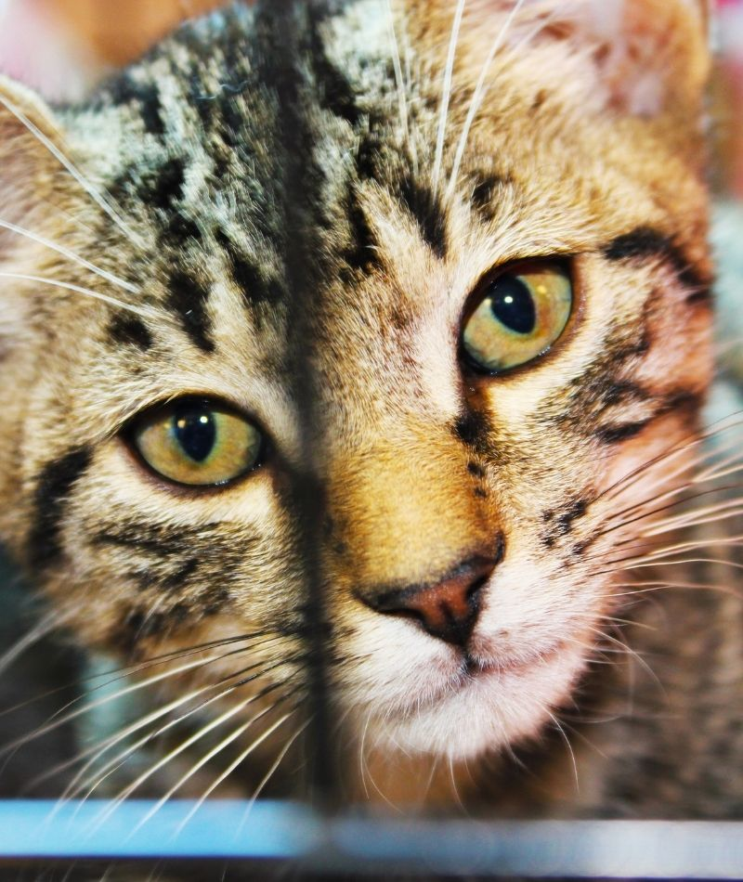
Cats & Sterilization Timing
Prealtered cats had shorter LOS, but not those altered after
Why?
  Decreased medical needs
  Displaying more desirable behaviors
Lepper et al. (2002) found adopters prefer altered pets. Odds ratio of being adopted if:
    Intact female: 1.00
    Altered female: 4.28
    Intact male: 1.17
    Altered male: 6.68
https://catclinicofdestin.com/shelters-and-rescues/
Notes:
As previously mentioned, adopted cats as well as those that are transferred out of their facilities for placement have shorter lengths of stay when sterilized prior to entering the shelter. Not only does being spayed or neutered likely reduce time in care by simply not needing the surgery prior to adoption (along with the associated wait times for those procedures), it is possible that altered cats’ lengths of stay may be reduced by displaying more desirable behavior in the shelter. Previous research has suggested that feline spay-neuter surgeries are associated with positive changes in cat behavior, such as decreased hyperactivity as well as reductions in aggression and sexual behaviors, such as urine spraying. Additionally, in a 2002 study by Lepper and colleagues, the authors found that potential adopters preferred altered animals. In their research, they observed that intact females and males had odds ratios of being adopted of 1.00 and 1.17, respectively, while sterilized females and males had odds ratios of being adopted of 4.28 (females) and 6.68 (males).

Slide 27
Intact & Altered Cats
Previous studies have reported that intact cats display more problem behaviors
  Aggression
  Destructive behaviors
  Excessive vocalization
  House soiling
  Urine spraying
It is possible that altered cats’ shorter LOS may be related to displaying more desirable behavior
https://catclinicofdestin.com/shelters-and-rescues/
Notes:
As previously mentioned, adopted cats as well as those that are transferred out of their facilities for placement have shorter lengths of stay when sterilized prior to entering the shelter. Not only does being spayed or neutered likely reduce time in care by simply not needing the surgery prior to adoption (along with the associated wait times for those procedures), it is possible that altered cats’ lengths of stay may be reduced by displaying more desirable behavior in the shelter. Previous research has suggested that feline spay-neuter surgeries are associated with positive changes in cat behavior, such as decreased hyperactivity as well as reductions in aggression and sexual behaviors, such as urine spraying. Additionally, in a 2002 study by Lepper and colleagues, the authors found that potential adopters preferred altered animals. In their research, they observed that intact females and males had odds ratios of being adopted of 1.00 and 1.17, respectively, while sterilized females and males had odds ratios of being adopted of 4.28 (females) and 6.68 (males).

Slide 28
Shelter Cat Housing
Shelter housing options are more limited for intact shelter cats
  Female cats may have up to 5 litters, so co-housing intact male & female cats is unlikely
Suchak & Lamica (2018) found that cats are more often viewable in group housing
  Single-housed cats: 67%
  Group-housed cats: 97%
  Single-housed cats were also 3.2 times more likely to be moved isolation
https://catclinicofdestin.com/shelters-and-rescues/
Notes:
As previously mentioned, adopted cats as well as those that are transferred out of their facilities for placement have shorter lengths of stay when sterilized prior to entering the shelter. Not only does being spayed or neutered likely reduce time in care by simply not needing the surgery prior to adoption (along with the associated wait times for those procedures), it is possible that altered cats’ lengths of stay may be reduced by displaying more desirable behavior in the shelter. Previous research has suggested that feline spay-neuter surgeries are associated with positive changes in cat behavior, such as decreased hyperactivity as well as reductions in aggression and sexual behaviors, such as urine spraying. Additionally, in a 2002 study by Lepper and colleagues, the authors found that potential adopters preferred altered animals. In their research, they observed that intact females and males had odds ratios of being adopted of 1.00 and 1.17, respectively, while sterilized females and males had odds ratios of being adopted of 4.28 (females) and 6.68 (males).

Slide 29

Pros & Cons to Post-Adoption Sterilization Contracts
Pros
  Contracts may reduce animals’ LOS
  In 2023, a shelter in WI indicated that < 10 adopters had not complied with contract
    Shelter places 3,000+ animals/year
Cons
  Alexander & Shane (1994) found that 41% of new owners complied with post-adoption sterilization requirements
    53.8% of intact cats were sterilized
    38.3% of intact dogs were sterilized
https://www.flickr.com/photos/115089924@N02/15633818714
Notes:
Our findings both agree with and contradict the previous literature, with Gunter et al. 2022 being one. *CLICK* As mentioned before Gunter and colleagues determined that puppies had shorter lengths of stay when sterilized after outcome, but they established that dogs over 8 weeks old had longer lengths of stay when altered after their outcome. It is possible that the discrepancy in our findings may be related to our much larger dataset of 177,056 canine records, which only included dogs that had positive outcomes from their shelters, whereas Gunter and colleagues utilized a smaller sample of puppies and dogs, 2,225, that had both positive and negative outcomes from the participating shelters. Taken together, our findings seem to suggest that sterilization can shorten the length of stay for young dogs in the shelter if it occurs after their shelter stay, as found by Gunter et al., but it can also lead to shorter stays for adult dogs that have positive outcomes from the animal shelter as well.
Both adopted dogs and cats that entered the animal shelter already altered had shorter lengths of stay, regardless of their positive outcome. It is likely that when animals arrive at the shelter sterilized, the time required for their medical procedures prior to adoption availability shortens, reducing their lengths of stay. Guerios and colleagues (2022) found that following the pandemic, there was a deficit of more than 2.7 million sterilization surgeries at U.S. veterinary clinics. Of 140 animal shelters surveyed by Kogut and colleagues (2024), 91% faced this backlog of procedures, with a total of 18,648 animals waiting for sterilization. In general, client wait times for veterinary services have been reported to be anywhere from two to six weeks to over two months. It is possible that the sterilization procedure itself and recovery as well as the time waiting to receive this veterinary care in the shelter contributed to the longer lengths of stays for dogs and cats that we observed in our study.

Slide 30
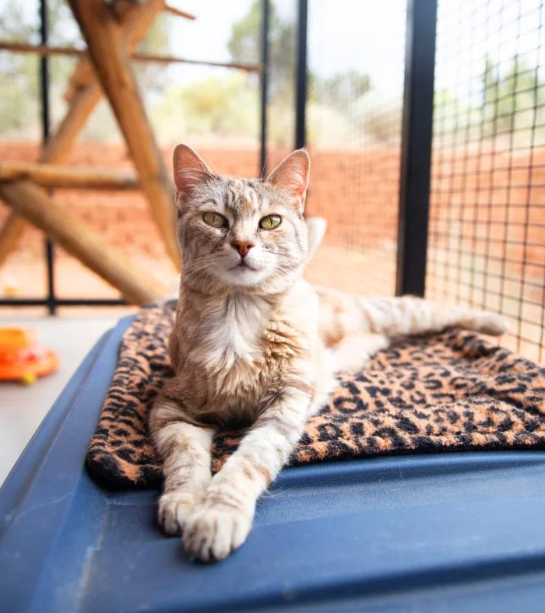
Intake at Northeast Shelters
NE shelters have fewest number of dogs entering & most likely to transport in dogs (Woodruff & Smith, 2020)
Previous studies have found behavior-related problems, one of most cited reason for surrender
  Dogs with behavior problems can be at higher risk for longer LOS
With less animals entering, Northeast shelters may have resources to place animals with behavioral problems
https://bestfriends.org/sanctuary/about-sanctuary/animal-areas/cat-world
Notes:
For adopted animals, shelter lengths of stay varied considerably between regions, ranging from an average of 25 days in Midwest to 35 days at shelters in the Northeast. Many studies have reported that Northern and Eastern states simply do not have the number of shelter animals to meet the demand of potential adopters with shelters in the Northeast region, in particular, having the fewest number of dogs entering their shelters. Behavior-related problems are one of the most cited reasons for animals, specifically dogs, to be surrendered by their owners to animal shelters. In 2000, one of the earliest studies describing shelter relinquishment, Salman and colleagues found that behavioral problems, specifically aggression towards people and other animals, was the most frequently given reason for the surrendering of dogs and the second most common reason for surrendering cats. More recently in 2020, Hawes and colleagues found that aggression was the most cited reason for a dog to be returned to the shelter. Considering the difficulties owners face living with animals that have behavioral issues, it is reasonable that shelter animals with behavioral problems may have longer lengths of stay. Raudies and colleagues found that dogs who displayed a range of problematic behaviors, such as aggression and high arousal, were at a high risk of staying in the shelter for over a year, especially when coupled with other traits deemed less desirable by potential adopters, like larger size, older age, and breeds they deem dangerous. ). It is possible that with less animals entering shelters in the Northeast, these organizations may be more inclined and have the resources to place animals with behavioral issues, leading to the longer lengths of stay we observed for Northeast shelters in our study.

Slide 31
Intake at Midwest Shelters
Midwest shelters have one of the lowest levels of dog intake in US
  May be related to legislation regarding leash laws, sterilization requirements, education programs, pet ownership standards, and climate (Woodruff & Smith, 2020)
Shelters in the Midwest are most likely to decline transports of certain breeds of dog
  May be related to insurance restrictions, breed-specific legislation, overabundance of breed locally, concerns about potential behavioral issues (Simmons & Hoffman, 2016)
https://bestfriends.org/sanctuary/about-sanctuary/animal-areas/cat-world
Notes:
For adopted animals, shelter lengths of stay varied considerably between regions, ranging from an average of 25 days in Midwest to 35 days at shelters in the Northeast. Many studies have reported that Northern and Eastern states simply do not have the number of shelter animals to meet the demand of potential adopters with shelters in the Northeast region, in particular, having the fewest number of dogs entering their shelters. Behavior-related problems are one of the most cited reasons for animals, specifically dogs, to be surrendered by their owners to animal shelters. In 2000, one of the earliest studies describing shelter relinquishment, Salman and colleagues found that behavioral problems, specifically aggression towards people and other animals, was the most frequently given reason for the surrendering of dogs and the second most common reason for surrendering cats. More recently in 2020, Hawes and colleagues found that aggression was the most cited reason for a dog to be returned to the shelter. Considering the difficulties owners face living with animals that have behavioral issues, it is reasonable that shelter animals with behavioral problems may have longer lengths of stay. Raudies and colleagues found that dogs who displayed a range of problematic behaviors, such as aggression and high arousal, were at a high risk of staying in the shelter for over a year, especially when coupled with other traits deemed less desirable by potential adopters, like larger size, older age, and breeds they deem dangerous. ). It is possible that with less animals entering shelters in the Northeast, these organizations may be more inclined and have the resources to place animals with behavioral issues, leading to the longer lengths of stay we observed for Northeast shelters in our study.

Slide 32
Shelters in the West
Western shelters have previously been noted to have one of longer lengths of stay for transferred out animals
  Second least likely region to transfer out dogs (Woodruff & Smith, 2020)
These shelters may be attempting to place dogs via adoption before ultimately transferring them to another organization
https://bestfriends.org/sanctuary/about-sanctuary/animal-areas/cat-world
Notes:
For adopted animals, shelter lengths of stay varied considerably between regions, ranging from an average of 25 days in Midwest to 35 days at shelters in the Northeast. Many studies have reported that Northern and Eastern states simply do not have the number of shelter animals to meet the demand of potential adopters with shelters in the Northeast region, in particular, having the fewest number of dogs entering their shelters. Behavior-related problems are one of the most cited reasons for animals, specifically dogs, to be surrendered by their owners to animal shelters. In 2000, one of the earliest studies describing shelter relinquishment, Salman and colleagues found that behavioral problems, specifically aggression towards people and other animals, was the most frequently given reason for the surrendering of dogs and the second most common reason for surrendering cats. More recently in 2020, Hawes and colleagues found that aggression was the most cited reason for a dog to be returned to the shelter. Considering the difficulties owners face living with animals that have behavioral issues, it is reasonable that shelter animals with behavioral problems may have longer lengths of stay. Raudies and colleagues found that dogs who displayed a range of problematic behaviors, such as aggression and high arousal, were at a high risk of staying in the shelter for over a year, especially when coupled with other traits deemed less desirable by potential adopters, like larger size, older age, and breeds they deem dangerous. ). It is possible that with less animals entering shelters in the Northeast, these organizations may be more inclined and have the resources to place animals with behavioral issues, leading to the longer lengths of stay we observed for Northeast shelters in our study.

Slide 33
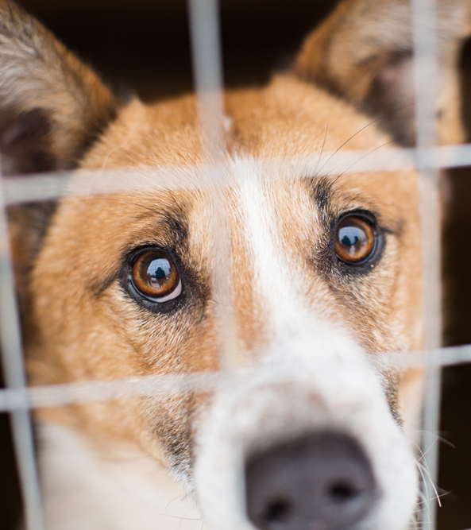
Intake Types & LOS
https://www.ovrs.com/blog/challenges-with-shelter-pets/
Laws & policies likely lengthen stays for seized or custody animals
  Cases can take over a year & owners can appeal cases (Berry et al., 2005)
Stray holds can lengthen LOS
  Typically, in the range of three to 10 days (Wisch & Dillingham, 2017)
Seized or custody case & stray animals may require medical attention, in all may explain longer LOS for these types (Berry et al., 2005; Janke et al., 2017)
Notes:
Our data indicated that an animal’s intake type affected its length of stay with animals having the longest lengths of stay when they were part of seizure or custody cases, particularly those that were transferred out. This is likely due to the laws and policies regarding animals whose owners are facing cruelty or neglect investigations. Typically, these animals are held until the completion of the legal proceedings, which can extend to over a year, as the animal is considered the owner’s property and is not eligible for placement in another home during this time. Additionally, it is possible that owners will appeal their cases, further lengthening the hold these animals experience, and communication difficulties between authorities can increase stays even longer.
It is worth noting that we observed that few animals enter the sheltering system due to seizure or custody cases as compared to strays and those that are surrendered by their owners. In our dataset of dogs and cats entering US animal shelters that had positive outcomes, seized or custody case animals only accounted for 6.6% of the animal records. Previously, Shelter Animals Count reported that intake types other than those that were transferred in, stray, and relinquished, accounted for 9% of all intakes in 2023, regardless of outcome.

Slide 34
Stray Animals
https://www.ovrs.com/blog/challenges-with-shelter-pets/
Dybdall and Strasser (2014) found that potential adopters have unconscious biases against strays
  When cats were labeled as owner surrenders, their adoption profiles were scored higher in adoptability than when the same cats were labeled as stray
This bias may also contribute to differences we found in longer LOS for stray versus OS animals
Notes:
Our data indicated that an animal’s intake type affected its length of stay with animals having the longest lengths of stay when they were part of seizure or custody cases, particularly those that were transferred out. This is likely due to the laws and policies regarding animals whose owners are facing cruelty or neglect investigations. Typically, these animals are held until the completion of the legal proceedings, which can extend to over a year, as the animal is considered the owner’s property and is not eligible for placement in another home during this time. Additionally, it is possible that owners will appeal their cases, further lengthening the hold these animals experience, and communication difficulties between authorities can increase stays even longer.
It is worth noting that we observed that few animals enter the sheltering system due to seizure or custody cases as compared to strays and those that are surrendered by their owners. In our dataset of dogs and cats entering US animal shelters that had positive outcomes, seized or custody case animals only accounted for 6.6% of the animal records. Previously, Shelter Animals Count reported that intake types other than those that were transferred in, stray, and relinquished, accounted for 9% of all intakes in 2023, regardless of outcome.

Slide 35

Limitations
https://stock.adobe.com/search?k=cats+and+dogs&asset_id=269478900
Dataset spanned a single year (2023)
Only shelters utilizing PetPoint and data submitted to Shelter Animals Count
Only focused on dogs & cats adopted or transferred out
Uncertainty about animals sterilized after outcome
Number of records had missing data
Small number of records in certain categories
Focus on shelters with physical locations
Lacks specificity in some data categories
Different policies and legalities increase variability
Notes:
There are inherent limitations in this study. *CLICK* One such is that the dataset only spans a year, 2023, The inclusion of more years of data would have furthered our understanding of how our variables of interest were related to the animals’ lengths of stay. Furthermore, the COVID-19 pandemic saw a drastic increase in the demand for veterinary care, which exacerbated the already present shortage of veterinary practitioners. So it is possible that the utilization of the 2023 dataset acutely reflected this shortage, leading to differences we found in spay-neuter timing, that may not have been detected in previous years.
Another limitation this study faces is *CLICK* the inclusion of only shelters using PetPoint and submitting their data the Shelter Animals Count. PetPoint is only one of many data management systems used by shelters across the country. In a study by Vinic and colleagues (2019) of animal shelters located in Massachusetts, 47.2% of shelters used PetPoint, while the remaining used other systems, such as Chameleon, ShelterPro, iShelter, and Sheltermanager. Some even reported to only use paper documentation or commercially available software programs such as Excel, or a custom software program.
*CLICK*
Our dataset exclusively focused on dogs and cats that were either adopted or transferred out. It is highly likely that the inclusion of animals with non-live outcomes, such as those that died in care, or differing live outcomes, like those that were returned to their owners, would have influenced our findings. Nevertheless, our primary research question involved the timing of spay-neuter surgery, and specifically after the animal had left the shelter. As such, unaltered animals that do not leave the shelter alive are not able to experience post-placement sterilization and were excluded from our dataset. Additionally, there are a large variety of other companion animals served by shelters that were not included in our dataset. The inclusion of other animal types, such as rabbits and horses, would have broadened the scope of our findings.
*CLICK*
It is worth noting that a number of records had missing data specially involving our primary research question, such as the animal’s alteration status upon entry to the animal shelter, its sex, and the timing of their spay and neuter surgery following intake at the shelter (if it occurred during this time). In total, over 90,000 records had at least one missing or unknown piece of data regarding these variables; and as such were removed from our dataset. Their inclusion would have increased our sample size and subsequent ability to detect main effects and interactions in our analysis.
*CLICK*
Our study focused on animal shelters with physical locations. This was done as 85% of community intakes occur through these animal welfare organization. Conversely, rescues are typically more specialized, whether that is breed-specific, or medical or behavioral needs, and are often foster based, meaning the animals do not reside in a shelter environment. Foster homes reduce the stress of animals in need of homes which in turn reduces the immediate welfare need for fast adoption placements. As we were interested in the impact of the spay-neuter surgery on the animal’s time in the shelter, we elected to exclude rescues from our dataset, limiting our ability to relate this study’s findings to these types of organizations.
*CLICK*
Finally, the dataset lacks specificity in some data categories. For example, it is unknowable whether sterilization procedures that occurred at the shelter were initiated after having an approved adopter or if animals were sterilized as standard shelter practice irrespective of an interested party. Without appreciating an individual shelter’s criteria for sterilization selection, it is possible that the timing of the procedure in the shelter could affect an animal’s stay if it is viewable for adoption unaltered. Additionally, already altered animals may arrive to the shelter more often with obedience training or possess other desirable qualities than animals that arrive unaltered; and as such, have a positive influence on these animals’ lengths of stay in the shelter, regardless of spay-neuter status. Nevertheless, we would not expect such biases to disproportionately affect animals that were altered during their time in the shelter versus those that were altered post-outcome.

Slide 36
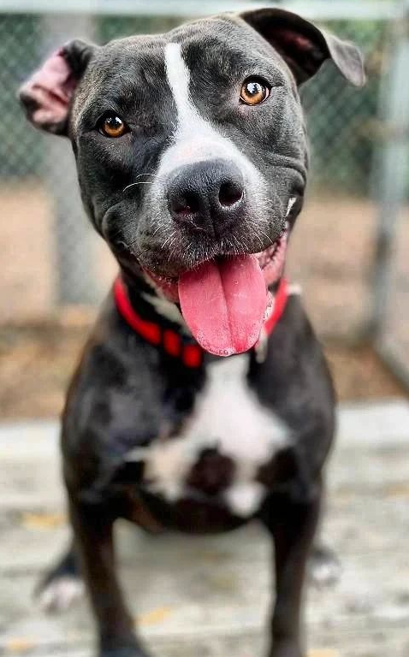
Future Directions
Experimental study randomizing timing of animal’s sterilization surgery to better understand sterilization’s effect on LOS
Exploration of current public opinion on spay/neuter procedures
Implementation of post-adoption sterilization contract programs & measuring effects on post-adoption sterilization
https://happyhound.com/dog-foster-program/
Notes:
When we are thinking about our findings in regard to our primary research question and the findings of previous literature, it would seem to suggest that an animal’s length of stay in the shelter may be influenced by the timing of their spay or neuter surgery. As both our study and the 2022 Gunter et al. study were correlational in their designs, *CLICK* an experimental study that randomizes the timing of animal’s sterilization surgery, at least for those that arrive unaltered, could better inform our understanding. Individuals could be matched across sterilization timings on animal factors known to impact length of stay, such phenotypic and behavioral characteristics, to allow for balanced proportions in each of the surgery groups and improve our causal inference abilities.
Nevertheless, present findings suggest that shelters may be able to reduce an animal’s time in care by waiting to spay and neuter after placement, whether that occurs in an adoptive home or in the care of a transfer partner. Previous literature has recommended that animals being transferred should be sterilized at the destination shelters for a multitude of factors, such as surgical capacity, length of stay, community need, and increased disease risk associated with longer stays at source shelters. However, for post-outcome sterilization of adopted animals to become a viable option for sheltering organizations, much more research is needed on the practice of post-adoption spay/neuter contracts and adopter compliance. *CLICK* To this aim, exploration of public opinion could provide insight on the reservations that adopters have about spay and neuter. *CLICK* By understanding the efficacy of post-adoption sterilization programs, resource-limited animal shelters could be better informed about the costs of care for animals of various sterilization surgery timings and implement practices that are best-suited for their communities.

Slide 37

Questions?
https://www.livescience.com/animals/land-mammals/why-do-cats-claws-retract-but-dogs-claws-dont/
Notes:
And with that we have reached the end of my presentation on my final project. Thank you all for your time. Are there any questions? A brief reference section is listed in the next slides.

Slide 38
References
2023 Statistics. (2024). Shelter Animals Count. https://www.shelteranimalscount.org/stats
Alexander, S. A., & Shane, S. M. (1994). Characteristics of animals adopted from an animal control center whose owners complied with a spaying/neutering program. JAVMA, 205(3). https://doi.org/10.2460/javma.1994.205.03.472
Berry, C., Patronek, G., & Lockwood, R. (2005). Long-Term Outcomes in Animal Hoarding Cases. Animal Law Review, 11(1). https://lawcommons.lclark.edu/alr/vol11/iss1/7
Clevenger, J. & Kass, P.H. (2003) Determinants of Adoption and Euthanasia of Shelter Dogs Spayed or Neutered in the University of California Veterinary Student Surgery Program Compared to Other Shelter Dogs. JVME, 30(4), 372-378. https://doi.org/10.3138/jvme.30.4.372
Dakin Humane Society. (2024). Average Cost of Care per Animal: How Does It Figure? https://www.dakinhumane.org/permanent-pages/average-cost-of-care-per-animal-how-does-it-figure
Doyle, E., Gupta, M., Spindel, M., Dolan, E. D., Slater, M. R., & Janeczko, S. (2020). Impact of the timing of spay-neuter related to transport on disease rates in relocated dogs. Animals, 10(4), 630. https://doi.org/10.3390/ani10040630
Gouveia, K., Magalhães, A., & de Sousa, L. (2011). The behaviour of domestic cats in a shelter: Residence time, density and sex ratio. Applied Animal Behaviour Science, 130(1-2). doi:10.1016/j.applanim.2010.12.009

Slide 39
References (Cont.)
Gunter, L. M., Gilchrist, R. J., Blade, E. M., Reed, J. L., Isernia, L. T., Barber, R. T., Foster, A. M., Feuerbacher, E. N., & Wynne, C. D. (2022). Emergency fostering of dogs from animal shelters during the COVID-19 pandemic: Shelter Practices, Foster caregiver engagement, and dog outcomes. Frontiers in Veterinary Science, 9(862590). https://doi.org/10.3389/fvets.2022.862590
Grigg, E. K., & Kogan, L. R. (2019). Owners’ Attitudes, Knowledge, and Care Practices: Exploring the Implications for Domestic Cat Behavior and Welfare in the Home. Animals, 9(978). doi:10.3390/ani9110978
Griffin, B. (2012). Population Wellness: Keeping Cats Physically and Behaviorally Healthy. The Cat, 1312-1356. doi: 10.1016/B978-1-4377-0660-4.00046-6
Hawes, S. M., Kerrigan, J., Hupe, T., Nawyn, T., & Morris, K. N. (2018). Estimating the Cost to Care for Animals at Austin Pets Alive! Program Evaluation Report, November 2018. Institute of Human-Animal Connection: Graduate School of Social Work of University of Denver. https://www.maddiesfund.org/assets/grants/FinalReports/cost-for-care-at-apa.pdf

Slide 40
References (Cont.)
Haworth, D. (2019) Current state of spay/neuter programs in United States and effect on overall animal numbers. Clinical Theriogenology, 11(3), 219-223.
Hodges, C. (2010). State spay and neuter laws. Animal Law Legal Center. https://www.animallaw.info/intro/state-spay-and-neuter-laws
Janke, N., Berke, O., Flockhart, T., Bateman, S., & Coe, J. B. (2017). Risk factors affecting length of stay of cats in an animal shelter: A case study at the Guelph Humane Society, 2011–2016. Preventive Veterinary Medicine, 148, 44-48. http://dx.doi.org/10.1016/j.prevetmed.2017.10.007
Jeusette, I., Detilleux, J., Cuvelier, C., Istasse, L., & Diez, M. (2004). Ad libitum feeding following ovariectomy in female Beagle dogs: effect on maintenance energy requirement and on blood metabolites. Journal of Animal Physiology and Animal Nutrition, 88(3-4), 117–121. https://doi.org/10.1111/j.1439-0396.2003.00467.x
Kogut, S., Montgomery, M. L., & Levy, J. K. (2024). The nonprofit veterinarian shortage: who will care for the pets most in need? PREPRINT (Version 1) available at Research Square. https://doi.org/10.21203/rs.3.rs-3915925/v1
Lepper, M., Kass, P. H., & Hart, L. A. (2002). Prediction of Adoption Versus Euthanasia Among Dogs and Cats in a California Animal Shelter. Journal of Applied Animal Welfare Science, 5(1), 29-42. https://doi.org/10.1207/S15327604JAWS0501_3

Slide 41
References (Cont.)
Levy, J., Crawford, C., & Griffin, B. (2020). Shelter Animals and Behavior Problems. University of Florida. https://ufl.pb.unizin.org/integratingveterinarymedicinewithsheltersystems/chapter/shelter-animals-and-behavior-problems/
Raudies, C., Waiblinger, S., & Arhant, C. (2021). Characteristics and Welfare of Long-Term Shelter Dogs. Animals, 11, 194. https://doi.org/10.3390/ani11010194
Rowan, A., & Kartal, T. (2018). Dog Population & Dog Sheltering Trends in the United States of America. Animals, 8(5), 68. https://doi.org/10.3390/ani8050068
Salman, M. D., Hutchison, J., Ruch-Gallie, R., Kogan, L., New, J. C., Kass, P. H., & Scarlett, J. M. (2000). Behavioral Reasons for Relinquishment of Dogs and Cats to 12 Shelters. Journal of Applied Animal Welfare Science, 3(2), 93–106. https://doi.org/10.1207/S15327604JAWS0302_2
Simmons, K. E., & Hoffman, C. L. (2016). Dogs on the Move: Factors Impacting Animal Shelter and Rescue Organizations’ Decisions to Accept Dogs from Distant Locations. Animals, 6(11). doi:10.3390/ani6020011
Suchak, M., & Lamica, J. (2018). A Comparison of Cats (Felis silvestris catus) Housed in Groups and Single Cages at a Shelter: A Retrospective Matched Cohort Study. Animals, 8(29). doi:10.3390/ani8020029

Slide 42
References (Cont.)
Syufy, F. (2022). How Many Litters Can a Cat Birth in One Year? The Spruce Pet. https://www.thesprucepets.com/how-many-pregnancies-per-year-554845
Tanaka, A., Wagner, D. C., Kass, P. H., & Hurley, K. F. (2012). Associations among weight loss, stress, and upper respiratory tract infection in shelter cats. JAVMA, 240(5), 570-576. DOI: 10.2460/javma.240.5.570
They Did It: Decreased Length of Stay with Post-Adoption Spay/Neuter Contracts (U. Donnet & K. Matt, Interviewees). (2023, January 31). ASPCApro. https://www.aspcapro.org/resource/they-did-it-decreased-length-stay-post-adoption-spayneuter-contracts
Vinic, T., Dowling-Guyer, S., Lindenmayer, J., Lindsay, A., Panofsky, R., & McCobb, E. (2020). Survey of Massachusetts Animal Shelter Record-Keeping Practices in 2015. Journal of Applied Animal Welfare Science, 23(4). doi:10.1080/10888705.2019.1646135.
Weir, M., Llera, R., & Yuill, C. (n.d.). Estrous Cycles in Dogs. VCA Animal Hospitals. https://vcahospitals.com/know-your-pet/estrus-cycles-in-dogs
Wells, D. L., Graham, L., & Hepper, P. G. (2002). The Influence of Length of Time in a Rescue Shelter on the Behaviour of Kennelled Dogs. Animal Welfare, 11(3), 317-325. doi:10.1017/S0962728600024891

Slide 43
References Cont.
Woodruff, K. & Smith, D. R. (2020). An Estimate of the Number of Dogs in the US Shelter in 2015 and the Factors Affecting Their Fate. Journal of Applied Animal Welfare Science, 23(3), 302-314. https://doi.org/10.1080/10888705.2019.1663735

