Slide 1
CTE Website
Tolu Akinyemi, Tsion Woldeab, Jae Lee
Dr. Edward Fox
CRN: 13414
CS 4624: -> Multimedia, Hypertext, and Information Access
Virginia Tech, Blacksburg VA 24061
05/04/2023

Slide 2
Outline
Motivation and Background
Deliverables
Site Architecture
Implementations
Process of Management
Results
Timeline
Challenges/Future Work
Acknowledgements
References

Slide 3

Motivation and Background
Dr. Murali requested a new Content Management System for functionality
Our solution: Wordpress
Previous CTE Website | Our Client’s Goals
Long process to stage, preview, and publish website Not easy to maintain/edit website Need ways to improve automation in website | Ways to automatically update information Easy process to edit information / add new information Easily preview and stage website

Slide 4
Deliverables
Admin should have the ability to edit permissions
A new entry can automatically be added to a list
Live Preview of Changes
Certain fields can display a list of categories
Customization should be robust without the need for coding

Slide 5
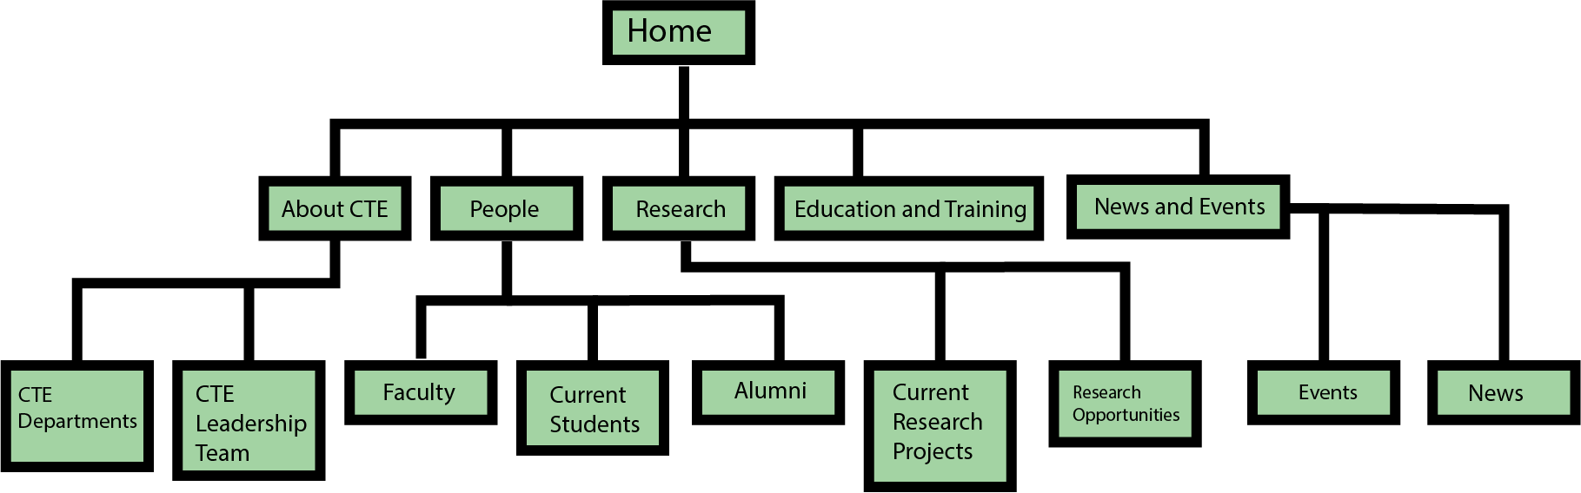
Site Architecture

Slide 6
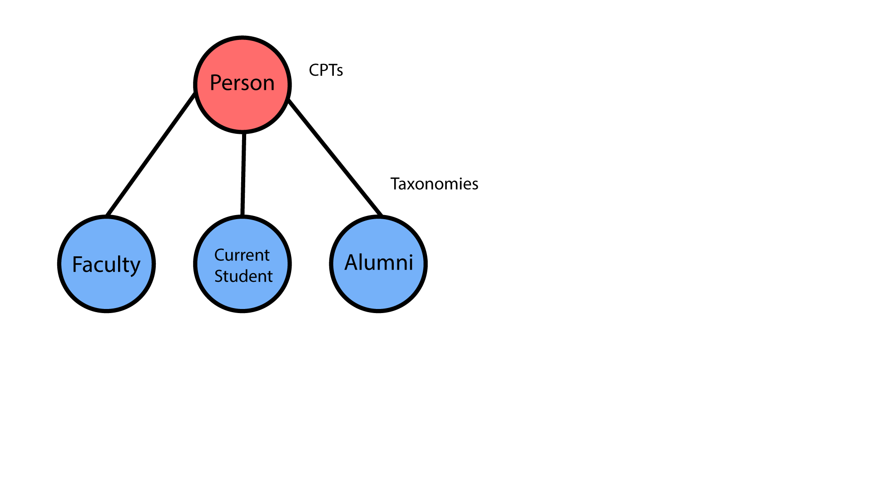
Implementations - Custom Post Types and Taxonomies
Custom Post Types: User-created custom content types
People
Research
News
Events
Taxonomies: Is a way to put posts together based on a set of connections (Categories)
Faculty, Current Student, Alumni
Research Opportunities, Current Research Projects
None for News
Occurring, Passed

Slide 7




Implementations - Tools/Plugins
Plug-ins | Front-end/Back-end | Benefits
Elementor | Front-end | Makes it easy to modify the front-end
CPT UI | Back-end | Makes it easy to create CPTs and taxonomies
ACF | Back-end | Allows us to create CPT fields
JetSmart filters | Front-end | Allows us to filter the CPT

Slide 8
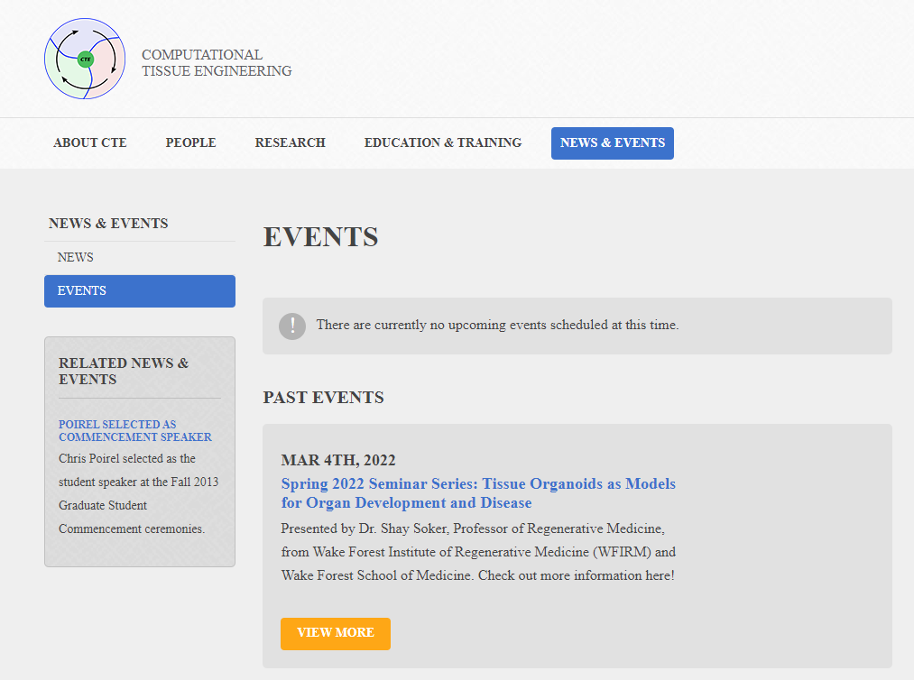
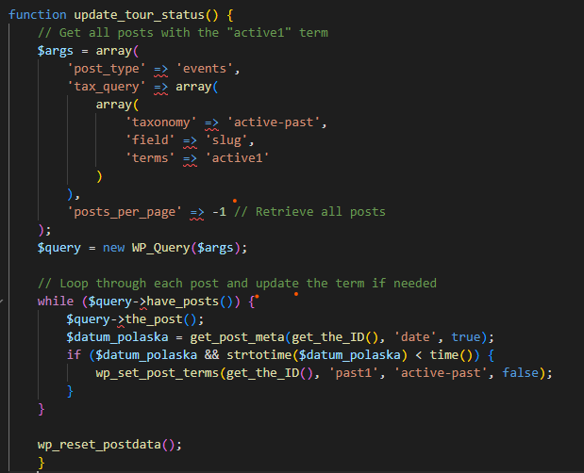
Implementations - Automation
Based off Taxonomies
Schedule time-based tasks
WP-Cron
Can switch taxonomies based on conditions

Slide 9
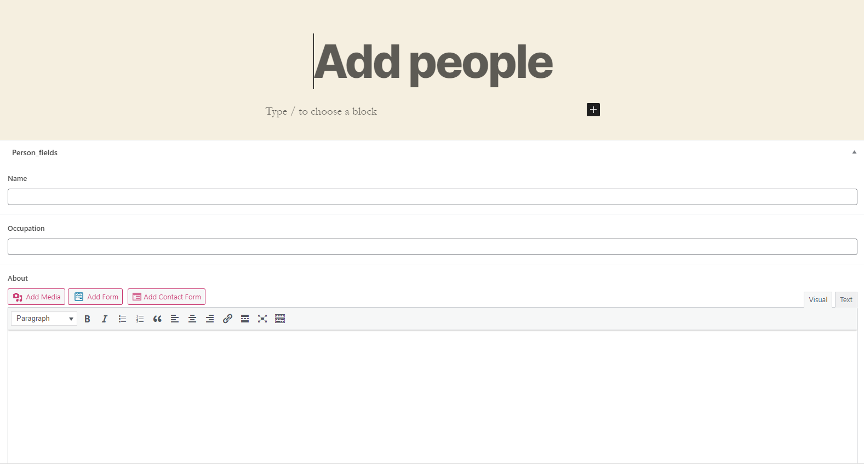

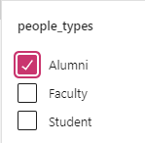
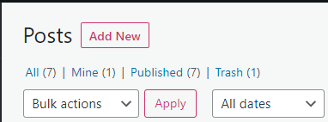
Process of Management
Wordpress will use these fields to populate a Custom Template
Custom templates that we made will be populated automatically with individual pages
Select Custom Post Type
Click on the wordpress sidebar with different post types and click “Add new”
03
01
02
Fill Out Custom Post Fields
Different Custom Posts will have different fields and Taxonomies

Slide 10
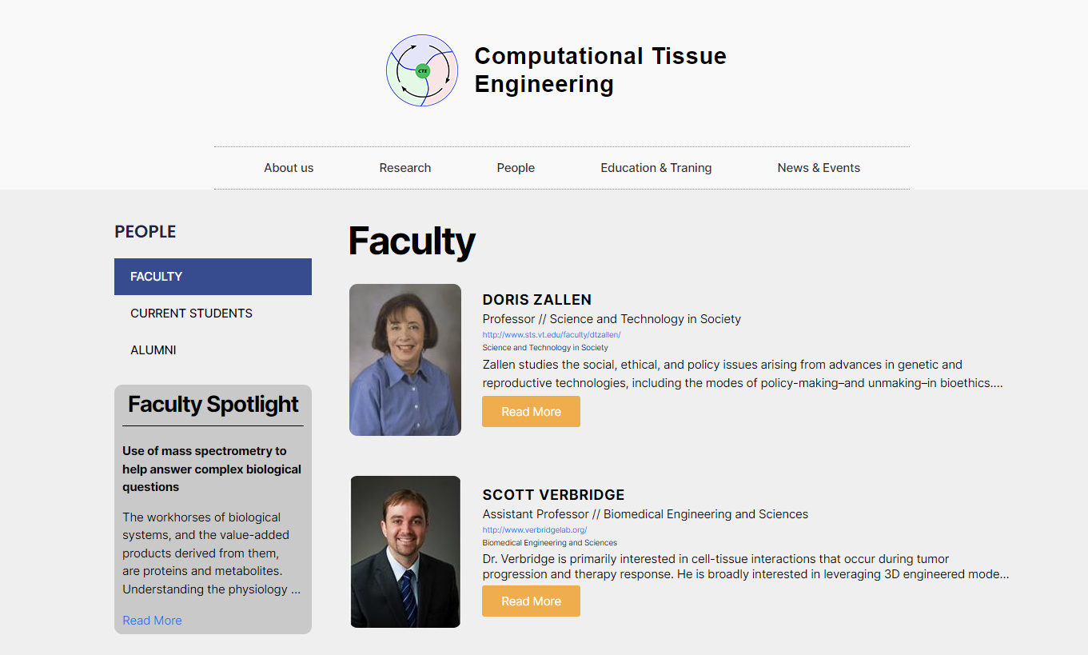
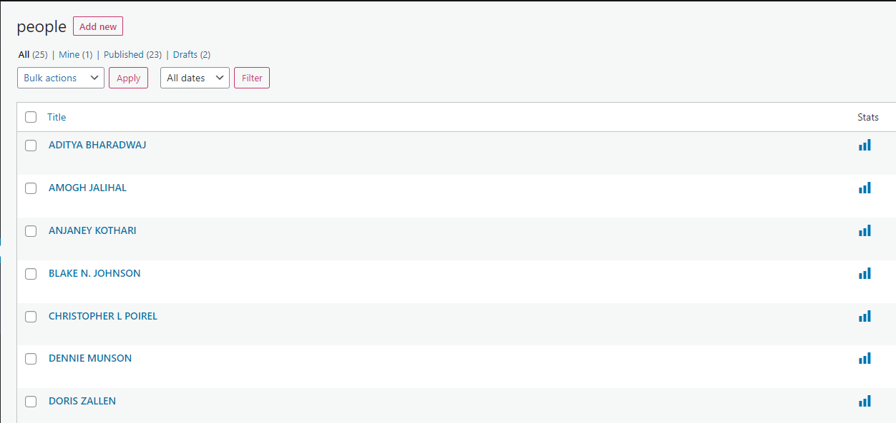
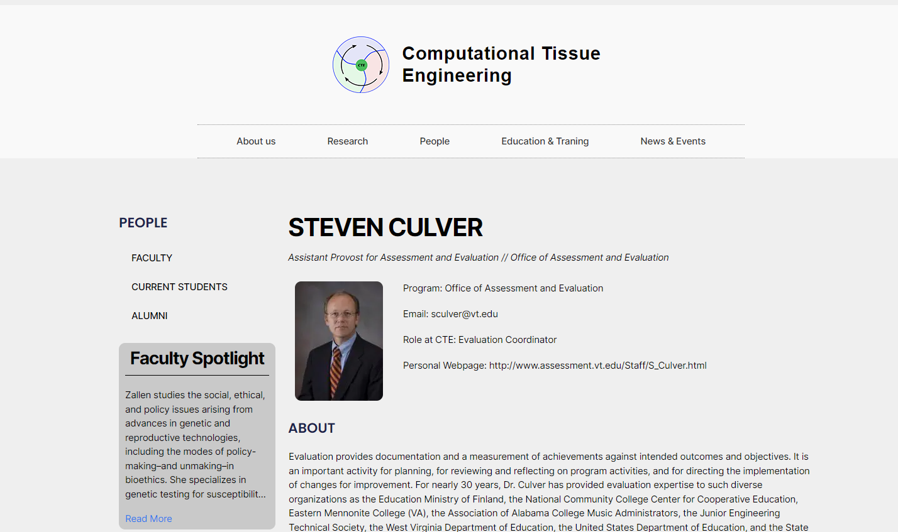
Results

Slide 11
Milestones/Timeline
Initial Research
Research into what type of CMS to use, and finally ended with Wordpress
Creation of Custom Post Types/Taxonomy
Created Templates of Custom Posts and their fields for ease of access
March
Current
February
April
Wordpress Familiarity/Plugins
Acquirement of different plugins such as Jetpack, Elementor, WP-Crontrol
Population of Data/Polishing Site
Filled in data for the Posts and polished the overall site.

Slide 12
Challenges/Future Work
Challenges
Simple tasks in Elementor were not always straightforward
Learning how to add/edit pages
Creating a select filter led to slight glitches
Future work
Export website into VT Wordpress environment
Acquire VT domain name and finalize hosting

Slide 13


Acknowledgements
Dr. Murali
Dr. Edward Fox

Slide 14
References
https://www.youtube.com/watch?v=8owJ_OYxUzA
https://wordpress.org/plugins/advanced-custom-fields/
https://wordpress.org/plugins/elementor/
https://dac.cs.vt.edu/person/edward-fox/
https://cs.vt.edu/people/faculty/tm-murali.html
http://cte.cs.vt.edu/ (CTE Website)

