Slide 1

Understanding and Building Effective Narrative on Veteran Experiences to Compel Program and Policy Action
Mary Beth Dunkenberger, Principal Investigator
Suzanne Lo, Project Manager
Virginia Tech Institute for Policy and Governance

Slide 2

The Virginia Tech Institute for
Policy and Governance
Interdisciplinary community of collaborating faculty, staff and students
Provide technical assistance and governance-related research
Conduct population needs and organizational assessments, policy and program evaluation, strategic planning and strategic interventions
Experience in public health, mental/behavioral health, human service programs, disability services, reentry programs

Slide 3
VTIPG Veteran Related Projects
2010 Virginia Veterans Assessment of Experiences and Service Needs
Virginia Wounded Warrior Program – Development and Management of Case Management and Reporting System
2014 Veterans and Broadband Access in Virginia: Implications for Healthcare Planning and Policy
2015 Virginia Veterans Assessment of Experiences and Service Needs

Slide 4
Context for Policy and Program Research?
Federal and State officials want empirical research that is
  Valid
  Reliable
  Actionable
  Representative
  Measurable
Veterans want program and policy action that is responsive to
  Individual needs
  Family members
  Service context
  Geographic context
  Comprehensive – health, education, employment, well-being

Slide 5
What are the challenges?
Veterans are faced with wide-ranging and complex health and well-being needs.
Veterans experiences and resulting needs vary greatly
Nature of OIF and OEF deployments and combat have resulted in different and more immediate impacts than in prior conflicts.
Veterans services and programs remain fragmented and institutionally grounded rather than individually focused.

Slide 6
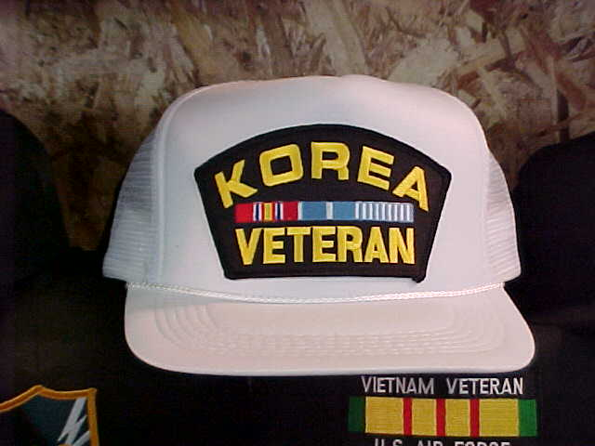
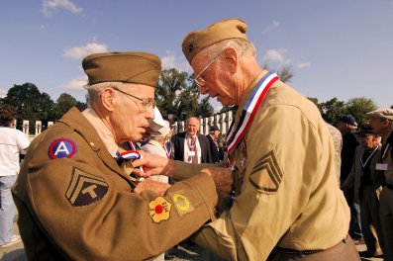



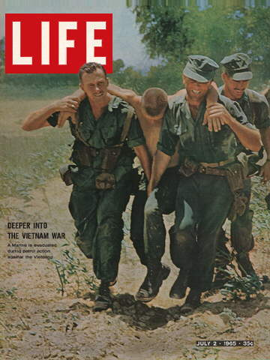
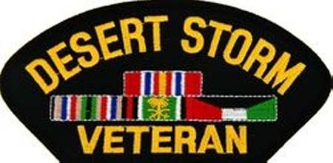
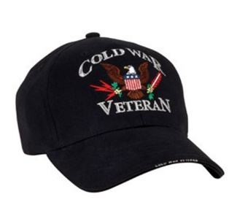





Factors that Impact the Narrative
Era of service
Branch of Service

Slide 7
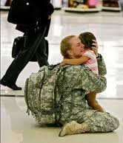
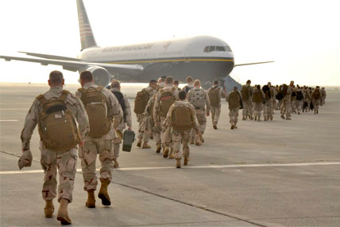
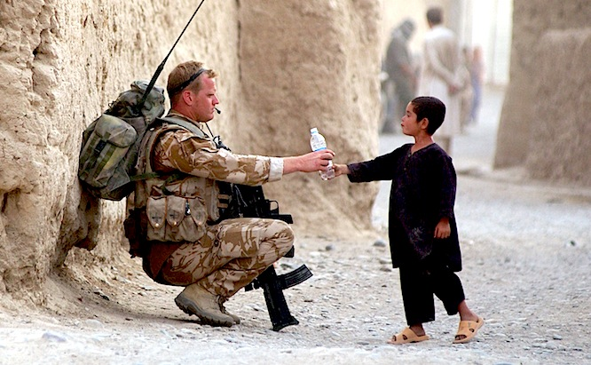
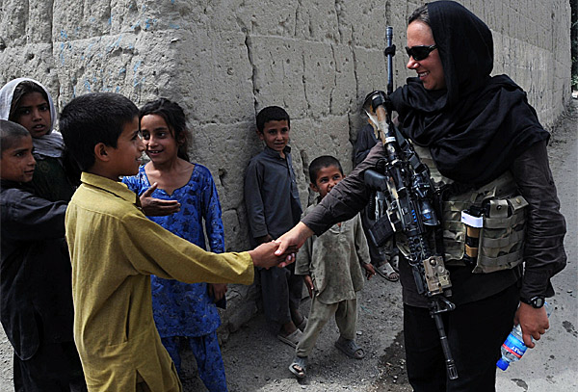
Factors that Impact the Individual Narrative
Military Status:
Active Duty
Reserves
National Guard
  Active Guard Reserve
  Drilling
  Mobilized
Deployments
  Combat/Noncombat
  Multiple/Length/Extended

Slide 8
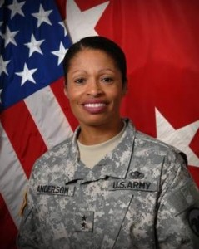
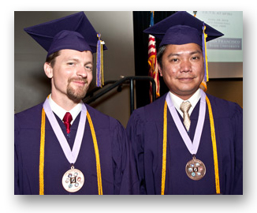

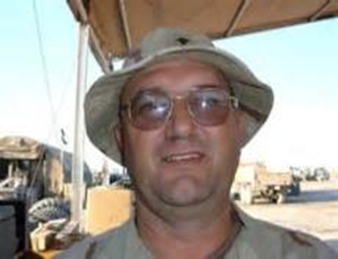
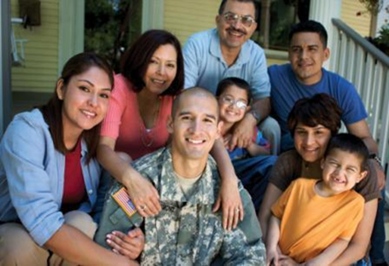
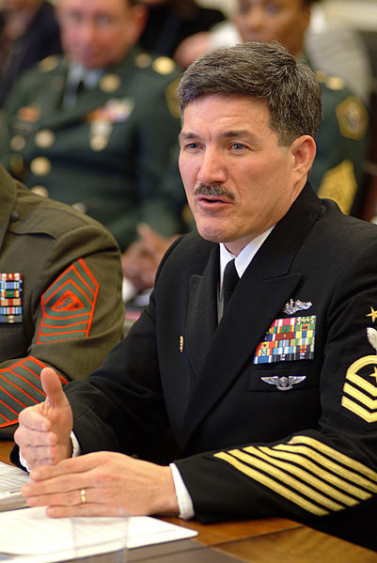
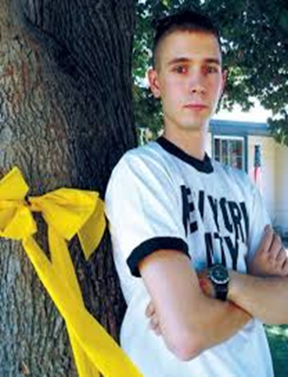
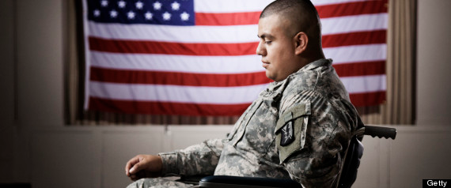
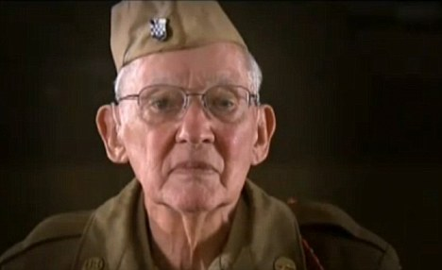

Factors that Impact the Individual Narrative
Sex, Gender, Age, Race, Ethnicity, Rank, Education, Family Structure

Slide 9
Aim of Research: Grow the sweet spot
Veterans’ Needs
Private and nonprofit engagement
(Political)
Public Policy and Program Capacity
Where services, programs and policies are most effective
Notes:
While baseline technologies are required that do not exit in certain parts of the state, more than a technology issue, The challenge is currently with market and policy dynamics

Slide 10
Effective Research:
Imperative 1 – Scientific Rigor
Establish Research Question(s)
1. What are the services needs of Virginia Veterans?
2. How does broadband impact veterans health services?
3. Does CBT model 1 improve PTSD symptoms among female veterans?
Identify Variables
1. Characteristics of veterans
2. Geographic scope
3. Existing resources – program parameters
4. Policy parameters
5. Intervening
Data Collection
1. Secondary
a. Literature Review
b. Administrative Data
2. Primary
a. For all variables
b. Representative of population
3. Qualifying/Causal Data (The Narrative)
Steps to Empirical Research with Scientific Rigor

Slide 11
Effective Research:
Imperative 2 – Capture the Narrative
Digital Storytelling
Gathering veteran stories to produce short videos using their own and local communities’ voices to tell their individual story.
Empower veterans involved and offers a culturally relevant perspective in a creative and visually powerful way.
Culture, Storytelling, Narrative
Framing veteran issues for public understanding and support.
Research-based approaches to better public understanding and engagement.

Slide 12
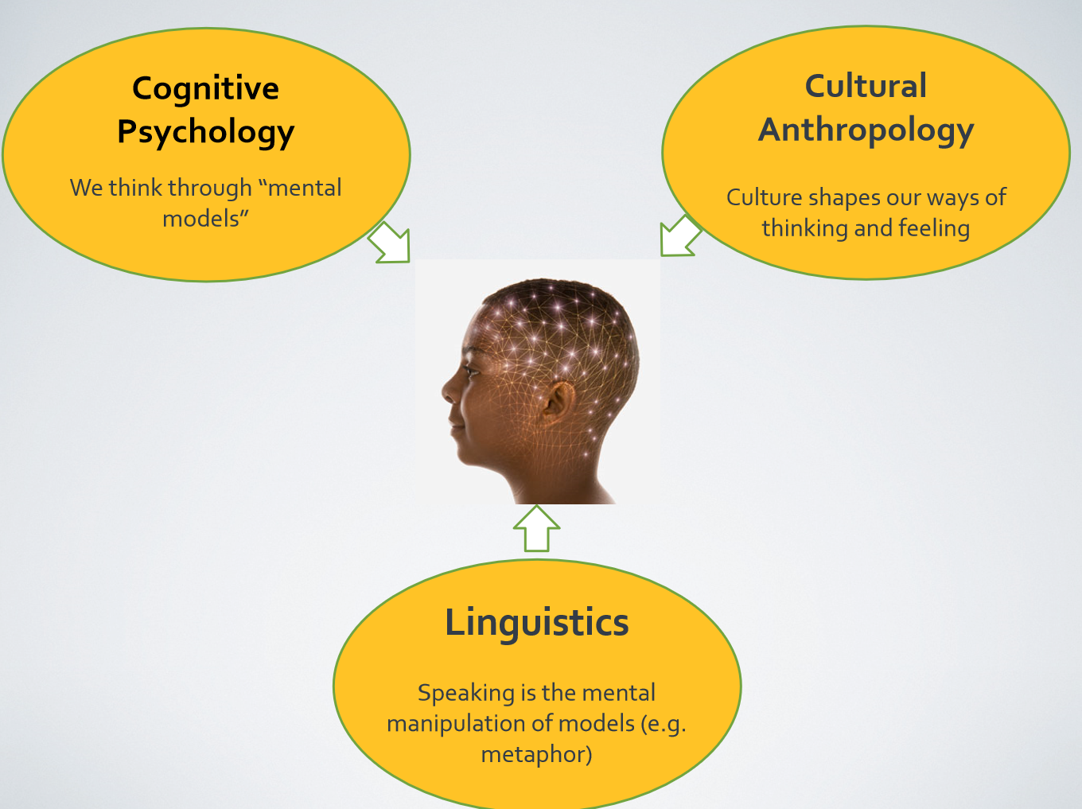
Effective Research:
Culture & Stories
Notes:
There are many different fields and disciplines that study culture.
Anthropology, Psychology, Linguistics – to name a few.
Others include Sociology, Public Health, Policy, Governance, Political Science, etc.

Slide 13
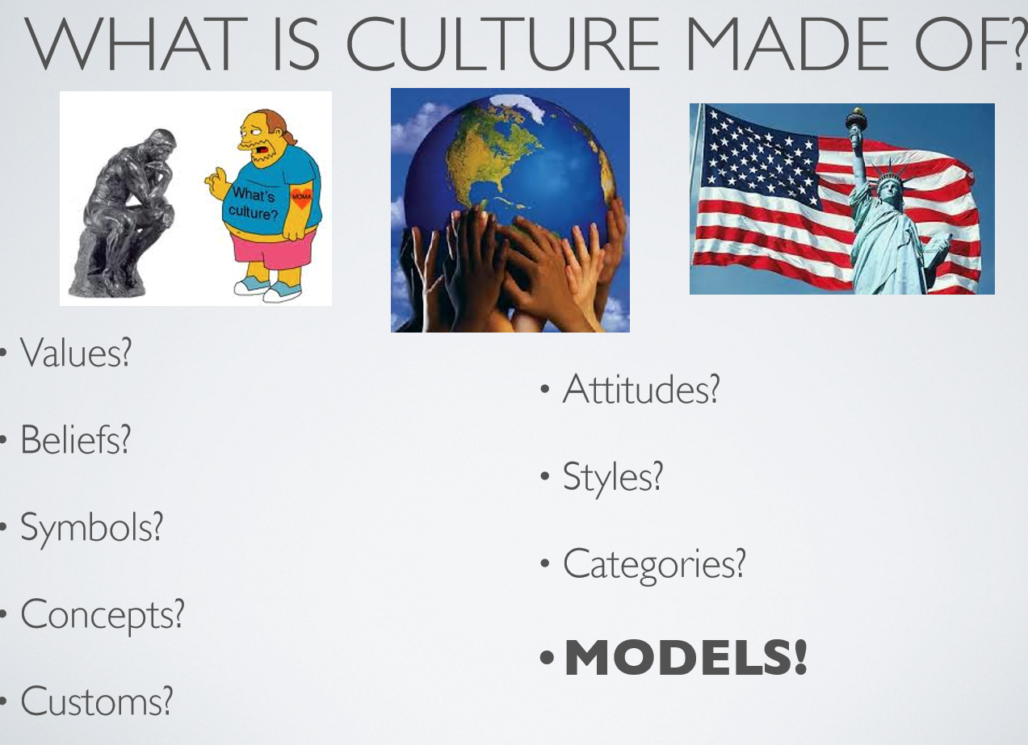
Effective Research:
Culture & Stories

Slide 14
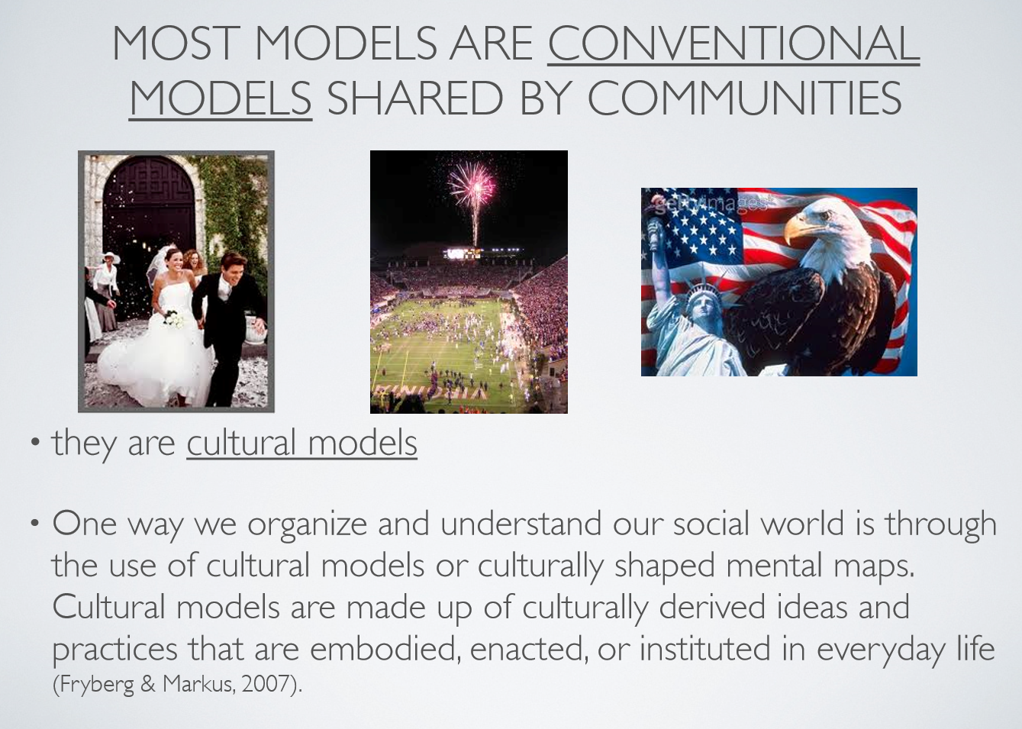
Effective Research:
Culture & Stories

Slide 15
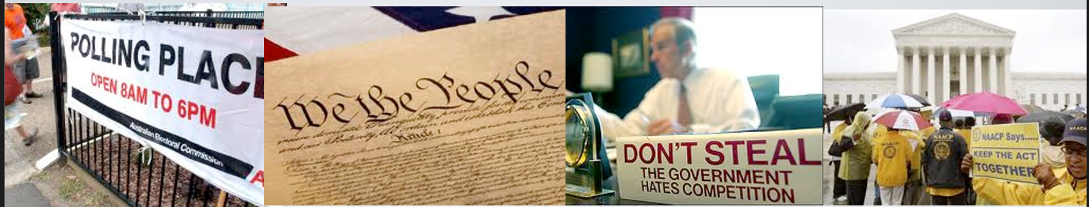
Effective Research:
Culture & Stories
UNDERSTANDING THE AMERICAN PUBLIC
Lacking political knowledge and the incentive and time to acquire it, the vast majority of citizens “substitute low-cost cues for the detailed information that they lack” –Lupia, Arthur, 1994.
Heuristics are judgmental shortcuts, efficient ways to organize and simplify political choices, efficient in the double sense of requiring relatively little information to execute, yet yielding dependable answers even to complex problems of choice. –Sniderman, Pal, Brody, Richard, Tetlock, Phillip, 1991

Slide 16
Effective Research:
Culture & Stories
CORE PRINCIPLES
Social issues advocates need to understand that they are framers of social problems
There is a science of cognition – how people think and process information – which informs the framing of social issues
There is also a science to communications on social issues

Slide 17
Effective Research:
Storytelling – Frame Elements
“The way a story is told – its selective use of particular values, symbols, metaphors, and messengers – which in turn, triggers the shared and durable cultural models that people use to make sense of their world” –FrameWorks Institute
Different stories set up different solutions
  episodic vs. thematic
  Values, Order, Context, Metaphors, Social Math, Solutions, Tone, Visuals, etc…

Slide 18
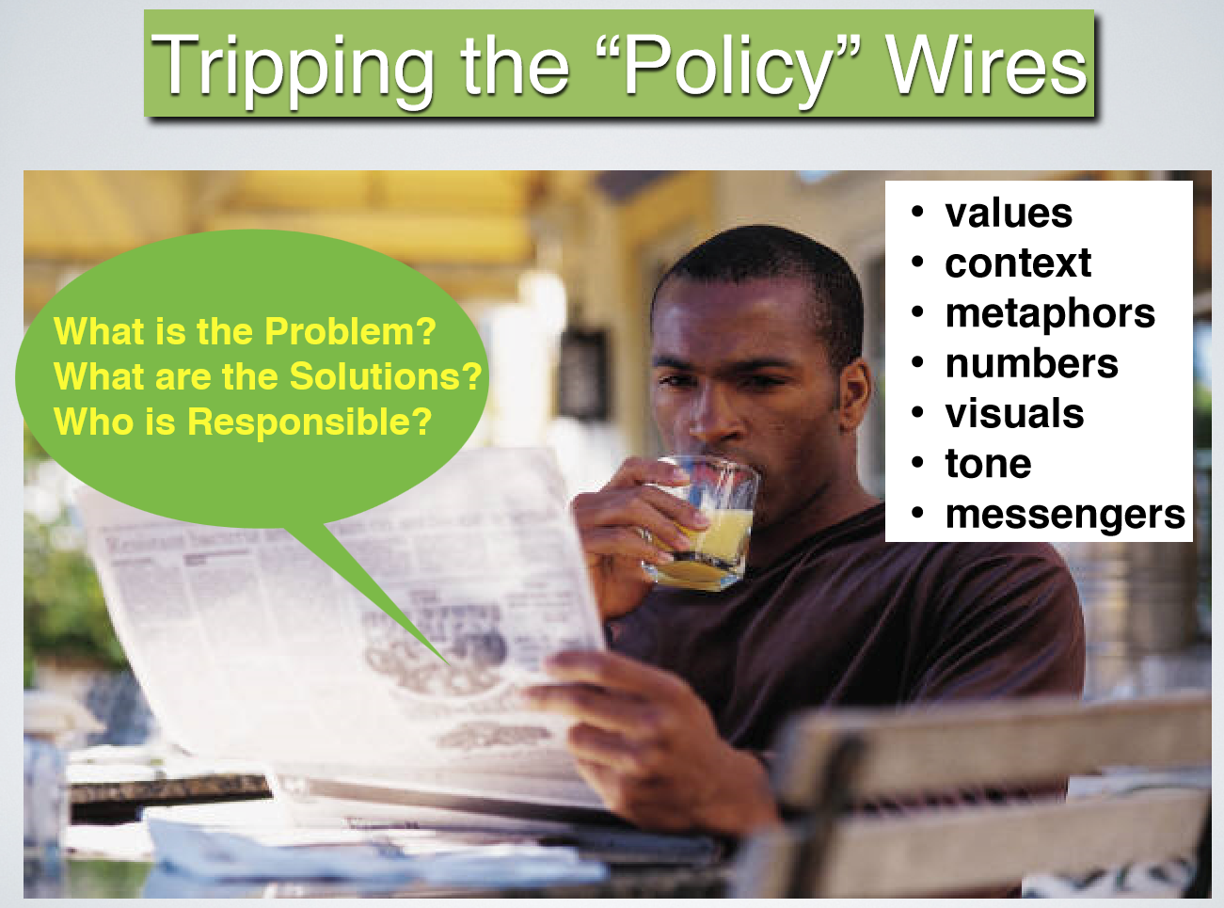
Effective Research:
Storytelling – Frame Elements

Slide 19
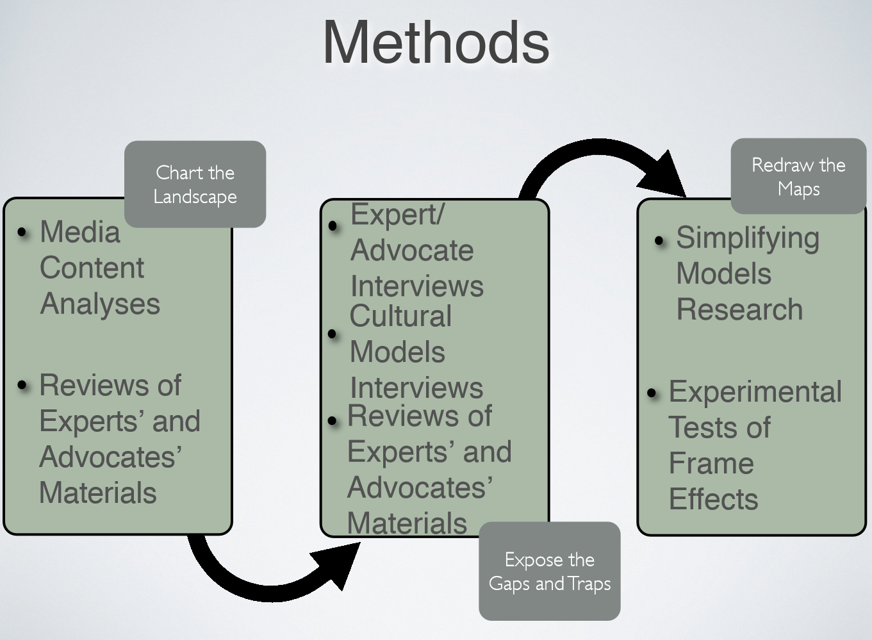
Effective Research:
Research Methods

Slide 20
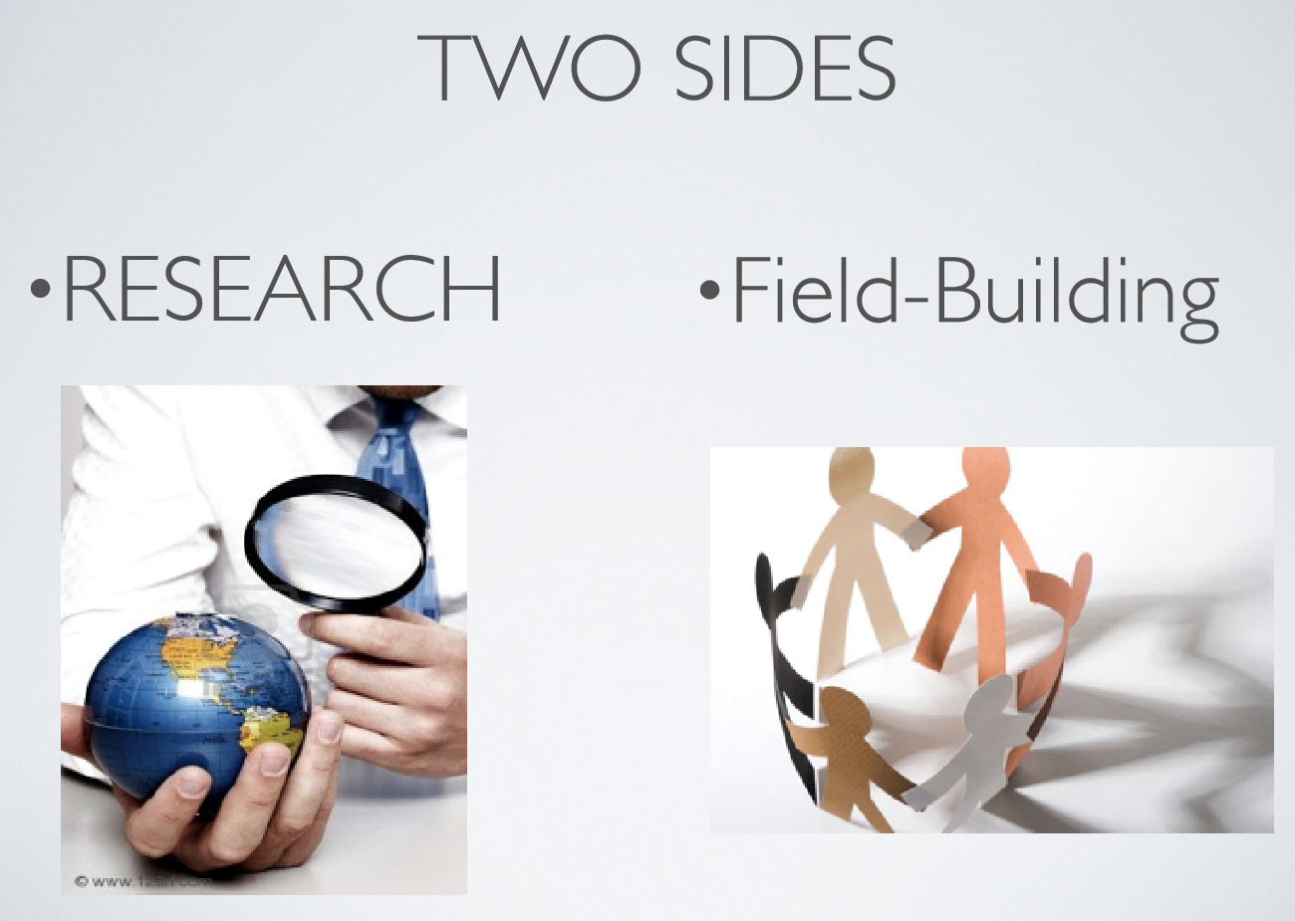
Effective Research:
Research Methods

Slide 21
Needs Assessment as Case Study
Framing veteran issues for public understanding and support is imperative.
It is necessary to utilize research-based approaches to better public understanding and engagement.
Outcomes:
  Understanding of veteran culture around issues and needs
  Understanding of what veteran and their families want to convey
  Reframes will help bridge the gap– deepen public understanding, perceptions, knowledge and therefore help communities make informed decisions, including supporting policies that will help veterans and their families

Slide 22
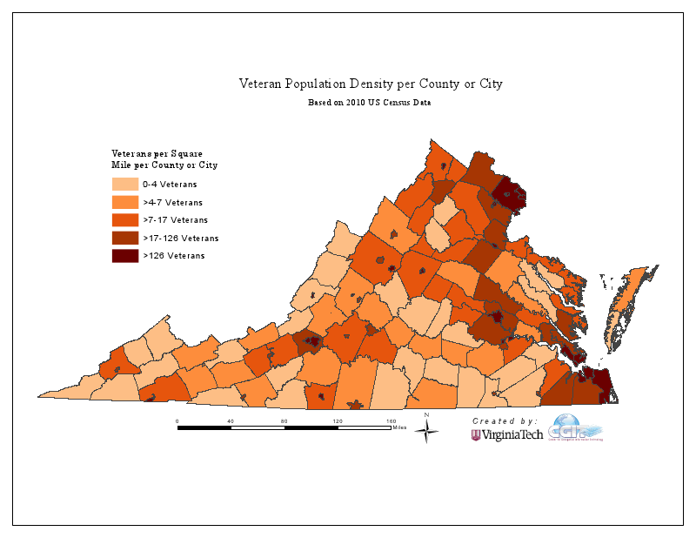
Veterans comprise 13% of Virginia’s Population
Notes:
Sept 30, 2014 – 840,000 Veterans
404,000 – OIF/OEF

Slide 23
Era of Service Cohorts
September 2013 - US Department of Veteran Affairs (840,000 Virginia Veterans)
Notes:
Gulf War, Vietnam, Peacetime, Korean and WWII
840,000

Slide 24
In 2012, 135,910 Veterans received treatment at a Virginia-based Veteran Administration health facility.
Veteran population estimates, as of September 30, 2013, are produced by the VA Office of the Actuary (Vetpop 2011).
Notes:
Veterans getting services at VA
Southwest 31% (28)
Central 21% (23)
Northwestern 17% (15)
Tidewater 15% (11)
Northern 7% (10)

Slide 25

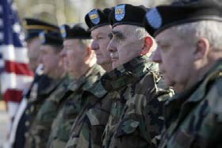
Contextual Attributes of Veterans
Older Veterans – Age 55 +
Younger Veterans - < 55
Higher levels of chronic disease.
Higher demand for care coordination and specialty services
Greater satisfaction with medical care and ability to pay
Higher levels of reported depression
Higher levels of multiple disabilities (Physical, mental, head injuries, post-traumatic stress disorder)
Lower satisfaction with medical care and ability to pay
Virginia Wounded Warrior Program Needs Assessment Study , 2010.
Notes:
The type and amount of VA benefits are affected by a variety of factors.
The two most important factors are….

Slide 26
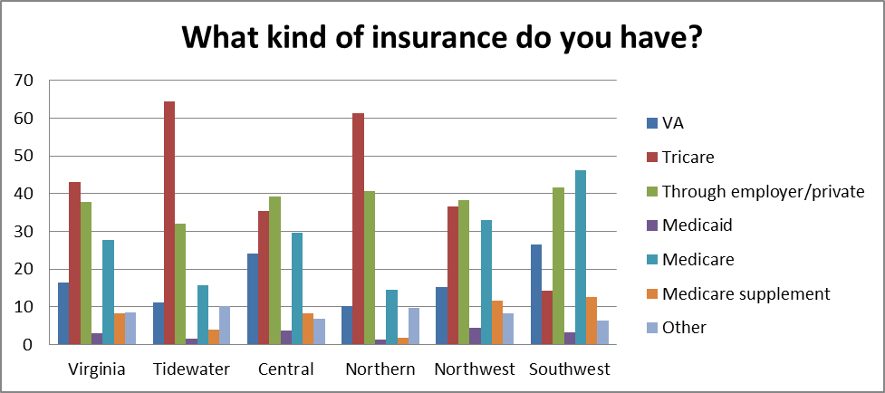
Type of insurance by VWWP region
Virginia Wounded Warrior Program Needs Assessment Study , 2010.
Notes:
Highlight all the different types of insurances that Veterans could have.
Tidewater and Northern more urban, others are more rural

Slide 27
Contextual Attributes of Veterans
Rural Virginia Veterans have….
  higher rates of reported depression, traumatic brain injury (TBI), substance abuse and post-traumatic stress disorder (PTSD).
  higher rates of chronic health conditions such as diabetes and hypertension.
  less access to medical center or specialist care.
Virginia Wounded Warrior Program Needs Assessment Study , 2010.
Notes:
Similar to other state and national findings

Slide 28
Priority Health Service Needs of Veterans
Identified health needs of Veterans from the narrative:
Inclusiveness and Accessibility of Healthcare
Availability of Healthcare
Coordination of Health Services
Cultural Competency of Healthcare Providers
Obtaining and Maintaining Eligibility for Services
Virginia Wounded Warrior Program Needs Assessment Study , 2010.

Slide 29
Priority Service Delivery Preferences – from the Narrative
Want to be able to help them selves – independence, not dependence in services
Veterans trust other veterans
Shared experience is the key, not current or past status
Better connections between the science and the experience
Ability to create, not react- take the initiative to connect and learn from one another – structure follows action, not vice versa
View need for ongoing services – to individual and family as cost of war
.

Slide 30
Connection to Discourse Discussion
Focus on Emerging Populations
  Student Veterans
  Female Veterans
  Military/Veteran Families
The Power to Communicate (lesson from Sophocles)
  Advocacy coalition framework – broad stakeholders
  Ability to create, not react- take the initiative to connect and learn from one another – structure follows action, not vice versa
How do you make the narrative consumable and effectual to larger audience?
  Bridge the gap among those with military experience and between those with and without military experience
.

Slide 31


Questions/Comments/Suggestions
Notes:
Grants
VHCF July Deadline
Ask about how to incentivize student residents….

Slide 32
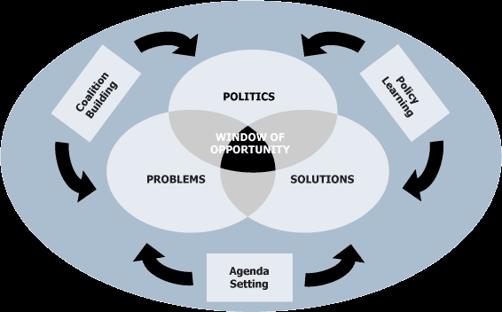
Advocacy Coalition Framework

Slide 33
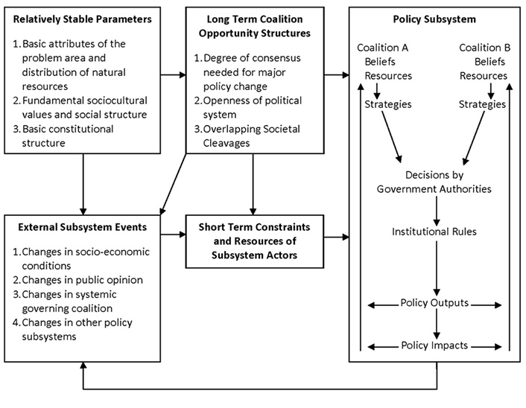
Advocacy Coalition Theory

