Slide 1
IDEAL Tweet Collection Categorization
May 3, 2015
CS 4624 Multimedia, Hypertext and Information Access
Virginia Tech
Blacksburg, VA 24061
Team member: Stephen Won
Client: Sunshin Lee

Slide 2
Background, Goal and Approach
1.1 billion tweets archived by April 2016
Goal
  Aid IDEAL team to manage > 1000 collections
Approach
  Interface for collection management
  Tagging/Categorizing collections

Slide 3
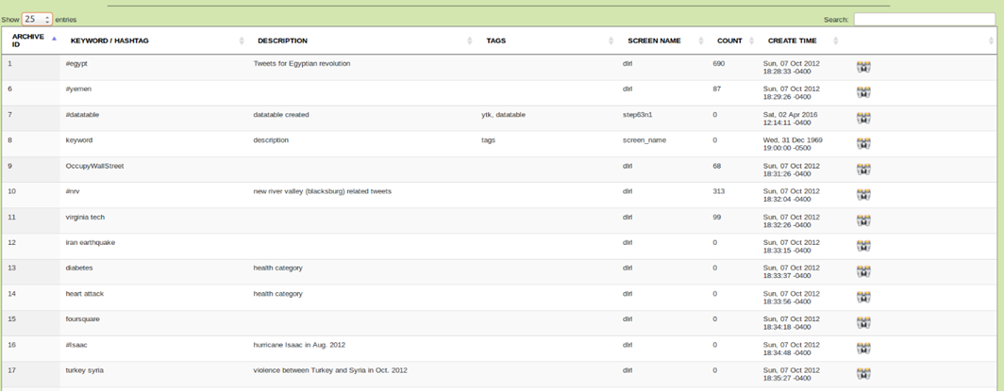
GUI - table
Create interactive table
  filter the collections from the search box
  will enable users to use column ordering.
Notes:
instead of sentences make it into phrases
bigger image

Slide 4
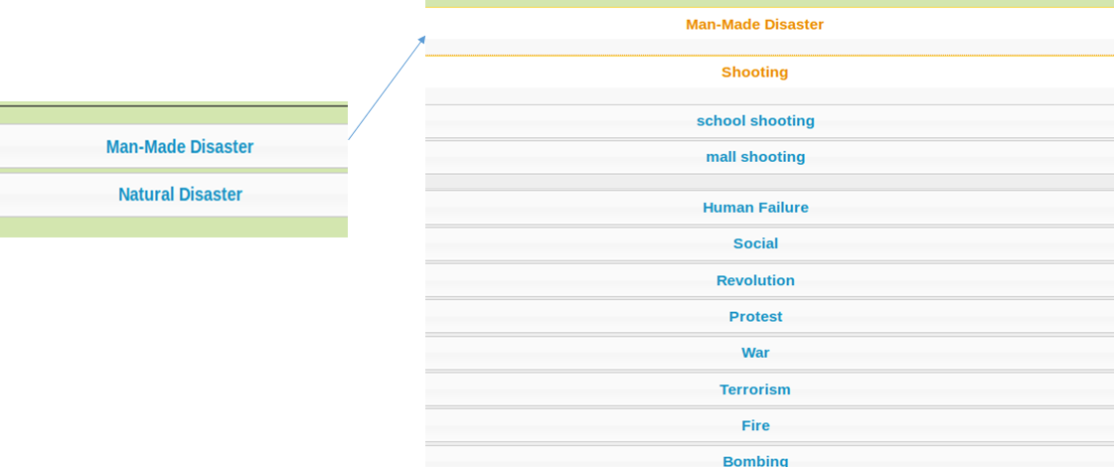
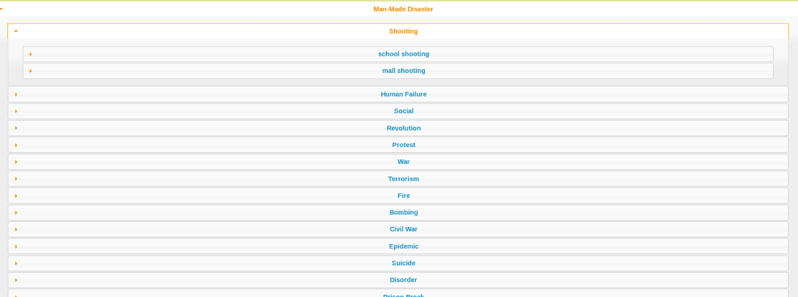
GUI - Categories Added
Notes:
bigger right image

Slide 5
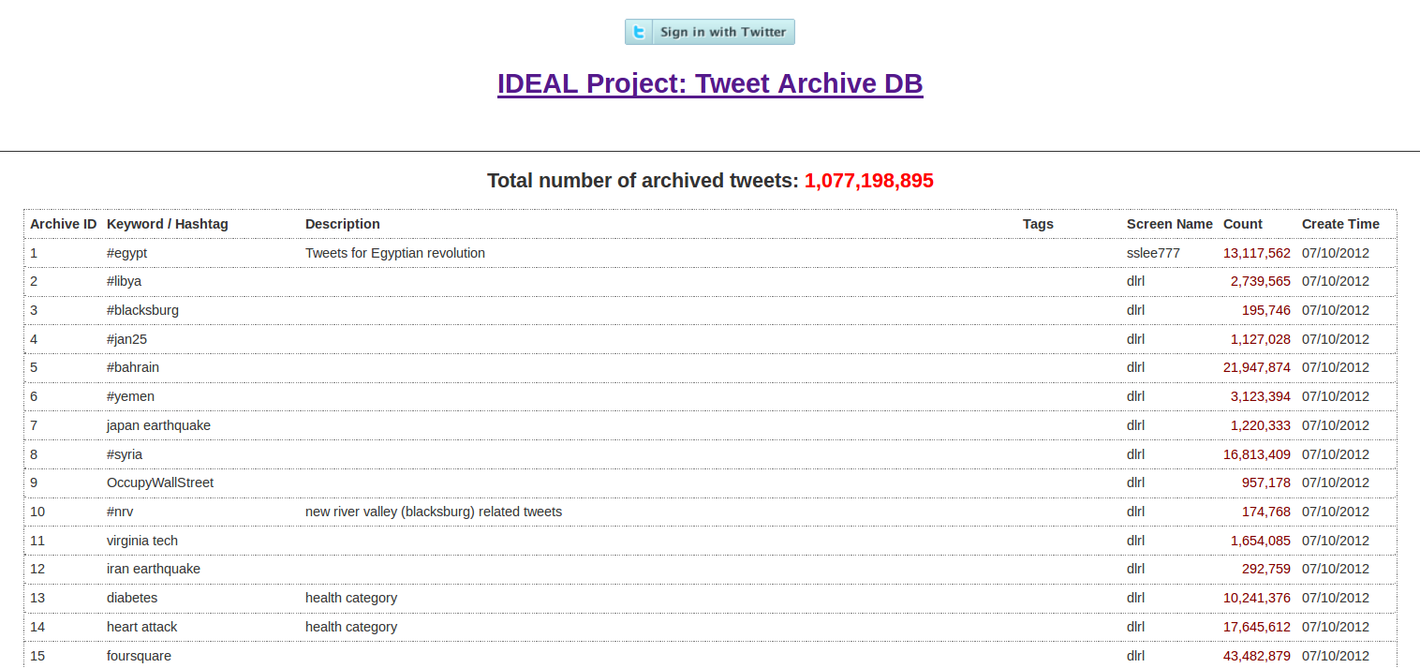

Slide 6
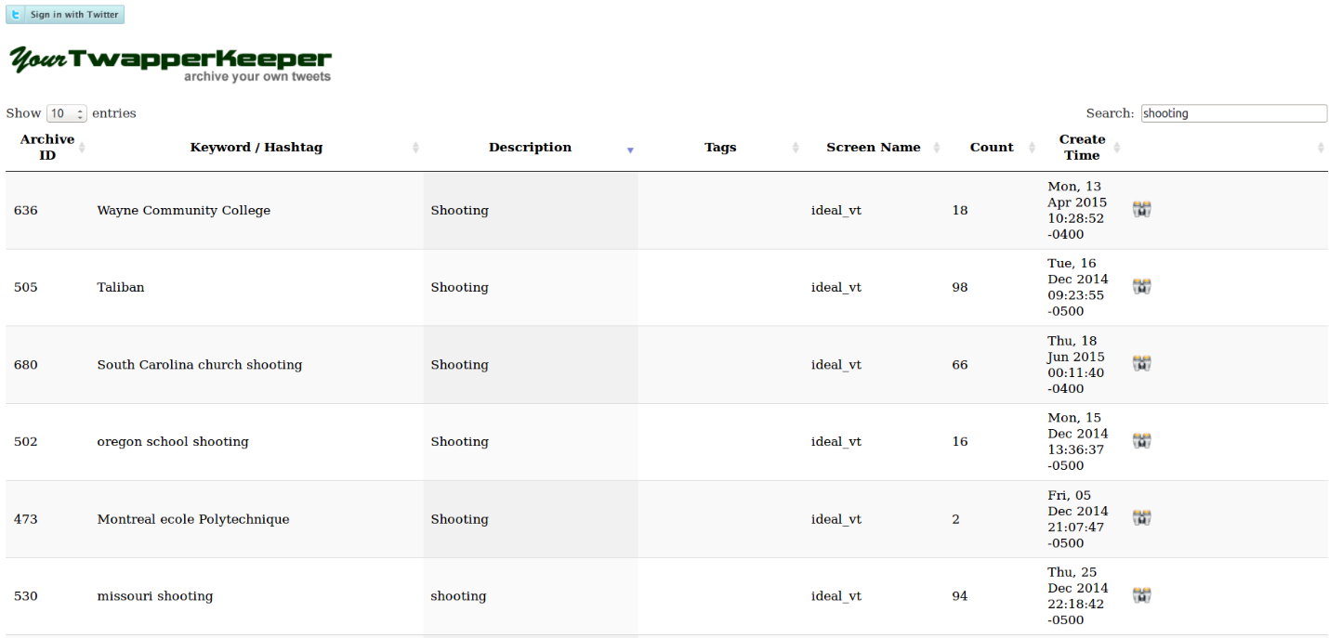

Slide 7
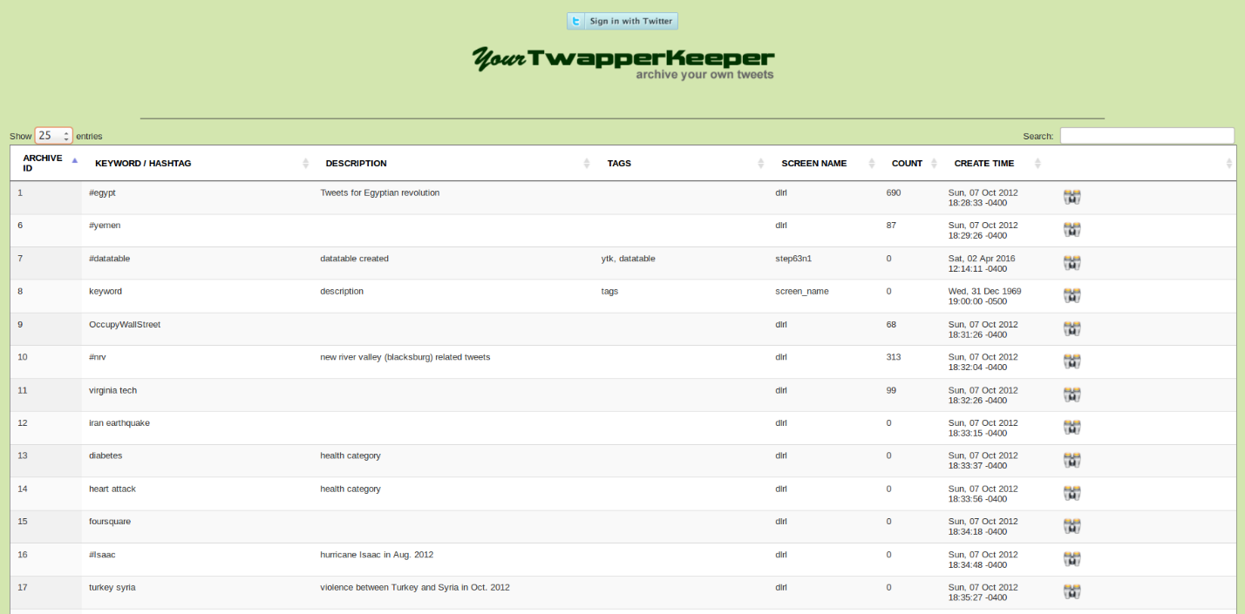

Slide 8
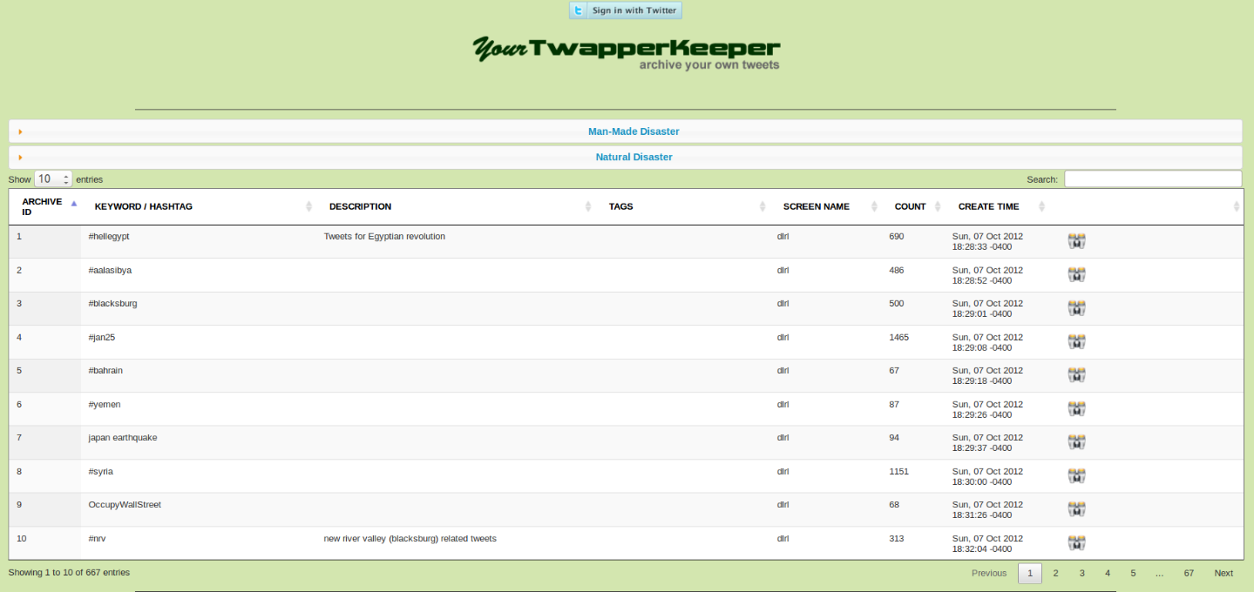

Slide 10
Categorization - taxonomy
Top levels of taxonomy of 2 sub-trees for disasters/crises
Man Made
Natural Disaster
Conflict
Human System Failure
Terrorism
Biological
Climatological
Geophysical
Revolution
Aircraft
Shooting
Health
Storm
Volcano
War
Rail
Bombing
Epidemic
Weather
Earthquake
Civil War
Ship
Cyclone

Slide 11
Tagging
Use tag system for event type, place and date.
Event Type | Types of event
Place | Place where the event happened, or related places of the event
Date | Date the event has occurred

Slide 12

Search on Place Tag
Keyword | Event type | Place | Date
Hurricane sandy | Hurricane | Carolinas, Virginia, Washington D.C, USA … | October, November, 2012
Hurricane issac | Hurricane | Arkansas, Mississippi, Alabama, Louisiana, USA … | August, September, 2012
Oregon shooting | Shooting | Clackamas, Oregon, USA | December, 2012
Hurricane | Hurricane
#Tucson shooting | Shooting | Tucson, Arizona, USA | January, 2011
…
Search tag & keyword
Place | USA
Notes:
bigger

Slide 13
Tagging with Taxonomy
Event Type
  General Event
  More Specific Event
  Even More Specific Event
Place
  Country
  State
  City
Date
  Year
  Month
  Day
Notes:
bigger texts

Slide 14
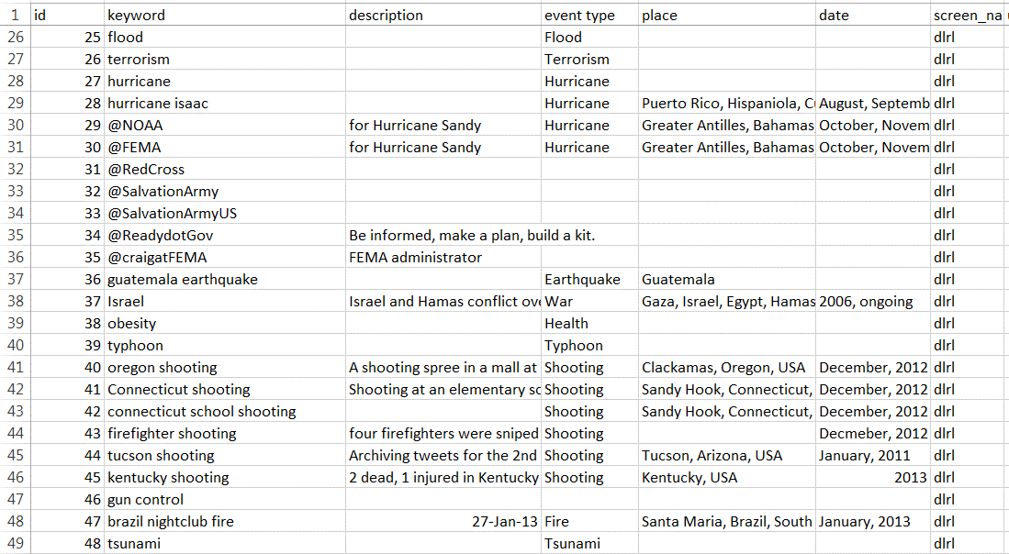

Slide 15
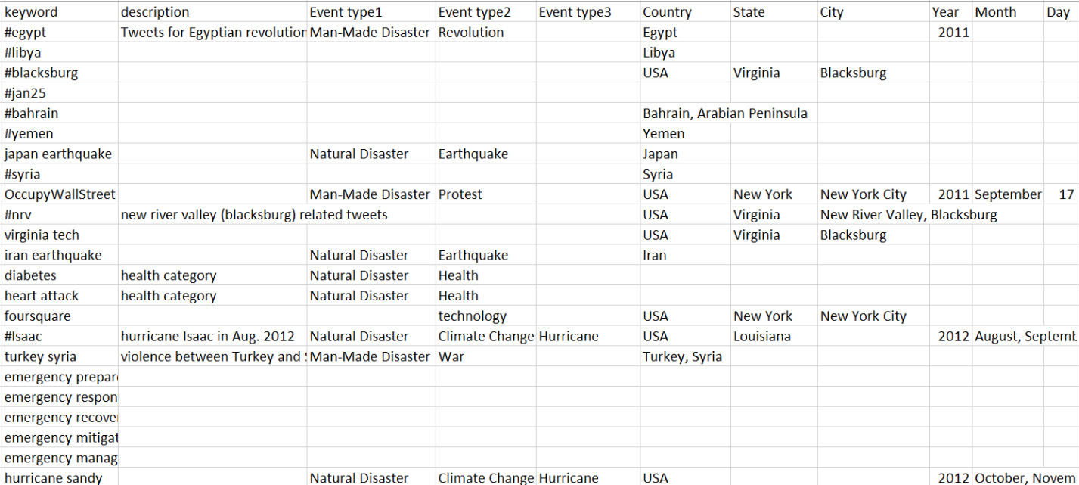

Slide 16
Lessons Learned
Feedback
  understand the user’s needs
  have clearer goals
Communication
  May find easier solutions to problems

Slide 17
Acknowledgements
Dr. Edward Fox
  For all the help, guidance, encouragement and suggestions
Sunshin Lee
  for taking time and guiding throughout the project
IDEAL team
  for valuable feedback
NSF IIS - 1319578

