Slide 1
Practice 10k Music App
CS4624: Multimedia, Hypertext, and Information Access
Professor Mohamed Farag
Virginia Tech, Blacksburg VA 24061
November 14th, 2023
By: Alexander Georgiev, Bailey McKelway, Claire Holmes, Mahlet Zemui, Rahul Aneja

Slide 2
Outline
1. Description
6. Future Development
2. Deliverables
7. Takeaways
3. Tools
8. Acknowledgments
4. Data Management
9. References
5. Demo

Slide 3
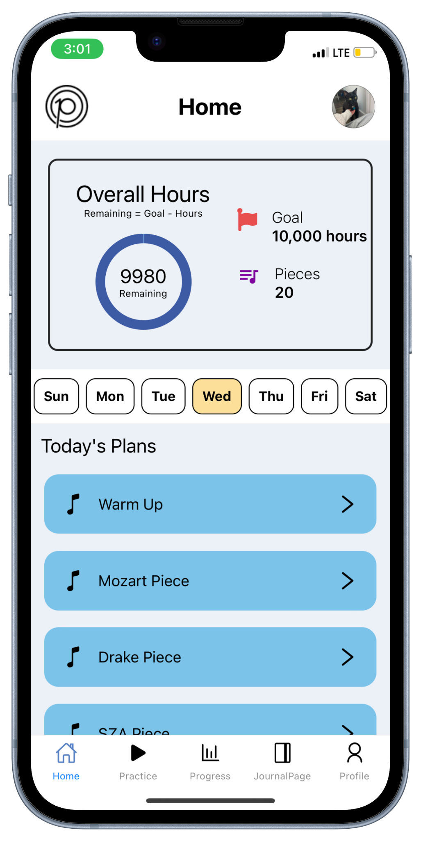
Description
A Practice Music Mobile Application
  Compatible on IOS & Android
All-in-One Application for Practice Needs
  Plans weekly practice sessions
  Initiates/Records daily practice sessions
  Tracks progress
Concept created by VT Professors
  Dr. Annie Stevens & Dr. John Irrera
Figure 1: Application’s Home Screen

Slide 4
Deliverables
Planning/Practice Portal
User Accounts
Practice Plan History
Practice Timer
Music Pieces Memory

Slide 5
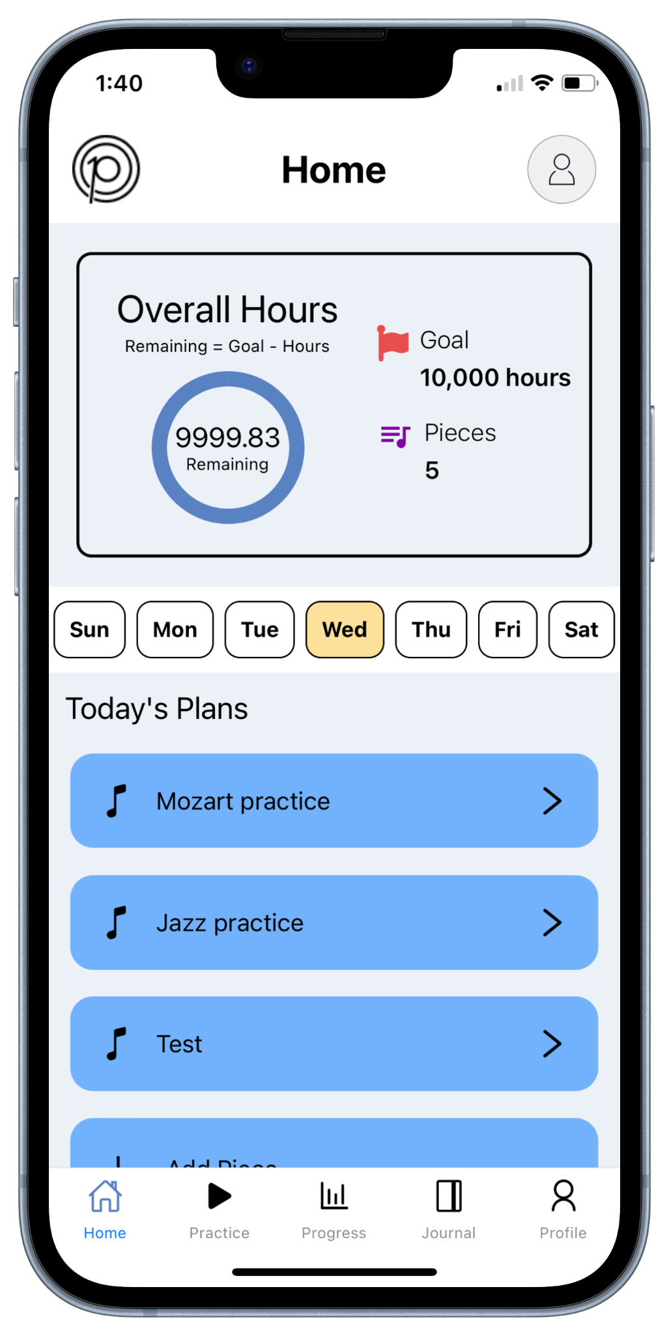
Planning Portal Feature
Figure 2: Application’s Home Screen

Slide 6
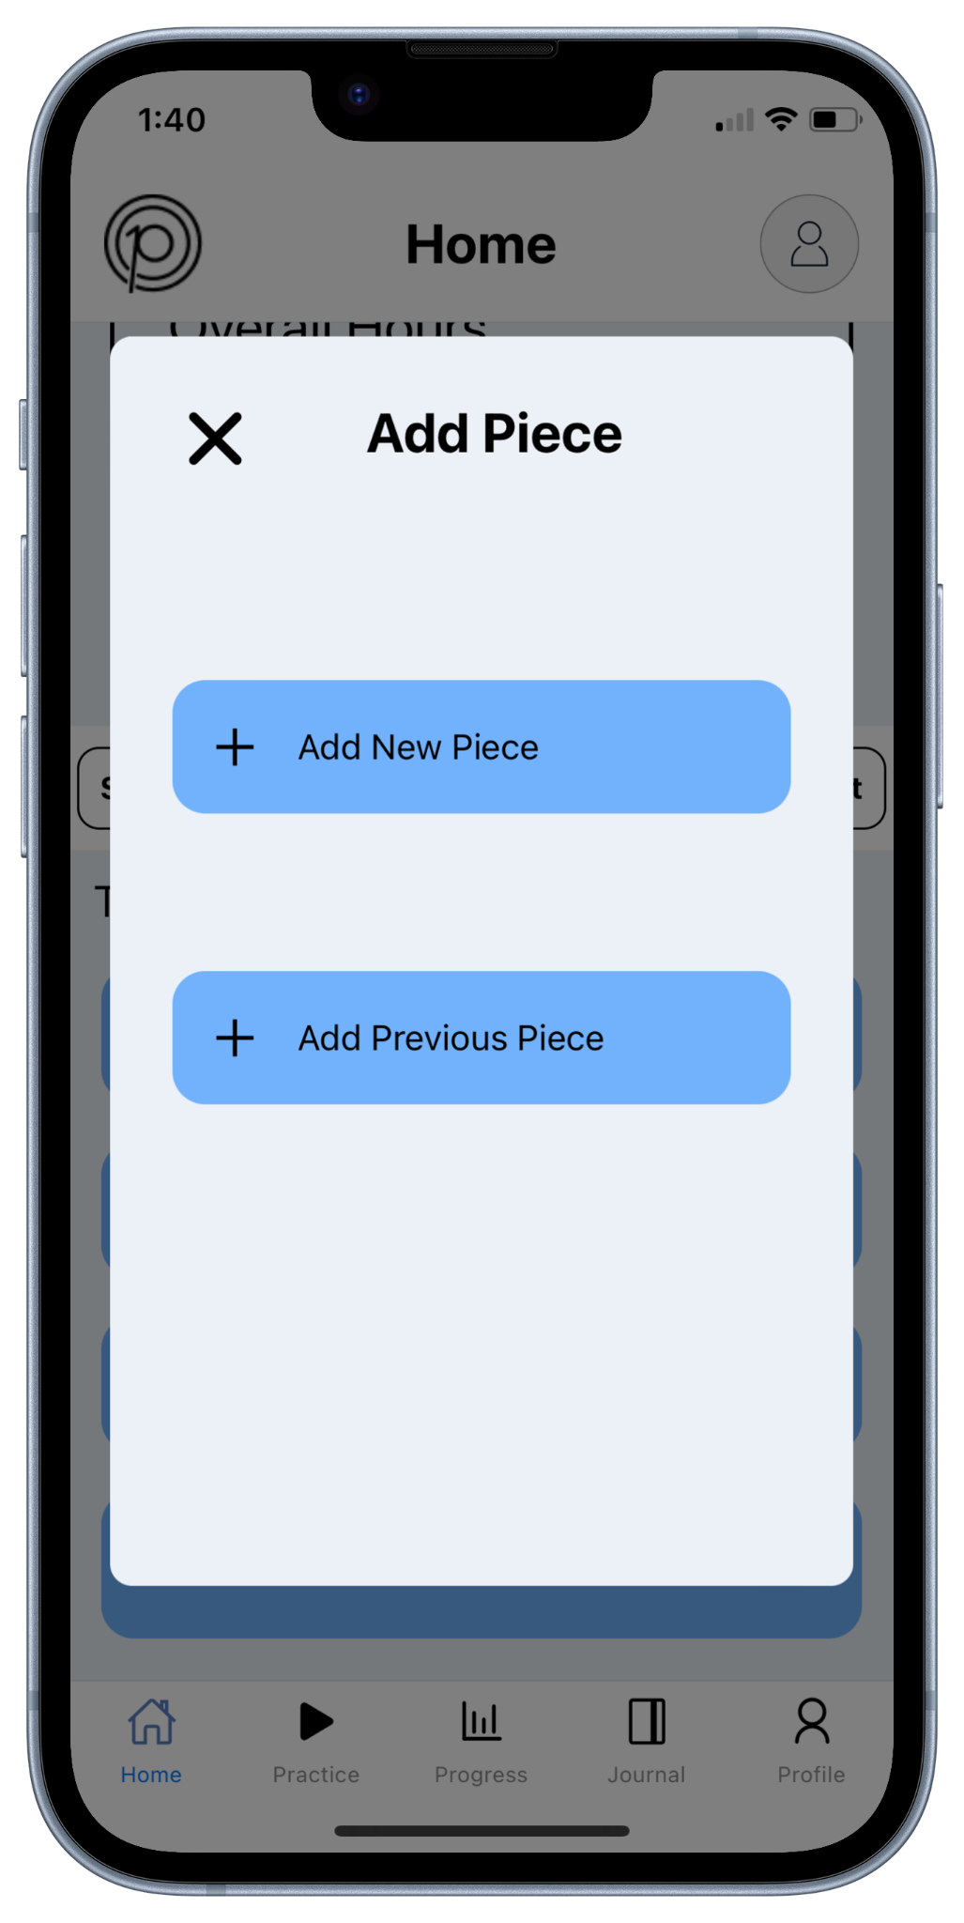
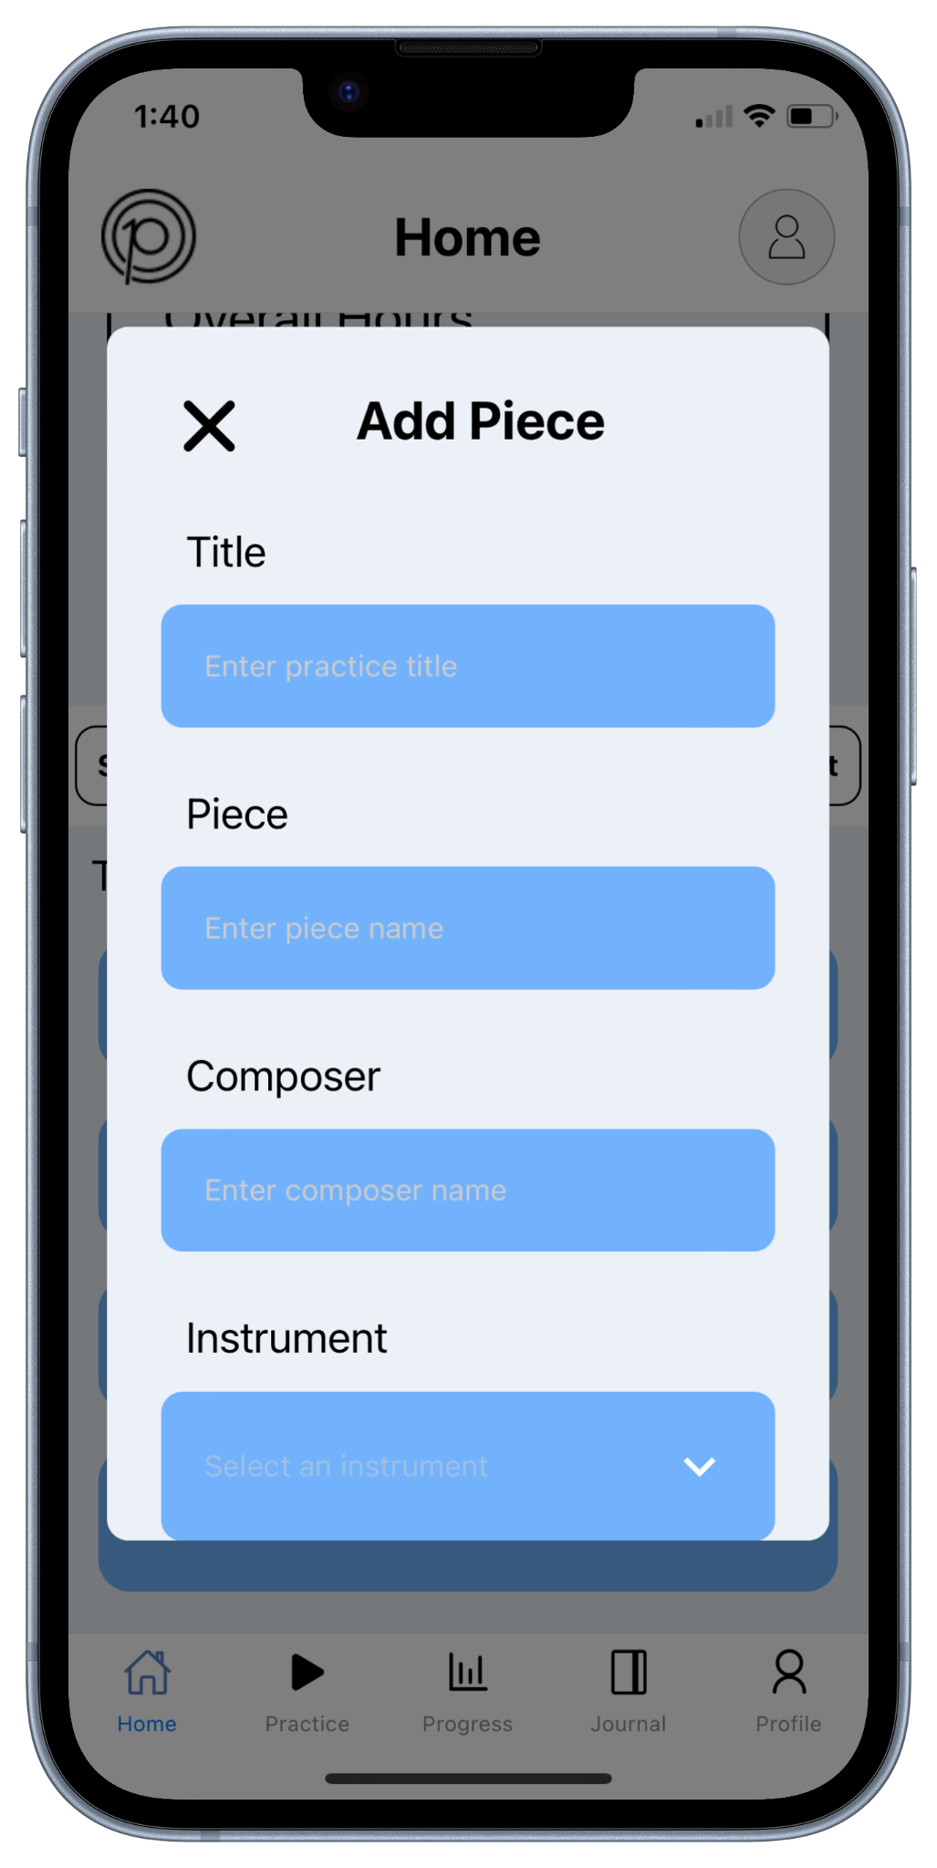
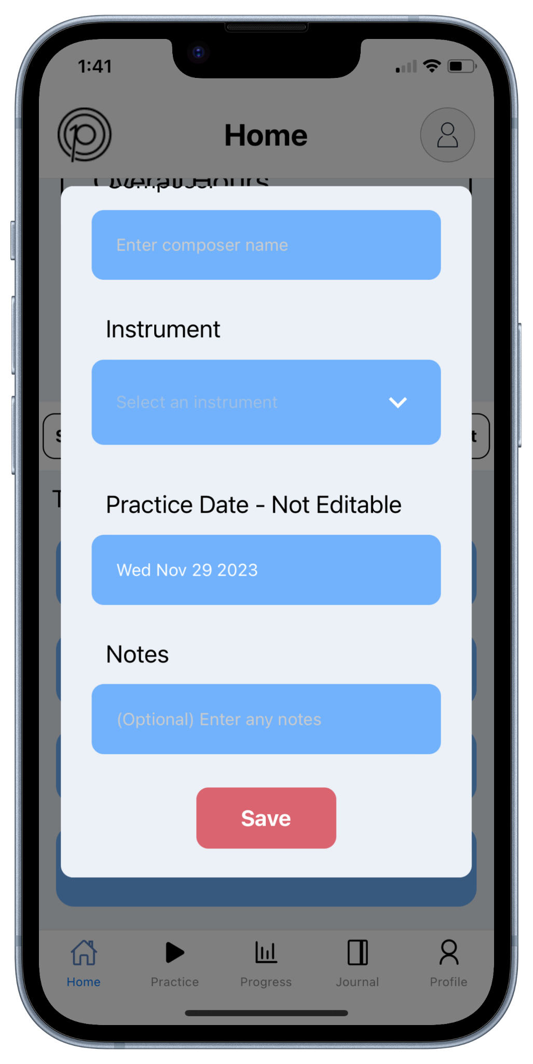
Planning Portal Feature
Figure 3: Application’s Add New Plan Modals

Slide 7
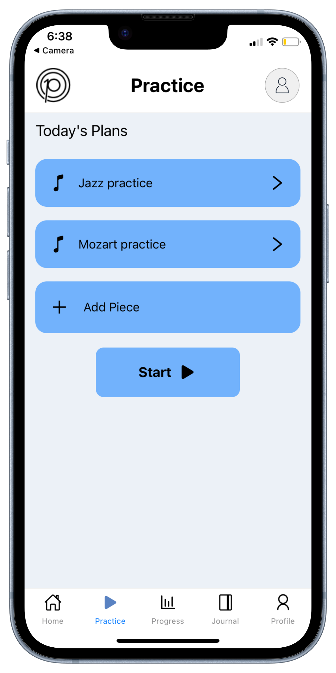
Practice Portal Feature
Figure 4: Application’s Practice Screen

Slide 8
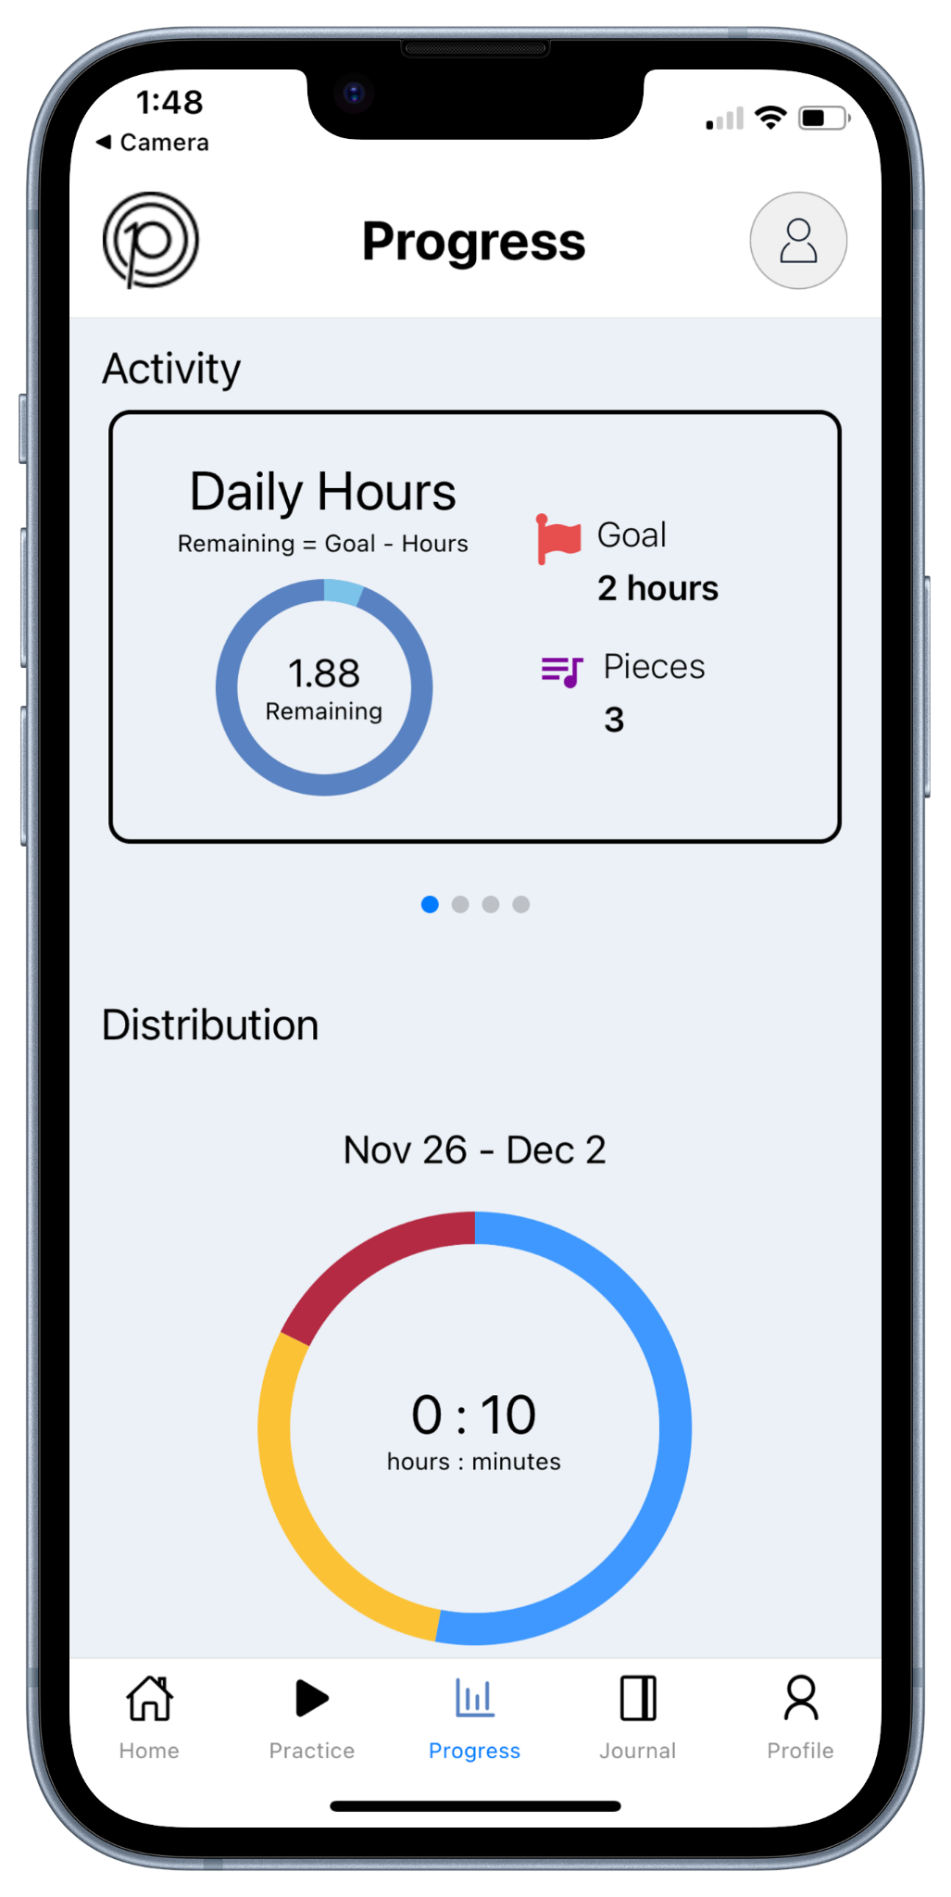
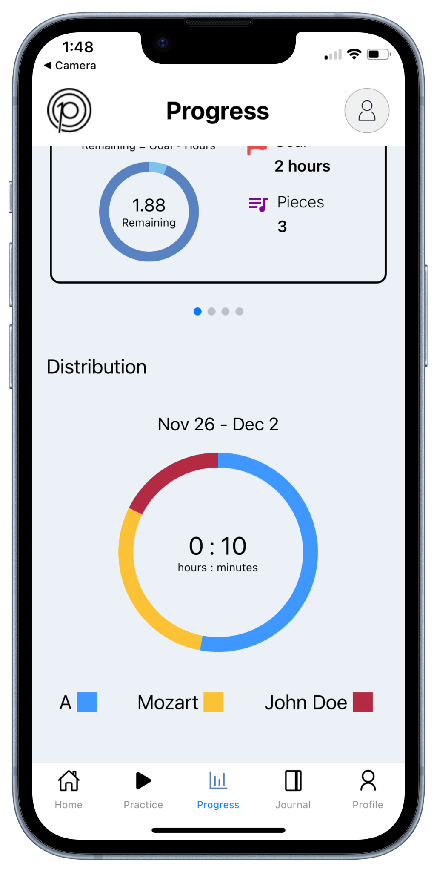
Practice Portal Feature
Figure 5: Application’s Progress Screen

Slide 9
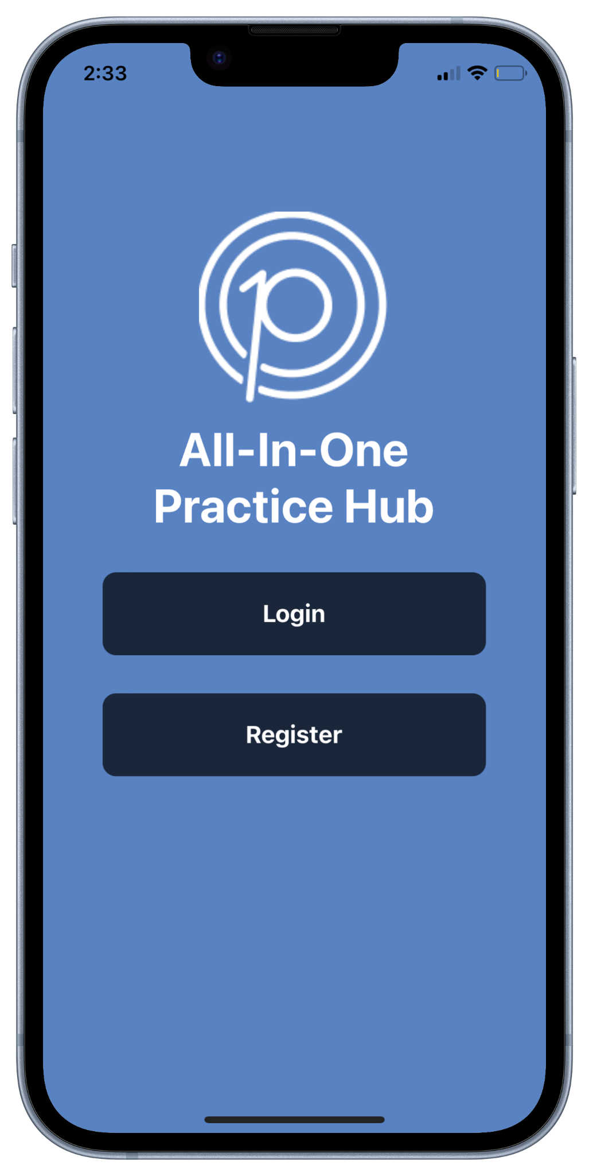
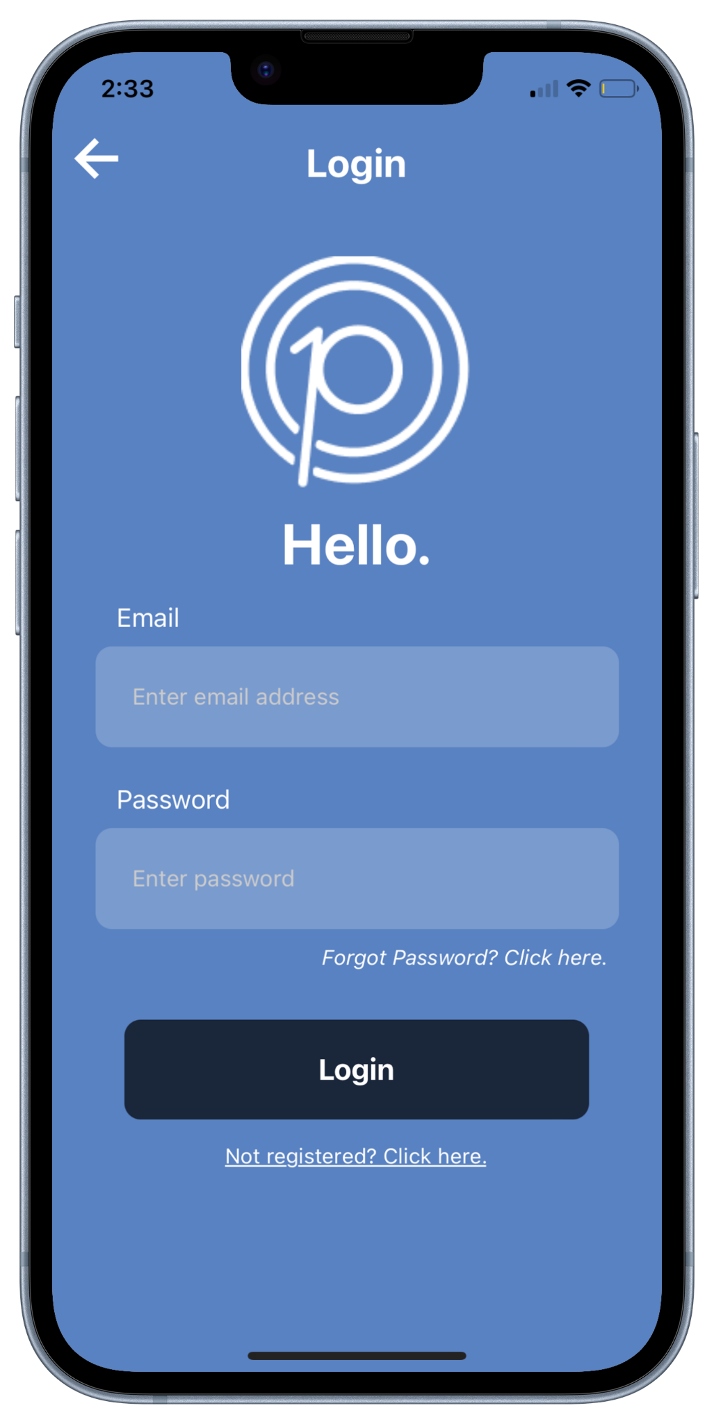
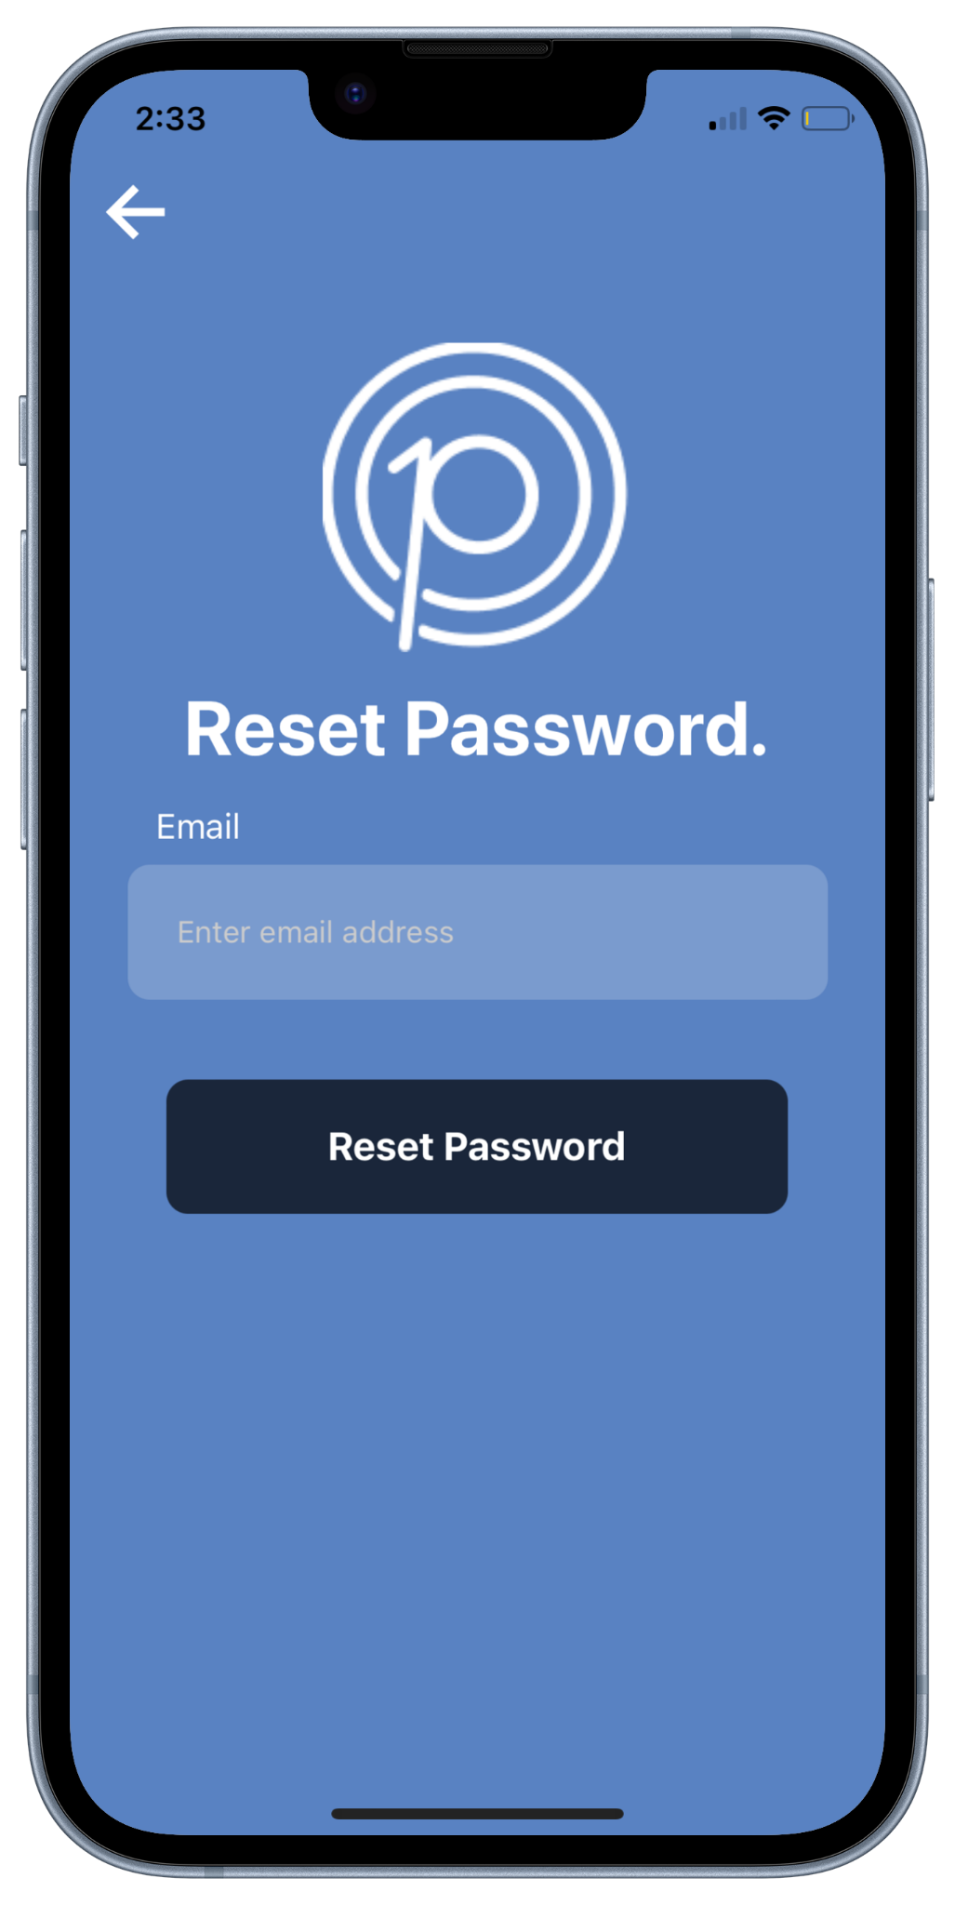
User Accounts Feature
Figure 6: Application’s Start, Login and Reset Password Screens

Slide 10
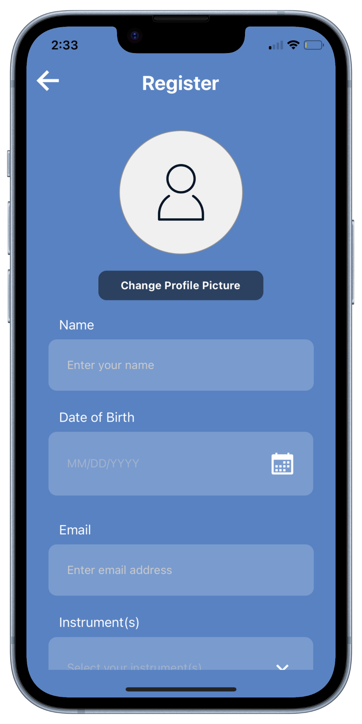
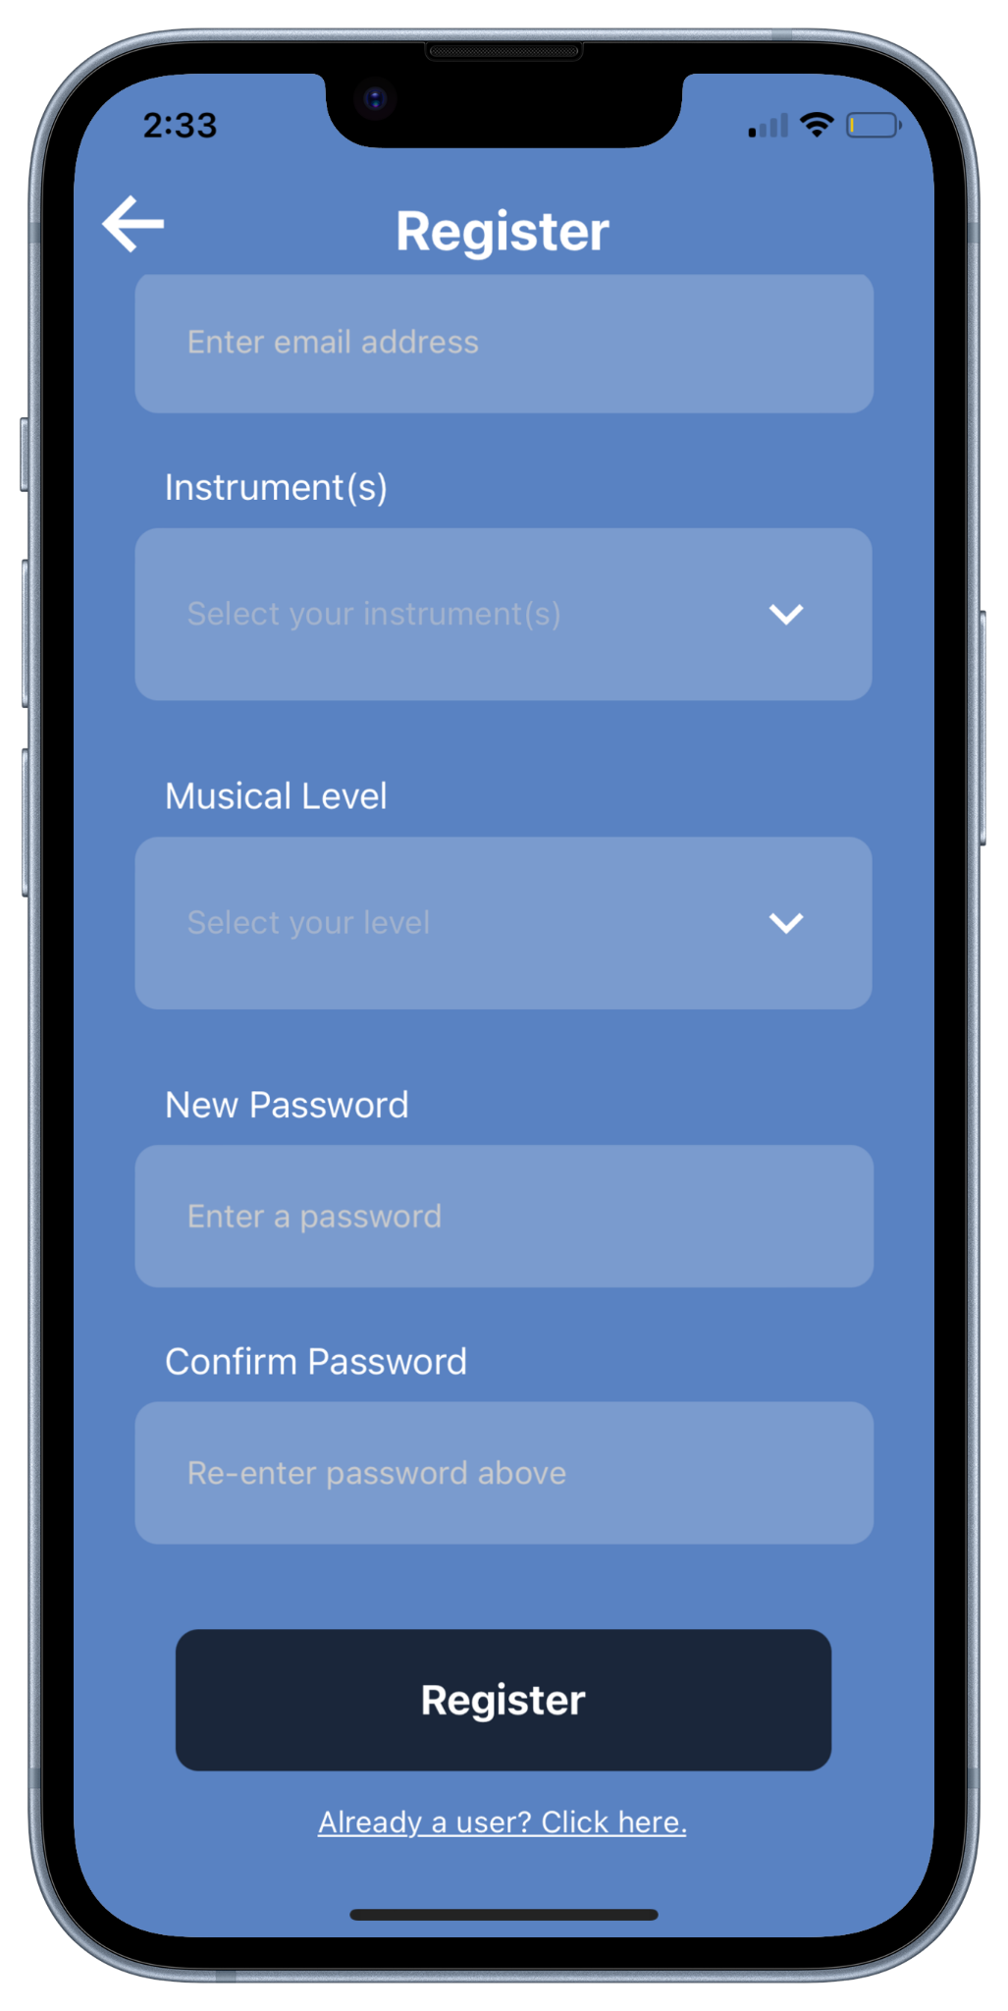
User Accounts Feature
Figure 7: Application’s Register Screen

Slide 11
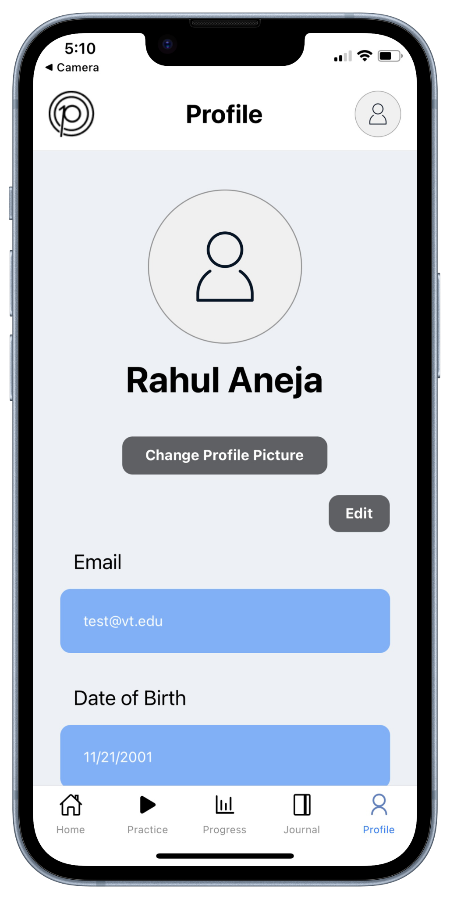
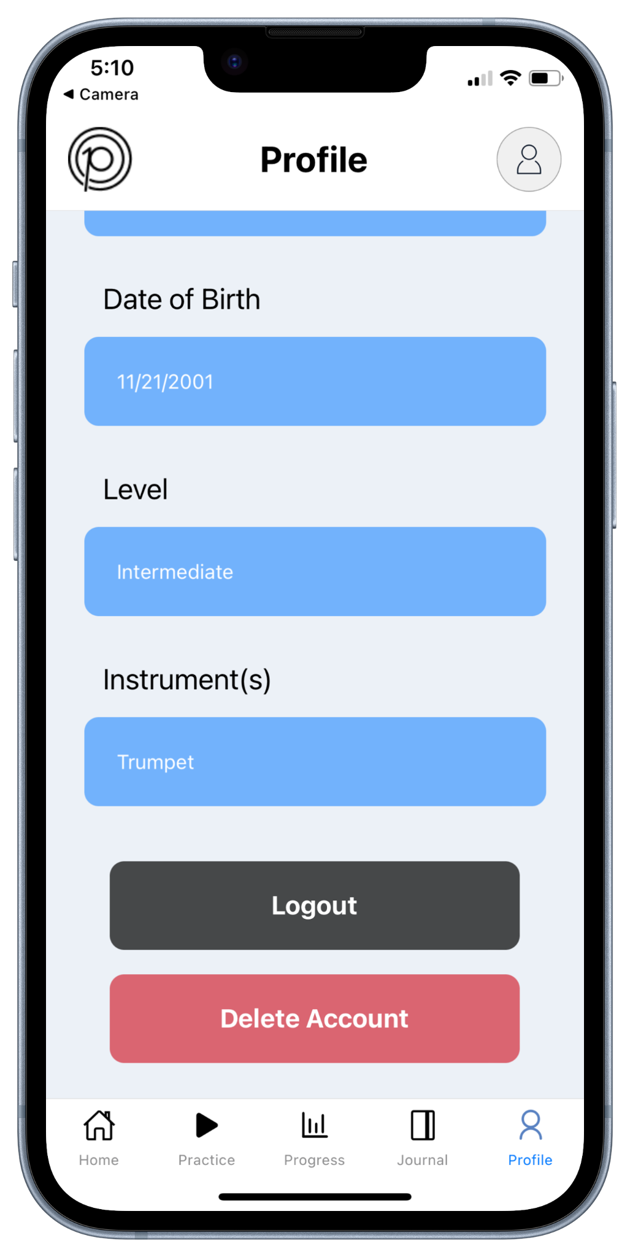
User Accounts Feature
Figure 8: Application’s Profile Screen

Slide 12
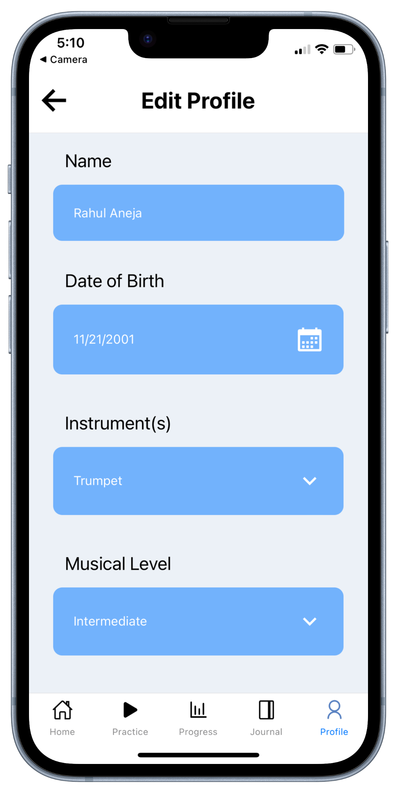
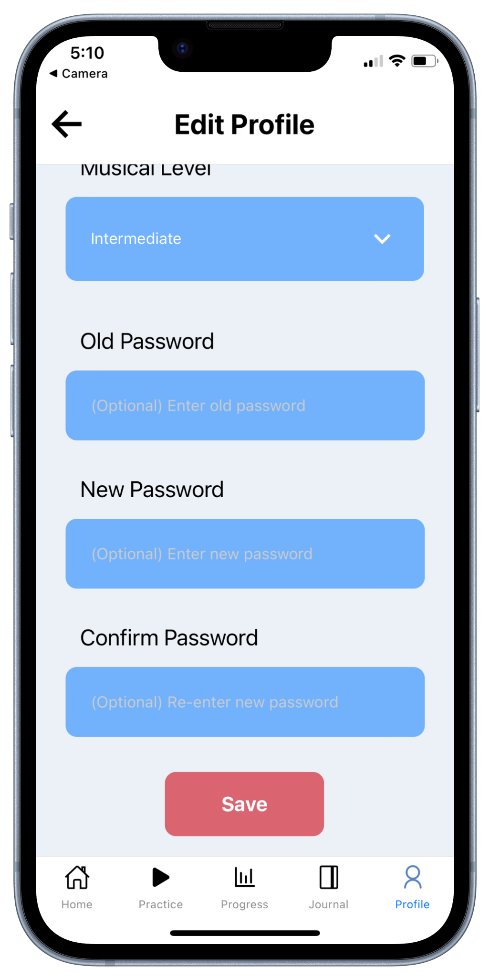
User Accounts Feature
Figure 9: Application’s Edit Profile Screen

Slide 13
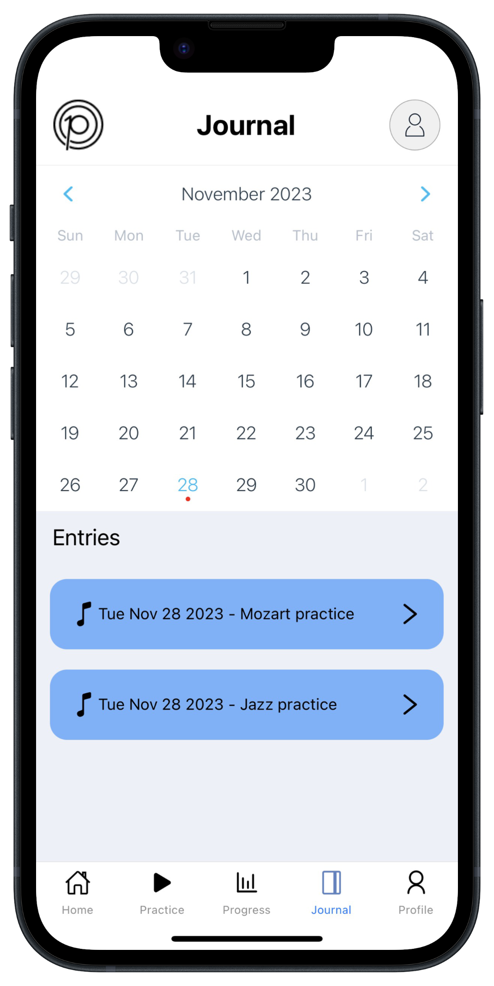
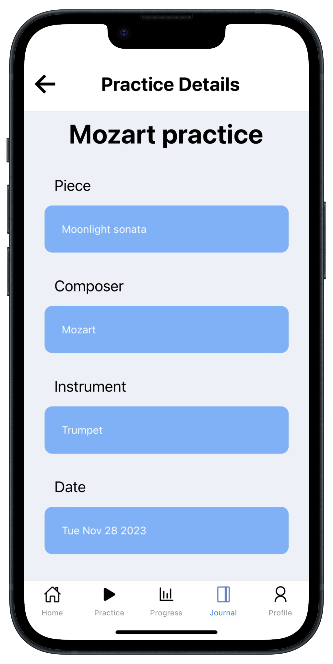
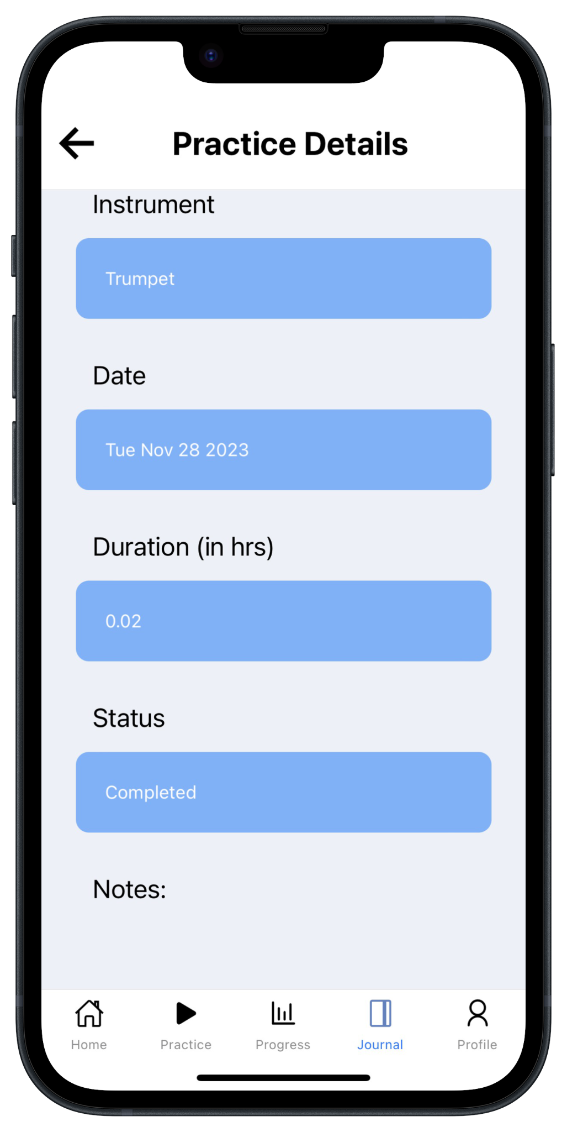
Practice Plan History Feature
Figure 10: Application’s Journal and Practice Details Screens

Slide 14
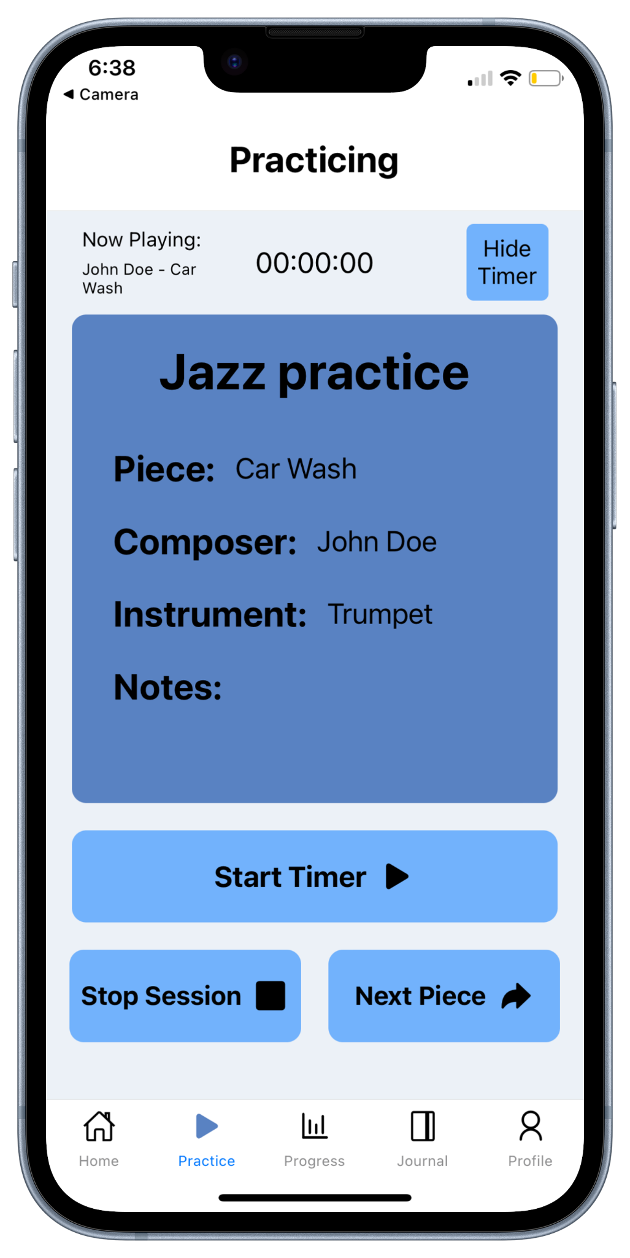
Practice Timer Feature
Figure 11: Application’s Practice Timer Screen

Slide 15
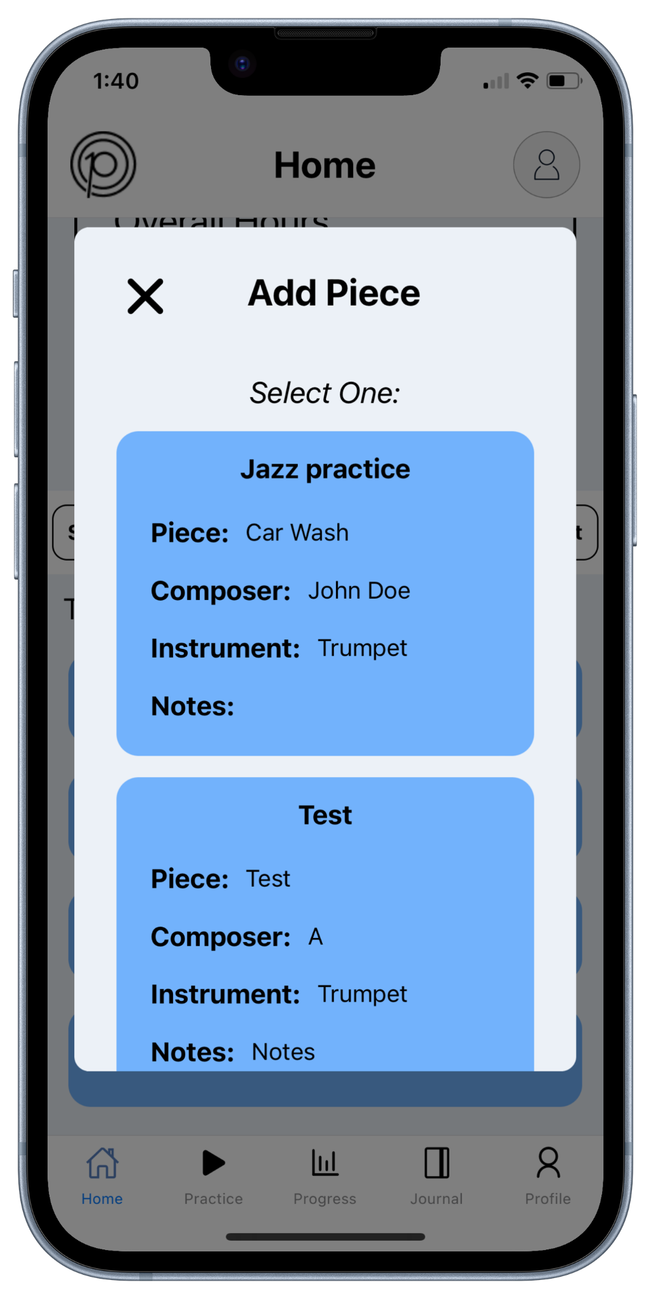
Music Pieces Memory Feature
Figure 12: Application’s Add Previous Plan Modals

Slide 16
Tools
For an organized collaboration process
Github
For rapid visualization during application development
Expo
For code reliability with type checking
Typescript

Slide 17
Tools
For cross-platform compatibility
React Native
For efficient local data storage
Redux
For authentication and data management
Firebase

Slide 18
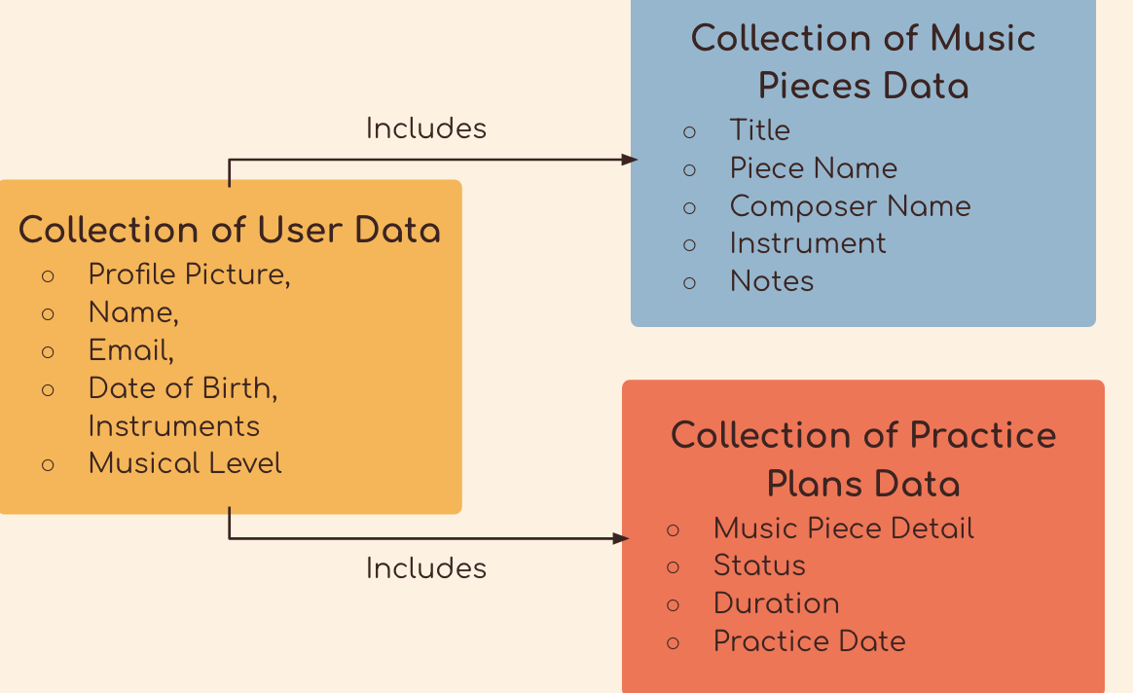
Data Management

Slide 19
Future Development
Add metronome and tuner on practice page
Gamifying app
  Challenge friends to practice
  Profile badges
  Add friends as practice buddies
Potentially change backend
  Switching backend to be an express.js api
  Makes it possible to easily switch to MongoDB from Firebase
Ultimate goal is to deploy app to App Store and Google Play

Slide 20
Takeaways
Challenges
Lessons
Learning new tools
  Ex: firebase, redux, react native
Reducing Firebase reads
  Frequent calls to Firebase for practice data
Defining and planning features based on clients’ needs
Plan the development order early
  Adding practice data to the backend was one of the last items implemented
Make sure to accurately estimate capacity for work
  We were able to deliver the 5 promised deliverables

Slide 21


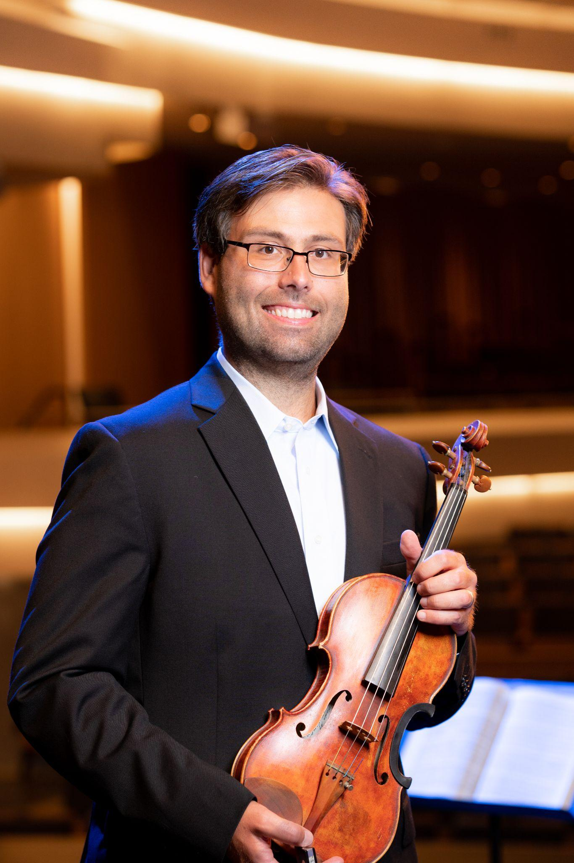
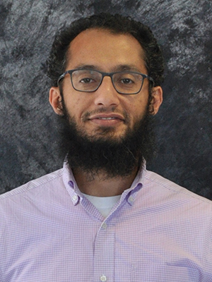
Acknowledgements
Dr. Annie Stevens
Percussion Professor at Virginia Tech
Ben Winters
Technical Consultant
Dr. John Irrerea
Assistant Professor of Violin at Virginia Tech
Dr. Mohamed Farag
Computer Science Professor at Virginia Tech

Slide 22
References
[1] Gladwell, M. (2010). Outliers: The Story of Success. Personnel Psychology, 63(1), 258–260. https://doi.org/10.1111/j.1744-6570.2009.01168_5.x
[2] Expo Documentation. (n.d.). Expo documentation. [Online]. Available: https://docs.expo.dev/
[3] React Native · Learn once, write anywhere. (n.d.). [Online]. Available: https://reactnative.dev/
[4] Firebase. (n.d.). Documentation. [Online]. Available: https://firebase.google.com/docs

