Slide 1
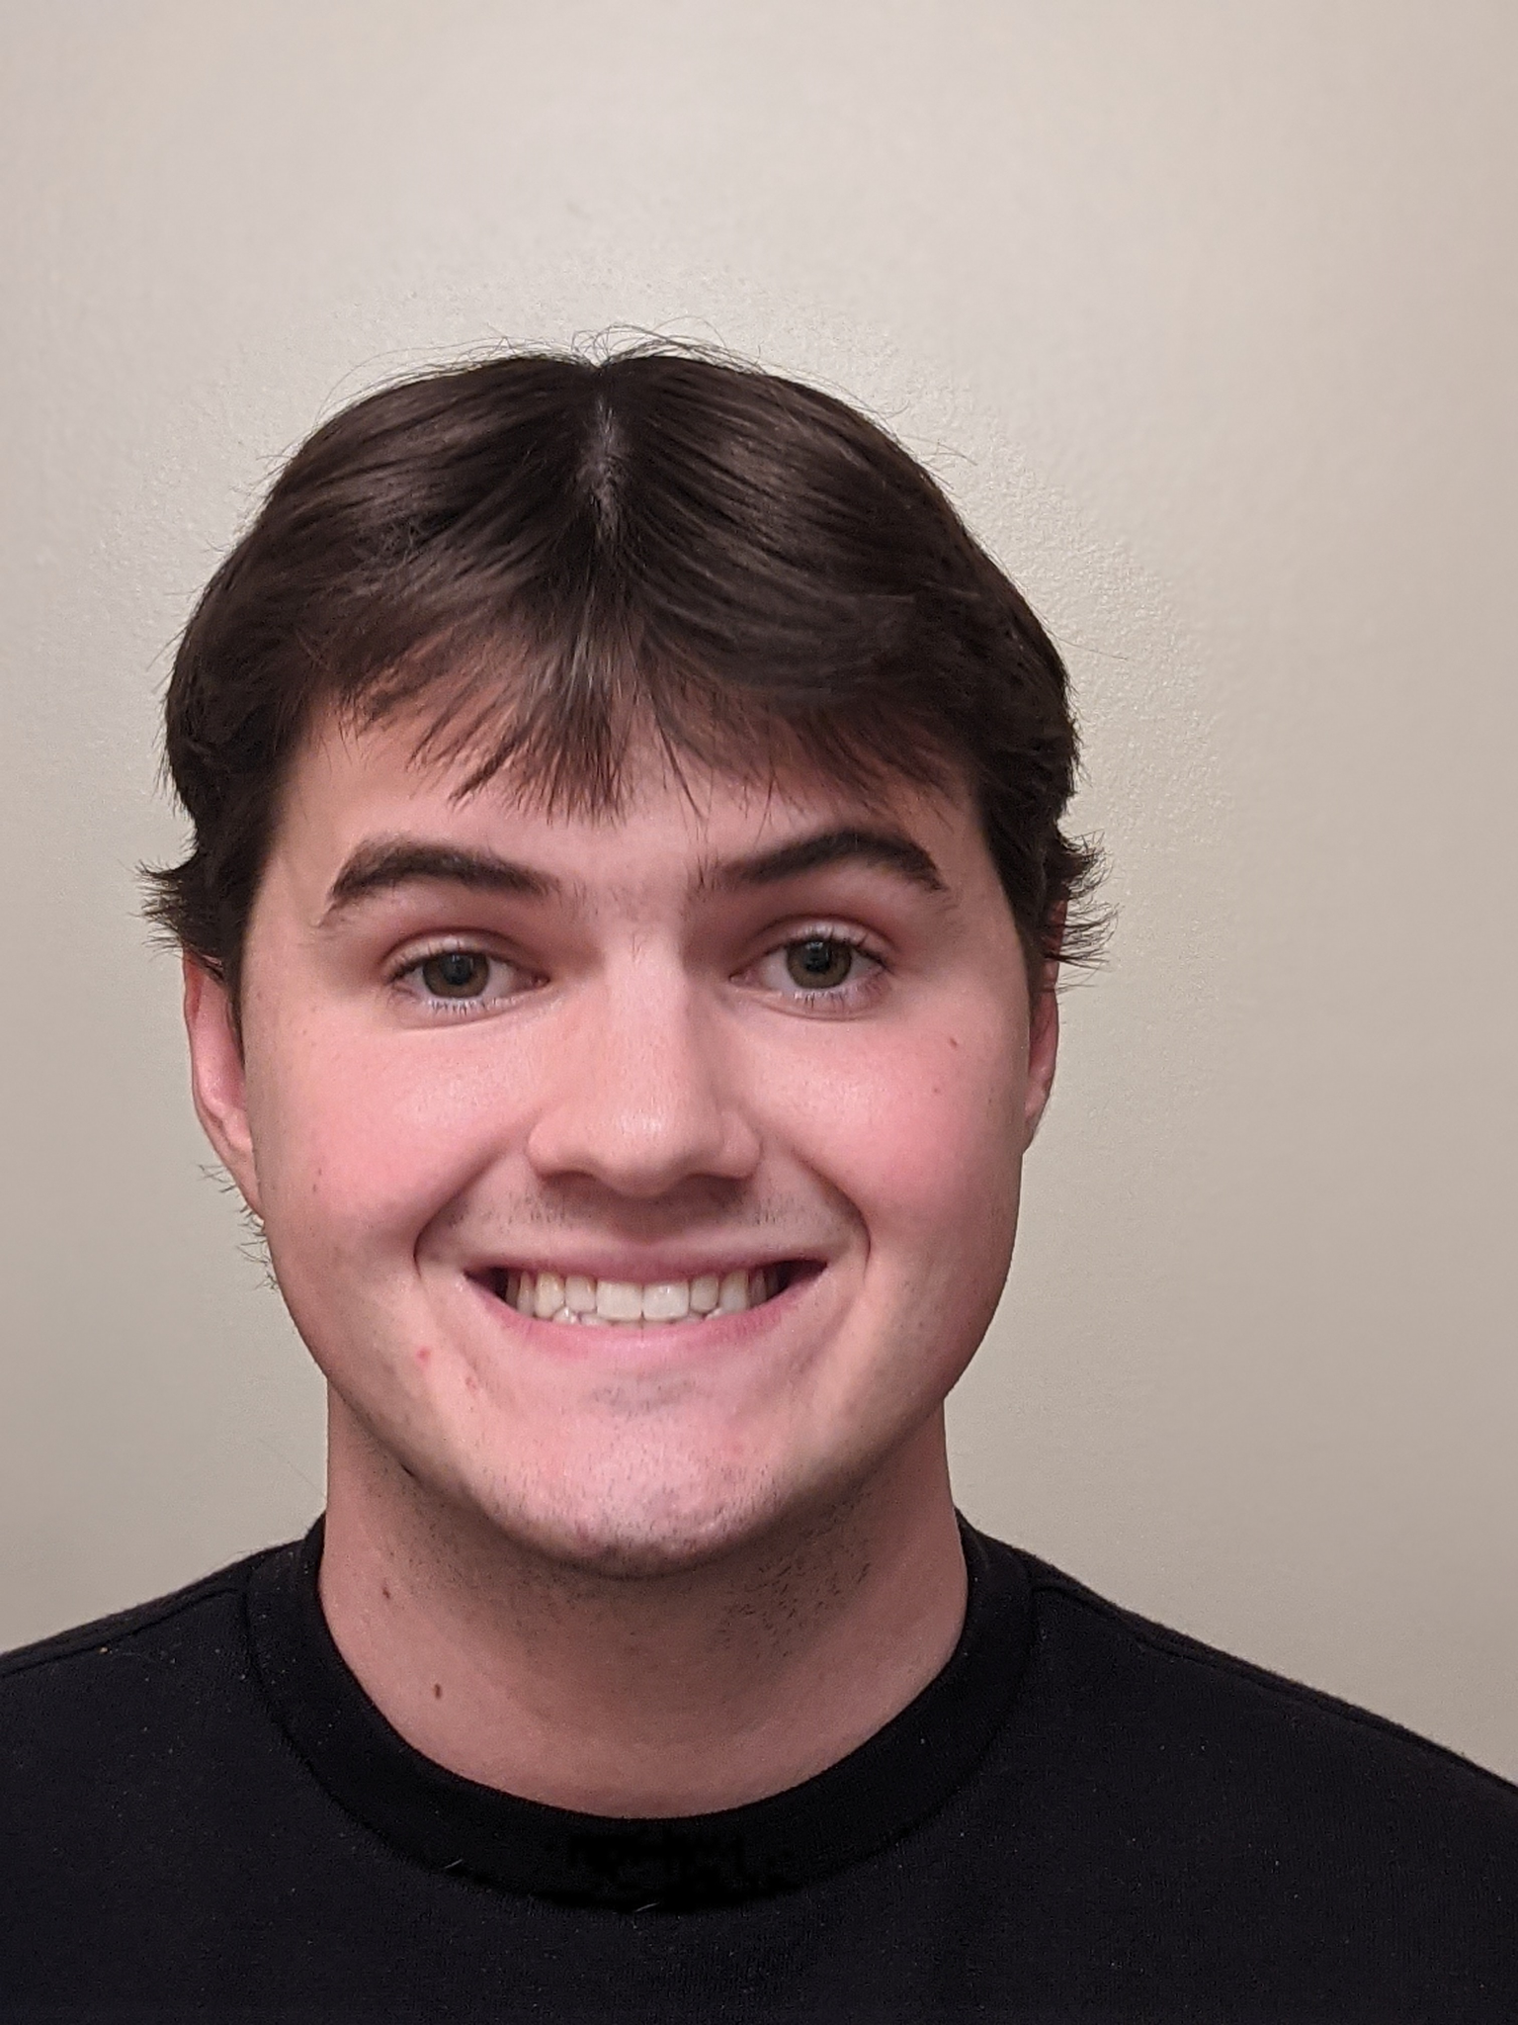



Wildlife Diseases Website
Meet Team 13
CS 4624: Multimedia, Hypertext, and Information Access
Edward A. Fox
Virginia Tech, Blacksburg VA 24061
December 15, 2021
Bryant Nguyen
Maanas Muddam
James Kim
Kristopher Moratti
Back-End Development, QA
Front-End Development, QA
Front-End Development, QA
Team Lead, Suppl. Development
Notes:
Each of us can introduce ourselves and our roles.

Slide 2
Outline
01
02
03
04
05
06
07
Overview
Timeline
User Flow Walkthrough
Technologies Used
Final Work to Be Done
Challenges/Lessons
Acknowledgement
Notes:
Kris

Slide 3
Overview
What is the objective?
Overhaul of current Wildlife Disease Research Website
Minimalistic Design
Informative and simplistic user interface
Ability for admins to easily upload information
Notes:
Reminder of what our goal is

Slide 4
Timeline
Begin
Sept. 15
Sept. 30
-Define views, user flow, and functionalities
-Determine dev. Technologies
-Initialize codebase and team environment
-Complete wireframe
-Finalize user interface design
-Begin development
Oct. 15
-Complete 3/6 tabs
-Landing, About, Research
-Review code and test
Oct. 31
Nov. 15
-Complete 6/6 tabs
-Publications, News, Contact
-Review code and test
-Final QA testing
-All requirements met
-Produce Final Deliverables
Finish
Notes:
Where we are at right now

Slide 5
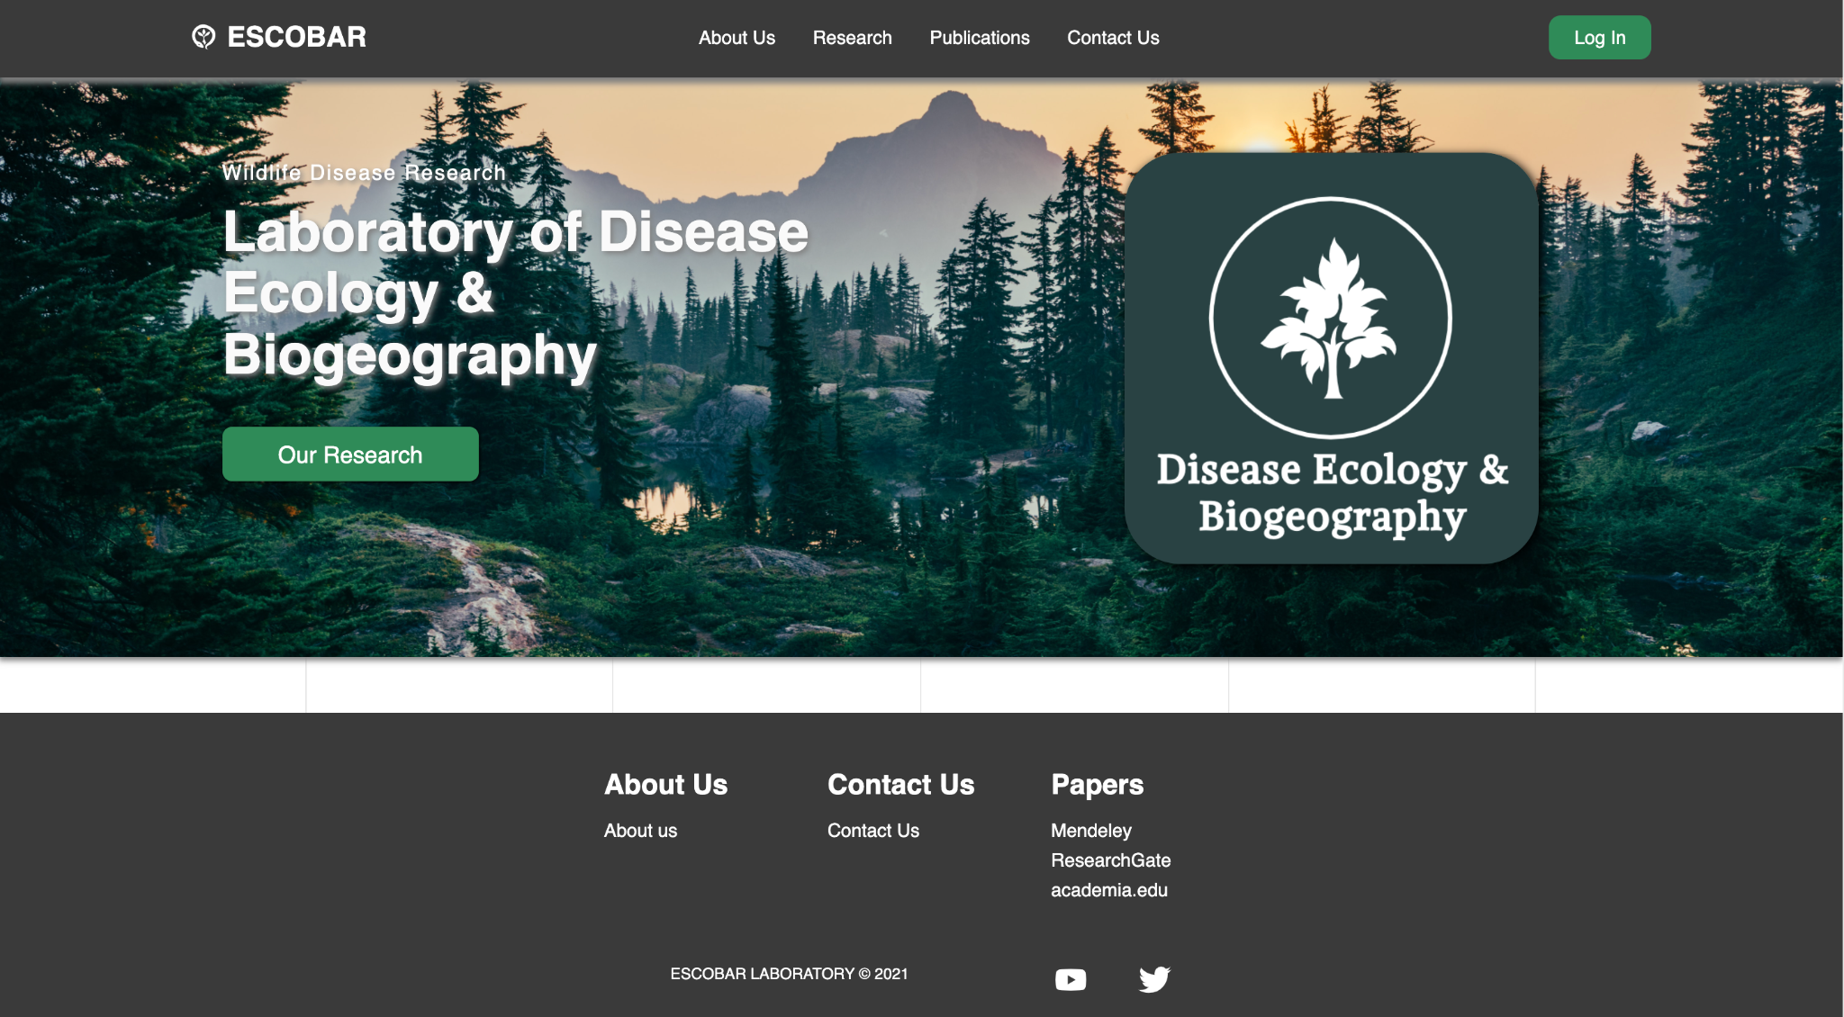

Website User Flow: Landing Page
1) User is directed to landing page
4) Admin login...
2) Minimalistic, sleek, modern, responsive design, functional footer
3) Removed newsletter subscription function
Notes:
Bryant

Slide 6
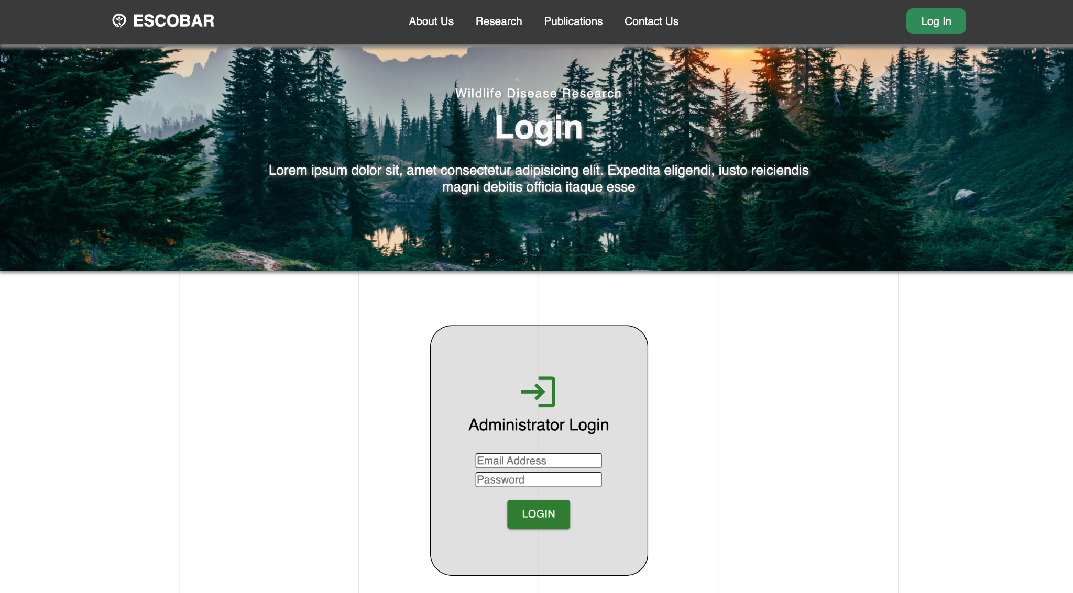
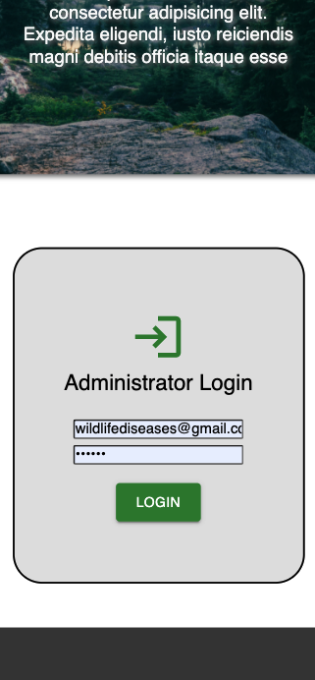
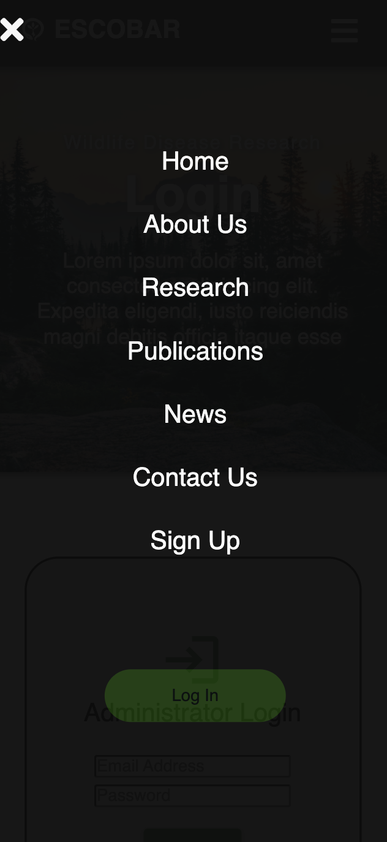
Website User Flow: Login
Mobile view
1) Email & password verification
Notes:
Bryant

Slide 7
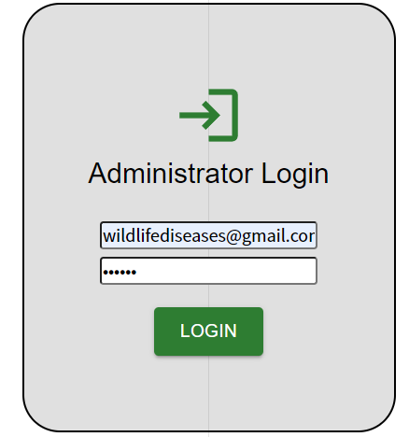
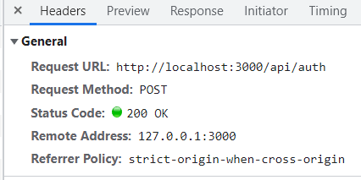
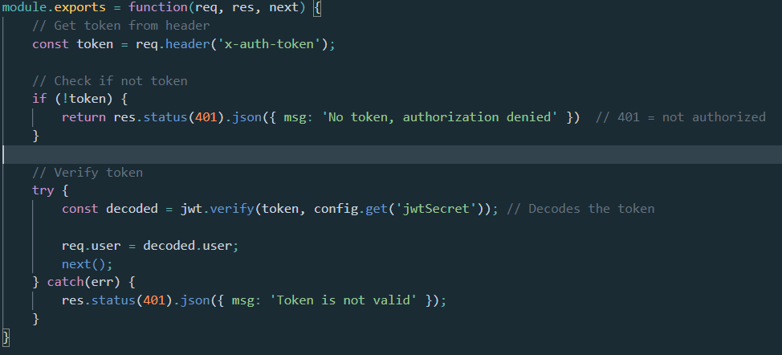
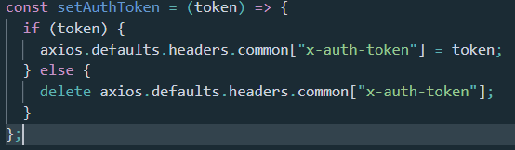
Website User Flow: Login
Notes:
Bryant

Slide 8
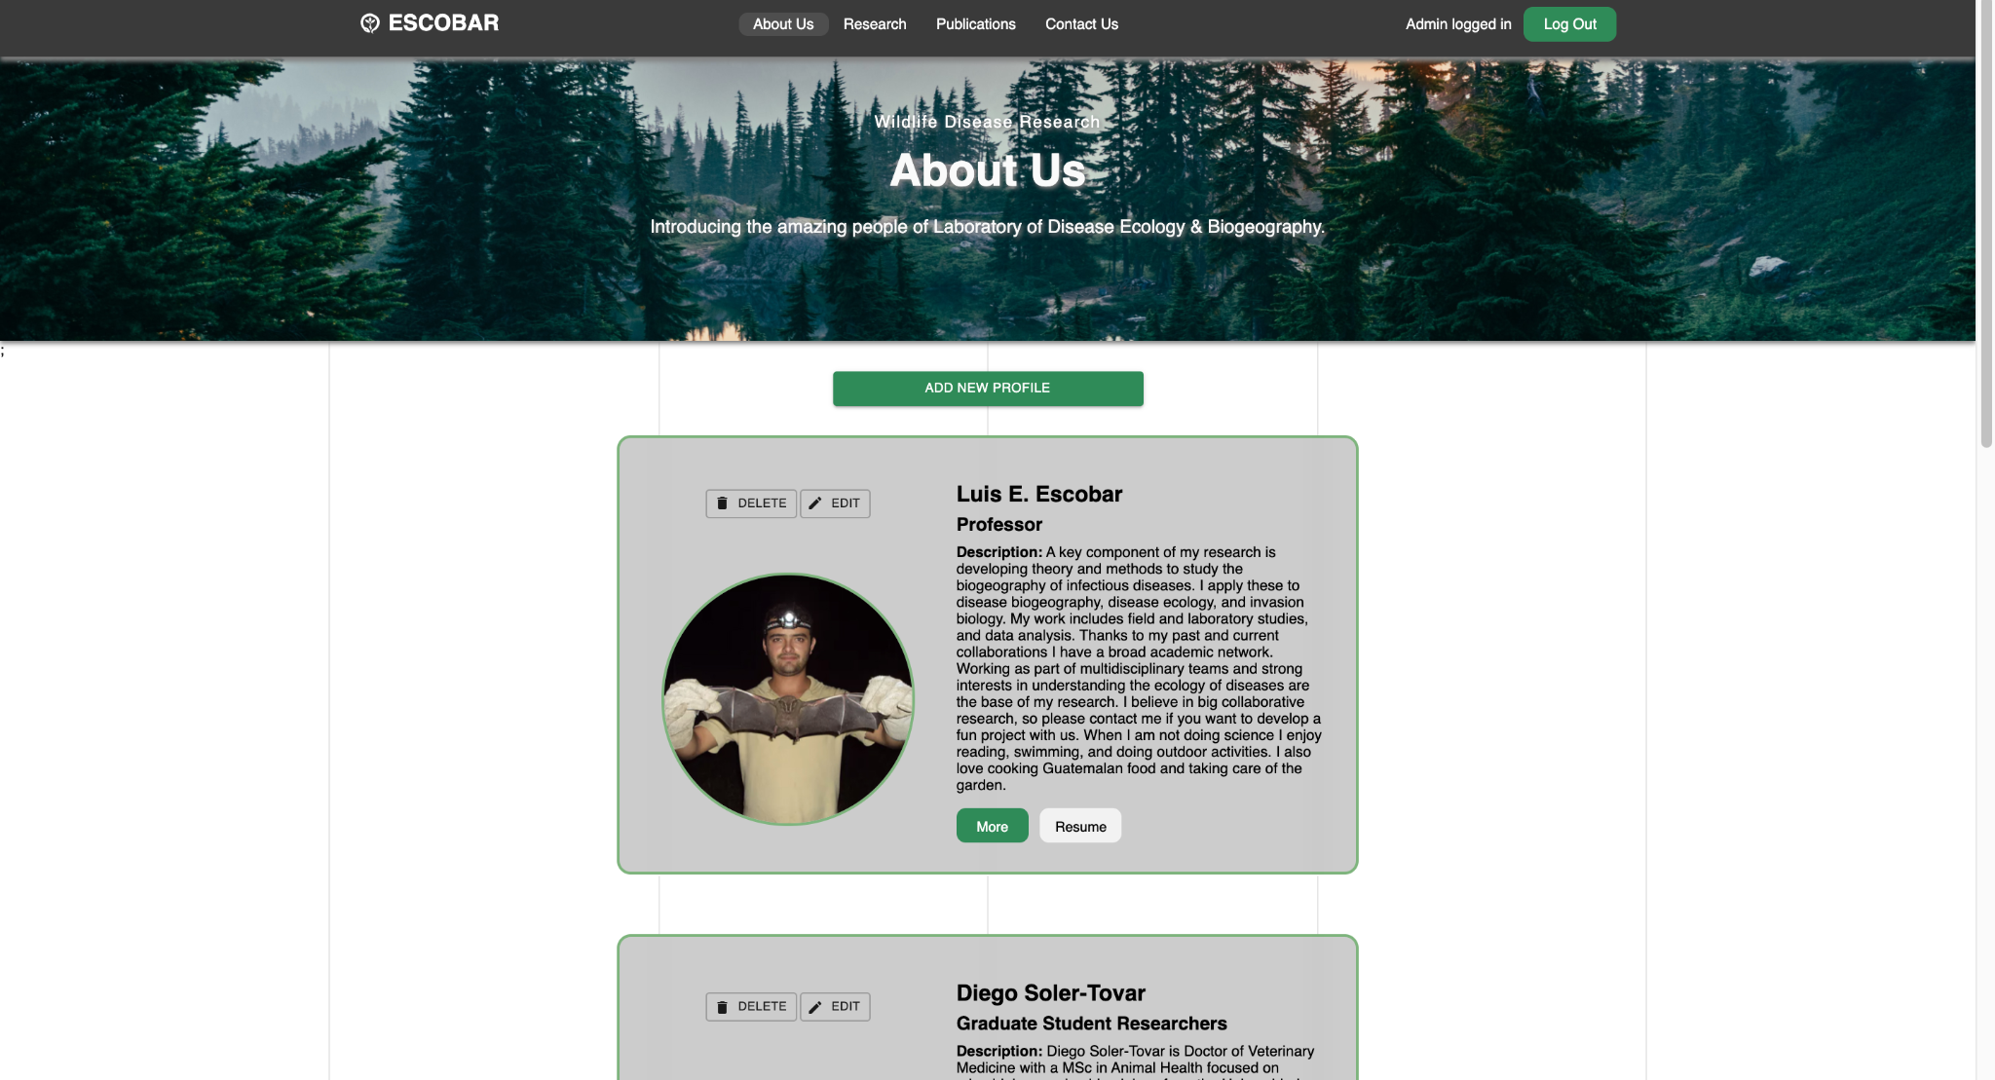
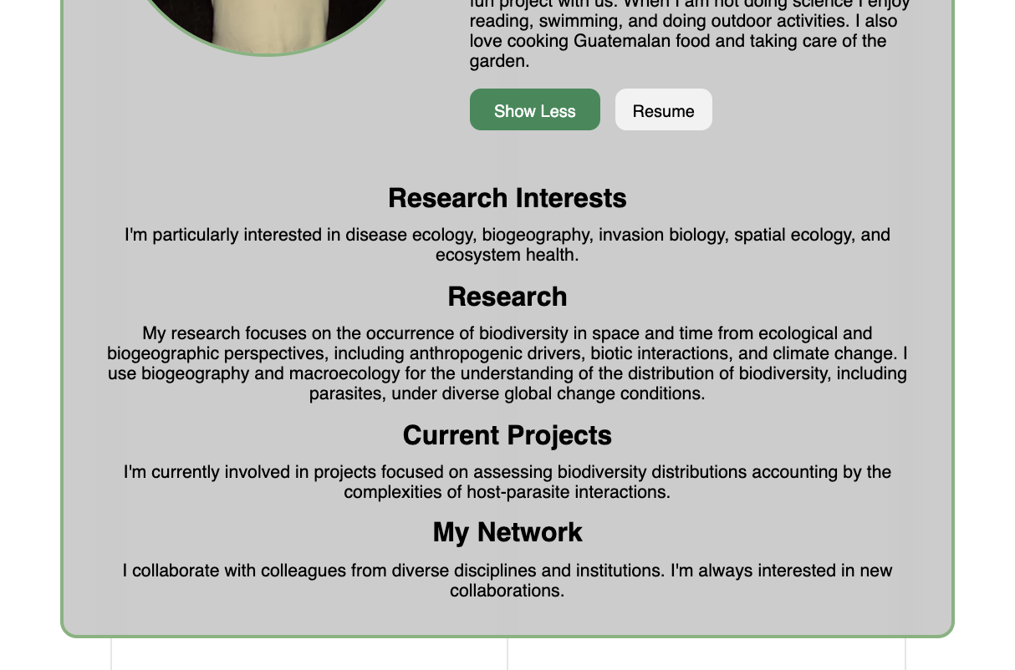
Website User Flow: About Us
1) Indication of logged in state.
3) Admins can add new profiles, delete or edit existing profiles...
2) Button functionalities.
Notes:
Bryant

Slide 9
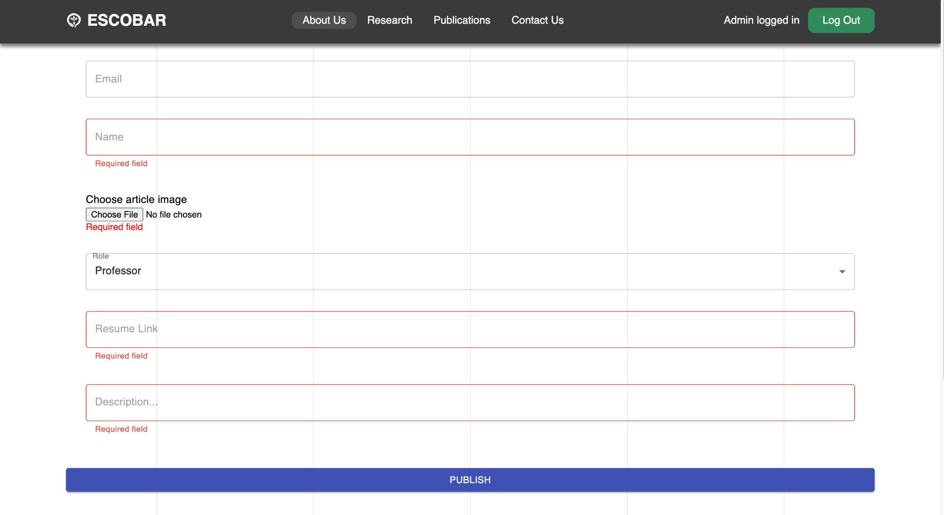
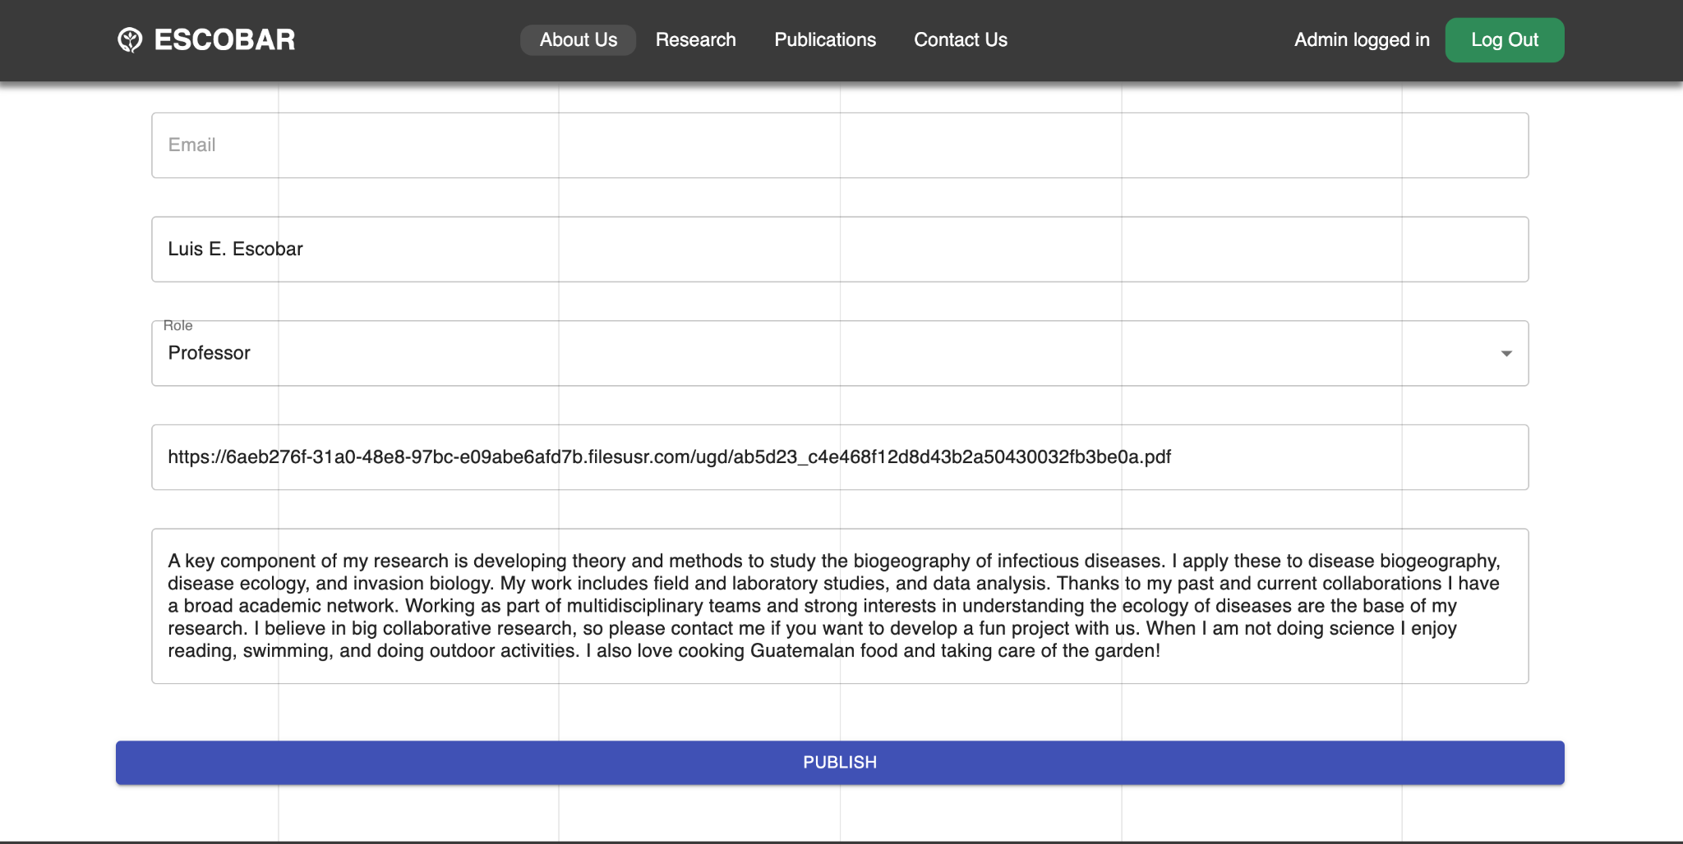
Website User Flow: Add/Edit Post
Information published and saved to MongoDB with POST request.
Notes:
James

Slide 10
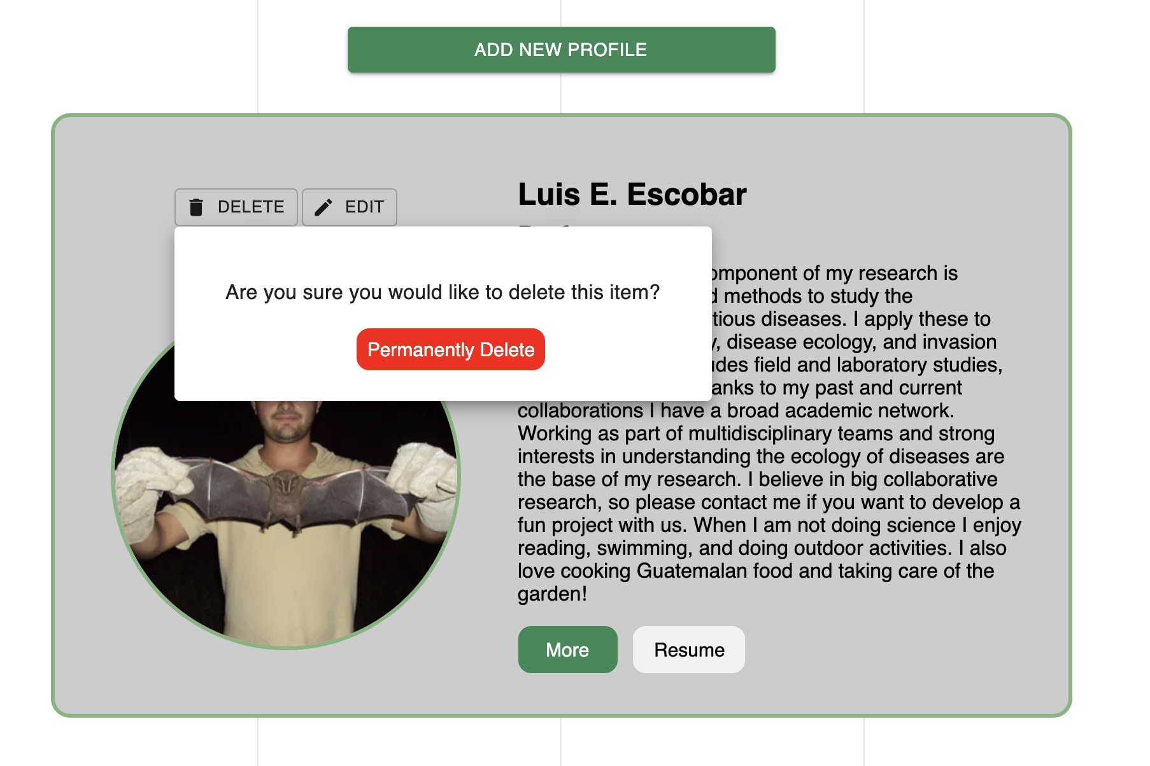
Website User Flow: Delete Post
Double check!
Flexibility
Scalability of contents
User interaction
Standard add, edit, and delete for all pages
Notes:
James

Slide 11
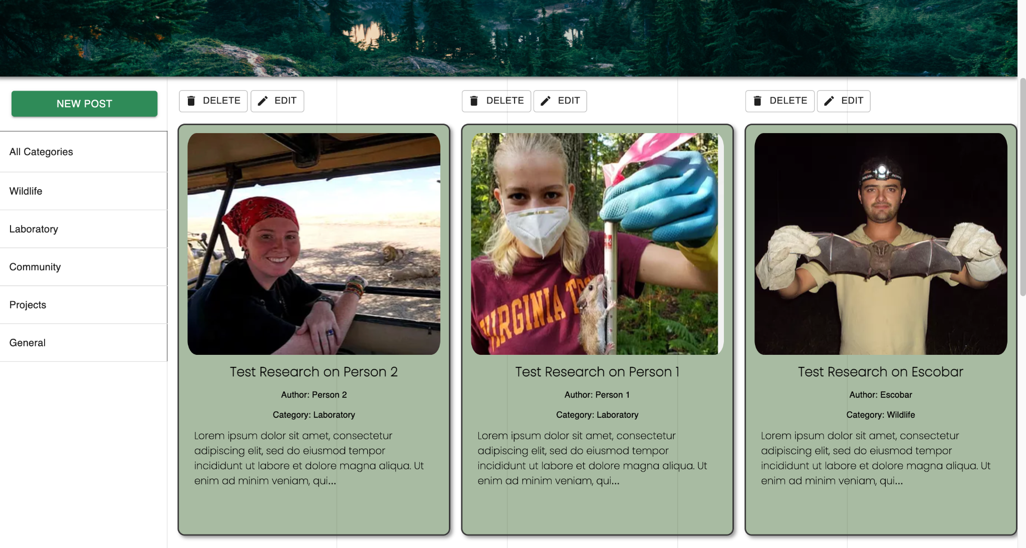
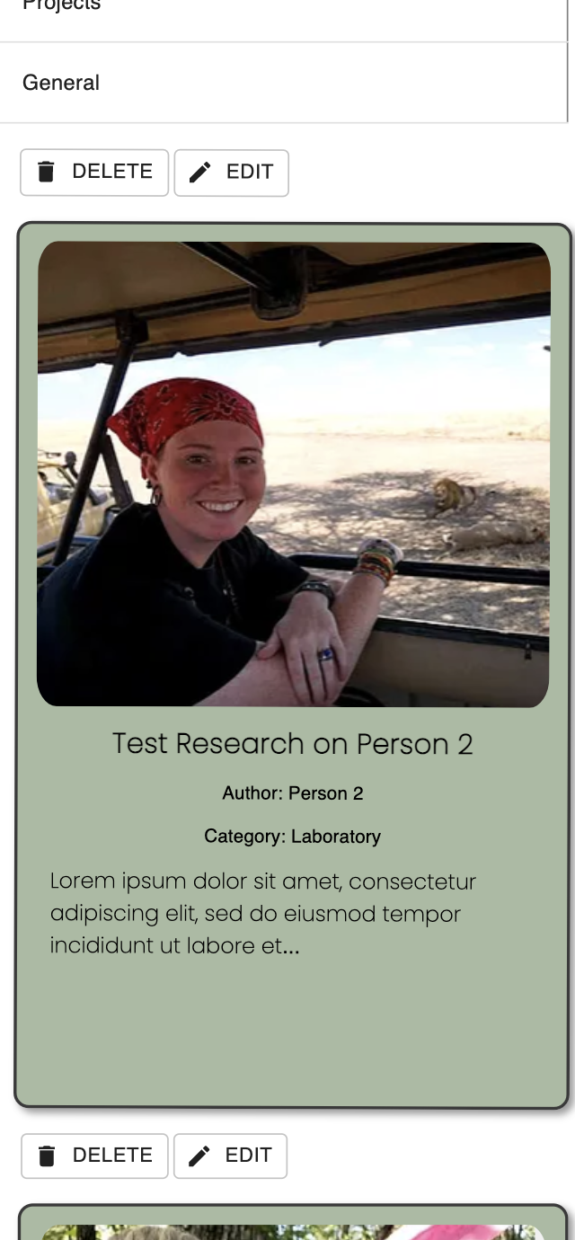
Website User Flow: Research
Mobile View
1) Admins can publish, delete, edit posts
2) Posts filtered by categories
3) Informative research cards...
Notes:
James

Slide 12
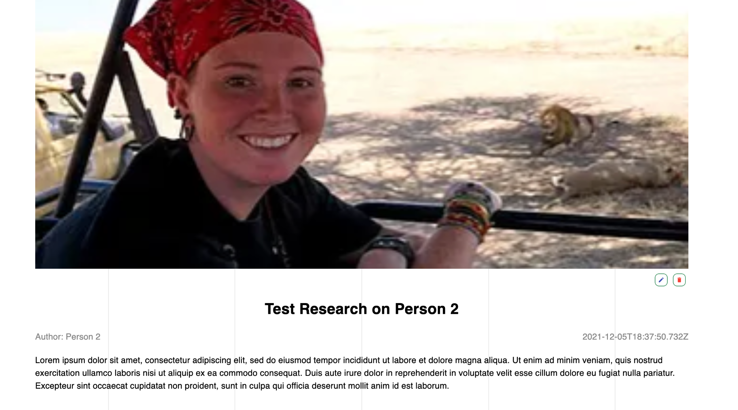
Website User Flow: Detailed Article View
Medium for entire article content.
Notes:
James

Slide 13
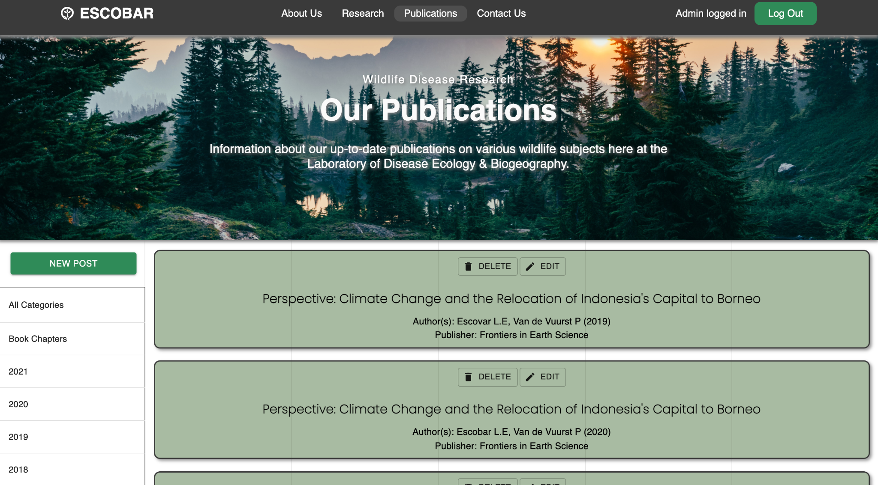
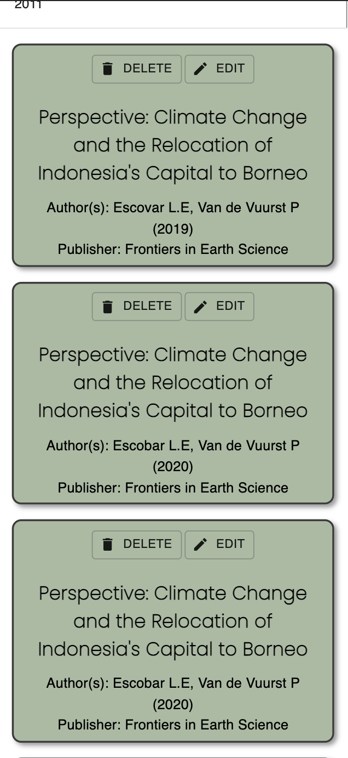
Website User Flow: Publications
Mobile View
1) Admins can publish, delete, edit publications
3) Link to external third-party website.
2) Posts filtered by Book Chapters and year
Notes:
James

Slide 14
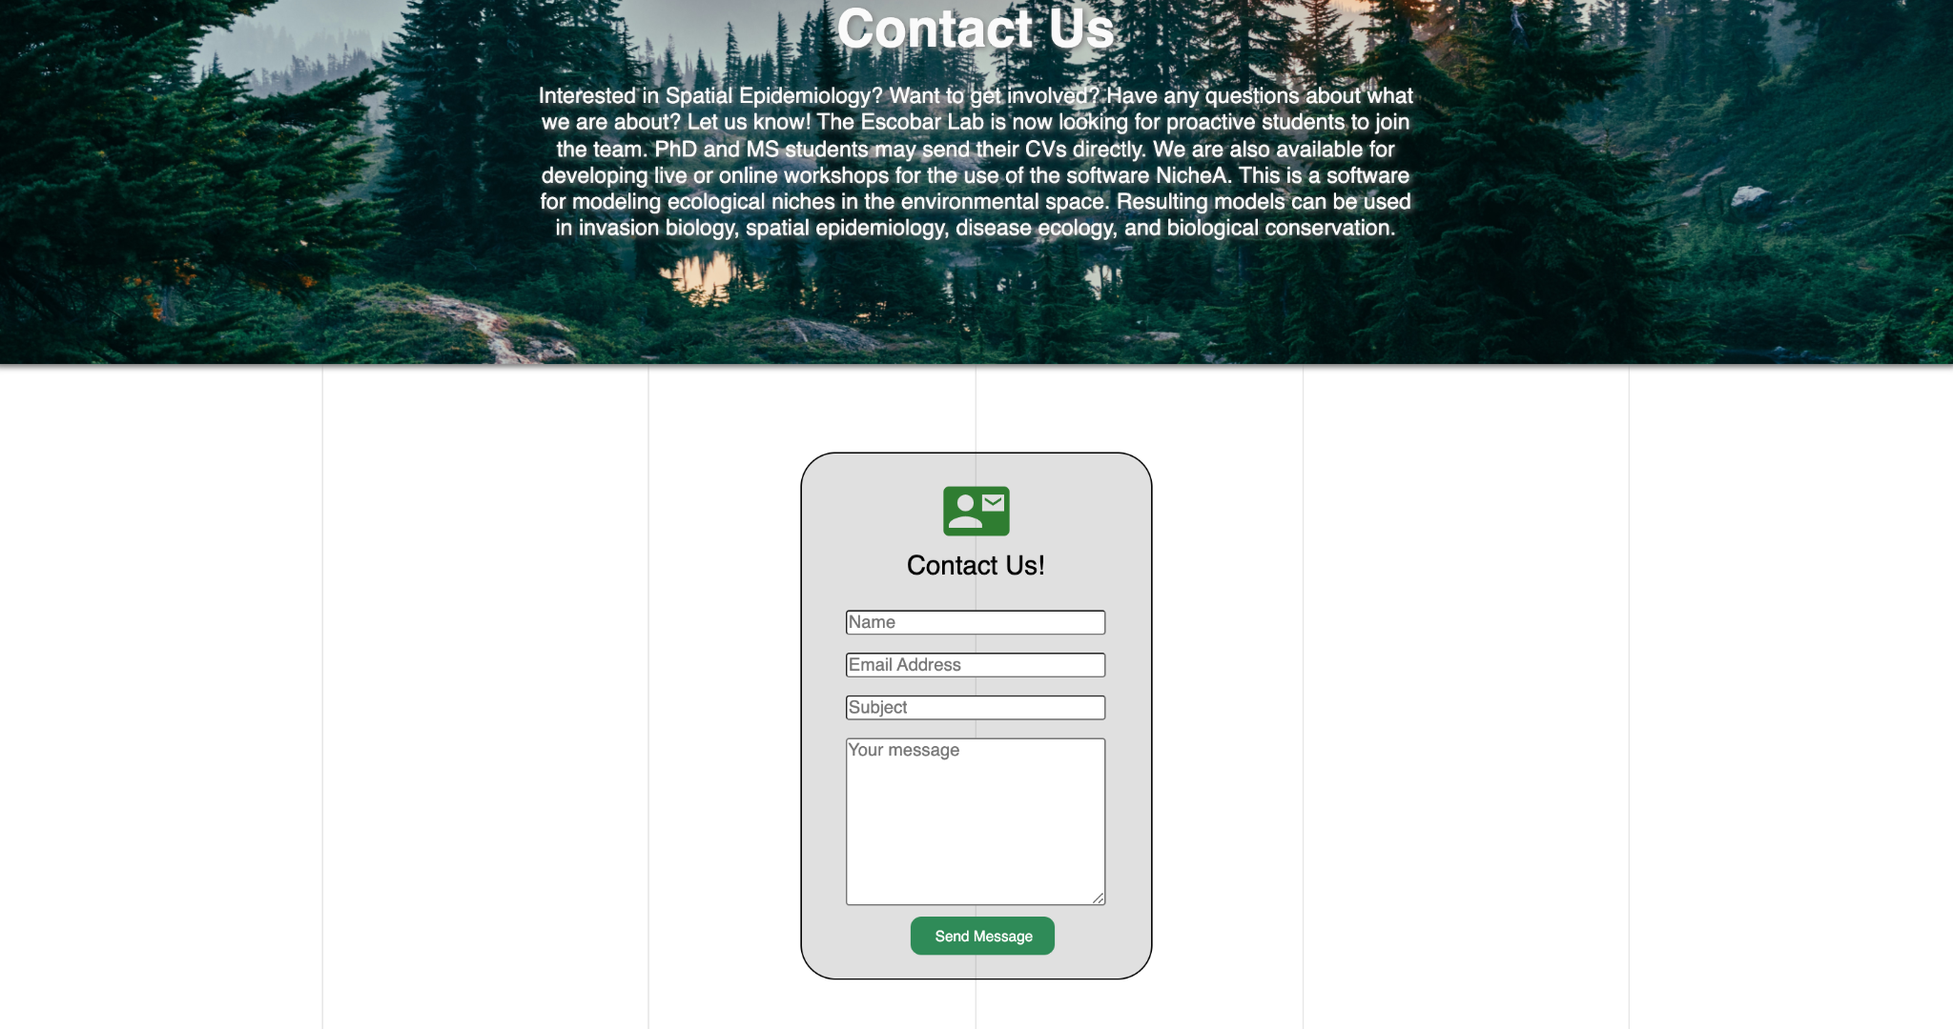
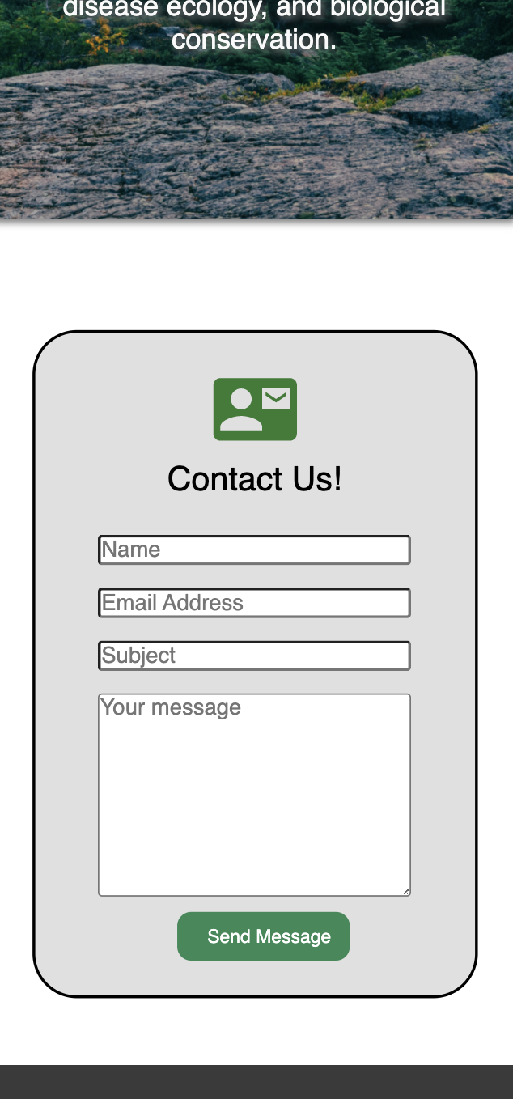
Website User Flow: Contact Us
Mobile View
Notes:
Kris

Slide 15
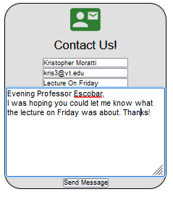
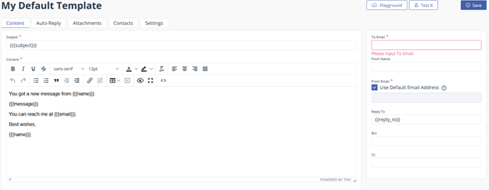
EmailJS

Slide 16




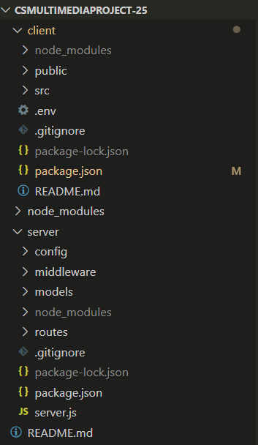
Technologies Used, Codebase Architecture
Figma for Wireframe and Prototype
React.js with Material UI for Front-end development
Node.js and MongoDB for Back-end development
Client directory for Front-end and Server directory for Back-end
GitHub to manage codebase
VS Code to develop and test
Deployment
Notes:
So for the technologies and software we used, first, for the Wireframe design, we used Figma for prototyping the Front-end. It is a free and open source software targeted at creating prototype designs.
Later, for the Front-end development of the website we used React.js along with CSS and libraries like Material UI to create the Responsive front-end of the website shown previously
For the Back-end, we used Node.js along with MongoDB to Create, Update and delete new posts and for user authentication
As you can see from the two screenshots, we divided our codebase into the Client and Server directories. The client directory consists of the Front-end code along with all the UI components. The server directory consists of all the backend code required for integration, authentication and posts management. We used VS code to develop and test and we used GitHub to manage our code.

Slide 17
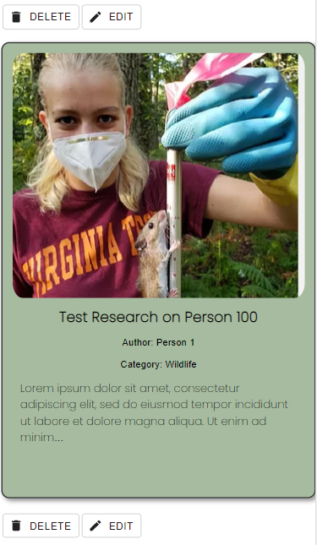
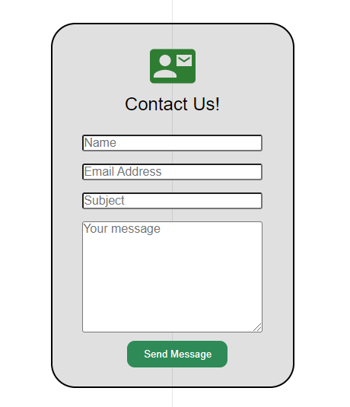
Final Work
Replacing the placeholder data with original data
Deployment of the Application
Fix any minor design issues
Notes:
Coming to the final work we have, we need to replace some placeholder data, as the one shown in the picture for the research posts into actual data from the database.
Furthermore, we should also decide on how to deploy the website and how to maintain it further. We should also make a few changes to our design, like the contact page here.

Slide 18
Challenges & Lessons Learned
Developing the entire application from scratch
Wireframe to Front-End conversion
Integration with the Back-end for Add/Delete/Update posts
Underestimation of timeframes
Notes:
For the challenges we faced and the lessons we learned throughout the design and implementation process. We are asked to develop the application from scratch. Even though we had all the data like the research and publication posts and about data, we still had to figure out how the newly designed webpage must look and feel like. We went through quite a few re-renderings of the webpage during initial stages. We also faced difficulty especially when converting the wireframe design to writing actual code to make the website look similar since we had latest functionality like add/edit/delete posts, we also underestimated our timelines especially one the basic front-end is done due to our tight schedules. We waited for a while to further develop the Front-end and get it ready to be integrated with the back-end. However, we were finally able to achieve that by the deadline.

Slide 19
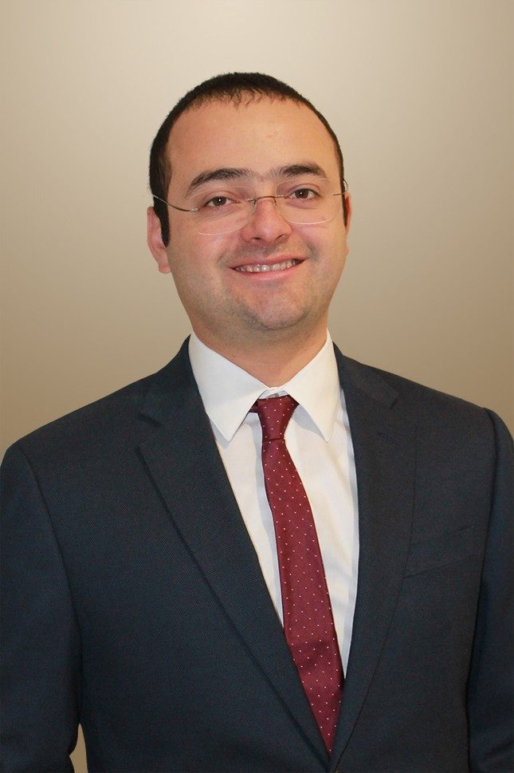
Thanks!
Acknowledgements
Professor Luis E. Escobar
Laboratory of Disease Ecology and Biogeography
Professor Edward A. Fox
Questions?

