Slide 1
Chemistry Websites Enhancement
James Kirk
CS 4624 (Multimedia, Hypertext, and Information Access)
Virginia Tech, Blacksburg, VA 24061
Instructor: Dr. Edward Fox
Client: Karen Iannaccone
4/25/19

Slide 2
Outline
Virginia Tech Center for Drug Discovery
  Now complete
  Usability Testing
Virginia Drug Discovery Consortium
  Usability Testing

Slide 3


Virginia Tech Center for Drug Discovery
Now live with new updates
Usability Testing being done
Setting up a Google Analytics account

Slide 4
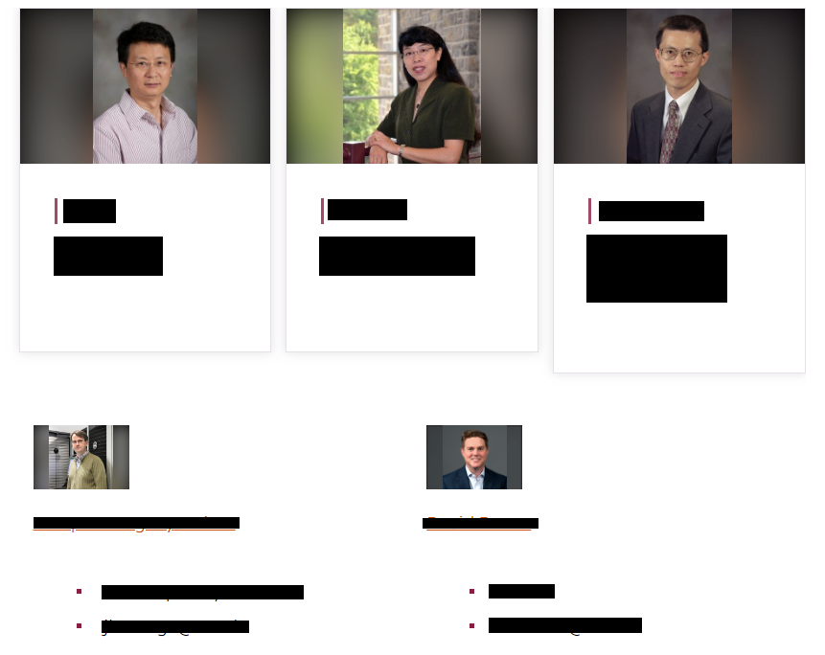
Faculty Page

Slide 5
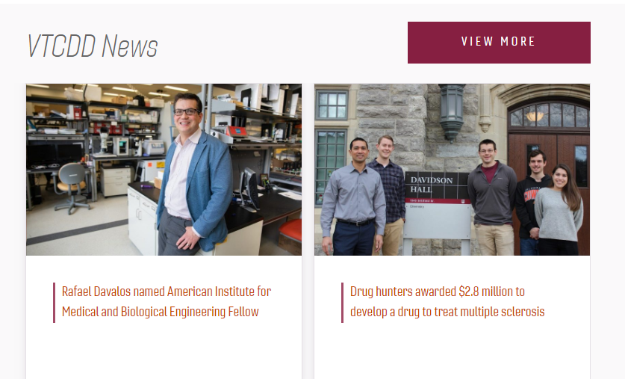
News

Slide 6
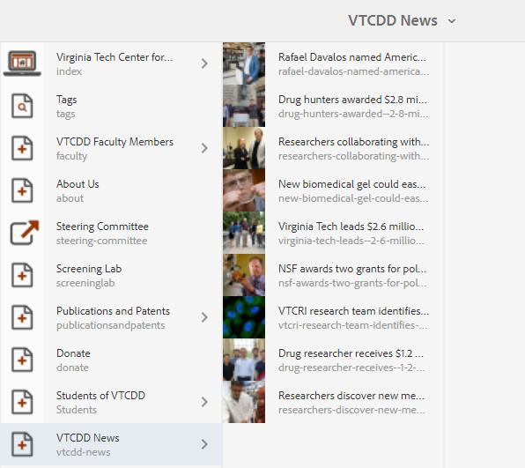

Slide 7

Virginia Drug Discovery Consortium
Usability Testing being done

Slide 8
References
http://www.vtcdd.science.vt.edu/
https://vaddc.org/
https://ensemble.cms.vt.edu/
https://analytics.google.com/analytics/web/

