Slide 1


Do Maryland's Stormwater Management Regulations Protect Channel Stability?
Tess Wynn Thompson, Associate Professor
Biological Systems Engineering
Notes:
I’m going to report on two related projects.

Slide 2
Project partners and contributors
David Sample, Professor and Extension Specialist Biological Systems Engineering, Virginia Tech
Mohammad Al-Smadi, PhD, PE, Water Resources Consultant
Sami Towsif Khan, Center for Watershed Protection
Mina Shahed Behrouz, Water Resources Designer, Stantec
Andrew Miller, Professor, Geography and Environmental Systems, University of Maryland, Baltimore County
Jon Butcher, Professional Hydrologist, TetraTech

Slide 3










Acknowledgment Slide
We thank the many partners who support the Restoration Research program for their funding and interest. Major funding for this phase of the work was provided by the U.S. Environmental Protection Agency. We also thank the US Geological Survey and Montgomery County for sharing data and their personal observations of Tributary 109.

Slide 4
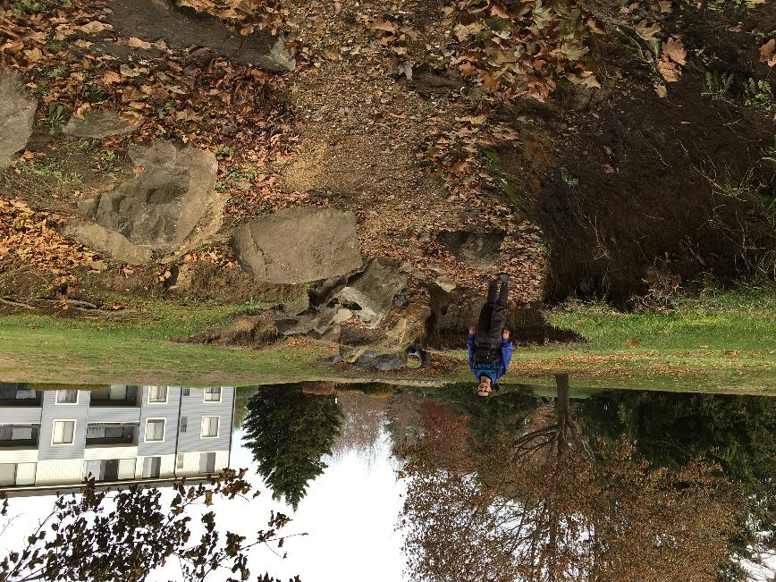
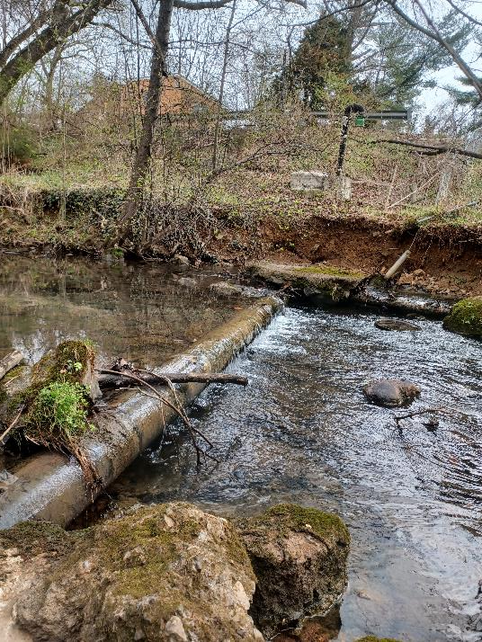
Paying for good stormwater management now means you don’t pay to fix things later.
Notes:
Quote from 1971 TV commercial for the FRAM oil filter company

Slide 5

How can we develop land and protect streams?
Does unified stormwater sizing criteria (USC) protect channel stability under current and future climate?
How can we “tweak” stormwater regulations to protect channel stability?
Notes:
While we have several formally stated hypotheses, which we’ll address in greater depth in our final reports, in the interest of time, I’ll keep it short and simple.
For the sake of non-stormwater and non-Maryland participants, ESD is a development technique where natural drainage features are preserved, stormwater management is distributed throughout the watershed, and there is a combination of structural and non-structural BMPs (or SCMs if you prefer). ESD is similar to LID and I’ll show an example of that soon.
During this talk I’ll explain how we came to this conclusion and what are some alternative ways of designing stormwater management systems that are being used in other states. Before I do that, we need to have some common vocabulary to avoid misconceptions. Since this is review, I’m going to go through it pretty quickly.

Slide 6

Before we talk research…

Slide 7
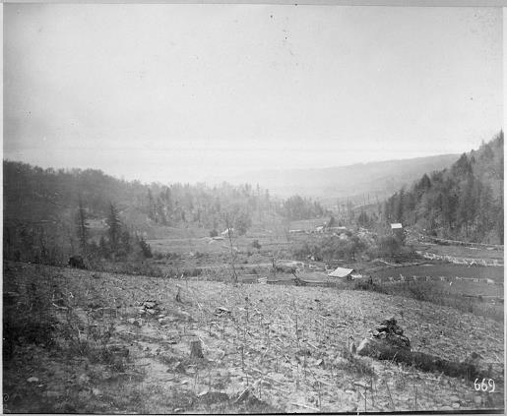
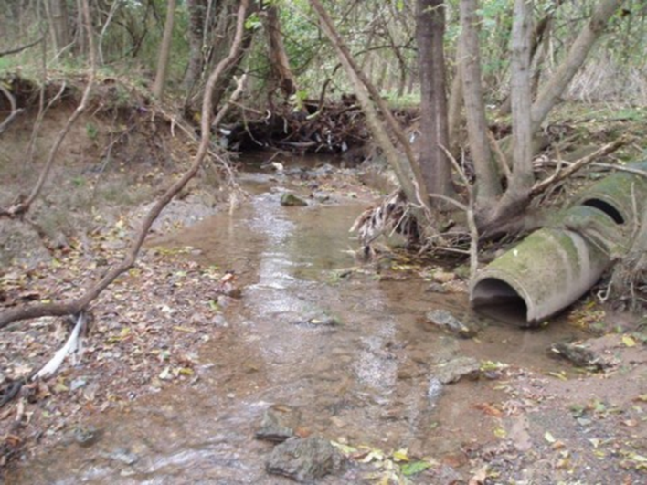
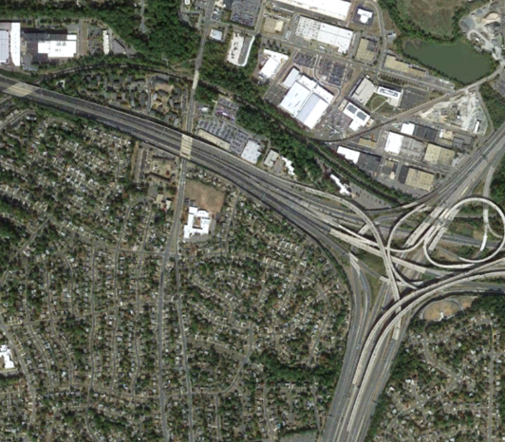
In this talk, stream “stability” means the channel is not becoming deeper and/or wider
Google Earth
Notes:
Given the long history of impacts to streams in the Bay watershed, I think the argument could be made that many streams in the Bay watershed are still adjusting from prior impacts. There’s also evidence that many streams were multi-thread, anastomosing stream/wetland complexes. So, for this discussion, I think we can agree that channels in the Bay watershed that are incising and/or widening over a time frame of decades are not stable.

Slide 8

Maryland stormwater history in brief…
1984
No statewide stormwater regulations
Local regulations largely focused on flood control
1984-2000
Statewide stormwater regulations for peak flow control
Local regulations to treat runoff from first ½” of rainfall
2000-2007 – Unified stormwater sizing criteria (USC)
Water quality volume - capture and treat runoff from 1" of rainfall
Channel protection volume – detain runoff from 1-yr, 24-hr rainfall
2008+ Environmental site design (ESD)
Required better site planning and use of LID/GI before traditional stormwater ponds
Changed method for calculating required storage/infiltration volume
Thanks Stew Comstock!!

Slide 9
Where did the channel protection volume come from?
The 1-yr, 24-hr storm produces the 1-yr RI Q
Detaining the runoff from the 1-yr RI storm event for 12/24 hours maintains pre-development 1-yr RI Q
Bankfull discharge can be approximated as the 1-2 yr RI discharge
Channel stability is maintained if the frequency of the bankfull Q does not change

Slide 10


All models are wrong, but some are useful
- George Box, British statistician
Adjust the model to match observed conditions (calibration).
Apply common sense.
http://www.clipartpanda.com/clipart_images/reality-check-ahead-59860852
http://www.clipartpanda.com/clipart_images/reality-check-ahead-59860852
Notes:
Models are a simplification of reality, so they will always be wrong. We adjust the model inputs so the outputs match observed conditions, such as streamflow records, as best as we can. This calibration brings us from the outfield, to the infield, but not to home plate. Models are useful for asking “what-ifs” about management actions that we don’t have the time, space, or money to test experimentally.

Slide 11
Ok, let’s talk research…

Slide 12
Tributary 109 to Little Seneca Creek served as a case study
0.3 mi² drainage area, 44% TIA
Developed 2006 - 2016
USGS stream gage (2004)
USGS rain gage
Montgomery County data
  Cross sections
  Longitudinal profiles
  Pebble counts
Multiple lidar datasets

Slide 13
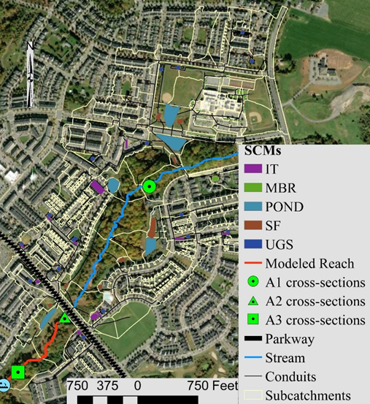
Stormwater system was designed to meet the 2000 USC requirements:
5 ponds
26 micro bioretention (MBR)
10 infiltration trenches (IT)
11 sand filters (SF)
18 underground storage facilities (UGS)
“Distributed” stormwater control practices
Notes:
The stormwater management for this development was designed based on the original ESD regulations from 2008. So the water quality and channel protection volumes were additive. As a result, stormwater management in this watershed is overdesigned by todays regs and consists of ponds plus smaller, distributed practices in a treatment train. To compare the relative impact of the infiltration practices versus the traditional storage practices, we took the calibrated model and then removed some stormwater practices from the watershed to see what the hydrologic response would be.

Slide 14
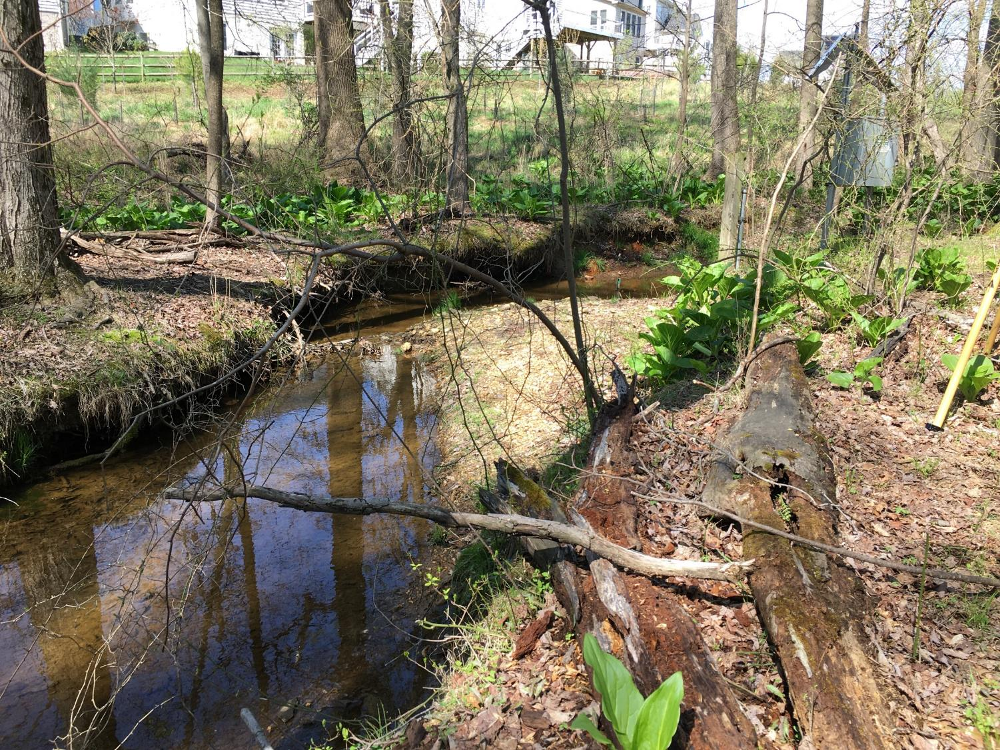
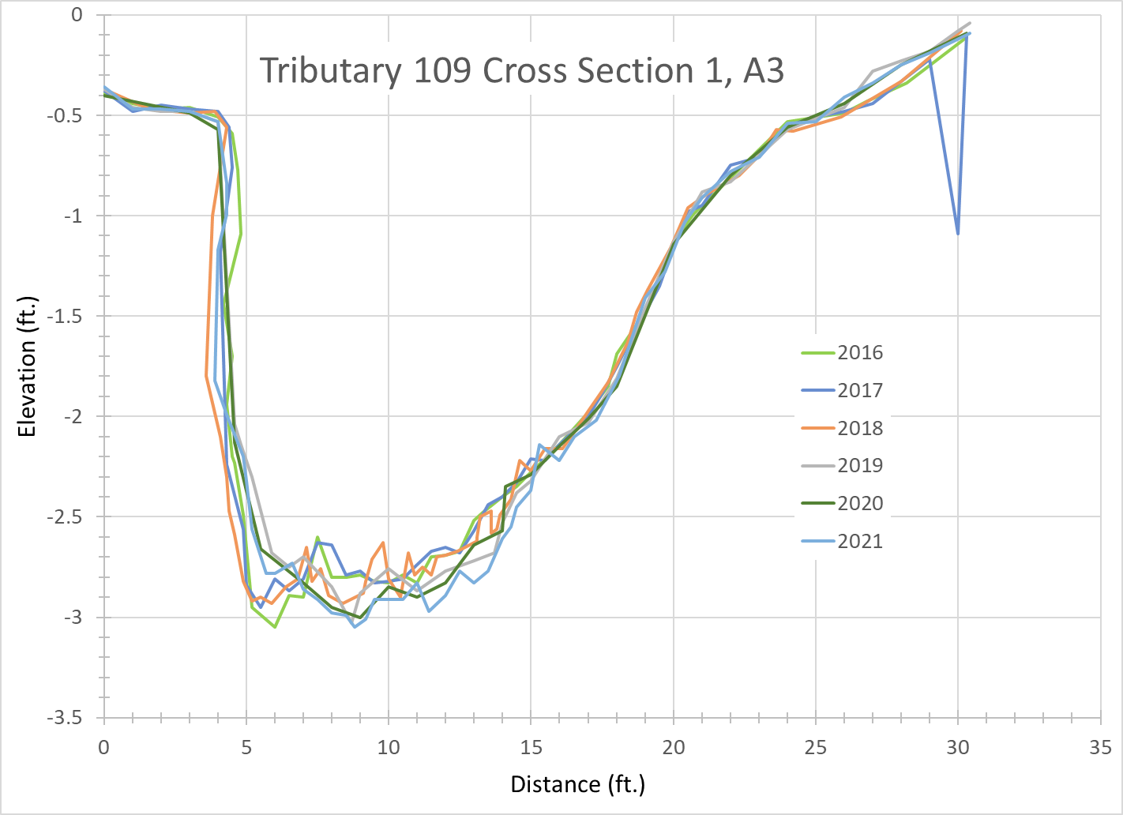
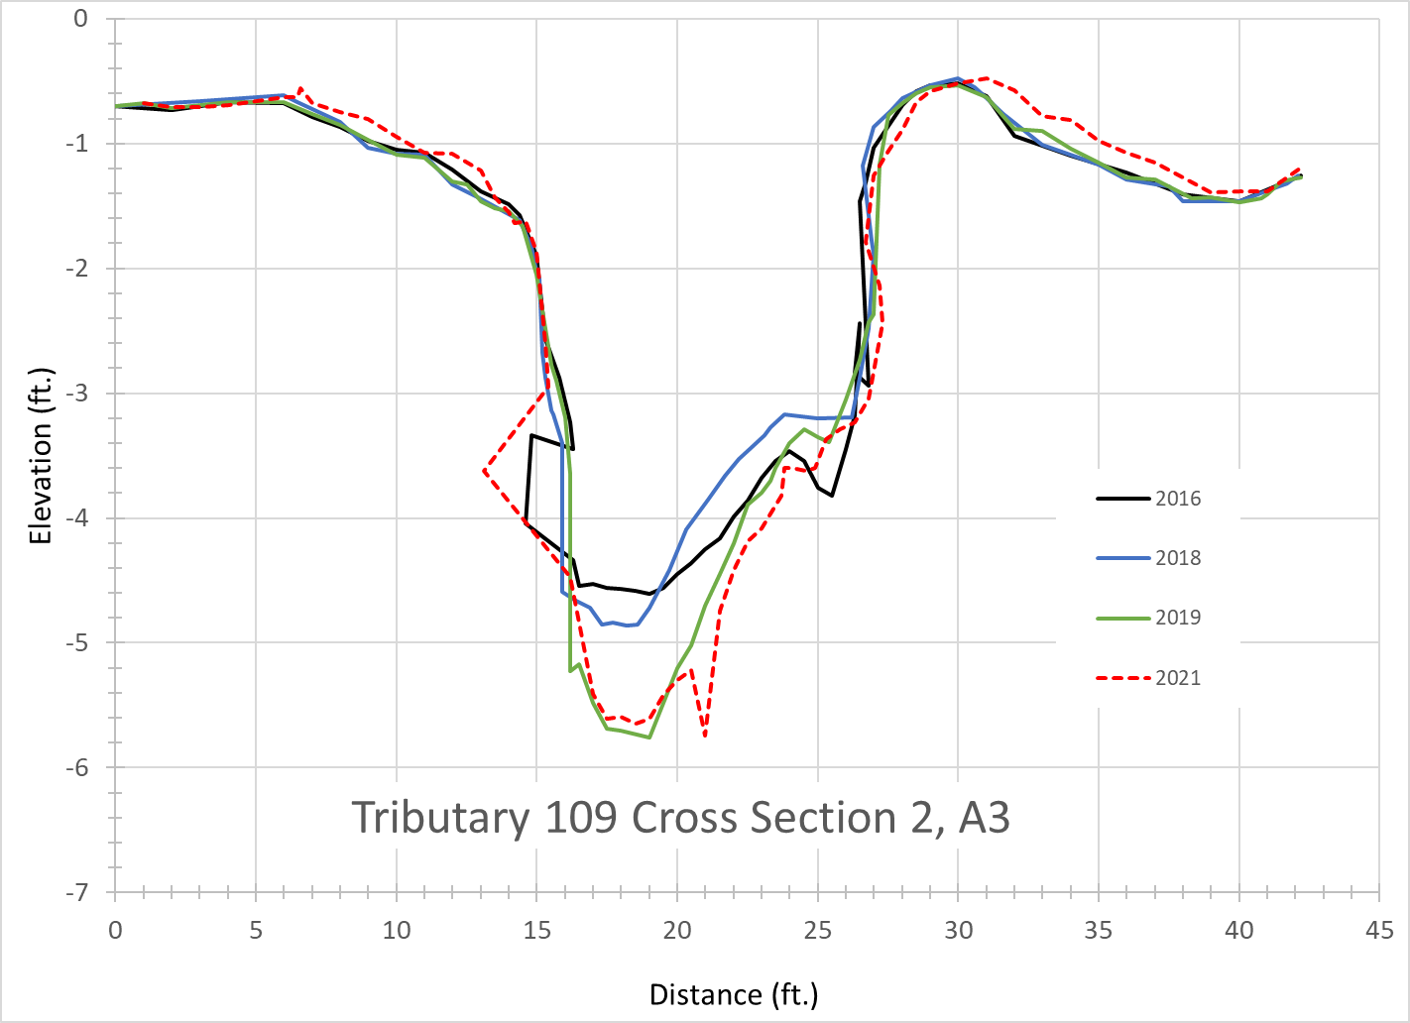

Slide 15
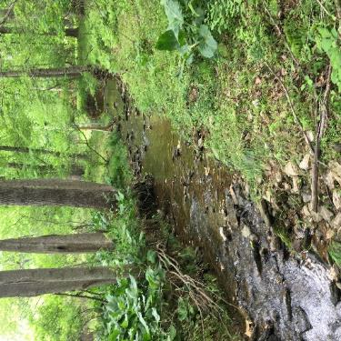
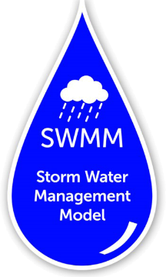

Channel stability is a two-part problem
Water
Sediment
HEC-RAS 6.3
Notes:
To evaluate the impact of development, stormwater management, and climate change on channel stability, we needed to first ask what the role of development and stormwater management is on stream flows and then what is the effect of those flows on sediment transport in a given stream. To do this, we used two different models. SWMM simulated the hydrologic response of the Trib 109 watershed to continuous precipitation time series, both measured rainfall and downscaled climate data from TetraTech. We also used SWMM to evaluate how different stormwater management designs affected flows from both types of precipitation time series. The stream flows output by SWMM served as input to HEC-RAS to simulate changes in sediment transport and channel form over time.

Slide 16
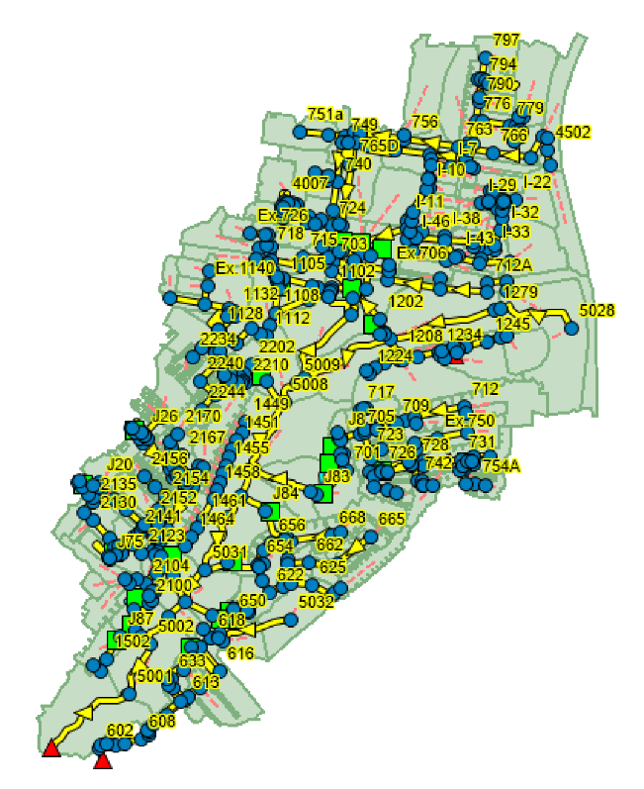
SWMM model development
Watershed characteristics and stormwater infrastructure attributes entered into models
Models calibrated based on observed USGS flow data
Calibrated models used to explore 4 stormwater management and 64 climate change scenarios
SWMM-modeled stream discharge used as input to HEC-RAS model (5-min. data)
Notes:
Since the stormwater management practices in Trib 109 were extensive, we modeled flows from the watershed without the infiltration BMPs or without the storage BMPs to evaluate the effects of each type of practice. We also input downscaled weather data from TetraTech to evaluate changes in stream flows under different climate change scenarios.

Slide 17
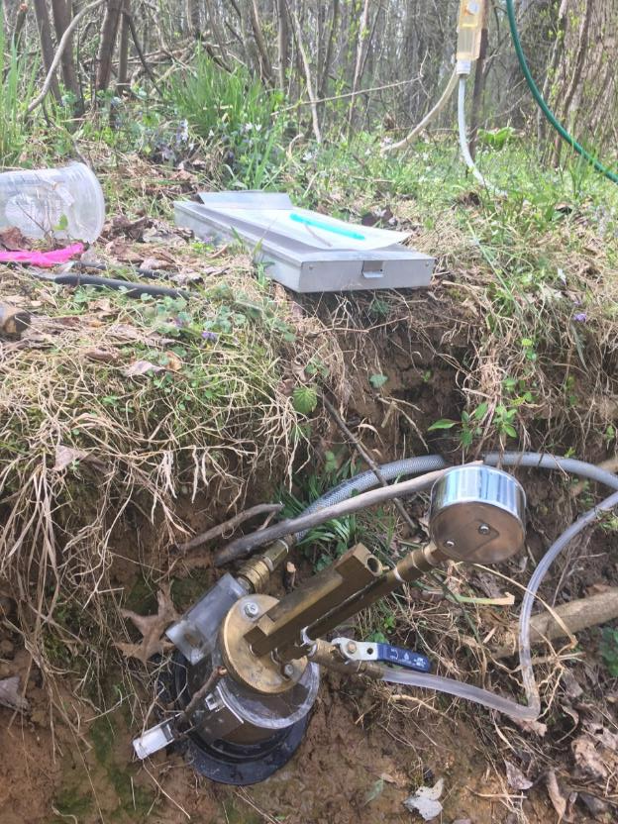
HEC-RAS quasi-unsteady, 1-D model development
Lidar data and measured cross sections used to create channel geometry
Bed particle counts, bulk subsurface sediment samples, and USGS suspended sediment data (Fairfax, VA) used to parameterize sediment transport routines
Calibrated HEC-RAS to USGS stage data and measured cross section change
Modeled channel response to stormwater scenarios and climate change scenarios using SWMM output
Evaluated effectiveness of alternative stormwater management design techniques to protect channel stability

Slide 18
Results…
Notes:
We’ll look at a brief summary of the hydrologic results and then spend more time on channel stability.

Slide 19
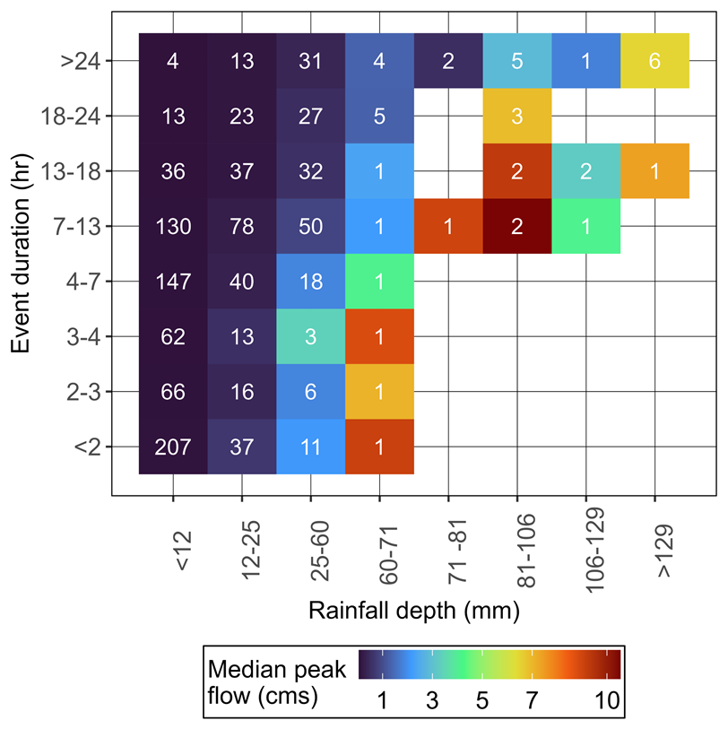
Cp_{v}
1141 individual rainfall events over 16 years
81% of the storm events had depths <1”
The water quality volume will treat the majority of storm events
Wide range of runoff rates from the 1-yr recurrence interval storm event (Cp_{v})
Regulations and extended detention design standard focus on detaining runoff volume, not reducing peak flows
24-hr duration storm events produce lower peak runoff than shorter-duration, higher intensity storms
In small, urban watersheds, runoff depends most on rainfall intensity, not rainfall depth over 24 hrs
WQ_{v}
Notes:
First, we examined measured rainfall characteristics and the predicted runoff from Trib 109 and then compared that to the regulations. Let me walk you through this. Sami identified over 1100 individual rainfall events over a 16 year period. He then grouped them based on the total amount of rainfall that fell and the storm duration. Then, he counted the number of storm events that fit into each range, which are the numbers in the colored boxes. For reference, 25 mm is 1 inch. The then looked at the stream flow predicted by SWMM for each storm event in each grouping and used the color of the boxes to indicate the median peak flow

Slide 20
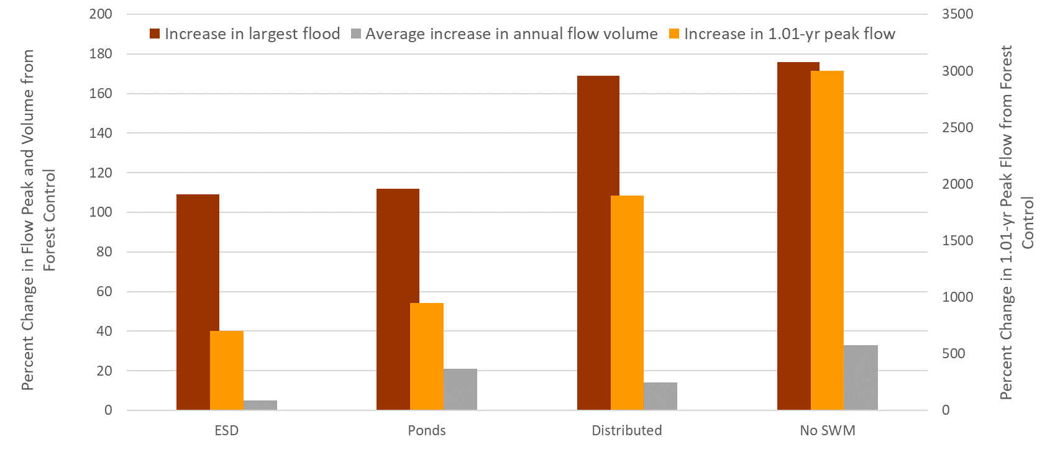
Both ponds (storage) and distributed SCMs are needed to minimize hydrologic impacts of development
16 years, measured precipitation
As compared to forest control
USC
Ponds
Distributed
No SWM
Notes:
Out of concern for time and because I presented the SWMM model results last year, I’m just going to highlight them. These bars represent the percent change in a flow parameter as compared to the forested control watershed, which is Soper Branch. All the Soper Branch flows were scaled to the watershed area of Trib 109. The maroon bars are the percent increase in the largest flood over 15 years. The yellow bars are the 1.1-yr RI flow, and the brown bars are the % increase in average annual runoff volume. The largest flood doubles in magnitude regardless of stormwater management. Infiltration practices provide little benefit in controlling large floods. Even though ESD is designed for the 1-yr 24-hr RI storm event, that does not mean the 1-yr RI flood is controlled. Increases in the 1-yr RI flood range from 5X the forested control to 30X the forested control. When the average annual runoff volume is considered, ESD is effective at reducing annual flood volumes.

Slide 21
What does the change in hydrology mean for channel stability?

Slide 22
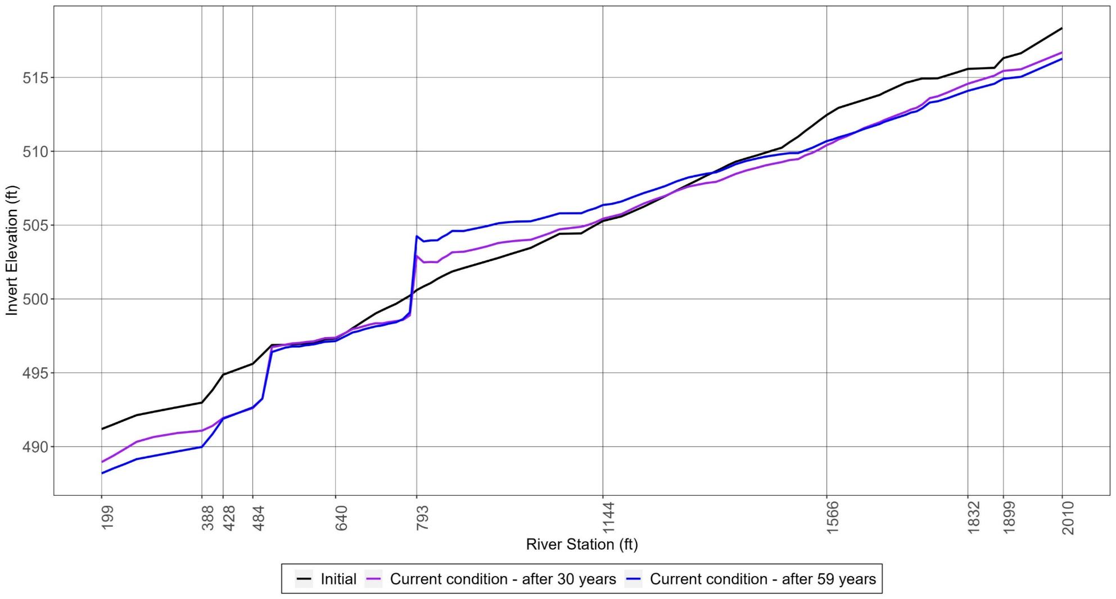
Unified sizing criteria (and ESD) will not protect channel stability long-term.
Snowden Farm Parkway
Channel Bed Elevation (ft)
Confluence with tributary
Aggradation
Degradation
Knickpoint (headcut)
climate
climate
Notes:
In fact, channel degradation is already evident in Trib 109 – the riffles are becoming shorter and steeper and the pools are deepening. The HEC-RAS model shows this, as best as a 1-D model can. The upper end of the reach erodes and coarse sediment (cobbles and small boulders) are deposited at RS 793, upstream of a channel constriction, forming a steep riffle. The downstream end of the reach degrades to bedrock and a knickpoint migrates upstream. While these exact changes may not occur, the model does predict that the channel will degrade over time.

Slide 23
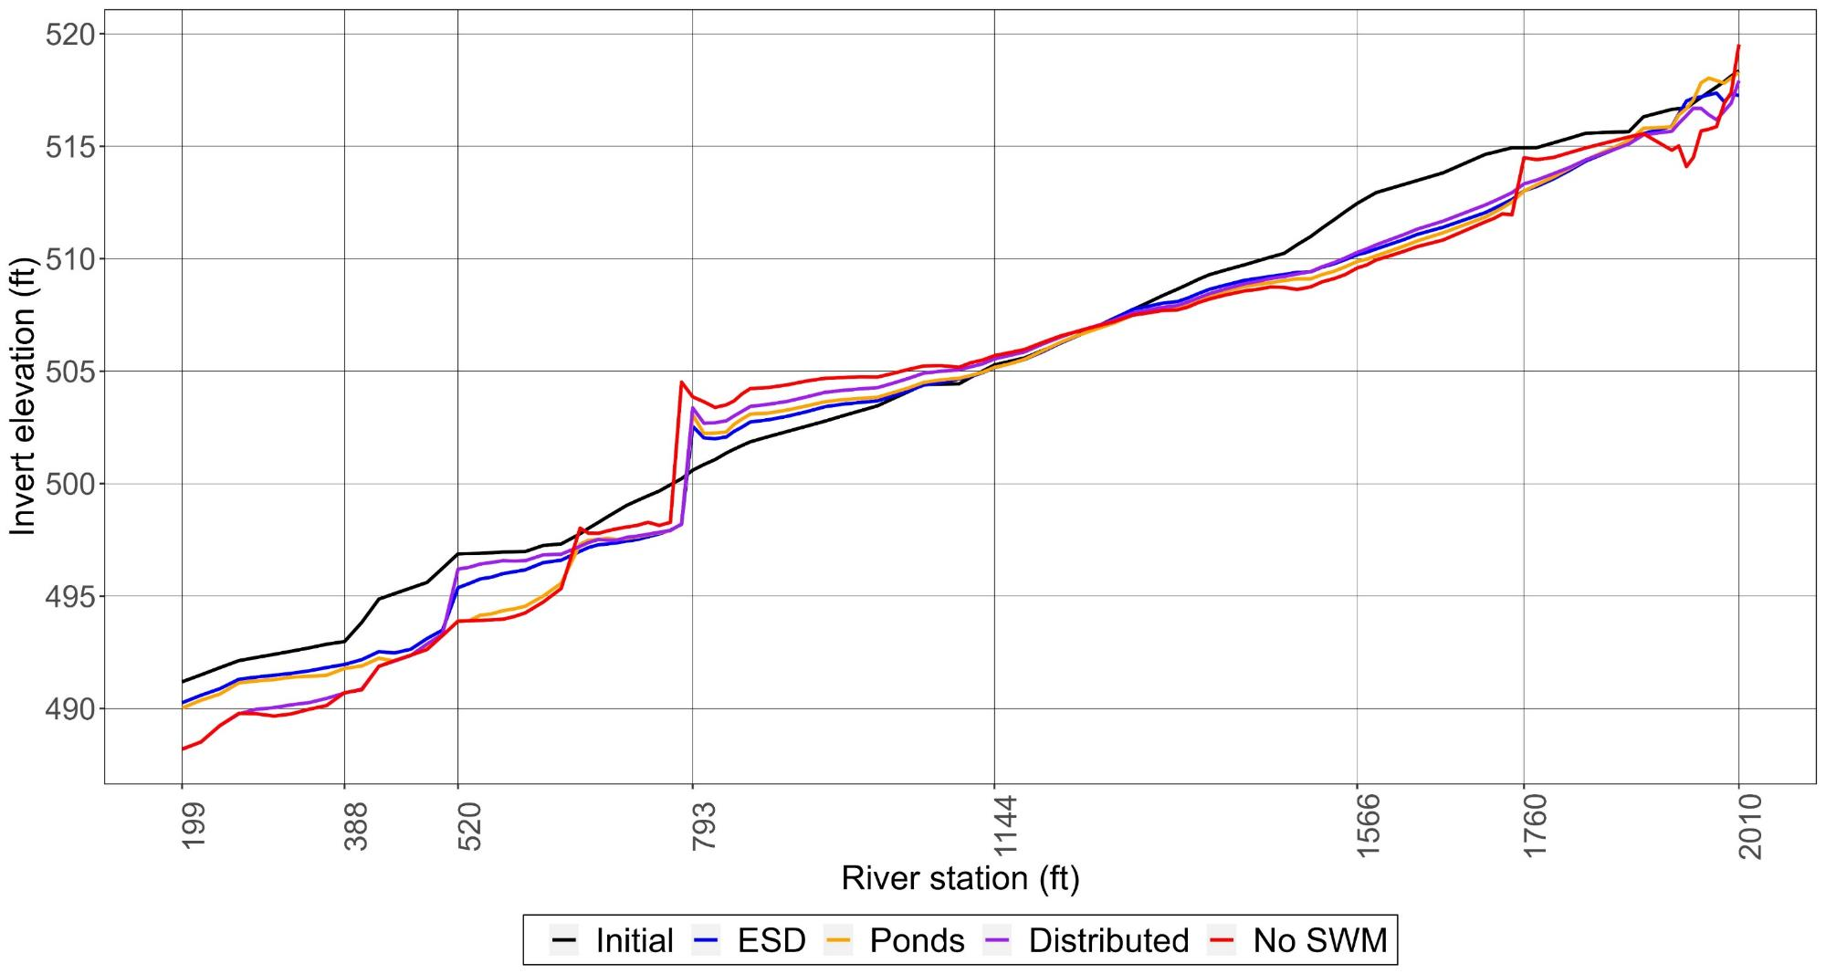
However, USC performs better than just distributed SCMs or only ponds.
Channel Bed Elevation (ft)
Notes:
ESD does perform better than infiltration only or storage only practices and certainly better than not having any stormwater management.

Slide 24
USC
Ponds
Distributed
No SWM

Slide 25
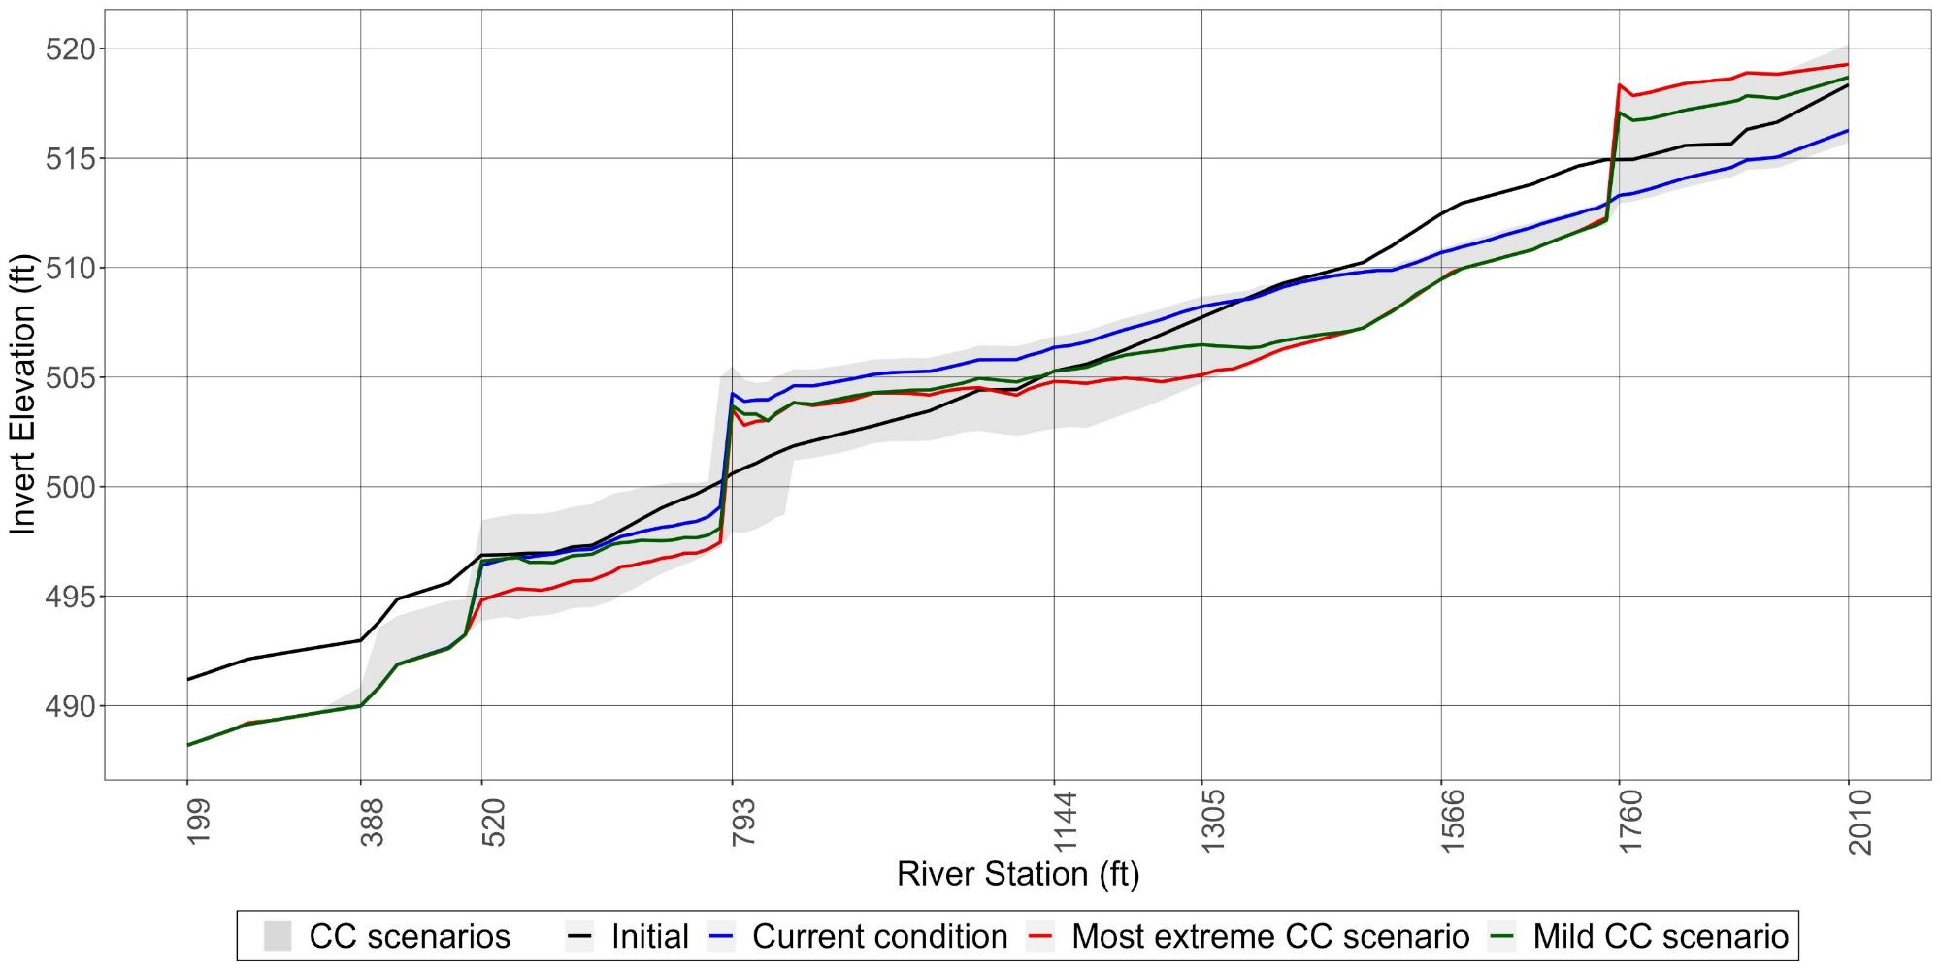
Channel degradation will be worse with climate change.
Channel Bed Elevation (ft)
climate
Notes:
With climate change, the really large storm events that mobilize previously immobile particles, like the small boulders, will become more common and more intense and will mobilize previously stable bed particles, causing greater channel degradation.

Slide 26
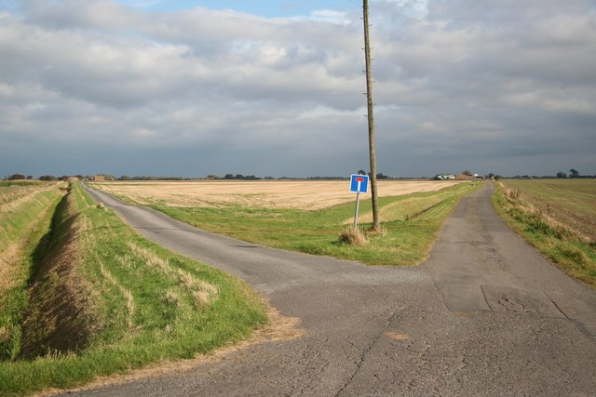
Where do we go from here?
geograph.org.uk

Slide 27
Channel stability is a two-part problem
Water
Sediment
Notes:
To evaluate the impact of development, stormwater management, and climate change on channel stability, we needed to first ask what the role of development and stormwater management is on stream flows and then what is the effect of those flows on sediment transport in a given stream. To do this, we used two different models. SWMM simulated the hydrologic response of the Trib 109 watershed to continuous precipitation time series, both measured rainfall and downscaled climate data from TetraTech. We also used SWMM to evaluate how different stormwater management designs affected flows from both types of precipitation time series. The stream flows output by SWMM served as input to HEC-RAS to simulate changes in sediment transport and channel form over time.

Slide 28
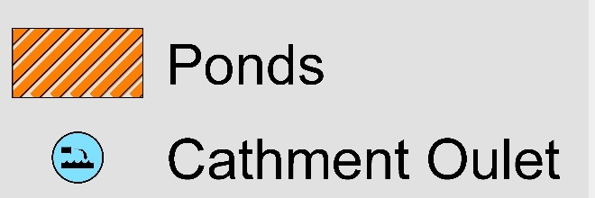
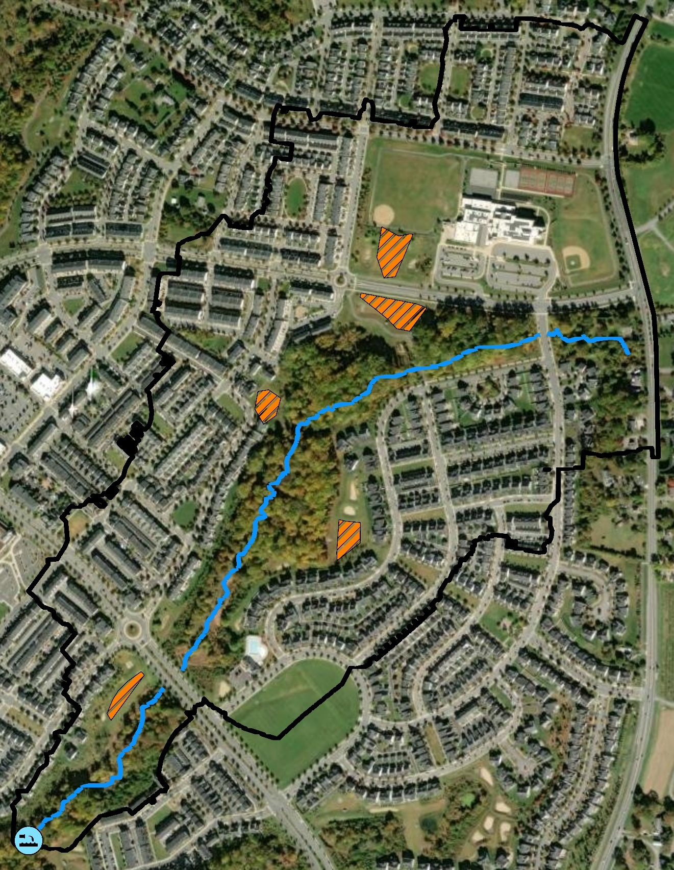
We evaluated two different design criteria for stormwater storage that focus on sediment transport.
1-, 2-, 5-yr 24 hr.
design storms
Erosion Potential (E_{p}) Scenario
Cumulative Sediment Transport Mass
Outlet
Hydrograph
Predeveloped
Condition
Redesigning
Effective work
Effective Work (E_{W}) Scenario
Notes:
We evaluated two different design criteria for stormwater storage that focus on sediment. The first is called the Erosion Potential Scenario – it is based on maintaining the same amount (mass) of sediment transported in the stream after development as before. This method has been proposed by multiple researchers, but never implemented, to the best of my knowledge. The second method is called Effective work. Work is basically the force of the water above a critical value, multiplied by the time that force occurs, summed up over an entire design storm. You match post-development work to pre-development work. Both of these calculations take into account the size of the sediment in the stream channel and the shape of the channel and the floodplain. To test these two design methods, Sami redesigned the outlet structures for the five existing storage ponds in the watershed to meet these criteria.

Slide 29
The pond outlet structures were changed to meet Ep and Ew design targets.
Riser
structure
Emergency Spillway
High stage outlet
Intermediate stage outlet
Low stage orifice
Scenario | Riser structure height increased
Ep | 5 ponds
Ew | 2 ponds
Notes:
The adjustments to the outlet structures consisted of reducing the low stage orifice, adding an intermediate stage orifice and increasing the riser height to store more water, while keeping the riser height less than the emergency spillway.

Slide 30
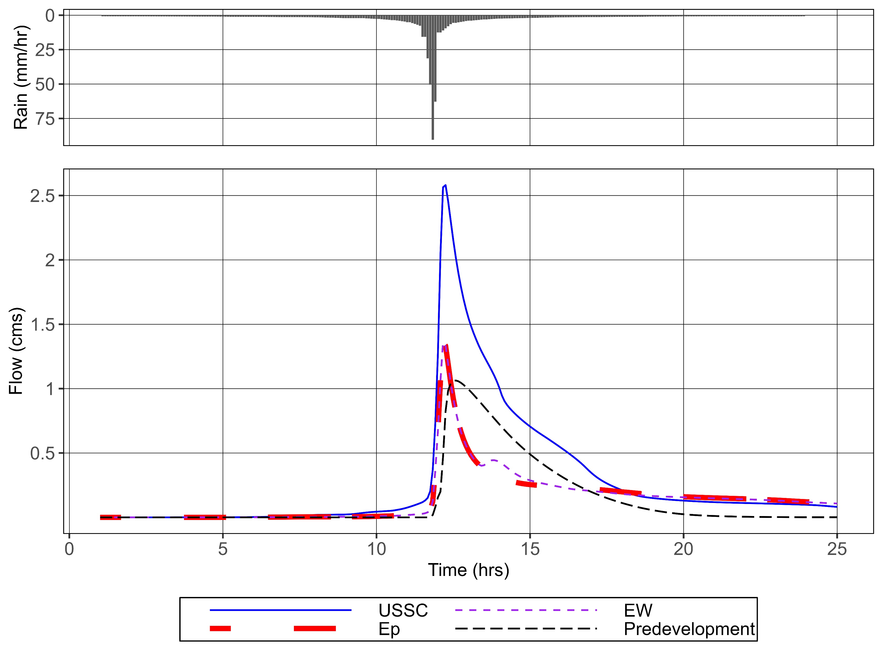
1-yr, 24 hr. storm
Notes:
As a result of implementing the Ew or Ep design criteria, peak flows are greatly reduced, as compared to the USC regulations, but lower flows are elevated for longer periods of time.

Slide 31
Ratio of sediment transported after development to before development
Notes:
For USC, sediment transport amounts are more than double the amounts pre-development for a 1-yr, 24-hr design storm, which is why channel degradation is occurring. Comparison of erosion potential values for USC, Ep, and Ew designs, with only adjustments of the outlet structures – did not quite meet a value of 1.0 – next step is to increase the pond size slightly.

Slide 32
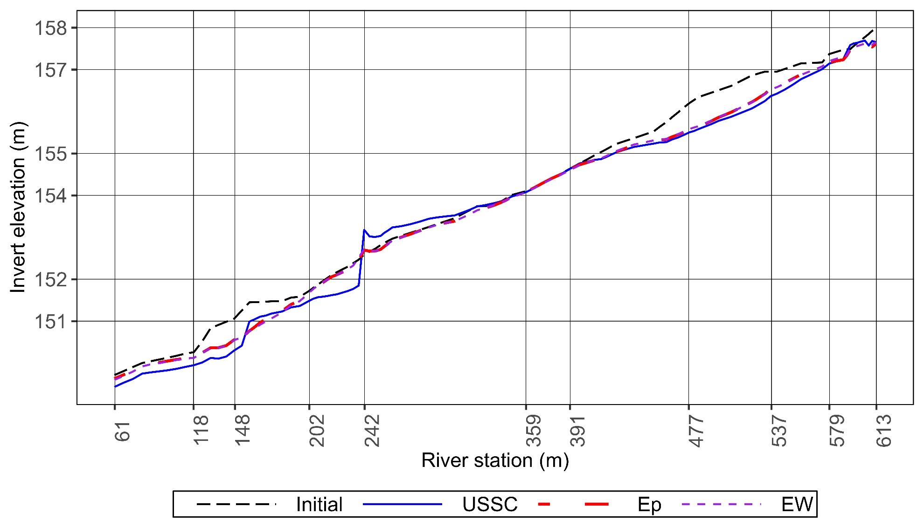
Designing SCMs based on sediment transport considerations significantly reduces channel disturbance
Did not achieve Ep or Ew = 1.0 with just changes in outlet structure – will need to enlarge the ponds slightly.
Ep and Ew calculated using 24-hr design storms, not continuous simulation
Notes:
Making these changes will require slightly more storage than even USC; however,

Slide 33
Summary
Unified stormwater sizing criteria (and environmental site design) is an improvement over conventional stormwater management, but will not protect channel stability.
To protect channel stability, stormwater management needs to be designed to meet sediment transport or effective work targets.
Stormwater storage is needed to manage high flows.
An investment in good stormwater management now will mean fewer repairs to sewer lines, culverts, and bridges and improved stream physical integrity

Slide 34
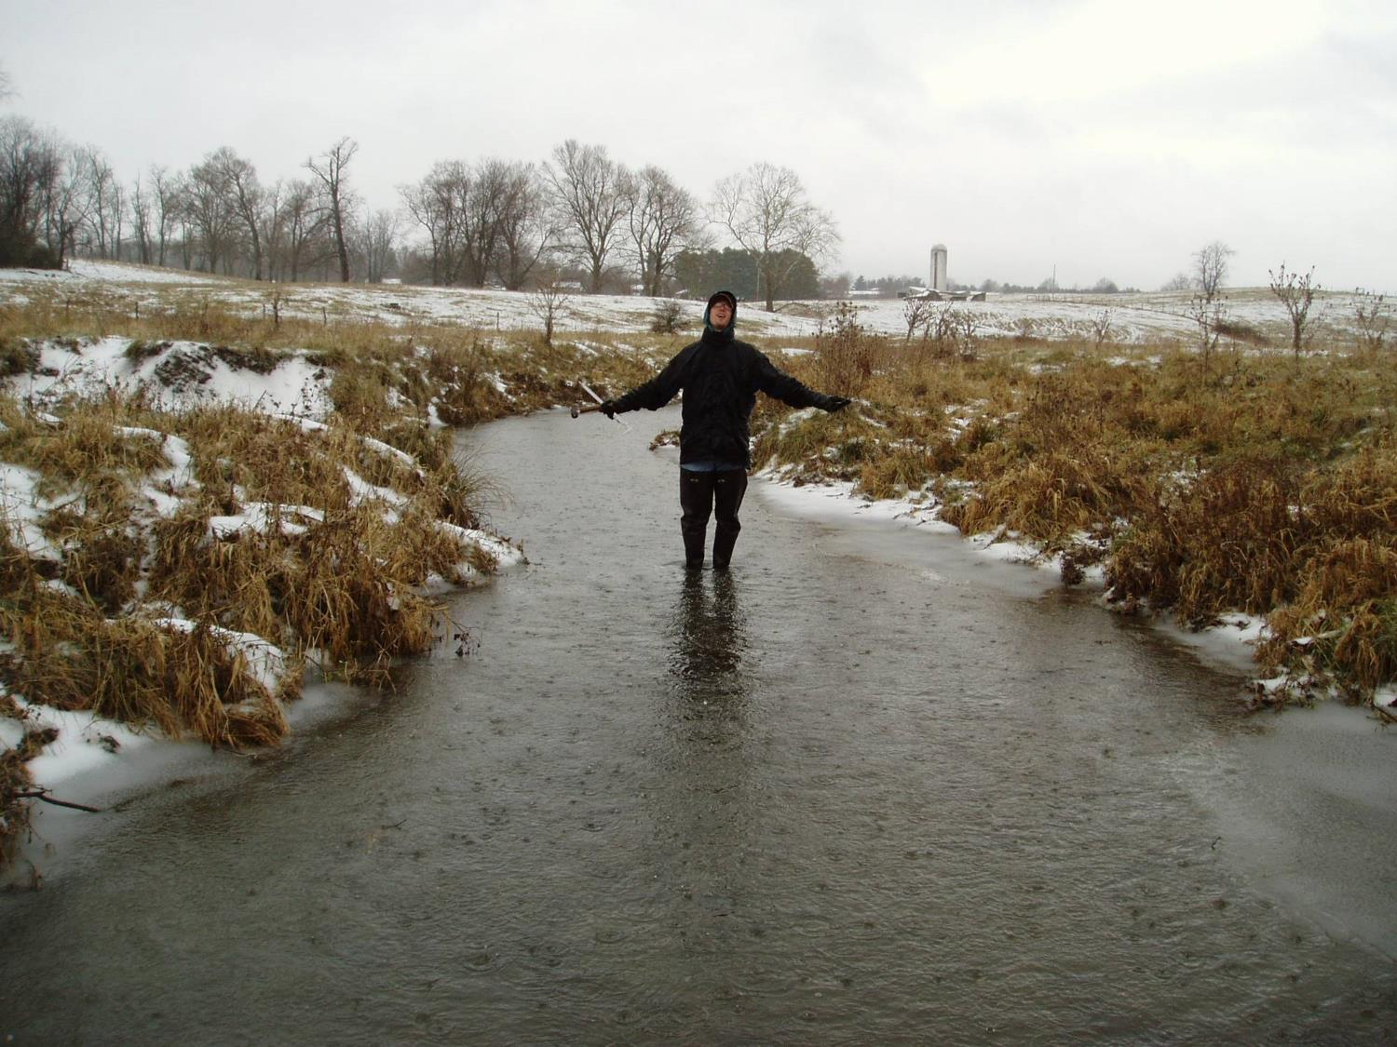
Questions?
Questions?

