Slide 1
CS 5604 Information Storage and Retrieval
Presenters: Andrej Galad, Long Xia, Shivam Maharshi, Tingting Jiang
Spring 2016 CS 5604
Information Retrieval and Storage
Virginia Polytechnic Institute and State University
Blacksburg, VA
Professor: Dr. E. Fox

Slide 2
Project Overview
Integrated Digital Event Archive and Library (IDEAL) project
Data source: social media (tweets, related web pages)
Goal: build a state-of-the-art information retrieval system
Management: separate teams, Solr team, Front-end team
Solr team’s responsibility
Data storage and HBase schema
Indexing
Custom search (query handler, ranking function, etc.)
Support for other teams (Front-end, Collaborative filtering)
Notes:
Get people working

Slide 3
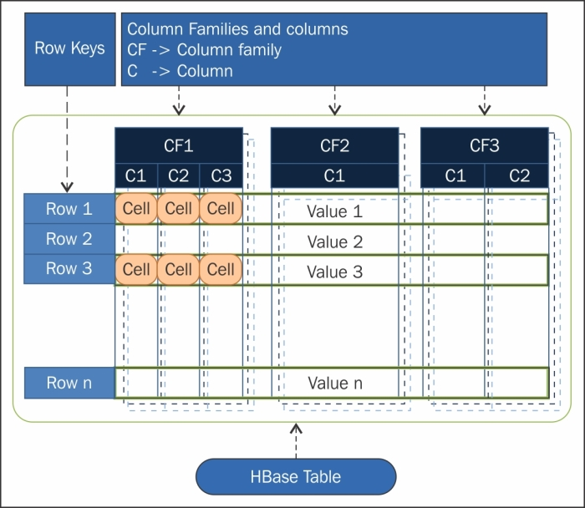
Data Storage and HBase Schema
Why use HBase
Non-relational, column-family-oriented, key-value-based database
Great scalability and flexibility
How data stored
HBase schema
Import data into HBase

Slide 4
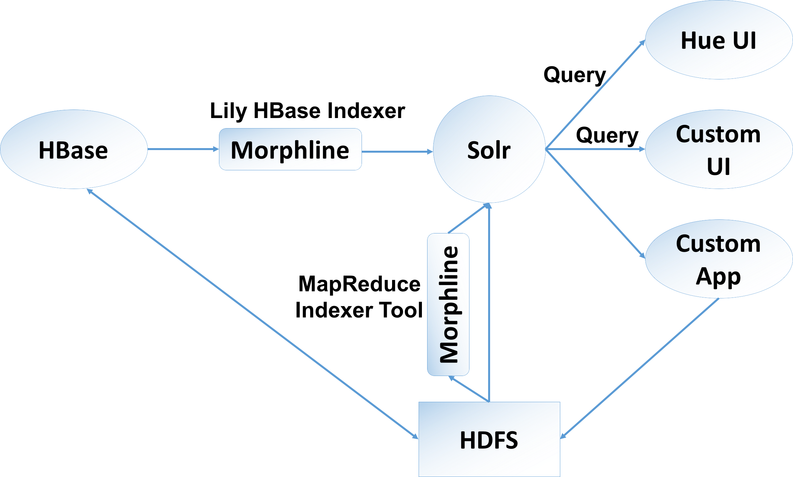
Indexing
Indexing pipeline
Notes:
we use Morphline LilyIndexer transform data from HBase to Solr. With Solr, we can perform search query, do custom ranking, etc, which Shivam and Andrej will talk more on this.

Slide 5
Indexing
Two types indexers
Lily HBase Batch Indexer
Lily HBase Near Real-time (NRT) Indexer
Morphlines
Data extracting, transforming, and loading to Solr
Morphlines configuration file
Solr Schema

Slide 6
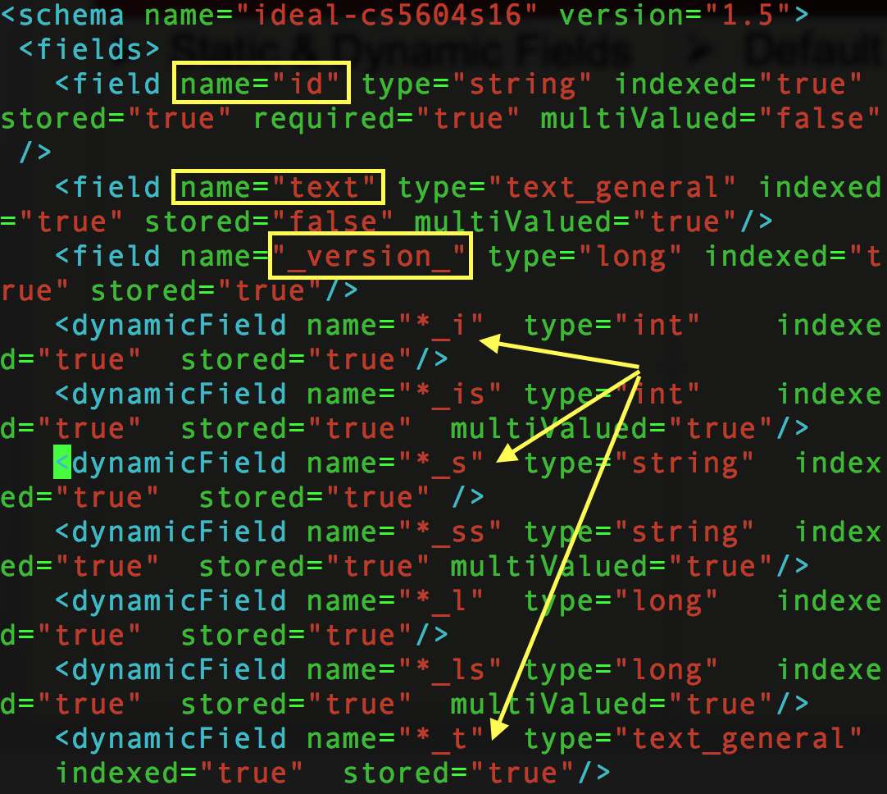

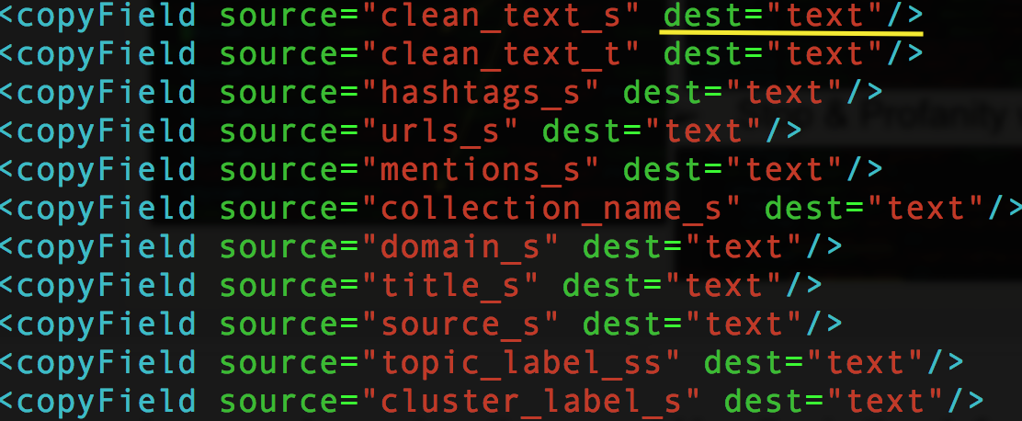
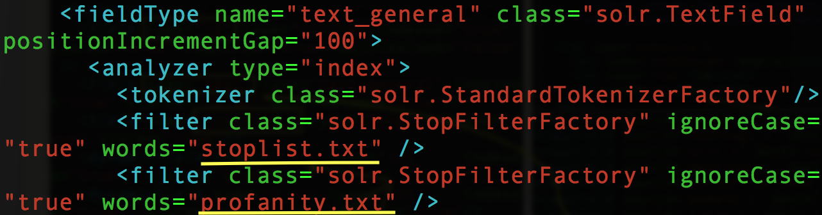
Solr schema.xml & solrconfig.xml
Static & Dynamic Fields
Default & Copy Fields
Stop & Profanity words

Slide 7
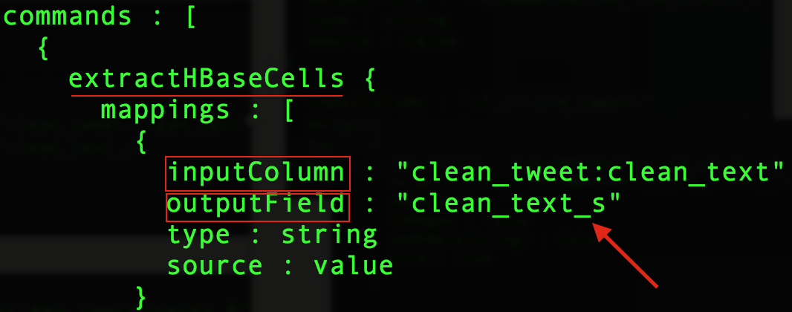
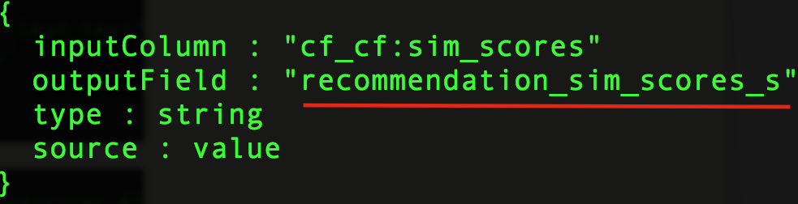
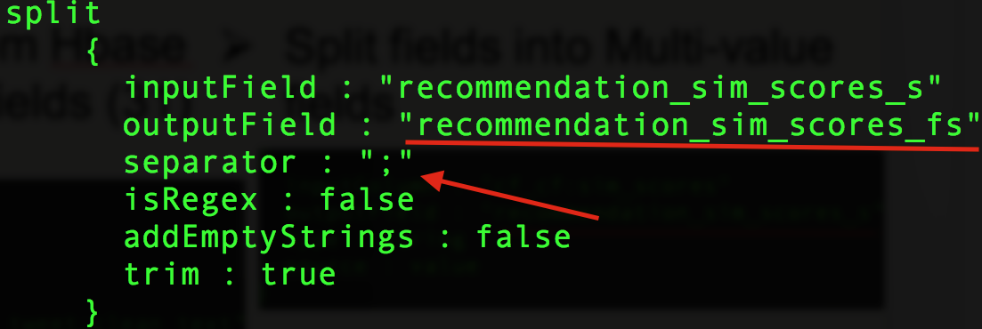
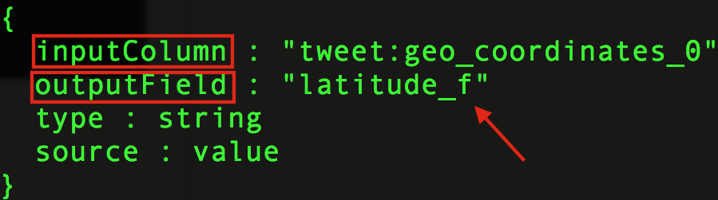
Morphline Configuration
Mappings from Hbase cells to Solr fields (31 fields)
Split fields into Multi-valued fields (4 fields)

Slide 8
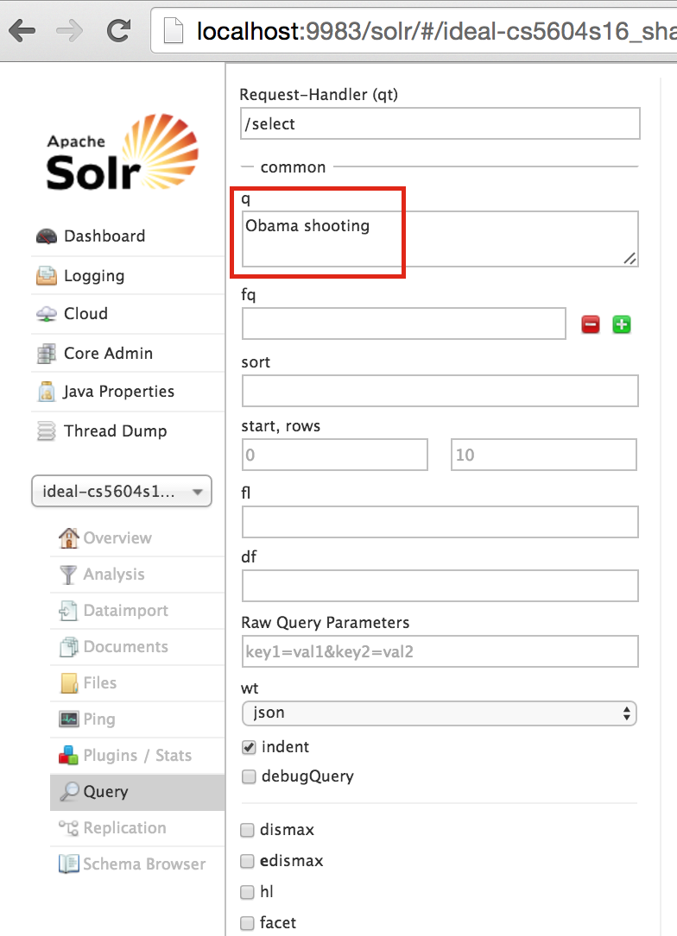
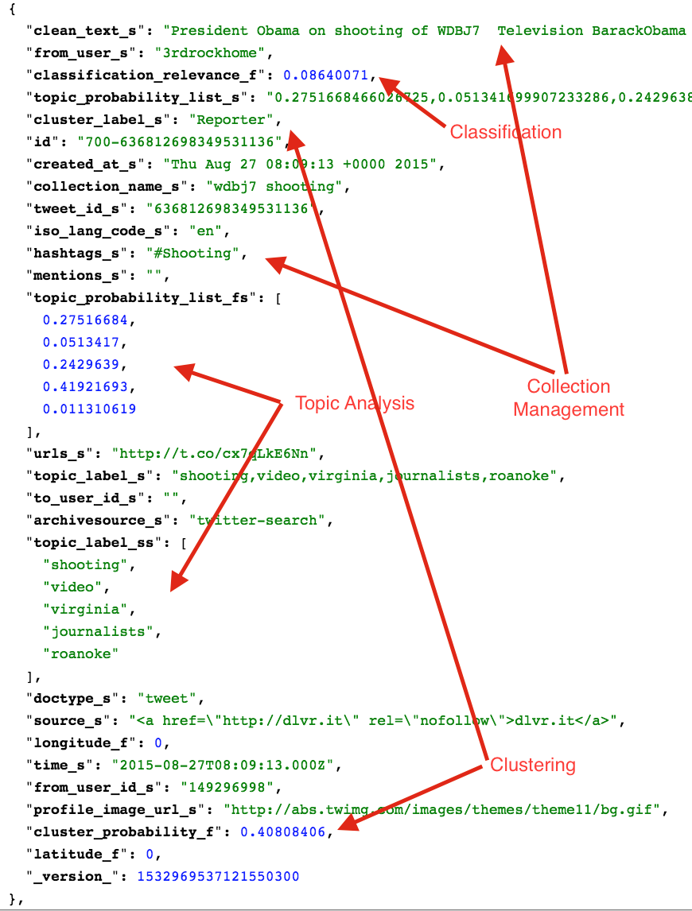
Solr Search Admin UI

Slide 9
Custom Ranking
Solr score (tf-idf) + custom scores (other teams)
  Custom Relevance Score = W_{Topic} * (Document Score)_{Topic} + W_{Clustering} * (Document Score)_{Clustering} + W_{Collection} * (Document Score)_{Collection}
Weight techniques
  Multiple linear regressions
  Empirical analysis for the Fractional Relevant Documents
Ultimately…
  Query Boosting + Query expansion + Re-ranking + Pseudo-Relevance feedback

Slide 10
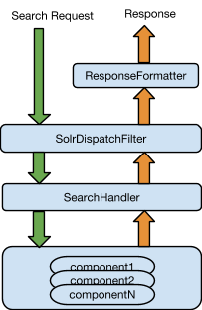
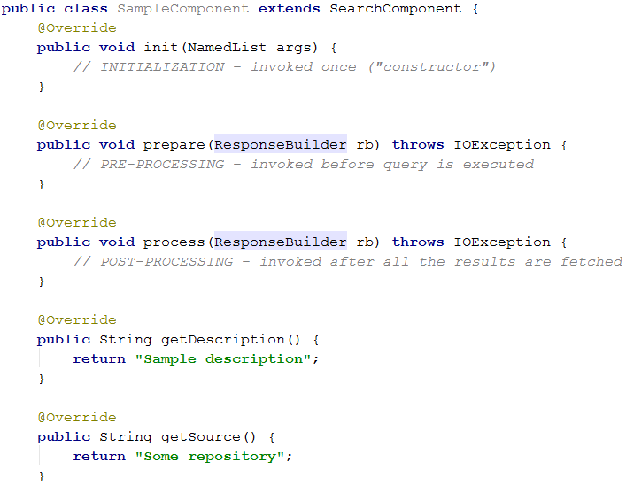
Solr Search Components
Solr - pluggable web application
  Custom handlers, components, libraries
  Dynamic linking
    Custom classloaders
    Declarative discovery - solrconfig.xml
    Pain while debugging!!!
Sample Component

Slide 11
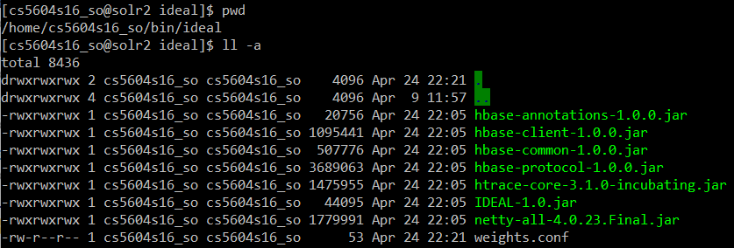
Solr: Component Configuration
Build and upload JAR(s) + dependencies to all Solr nodes

Slide 12
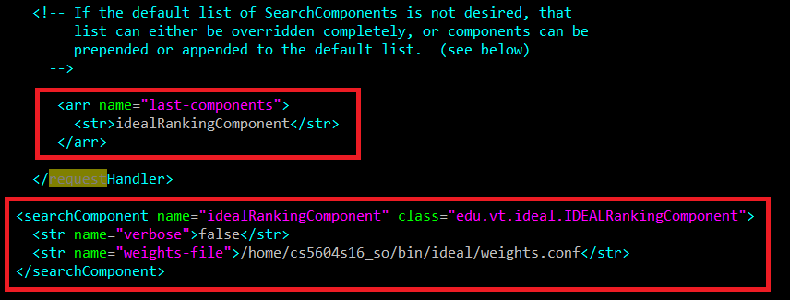
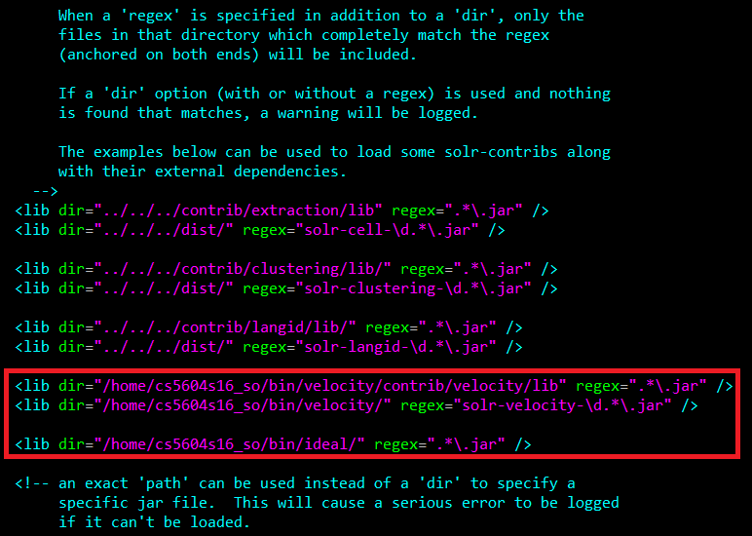
Solr: Component Configuration
Build and upload JAR(s) + dependencies to all Solr nodes
Register component in solrconfig.xml

Slide 13
Solr: Component Configuration
Build and upload JAR(s) + dependencies to all Solr nodes
Register component in solrconfig.xml
Update configuration and reload collection
  $ solrctl instancedir --update <collection_name> <collection_configuration>
  $ solrctl collection --reload <collection_name>

Slide 14
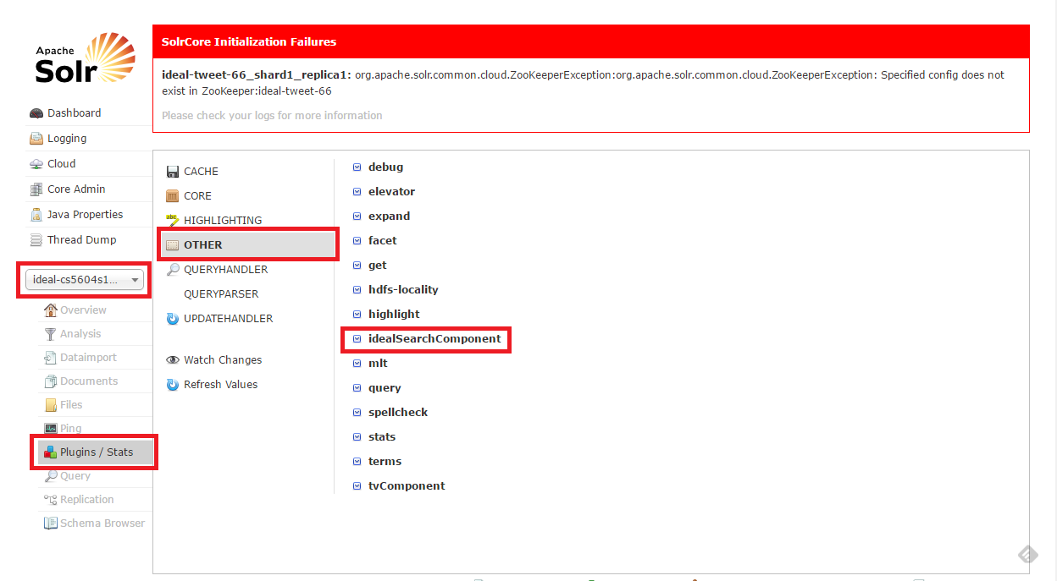
Solr: Component Verification

Slide 15
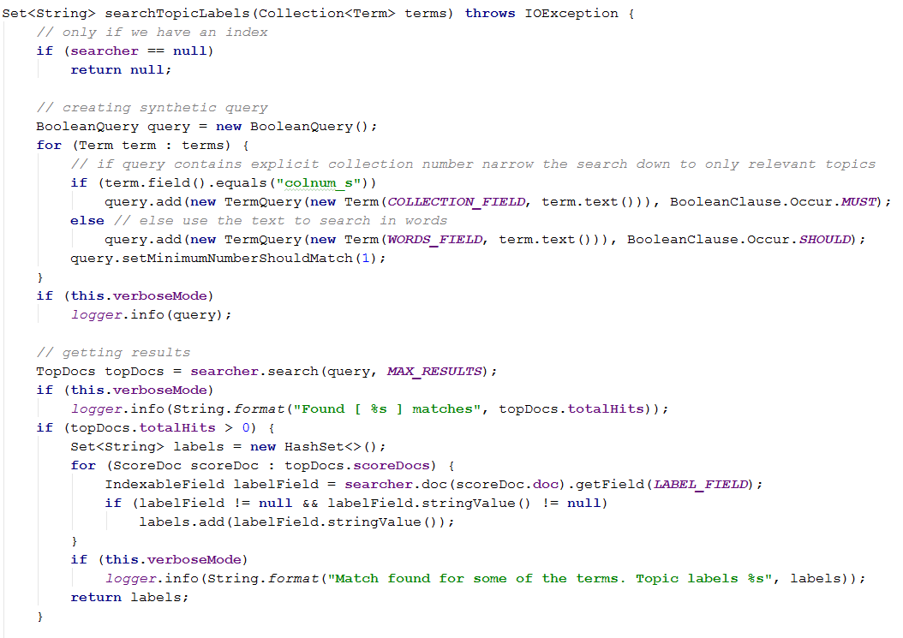
Query Manipulation
Query Expansion
  In-memory Lucene index based on ideal-cs5604s16-topic-words
  Schema: label, collection_id, words

Slide 16
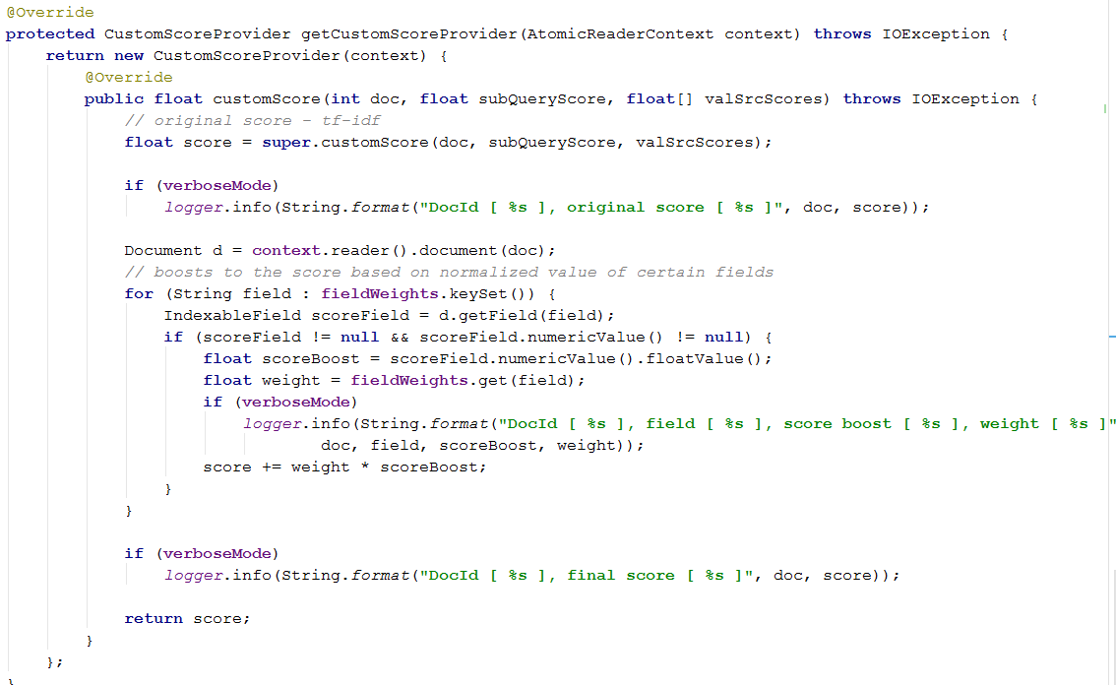
Query Manipulation
Re-ranking
  Tf-idf + weight ₁ * custom score ₁ + ...

Slide 17
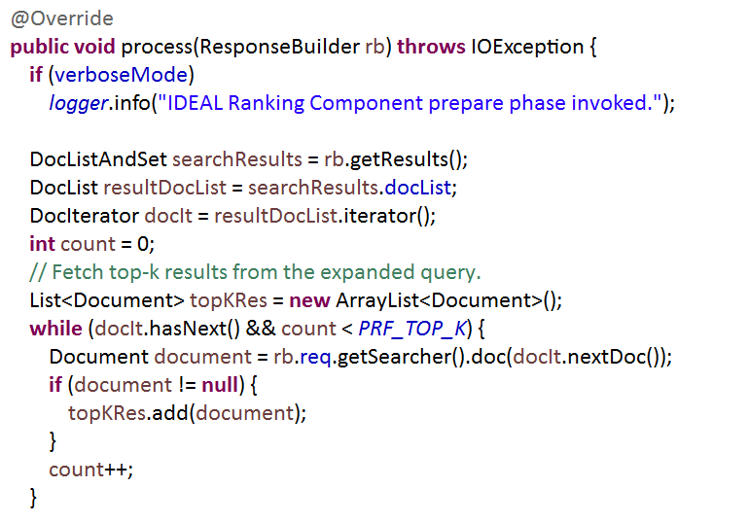
Pseudo Relevance Feedback

Slide 18
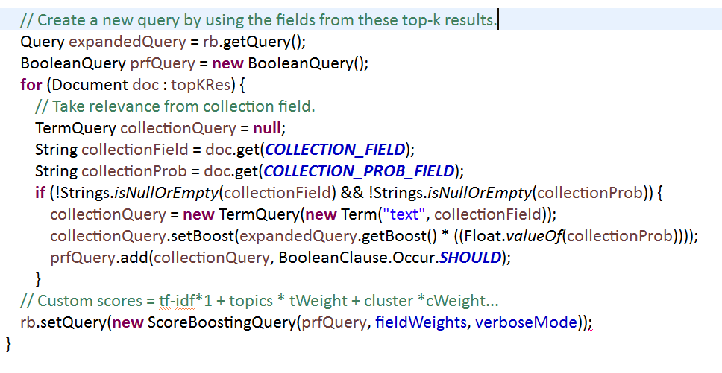
Pseudo Relevance Feedback

Slide 19
Problems Faced
Reflection, reflection, reflection
Lack of solid documentation
  attempt => failure
Cluster upgrade
  API versions mismatch
Getting the data into HBase from all teams
Pain to debug Solr on cluster
Insufficient access privilege to the cluster

Slide 20
Lessons Learned
Clear scope and requirement details
Clear contract and team deliverables
More effective communications
Future Work
1. Precision and Recall evaluation
2. Performance improvements
3. Calculate the weights for custom ranking

Slide 21
Acknowledgement
NSF grant IIS - 1319578, III: Small: Integrated Digital Event Archiving and Library (IDEAL)
Dr. Edward A. Fox
GRA: Sunshin Lee and Mohamed Magdy Farag
All other teams

