Slide 1
Clustering and Topic Analysis
Presenters: Abigail Bartolome, MD Islam, Soumya Vundekode
December 6, 2016
CS 5604 Information Storage and Retrieval, Fall 2016
Virginia Polytechnic Institute and State University
Blacksburg, VA 24061
Professor Edward A. Fox

Slide 2
Acknowledgements
Dr. Edward Fox and GRA Sunshin Lee
Digital Libraries Research Laboratory (DLRL)
Integrated Digital Event Archiving and Library (IDEAL) Grant:
IIS-1319578
Global Event and Trend Archive Research (GETAR) Grant:
IIS-1619028
All of the teams in CS 5604 Fall 2016
Topic Analysis Team of Spring 2016
Clustering Teams in Fall 2015 and Spring 2016

Slide 3
Goal
To use topic analysis and clustering algorithms on documents about real world events to extract topics discussed regarding the real world events and to find groupings of similar documents
Pull and Clean Documents, then Store in HDFS
Topic Analysis
Clustering
Evaluation

Slide 4
Classify Documents into Real World Events
LDA on Documents
K-Means Clustering on Documents
Document Topics
Topic Labels
Document Clusters
HBase
Use Topic Labels and Topic Probabilities to Label Clusters and Calculate Probabilities
REPORT RESULTS

Slide 5
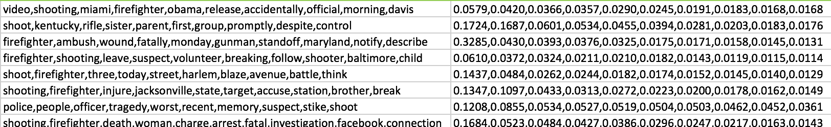
What is a Topic?
Distribution of words that describes a topic
Likelihood that a word belongs to a topic

Slide 6
Latent Dirichlet Allocation (LDA)
Input:
K Number of Topics, Number of Iterations, Input File
Output:
K Topics in 10 Word Distributions,
Topic Labels for K Topics, Corresponding Document Result File
Input File:
Document Identifier, Cleaned Text
Output File:
Document Identifier, Probabilities Corresponding to Respective Topics

Slide 7
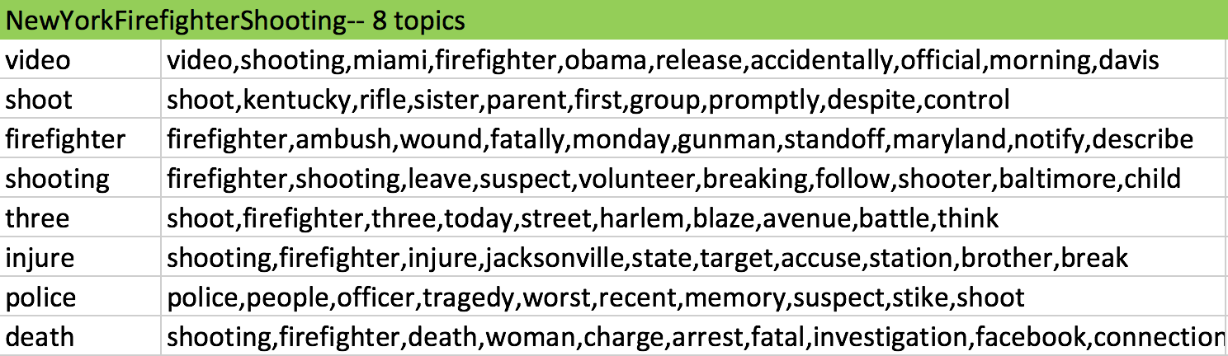
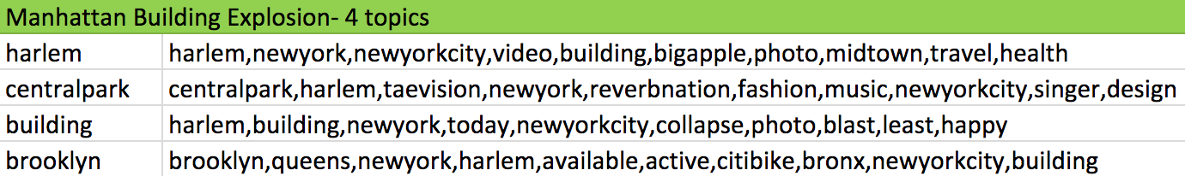
Topic Extraction

Slide 8
Topic Distributions for New York Firefighter Shooting
Tweet Identifier | P(Topic 1), P(Topic 2), P(Topic 3), P(Topic 4), P(Topic 5), P(Topic 6), P(Topic 7), P(Topic 8)
23-728176223734616064 RT @brendanredmond: @kevburkeie @CitizenGain @frankmcdonald60 @Giulia_Vallone agreeed - New York is taking it as an opportunity | 0.2815, 0.0775, 0.0806, 0.1441, 0.1652, 0.0795, 0.1003, 0.0714
43-284087471258615808 'Brother hang tight' wounded New York firefighter told as two colleagues lay ... - CNN | 0.0089, 0.0011, 0.2462, 0.0144, 0.0118, 0.7006, 0.0049, 0.0123
43-466357519523532801 RT @BillBishopKHOU: Houston firefighter arrested for allegedly telling co-workers he was "going to start shooting people." #KHOU | 0.0224, 0.0013, 0.2190, 0.0625, 0.2721, 0.0675, 0.1503, 0.2049

Slide 9
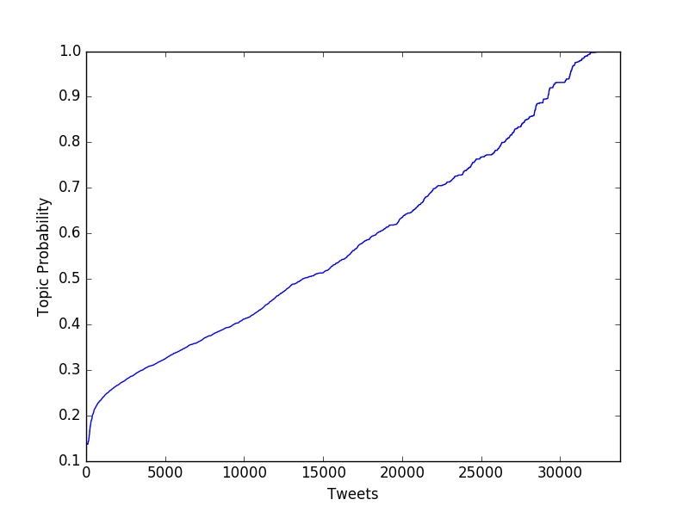
Likelihood that a Tweet Belongs to its Most Probable Topic for New York Firefighter Shooting

Slide 10
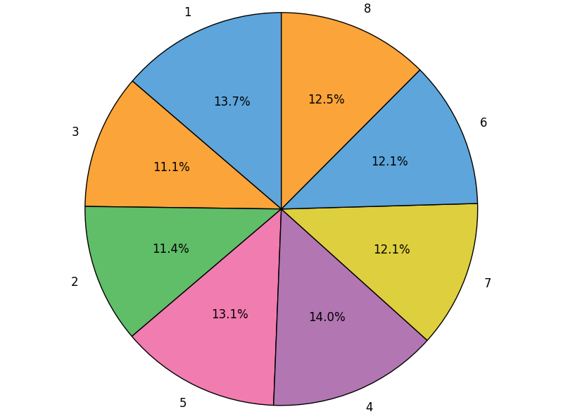
Distributions of Topics for New York Firefighter Shooting

Slide 11
K-Means Clustering
Feature extraction : Word2Vec
Tweet Identifiers,
Number of clusters (K)
Tweet Identifier, Assigned Cluster

Slide 12
K-Means Clustering - Input
Tweet ID | Tweet
42-279768965641797632 | ctshoot suspect brother take custody general question official say
42-280759867420069890 | live video new york city mayor michael bloomberg make announcement gun control
42-281559283785666563 | autofollow newtown one one one one fresh heartbreak hearse cri
42-282168798205853696 | shoot way door
42-287617832315912192 | gun show debate organizers tone down displays amid scrutiny chicago lead nation gun violence despite tough
42-291064820155969536 | senate take first step tighten gun controls

Slide 13
K-Means Clustering - Output
K = 6
Tweet ID | Cluster
42-281559283785666563 | 0
42-280759867420069890 | 2
42-287617832315912192 | 1
42-279768965641797632 | 3
42-291064820155969536 | 5
42-282168798205853696 | 4

Slide 14
Improving Clustering with Topic Analysis
Topic Analysis Results:
Topic Probabilities for each Document
Aggregation Matrix:
Tweet Identifier, Top 2 Topics, Corresponding Probabilities
Mean Topic Frequency Matrix:
Mean Probability and Frequency of Each Topic Per Cluster

Slide 15
Cluster | Topic1 | Topic2 | Topic3 | Topic4 | Topic5 | Topic6 | Topic7 | Topic8
'0' | 1304, 0.0123 | 16, 0.2365 | 12, 0.2597 | 76, 0.3677 | 67, 0.3330 | 15, 0.2789 | 1293, 0.9820 | 21, 0.3886
'1' | 2118, 0.4291 | 1917, 0.4732 | 1020, 0.3329 | 3757, 0.4035 | 2218, 0.3263 | 869, 0.5131 | 787, 0.3231 | 502, 0.2842
'2' | 1737, 0.3432 | 644, 0.5752 | 925, 0.4522 | 1307, 0.2970 | 1284, 0.4866 | 449, 0.5321 | 211, 0.4113 | 219, 0.3853
‘3' | 2966, 0.3934 | 544, 0.1530 | 7167, 0.2850 | 3211, 0.3421 | 1646, 0.3275 | 4738, 0.4051 | 3181, 0.2583 | 4939, 0.448
'4' | 1175, 0.3495 | 4728, 0.4354 | 1049, 0.3444 | 969, 0.2935 | 3194, 0.2907 | 829, 0.3041 | 2119, 0.4327 | 1165, 0.3759
'5’ | 62, 0.3107 | 327, 0.1498 | 36, 0.2762 | 68, 0.240 | 561, 0.6632 | 23, 0.3062 | 98, 0.2303 | 13, 0.2706

Slide 16
Cluster Probabilities
Cluster - Most frequent topics
Cluster | Topics
'0' | Topic 1, Topic 7
'1' | Topic 4, Topic 5
'2' | Topic 1, Topic 4
'3' | Topic 3, Topic 8
'4' | Topic 2, Topic 5
'5' | Topic 5, Topic 2

Slide 17
Cluster Probabilities
Cluster probability for each tweet = prob(Ta) + prob(Tb)
Where Tk : Probability of tweet belonging to Topic K
Tweet ID | Cluster | Cluster Probability
'45-689639327538675712' | 2 | 0.9620965254089693
'43-547709535268634625' | 5 | 0.27724837702230876

Slide 18
Automated Cluster Labeling
NewYorkFirefightershooting
Cluster 0 | video,shooting,police,people
Cluster 1 | shooting,firefighter,three,shoot
Cluster 2 | video,shooting,firefighter
Cluster 3 | firefighter,ambush,death,shooting
Cluster 4 | shoot,kentucky,three
Cluster 5 | three,shoot,kentucky
Use labels of the most frequent topics of the cluster for cluster labeling

Slide 19
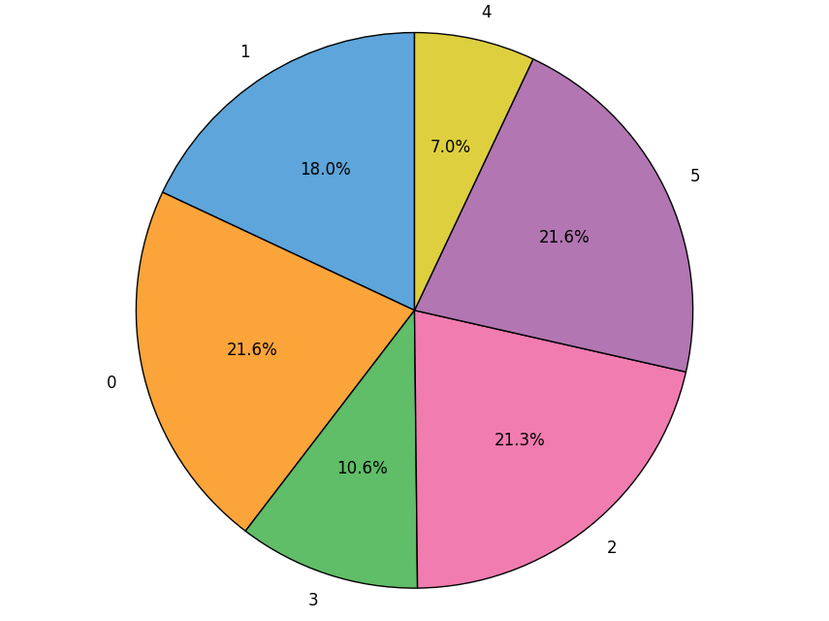
K-Means Clustering - Kentucky Accidental Child Shooting

Slide 20
Cluster Evaluation
Used cluster probabilities of tweets to pick K
Best case : Highest mean probability of tweets belonging to their assigned clusters.
Experiments :
K = 4, 5, 6
Picked most efficient value of K for each collection

Slide 21
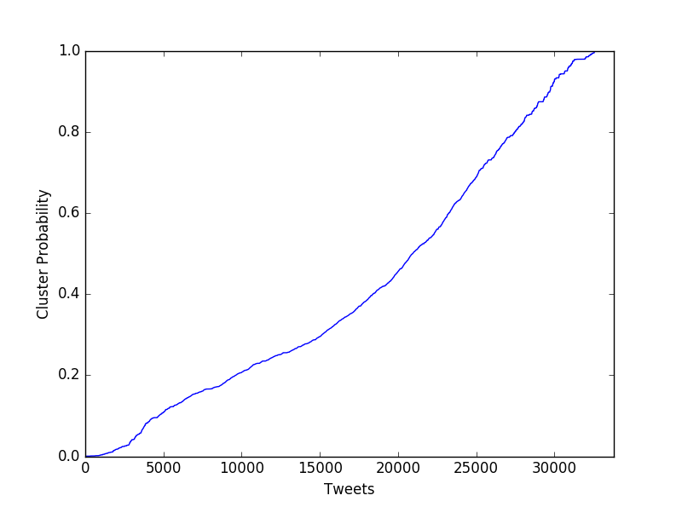
Cluster Probabilities

Slide 22
Cluster Labeling (Manually)
Manually group documents into subsets by similarity
Logically create clusters that are logically similar
Internal documents are as similar as possible
Internal documents are dissimilar from documents in other clusters

Slide 23
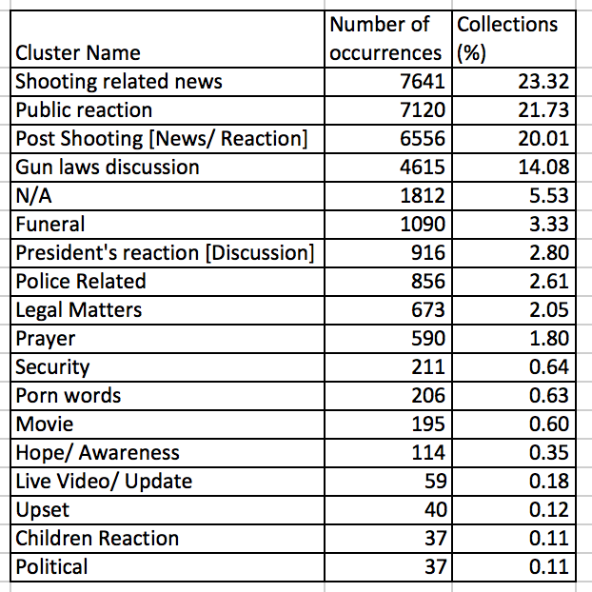
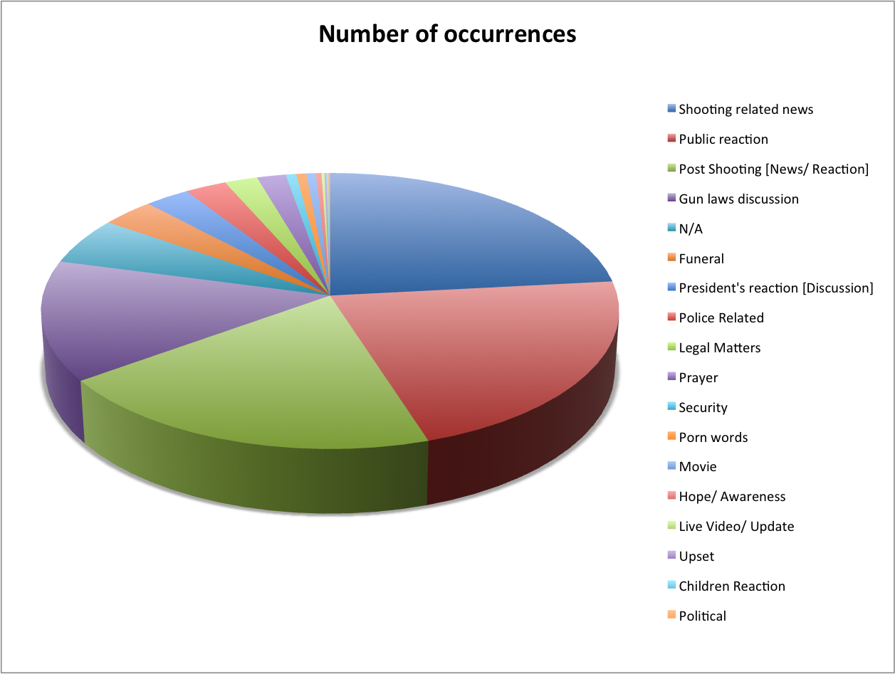
Manual Cluster Labeling Results
(Sandy Hook Elementary School shooting)
Notes:
32768

Slide 24
Conclusions
Extracted topics from collections of tweets about 9 real world events
Automatically labeled the topics and mapped the topic probabilities back to each tweet
Clustered tweets about 9 real world events and used the topic labels and probabilities to determine cluster labels and cluster probabilities
Compared clustering results to a collection that was manually clustered

Slide 25
Results

Slide 26
Real World Event | Number of Topics | Topics
NewYorkFirefighterShooting | 8 | Video, Shoot, Firefighter, Shooting, Three, Injure, Police Death
KentuckyAccidentalChildShooting | 8 | Field, Connecticut, Police, Throw, Wisconsin, Shoot, Sister
NewtownSchoolShooting | 8 | School, Kentucky, Harlem, Victim, Newtown, Obama, Report, Elementary
ManhattanBuildingExplosion | 4 | Harlem, Centralpark, Building, Brooklyn
ChinaFactoryExplosion | 8 | People, Sandy, Computer, Media, Black, Kentucky, Police, Hurricane
TexasFertilizerExplosion | 10 | Federal, Cause, Firefighter, Report, Boston, Video, Explode, Obama, First, Blast
HurricaneSandy | 8 | Manhattan, Amazing, Newyork, Isaac, Skyline, Speak, Brooklyn, Latest
HurricaneArthur | 8 | Sandy, Power, Merlin, Texas, Still, Minha, North, Missingmerlin
HurricaneIsaac | 8 | Sandy, School, Please, Power, Storm, History, Since, Victim

Slide 27
Real World Event | Number of Clusters | Clusters
NewYorkFirefighterShooting | 6 | “Video,shooting,police,people”,“shooting,firefighter,three,shoot”,“video,shooting,firefighter”,“firefighter,ambush,death,shooting”,“shoot,kentucky,three”,“three,shoot,kentucky”
KentuckyAccidentalChildShooting | 6 | “Police,trooper,connecticut,people”,“connecticut,people,throw,shoot”,“wisconsin,shoot,throw”,“sister,shoot,guard”,“shoot,guard,sister”,“field,percent,wisconsin,shoot”
NewtownSchoolShooting | 6 | “Report,school,newtown”,“harlem,school,report”,“school,newtown,victim”,“obama,school,newtown”,“kentucky,police,harlem,school”,“victim,school,newtown”
ManhattanBuildingExplosion | 6 | “centralpark,harlem,brooklyn,queens“,“harlem,newyork,building“,“building,harlem,centralpark”,“newyork,centralpark“,“harlem,newyork,brooklyn,queens”,“building,harlem,newyork”
ChinaFactoryExplosion | 5 | “media,think,hurricane,sandy”,“kentucky,state,computer”,“black,white,computer,kentucky”,“people,romney,police,rifle”,“sandy,hurricane”

Slide 28
Real World Event | Number of Clusters | Clusters
TexasFertilizerExplosion | 6 | “first,responder,report,massive”,“report,massive,firefighter,investigation”,“boston,bombing,firefighter,investigation”,“federal,still,firefighter,investigation”,“explode,firefighter,report,massive”,“cause,criminal,blast,facility”
HurricaneSandy | 6 | “skyline,manhattan,latest”,“newyork,manhattan,amazing”,“speak,manhattan,latest”,“skyline,manhattan,amazing”,“isaac,manhattan,speak”,“manhattan,harlem,speak”
HurricaneArthur | 6 | “minha,lindo,still,storm”,“sandy,death,texas”,“missingmerlin,merlin”,”north,storm,still”,”texas,sandy,power,canada”,”missingmerlin,merlin,texas,sandy”
HurricaneIsaac | 6 | “storm,right,power,sandy”,”school,sandy,history,deadliest”,”victim,sandy,history,deadliest”,”power,sandy,school”,”storm,right,history,deadliest”,”since,sandy,school”

