Slide 1
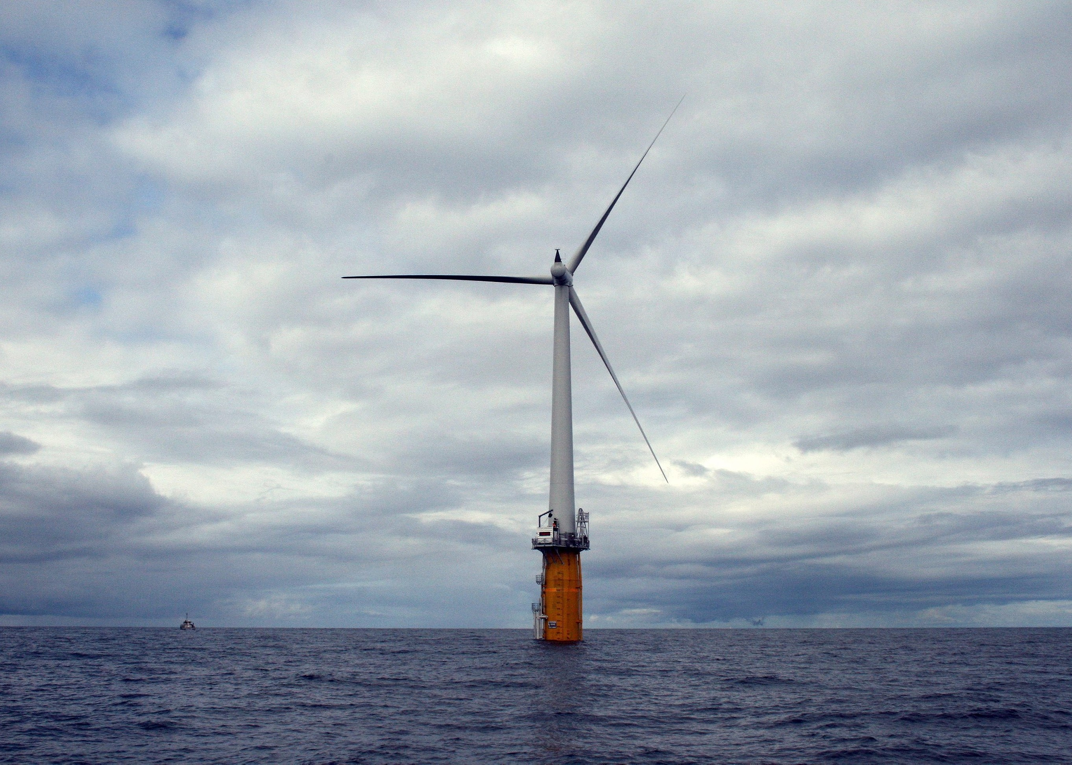
System-Level Simulation of Floating Platform and Wind Turbine Using High-Fidelity and Engineering Models
Image copyright © Mercator Media 2015
Di Zhang and Eric Paterson
Aerospace and Ocean Engineering
Virginia Tech
NAWEA 2015, 11th Jun 2015

Slide 2
Overview
Introduction
  Objectives
  Review
Approach
  Computational methods
  System geometry
  Test cases and flow conditions
  Computation resource
  Analysis methods
Preliminary Results
Conclusion and Future Work

Slide 3
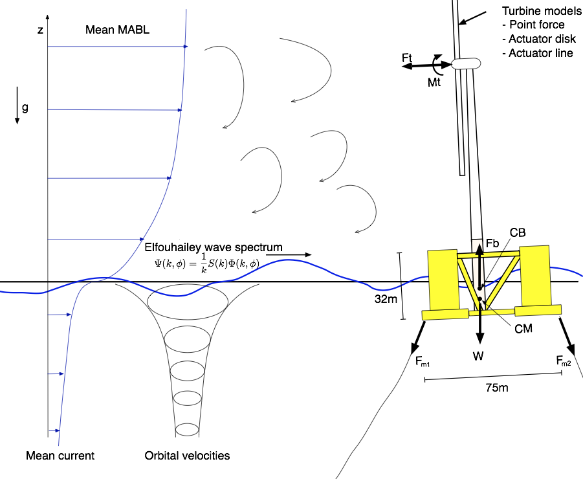
Objectives
Study the effect of mooring system on offshore wind turbine dynamics
  Full-system simulations, including mooring-line and turbine aerodynamics
  Based on OC3 configurations
Study the interaction of wave field and wind-turbine platform dynamics
  From linear waves to real wave fields
  Quantify impact of platform motion and waves on turbine inflow
  Validate against limited experimental data (OC3)
Analyze turbine performance near Virginia coastline
  Wave and meteorological data from statistics
Full hydrodynamic model

Slide 4
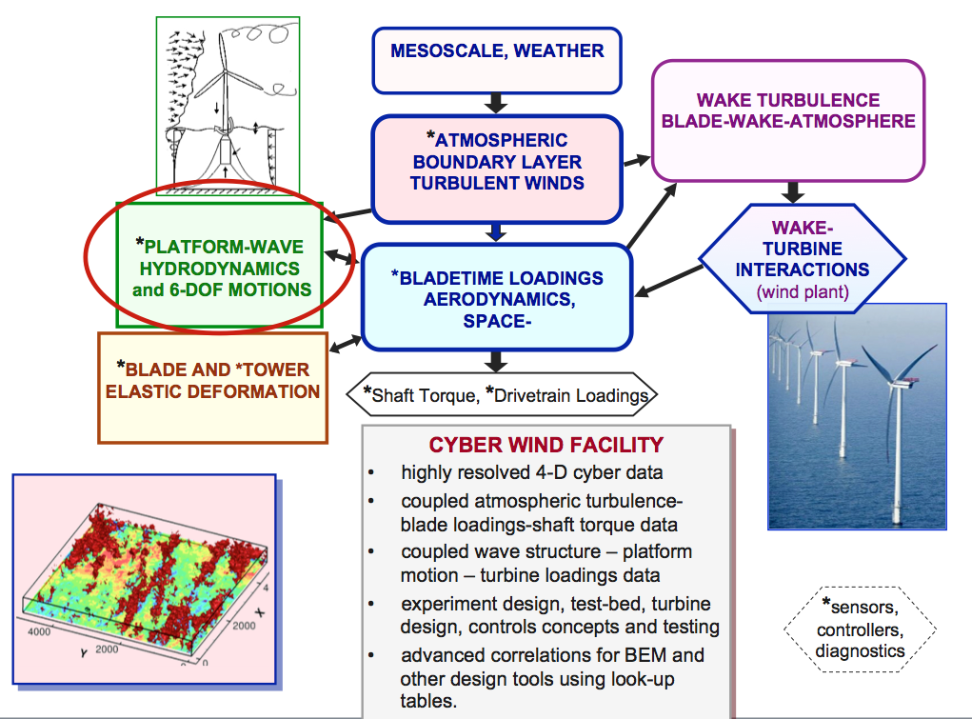
Review
Cyber Wind Facility

Slide 5
Review
Turbine platform hydrodynamics by CFD
  Dunbar et al. (2013) – coupled solver
  Calderer et al. (2014) – fluid structure interaction
Turbine and buoy
  Jonkman et al. (2009) - 5MW Turbine
  Jonkman et al. (2010) – OC3 spar buoy
Mooring line modeling
  Faltinsen (1990) – catenary line
Actuator Line model(ALM)
  Sørensen and Shen (2002) – ALM theories
  Churchfield et al. (2012) - SOWFA
  Jha et al., 2014 - CWF
Waves
  Jacobsen et al.(2012) – waves2Foam
Offshore statistics
  National Buoy Data Center(DBDC)
Cyber Wind Facility(CWF)
  Vijayakumar et al. (2014) – blade aerodynamics module
  Jha et al. (2013) – wake modulations module
  Motta-Mena et al. (2013) – structural dynamics module
  Dunbar et al. (2014) – hydrodynamic module
Image copyright © Statoil 2015
Image copyright © NBDC 2015

Slide 6
Project Approach
Implementation steps:
  Generate surface wave with wave2Foam library and inspect the platform response: Done
  Implement mooring line model in CFD code: Done
  Integrate ALM with multi-phase solvers: Done
  Run simulations on the cases with OC3 configurations: In-progress
  Incorporate mooring line model and ALM with tightly-coupled 6DOF solver: Under-development

Slide 7
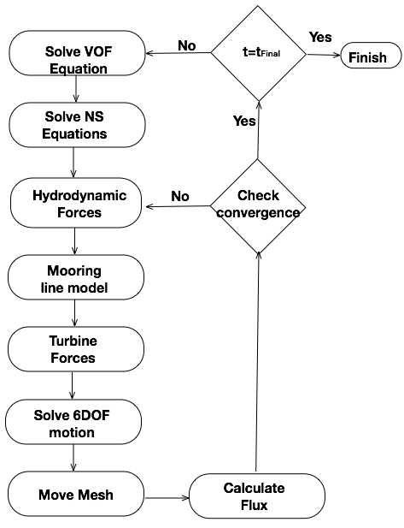
Multiphase CFD + 6DOF solver
CFD solver: interDyMFoam
  Two-phase incompressible solver
  Interface tracking technique with Volume of Fluid (VOF) field alpha
  Pressure Implicit with Splitting of Operator(PISO) algorithm solves the pressure-velocity coupled system
  Coupled with 6DOF solver:
    Extract force and moment from pressure and viscous effects
    Calculate acceleration according to the mass of the object
    Move center of mass
    Rotate and translate patches
  Tightly-coupled solver introduces inner loop for algorithm stability under large structure displacement (Dunbar et al. 2013)

Slide 8
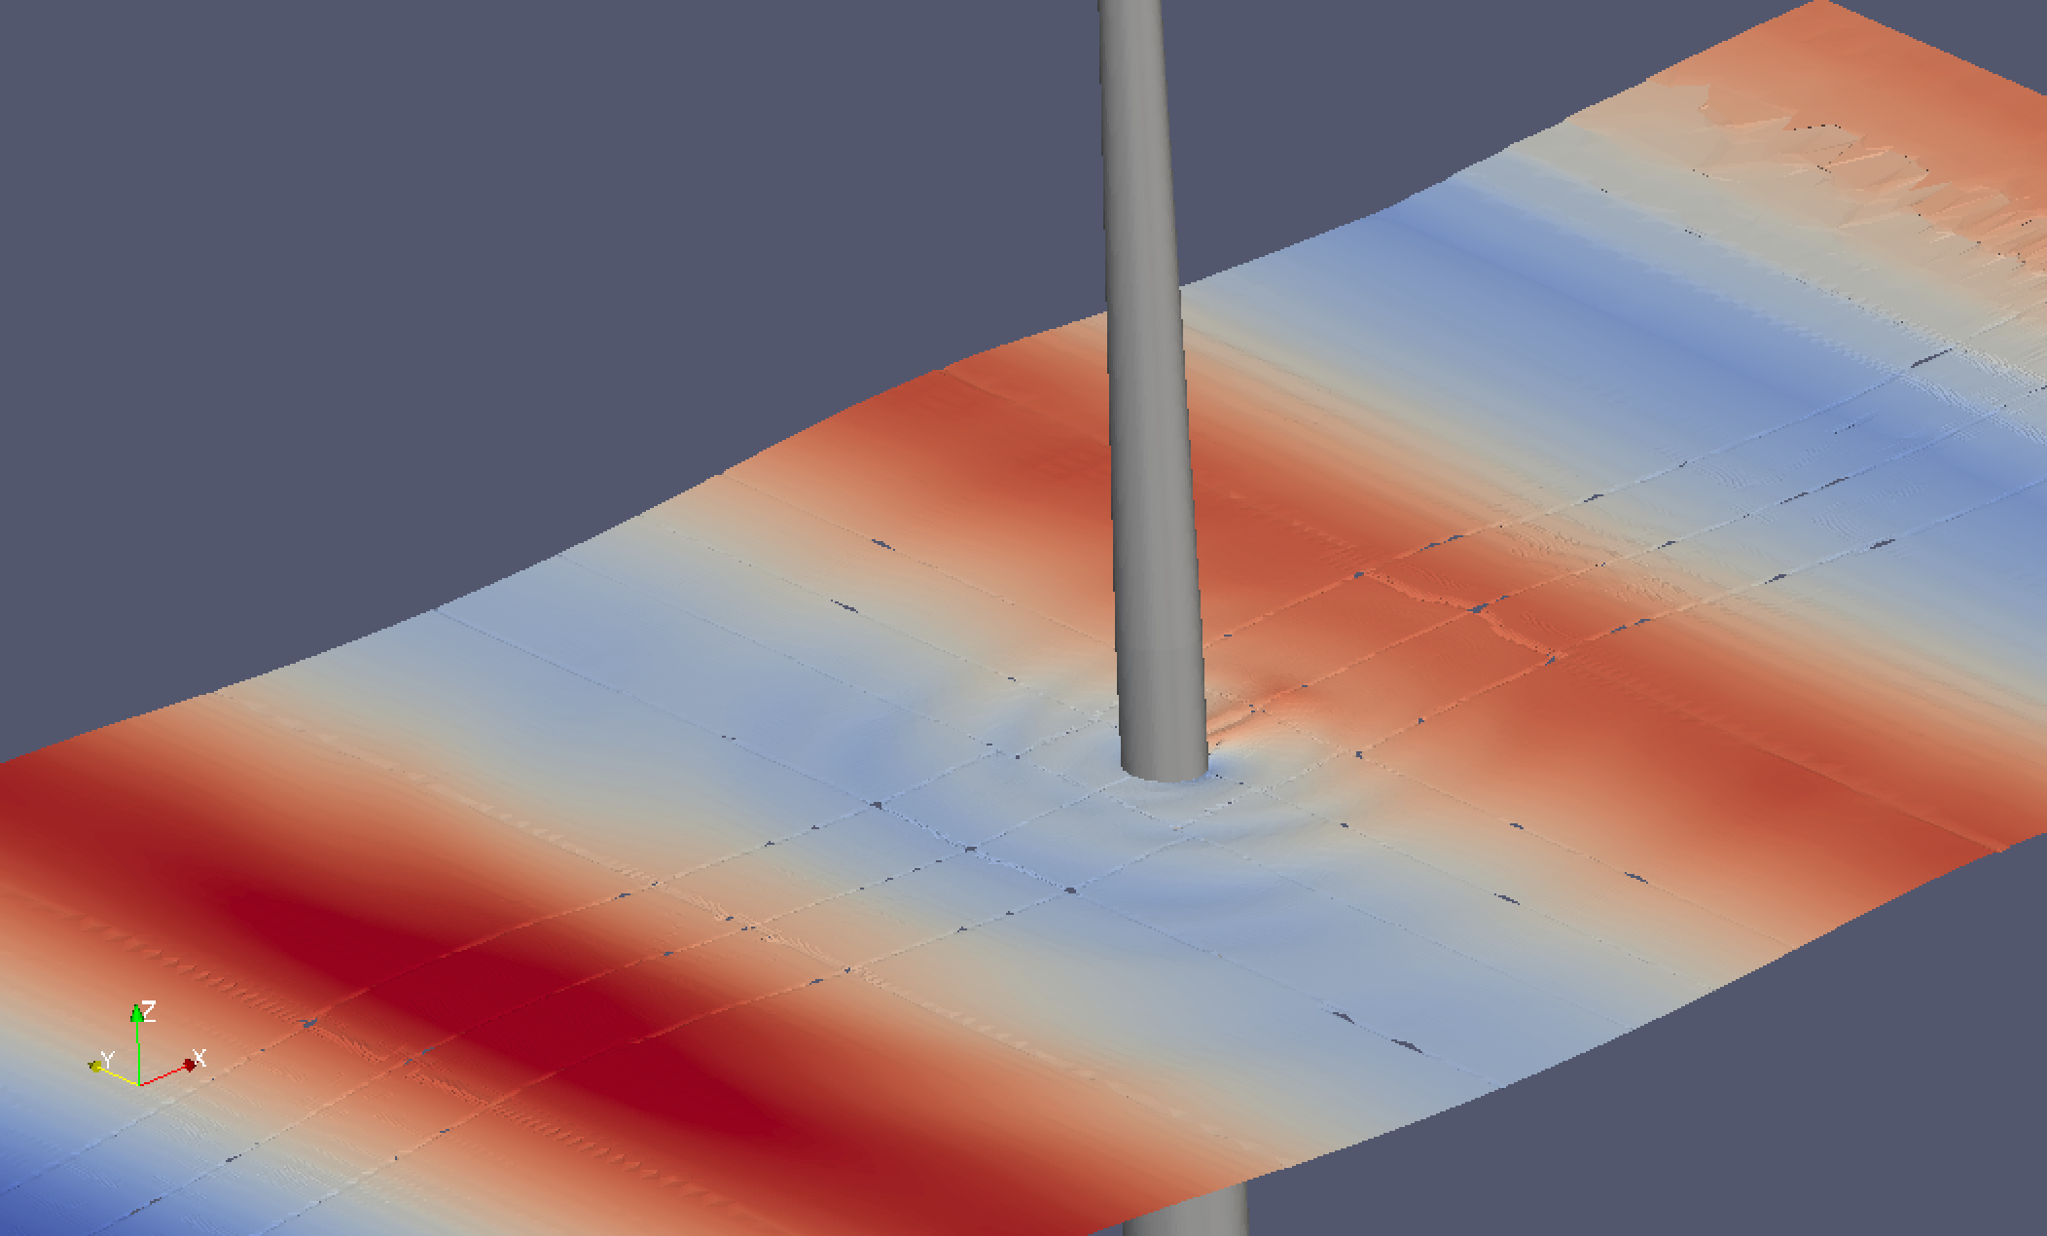
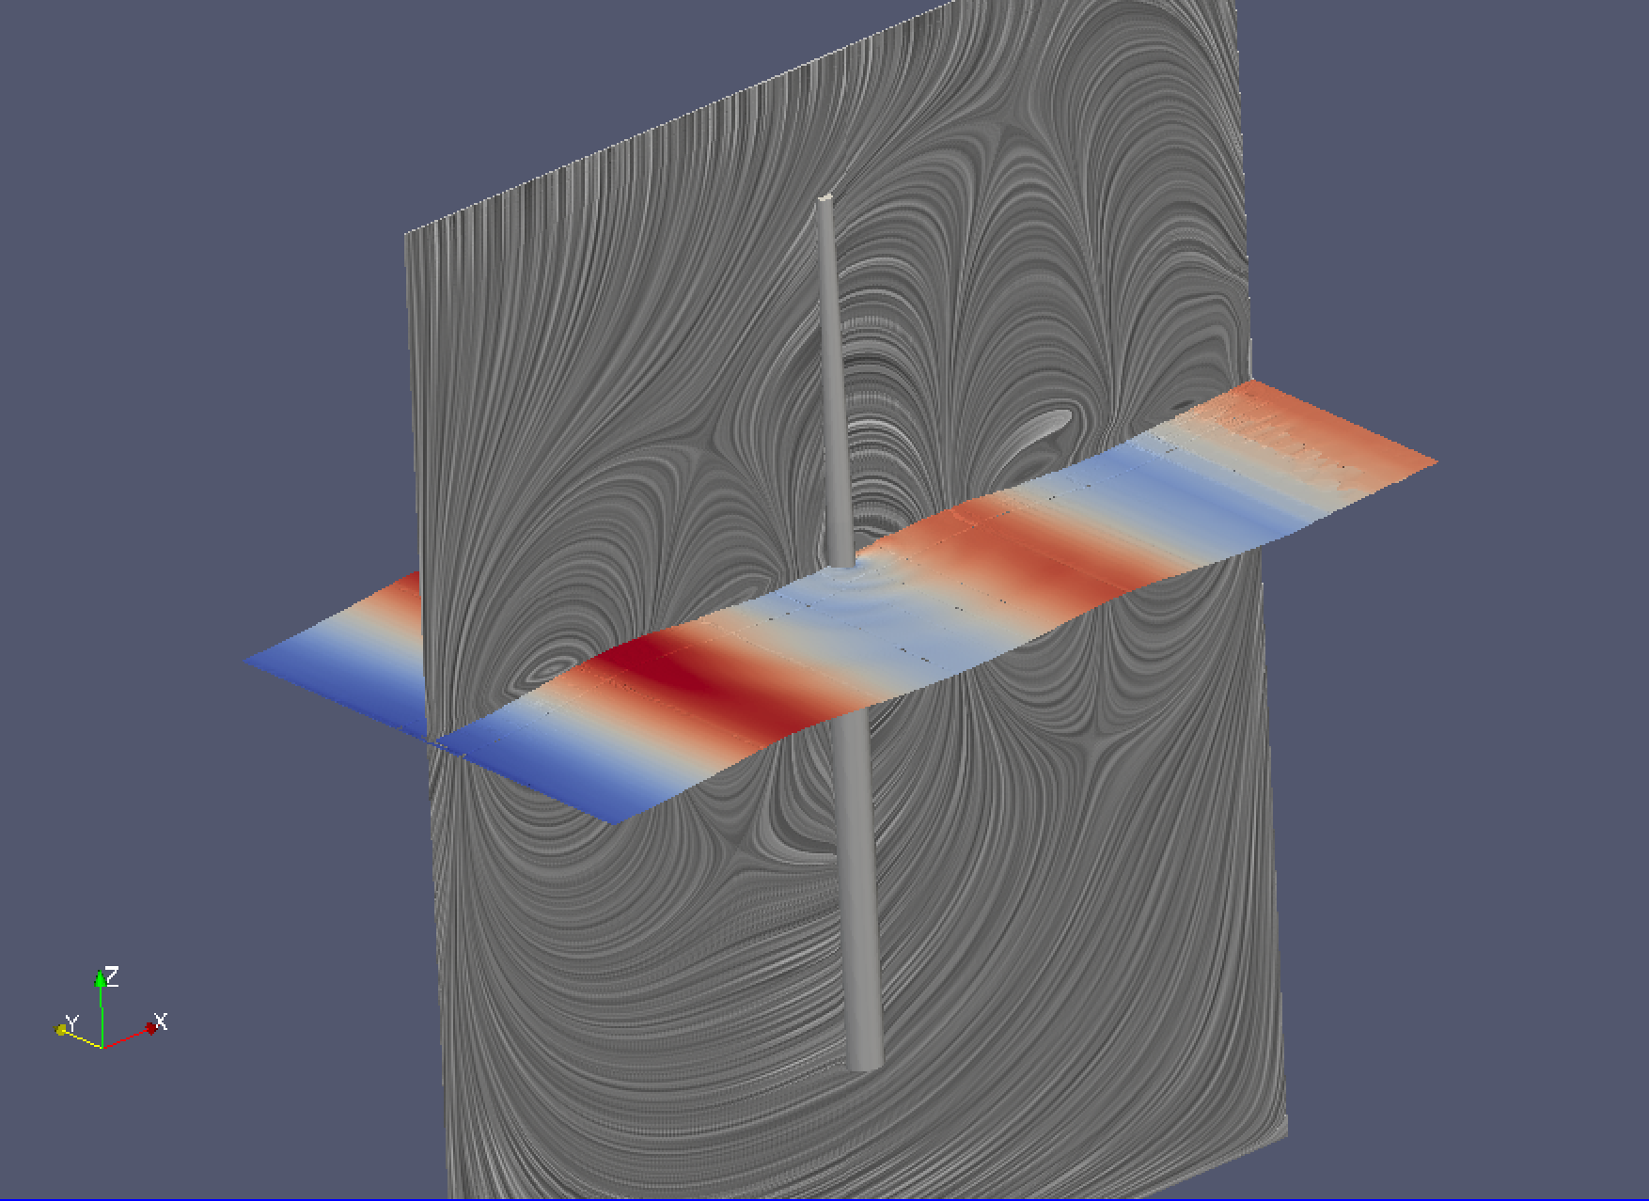
waves2Foam
Wave elevation on free surface (H=7m, L=90m)
Waves2Foam: wave generating toolbox
  Common wave theories
    Potential current
    Regular waves: Stokes wave
    Solitary wave
    Irregular waves
  Boundary conditions apply wave theories to corresponding field
  Relaxation zones control wave reflections on boundaries
  Utilities that initialize wave field
Wave forces on OC3 spar buoy has been studies by direct CFD and Morison equation
  Morison equation is a pure empirical approach
Wave elevation on free surface with wave-induced circulations in y–plane (H=7m, L=90m)

Slide 9
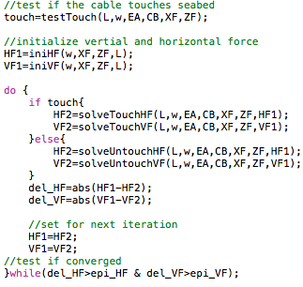
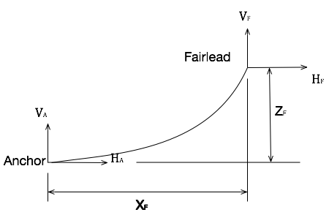
Mooring-line model
Quasi-static mooring line
  Based on catenary line equation
  Mooring system dynamics are ignored
  Mooring force is calculated at each time step according to current geometry
Pseudo code of mooring-line model implementation in OpenFOAM
Catenary Mooring line

Slide 10
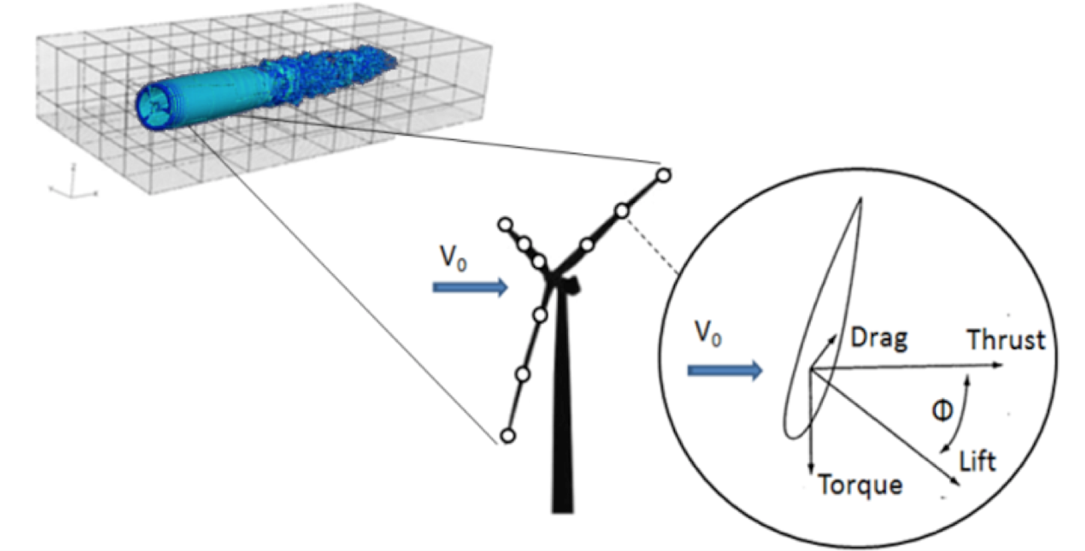
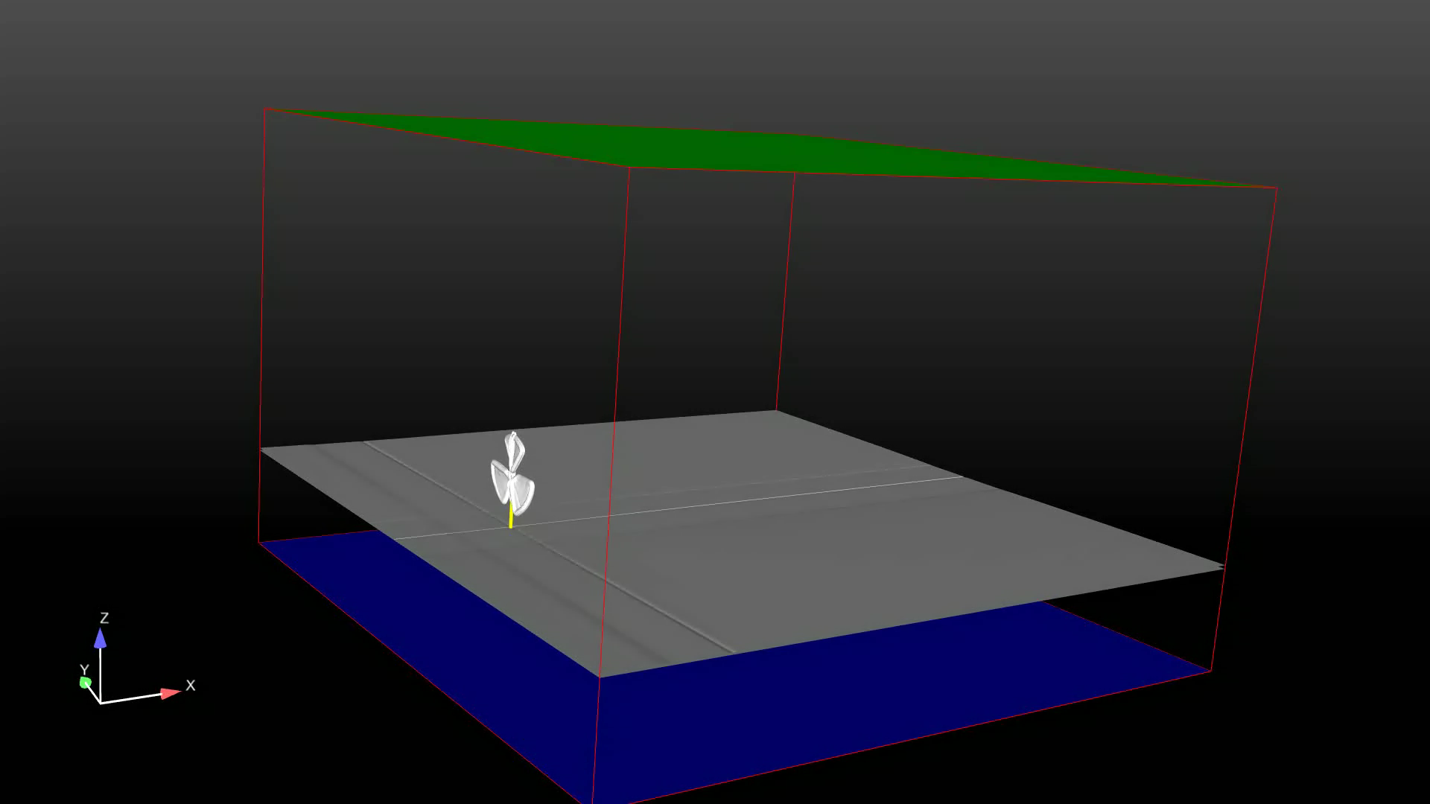
Actuator-Line Model
Actuator Line Model (ALM) – Pankaj / Churchfield
  Discretize each blade into sections, assume uniform blade configuration and flow condition for each section
  Sectional force of each element is calculated according to local flow conditions and airfoil lookup table
  Spread sectional force from each element by Gaussian distribution as additional body force at each cell
Multiphase solver with ALM was tested
Image copyright © Jha 2015

Slide 11
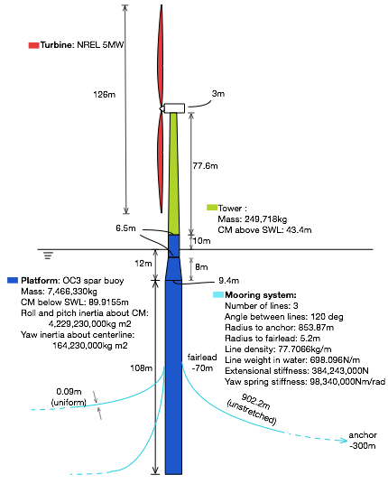
OC3 System Geometry
NREL 5MW turbine
  Diameter: 126m
OC3 spar buoy
  Total draft: 120m
  Weight: 7,466,330kg
Uniform mooring cables
  Fairlead at 70m below Still Water Line(SWL)
  Anchor point at 320m below SWL
  853.87m from buoy centerline to anchor
  The vertical force on buoy is -1.66e6N

Slide 12
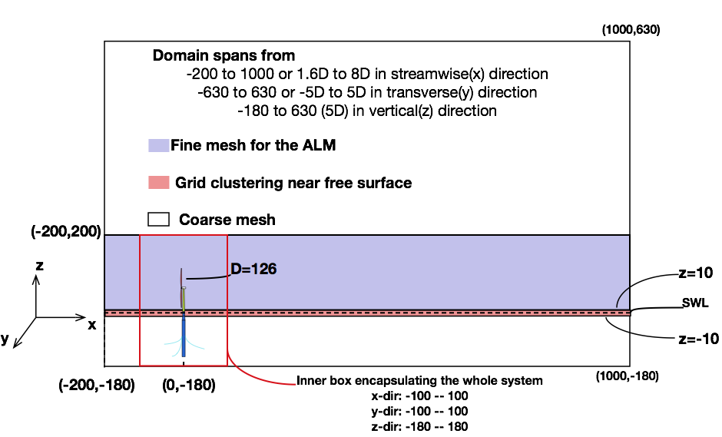
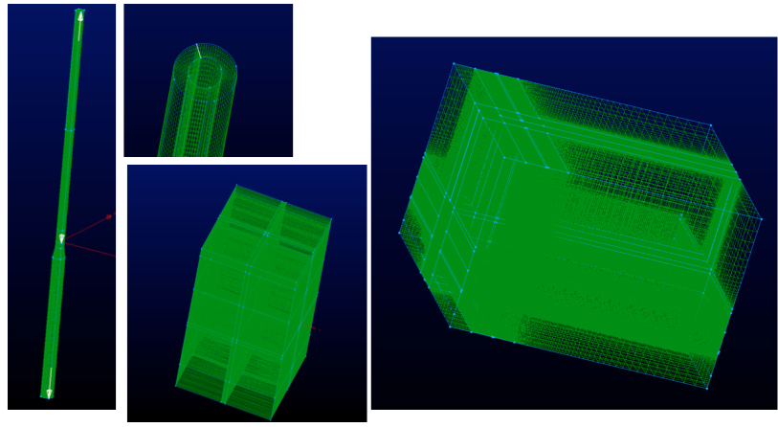
Test Cases and Flow Conditions
In order to study the effect of free surface on turbine performance, 6 cases are tested:
  LES: Smagorinsky
  DES: SpalartAllmarasDDES
  RANS: Standard SpalartAllmaras
Domain is cut at the SWL (z=0) for cases with solid surface
Flow conditions:
  U=8m/s uniform in air
  Water is kept still
  Structure is fixed
Computational domain with free surface
Free surface | LES | DES | RANS
Level ground | LES | DES | RANS

Slide 13
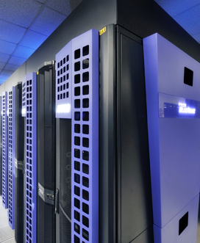

Computational Resource
All simulations are supported by Advanced Research Computing(ARC) in VT
  Blueridge: 408-nodes Cray cs-300 cluster
    Release in 2013
    Two octa-core Intel Sandy Bridge CPUs per node
    64 GB of memory per node
  Each case is ran on 64 cores
    7.2 millions cells for free surface cases
    1.12e5 cells/core
  Simulation walltime is set to 72-hours
    Initial turbine rotational speed ad 11rpm
    Approximately 9.7rpm in steady state
    Simulation runs until ≈120s
    0.6hour/revolution
  Post-processing by Ensight
    Parallel client-server using 4 cores
Image copyright © ARC VT 2015
Image copyright © ARC VT 2015

Slide 14
Analysis
  The following fields will be analyzed:
    Time history of thrust, torque on turbine blades
    Diagnose angle-of-attack vs. radius over turbine rotation
    Turbine wake at x/D = 0.5, 1.0, 2.0
      Instantaneous U, TKE, vorticity
      Mean U, TKE, vorticity
    Surface shear stress and limiting streamlines on ground and water free surface
    Wave field generated by turbine aerodynamics and platform hydrodynamics

Slide 15
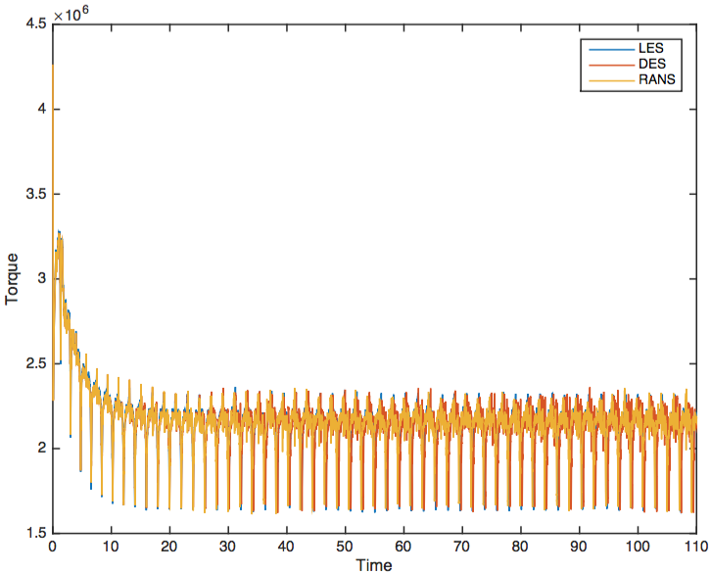
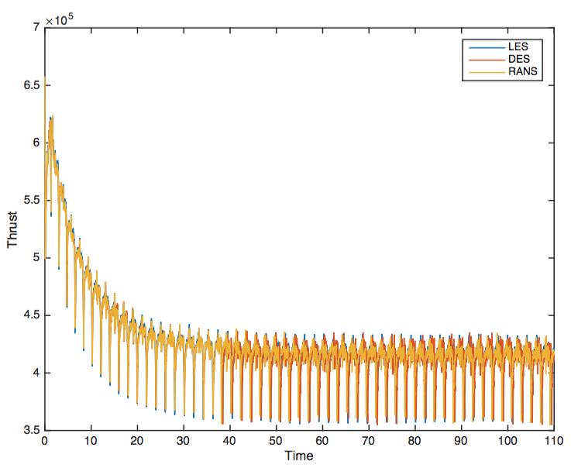
Preliminary Results
  Turbine Thrust of the cases with level ground surface
  Turbine Torque of the cases with level ground surface

Slide 16
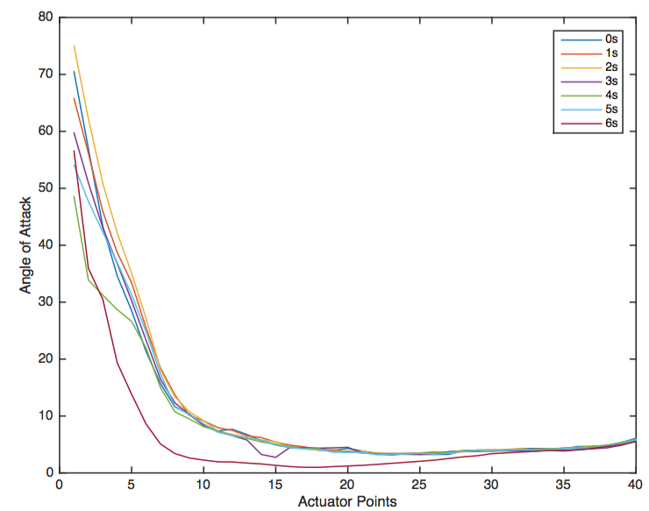
Preliminary Results
Angle of attack at each actuator point of turbine blade over one rotation

Slide 17
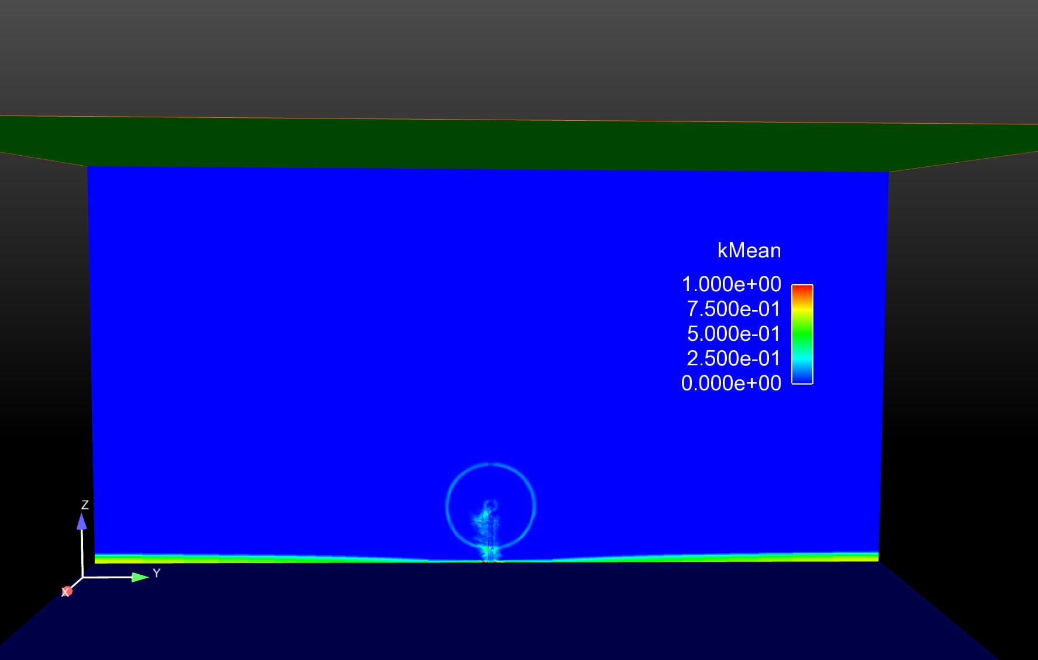
Preliminary Results
Mean turbulence kinetic energy 0.5D downstream

Slide 18
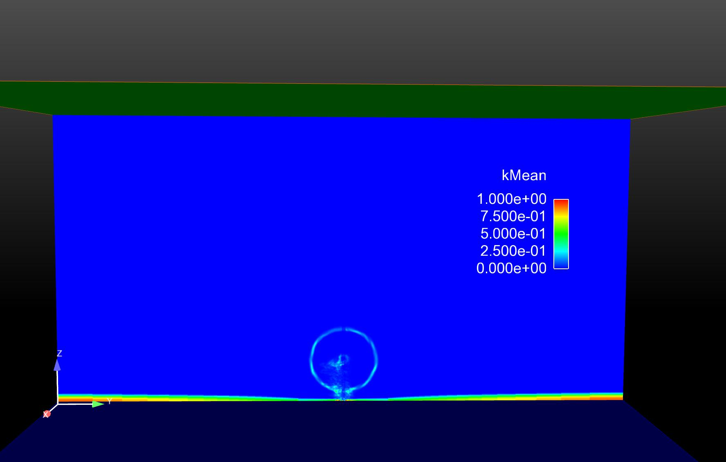
Preliminary Results
Mean turbulence kinetic energy 1D downstream

Slide 19
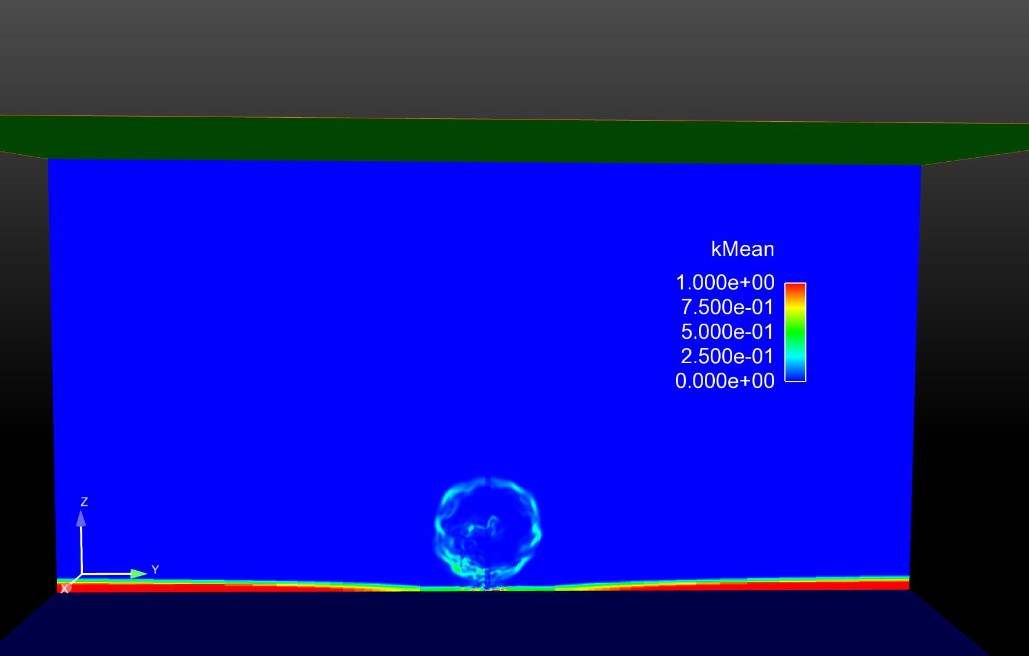
Preliminary Results
Mean turbulence kinetic energy 2D downstream

Slide 20
Conclusion and Future Work
The implementation of mooring-line model in OpenFOAM provides restoring force for the platform, further validation is needed(NREL’s HydroDyN).
Actuator Line Models works with multiphase solver, studies on turbine-wave interactions can be conducted bases on it.
Use of robust HPC resources at VT-ARC gives good turn-around.
Current multiphase solver was proven to be unstable under large structure displacement, tightly-coupled solver will be adopted in future work.
waves2Foam supports various long-crest wave theories, in order to model statistical conditions, it needs to be extended for directional spectrum and short-crested wave model.

Slide 21
Reference
Calderer, A., Guo, X., Shen, L., Sotiropoulos, F. 2014 Coupled Fluid-Structure Interaction Simulation of Floating Offshore Wind Turbines and Waves: A large Eddy Simulation Approach, Journal of Physics: Conference Series 524(2014)012091
A. Dunbar, E. Paterson, B. Craven, J. Brasseur CFD Experiments for Wind-Turbine- Platform Seakeeping Models and Flow Physics. 66th Annual meeting of APS 2013.
J. Jonkman, S. Butterfield, W. Musial, G. Scott Definition of a 5-MW Reference wind Turbine for Offshore System Development Technical Report, NREL/TP-500-38060, Feb 2009.
J. Jonkman Definition of the Floating System for Phase IV of OC3 Technical Report, NREL/TP-500-47535, May 2010.
O.Faltinsen SeaLoadsonShipsandOffshoreStructures.CambridgeUniversityPress1990.
J. Sørensen, W. Shen Numerical Modeling of Wind Turbine Wakes Journal of Fluids Engineering, Vol. 124, Jun, 2002.
M. Churchfield, S. Lee, P. Moriarty NWTC Information Portal (SOWFA). https://nwtc.nrel.gov/SOWFA. Last modified 31-March-2015 ; Accessed 06-June-2015
P. Jha, M. Churchfield, P. Moriarty, S. Schmitz Guidelines for Volume Force Distributions Within Actuator Line Modeling of Wind Turbines on Large-Eddy Simulation-Type Grids. Journal of Solar Energy Engineering, Vol. 136, Aug 2014.
N. Jacobsen, D. Fuhrman, J. Fredsøe A wave generation toolbox for the open-source CFD library:OpenFoam. Int. J. Numer. Meth. Fluids 2012.

Slide 22
Reference
Vijayakumar, G., lavely, A., Jayaraman, B., Craven, B., Brasseur, J. 2014 Blade Boundary Layer Response to Atmospheric Boundary Layer Turbulence on a NREL 5MW Wind Turbine Blade with Hybrid URANS-LES, 32nd ASME Wind Energy Symposium, 13-17 January 2014, National Harbor, MD, AIAA 2014-0867
Jha, P., Schmits, S. 2013 An Actuator Curve Embedding Method to Model Wind Turbine Wakes, American Physical Society DFD Meeting
Motta-Mena, J., Jha, P., Campbell, R., Schmitz, S., Brasseur, J.G. 2013 Coupling the Actuator Line and Finite Element Methods to Model Fluid Structure Interaction of a Commercial Wind Turbine in the Atmosphere, (abstract) Bull. Amer. Phys. Soc. 58 (18)
Dunbar, A., Craven, B., Paterson, E., Brasseur, J. 2014 Application of a Tightly-Coupled CFD/6DOF Solver for Simulating Offshore Wind Turbine Platforms, 2nd Symposium on OpenFOAM in Wind Energy, May 19-21, 2014, Boulder, Colorado, USA.

