Slide 1
Twitter Disaster Behavior
Group 15
Kayley Bogemann, Shane Burchard, Jessie Butler, Austin Spencer, Taylor Thackaberry
CS 4624: Multimedia, Hypertext, and Information Access
Dr. Fox
Virginia Tech, Blacksburg, VA 24061
April 30, 2020
Notes:
Speaker: Jessie
Plan on 11 minutes
"The final presentation will cover testing and assessment, as well as deliverables, accomplishments, lessons learned, and ideas for the future." It will be a summary of the work and results of your project.

Slide 2
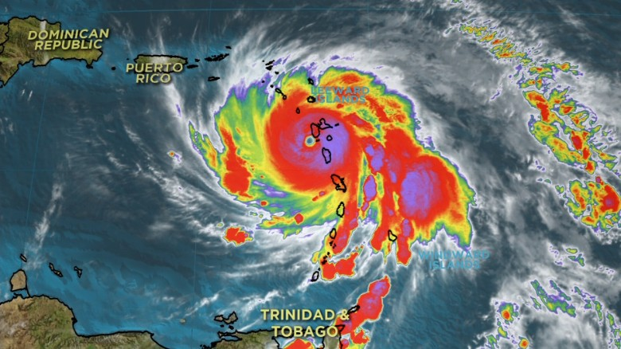
Outline
Topics to be discussed:
Project Recap
Work Completed
Project Timeline
Topic Analysis
Deliverable: Poster
Conclusions
Lessons Learned
Future Work
Acknowledgments
References
Image Source: https://cdn.cnn.com/cnnnext/dam/assets/170919021311-hurricane-maria-screengrab-category-4-091917-0200-exlarge-169.jpg
Notes:
Speaker: Jessie

Slide 3

Project Recap
Overall Goal: Identify patterns in behavior during and following natural disasters
Organize this data with graphs and maps
Communicate data to researchers
Gather data from social media, specifically Twitter
Our research specific to recent Puerto Rico earthquakes and Hurricane Maria
Notes:
Speaker: Jessie

Slide 4
Project Timeline
Date | Description
January 29, 2020 | Began word frequency analysis on an initial, smaller set of data
February 4, 2020 | Created smaller dataset of tweets containing geotags
March 2, 2020 | Completed word frequency analysis for final datasets of earthquake and hurricane twitter data
March 4, 2020 | Completed draft of ISCRAM poster
March 30, 2020 | Created map of geotag location changes during and after earthquake and hurricane
April 6, 2020 | Conducted topic analysis on all tweets related to earthquake
April 20, 2020 | Completed analysis on topics discussed by individuals vs organizations
April 26, 2020 | Initial submission to VTechWorks
April 30, 2020 | Final presentation
Notes:
Speaker: Taylor

Slide 5
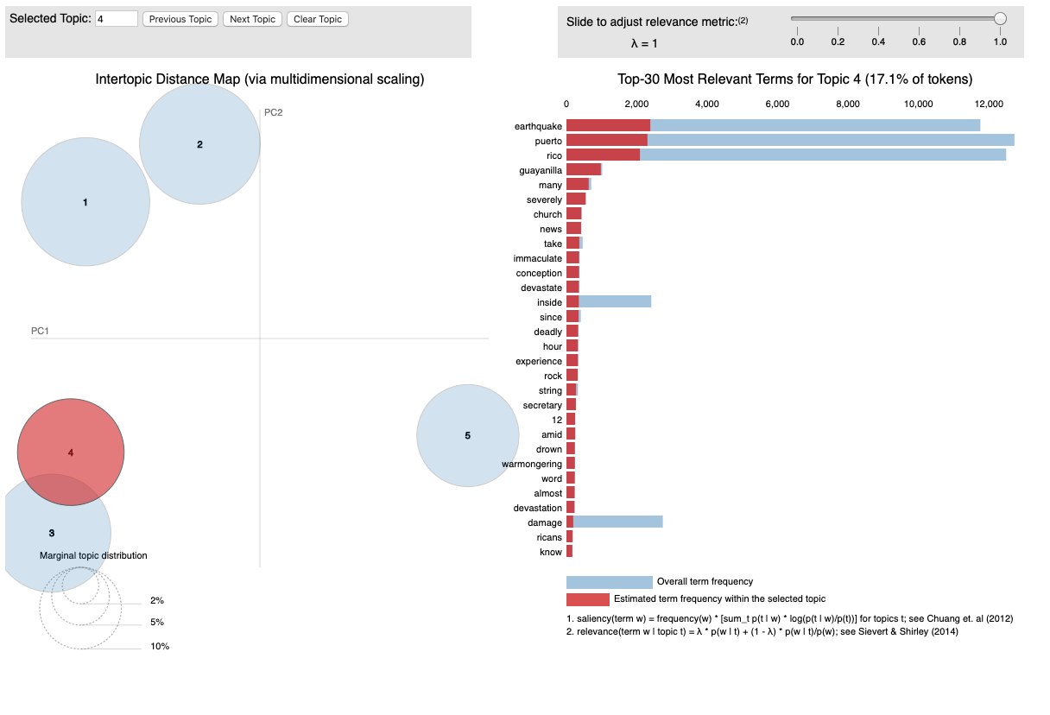
Topic Analysis
Identified most common topics in tweets
Separated tweets from individuals vs. brands/companies
Visualization identifies 3-5 topic groups for 1-word, 2-word, and multi-word topics
Notes:
Topic Analysis - we identified the most common topics in the tweets. We separated the tweets between personal accounts, and verified accounts like news sources or companies. The visualization identifies groups of topics that have similar words, and analysis is done on the most common one-word, two-word, and multi-word topics.

Slide 6
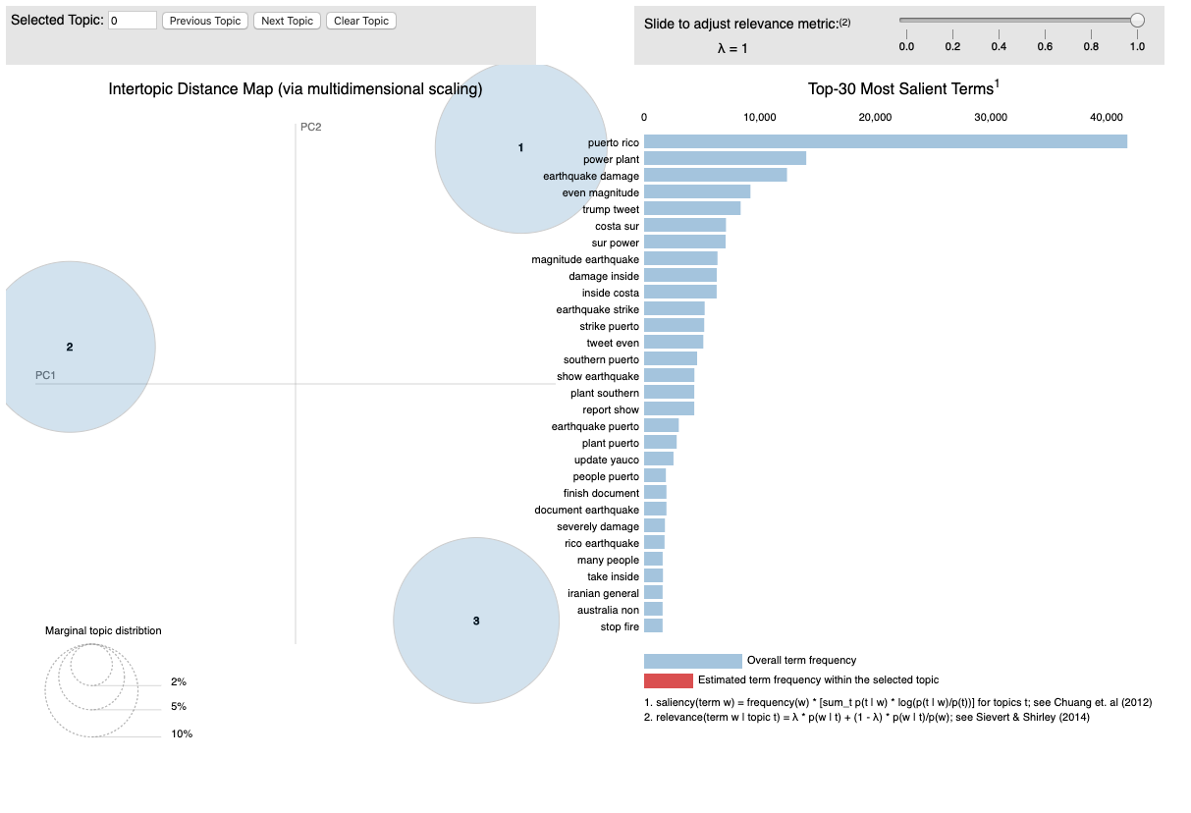
Notes:
This is an example of two-word analysis on verified or brand accounts. The three circles represents topic groups, in this case Group 1 focuses on power plants and loss of electricity, Group 2 focuses more on the magnitude and severity of the earthquake, and Group 3 focuses generally on damage from the earthquake. The Top 30 terms lists shows phrases like “power plant”, “magnitude earthquake”, and “damage inside”.

Slide 7
Topic Analysis - Earthquake
 | Individual | Brands / Official Accounts
One Word | power, electricity, magnitude, aftershock, devastation, health | emergency, damage, deadly, response, tremor, electricity
Two Word | church guayanilla, people homeless, trump administration, worst earthquake | power plant, without power, state emergency, damage inside, public health,
Multi Word | earthquake aftershock power, thousands residents sleep car, waiting federal aid | public health emergency response, thousands people homeless, power outage effects, withhold aid
Notes:
After completing the analysis and visualizations, we noticed some differences between how individuals and official accounts discuss the earthquake. Both types of accounts mentioned power outages, as that was the main side effect of the earthquake. Both types mentioned homeless as a result of the earthquake, but individual accounts emphasized this more, with phrases such as “thousands of residents sleeping in their cars”. Official accounts talked more generally about the government, public health and emergency response. Individual accounts talked about government response as well, but focused more on people waiting for federal aid, and individuals tended to specifically mention the trump administration. Another topic that was more popular among individuals was a church in guayanilla that was damaged as a result of the earthquake, that was a very popular topic that probably resonated with residents of puerto rico.

Slide 8
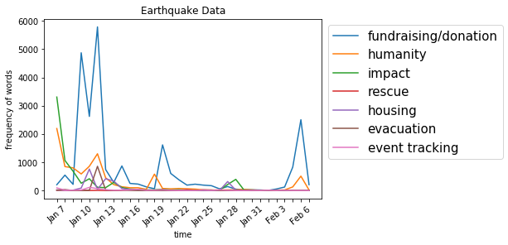
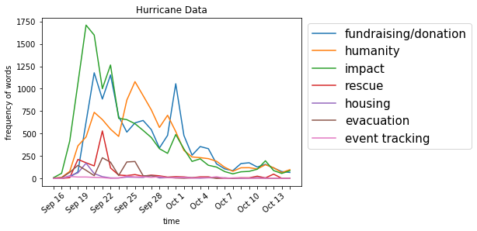
Deliverable: Poster
Small visual updates
Updated graphs to highlight interesting trends
“Prepare” didn’t make sense for an earthquake
Submitted findings in document form to ISCRAM website
Poster submitted along with final report to VTechWorks
Notes:
After receiving feedback on our poster, we made a few improvements - including altering certain graphs and bolding keywords. Since earthquakes cannot be predicted and, therefore, cannot be prepared for, the two graphs highlighting preparation only were removed. After finalizing the poster, we submitted it to VTechWorks with our final report and submitted a write up on the poster to the conference website.

Slide 9
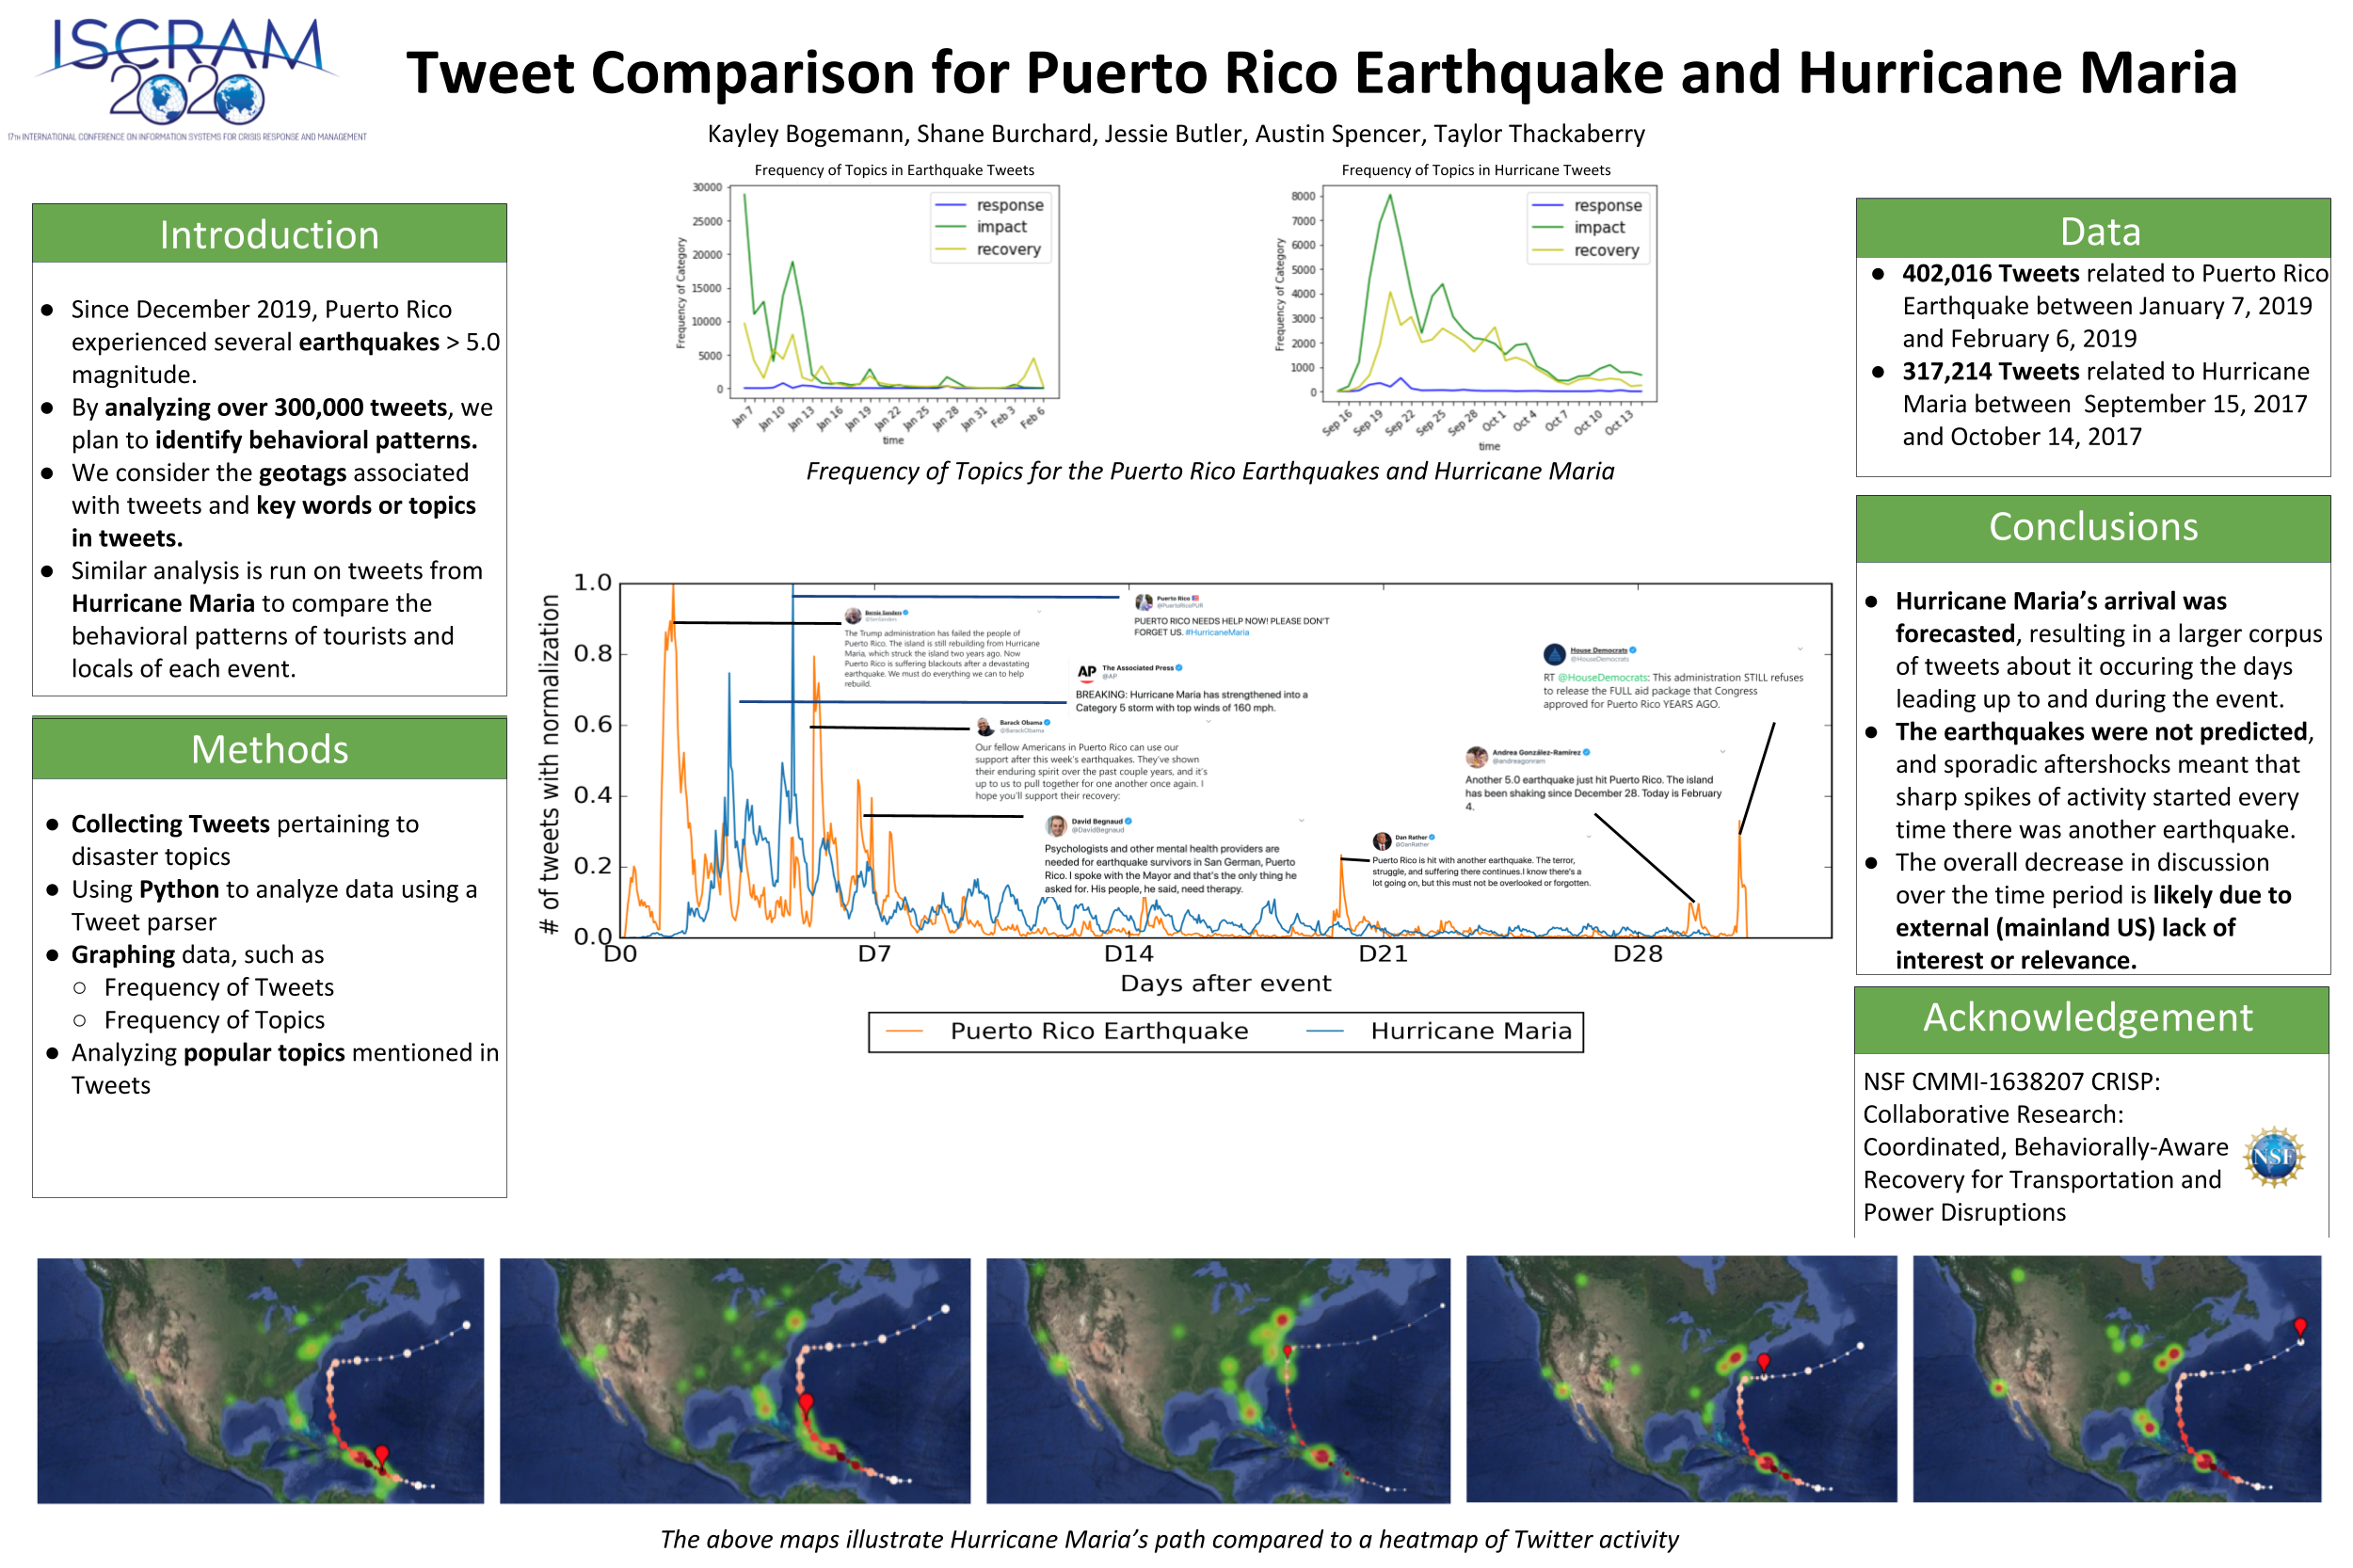
Notes:
Here is an image of the updated poster. .

Slide 10
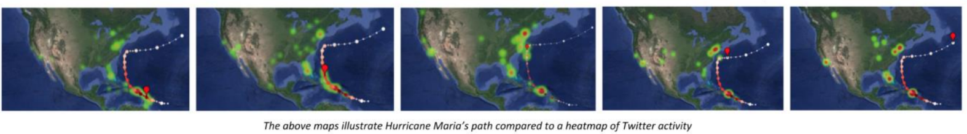
Conclusions
Difficult to filter out irrelevant information on Twitter
Forecasted events, such as Hurricane Maria
Much more data leading up to the event
Geolocation of tweets showed the path Hurricane Maria followed
Unpredicted events, such as earthquakes
Sharp spikes of activity with the sporadic aftershocks
Tweet activity overall decreases over the time period
Notes:
Taylor

Slide 11
Lessons Learned
Importance of communication
GroupMe
Important to give updates as soon as possible
Transition to Zoom meetings was difficult
Varying levels of internet quality
Not all team members could attend all meetings
Creating clearer project goals and deliverables
Planning ahead
Notes:
Shane
Throughout this project we learned a lot about working together and in the end we came to an understanding of what was needed to complete this project. We discovered very early on that communication was key and our primary form of communication between group members was through GroupMe. We communicated with our client through email and weekly meetings. Over time we realized it was better to present updates when completed rather than waiting for client meetings as this allowed items to be fixed beforehand so meetings would continue without a hitch.
Just like everyone else the transition to meeting on zoom was difficult

Slide 12

Future Work
Analysis we conducted could be expanded
COVID-19, future natural disasters
Storage of data into SQL Database
Python analysis ran slow
Implementation of other Natural Language Processing Techniques
Our topic analysis used pyLDAvis.gensim, nltk
spaCy
Prepare the dataset for deep learning
Image: https://www.amazon.com/Natural-Language-Processing-Python-Analyzing/dp/0596516495
Notes:
Taylor

Slide 13
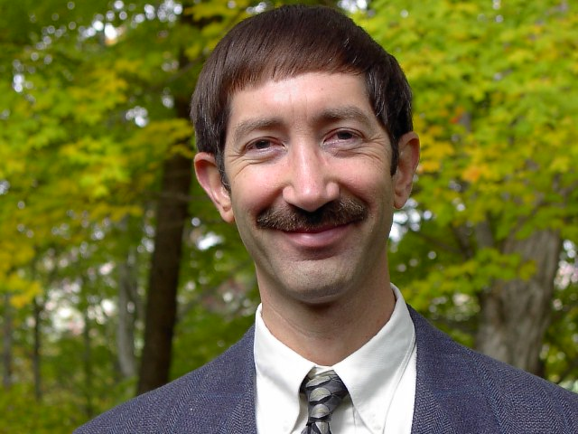
Acknowledgements
References
Professor: Dr. Edward A. Fox
Client: Alice Song
“Collaborative Research: Coordinated, Behaviorally-Aware Recovery for Transportation and Power Disruptions” (NSF-CMMI-1638207)
Work from previous semester with Hurricane Irma (Google Drive)
Notes:
Speaker: Shane

