Slide 1
Hadoop Team:
Role of Hadoop in the IDEAL Project
Jose Cadena
CS5604 Spring 2015
Instructor: Dr. Edward Fox
Mengsu Chen
Chengyuan Wen

Slide 2
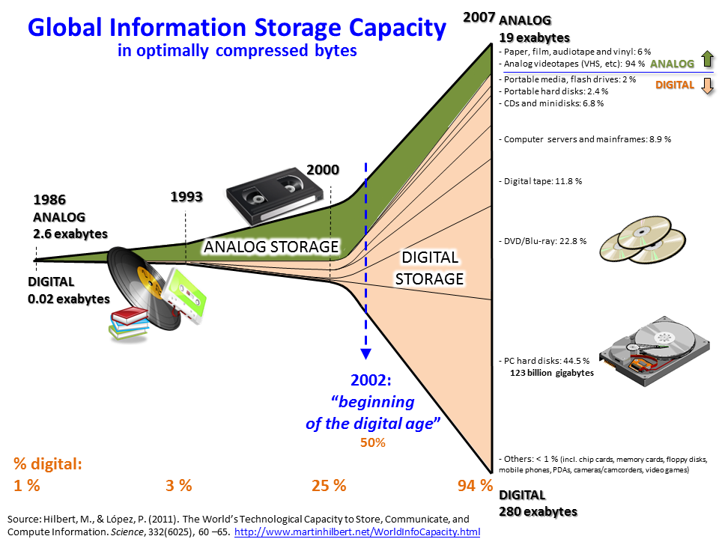
Big data and Hadoop

Slide 3
Big data and Hadoop
Data sets are so large or complex that traditional data processing tools are inadequate
Challenges include:
analysis
search
storage
transfer

Slide 4
Big data and Hadoop
Hadoop solution (inspired by Google)
distributed storage: HDFS
  a distributed, scalable, and portable file-system
  high capacity at very low cost
distributed processing: MapReduce
  a programming model for processing large data sets with a parallel, distributed algorithm on a cluster
  is composed of Map() and Reduce() procedures
Notes:
3 times cheaper

Slide 5
Hadoop Cluster for this Class
Nodes
  19 Hadoop nodes
  1 Manager node
  2 Tweet DB nodes
  1 HDFS Backup node
CPU: Intel i5 Haswell Quad core 3.3Ghz, Xeon
RAM: 660 GB
  32GB * 19 (Hadoop nodes) + 4GB * 1 (manager node)
  16GB * 1 (HDFS backup) + 16GB * 2 (tweet DB nodes)
HDD: 60 TB + 11.3TB (backup) + 1.256TB SSD
Hadoop distribution: CDH 5.3.1

Slide 6
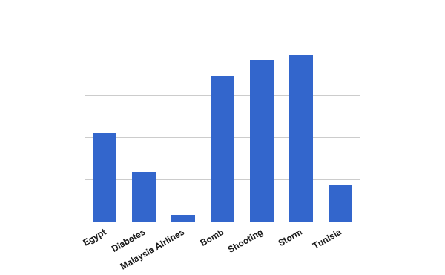
Data sets of this class
9.9 GB
~87 million of tweets in total
9.6 GB
8.7 GB
5.3 GB
3.0 GB
2.2 GB
0.5 GB

Slide 7
Mapreduce
Originally developed for rewriting the indexing system for the Google web search product
Simplifying the large-scale computations
MapReduce programs are automatically parallelized and executed on a large-scale cluster
Programmers without any experience with parallel and distributed systems can easily use large distributed resources
Notes:
MapReduce is a programming model for processing large data sets with a parallel, distributed algorithm on a cluster.

Slide 8
Typical problem solved by MapReduce
Read data as input
Map: extract something you care about from each record
Shuffle and Sort
Reduce: aggregate, summarize, filter, or transform
Write the results

Slide 9
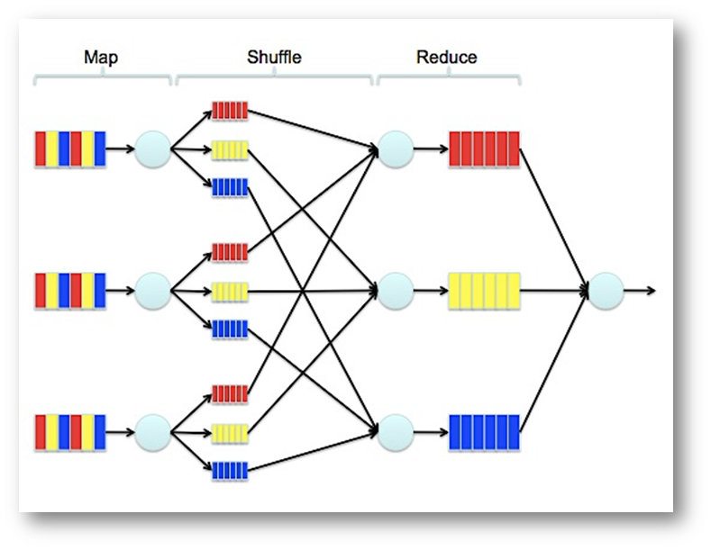
MapReduce Process
Input

Slide 10
Requirements
Design a workflow for the IDEAL project using appropriate Hadoop tools
Coordinate data transfer between the different teams
Help other teams to use the cluster effectively

Slide 11
HADOOP
SQL
Sqoop
HDFS
Tweets
Webpages
Original tweets
Noise Reduction
Original web pages (HTML)
Webpage-text
Analyzed data
Noise-
reduced tweets
Noise-reduced web pages
Nutch
Avro Files
seedURLs.txt
MapReduce
tweets
webpages
HBASE
Social
Lily indexer
LDA
NER
Clustering
Classifying
SOLR

Slide 12
Schema Design - HBase
Separate tables for tweets and web pages
Both tables have two column families
  original
    tweet / web page content and metadata
  analysis
    results of the analysis of each team
Row ID of a document
  [collection_name]--[UID]
  allows fast retrieval of the documents of a specific collection

Slide 13
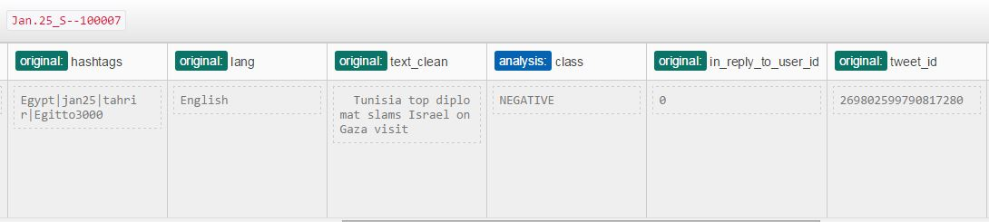
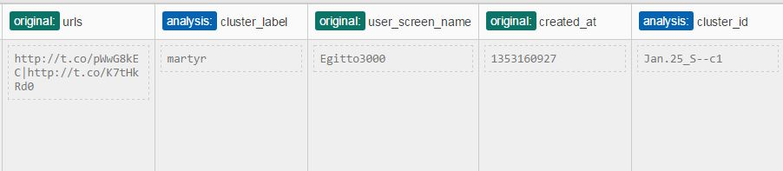
Schema Design - HBase

Slide 14
Schema Design - HBase
Why HBase?
  Our datasets are sparse
  Real-time random I/O access to data
  Lily Indexer allows real-time indexing of data into Solr

Slide 15
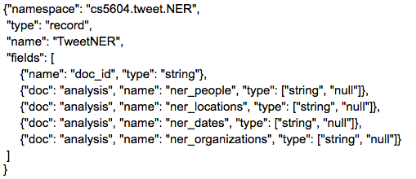
Schema Design - Avro
One schema for each team
  No risk for teams overwriting each other’s data
  Changes in schema for one team do not affect others
Each schema contains the fields to be indexed into Solr

Slide 16
Schema Design - Avro
Why Avro?
  Supports versioning and a schema can be split in smaller schemas
    We take advantage of these properties for the data upload
  Schemas can be used to generate a Java API
  MapReduce support and libraries for different programming languages used in this course
  Supports compression formats used in MapReduce

Slide 17
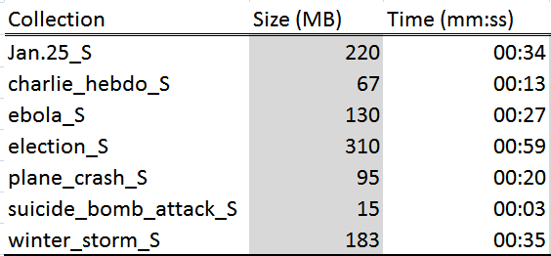
Loading Data Into HBase
Sequential Java Program
  Good solution for the small collections
  Does not scale for the big collections
    Out-of-memory errors on the master node

Slide 18
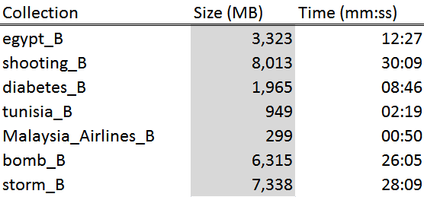
Loading Data Into HBase
MapReduce Program
  Map-only job
  Each map task writes one document to HBase

Slide 19
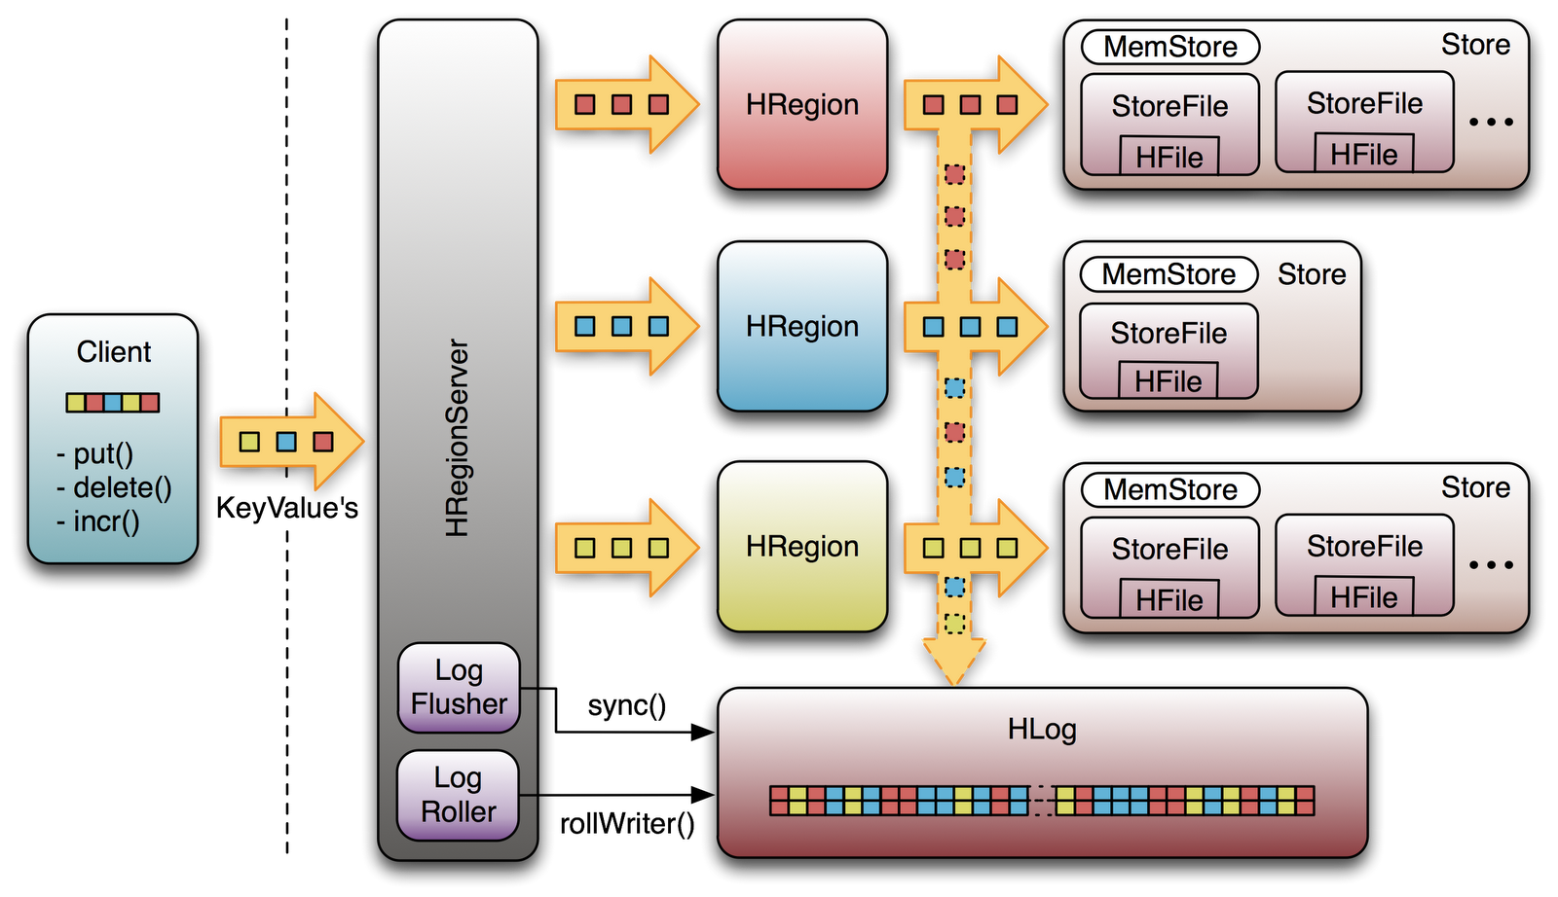
Loading Data Into HBase
Bulk-loading
  Use MapReduce job to generate HFiles
  Write HFiles directly, bypassing the normal HBase write path
  Much faster than our Map-only job, but requires pre-configuration of the HBase table
http://www.toadworld.com/platforms/nosql/w/wiki/357.hbase-write-ahead-log.aspx
HFile

Slide 20
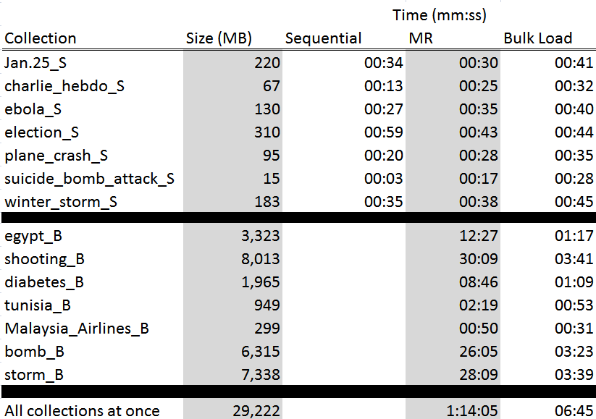
Loading Data Into HBase

Slide 21
Collaboration with other teams
Helped other teams to interact with Avro files and output data
  Multiple rounds and revisions were needed
  Thank you, everyone!
Helped with MapReduce programming
  Classification team had to adapt a third-party tool for their task

Slide 22
Acknowledgements
Dr. Fox
Mr. Sunshin Lee
Solr and Noise Reduction teams
National Science Foundation
              NSF grant IIS - 1319578, III: Small: Integrated Digital Event Archiving and Library (IDEAL)

Slide 23
Thank you

