Slide 1

Writing papers for academic audiences
Jeffrey Alwang (alwangj@vt.edu)
Professor, Department of Agricultural and Applied Economics
29 April 2021

Slide 2


Slide 3


Overview
Writing is the most durable and important thing we do; we are writers
It is how we present our ideas to audiences
The art of persuasion—show the reader why you’re right and why it’s interesting that you are right
Paper content is judged by means of presentation
Writing is hard when done properly

Slide 4
Questions
How many of you are working on or have completed papers?
What are topics?
Have you submitted them/are you planning to submit them?
What has been your experience with submissions to international journals?
What incentives do you have to write/submit such papers?
Job expectation?
Increased possibility of advancement?
Monetary compensation?
Own initiative?
What experience do you have conducting reviews for international journals?

Slide 5


Layout of typical paper in (applied) economics
Abstract
Introduction
Theory/Conceptual framework
Empirical framework
Data
Results
Conclusion
Annex

Slide 6
Organization: Start of paper
Like a newspaper, not a joke:
Let the message come out clearly at the start (readers are busy)
Fill in background later
Abstract and introduction are critical: They get your “foot in the door”
Abstract
Communicate main message
Do not mention methods (unless the methodology is part of the main message)
Do not mention literature
Introduction
Begin with the central idea of the paper
Write a clear paragraph describing it
Set the hook, allow the reader to skim
Literature review? Some say yes, some say no

Slide 7
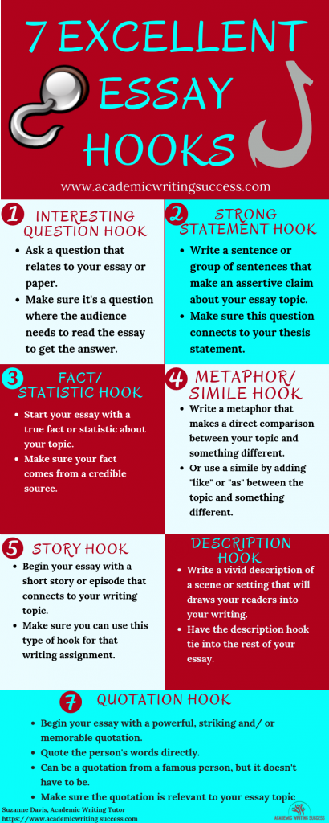
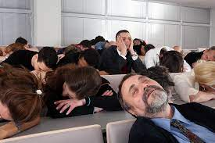
Hook: Just like fishing
Engages the audience
Draws reader in
Sparks curiosity
Essential for an outstanding introduction

Slide 8
The minimal introduction
Introduce your topic, and in a way that indicates its importance
Indicate briefly the research that has been done on the topic
Identify a gap, problem, controversy, etc., in the existing research
Explain how the present paper will fill that gap, solve that problem, etc.
State the thesis of the paper—the answer to the research question that the paper attempts to answer
Indicate briefly the limits of your study
Describe the organization of the paper (usually in last paragraph of introduction)

Slide 9
Organization: Body of the paper
Body of the paper
Rule: There should be nothing before the main result that a reader does not need to know in order to understand the main result
Conceptual framework/Theory:
Only include the minimum necessary to understand the main result
No “general model”
Empirical results & data:
Begin with the main message, do not “tease” or “warm up” the audience
Do not include tables that you don’t refer to
Follow main result with tables and figures
Robustness—only essential criticisms

Slide 10

Organization: Conclusions
(Not really necessary if you’ve written well)
Short and sweet
Do not restate all your findings
Minimize discussion of limitations and further research
Do not include opinions: Stick to the facts

Slide 11
Style and writing principles
Simple and short is the best policy
Shorten paragraphs and sentences. Make each word count!
Repetition is boring
Avoid unnecessary words: “to” instead of “in order to”, “equals” instead of “is equal to”
Never say “in other words.” If you do, it means that the original explanation was inadequate
Previews and reviews should be avoided—organize better
First describe what you do, then explain it, compare it to alternatives, and compare it to others’ procedures. Not the other way around!
Make your headings specific and descriptive (e.g. not “Model”)

Slide 12

Tips: How to improve your writing
Re-write
Nothing is completed quickly. Read and re-read; scrutinize your words
Don’t be afraid to make big changes
Do not rush
Share with others; adjust to address their criticisms
Writing center at your university
When writing in non-native language, share with a native speaker
Be your own worst enemy (otherwise someone else will)
Present frequently: Seminar attendees are often trying to catch you, take advantage of it

Slide 13
Tips
Do not use footnotes for parenthetical statements; use to present information that some, but not all, readers will want
Do not plagiarize: Read, understand and summarize
Tables and figures should be understood without referring to the text
Correct number of significant digits
Units: .0000 as a coefficient indicates the variable should be rescaled
Figures: Make sure the message comes through
Know your audience and write to her (journal styles)
Use active tense (avoid is/are)
I like the present tense, but be consistent
Simple words are better than longer ones (use instead of utilize)
Scour the paper for typos—get rid of them

Slide 14
Further thoughts
Double, triple check for accuracy (tables and numbers)
Don’t begin writing paper without a good idea of where you would like to see it go (write to the audience)
Don’t get discouraged:
Reviewers can be harsh; be nice to them and figure out how to address their concerns
Know how to read the review
Never send an email to the editor expressing anger: No emails before one week!!!
Reviewers are like rolling the dice
Many good papers have been rejected multiple times: George Akerlof’s “Market for Lemons” was rejected by three journals prior to its publication by QJE

Slide 15
Final thoughts
Writing is hard, good writing is even harder; but, it doesn’t have to be perfect
Always include dates, page numbers, contact information
Strategies for publication:
Make sure draft is well written (take time); include graphics where relevant
Make sure you read the literature
Start out with the “best” possible journal target (be realistic)
Get useful reviews and improve paper
Make sure you read the “author instructions” and follow them
Include articles from target journal in references (relevant to readership)
Conduct reviews; always respond to a request
Don’t argue with the reviewers

Slide 16
Additional reading
Nikolov, Plamen “Writing tips for economics research papers” https://www.people.fas.harvard.edu/~pnikolov/resources/writingtips.pdf
Duke University writing center https://twp.duke.edu/sites/twp.duke.edu/files/file-attachments/econ.original.pdf
Cochran, John H. “Writing tips for PhD students” University of Chicago Graduate School of Business

Slide 17


