Slide 1
Risk Prediction Sentiment
Jhanavi Ghadia, Sai Gurrapu, Tarun Singh, Sai Krishna Yeshala
Instructor: Edward A. Fox
Client: Christian Johnson
Class: CS 4624 - Multimedia/Hypertext and Information Access
Virginia Tech, Blacksburg, VA 24061, May 14, 2021.

Slide 2
Presentation Outline
Project Overview
Solution Approach
Work Survey Dataset
Data Cleaning
What is Sentiment Analysis
Sentiment Analysis structure
Sentence Tagging
Speech To Text
Django Web App Walkthrough
Future Plans
Acknowledgements
References

Slide 3
Project Overview
Primary goal: Evaluate the safety levels and risks for the workers at any workplace
Solution approach: Perform sentiment analysis on the narrative data provided by the workers from their experience and provide a clear idea about the safety levels
Client: Christian Johnson, Founder at www.riskinsights.ai

Slide 4
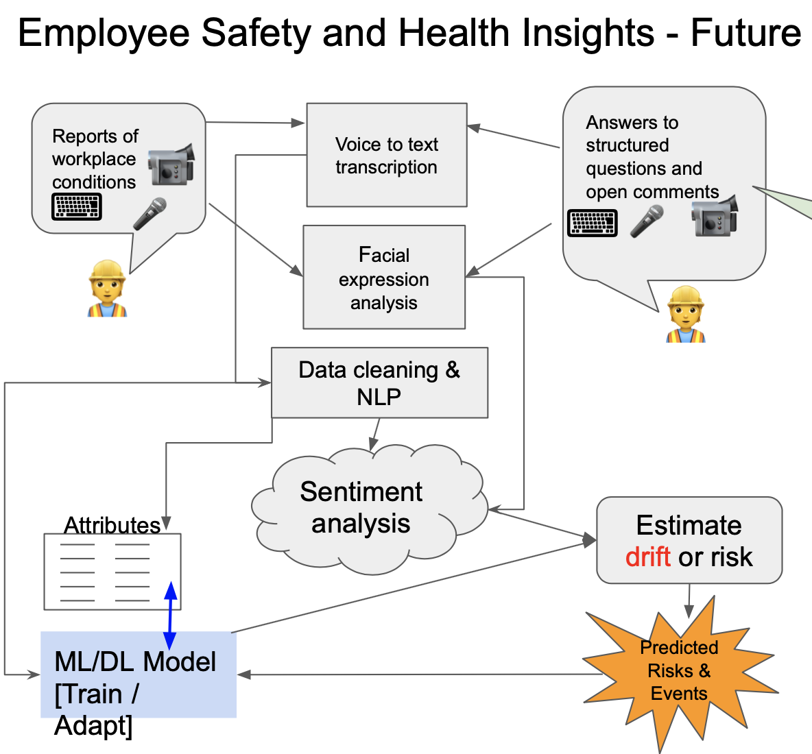
Solution Approach
Research on sentiment analysis tools
A relevant web interface model
Speech-to-text conversion tool
Effective integration of all the parts

Slide 5
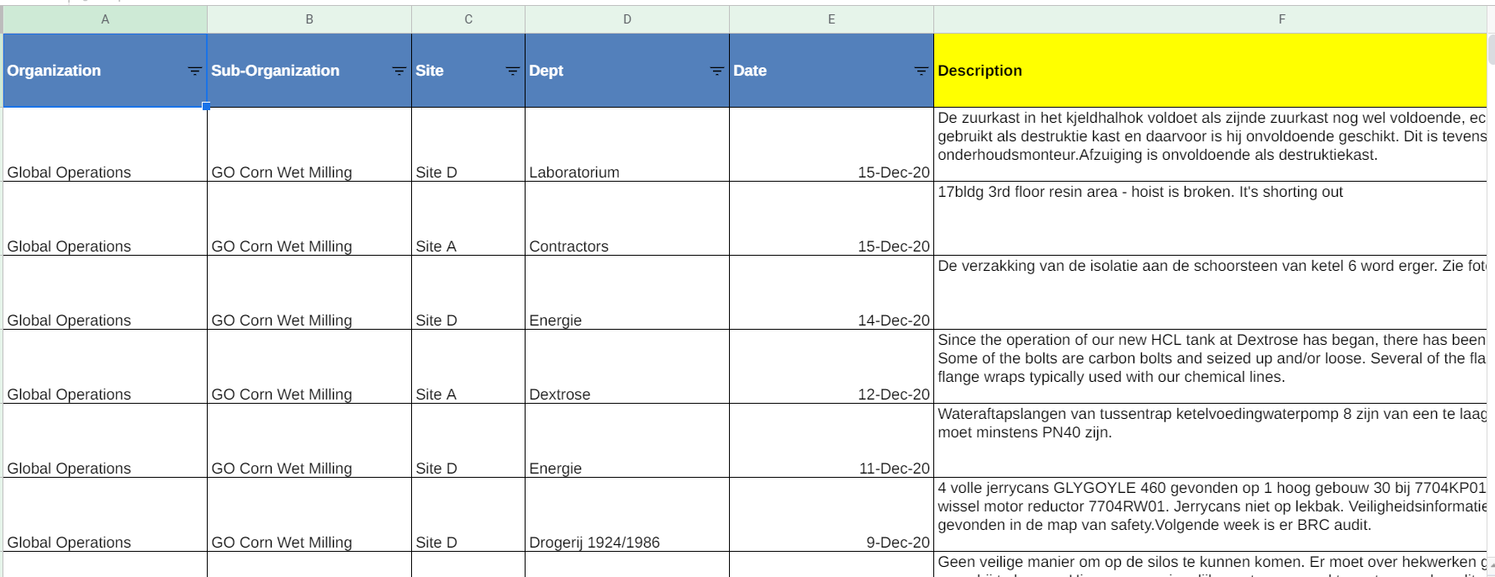
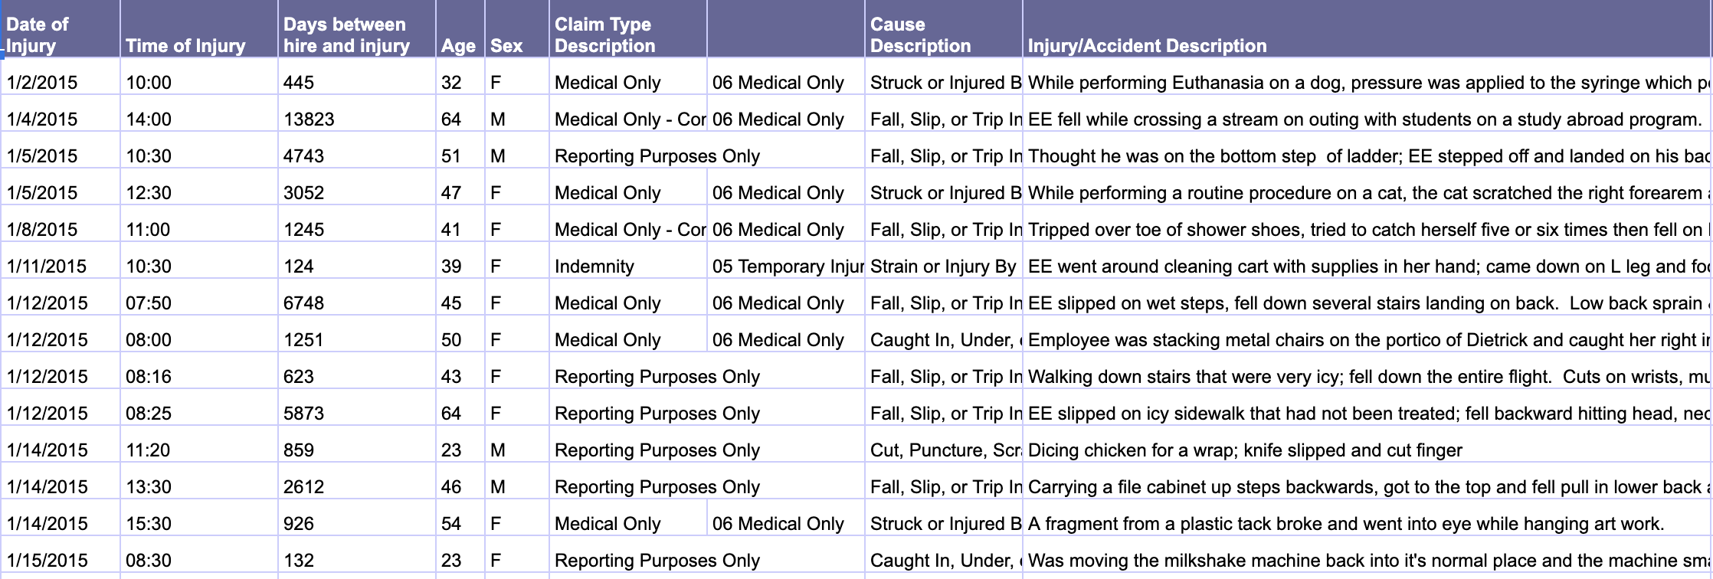
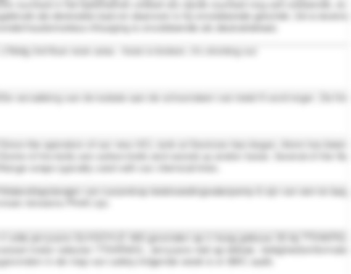
Worker Survey Dataset
Description column blurred to preserve privacy.

Slide 6


Data Cleaning
The given data set consists of various null entries, feedback in a foreign language and some irrelevant information.
We cleaned out the dataset by removing all of these entries and passed the most accurate and relevant data to our sentiment analysis tool.

Slide 7

What is Sentiment Analysis?
Use of natural language processing to assess and quantify sentences
Determine whether a piece of writing has positive, negative or neutral sentiment

Slide 8
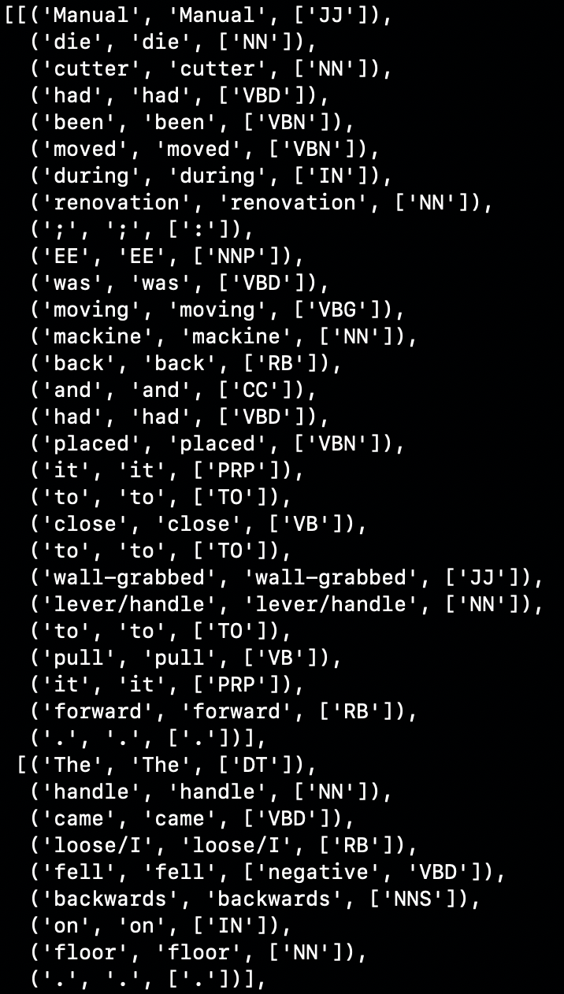
Sentiment Analysis Structure
Each text is a list of sentences
Each sentence is a list of tokens
Each token is a tuple of 3 elements:
A word form, a word lemma, list of associated tags

Slide 9
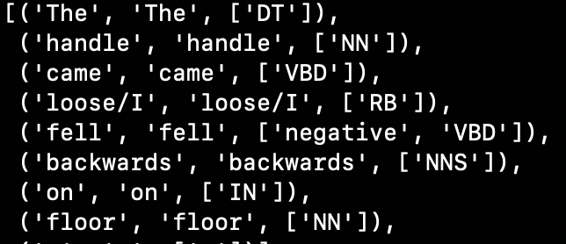
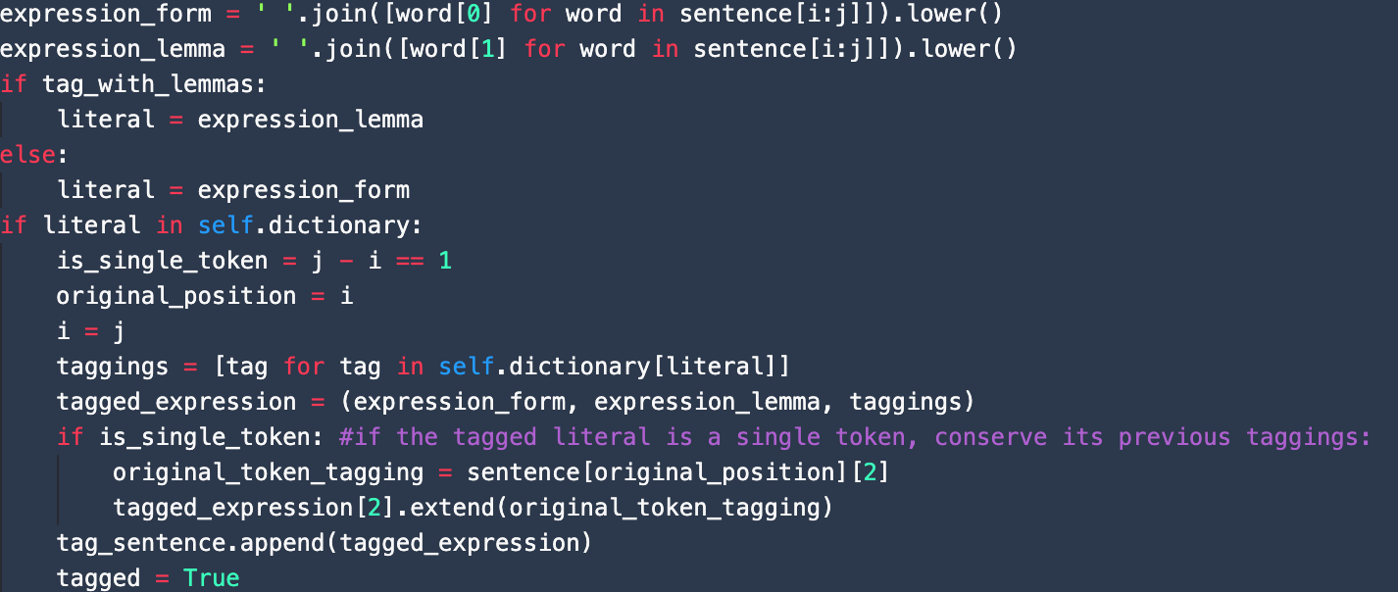
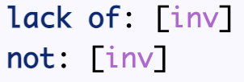
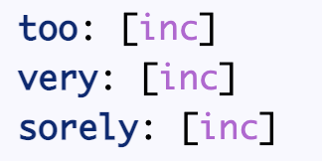
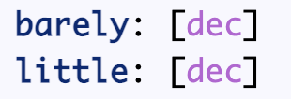
Tagging Sentences

Slide 10
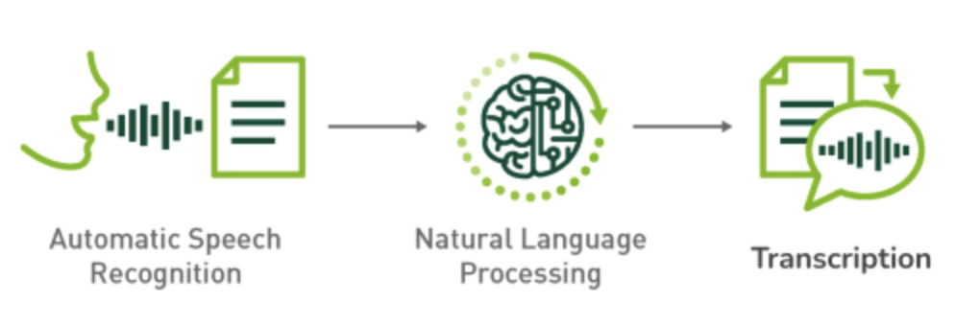
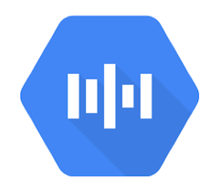
Speech to Text
Goal: Take in detailed narrative information and descriptions of the employee’s feedback through voice
Input: Voice data through computer mic
Output: Text transcription generated for data cleaning/sentiment analysis
Google Web
Speech API

Slide 11
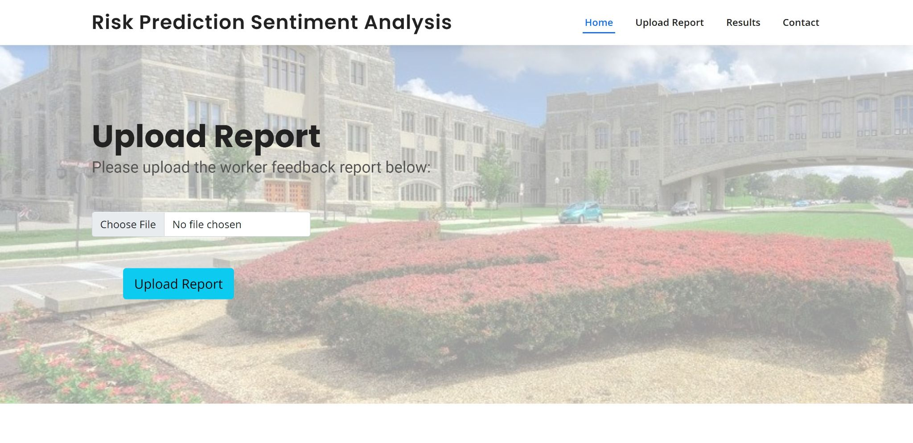
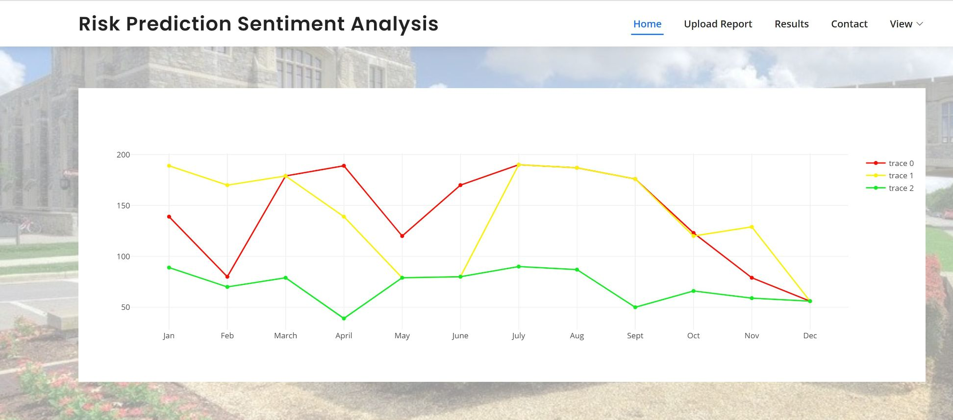
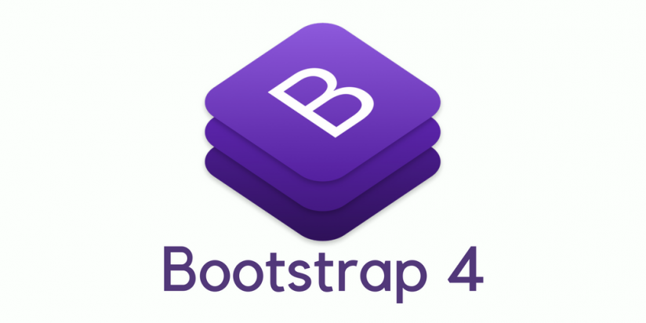
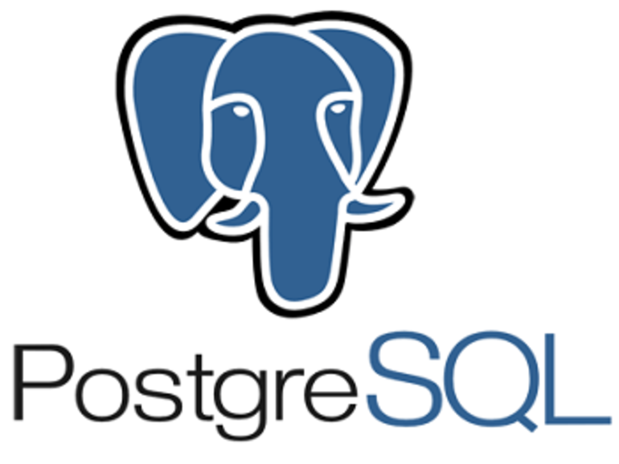

Django Web App
Web App displaying the Upload Report page(left) and the Results page graphs(right).

Slide 12
Future Plans
Work on discrete industrial data with more precise AI trained model
Make the tool more flexible with several additional features
Perform a data science project to prove whether safety 'sentiment' is correlated with other company performance measure
Notes:
Then make user interface improvements to allow that code to be linked to a company's other data systems
. For example, if a company's safety sentiment is growing more positive, are they also experience improved performance in safety, like lower rates of injury??

Slide 13
Lessons Learned
Iteration and consistent communication
Planning
Cleaning the Dataset (includes foreign languages)
Speech to Text Accuracy
UI principles
Add time for debugging
Leverage existing work in the field

Slide 14
Acknowledgements
Client: Christian Johnson,
  LinkedIn: www.linkedin.com/in/cjohnson-ehs
  Founder: www.riskinsights.ai
  Present: Director at AstraZeneca for Safety, Health, and Environment
Professor: Edward Fox
  Email: fox@vt.edu

Slide 15
References
[1] Nvidia Corporation. (2020, October 13). How to build domain specific automatic speech recognition models on GPUs. Retrieved April 09, 2021, from https://developer.nvidia.com/blog/how-to-build-domain-specific-automatic-speech-recognition-models-on-GPUS/
[2] J. Wiebe and E. Riloff, "Finding Mutual Benefit between Subjectivity Analysis and Information Extraction," in IEEE Transactions on Affective Computing, vol. 2, no. 4, pp. 175-191, Oct.-Dec. 2011, doi: 10.1109/T-AFFC.2011.19.
[3] SketchBubble. (2021). SketchBubble Data cleansing. Retrieved April 09, 2021, from https://www.sketchbubble.com/en/presentation-data-cleansing.html
[4] Google Cloud. (2021). Speech-to-Text: Automatic speech Recognition | Google Cloud. Retrieved April 09, 2021, from https://cloud.google.com/speech-to-text,
[5] Beri, A. (2020, May 27). Sentimental analysis using VADER. Retrieved April 09, 2021, from https://towardsdatascience.com/sentimental-analysis-using-VADER-a3415fef7664
[6] Clarabridge. (2019, March 05). Clarabridge Insight. Retrieved April 09, 2021, from https://www.ccma.org.uk/insight/clarabridge/
[7] Django Software Foundation. (2021). Django Web Framework. Retrieved April 09, 2021, from https://www.djangoproject.com/
[8] JavaTpoint. (2021). Django MVT - JavaTpoint. Retrieved April 9, 2021, from https://www.javatpoint.com/django-mvt
[9] Baer, T. (2018, April 20). Has the time finally come for PostgreSQL? Retrieved April 09, 2021, from https://www.zdnet.com/article/has-the-time-finally-come-for-PostgreSQL
[10] RealPython. (2021, April 03). The ultimate guide to speech recognition with Python. Retrieved April 30, 2021, from https://realpython.com/python-speech-recognition/

