Slide 1
OPERAcraft + Kinect
=
Cinemacraft
Client: Ivica Ico Bukvic, Institute for Creativity, Arts & Technology (ICAT)
Members: Brittany Barnes, Elsi Godolja, Marina Kiseleva
CS 4624, Virginia Tech, Blacksburg VA.
Spring 2016

Slide 2

OPERAcraft: Combines video games and opera to produce live productions
Opera + Minecraft = OPERAcraft
Notes:
Describe what Operacraft is first!
- TODO: Make icat text bigger

Slide 3
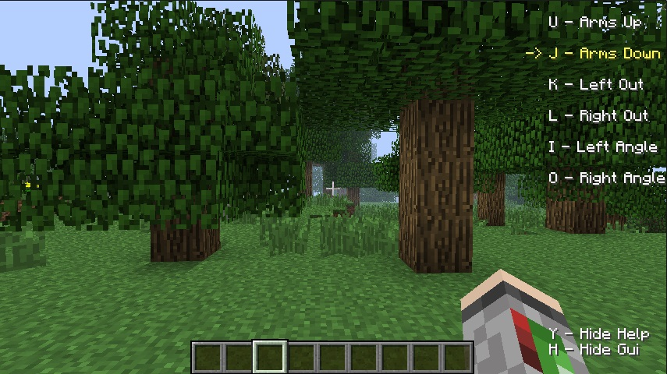
OPERAcraft Controls
Limited to the keyboard and predefined controls
*avatar not pictured

Slide 4
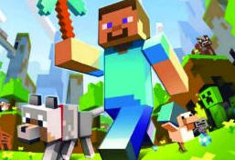

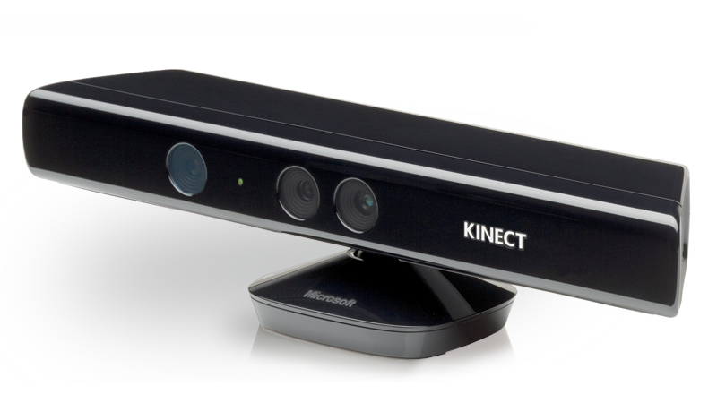
Kinect Sensing + OPERAcraft = CINEMAcraft
Kinect (Facial detection)
Pd-L2Ork
Kinect (Body/skeletal detection)
OPERAcraft Visual Display
Allows for production creation in real-time from unique perspectives
Goal: Get Minecraft avatar to ‘mirror’ user’s facial and skeletal movements via Kinect sensors
Notes:
Kinect code
Pd-L2Ork middleware (data correcting stuff)
Java changes to take in data properly
Anything else?

Slide 5
Software
Kinect code
  Language: C#
  Environment: Visual Basic (64 or 32 bit)
Pd-L2Ork
Minecraft code
  Language: Java
  Environment: Eclipse Luna/Mars (64 or 32 bit)

Slide 6
What’s Done?
Integral Feature | Base Level of Functionality | Does it need to be expanded? | Could it be expanded?
Skeletal: arm movement | complete | no | no
leg movement | complete | no | no
torso movement | complete | no | no
head movement | complete | no | yes
Facial: eyebrow movement | in progress | yes | yes
mouth movement | in progress | yes | yes
Minecraft: avatar art | complete | no | yes
world art | complete | no | yes
Notes:
Make less redundant skeletal & facial; bold

Slide 7
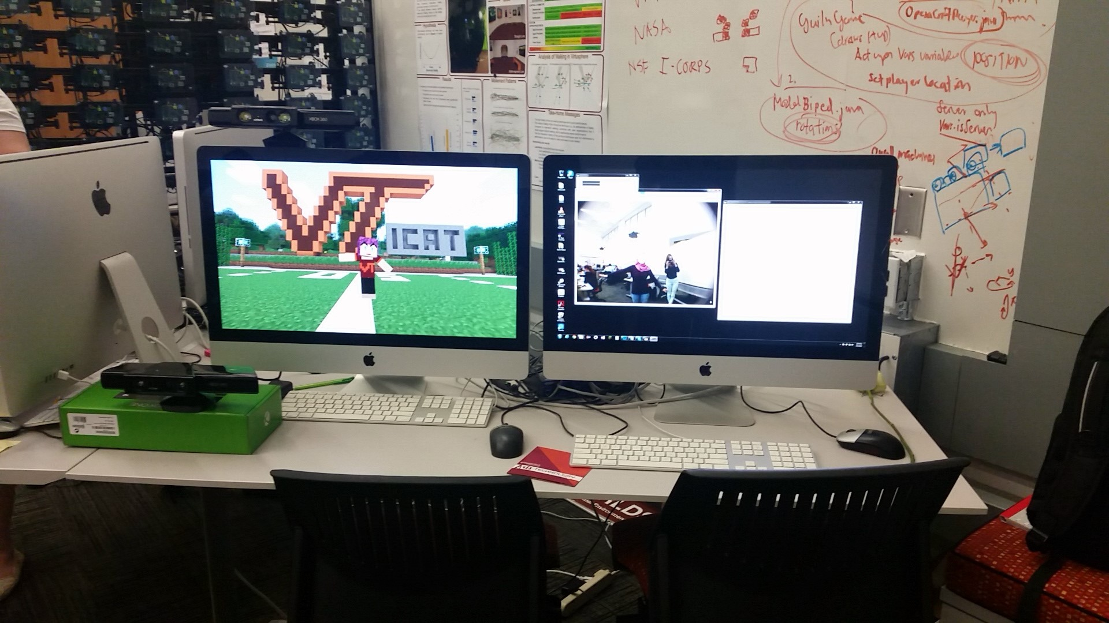
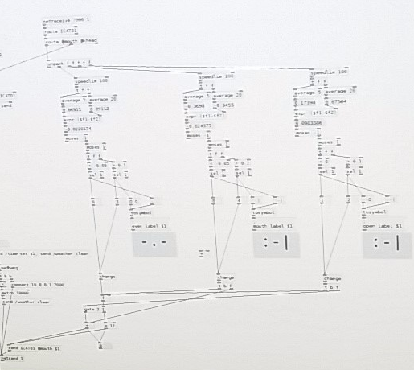
Kinect → Pd-L2Ork → Minecraft
Notes:
Give some defining information about each, ex. Lines of code/# of hours/effort
Measure of effort

Slide 8
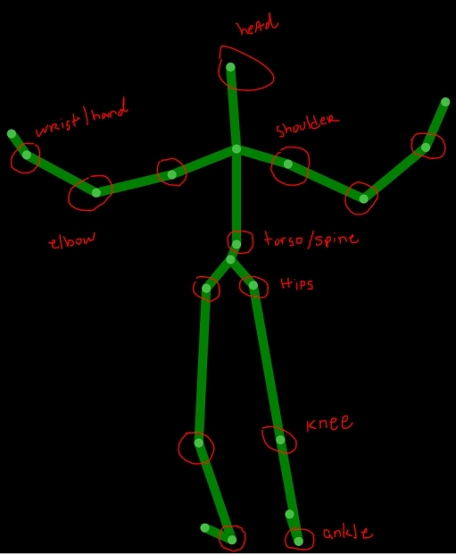
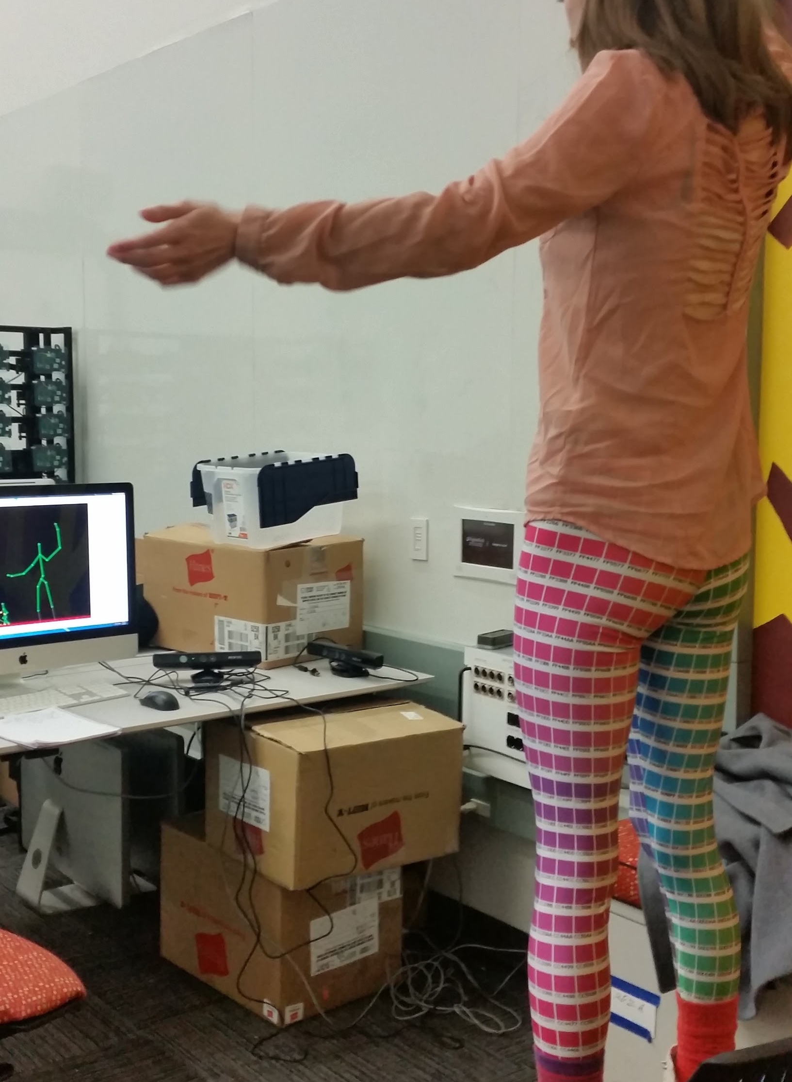
Skeletal Recognition
Notes:
Everything works nicely. Mention the circled joints are the ones we reference.

Slide 9
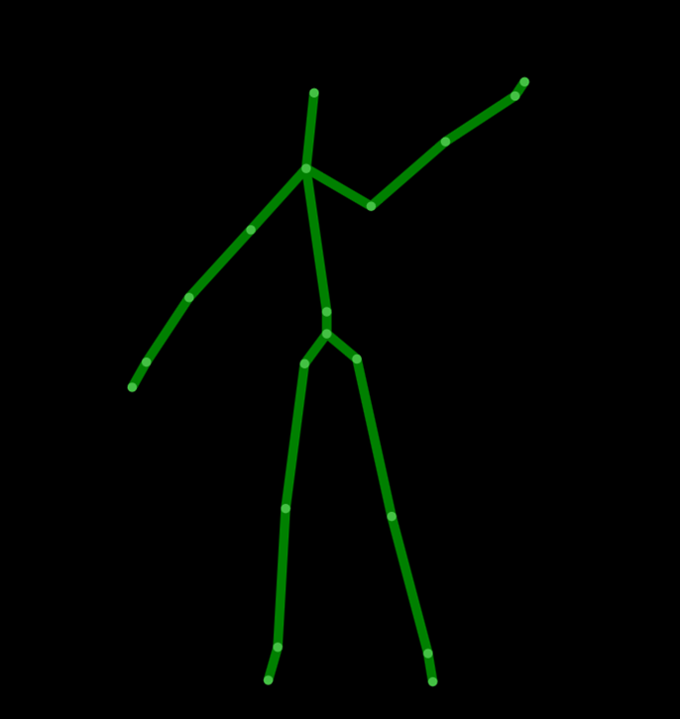
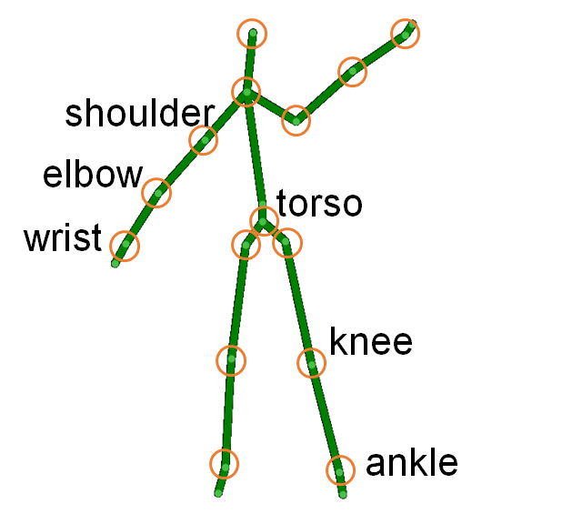
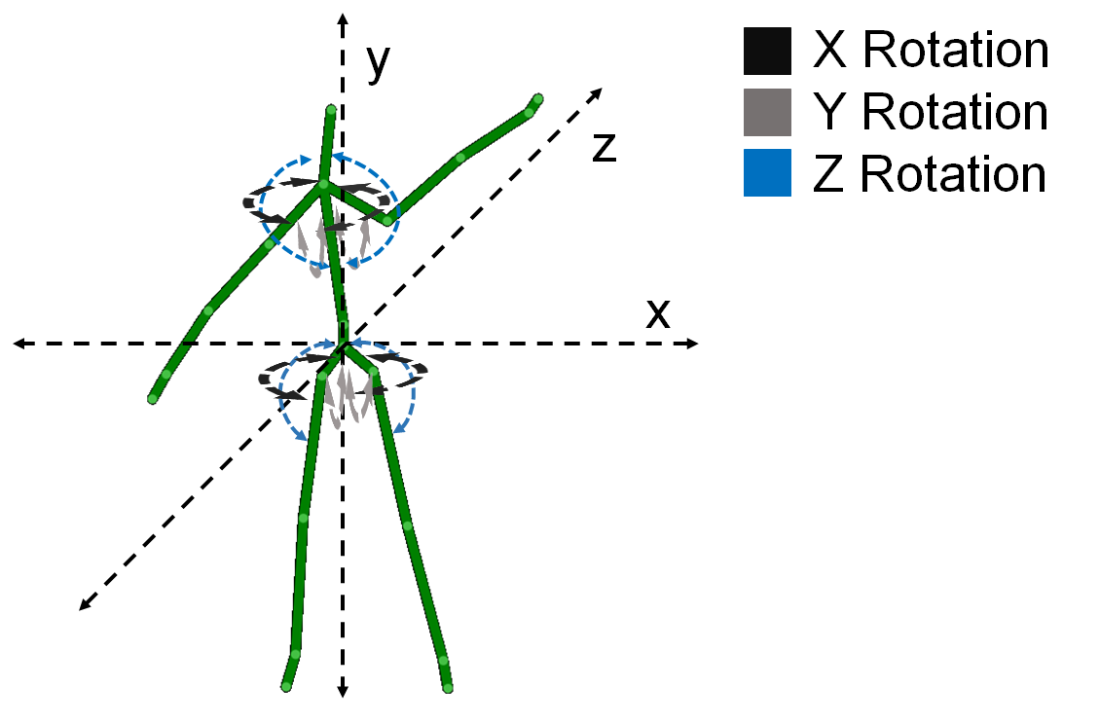
Translating Kinect data -> OPERAcraft movement
UDP Packet:
@karm ICAT01 24 36 …
Kinect Skeletal Tracking
Calculate angles of rotation
Send angles to OPERAcraft
Infer points

Slide 10
Angle Calculations
Compute angles of rotation in each plane
Points -> 3D Vectors -> compute angle between
Around Y axis: rotation in X plane
Around Z axis: rotation in Y plane
Around X axis: rotation in Z plane
Notes:
We cannot just spend spatial coordinates to OPERAcraft
We need to compute angles of rotation on each plane

Slide 11
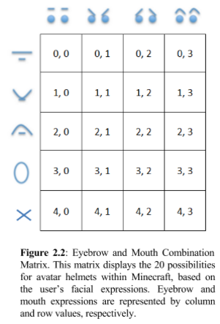
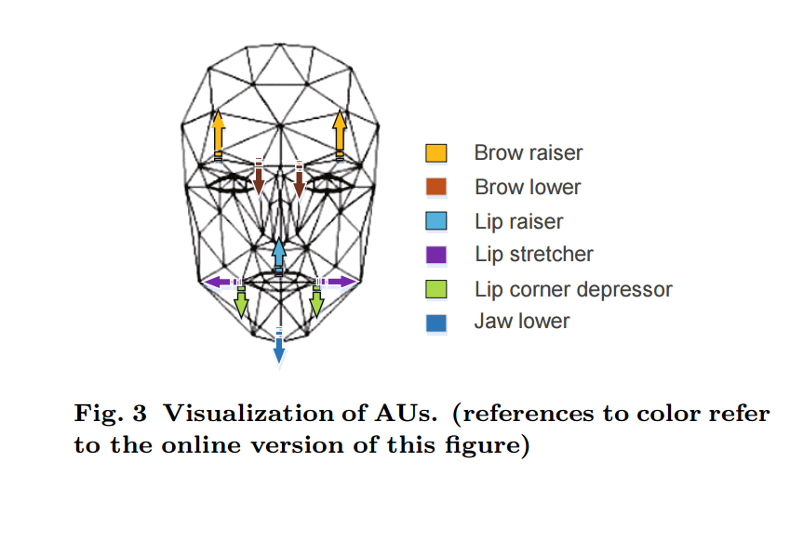
Facial Recognition
EYEBROW
MOUTH
Tracked Animation Units (AUs).
The areas of 2D points that would affect various AUs to yield the delta values from a face’s neutral position (4).
Eyebrow and Mouth Combination Matrix. The 20 possibilities for avatar helmets, based on the user’s facial expressions.
Notes:
Only able to achieve 6 (squared in red) out of desired 20 facial expressions

Slide 12
Kinect → Pd-L2Ork → Minecraft

Slide 13
UDP Packet Constraints
Delimiter(s) | Line Ending(s) | Avatar Movement Keywords | Movement Position Value(s) | Movement Position Types
whitespace | ;\n | eyes mouth head shoulder arm leg torso | {0-3} {0-4} {(-90)-(90)} {(-180)-(180)} {(y)} {(-180)-(180)}{(-180)-(180)} {(-90)-(90)} {(-90)-(90)} {(x)} {(y)} {(-180)-(180)} | integer integer float (xrot, yrot) float (y) float (xrot, zrot) float (xrot, zrot) float(x, y, yrot)
Notes:
Note how the movement position values for skeletal objects are in degrees
For faces: it is specific values corresponding to facial helmets

Slide 14
Pd-L2Ork: Averages/Normalization
Feature position data gets sent from Kinect for each frame
Pd-L2Ork averages the last five frames to reduce jumpiness in expressions/gestures
Sends the “patched” data to Minecraft

Slide 15
Kinect → Pd-L2Ork → Minecraft

Slide 16
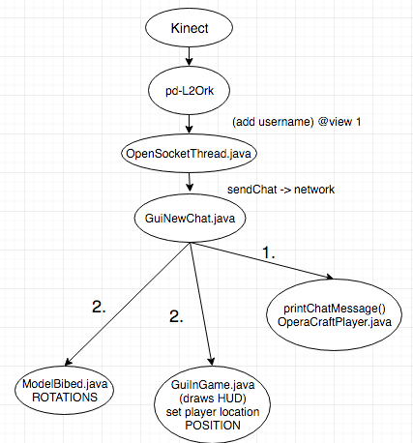
Minecraft Code: Dependencies and
Flow
Notes:
OpenSocketThread
Handles messages/UDP packets
GuiNewChat
Parses messages
ModelBiped
Constructs Minecraft avatar
OperaCraftPlayer
Handles x,y, and z rotations of arms, legs, torso, head

Slide 17




Minecraft Art: Facial Expression Helmets
Microsoft Paint
16x16 pixels
Female and male
Sad
Anxious brows
+
frown
Surprised
Surprised brows
+
open lips
Angry
Furrowed brows
+
frown
Kiss Face
Neutral brows
+
puckered lips
Notes:
All done in Microsoft Paint
Art created for both genders

Slide 18
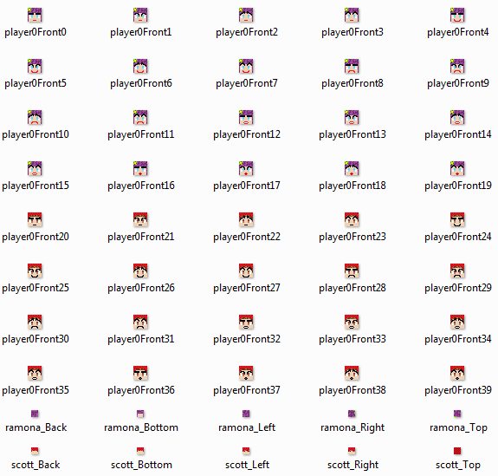

Slide 19
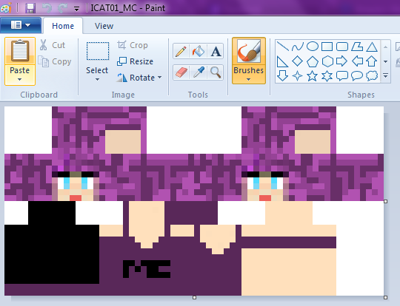
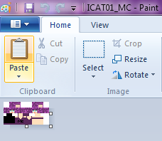
Minecraft Art: Avatar Skin
800% zoom
Microsoft Paint
32x64 pixels
Female and male
100% zoom

Slide 20
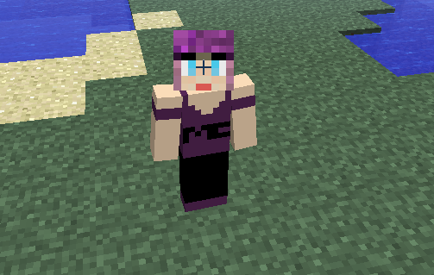
Notes:
Example of previous skin

Slide 21
Minecraft Art: Background World
In-game with various block types

Slide 22
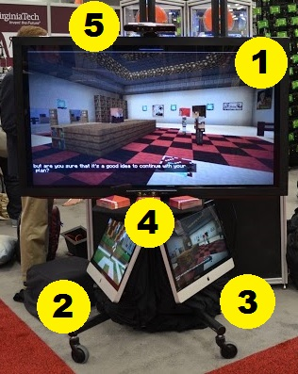
Prototype
Primary display monitor
Computer to process skeletal movements
Computer to process facial movements
Kinect sensor for skeletal tracking
Kinect sensor for facial tracking

Slide 23
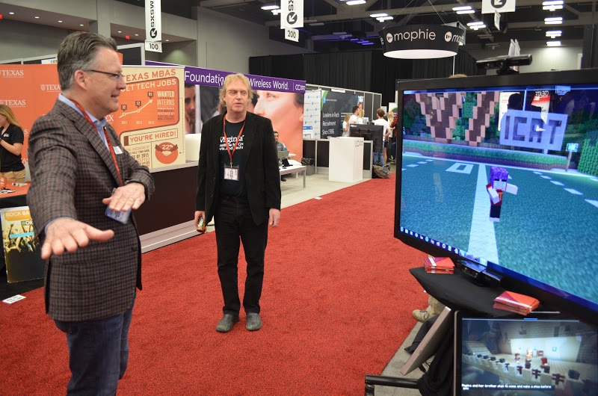
SXSW Prototype Demo
Video: https://drive.google.com/file/d/0B12jba-1Ut5jT2pPYTZoOExNWDg/view

Slide 24
QUESTIONS?

Slide 25
Resources
[Image] https://hidale.com/shop/dp-kinect/
[Image] http://vector.me/search/walking-stick-figure
[Image] https://www.icat.vt.edu/funding/operacraft

