Slide 1

Developing a Shark Validation Monitor
By: Jeremy Jenrette, Gregory Chang, Mason Mulgrew, Hunter Debay, and Steven Gordon
CS 4624 Multimedia, Hypertext, and Information Access CRN: 13179
Instructor: Edward A. Fox
Virginia Tech, Blacksburg VA 24061
5/1/2021
Notes:
Jeremy

Slide 2
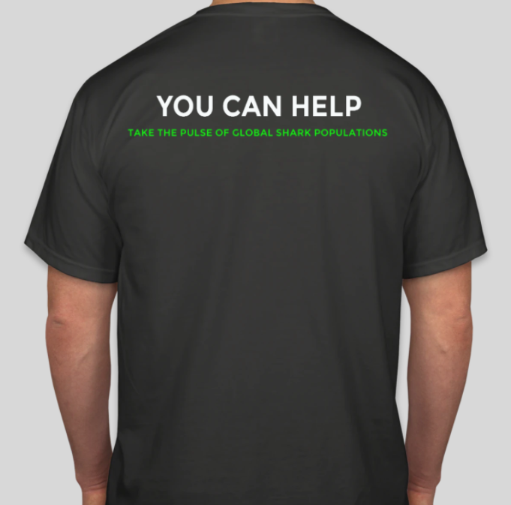
Validation Monitor Final Report
Monitor function
Media sourcing
Database management
Webserver
User Authentication
Gaming
Hackathon (prizes & achievements)
Notes:
Jeremy

Slide 3
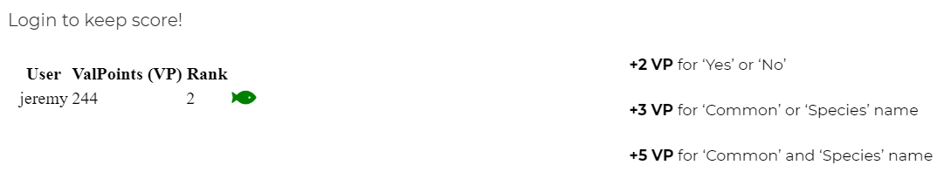
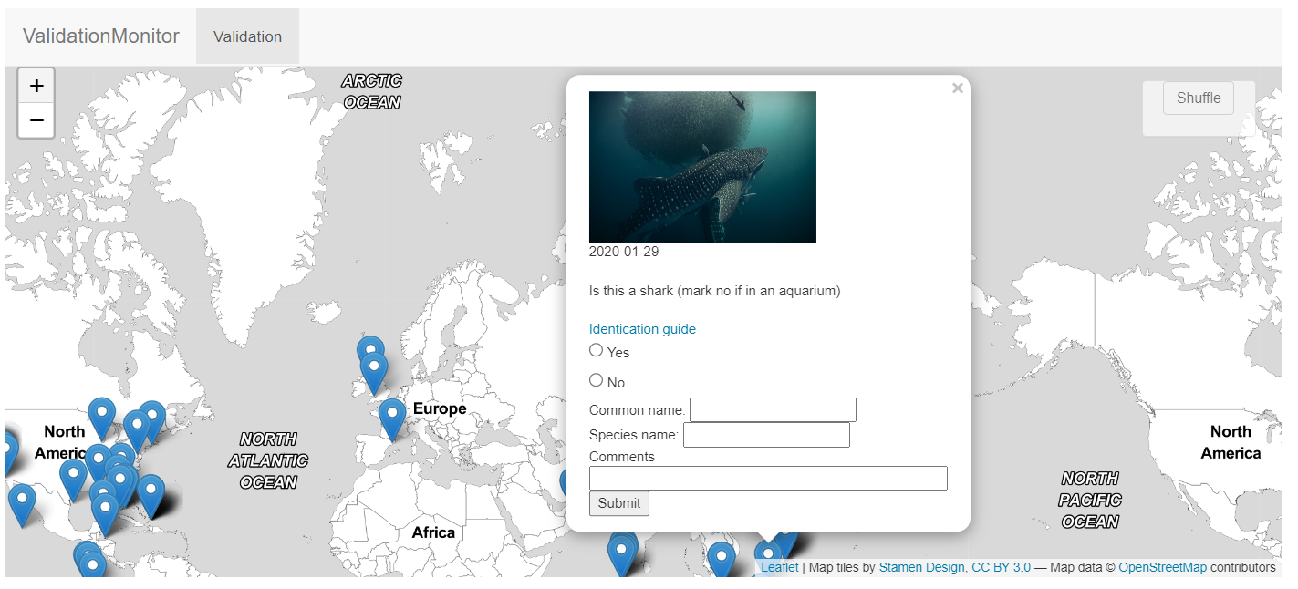
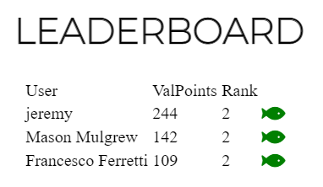
Principal Components

Slide 4

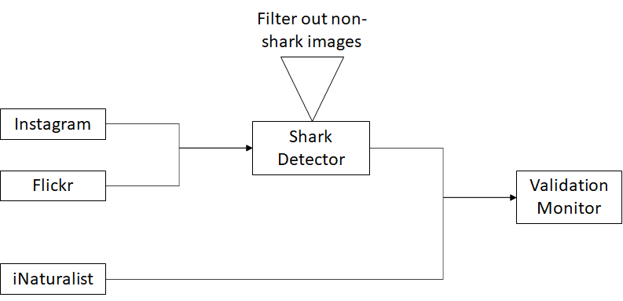
Media sourcing

Slide 5
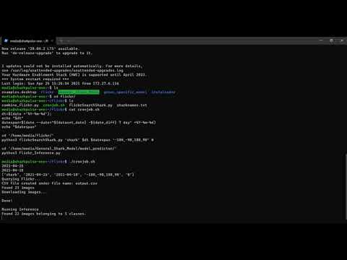

Slide 6

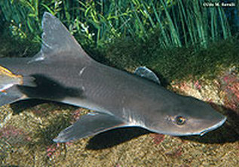
Database and PHP management
DB table name | Description | PHP script 1 | PHP script 2
userbase | Stores all user information | userbase.php - generates user profile | scoreboard.php - generates leaderboard
user_validation | Records all images validated and their validators | action_page.php - appends image with user ELO
data_mining | Stores all image information including validation progress | action_page.php - changes records based on user input
data_mining
userbase

Slide 7

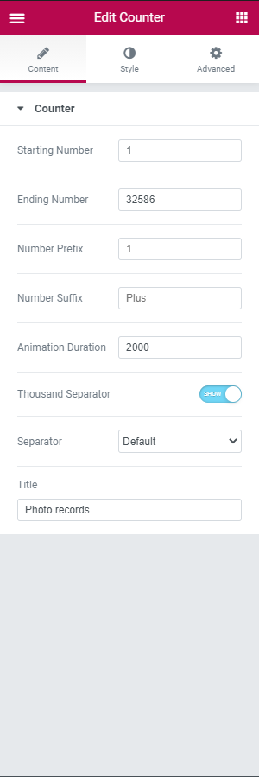
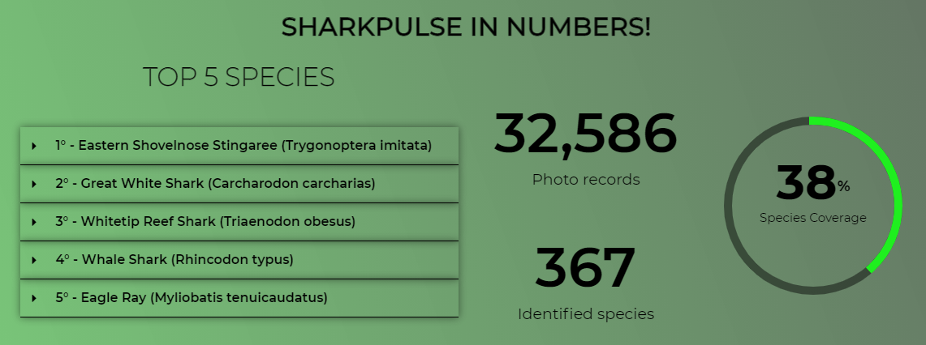
Webserver

Slide 8
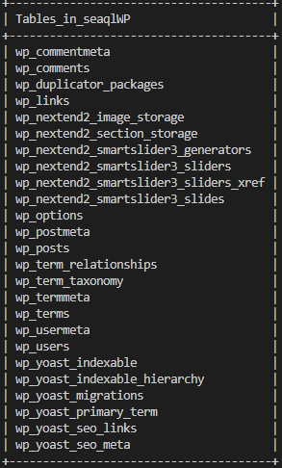
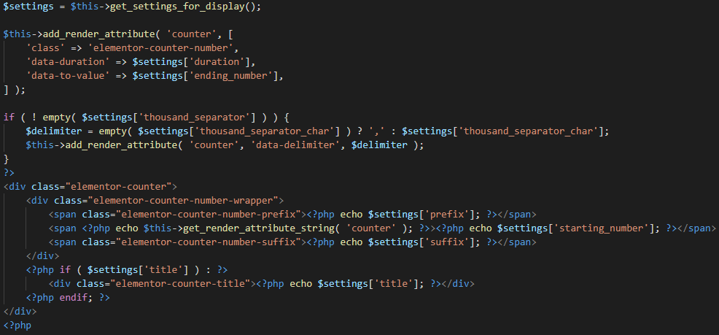

Webserver

Slide 9
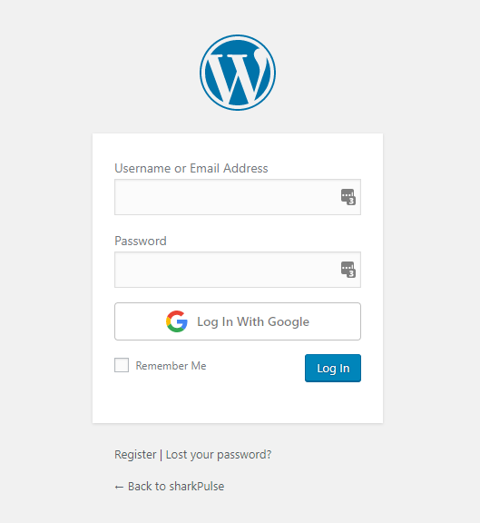

User Authentication
Current User Authentication system
Login without WordPress
One Click Login
Notes:
Gregory

Slide 10
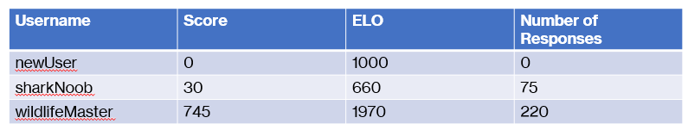
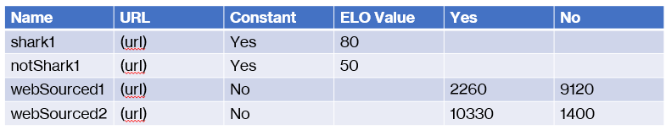
Gaming Rules and Systems
Autonomous scoring
  Controls
  ELO
User enjoyment and interaction
  Scoring
  Achievements
Rewarding features
  Leaderboards
  Prizes
Notes:
Steven

Slide 11

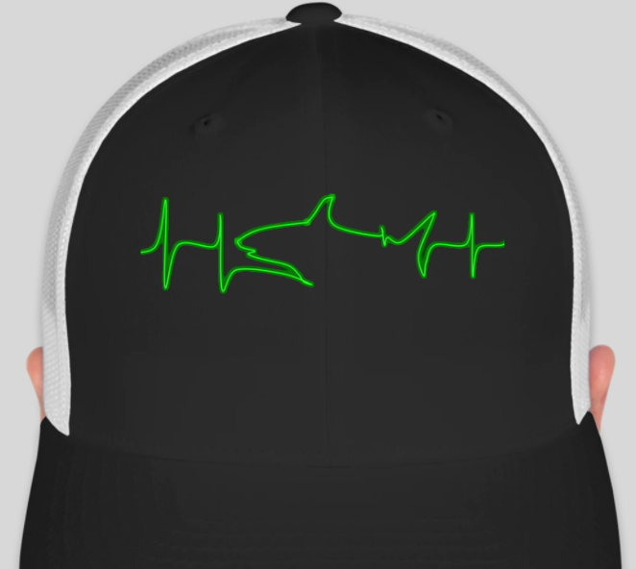
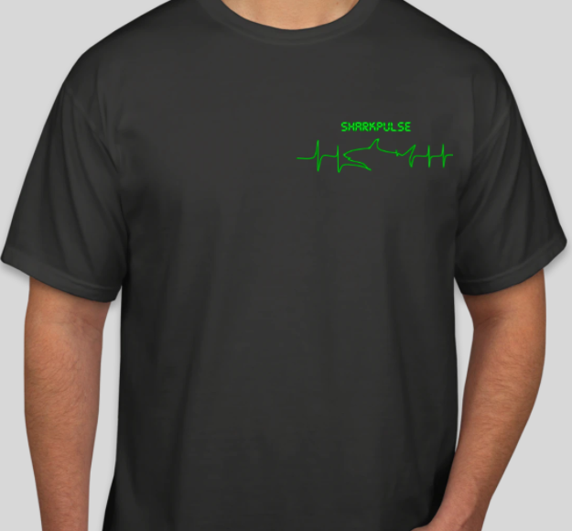

Gaming
Scoring
Achievements
Events and Prizes
Notes:
Steven

Slide 12
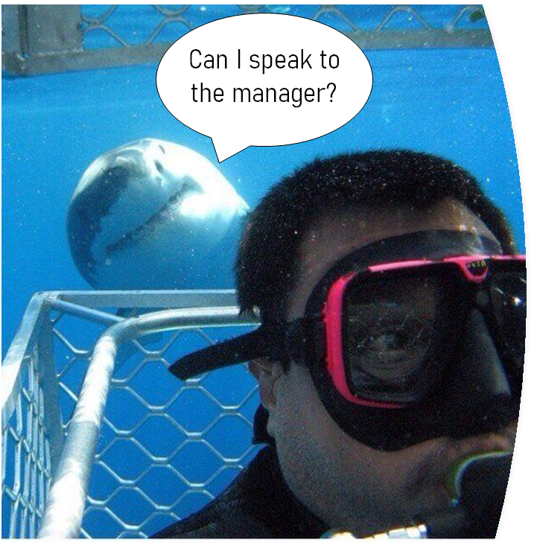
Acknowledgements
Client: Francesco Ferretti, PhD, Assistant Professor, Department of Fish and Wildlife Conservation
ferretti@vt.edu
Mentor: Dr. Edward Fox, PhD, Professor, Department of Computer Science
fox@vt.edu
sharkPulse, sharkpulse.org

Slide 13
References
McCool, R. 2020. Apache HTTP Server. Version 2.4.46. http://svn.apache.org/repos/asf/httpd/httpd/
Mason, S. 2018. PostgreSQL Global Development Group. Version 13.2. https://www.postgresql.org/about/news/postgresql-132-126-1111-1016-9621-and-9525-released-2165/
Ferretti, F. 2021. sharkPulse, take the pulse of global shark populations. https://www.sharkulse.org
Instagram. 2021. Capture and Share the World’s Moments. https://www.instagram.com/
Flickr. 2021. Share your photos. https://www.flickr.com/
iNaturalist. 2021. A Community for Naturalist. https://www.inaturalist.org/
Wordpress. 2021. Just another WordPress site. https://wordpress.com/

Slide 14
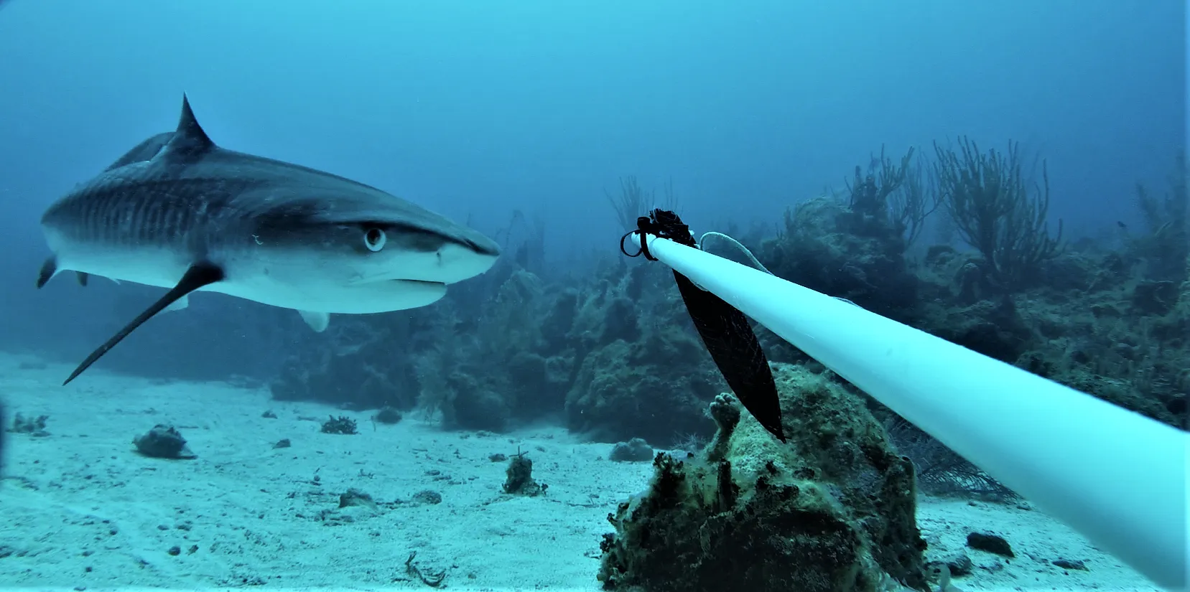
QUESTIONS?

