Slide 1
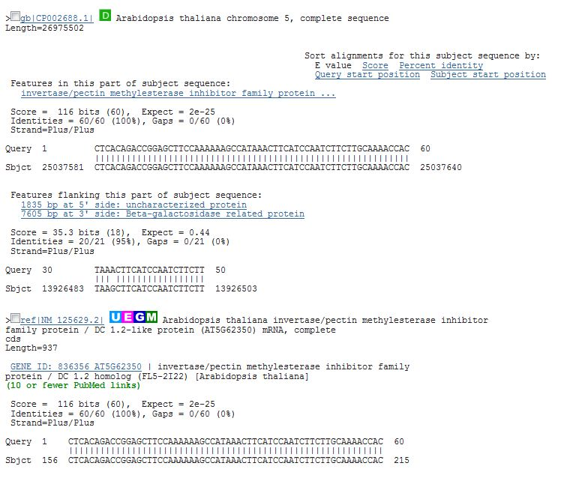
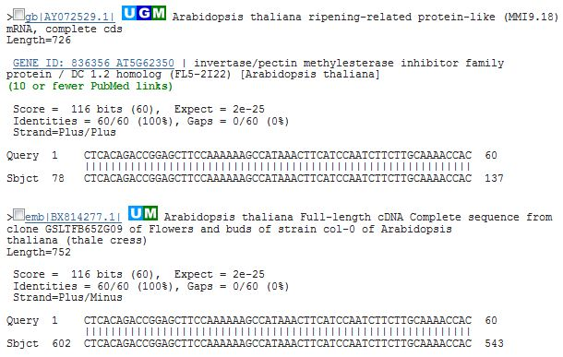
Additional file 4
Notes:
Additional file 4: The Col-0 sequence carrying SNPs, shown in Figure 2 (a), has three known cDNA sequences in GenBank.

