Slide 1

CRISIS EVENTS KNOWLEDGE GRAPH GENERATION
Team 5:
James De Chutkowski, Justin Turkiewicz, Matthew Walters, Anthony Tran, Geethika Abhilash
CS4624: Multimedia, Hypertext and Information Access
Instructor: Mohamed Farag
Virginia Tech, Blacksburg VA 24061
4/23/2024
Notes:
James

Slide 2
Outline
Architecture
Features
  Login
  Knowledge Graph
Challenges
Timeline
Future work
Live demo
Acknowledgements & References
Notes:
James

Slide 3








Architecture
User Account Info and Collections are stored in MongoDB
React frontend interacts with Flask backend API
MongoDB
Scrape and extract text from a list of URLs, HTML or TXT files. Saves the files into a local file server database
Use NER & Triplestores to classify words from extracted text using NLTK and CoreNLP Server
Send JSON of nodes and relationships to React to render the knowledge graph with Sigma.js
Build knowledge graph into Neo4j database using Neo4j's Cypher Query Language
Neo4j
Notes:
Geethika
Were using react frontend out frontend and flask for our backend. We use standford nlp nltk for generating knowledge graphs, neo4j for storing graphs, and sigma for rendering graphs. We use mongodb to store user information

Slide 4
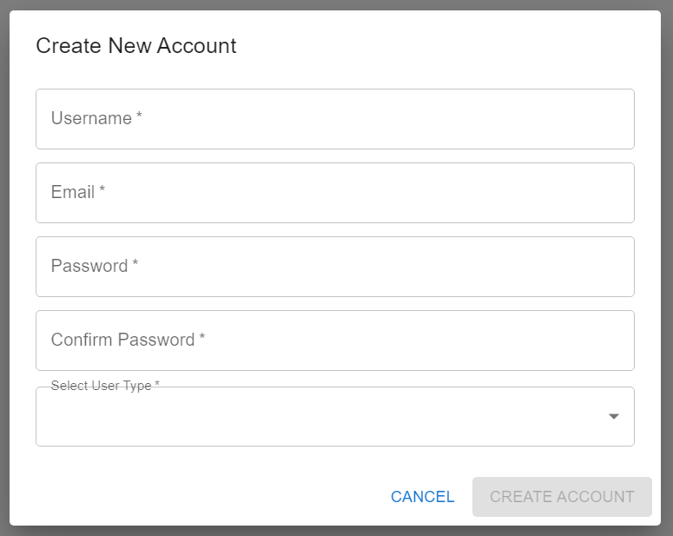
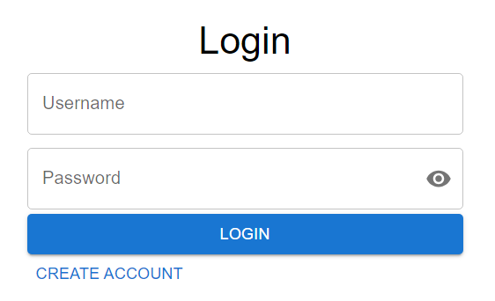
User Authentication Frontend
Notes:
Anthony – skip during presentation
(James says during demo)
Landing page when first start up
Two options
Login
Create new account

Slide 5
User Authentication Data-Flow
Frontend
Backend
Login
POST Login
Database
MongoDB
Create
POST Sign Up
Notes:
Anthony
Two paths for user authentication
Login
Calls REST endpoint
Checks if login information is valid
Logs user into application if it is
Signup
Same thing as above
But instead of returning a result it will create a new user in the mongoDB

Slide 6
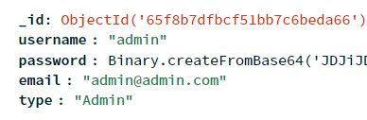
User Authentication Schema
Format
Id
Username
Password
  bcrypt
Email
Type of user
Notes:
Anthony
Current user collection in mongodb
Each user will have basic information like username and password which in here is encrypted using bcrypt before adding to db

Slide 7
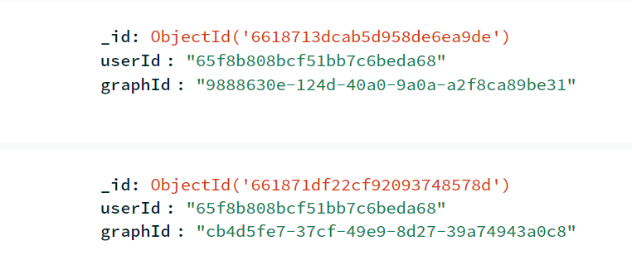
User Collections Schema
A collection's graphId is associated with the user's userId that created the collection

Slide 8
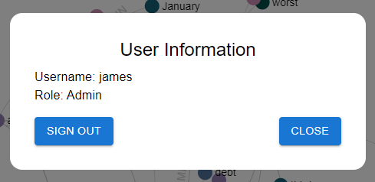

USER Session Frontend
Notes:
Anthony
(james say during demo)
Once the user is logged in, they are able to view their current user information by pressing on user info in the main page
They can also log out of their account which will take them back to the login screen

Slide 9
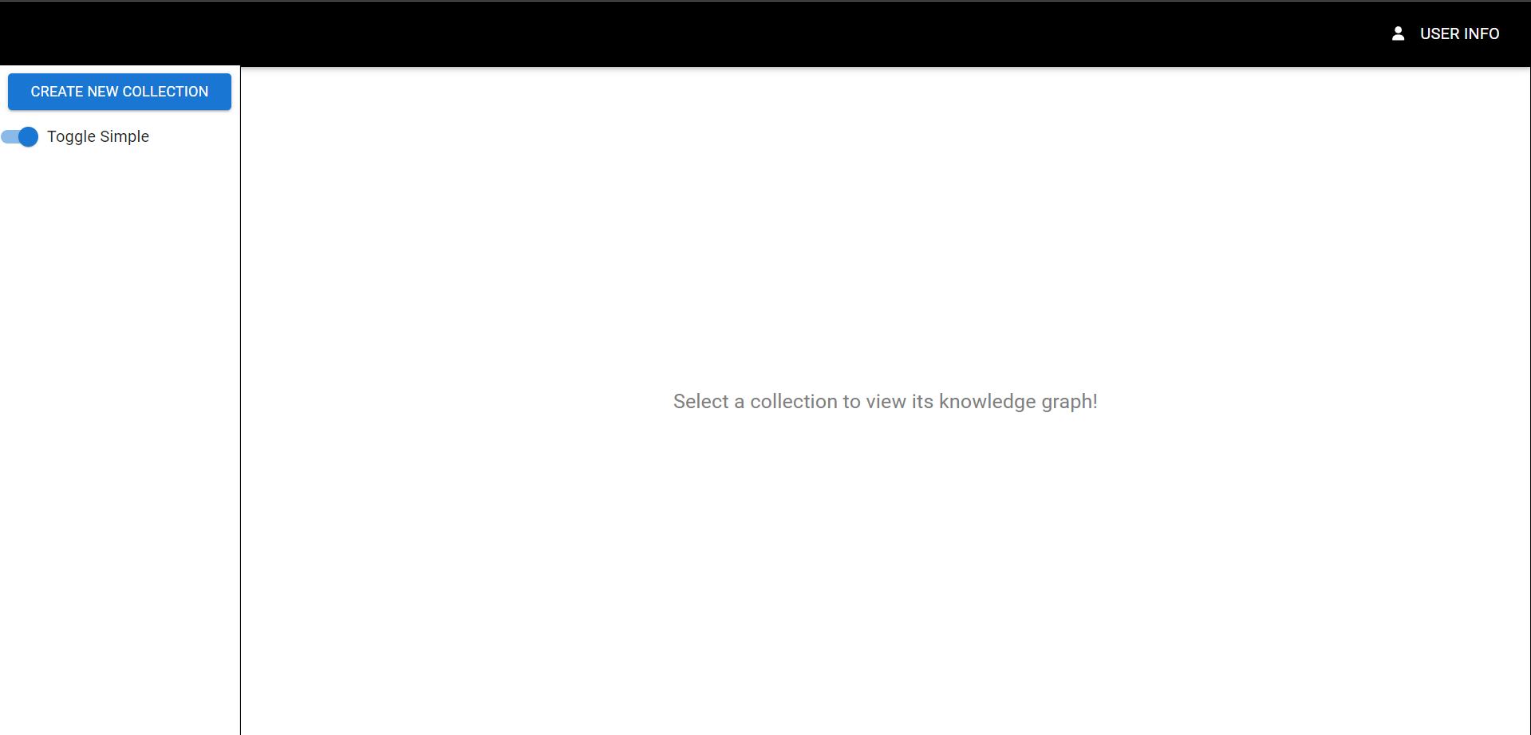
Home Page
Select Collection to show Graph
Notes:
James – skip
We'll go into more detail about the graph generation process that happens when a new collection is created
(say during demo)
On the home page, the user can view their knowledge graphs, create new collections to start the process to generate new knowledge graphs, delete existing collections and their knowledge graphs, view collection and knowledge graph info, and view their own user info. For the admin, the view will be similar as they will be like any user except they can additionally view/delete collections of other users.

Slide 10
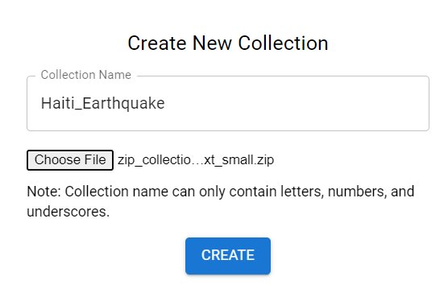
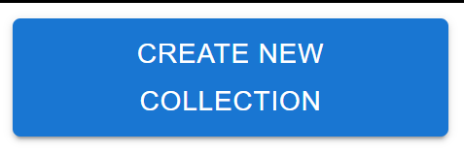
Create New Collection
Notes:
James – (skip during pres)
(say during demo)
When the user presses the "Create New Collection" button in the side menu, a modal will open up in the middle of the screen prompting them to input a name for the collection and a data file. The input file will be one the of formats previously mentioned: .txt file with urls, .zip w/ html, or .zip w text.
Once the user presses create, the data will be sent to the backend and while the knowledge graph is being generated, there will be a loading icon where the graph would appear in the home page as the user waits for the graph to finalize and be sent back to the page.
IMPORTANT: Graph Generation Pipeline
User uploads a file and its data is sent to flask api endpoint
processes text into triplestores using a ner model to generate a graph from the triplestores in a neo4j graph database.
Flask api returns graph data as json.
React + sigma.js to render the json data into a knowledge graph.

Slide 11
Triple extraction
John
Using Stanford CoreNLP Parser and OpenIE with NLTK
Forming Subject-Predicate-Object Triples
Input: John and Sally have hazel eyes
Has
Hazel Eyes
Has
Sally
Subject (Node) | Predicate (Edge) | Object (Node)
John | Has | Hazel Eyes
Sally | Has | Hazel Eyes
Notes:
Matthew – I'm going to quickly review the triple extraction, which is the underlying logic for determining the node values and edge relationships. We use the Stanford CoreNLP Parser with the Open Information Extraction with NLTK. The goal is to take a sentence and form triples of subject, predicate, object where the start node is the subject, the edge is the predicate, and the end node is the object. So for "John and Sally have hazel eyes" we get John has hazel eyes and Sally has hazel eyes which forms the knowledge graph on the right.

Slide 12
Reducing Redundancy
Haiti's history of national debt, prejudicial trade policies by other countries, and foreign intervention into national affairs contributed to the existing poverty and poor housing conditions that increased the death toll from the disaster.
Subject (Node) | Predicate (Edge) | Object (Node)
Trade policies | Contributed to | poverty
intervention | Contributed to | poverty
poverty | Is to | existing
Foreign intervention | Contributed to | Existing poverty
debt | Is of | national
countries | Is by | other
Haiti's history | Contributed to | poverty
Prejudicial trade policies | Contributed to | poverty
Prejudicial trade policies | Contributed to | Existing poverty
Notes:
Matthew – Multiple triples can be formed from one sentence, and with a complex sentence like the one above we get these 9 triples. However, some of the triples are repeats of others where they mean the same thing just have different values.

Slide 13
Cluster Triples
Subject (Node) | Predicate (Edge) | Object (Node) | Complexity Score
Trade policies | Contributed to | poverty | 5
Prejudicial trade policies | Contributed to | poverty | 6
Prejudicial trade policies | Contributed to | Existing poverty | 7
Simple: Lowest Score
Complex: Highest Score
Prejudicial Trade Policies
Trade Policies
Poverty
Existing Poverty
CONTRIBUTED_TO
CONTRIBUTED_TO
Notes:
Matthew – So in order to account for this redundancy, we use the fuzzywuzzy library to compare the similarity between the strings to form clusters of triples with the same meaning. We then score these triples based on their complexity, which is determined by the amount of words within a sentence. As you saw in the demo, the user can determine if they want the "simple" graph which gets the triples with the lowest score, so here it's trade policies contributed to poverty with a score of 5, or if they want the "complex" graph which gets the triples with the highest score so here it's "Prejudicial trade policies contributed to existing poverty".

Slide 14
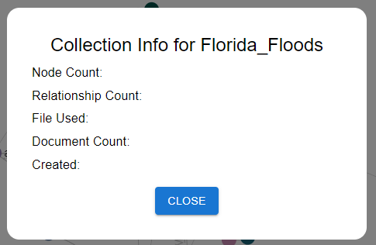

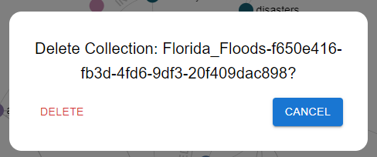

Viewing Info and Deleting Collection
Notes:
James
(say during demo)
The user can view a given collection's information by clicking the information icon next to its name in the sidebar. We are still figuring how what information to display, hence why this is blank. Additionally, a user can delete a collection by clicking the trash icon. This will send a request to the backend to delete it from the database.

Slide 15
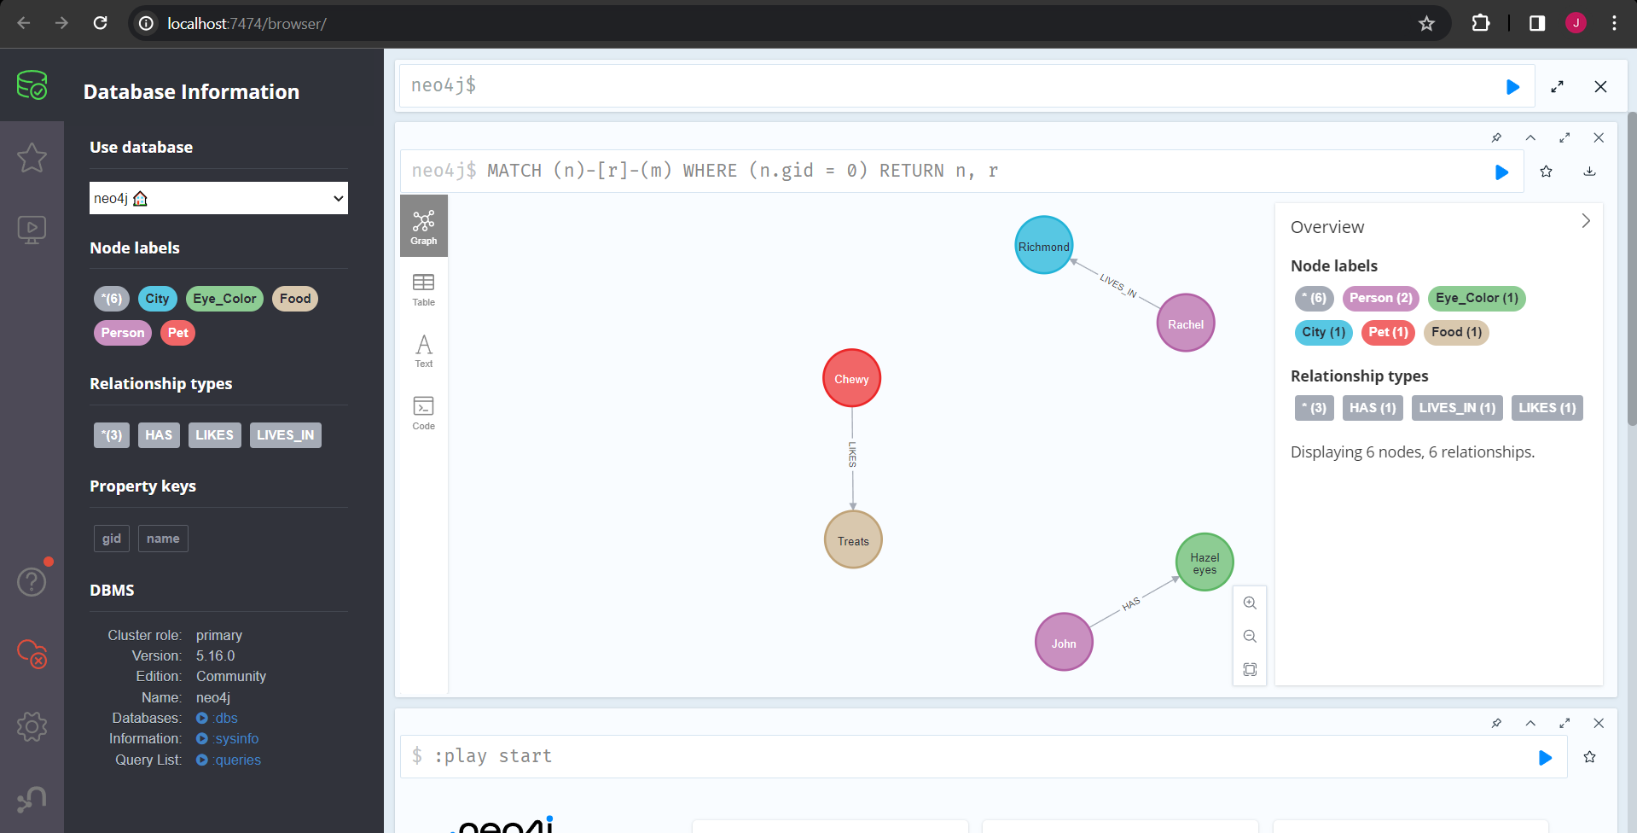
Data flow
JSON
TripleStoreJSON = [
{
"subject": {"value": "John", "label": "PERSON"},
"predicate": "Has",
"object": {"value": "Hazel Eyes", "label": "MISC"}
},
{
"subject": {"value": "Sally", "label": "PERSON"},
"predicate": "Has",
"object": {"value": "Hazel Eyes", "label": "MISC"}
}
]
Neo4j
Notes:
Matthew

Slide 16
UTILIZING CYPHER QUERY LANGUAGE ON NEO4J DATABASE
Use Neo4J's CQL to execute queries on Neo4J DB that creates the nodes and relationships from the triplestores
Need to Process Subject-Predicate-Object triplestores into (Start)Node-Relationship-(End)Node
A user collection has its own graph within the neo4j database. The nodes and relationships that form that graph are identified by their 'gid' property
Notes:
Justin
Once the triplestores and labels have been determined by the nlp and ner parsers, the data is sent to the knowledge graph code
Each triplestore is translated from subject-predicate-object to start node-relationship-end node.
To build the nodes in neo4j we use their cypher query language (cql) to create the nodes and relationships discussed on the next two slides
When a user creates a collection, they will have their own graph of data stored in the neo4j database. The entities associated with that graph have a 'gid' property that maps to the user's collection.

Slide 17
CQL – Creating nodes for graph with gid=0
Create nodes:
WITH $nodes AS batch UNWIND batch as node CREATE (n:Placeholder) SET n.name = node.name, n.gid = node.gid;
This command sends a batch of 'create' cql commands at a time to the neo4j database that creates a subset of nodes in the "nodes" array until all nodes in the "nodes" array are created
Notes:
Justin
To build the graph we start by creating the nodes.
Before that a composite index is applied to each label so that neo4j can more efficiency match nodes which occurs in the next slide. This is because the index is a combination of the label and the specified properties. Right now, we don't have labels coming in as input, so we use a 'Placeholder' label for now. These CREATE INDEX queries are run once on the database itself.
For creating the nodes, they are stored in a python list which cypher then iterates over to create nodes for each of them in a batch. The purpose of batching and unwinding is to efficiently create thousands of nodes at a time. This is what neo4j recommends for batch creation. UNWIND will turn the list of nodes provided---named "Batch" in this case---into individual rows and then iterate through each of those rows to create each node. This predictable format allows neo4j to compress and optimize the query as much as possible.
Create index to improve overall query efficiency:
CREATE INDEX composite_index FOR (n:Placeholder) ON (n.name, n.gid);

Slide 18
CQL – Creating Relationships for graph with gid=0
Get the nodes in the graph database and associate them with a label ('a' and 'b'):
MATCH (a:`Misc` {key:'m0', gid: 'cc98d65...'}), (b:`Misc` {key:'m1', gid: 'cc98d65...'})
Create the relationships between the nodes from the labels instantiated in the previous match commands:
CREATE (a)-[:`IS` {gid: 'cc98d65...'}]->(b)
Notes:
Justin
Next is creating the relationships.
First, the nodes to create the relationships must be retrieved. This is done with the MATCH cypher command who will get the nodes and associate them with a label. In this case, they are associated with a indexed label.
Finally, the relationships between the nodes are created using the indexed labels from the match and the predicates as the relationships between the nodes.
"MATCH (a:`Misc` {key: 'm0', gid: 'cc98d65a-62ec-4bb3-a3cb-970511500aac'}), (b:`Misc` {key: 'm1', gid: 'cc98d65a-62ec-4bb3-a3cb-970511500aac'}) CREATE (a)-[:`IS` {gid: 'cc98d65a-62ec-4bb3-a3cb-970511500aac'}]->(b)"

Slide 19
Dev View: Neo4j DB Container Running Locally
Notes:
Justin
To view the neo4j database, you can access it in the browser (or their desktop application). This is what the database admin view looks like for a neo4j database running in a docker. Users do not see this information and is purely for database management and development purposes

Slide 20
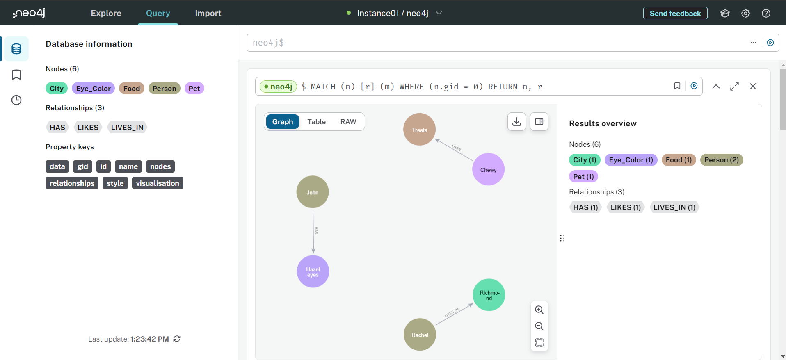
DEV View: Neo4j Aura DB Running in Google Cloud
Notes:
Justin
Similarly, here is the view for the neo4j aura database that is running in the cloud. We can store up to 200 thousand nodes and 400 thousand relationships in the cloud database for free.

Slide 21
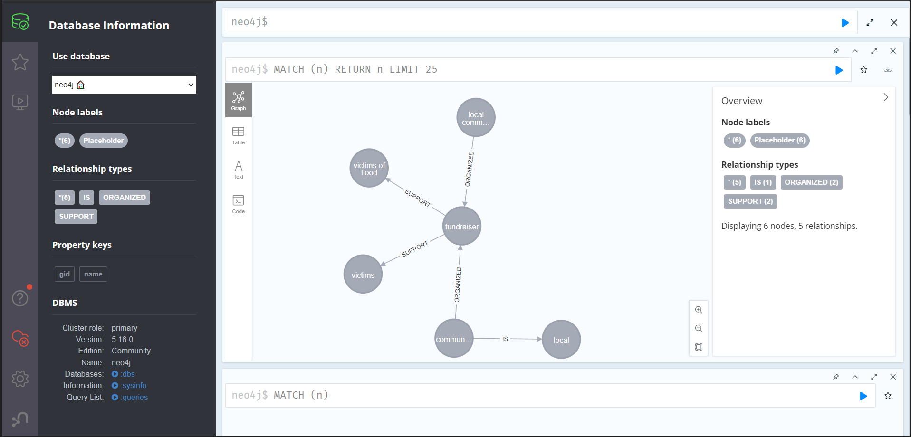
Triplestore Output of Following sentence:
"The local community organized a fundraiser to support the victims of the flood."
Notes:
Justin
Here is an example of a sentence we use for testing the graph generation pipeline.
This sentence gets sent to Stanford's CoreNLP server. The server sends back the triplestores of this sentence.
We don't have it working yet, but eventually the subjects and objects will be classified into classes with an named-entity-recognition parser.
Finally, the triplestores are generated in neo4j using the cypher query language.

Slide 22
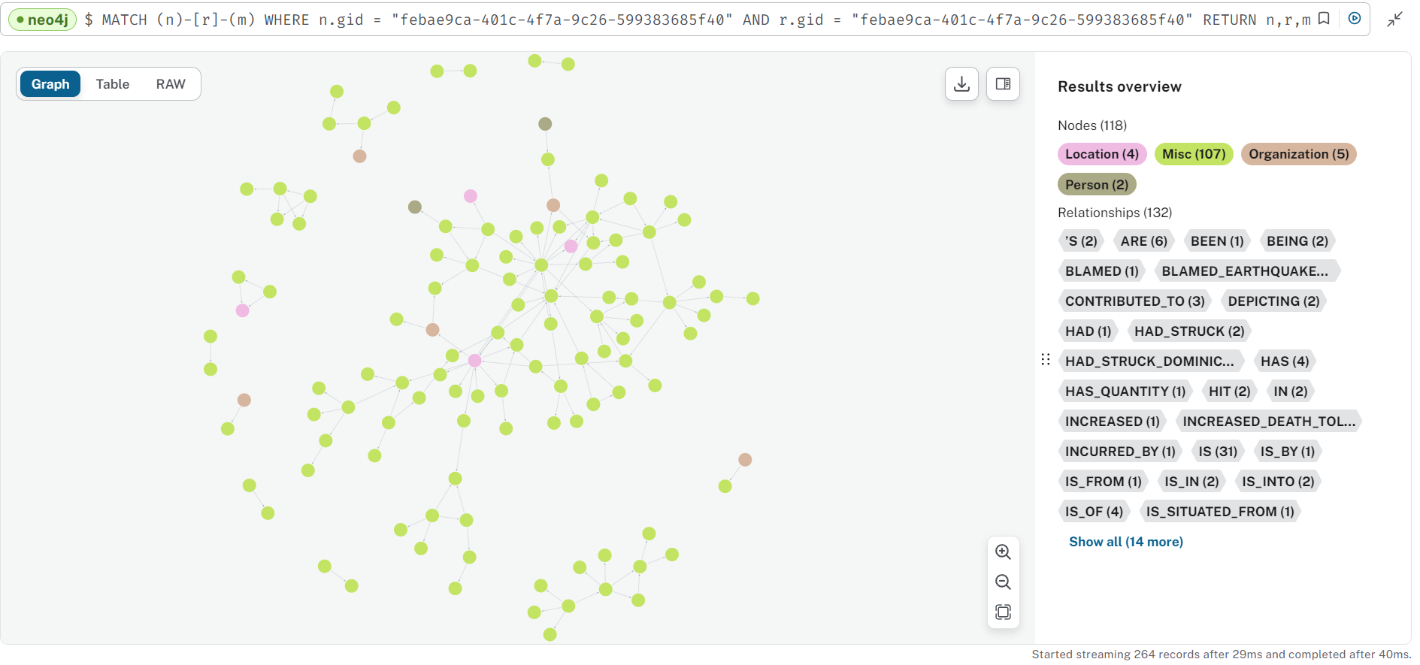
NEO4j View – Simple Knowledge Graph
Notes:
Justin

Slide 23
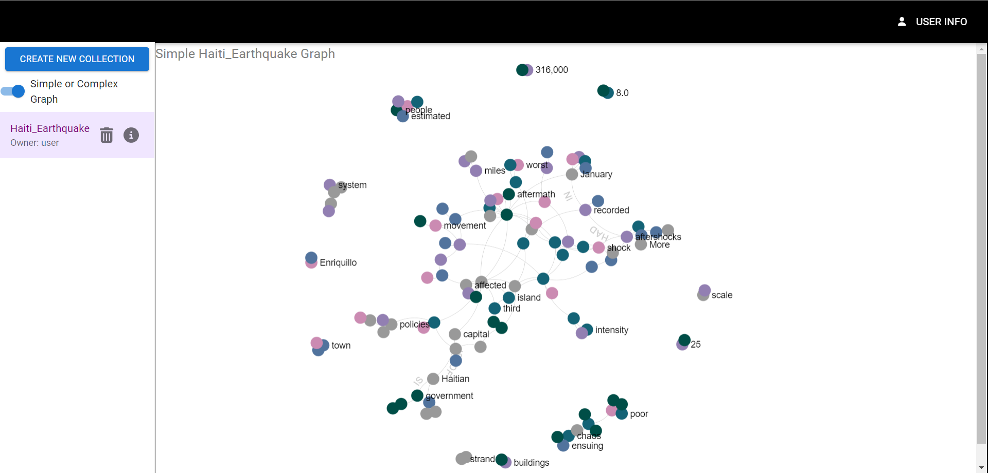
Rendering -SIMPLE KNOWLEDGE GRAPH
Nodes and edges extracted from JSON and plotted
Graphology's forceAtlas2 algorithm used for node locations
Notes:
Geethika
Here is the graph dynamically rendered in our ui when a user select a collection

Slide 24


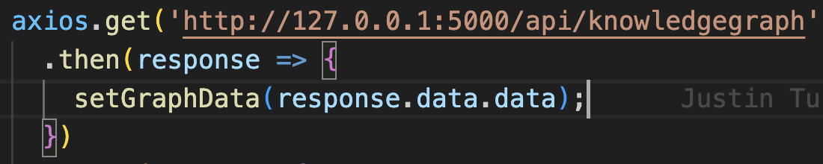

Rendering
User request
Request for graph
Frontend rendering
Using graphology and sigma
Request for graph
Graph as json
User
Interface
Neo4j graph database
Notes:
Geethika
We send a request to our backend to retrieve a graph in json format from the neo4j database and render it using sigma and graphology's forceatlat 2 algorithm

Slide 25
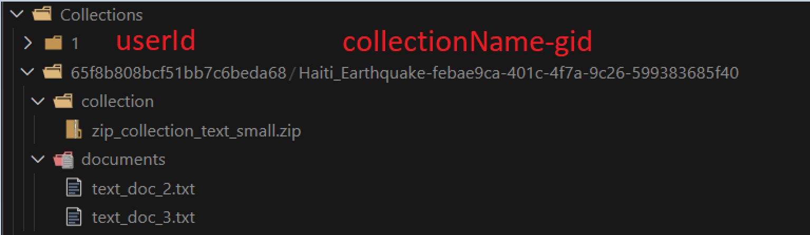
File Server Database
Notes:
Justin

Slide 26
Challenges
Working with NLP to form triplestores
Efficiently populating nodes and relationships in neo4j db with cypher query language
Managing three processes running for development
System compatibility between mac, windows and linux
Notes:
Matthew

Slide 27
Future work
Update existing collections and user information
Import and export graphs between users
Fine tuning triple extraction
Notes:
James

Slide 28
Updated Timeline
04/08
Finalizing Project
Rigorous Testing
Code Cleanup
03/21
Graph Creation
Lead By: Geethika & Justin
Finalize Graph Storage
Graph Display
Lead By: Justin & Matthew
Deployment
03/30
Finalize Backend
Lead By: James & Anthony
User Storage
Graph Storage
03/23
Information Processing
Lead By: Justin & Matthew
Converts document text to triples
Scraping html documents or a txt file of urls
03/27
Finalize Frontend
Lead By: James & Anthony
Finish User Login/Registration
Data Structures
02/08
Requirements & Design
Lead By: James
Understand Project Requirements
Example UI Wireframes
Finalize Contract
02/26
Prototyping
Lead By: Justin & James
Connecting Endpoints
UI Framework
Hardcoded Values
NER Tagging
Admin View
05/01
Final Report
Lead By: James & Geethika
Finalize Documentation
Make report
Notes:
Geethika

Slide 29
Live Demo

Slide 30
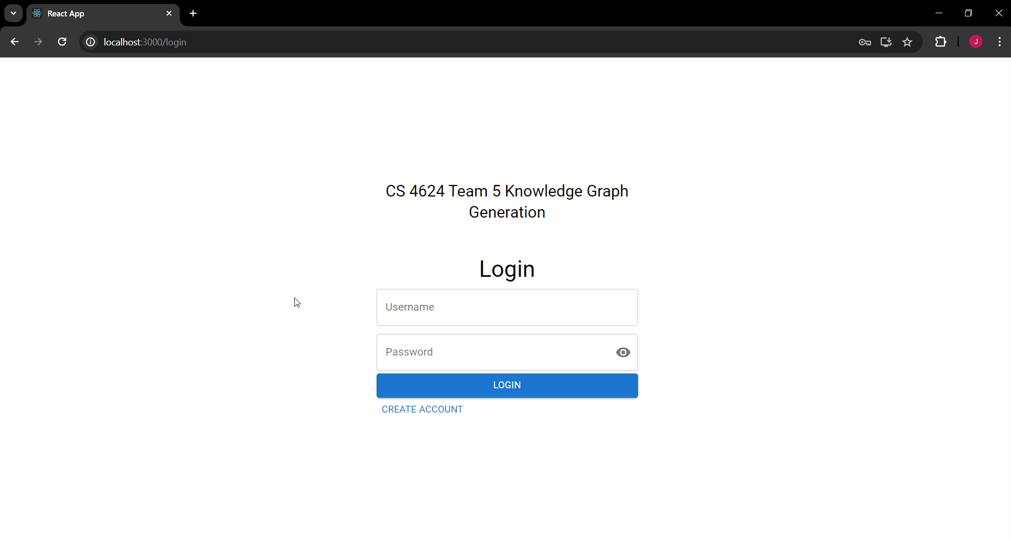
Create Account and Login as User

Slide 31
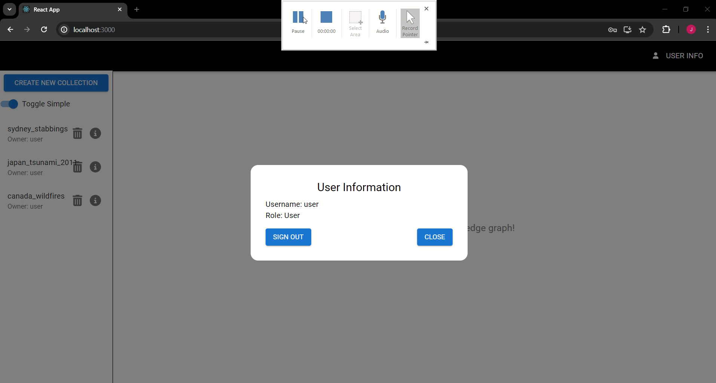
Admin View

Slide 32
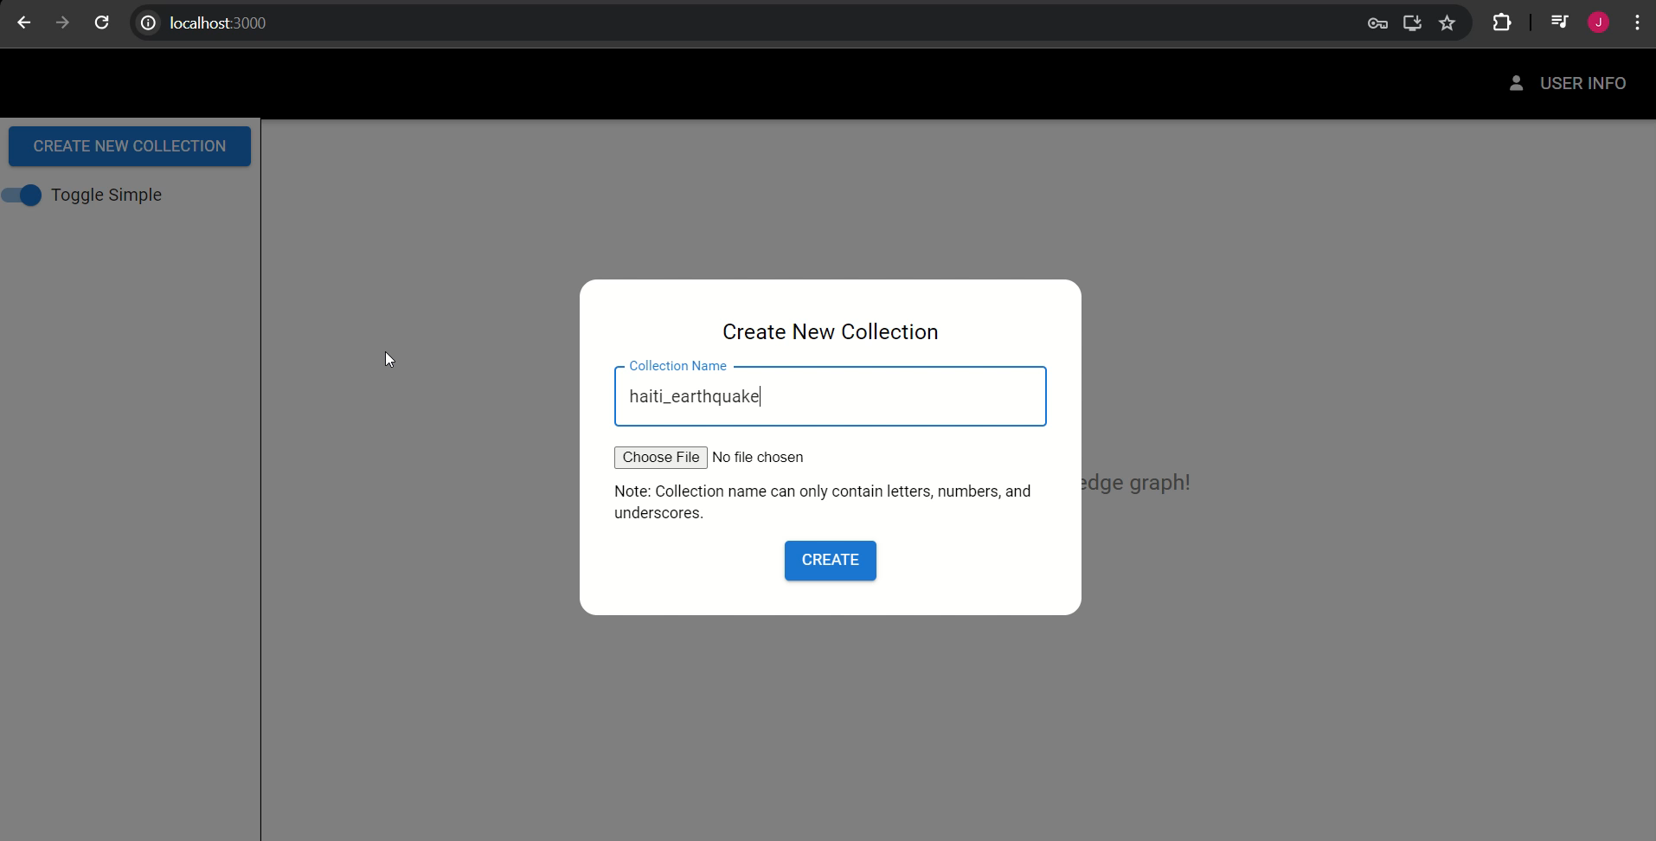
Create HTML collection Graph

Slide 33
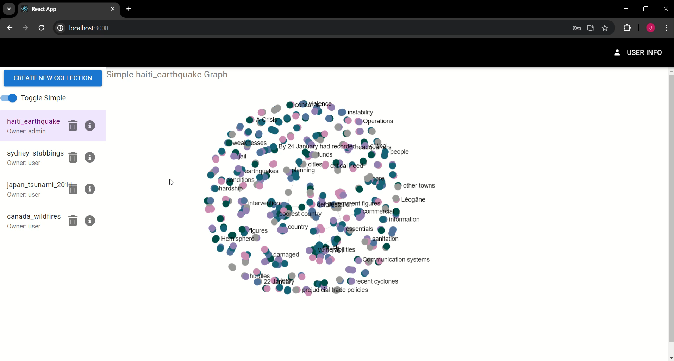
Simple & Complex Graph View

Slide 34
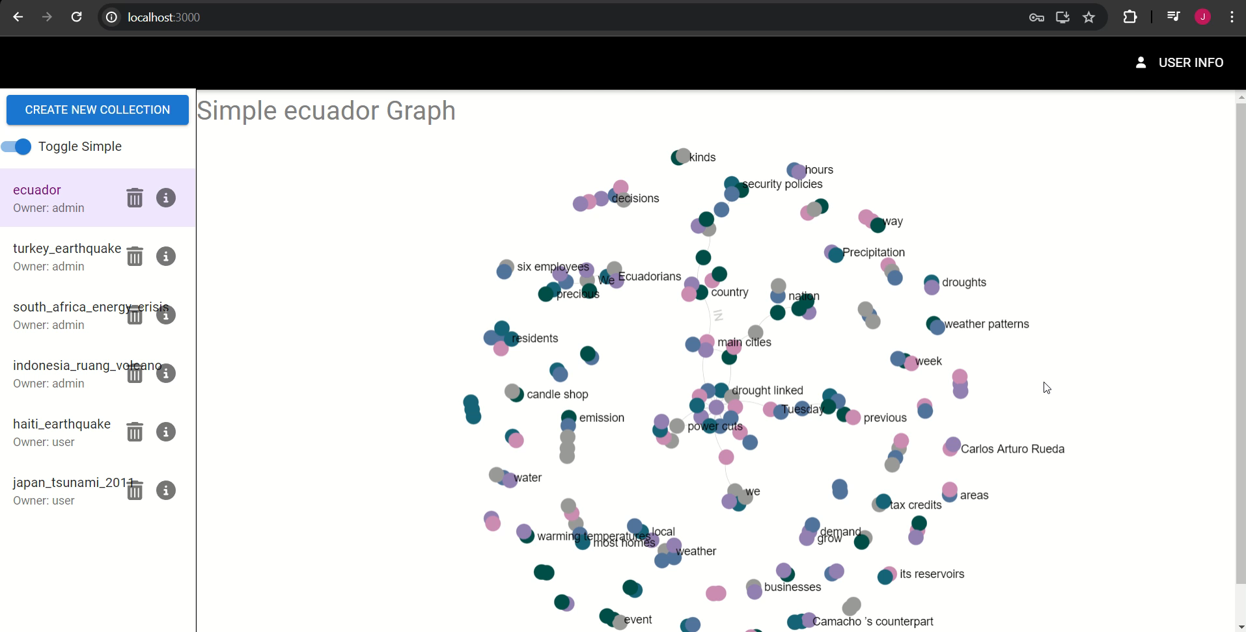
Simple VS Complex Nodes

Slide 35
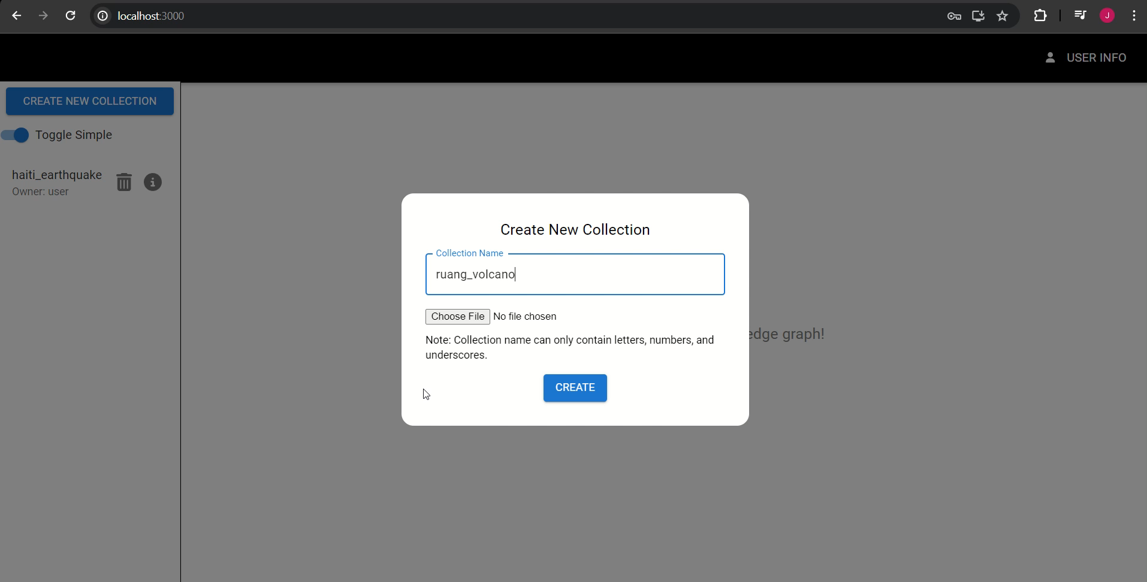
Create TEXT collection Graph

Slide 36
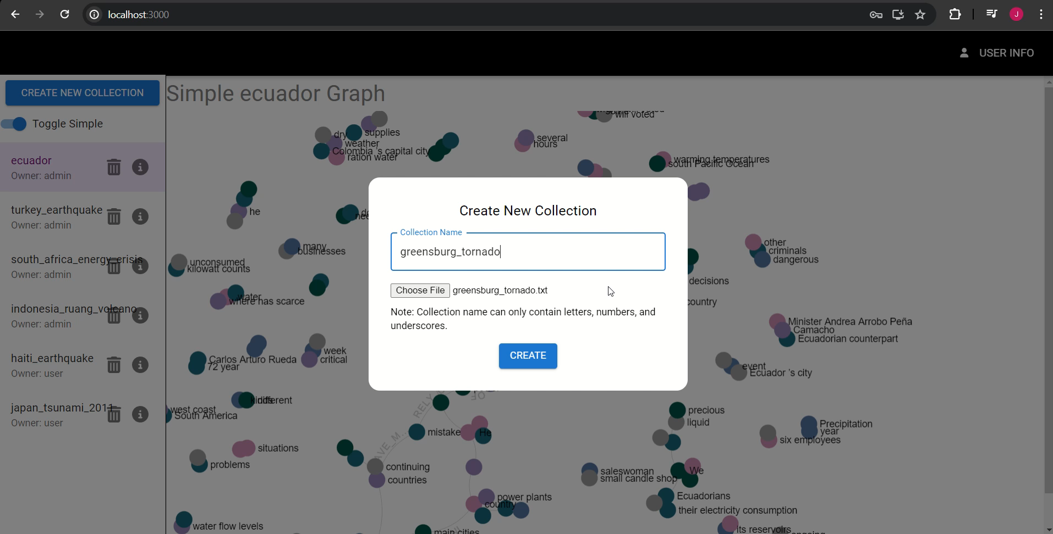
Create URL Collection

Slide 37
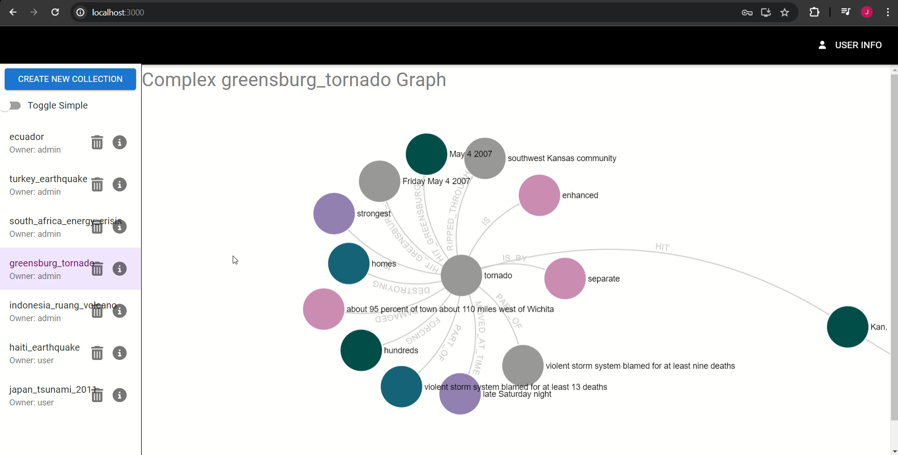
SHOW INFO TAB, DELETE COLLECTIONs and sign out

Slide 38

ACKNOWLEDGEMENTS
Dr. Mohamed Farag, the professor and client
Notes:
Geethika

Slide 39
References
https://www.sigmajs.org/
https://nlp.stanford.edu/software/CRF-NER.shtml
https://stanfordnlp.github.io/CoreNLP/corenlp-server.html
https://neo4j.com/
https://nlp.stanford.edu/software/openie.html
Notes:
Geethika

