Slide 1
Making IT Work Part II:
Integrating with IT to Develop a Sustainable Preservation System
Alex Kinnaman · Luke Menzies · James Tuttle
Virginia Tech University Libraries
Notes:
Hello. Welcome to "Making it Work/ Making IT Work, Part 2". (speaker introductions).
James Tuttle could not present with us due to last-minute scheduling conflicts, but we'd like to thank him for his contribution to this presentation, and his collaboration on the larger project.

Slide 2
Outline
Background and context
Challenges
Strategies
Outcomes
Next Steps
Notes:
In this presentation, we're going to walk through the following five sections:
1. a quick background for our collaboration with IT
2. some of the all-too-familiar challenges that we faced
3. the strategies we used to address these challenges
4. some of the positive outcomes from our collaboration
5. and finally, our next steps moving forward

Slide 3
Background
Exactly one year ago…
Sat on a panel with 3 other institutions to discuss how IT and preservation personnel communicate and “make it work”
4 months later…
VTUL digital preservation joined forces and moved directly into IT… ¯\_(ツ)_/¯
Notes:
At last year's NDSA DigiPres, we joined our colleagues from UCLA, the Computer History Museum, and the University of Arkansas, on a panel to discuss strategies for working with IT to accomplish digital preservation goals. The title of this project is a play on words, which arose from a phrase uttered by many a preservation specialist, along the lines of, "I just want it to work. Please just make it work!" Our goal was to bridge the communication gap between preservation and IT and to find ways to build positive, productive relationships with IT.
About the same time as last year's presentation, James Tuttle was hired, as Associate Director for Digital Library Development, to create a unified digital curation system, now called the Virginia Tech Digital Library Platform. Also, in February of this year our unit was moved into IT, and our collaboration with James' unit began in earnest.

Slide 4
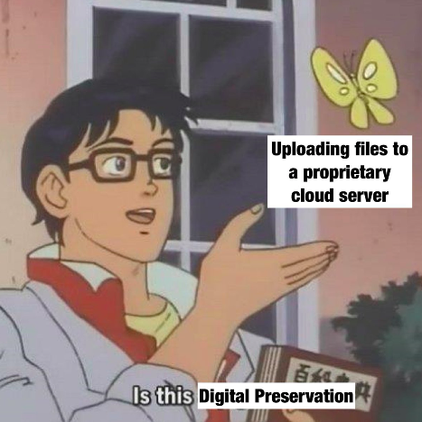
Challenges: Overview
IT
Advocacy for preservation within IT
  certain tasks considered unnecessary
Building trust on both sides
  we distrust each other, but for different reasons
Authority to implement preservation activities
  "On whose authority?"
Notes:
Among the many challenges -- or "opportunities" as I like to call them -- that we faced in our new roles as "IT-but-not-entirely-IT", most could be characterized in these three ways:
- First, a need to advocate for preservation activities with IT personnel. Some of what we wanted to do was thought to be unnecessary, and when we pressed these issues a common response was, "Don't worry about it. We have it all under control."
- Second, a need to build trust on both sides. WE wanted to protect the data. Systems administrators wanted to protect the systems. We distrusted each other, but for different reasons.
- Third, a need for the authority to implement preservation activities. Sometimes even minor suggestions from preservation were met with the equivalent of asking, "On whose authority?" Apparently, it was not enough that the two of us have advanced degrees, are specialists in this particular field, and were hired to do these things, if "Simon didn't say ... "

Slide 5
Not a communication issue
Working against IT's expectations, that users:
Break things
Want them to do unnecessary work
Try to tell them how to do their work
Use systems in unexpected ways
Notes:
Last year we presented on our attempts to bridge the communication barrier by learning the language of ITIL, DevOps, and Agile project management. In a frank conversation with James Tuttle, however, we discovered that the problem was not so much that the developers and systems administrators did not understand what we were trying to accomplish, but that -- to put it mildly -- "they think we're full of it". Predicated on the aforementioned lack of trust, IT's sentiment toward us was motivated by their experiences with inexpert users who: broke things, wanted them to do unnecessary work, wanted them to do things in particularly inefficient ways, and generally acting the way users do.

Slide 6
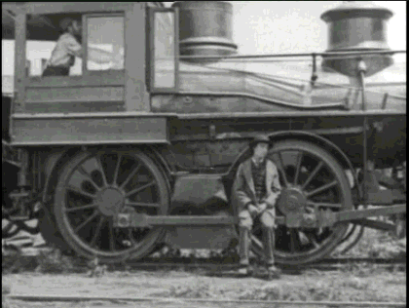
The Library System Train
IT is trying to keep the train on time
Digital preservation makes the train more complicated
Notes:
This image is the perfect metaphor for our current situation. If the library is a public transit system, systems administrators and applications developers are trying to "keep the trains running on time." Digital preservation adds a layer of complexity that, in effect, makes their work more difficult.

Slide 7
How do you implement a preservation policy, procedure, or workflow that relies on IT but that IT does not think is necessary?
Notes:
Something we've been hearing regularly in sessions at DLF and DigiPres is that many of us are struggling with the the fact that we are responsible for doing the digital preservation work that we were hired to do, but sometimes lack the authority to implement the activities and make the decisions necessary to carry out that work.
Digital preservation personnel are not usually systems administrators. Many of us have programming skills, but we’re not developers, per se. While we are authorities on digital preservation, we are not necessarily experts in the technical infrastructure upon which digital library and preservation systems are built. So the big question for us is, how do we implement a policy, procedure, or workflow that relies on IT but that IT does not think is necessary?

Slide 8
The answer: "We can't."
That is, we can't implement comprehensive and robust preservation without:
Strategic commitment at the institutional level
Institutional and IT leadership who understand and are committed to digital preservation
Targeted advocacy for preservation with IT systems and development
Notes:
The answer to this question that we have found is that WE can't implement digital preservation in a comprehensive way without:
* An intentional, strategic commitment to digital preservation at the institutional level
* Institutional leadership who understand and are committed to digital preservation
* Targeted advocacy for preservation with IT systems and development
Thankfully, our dean, head of IT, and our Associate Director for Digital Libraries all have extensive backgrounds in digital preservation. Thus, our library has made a strategic commitment to digital preservation because our leadership understand what's at stake and are committed to preservation. In order to accomplish active participation by IT systems and development, we are taking a multi-tiered approach to communicating preservation needs and the justifications for those needs, with varying degrees of granularity. We will talk more about this later in the presentation.

Slide 9
Strategies
Shared roadmap
Regular meetings between preservation and the rest of the DLP team
Preservation stakeholders as product owners
User stories and product requirements pages
JIRA task creation and prioritization
Library-wide cultural shift
Notes:
With our team's incorporation into IT, and largely due to our Associate Director of Digital Libraries' willingness to collaborate with us, we have launched into an effort to develop shared language, shared tools, and shared goals with the rest of the Digital Library Platform team.
The 6 strategies we have been using are:
1. Develop a shared roadmap, so that we're on the same path as we forge ahead
2. Regular meetings, both with leadership and with the rest of the DLP team
3. Conceptualizing preservation stakeholders as product owners
4. Using software development tools like user stories and product requirements pages to communicate preservation goals
5. Integrating preservation tasks and priorities into IT's JIRA instance
6. Finally, pushing for a gradual shift in our Library's culture, toward a collaborative, interdependent model that is based on trust

Slide 10
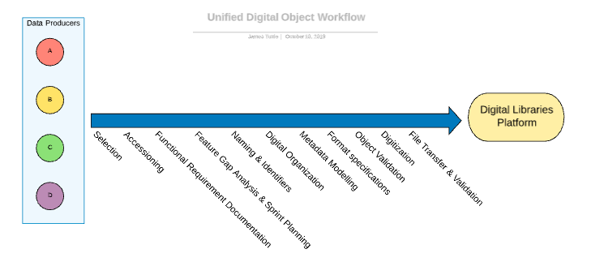
Shared Digital Libraries Platform Roadmap
Notes:
This DLP roadmap was created by James Tuttle, the Associate Director for Digital Libraries at VTUL, and shared with our entire library during our monthly Library Forum. This roadmap is the general workflow for ingesting content into our new Digital Libraries Platform (which also includes the preservation system). It is also preservation-centric. The system uses a lot of language related to access, but it is predicated on digital preservation. For example, we collaborate with all of our data/content producers and work with them to create archival copies during digitization; we collaborate with our metadata creators to ensure certain preservation metadata is present; and we work directly with IT to create derivatives from the archival copies.

Slide 11
Policy
Shared Roadmap requires preservation-specific policy
Preservation policies dovetail with DLP technical documentation
No one else wants to work on policy development
Our first successful IT and preservation integration!
Notes:
The shared DLP roadmap requires preservation-specific policy and procedure for each microservice, as well as general documentation that adheres to standards. Since preservation policies dovetail with DLP technical documentation and their need for policy, preservation has been able to apply [limited, but some] amounts of TDR and other preservation standards to some of our policy-making. This, coupled with the fact that most of our colleagues would rather do literally anything else than write policy or documentation, has been our first and most successful collaboration work between preservation and IT, where I draft everything I want and then haggle with IT on what is reasonable to actually implement.

Slide 12
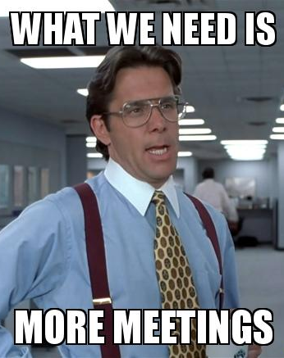
More and different meetings
New weekly Digital Curation Strategies meeting between preservation and IT exclusively
discuss policies, ideal procedures, instruction on using IT’s project management system
Preservation participates in weekly Digital Library Development meetings
updates on backend development and progress
Notes:
More meetings is not what most people ever need, but the right meeting can sometimes be productive. We established regular weekly Digital Curation Strategies meeting where preservation personnel and the AD of Digital Libraries (and Sys Admins when necessary) can make decisions together rather than as separate entities. This is where most policy and ideal procedure discussions occur, as well as the slow adaptation of ITs project management system are practiced.
Second, preservation has joined a standing weekly Digital Library Development, which is the team that works on the backend development tasks for current services and the ongoing development of our Digital Libraries Platform.

Slide 13
Workflow transition
Preservation as the last step of several different workflows
Preservation as a component of every microservice and service provided by the Digital Library Platform
Notes:
Now that we actually have access to IT and developers, right away it was decided that rather than preservation being the last step or even a middle step, that preservation will be a component of everything microservice and service provided by the Digital Library Platform.

Slide 14
Preservation product owners
Preservation personnel become product owners for preservation aspects for every system and service because we are the experts in this field.
Learned what a product requirements page was
Learned “how we do things around here”
Slowly gaining the authority to control its feature set, sprint priorities, scheduling, and just being at the table for any decisions
Notes:
To accomplish this workflow transition, we become product owners. Digital Preservation owns preservation as a product for each service in the Libraries because we are the experts in this field and understand the standards. So, for each service or system, we represents the interests and responsibilities of digital preservation for that system or service. Preservation isn’t an outside interest any longer. We own that part of the service and can better controle things like preservation’s feature set, digital preservation priorities in developer’s regular sprints, preservation scheduling, etc.
For example, the Scholarly Communications department might own VTechWorks our, institutional repository, and be in control of when to update that infrastructure, how access services function, etc. However, any aspect concerning digital preservation of VTechWorks is owned by digital preservation personnel,.
Ownership of the preservation aspect of that service means that preservation personnel are the first decision-makers; we are a part of the conversation with any other changes in the event that potential changes affect the preservation workflow and efficiency.

Slide 15
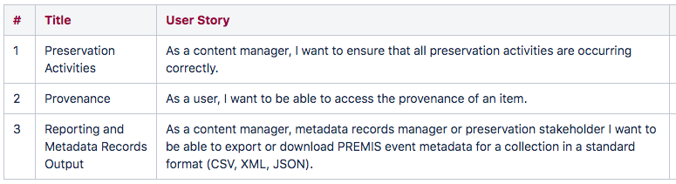
User stories
Create scenarios explaining a need for a service and the type of person who will use the service
Short, often only one sentence
e.g. The DLP Audit Service:
Notes:
We have approached the issue of advocacy with three combined methods.
The first is develop user stories. This outlines one or several scenarios that explain a need for a service, who will use the service, and why. These are very short and to the point, but tend to add much-needed context.
This image is an example from our Digital Library Platform Audit service with three different User Stories that are relevant to the service and its users.

Slide 16
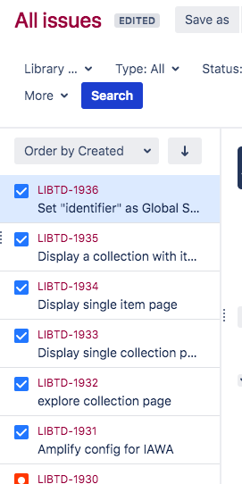
JIRA
JIRA: an agile project management tool by Atlassian
Projects and tasks; Bug tracking; Easy method for task/project prioritization
Use:
Create discrete, reasonable tasks related to a need
Work in a system IT is comfortable using
Task prioritization
Transparency
Notes:
The second strategy is to use our IT’s project management tool to develop discrete, specific tasks related to a service.
This also lends to working on better transparency with development team to know what their progress is and ability to manage and prioritize preservation backlog. We can communicate directly with developers to clear up questions and refine tasks, and all in a language that they are comfortable with using and interacting with.

Slide 17
Tiered, granular approach
As the product owners, provide rationale for a particular service/project:
User stories for context
JIRA tickets for potential discrete tasks
Narratives and lit reviews with supporting evidence from the field
Notes:
In short, these three levels of documentation build a tiered, easy to consume directive for managing work while still providing a theoretical support for digital preservation. Many times the background documentation isn’t necessary to the implementation team, but in other cases demonstrating that the work is predicated on best practices and standards is highly valuable. Similarly, breaking a project down into smaller tasks in JIRA may not be useful to upper administration, but is highly valuable to our developers.

Slide 18

Library-wide culture shift
Siloed, individual departments and workflows
Limits potential
Duplication of work
Shared model
Shared values
Shared processes
Shared tools
Shared policies
Trust
Notes:
Finally, the most challenging and collaborative strategy is to, very slowly, help to implement a library-wide culture shift. Like many other institutional libraries, our departments and workflows are very siloed. Sitting on islands by ourselves limits our potential to progress and get things done
and creates too much duplication of work. The goal of merging platforms and policies is to create a shared model, meaning shared values, shared processes, shared tools, and shared policies, and most importantly, trust.
The more we can share -- values, tools, processes, and policies -- the greater advantage to which we can put the expertise across our organization.
We can do more, better, faster.
Faster time to project completion
Safer treatment of our content
Better support of our systems
Greater recognition of our work
More time for you to focus on what you do

Slide 19
Outcomes
How our collaboration has positively impacted digital Preservation:
Better, modular, cloud-based, future-proof preservation components
Improved advocacy with IT, stakeholders, administration
How our collaboration has positively impacted IT:
More extensive documentation
Transparency regarding policies
Succession planning
Notes:
This process is iterative and ongoing and slow. We’re in the middle of a lot of things and not everything is great or even decent.
However, since February, there are have been several outcomes to our recent efforts. First, this integration has positively impacted preservation through providing support to a preservation system that is modular, cloud-based, and ultimately more “future-proof” because we now have the time and expertise of developers and not just two preservation people. This has also improved advocacy in IT (e.g. we’re not breaking things and our new additions and “complicating the train” are supported by upper administration).
Second, we have contributed to IT with extensive documentation (sometimes where they don’t even want it), which increases transparency and better policy-sharing. Further, we have started discussions on succession planning (which took several years to convey the importance of, and success is due to support from the AD of Digital Libraries), and which ultimately will require more structure and support for IT in the long-term.

Slide 20
Next Steps
Iterative development of the Digital Library Platform
More, better documentation (GitHub, JIRA best practices)
Incorporate OAIS justification
Decision records
IT Trainings for Preservation
Incorporate digital preservation standards/best practices, e.g. CoreTrustSeal and ISO 16363
More formal Agile (JIRA) process and backlog management
Notes:
This entire process of integrating with IT and build a Digital Libraries Platform is ongoing, iterative, and always evolving. However, we still have several ideas on where to improve in the near future.
More and better documentation, particularly focusing on GitHub, JIRA, Confluence, and general content management best practices;
Incorporating OAIS vocabulary (SIPs, AIPS, DIPs, Designated Community) and justification;
Develop documentation on decision choices and justification for those decisions;
IT training for preservation personnel, such a s ITIL and AWS certification;
Incorporate digital preservation standards and best practices like TDR and CoreTrustSeal for future self and official audits;
And finally, working with IT to develop more formal Agile processes and regular sprints, and manage backlog.

Slide 21
Thank you!
Alex Kinnaman
Digital Preservation Coordinator
alexk93@vt.edu
Luke Menzies
Digital Preservation Technologist
limen@vt.edu
James Tuttle
Associate Director for Digital Libraries
james.tuttle@vt.edu
Notes:
Thank you so much! Please feel free to email us or chat with us after the session!

