Slide 1

Safe Eats
Vlad Munteanu, Kevin Choo, Pranav Chavvakula
CS 4624 Multimedia, Hypertext, and Information Access
Dr.Edward Fox
Blacksburg VA 24061, Virginia Tech
05/09/2022

Slide 2
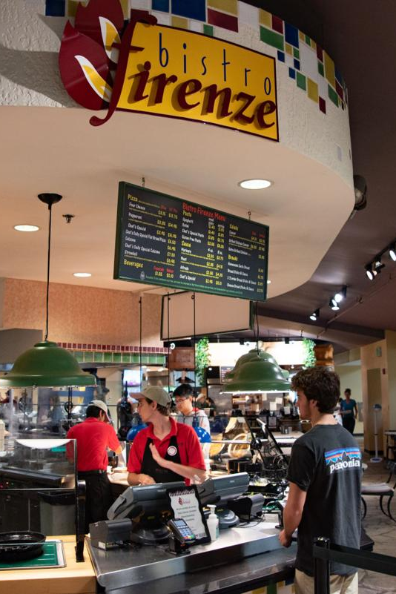
Outline
Our Vision & Mission
Main Issues with Current System
Goals of Our System
Our Current Implementation
Acknowledgements
References

Slide 3
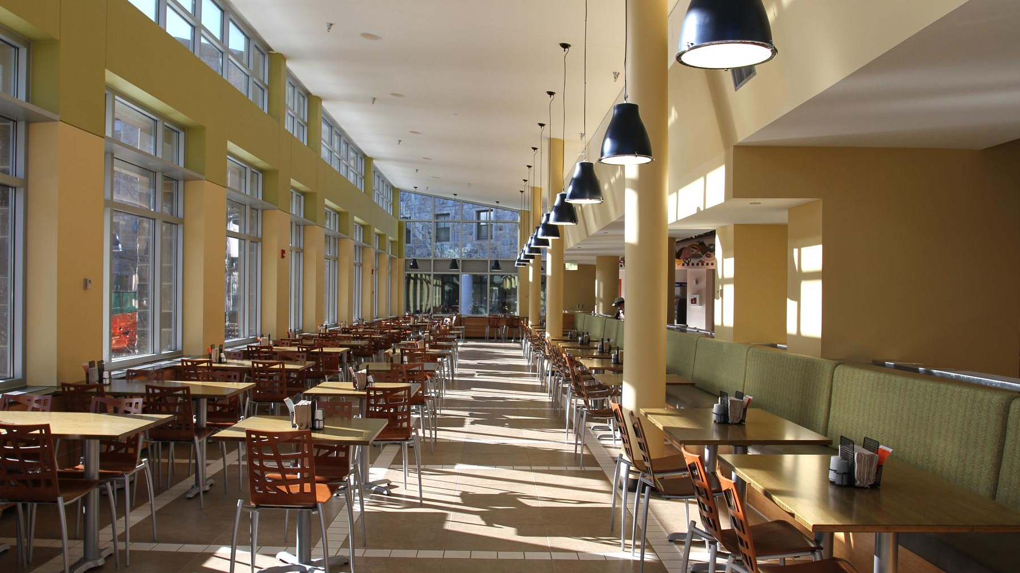
Our NEW Vision & Mission.
Vision
Our vision is a safer dining experience for students across all universities.
Mission
We are currently committed to the development of a better system for identifying allergens at Virginia Tech Dining Halls.

Slide 4
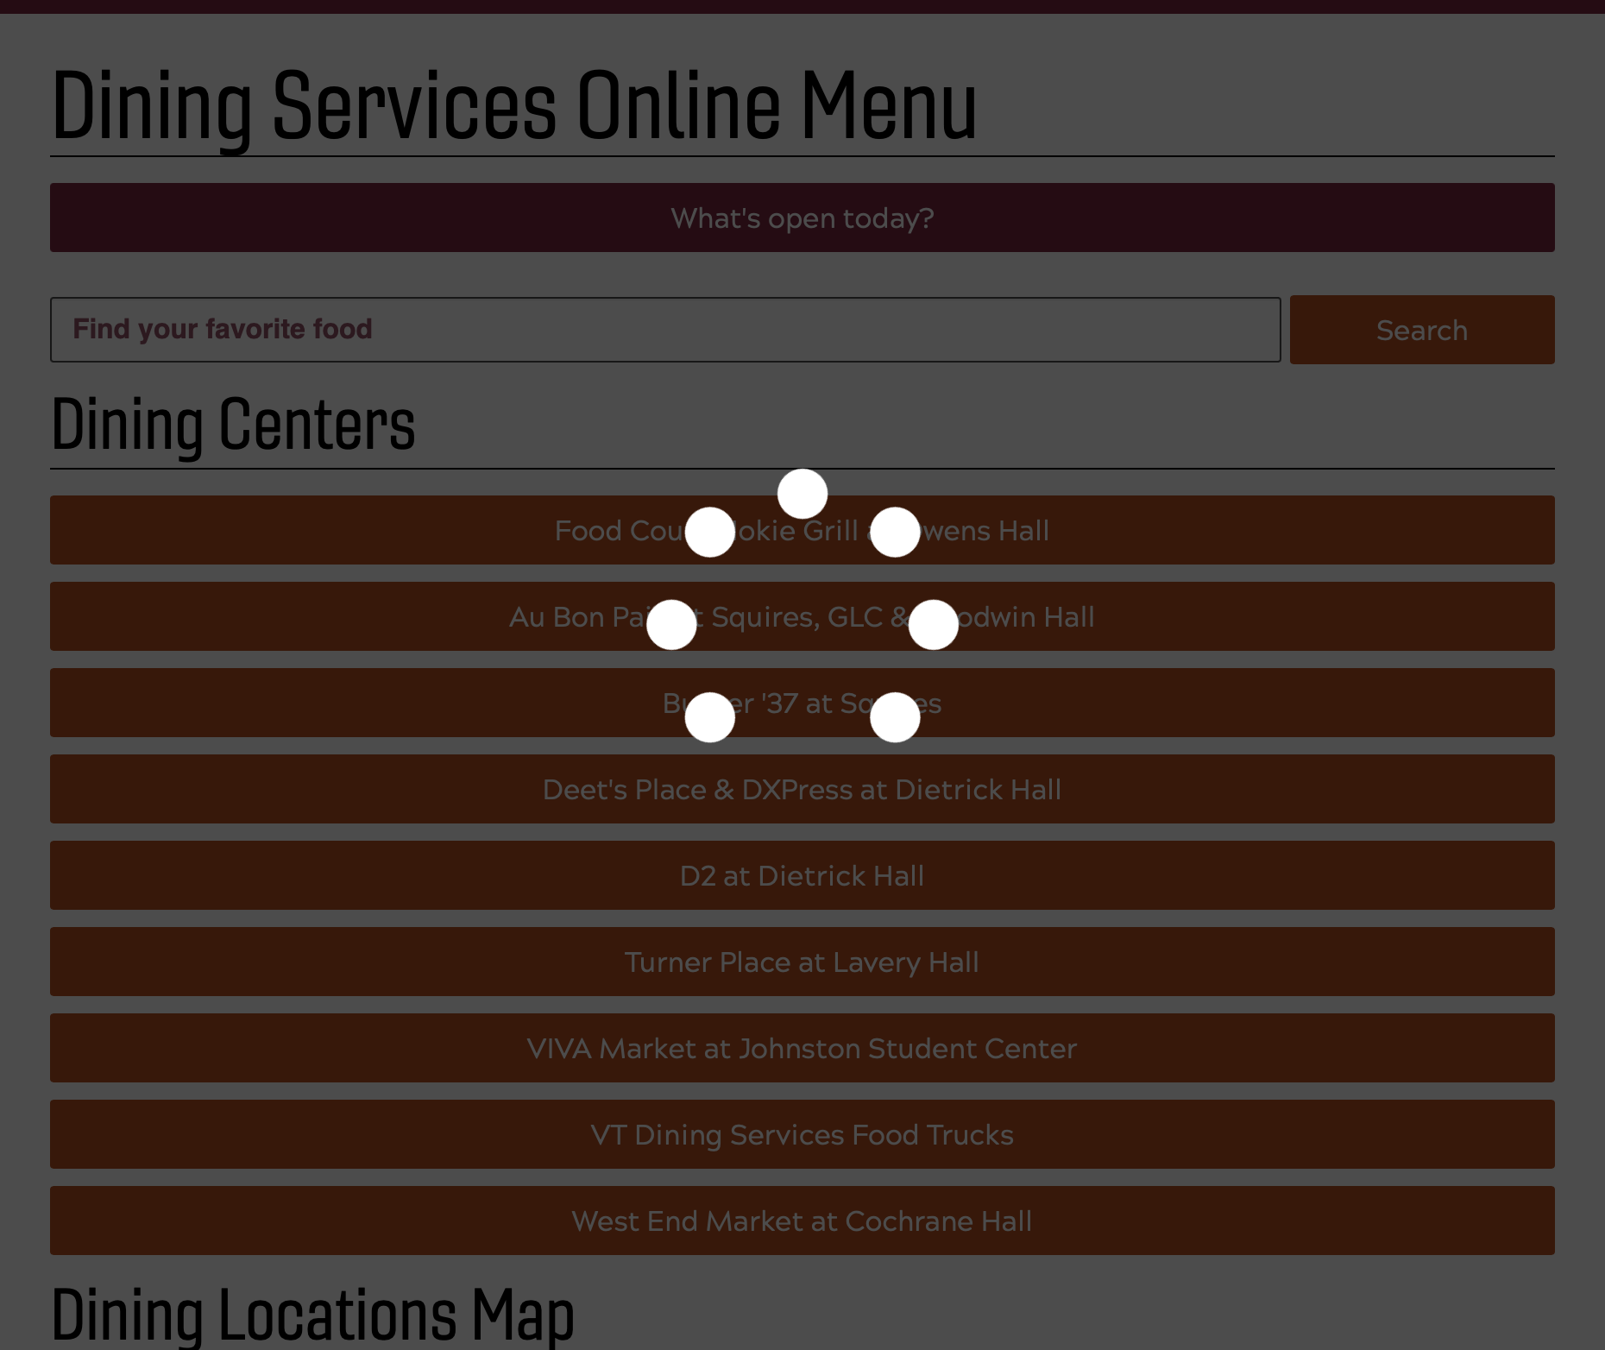
Main issues w/ current systeM
Slow
  Search Latency: 8.5 secs
  Lookup Latency: 6.3 secs
Running old software
  Server Software is Windows IIS 8.5, released 9 years ago
Data is not centralized
Overall lacks intuitive design
Quick
Source: http://foodpro.dsa.vt.edu/menus/ [3]

Slide 5
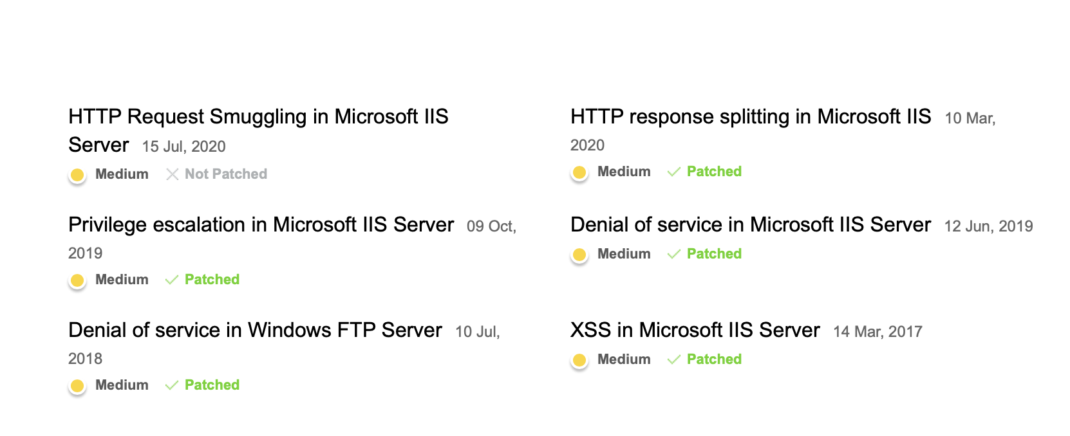
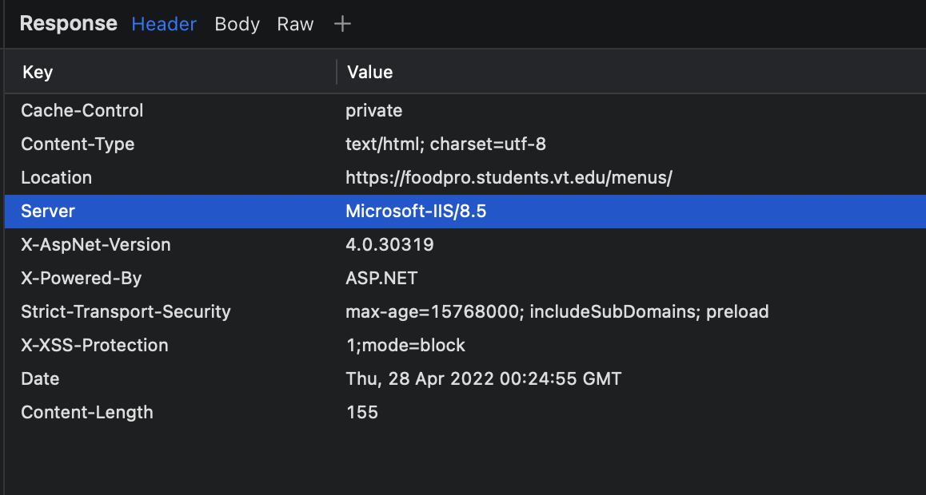
IIS 8.5
Source: http://foodpro.dsa.vt.edu/menus/ [3]
Source: http://foodpro.dsa.vt.edu/menus/ [3]

Slide 6
“i rarely use the website, i find it easier to just play it by ear”
Chris Provel

Slide 7
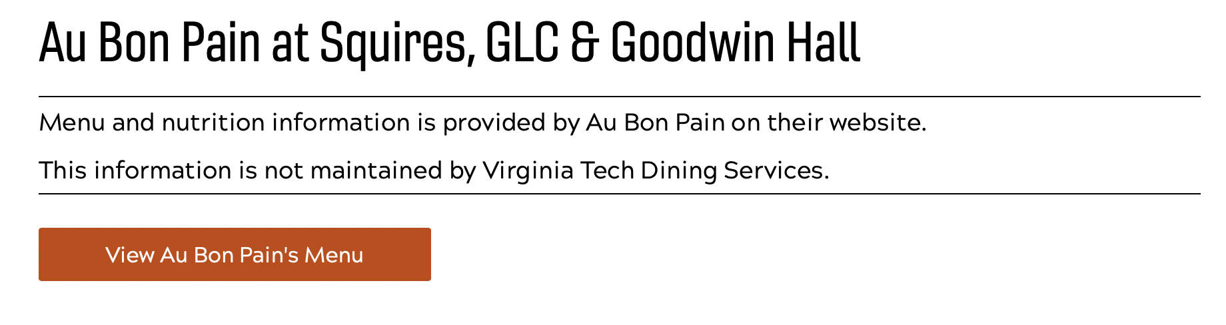
Source: http://foodpro.dsa.vt.edu/menus/ [3]

Slide 8
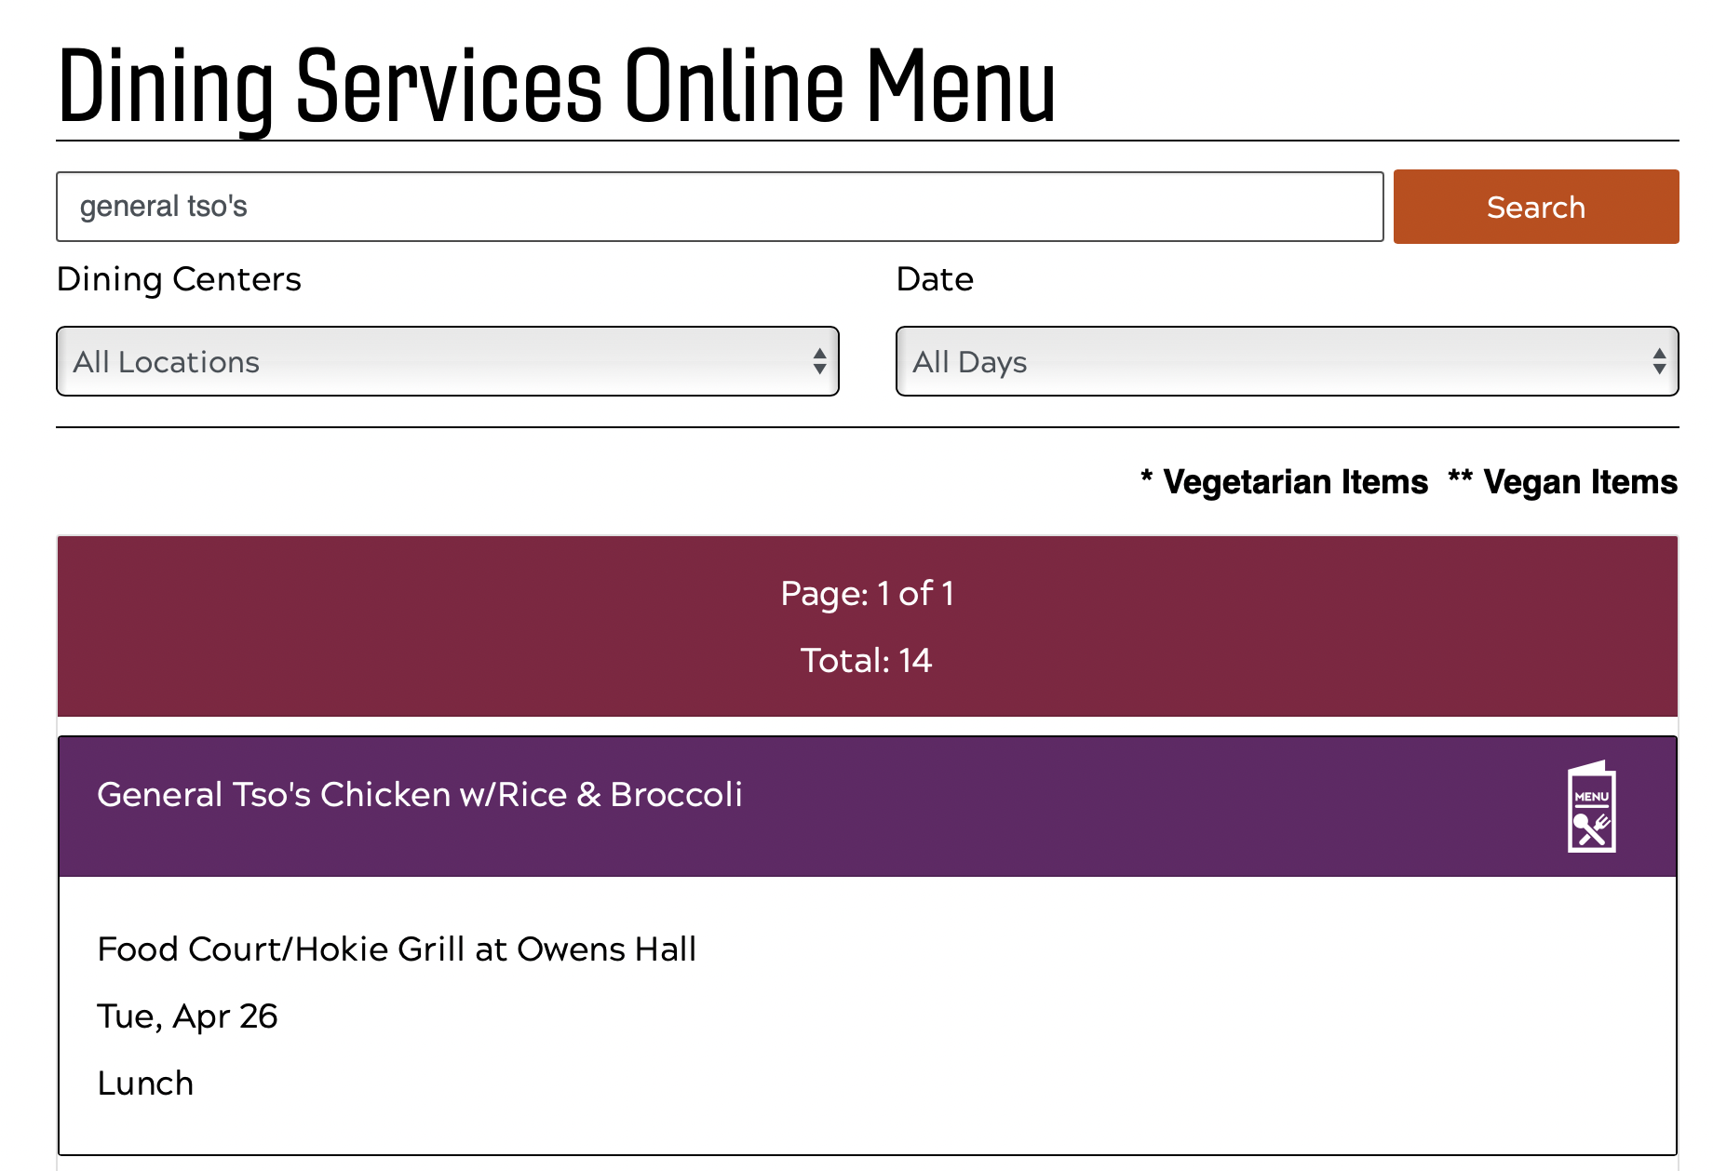
Source: http://foodpro.dsa.vt.edu/menus/ [3]

Slide 9
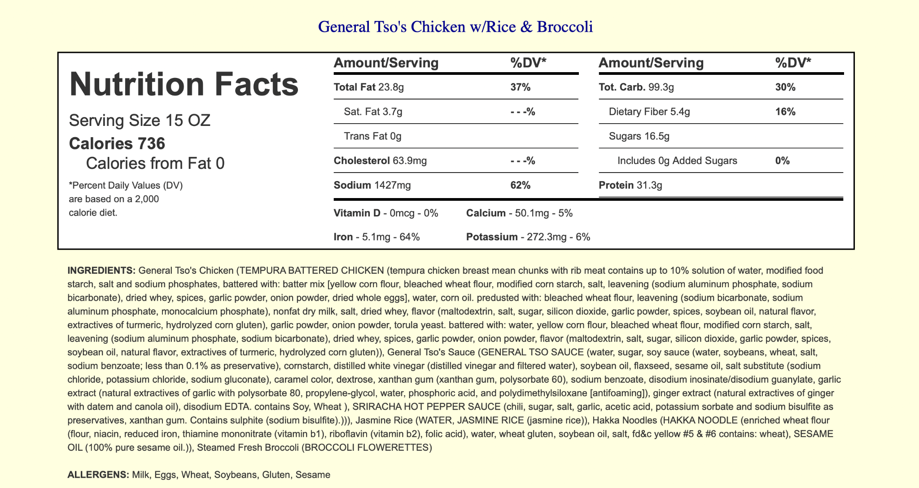
Source: http://foodpro.dsa.vt.edu/menus/ [3]

Slide 10
goals of our systeM
User-centered design
Speed
Utilizing newer cloud technology
Centralized data
Built with extensibility in mind

Slide 11
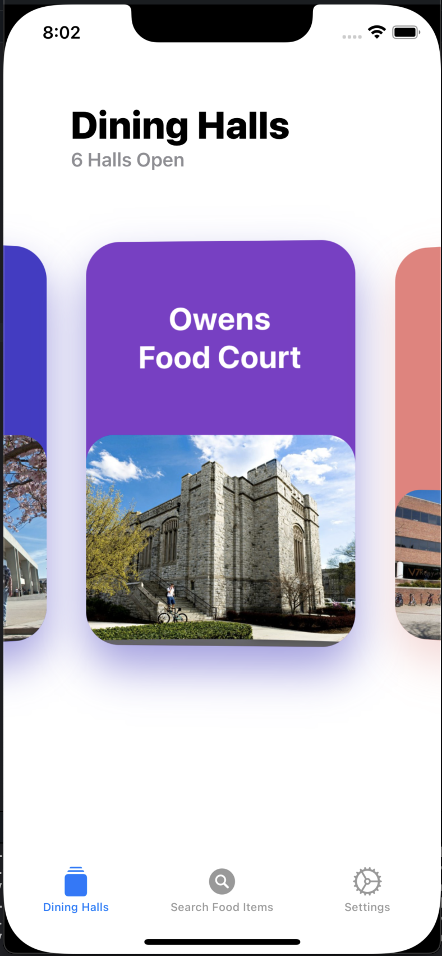
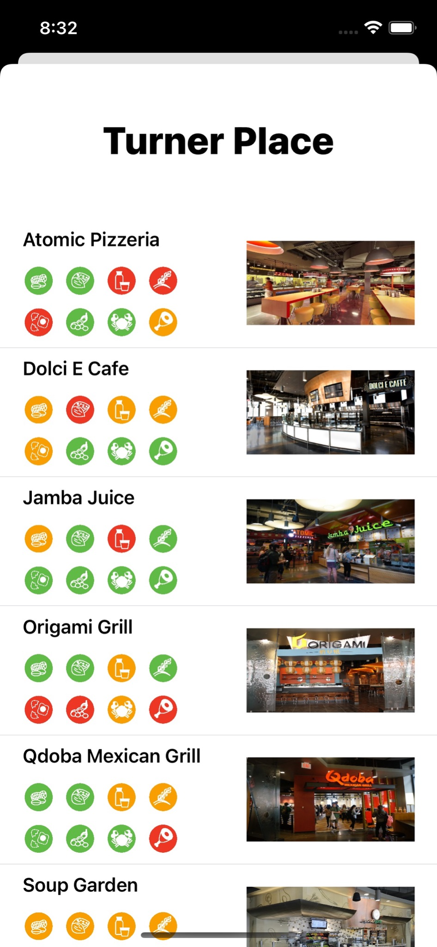
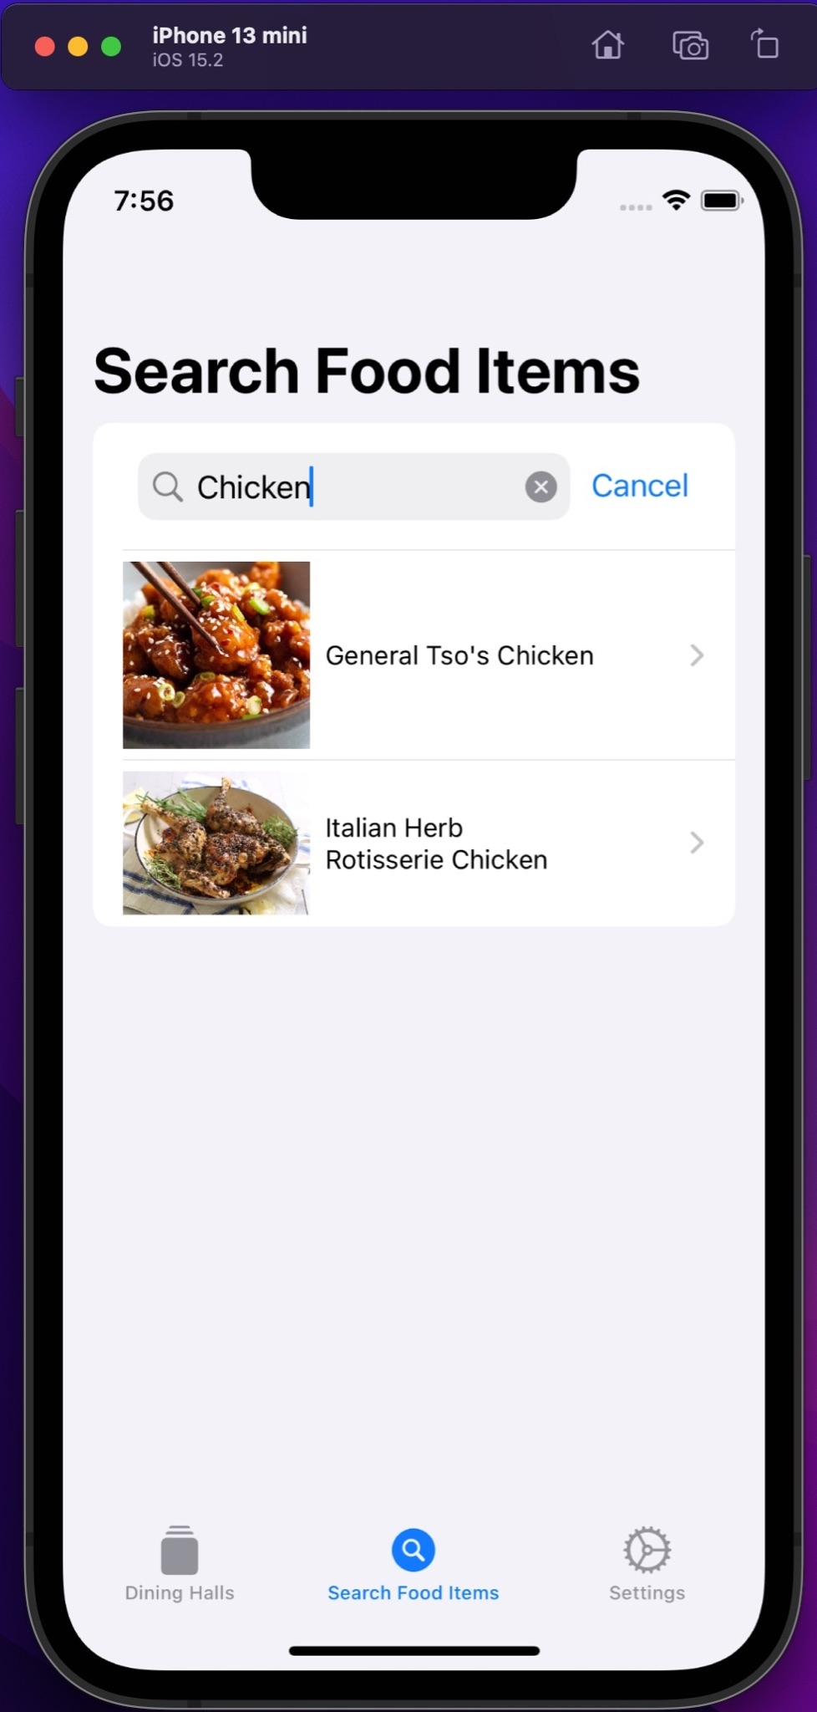
User-Centered Design

Slide 12


Speed, data, & stack
Our stack allows for significantly better latency
  Firebase Backend
The user interface is built with speed in mind
Our data is entirely centralized
Quick

Slide 13

extensibility & future work
Ultimate goal is to replace the current dining hall menu system & implement GrubHub directly
Barcode Scanner
Expand to other schools
Quick

Slide 14
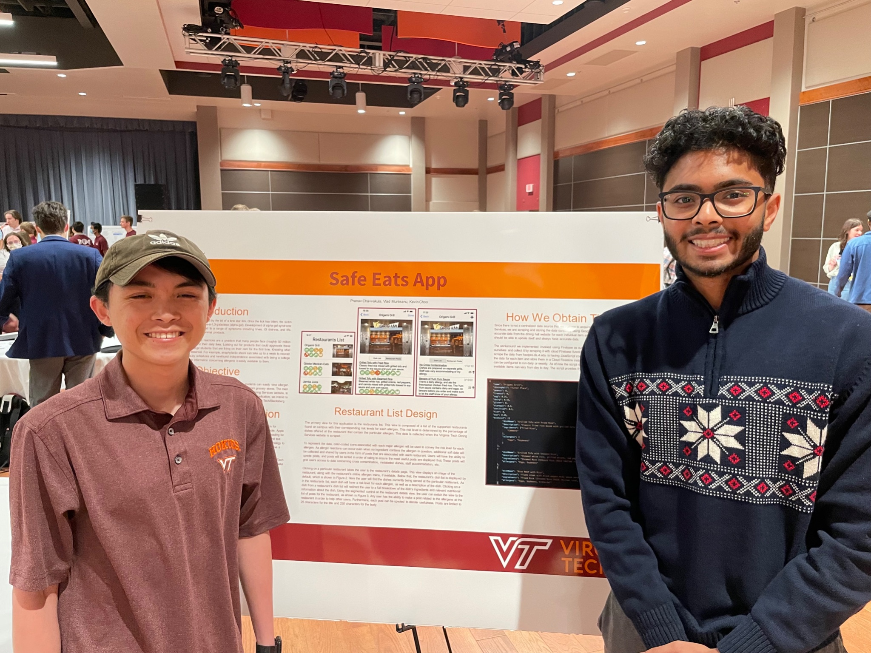
VTURCS
Industry (Marston) award 3rd place
Attended VTURCS on 04/24/2022
Presented our projects to students, faculty, and judges
Received helpful feedback for future directions

Slide 15
Acknowledgements
Client: Deborah Nichols & Candice Matthis
Supervisor: Dr.Edward Fox
Advisor: Ashley Foster

Slide 16
References
https://vt.edu/about/facts-about-virginia-tech.html
https://www.foodallergy.org/resources/facts-and-statistics
http://foodpro.dsa.vt.edu/menus/

