Slide 1
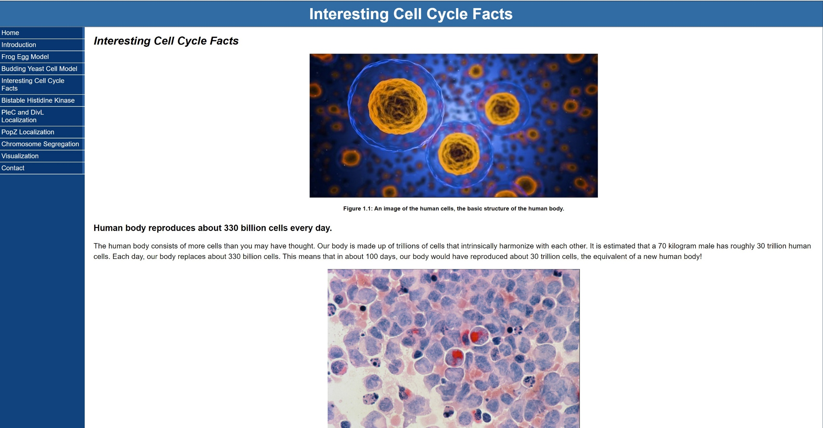
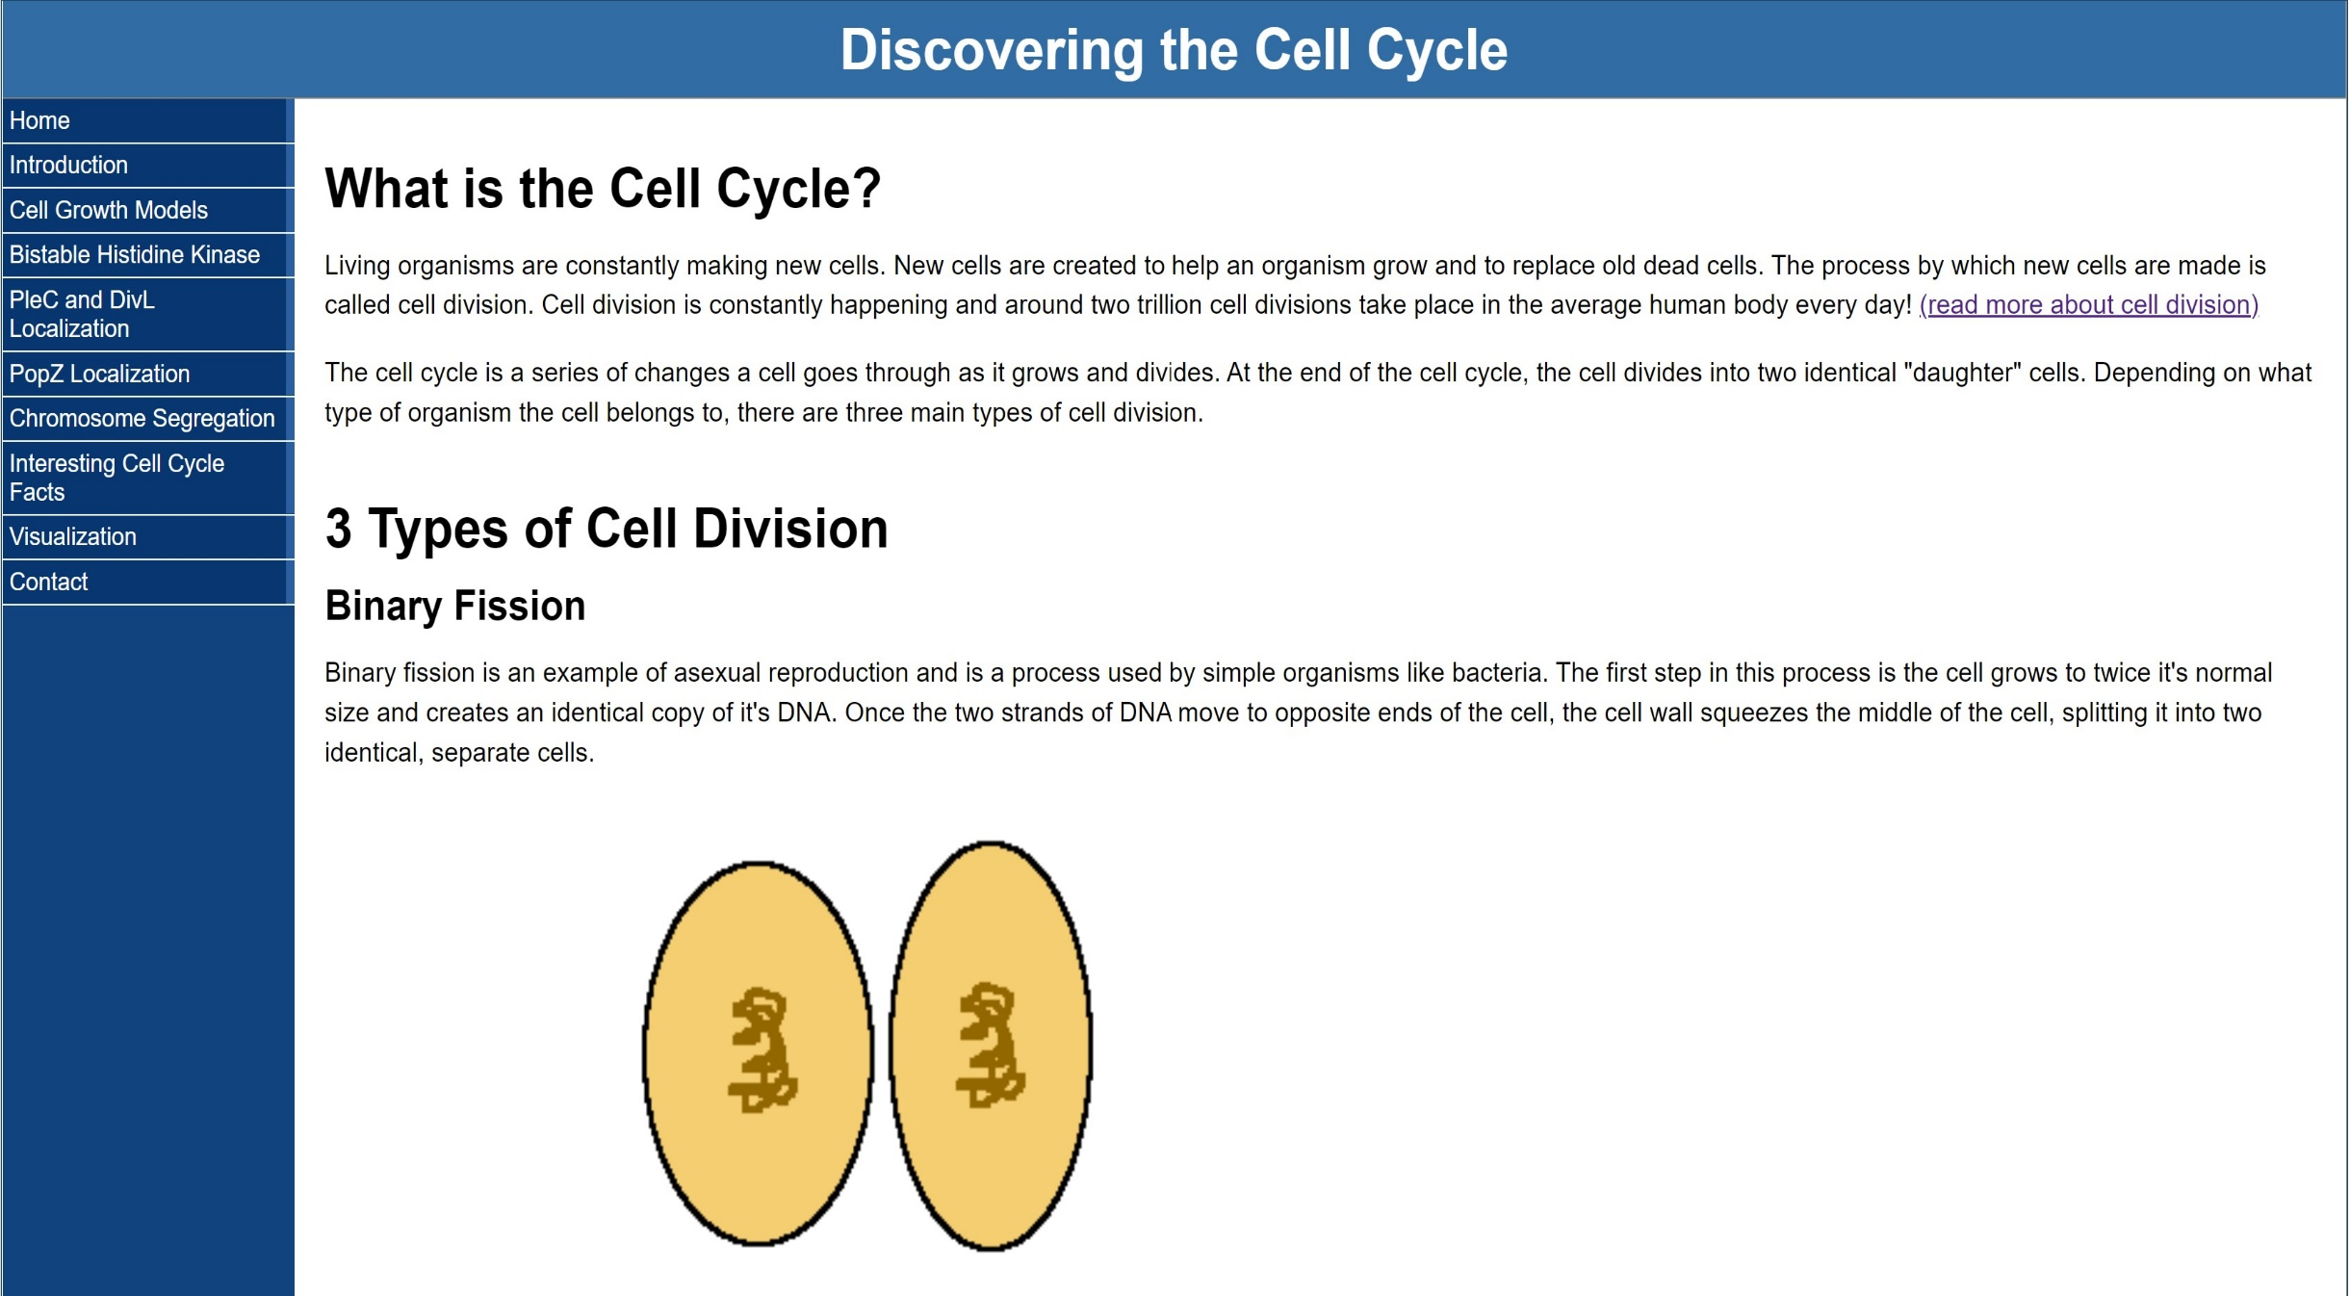
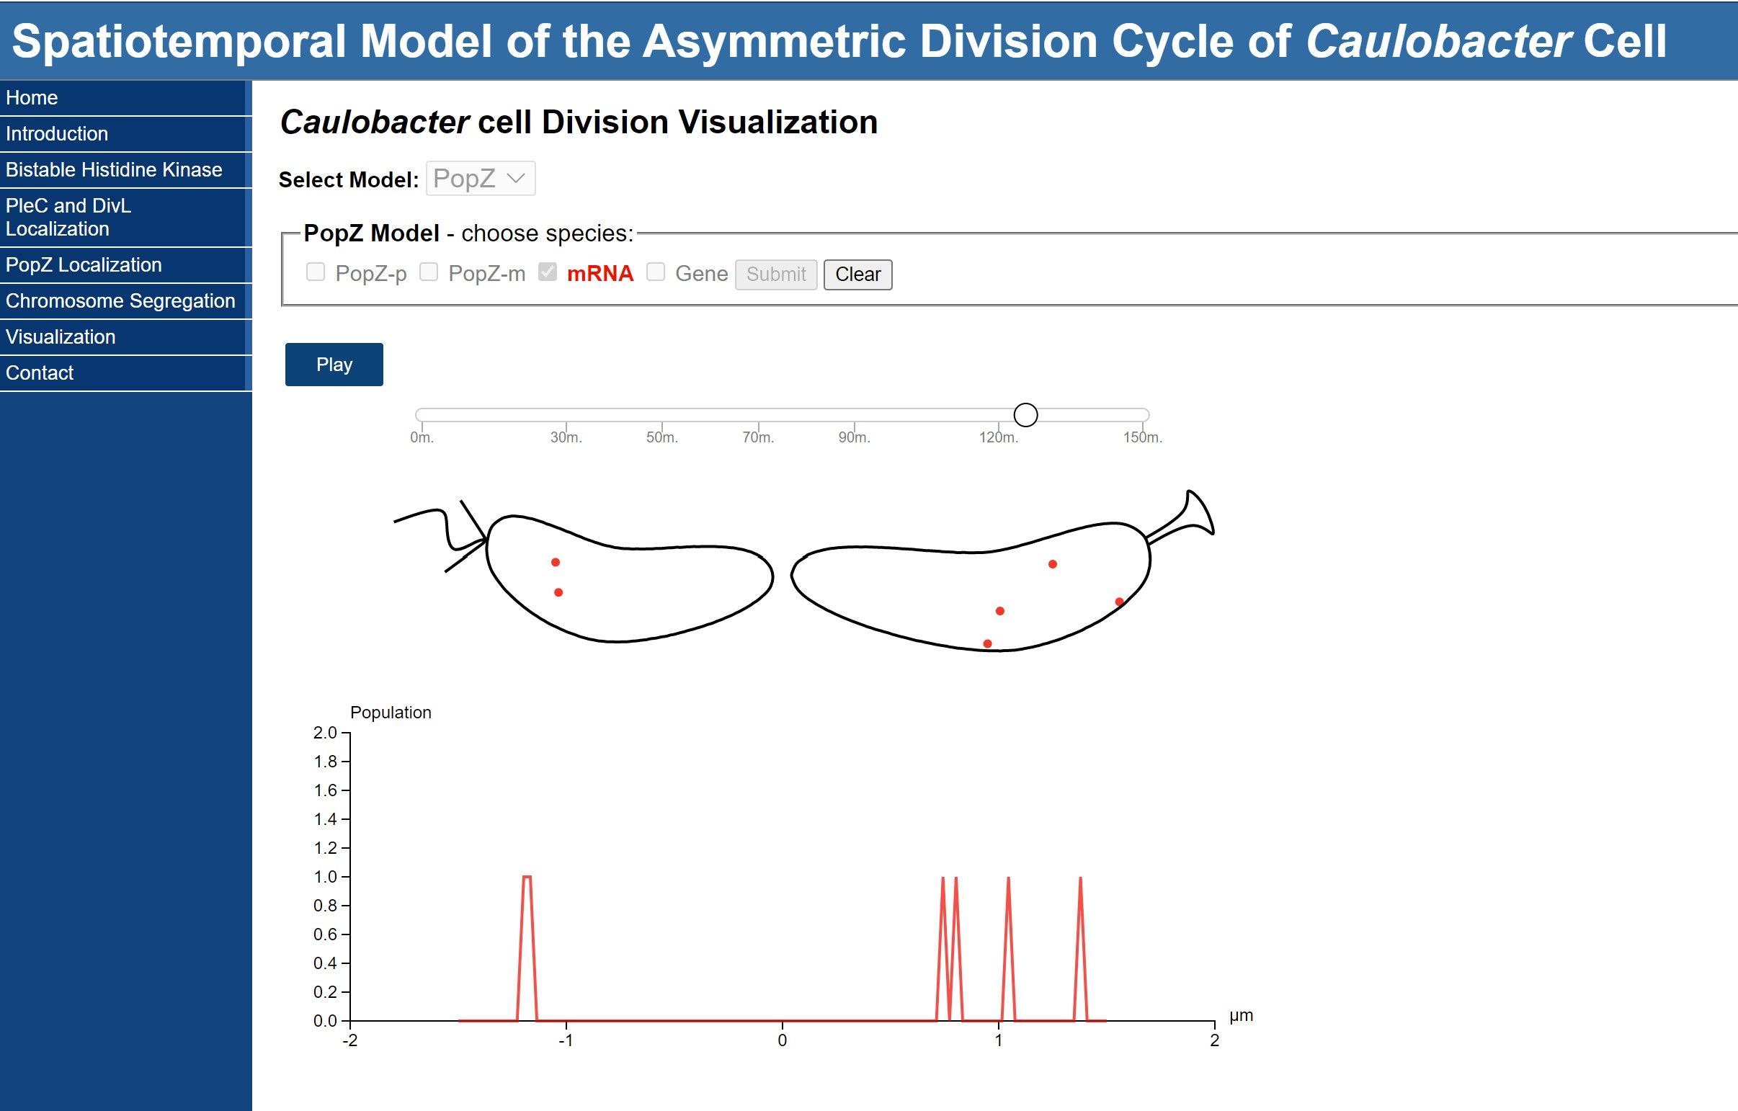
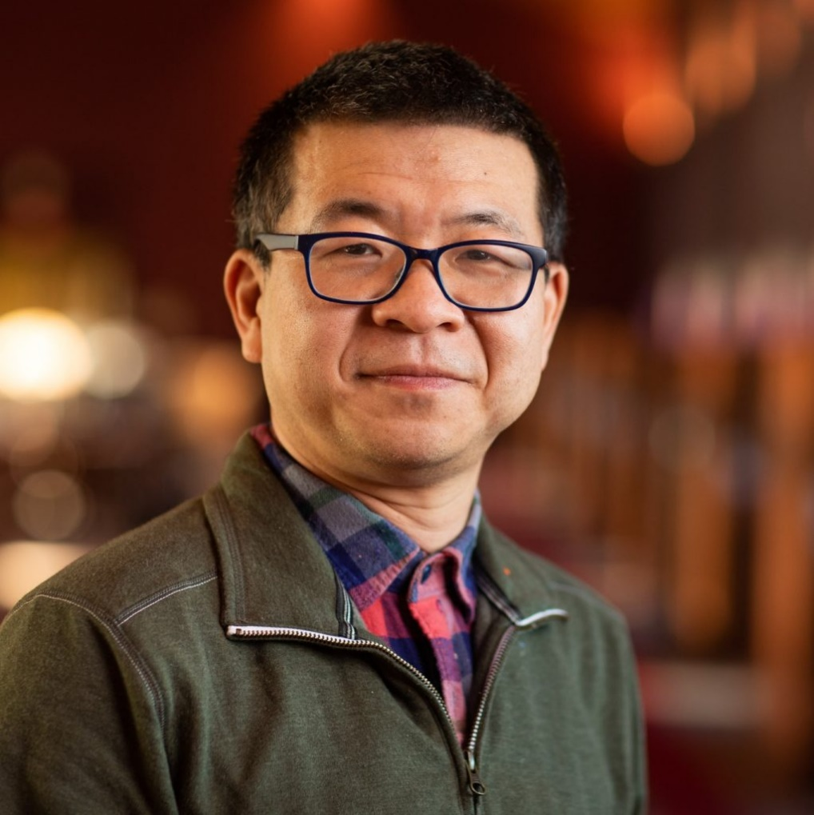
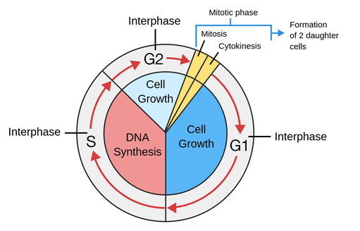
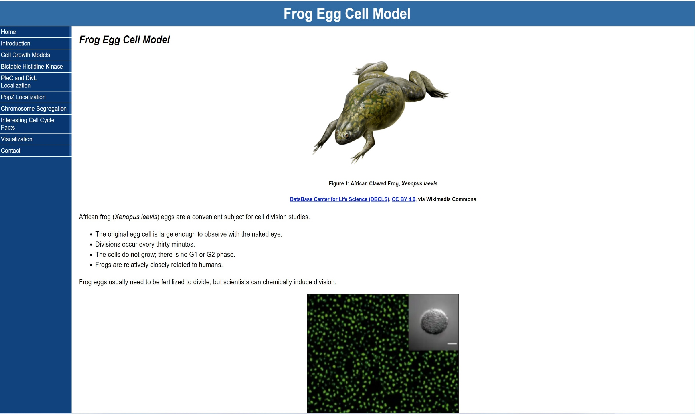
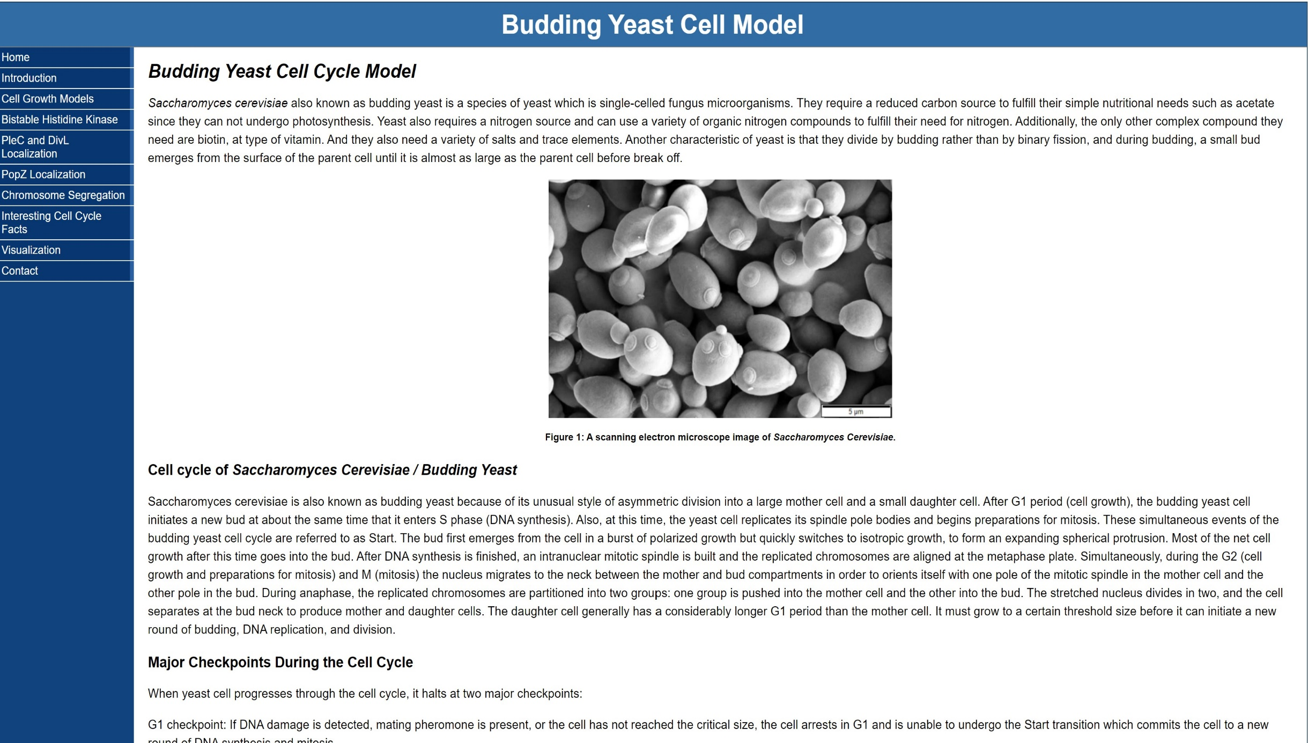
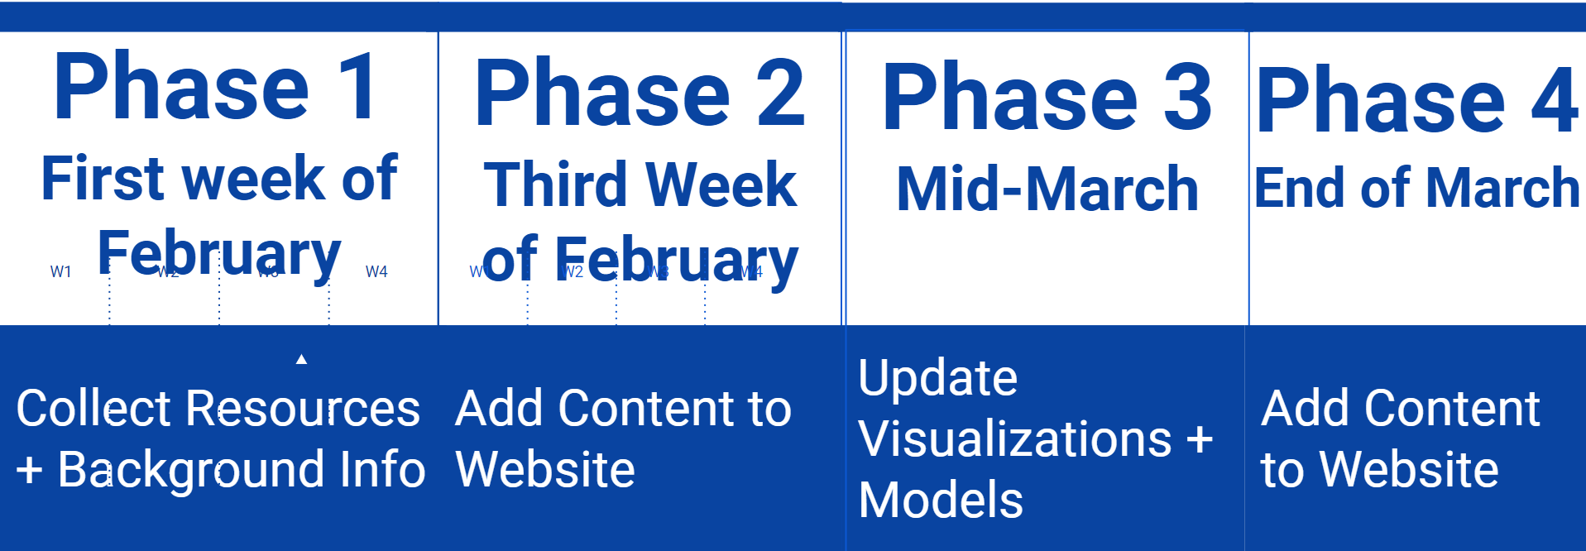
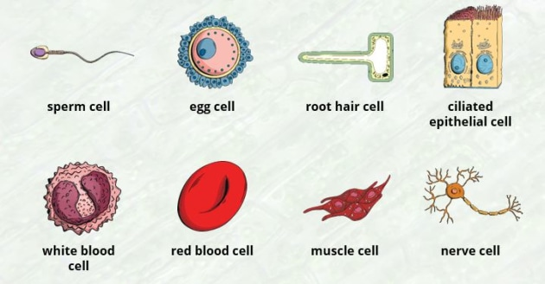
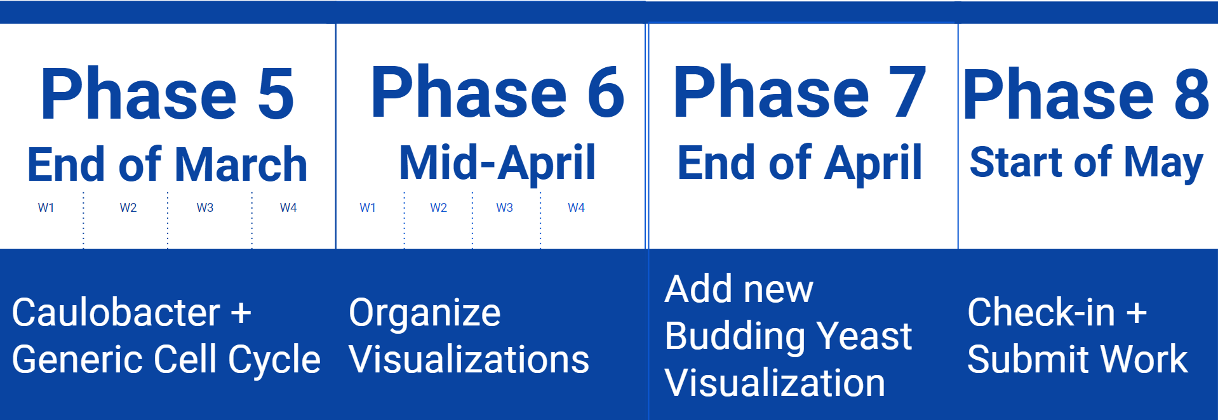
Cell Cycle Visualization
Presenters: Cesar Smokowski, Shuai Lin, Julia Van Dyke, Shuai Shin
Course: Multimedia/Hypertext Capstone (CS 4624), Client: Professor Young Cao
Introduction
Methods and Materials
Results
Interesting Cell Cycle Facts
Cell Cycle Visualizations
The goal of our capstone project is to create a website to explain the cell cycle with information for elementary students, the general public and those looking for mathematical data. We have been working with Professor Young Cao to make the website he used to display experiment data for the students in his lab more accessible and informative to the general public. The general structure of the website content is it begins simple, including more introductory information, and gets more complex.
The cell cycle visualization website was developed in HTML and some of the include materials are:
D3 Mathematical Models of Cell Growth
Cell Cycle Quiz to Test Your Knowledge
Background Information for Important Cell Growth Models
Explanations for the Phases and Checkpoints of the Cell Cycle
Data visualizations including data collected from Professor Cao’s lab
The cell cycle models discussed on the website include
Generic Cell Cycle (including phases and checkpoints)
Frog Egg Model: This page explains the unique process that frog egg cells go through as they duplicate
Budding Yeast Model: Budding yeast is a species of yeast which is a single-celled fungus microorganism. They have a very unique cell cycle, since they undergo photosynthesis
Below are pictures of the pages included in the updated website
Homepage
Frog Egg Model
Buddying Yeast Cell Model
Explanation & Background Info
Cell Cycle Website
Models & Experiment Data
Objectives
Meet with our client Professor Young Cao to understand his vision and goals for the website
Collect accurate, up-to-date information about each of the cell cycle models that are part of the website
Provide a mix of engaging, introductory information for younger students or the general public and accurate, descriptive research information for college students or experienced readers
Give detailed background information and explain all the parameters used in the mathematical models
Get users interested in learning more about the cell cycle and the unique applications of cell growth research knowledge
Accurately portray the data collected from Professor Cao’s lab
Conclusion
Implementation Stages
Our team is dedicated to creating a website that incorporates Professor Cao’s research and can be a helpful resource for people with a wide range of cell cycle knowledge. The next steps for our team are:
Creating a Generic Cell Cycle Page with detailed information about each phase
Outlining the research being done with Fission yeast cells
Incorporate a mathematical model for the Budding Yeast cell cycle page
First team meeting with Professor Cao to get familiar with the project and the new content need for the website
Collecting Background Information
Planning, wireframing and outlining the design of the website
Organizing content onto specific pages
Put together cell cycle pages
Acknowledgements
Dr. Edward Fox (Our Capstone Course Professor)
Young Cao (Our Project Client)
Ryan Wood (Our Capstone TA)

