Slide 1
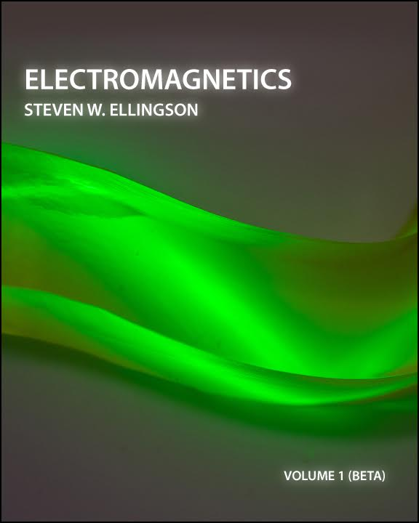
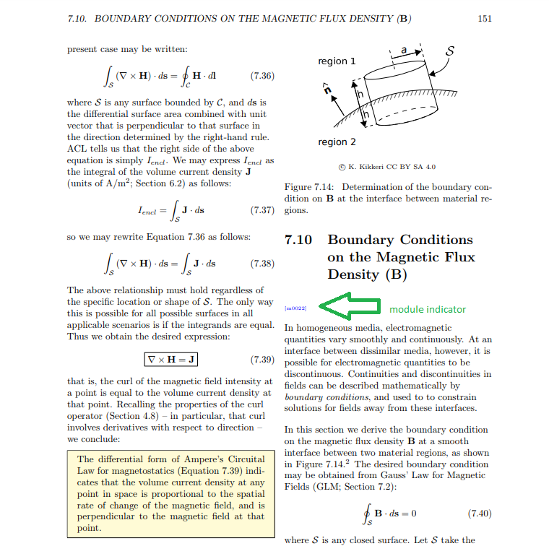
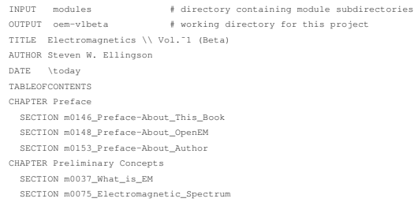

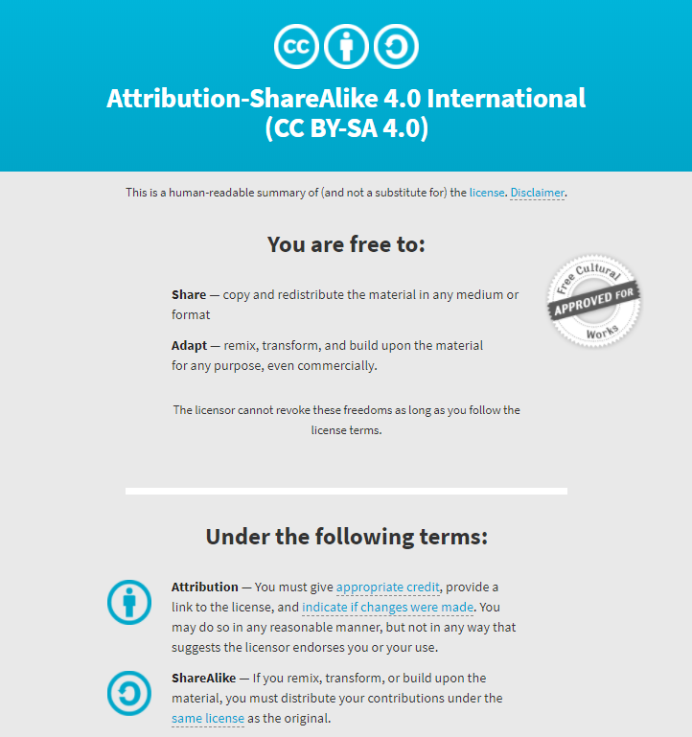
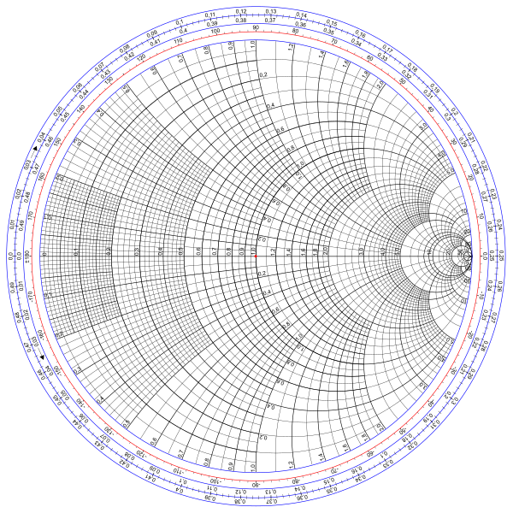

Adaptable Course Materials: Creating an Open Textbook for Electromagnetics
Anita R. Walz, University Libraries; Steven W. Ellingson, Electrical and Computer Engineering, Virginia Tech
Conference on Higher Education Pedagogy, February 14-16, 2018, Blacksburg, VA
Electromagnetics Volume 1 (Beta) (CC BY-SA 4.0) is a 224 page Beta version of an open educational resource intended to serve as a primary textbook for a one-semester first course in undergraduate engineering electromagnetics. It includes: electric and magnetic fields; electromagnetic properties of materials; electromagnetic waves; and devices that operate according to associated electromagnetic principles including resistors, capacitors, inductors, transformers, generators, and transmission lines. This book employs the "transmission lines first" approach, in which transmission lines are introduced using a lumped-element equivalent circuit model for a differential length of transmission line, leading to one-dimensional wave equations for voltage and current. This is intended for electrical engineering students in the third year of a bachelor of science degree program.
Availability: The Beta version of the book, freely and publically available as PDF in Virginia Tech’s Institutional Repository at https://doi.org/10.7294/W4WQ01ZM and for $27.55 from Amazon.com ISBN:978-0997920123).
Vol. 1 (BETA) & future versions: The BETA version of Volume 1 is being field tested in Virginia Tech’s ECE 3105 Spring 2018 course. Spring 2018 field testing includes mixed methods approaches: classroom observation, student survey, and student focus groups intended to identify student perceptions, usage patterns, and areas for improvement of the text.
Vol. 1 (BETA) will be updated and re-released in Summer 2018. The following will also be added: index (within the book), problem sets, solution manual, and LaTeX source code. A Vol. 2 (Beta) second semester text is planned for release in 2019.
Project funding and technical assistance:
This text is the result of a collaborative partnership between Virginia Tech’s University Libraries’ Open Education Faculty Initiative Grant Program and VTPublishing, and the author.
Project Intent and Intended Future Collaborative Development:
This textbook is part of the Open Electromagnetics Project led by Steven W. Ellingson at Virginia Tech. The goal of the project is to create no-cost openly-licensed content for courses in undergraduate engineering electromagnetics.
The project is motivated by two things: lowering learning
material costs for students and giving faculty the freedom
to adopt, modify, and improve their educational resources.
Use, sharing, contributions to, and customization of this book or portions of this book or figures are an inherent part of the intent of the way this book has been published. Potential collaborators are invited to contact the author.
Technical Solutions to Enabling Openness and Remix
Remix System
All books resulting from this project will be different remixes of the same common body of material. Here is a brief overview of the remix system. The system is comprised of “modules” which normally correspond to sections within a book.
Each module consists of a plain text LaTeX file fragment (not a complete LaTeX document) and the figures reference the text. Some features unique to the system are implemented using commands embedded in comments in the LaTeX file. For example: commands that identify text that should appear within highlight boxes, or are treated as examples and set off from the main text. Anyone who has created a document using LaTeX that includes equations and figures already knows LaTeX editing skills required to write a module.
Remix using Source Files
Alternatively, the source files for Electromagnetics will be made freely available at https://doi.org/10.7294/W4WQ01ZM with the revised Vol 1 in Summer 2018.
Remix by PDF Hacking
A third (but far less desirable approach) is to begin with the PDF, which may be reverse-engineered into a word processing program.
Cover credit: Robert Browder
Image credit: © Michelle Yost. Total Internal Reflection https://flic.kr/p/dWAhx5 is licensed with a Creative Commons Attribution-ShareAlike 2.0 license https://creativecommons.org/licenses/by-sa/2.0 (Modified)
Openness (with regarding to content)
As an Open Educational Resource (OER), this textbook is not only freely available, it is also licensed to be modified and shared.
Open Educational Resource: “teaching, learning, and research resources that
reside in the public domain or have been released under an intellectual
property license that permits their free use and re-purposing by others.
Open educational resources include full courses, course materials, modules,
textbooks, streaming videos, tests, software, and any other tools, materials, or
techniques used to support access to knowledge.” [1]
* Source material: This text utilizes and properly attributes figures contributed to the Public Domain, with CC BY, and CC BY SA licenses. The cover art is even licensed with a Creative Commons Attribution Share-Alike license.
* Overall license: The overall volume is licensed with a Creative Commons Share-Alike (CC BY SA) 4.0 license This license allows free use, adaptation, and sharing with attribution.[2]
Why Create an Intentionally Remixable Learning Resource?
Electromagnetics Vol 1 (Beta) employs the popular “transmission lines first” structure, in which transmission line theory is addressed first, followed by electrostatics, etc. as seen below:
Table of Contents
Chapter 1: Preliminary Concepts (16 pages)
Chapter 2: Electric & Magnetic Fields (11 pages)
Chapter 3: Transmission Lines (37 pages)
Chapter 4: Vector Analysis (24 pages)
Chapter 5: Electrostatics (37 pages)
Chapter 6: Steady Current & Conductivity (12 pages)
Chapter 7: Magnetostatics (27 pages)
Chapter 8: Time-Varying Fields (20 pages)
Chapter 9: Plane Waves in Lossless Media (19 pages)
However, many institutions prefer a “waves first” structure, in which transmission lines are addressed after electromagnetic waves. “Transmission lines first” vs. “Waves first” is certainly not the only issue for which educators and textbooks vary. Another issue is whether and when to address Smith Charts. Many courses introduce Smith Charts as an integral part of a transmissions
The first few lines of the remix specification file for Electromagnetics Vol. 1 (Beta)
lines curriculum, whereas others regard Smith Charts as a
separate topic or exclude it altogether. The most recent
Virginia Tech curriculum excludes Smith charts from the
two electromagnetics courses, so there is no
Immediate plan to include Smith Charts in a planned
Release of Electromagnetics, but we do plan to
Include Smith Chart material in the remix system
To support advanced courses that do address Smith
Charts, and as a service to those who a interested in
a remix of Electromagnetics that does contain this material.
Suggested citation: Ellingson, Steven W. (2018) Electromagnetics, Vol. 1 (Beta). Blacksburg, VA: VT Publishing. https://doi.org/10.7294/W4WQ01ZM Licensed with CC BY-SA 4.0 https://creativecommons.org/licenses/by-sa/4.0
References
[1] William and Flora Hewlett Foundation https://www.hewlett.org/strategy/open-educational-resources
[2] Best Practices for Attribution https://wiki.creativecommons.org/wiki/Best_practices_for_attribution
This poster is licensed with a Creative Commons Share-Alike 4.0 License.
A Smith chart ©Wldwd CC BY SA 3.0
https://commons.wikimedia.org/wiki/File:Smith_chart_gen.svg

