Slide 1
Object Detection
CS 4624: Multimedia, Hypertext, and Information Access
Edward A. Fox
Virginia Tech, Blacksburg VA 24061
May 4, 2022
Kecheng Zhu
JiangYue Li
Zachary Gager
You Peng
Shelby Neal
Dataset Creation,
Main Contact
Dataset Creation,
Documentation
Pipeline Model development
Dataset Creation,
Documentation
Assistating Pipeline Development, Evaluation
Client: Aman Ahuja

Slide 2
Outline
Objectives Recap
TimeLine
Dataset
Pipeline
Current Results
OCR
XML & Visualization
Acknowledgements
Notes:
You

Slide 3
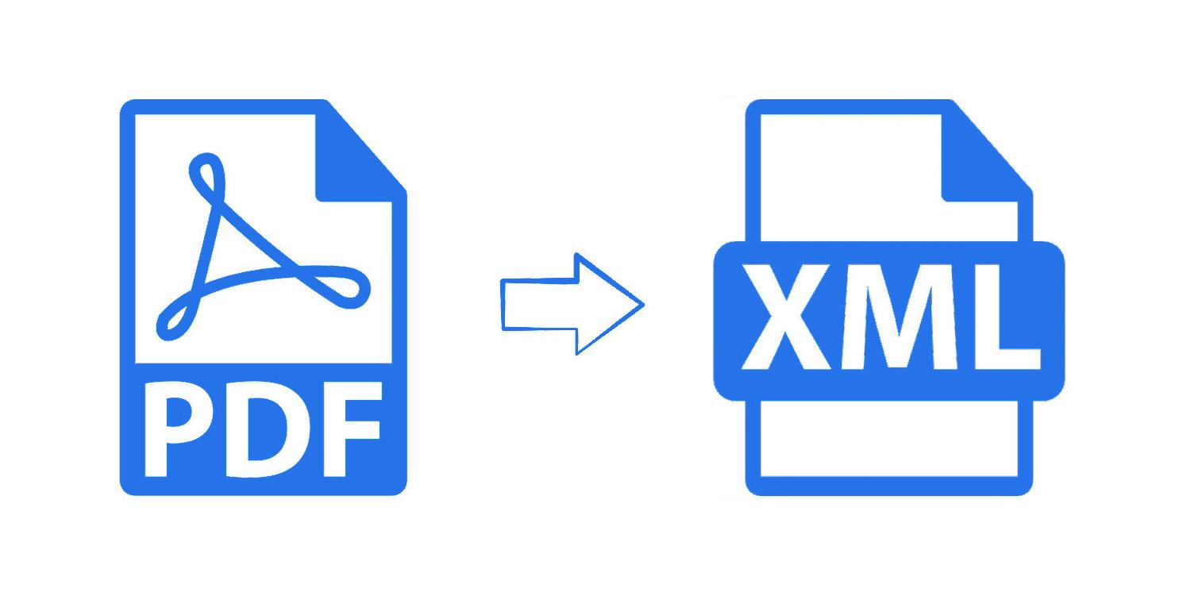
Objectives Recap
Annotate dataset of 150 - 200 ETDs
  ETDs: Electronic Theses and Dissertations
  Scanned ETDs (older papers)
  Digital / Electronic ETDs (embedded text)
Train / develop model that converts ETDs into machine readable format
Visualize results
Notes:
You

Slide 4
Timeline
Dataset Creation
-Finish labeling the first 50 ETDs (25% of the total labeling)
Dataset Creation
-Converting ETDs into pictures
March
February
Modeling
-Set up the Detectron2 model pretrained on Docbank dataset.
Modeling
-Preliminary Training
Notes:
you

Slide 5
Timeline
Dataset Creation
-Complete all the labeling work and review the previous labeling
Dataset Creation
-Complete 50% of the total labeling work
April
April
March
Modeling
-Retrain Model with more data
-Finish images to text function (OCR)
Modeling
-Finalize the pipeline
-Retrain the model
Notes:
you

Slide 6




Completed Work
Annotated 100 scanned and 100 digital ETDs
Trained 3 models on 10k iterations for scanned, digital, and merged (both scanned and digital)
Developed text extraction script
Developed visualization script
Evaluated and reported results to the client
Notes:
jiangyue

Slide 7
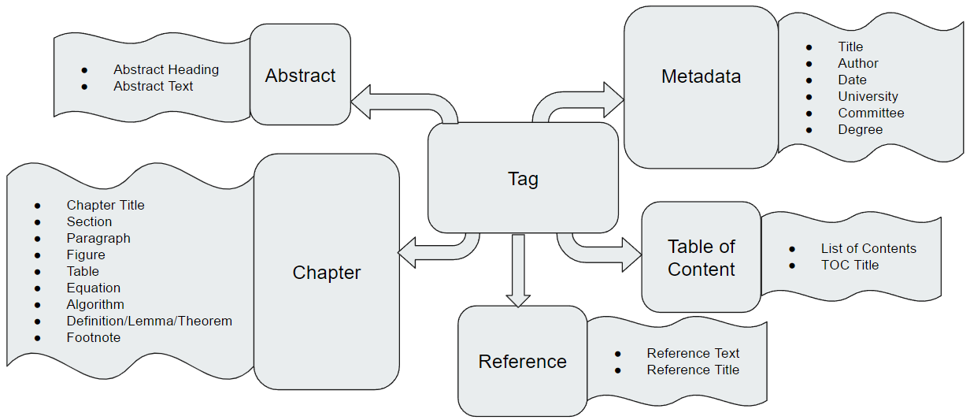
ETDs
Elements
Notes:
jiangyue

Slide 8
Preprocessing
Rules For Labeling
  Tables that are not part of the Table of Contents are labeled as Table
    Only the Table of Contents can be labeled Table of Contents
  Appendix is labeled as Chapter
    Can be identified by Chapter title
  Subsections of One-chapter ETDs are labeled as Chapter titles
  Subsections of Multi-chapter ETDs are labeled as Section
Notes:
jiangyue
Notes:
Add more tags because new type of element found in ETDs and client want them as separate tags
1. All types of Table of Contents (Table of Contents, Table of Figures, List of Figures, etc) are regarded as Table of Contents. They can be differentiated based on the TOC title.
2. Appendix is regarded as a chapter. It can be identified based on Chapter title.
3. For documents with only one chapter, regard different sections like introduction, experiments, conclusion etc as Chapters title.
4. For documents with multiple chapters, annotate headings of different sections / subsections clearly with the “Section” label.

Slide 9
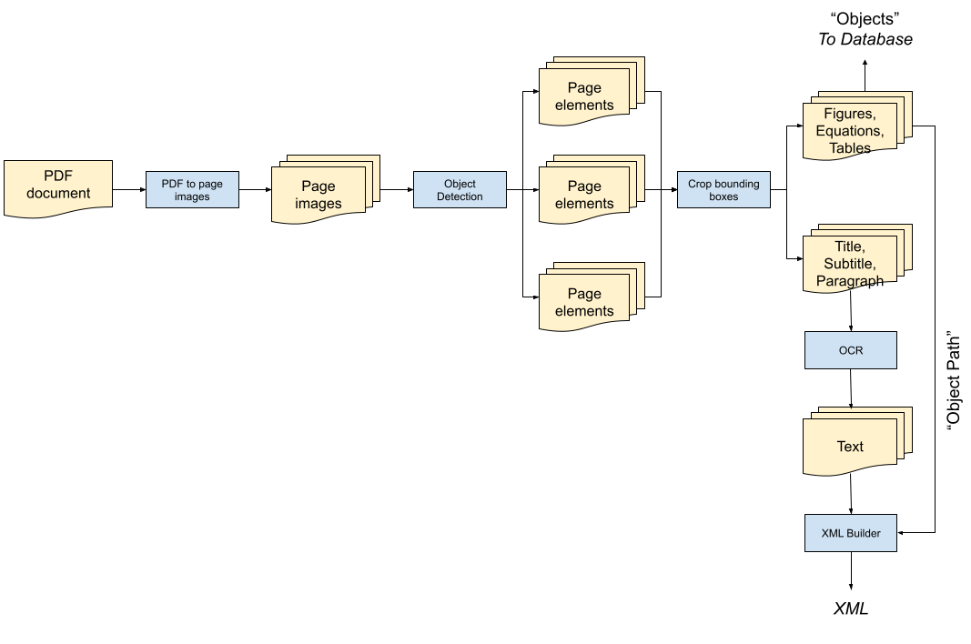
PipeLine Diagram
Notes:
Zach

Slide 10
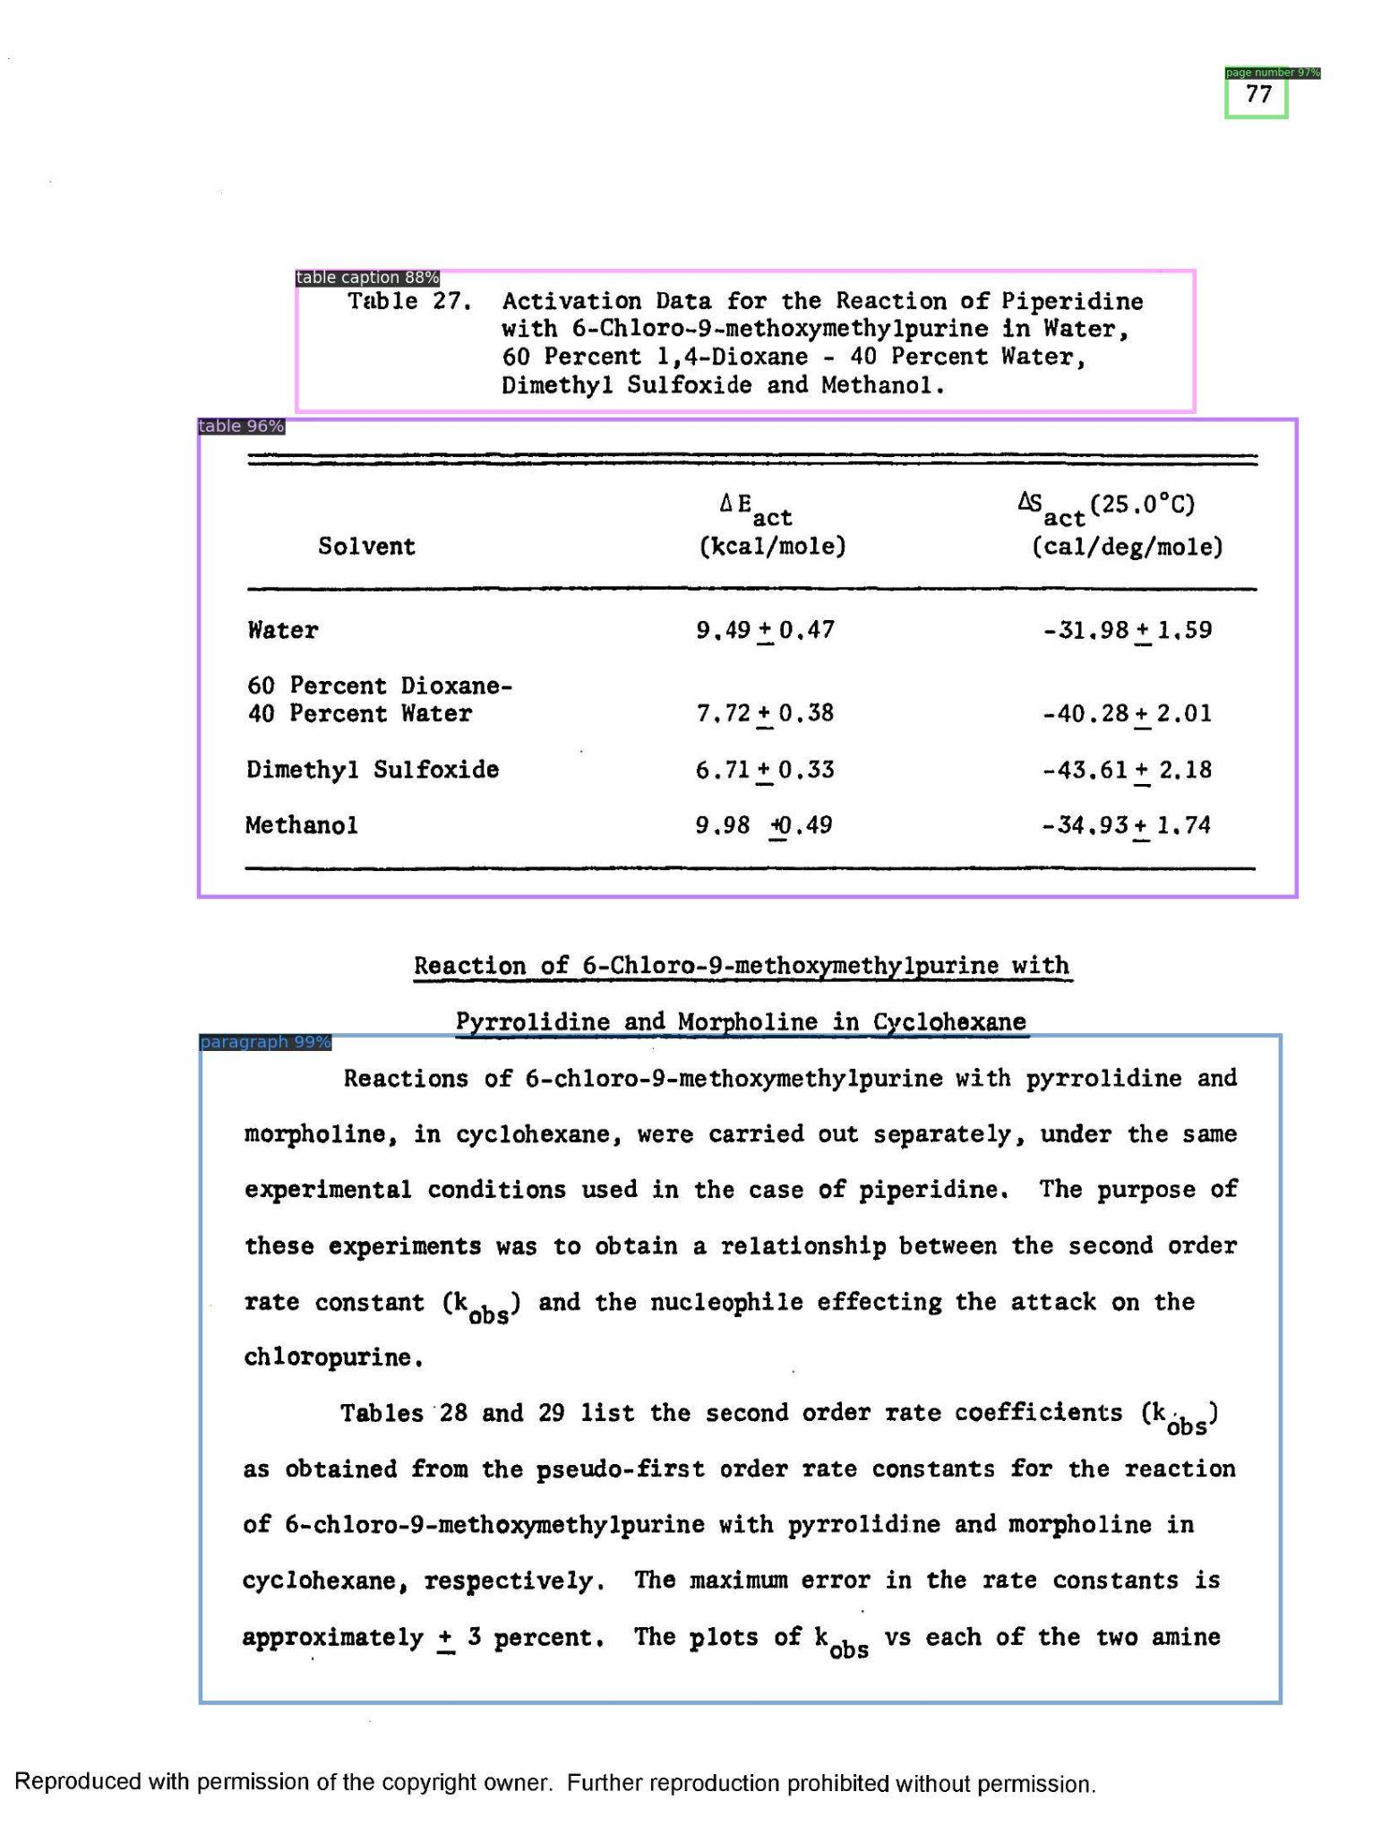
Object Detection Model
table caption
table
Detectron2
  Neural network (Base - RCNN- FPN Model)
Evaluation
  COCO evaluator (Common Objects in Context)
Train environment
  CUDA-enabled server (runs on private GPU)
paragraph
Notes:
Zach

Slide 11
Evaluated Metrics
Average Precision (AP):
  AP - Percentage AP at IoU = 0.50:0.05:0.95 (primary challenge metric)
  AP50 - Percentage AP at IoU = 0.50 (PASCAL VOC metric)
  AP75 - Percentage AP at IoU = 0.75 (strict metric)
AP Across Scales:
  APs - Percentage AP for small objects: area < 32^2
  APm - Percentage AP for medium objects: 32^2 < area < 96^2
  APl - Percentage AP for large objects: area > 96^2

Slide 12
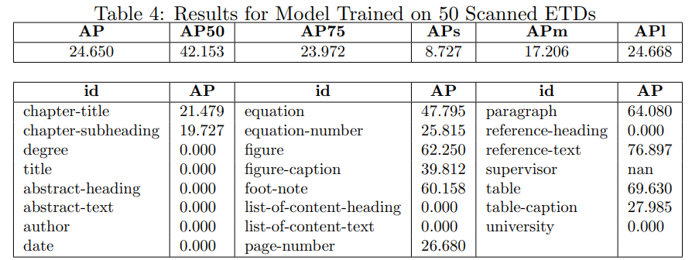
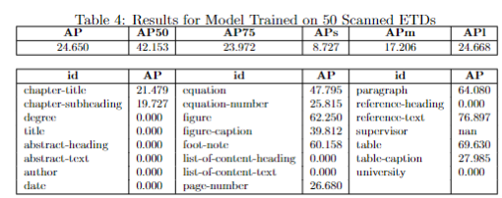
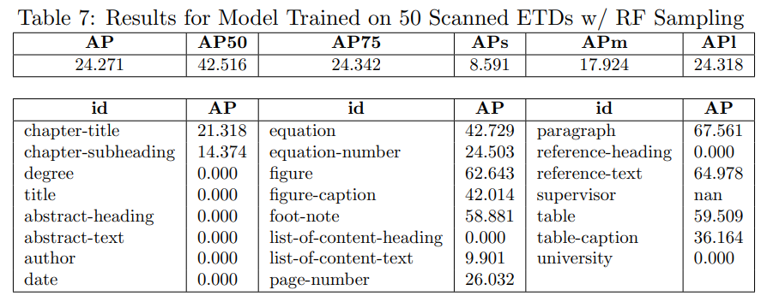
Results with Scanned ETDs
AP ~ 24
Repeat Factor Sampling
  Model weakened
  Captions improved
  Found list-of-content-text
2nd Strongest Model
Notes:
Shelby

Slide 13
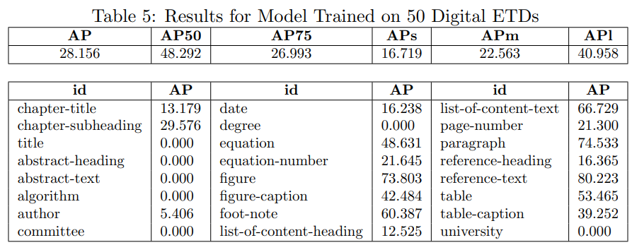
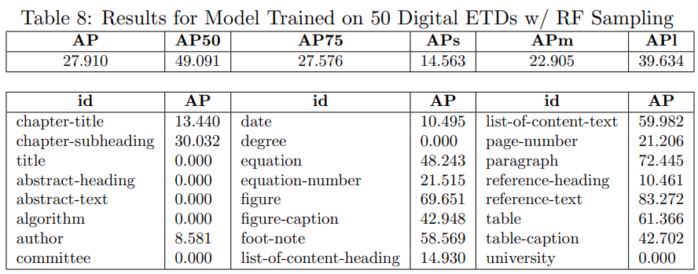
Results with Digital ETDs
AP ~ 28
Repeat Factor Sampling
  Model weakened
  Captions improved
Strongest Model
Notes:
Shelby

Slide 14
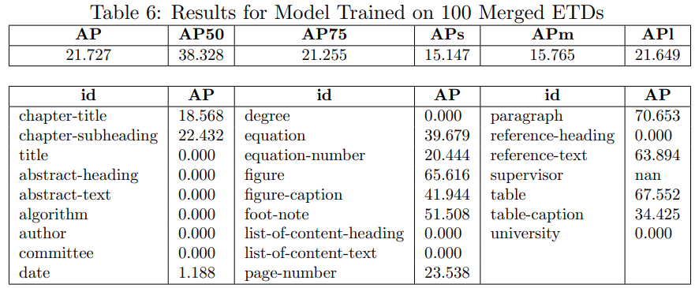
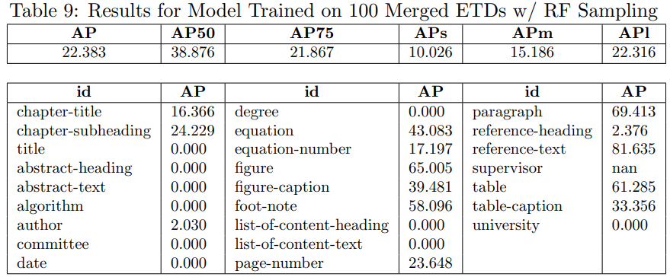
Results With Merged ETDs
AP ~ 22
Repeat Factor Sampling
  Model improved
  Captions weakened
  Found author
  Lost date
Weakest Model
Notes:
Shelby

Slide 15
Results Takeaways
Repeat Factor (RF) Sampling is a tool to address dataset label distribution imbalance
  i.e., many instances of “paragraph”, one instance of “title”
  Used because it is difficult to predict sparse elements
3 models trained with and without RF Sampling
  Digital ETDs are easiest to predict
  Merged ETDs are the most difficult
  RF Sampling caused minor changes to results
    Some good, some bad, inconsistent at this point
    Expected to be a valuable tool given more data
Notes:
Shelby

Slide 16
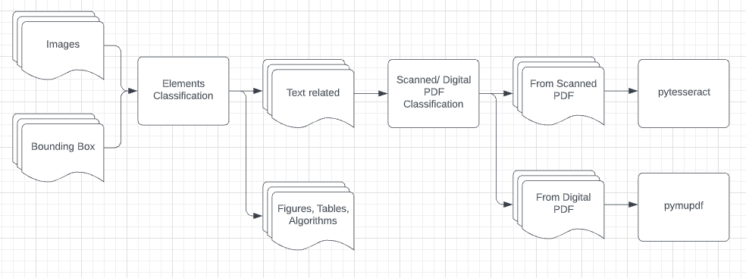
OCR (Optical Character Recognition)
Notes:
Shelby

Slide 17
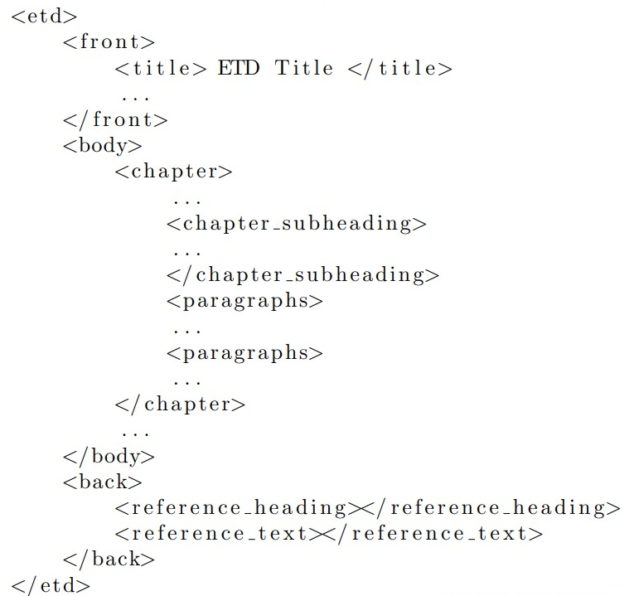
Generated XML
Front
  Metadata: Title, author, etc.
Body
  List of chapters
    Paragraphs
    Figures
    Tables
    Subheadings
    Algorithms
Back
  References
Notes:
Kecheng

Slide 18

Visualization in HTML
Notes:
Kecheng

Slide 19
Acknowledgements
Aman Ahuja
Professor Edward A. Fox
Notes:
Kecheng

Slide 20
References
Roboflow Logo
Detectron2
PyTorch
Python Logo
DocBank Repo
DocBank Essay
Notes:
Kecheng

