Slide 1
Therapy Dogs & Volunteering
Dr. Andy Overbay
Smyth County Ag Extension Agent

Slide 2
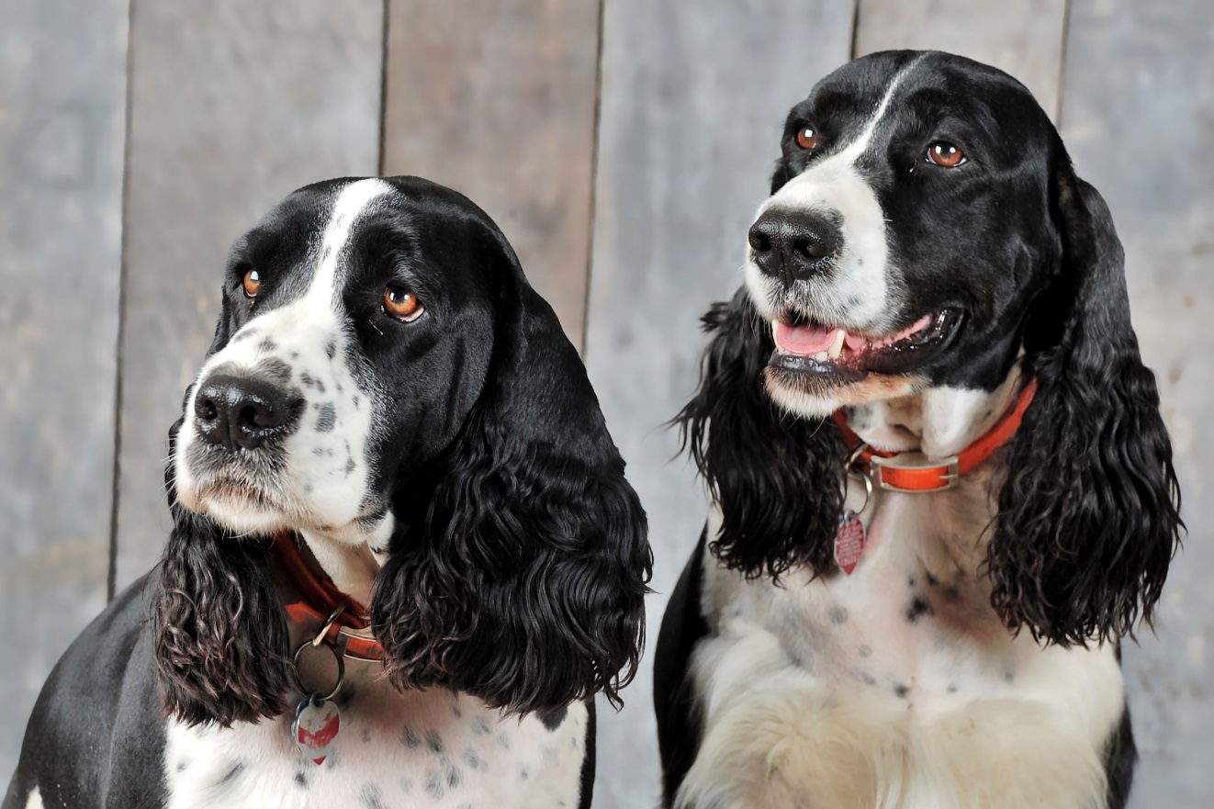
Bo & Ty Dawg

Slide 3
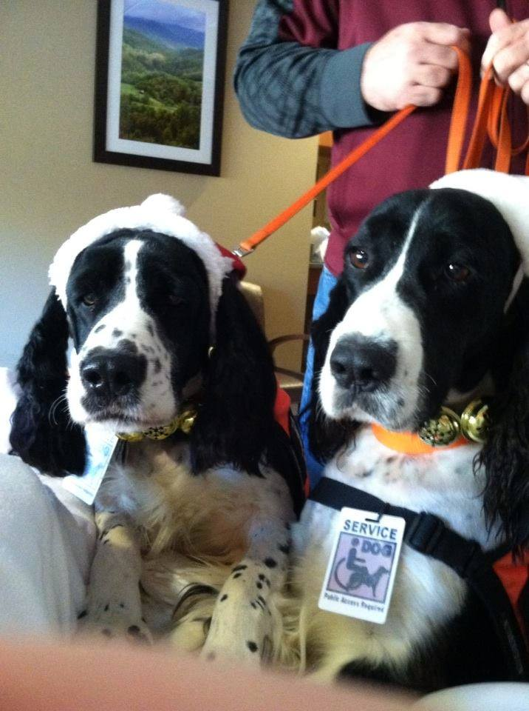
SCCH and Valley Health Care

Slide 4
How Do I Get My Dog Trained?

Slide 5
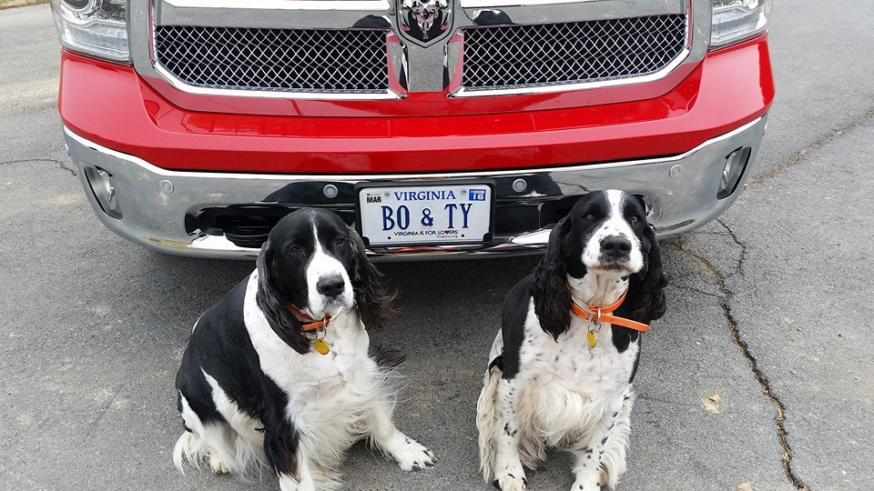
The Reality

Slide 6
Work Backwards…
Question #1

Slide 7
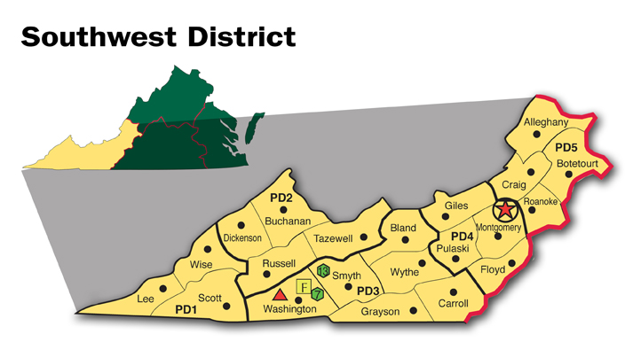
Work Backwards
Question #2

Slide 8
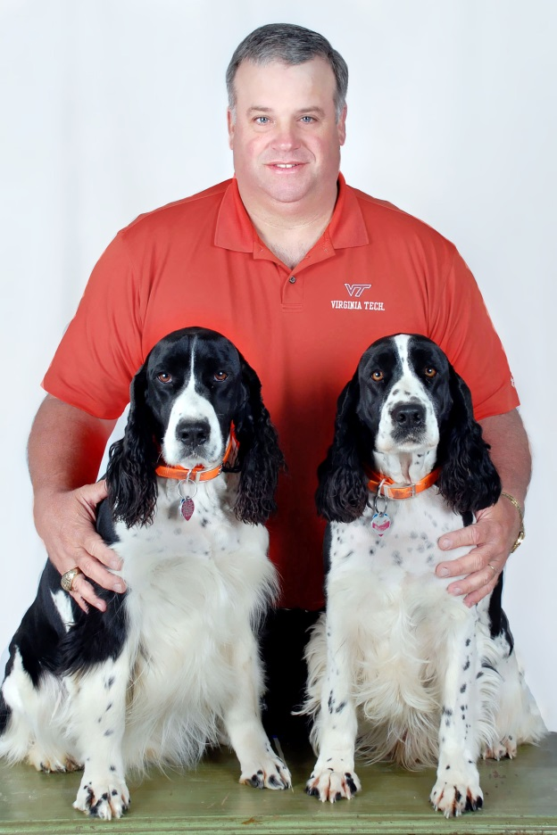
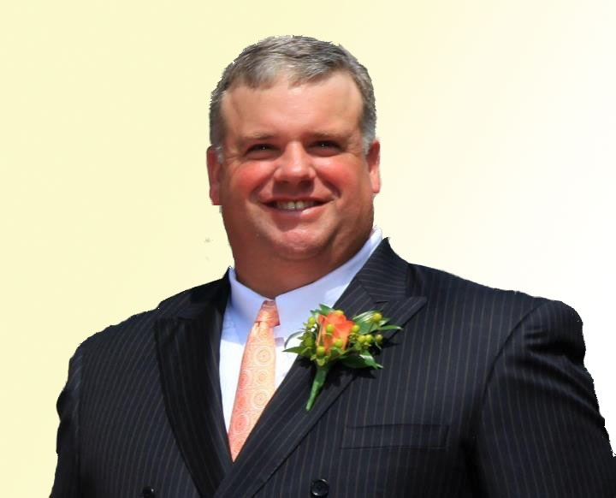
Work Backwards
Question #3

Slide 9
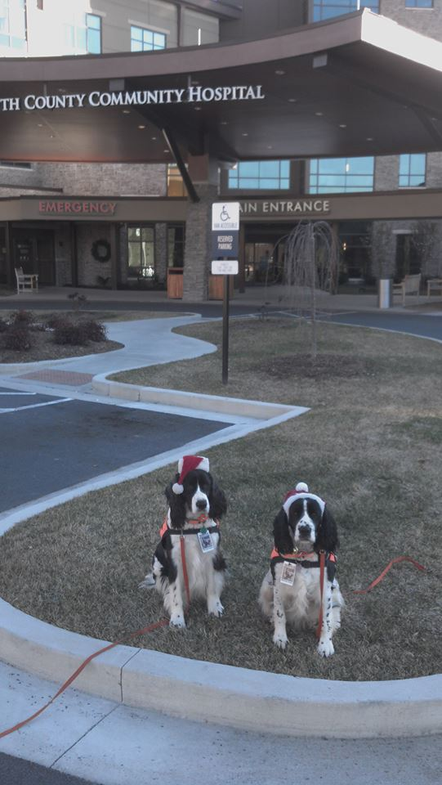
Work Backwards
Question #4

Slide 10
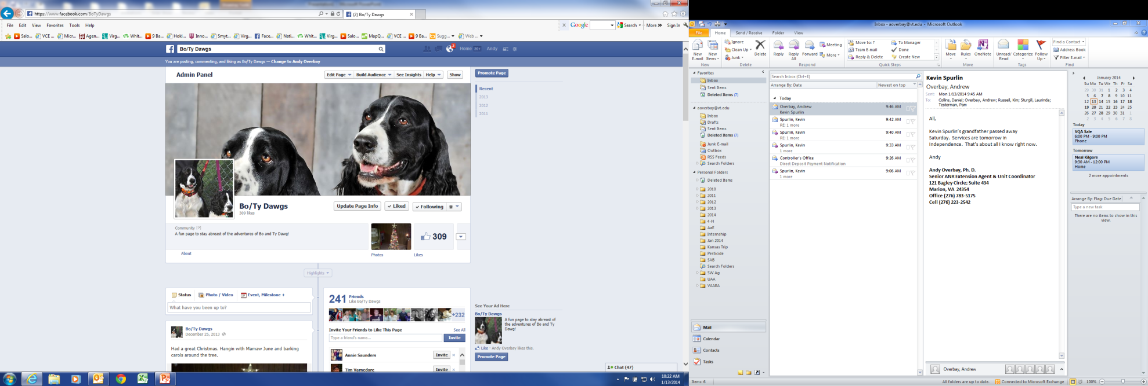
Social Media

Slide 11
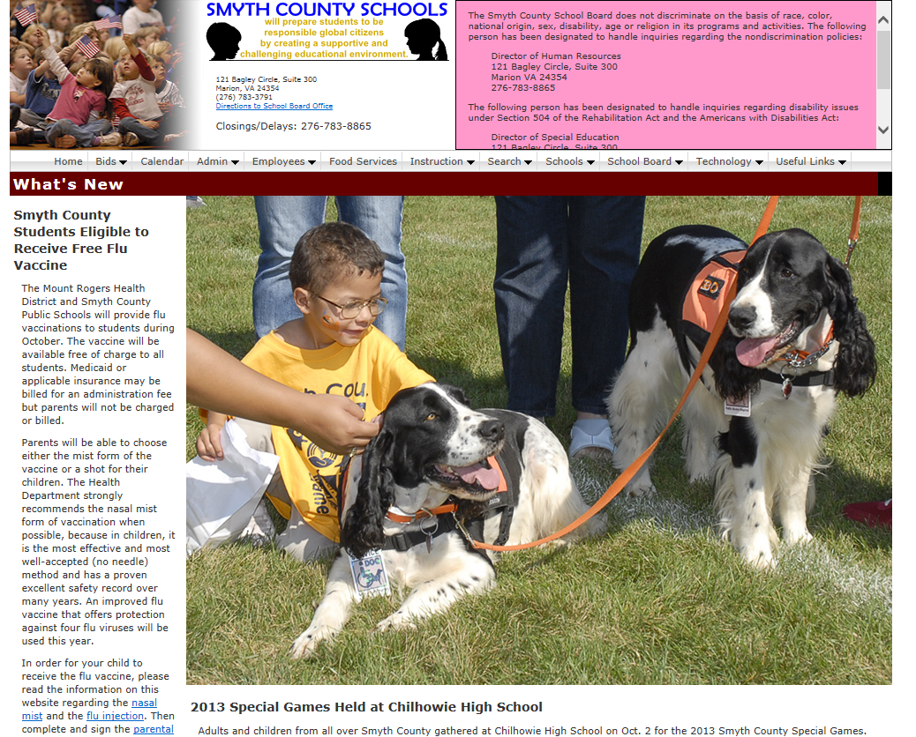
Passion and Purpose

Slide 12
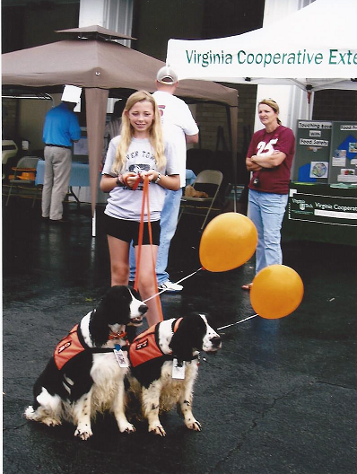
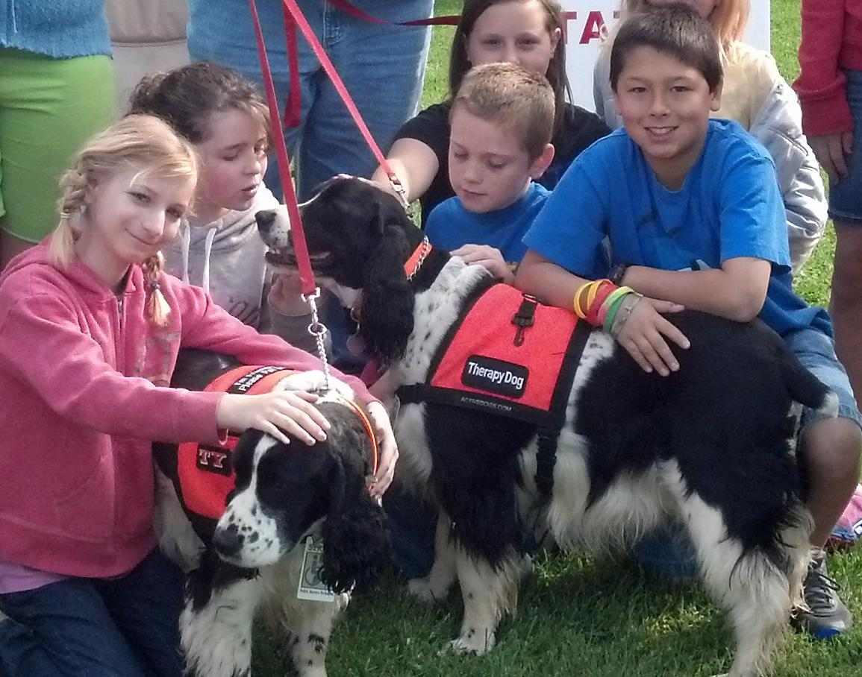
Passion and Purpose

Slide 13
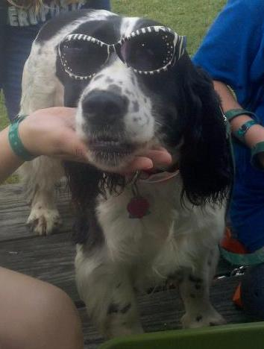
So In Review…
Do you have the time to visit?
What limitations do you have geographically?
Could you visit without the animal?
What are the needs and the requirements?
Go forth and have fun!

Slide 14
Contact
Andy Overbay
aoverbay@vt.edu
(276) 783-5175
Bo & Ty Dawg
www.facebook.com/BoTyDawgs

