Slide 1
Zenodo Data Archive
Irtiza Delwar, Michael Culhane, John Sizemore, Gil Turner
Client: Dr. Seungwon Yang
Instructor: Dr. Edward A. Fox
CS 4624 Multimedia, Hypertext, and Information Access
Virginia Tech
Blacksburg, VA 24061
April 27, 2017

Slide 2
Application Overview
Goals at the beginning of the semester:
Set up a data archive application (Zenodo) on a server running CentOS 7 operating system
Configure and populate archive with datasets
Create detailed Admin / User Guide
Add additional scripts for bulk uploads
👍 All goals completed!
Notes:
Mike

Slide 3
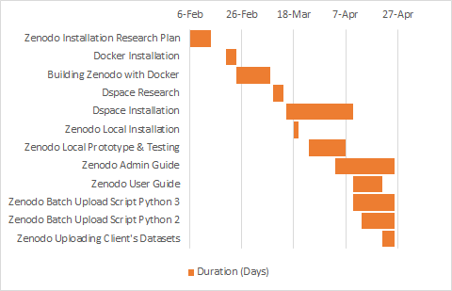
Timeline
Figure: Gantt Chart representing the timeline of our project
Notes:
Mike

Slide 4
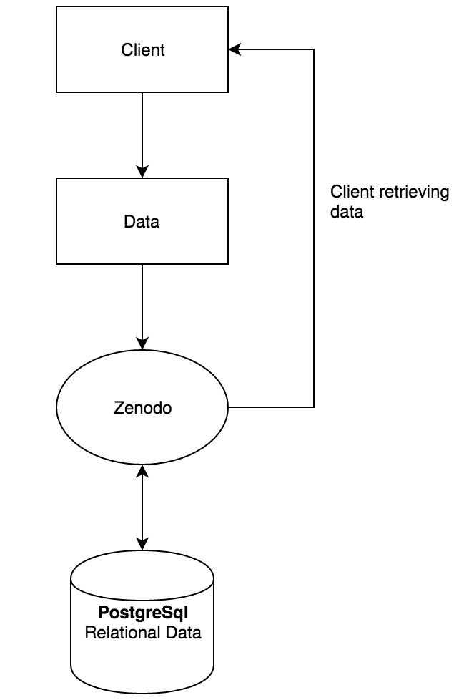
Design
Tools Used:
Linux CentOS
SSH
Zenodo
DSpace
PostgreSQL
Python
Zenodo Developer API
Data Flow Design
Notes:
John

Slide 5
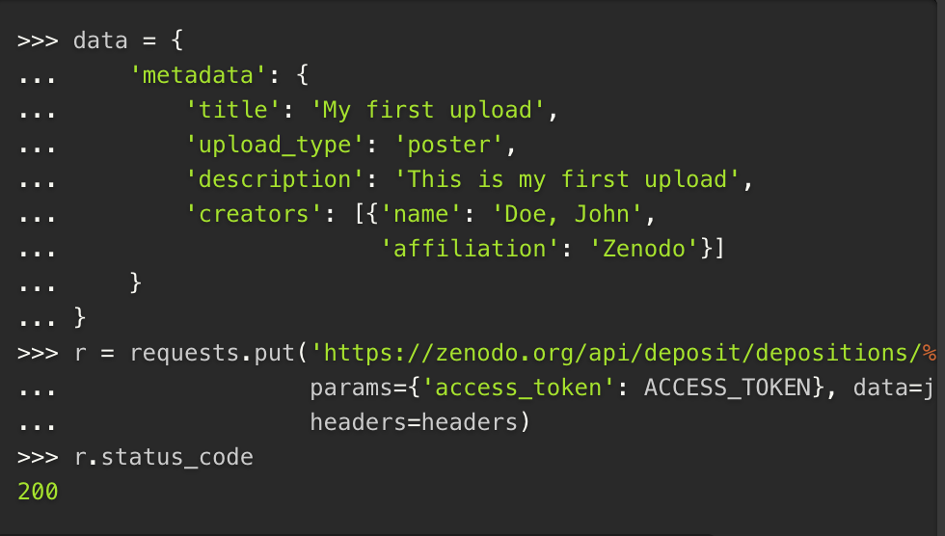
Refinement
Python Scripts
Zenodo Developer API
Single Upload
Bulk Upload
Python 2 v Python 3
Delete?
[2]
Notes:
Gil

Slide 6
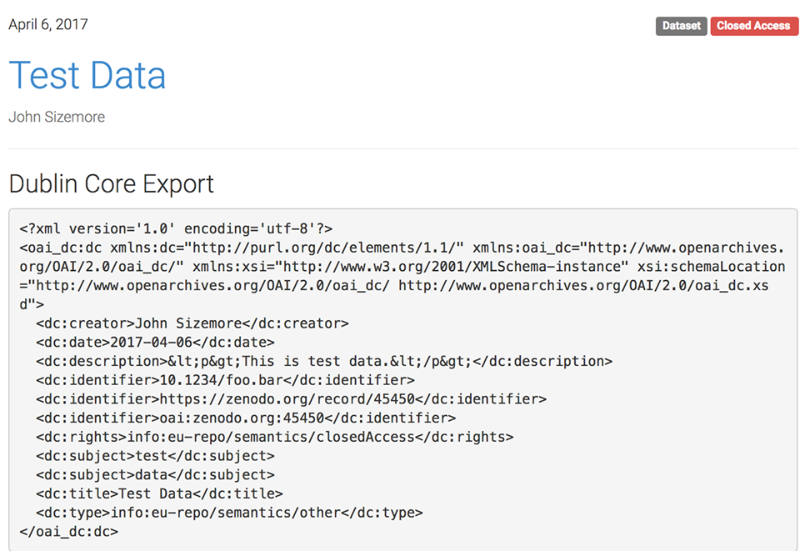

Testing
Upload different types of data
Search for different data sets
Create communities and upload to them
Export Metadata
Create additional scripts
Notes:
Irtiza

Slide 7
Guides
Administrator Guide
Installation
Configuration
API Information
Adding Scripts
General User Guide
Account Creation
Search
Upload
Communities
Metadata Export
Notes:
Irtiza

Slide 8
Demo
Local Zenodo Installation
  Upload a dataset
    Basic information
    Licensing information
  Search for a dataset
  Exporting metadata
Automated Python Scripts
  Single upload
  Batch upload
  Publishing option

Slide 9
Lessons Learned
Planning Effectively for a Large Technical Project
  Short term
  Long term
  Unforeseen issues
    Port issues
The Importance of Communication
  Long distance communication
  Dynamic project goals in accordance with client’s needs
Attention to Detail
Notes:
Irtiza

Slide 10
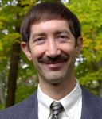
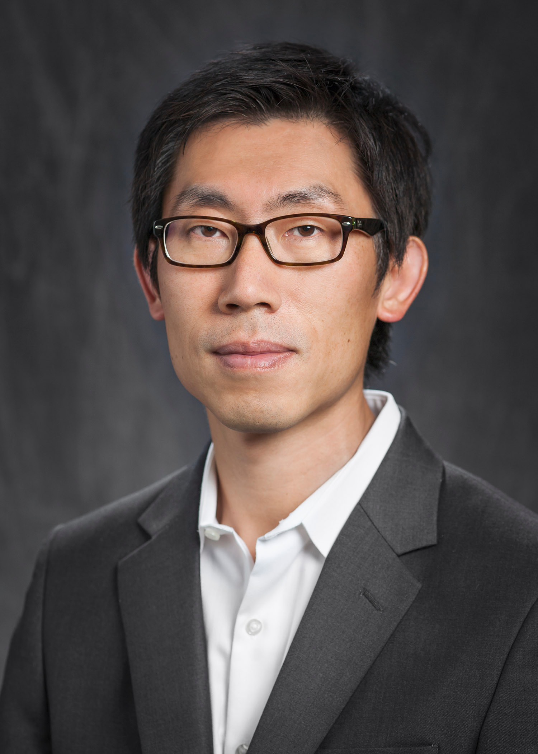
Acknowledgements
Dr. Edward A. Fox
Instructor: CS4624 Multimedia, Hypertext, & Information Access
Professor, Department of Computer Science
Virginia Tech
[5]
Dr. Seungwon Yang
Client
Assistant Professor, School of Library and Information Science and Center for Computer Computation and Technology
Louisiana State University
[3]

Slide 11
References
“Zenodo - Research. Shared.” Zenodo 3.0.0.dev20150000 Documentation, CERN, 2015. Accessed 26 Apr. 2017. <http://zenodo.readthedocs.io/>.
"REST API." Developers Zenodo. CERN Data Centre & Invenio, 2017, Web. 26 Apr. 2017. <http://developers.zenodo.org/>
Yang, Seungwon. “Seungwon Yang.” LSU School of Library & Information Science, Louisiana State University, 2017.
Accessed 20 Feb. 2017. <http://www.lsu.edu/chse/slis/about_us/bios/yang.php>
4. "DSpace." Wikipedia. Wikimedia Foundation, n.d. Web. 26 Apr. 2017. <https://en.wikipedia.org/wiki/DSpace>.
5. Fox, Edward A. Edward A. Fox Information Page. Virginia Tech, 2017. Web. 26 Apr. 2017. <http://fox.cs.vt.edu/foxinfo.html>

