Slide 1

Get Noticed
Managing your scholarly career in an age of metrics, social media, and open research
NLI Summer Session
June 12-13, 2017
This presentation is licensed CC BY 4.0 for reuse.
© Anita Walz, Virginia (Ginny) Pannabecker, Philip Young, Peter Potter, and Gail McMillan

Slide 2
Manage your scholarly career in an age of metrics, social media, and open research. This session is designed for busy faculty who want a jump start in developing new skills, mastering new tools, and learning new approaches related to sharing their work and extending their impact. University librarians and publishing experts will present a variety of tools and methods to:
(1) leverage your rights as an author
(2) build and manage your online presence
(3) share your work and get noticed, and
(4) demonstrate your impact.
Attendees will have the opportunity to set and refine individual goals for their workshop participation and beyond. Hands-on time and assistance will be included for attendees to make tangible progress in their identified areas. Time will also be allocated for attendees to discuss common problems and solutions.

Slide 3
Monday:
Your intended impact
Planning for a broader impact
Collaboration tools
LUNCH
Publishing case study
Open Access
Methods for broadening your impact

Slide 4

Write It Down:
What would be useful for you?
What would you like to work on or learn more about during this workshop?

Slide 5

Tuesday:
Breakfast 8-8:30am
Lightning round talks
Influencing what people find
Your role in promoting your work
Group and individual breakout sessions
Reflection exercise

Slide 6

Introduction: The Big Picture
Presenters & library services
Getting to know you

Slide 7
Presenters
Anita Walz, Open Education, Copyright and Scholarly Communication Librarian
Gail McMillan, Director, Scholarly Communication
Virginia (Ginny) Pannabecker, Health Sciences Research Support Coordinator
Peter Potter, Director, Publishing Strategy
Philip Young, Scholarly Communication Librarian

Slide 8
Services We Offer
Open Access Subvention Fund - Get financial help to publish your articles in OA journals
Data Consultations / Data Management Plans, Projects & Resources
VTechWorks - Share your work publicly in the Library’s Institutional Repository
Open Access Publishing & Resources - Publish your journals & conference proceedings with us
Publishing Consultations - Get help in publishing your work elsewhere
Copyright Consultations - Understand your rights and responsibilities as authors
Open Education/Open Educational Resource Consultations & Publishing - Create, adapt, or customize openly licensed content to fit your courses
Tell Your Story: Impact & Engagement consultations and resources - Discuss what you’re using and additional methods to optimize engagement with your work

Slide 9
Introductions - Please Tell Us:
Your Name
Your Department and Research Interests
What you hope to learn in this session

Slide 10
Introduction: The Big Picture
Leverage your rights as an author/creator
Build and manage your online presence
Share your work and get noticed
Demonstrate your impact

Slide 11

How (and why) do people show the
impact of their work
in your field?

Slide 12
Do you need a break?

Slide 13
Toward Impact
Metrics
Academic
Broader impact
Enhancing dissemination
Making your work discoverable
Making yourself discoverable
Resources
Evidence

Slide 14
Academic Metrics
Primarily citation-based at different levels of measurement
Research object
Article - citations, normalizations
Book - citations
Data/Software - citations, forks
Presentations - acceptance rate, attendance, downloads, views
Creative work- exhibits, performances, reviews
Journal
Journal impact factor, journal rank, acceptance rate, etc.
Author
Number of papers, h-index

Slide 15
Broader Impact
Altmetrics (for: articles, books, data, software, presentations, and more)
Links, saves, mentions, views, downloads
Books: reviews, library holdings, ratings (Amazon, Goodreads)
Altmetric.com data for EFARS, Library search, VTechWorks
Bookmarklet and badge embedding
Impactstory profile

Slide 16
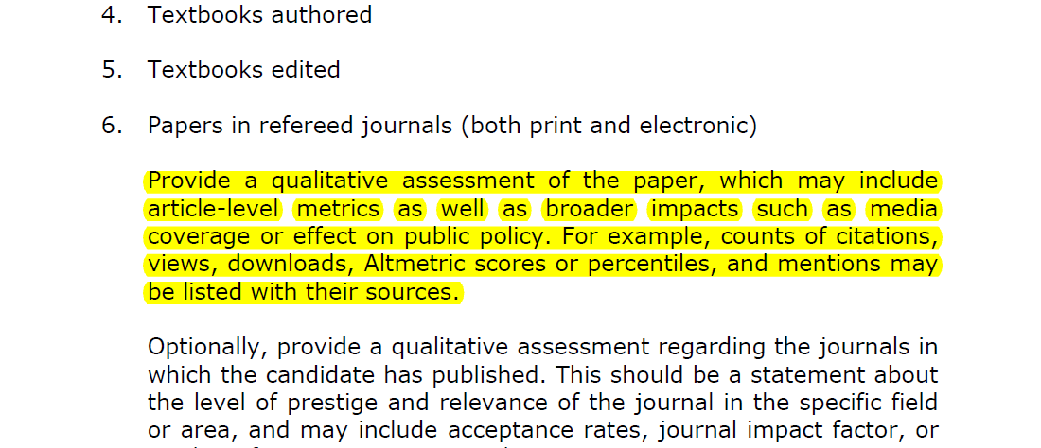
Broader Impact
Promotion and Tenure Guidelines 2016-2017.pdf (p. 11)

Slide 17
Enhancing Dissemination
Make Your Work Discoverable: Articles
Post a version online (permissions in your contract or at Sherpa/Romeo)
VTechWorks - via EFARS
Disciplinary repositories/Preprint servers
arXiv, PsyArXiv, bioRxiv, Humanities Commons, OSF
Proprietary repositories (ResearchGate, Academia.edu)
“For enduring impact consider enduring access” -me
Publish open access (Directory of Open Access Journals; limit to OA in
Ulrich’s Periodical Directory) Open access fund

Slide 18
Enhancing Dissemination
Make Your Work Discoverable: Books
Open Access for Books
OA Monograph Initiative (see Peter)
Open Access Book Publishers
Chapters - check permissions in advance
Rights Reversion

Slide 19
Enhancing Dissemination
Make Yourself Discoverable
Research Profiles
Google Scholar, ORCID, CollabVT
Career Professional Profiles
LinkedIn
Social Media
Twitter, Google+, Facebook
Outreach
Write: Blogs@VT, Signal to Noise, Footnote, The Conversation
VT News college communicators
Center for Communicating Science
Services: Kudos, Brevy, External Diffusion, Research Square, SPapers, Growresa

Slide 20
Enhancing Dissemination
Resources
Maintaining an Online Scholarly Identity (MathEd.net blog)
Impact Handbook for Social Scientists (LSE Impact blog)
Promoting Your Articles to Increase Your Digital Identity and Research Impact
(Jon Tennant, ScienceOpen)
Impact Toolkit (Economic and Social Research Council)
Effective Science Communication (Illingworth & Allen)
An Introduction to Social Media for Scientists (PLOS Biology)
The verdict: Is blogging or tweeting about research papers worth it? (Melissa Terras)

Slide 21
Enhancing Dissemination
Evidence
Open access citation advantage (46/70 studies)
Open access altmetrics advantage
Twitter and citations
Open access Wikipedia citation advantage (47%)
Open data citation advantage (8 studies, see Piwowar & Vision 2013)
Trend: more highly-cited papers from non-elite journals (1, 2, 3)
How open science helps researchers succeed

Slide 22
Responsible Metrics Resources
San Francisco Declaration on Research Assessment
Leiden Manifesto for Research Metrics
The Metric Tide - 2015 report from the UK
Centre for Science and Technology Studies, Leiden University

Slide 23
Impact
Context
Percentages, quartiles, etc.
Narrative
Who linked, cited, etc.

Slide 24
Write It Down:
What would be useful for you?
What would you like to work on or learn more about during this workshop?

Slide 25


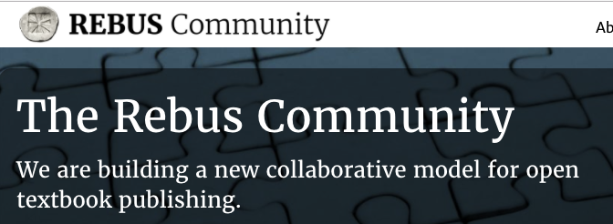
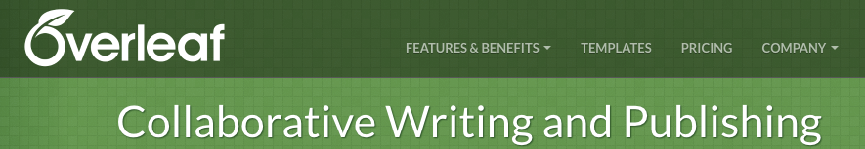

Planning Ahead to Share Your (Collaborative) Work - Tools
Data Management Plan
VT Libraries Services
Publication venue selection
Consider OA options and fee support

Slide 26
Share a collaboration experience:
What was the project?
Was it within VT or also with other institutions?
How did you manage collaborative writing, project tasks, and files overall?
  What tools or best practices would you recommend?
Notes document for this discussion

Slide 27
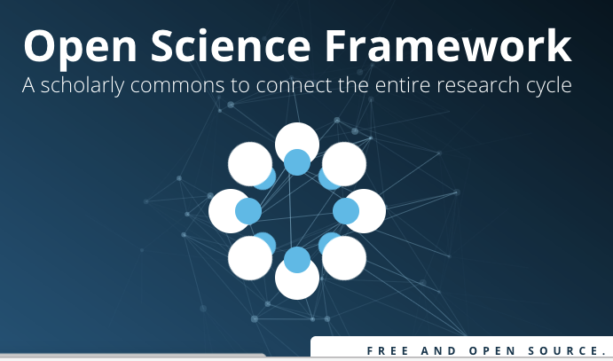
Open Science Framework
OSF @ VT
Project Management Dashboard
Version Tracking for files and writing
Control Access & Collaboration
  Permissions at item level
Register your project: freeze at any point
Integrate with other tools: Dropbox, Google Drive, GitHub, … more
Archive your data
Publish your project with a DOI for referencing
Project Analytics

Slide 28
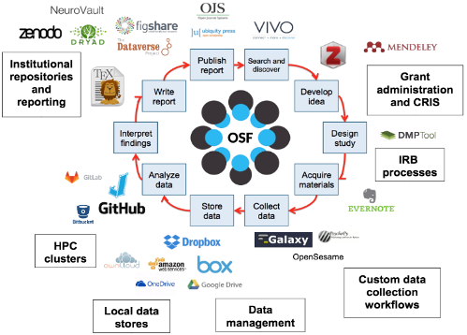
Open Science Framework
Image from Vicky Steeves’ “OSF Workshop” presentation files on GitHub:
https://github.com/VickySteeves/OSF-Workshop

Slide 29
Rebus Community

Slide 30
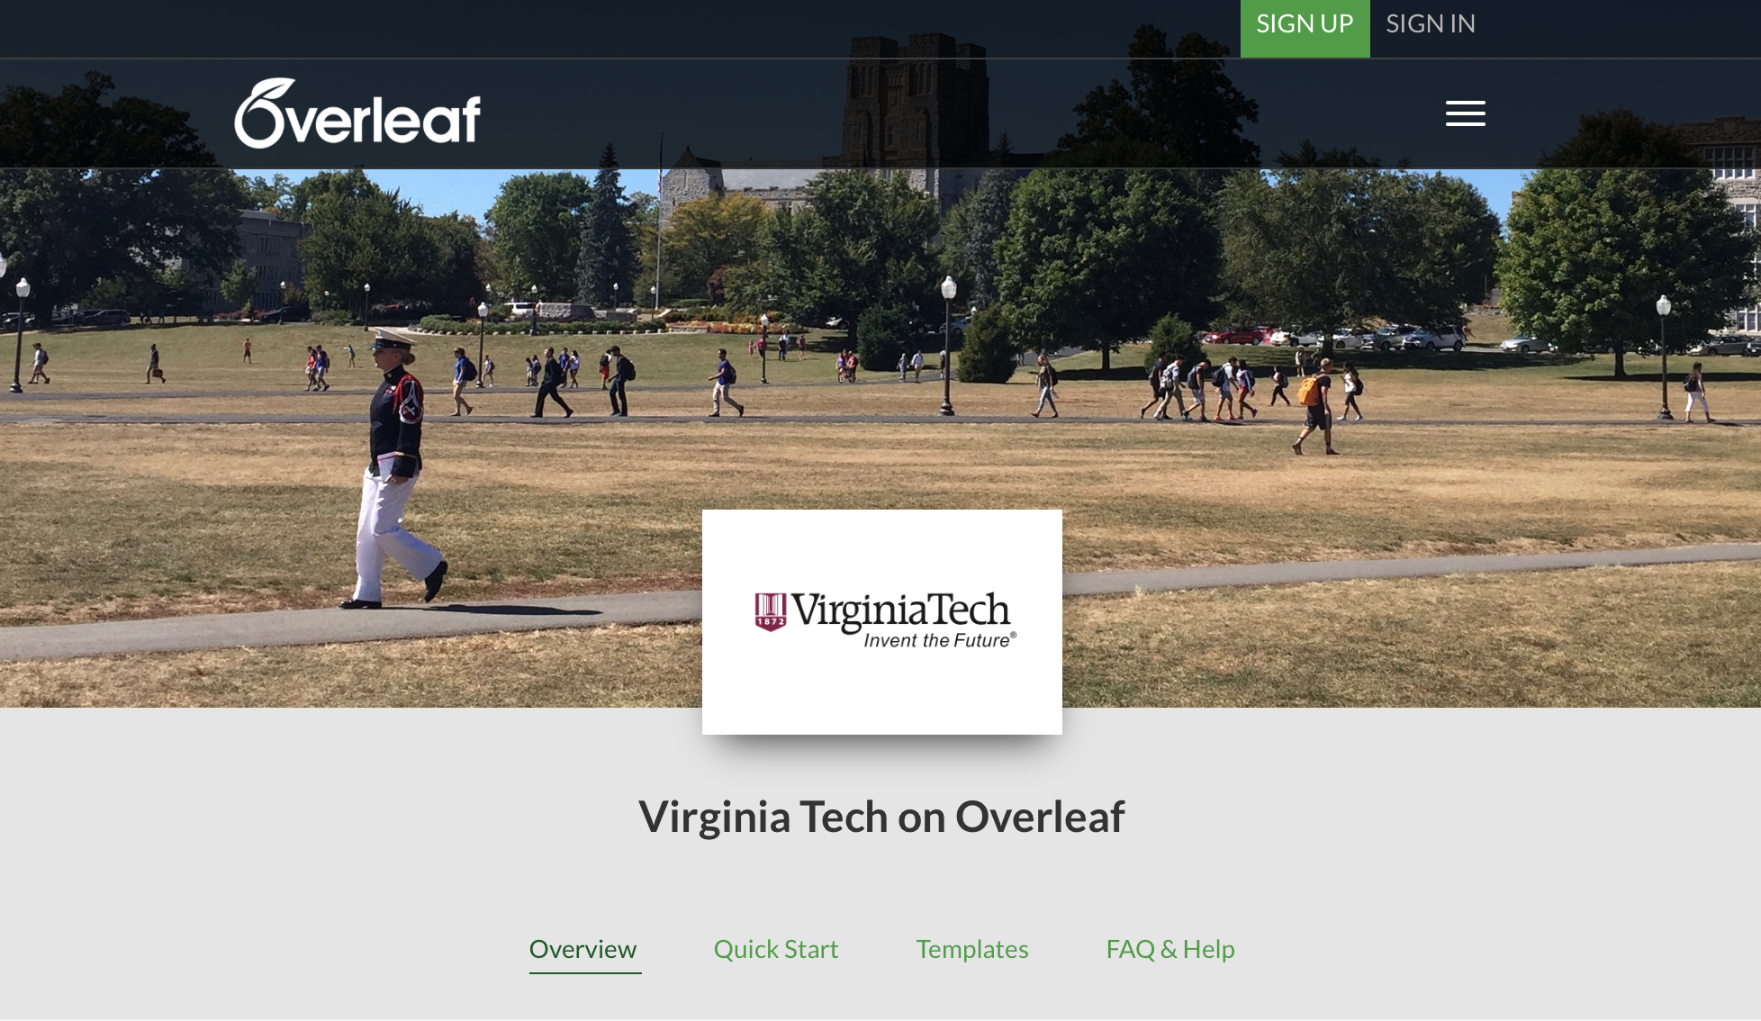
Planning to Share Your Work: Writing/Publishing Tools

Slide 31
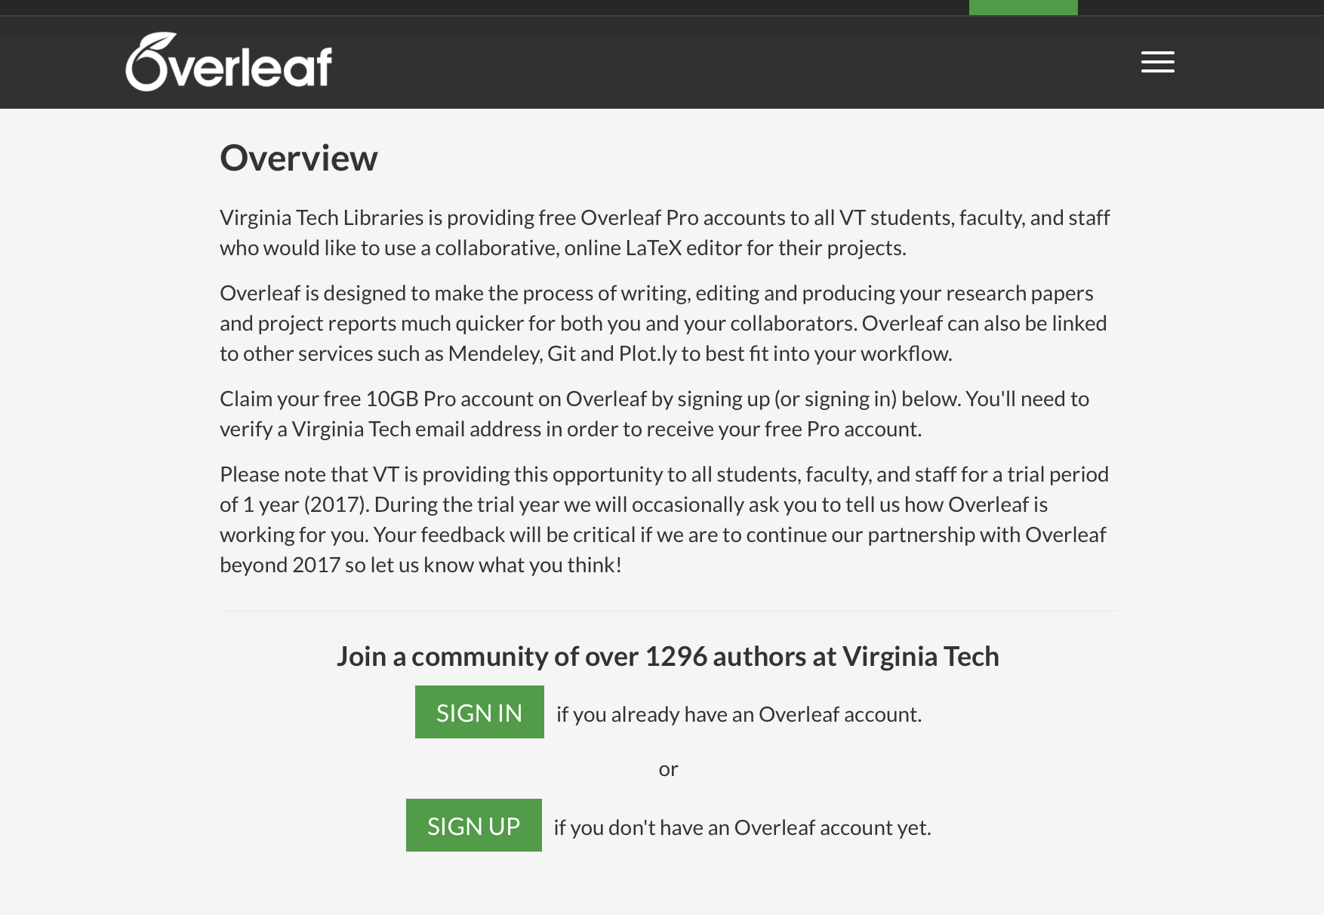
Planning to Share Your Work: Writing/Publishing Tools

Slide 32
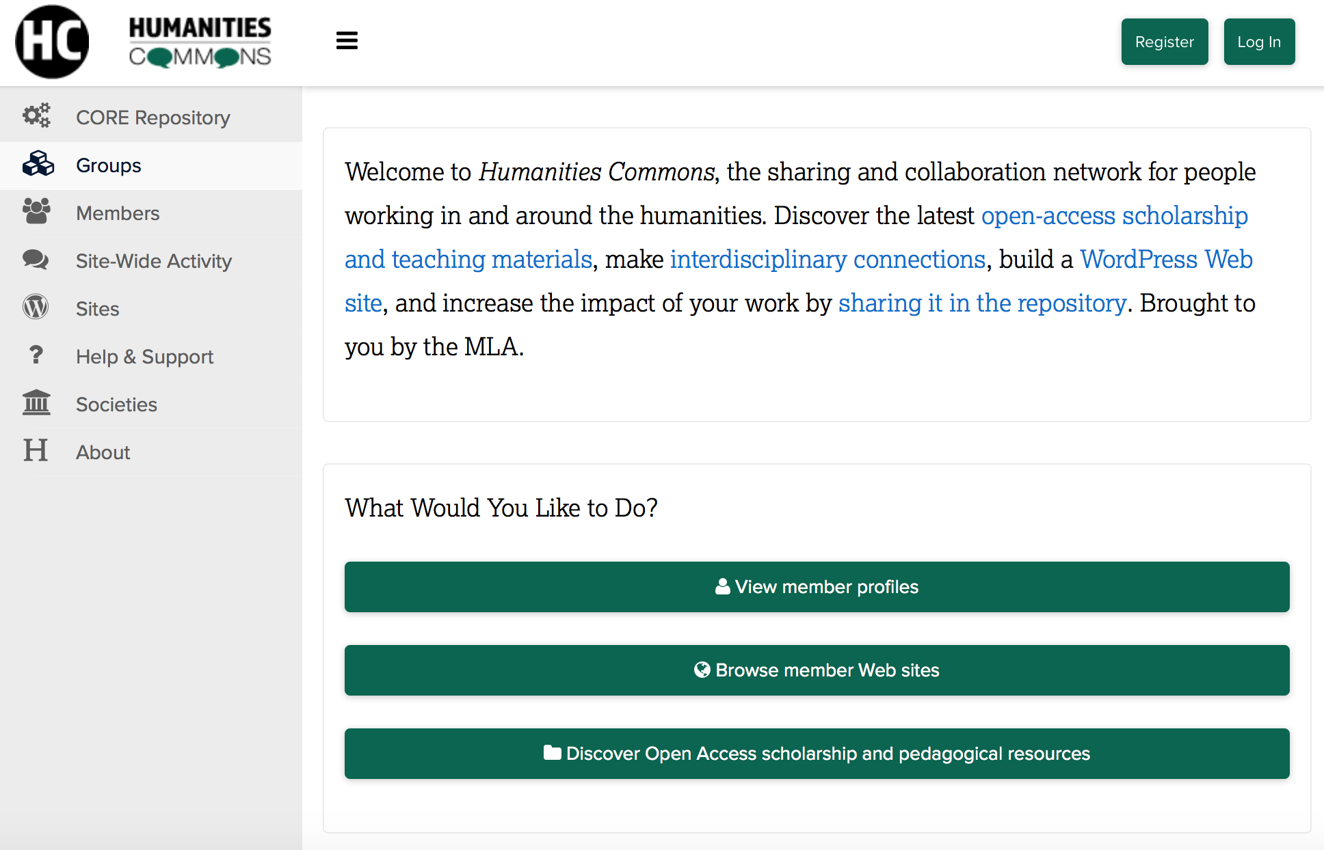

Slide 33
TOOLS TRY OUT
Choose a subgroup to join to explore one tool: OSF, Overleaf, Rebus, Humanities Commons, or something else brought up
Report back to the full group

Slide 34
LUNCH

Slide 35
Discussion: What is Open Access?
“Open Access (OA) Literature is digital, online, free of charge, and free of most copyright and licensing restrictions.”
—Peter Suber, Open Access (2012)
Notes:
Anita - OA is a small (but relatively new) option ...but we want to talk about this. What do you think “open access” means? Why might or might it not be valuable to you? How has it impacted your field? What do you think about OA?

Slide 36
Peter Potter
Director, Publishing Strategy
Virginia Tech Libraries
Scholarly Publishing Today

Slide 37




Scholarly Publishing Today
The Players
Scholarly Societies
American Chemical Society, Institute of Electrical & Electronics Engineers, Brookings Institution
University Publishers
University presses
Library publishers
Commercial publishers
Elsevier, Springer, Wiley, Sage
A New Force: Non-profit, Open Access publishers
PLoS, BioMed Central

Slide 38


Scholarly Publishing Today
Journals, books, and more
Global STM Market: $26 billion
Journals = 25% ($6.8b )
Books < 15%
Technical info, standards, databases, tools, etc. > 40%
Open Access (OA)
Growing but still small in revenue terms ($300m)
11,467 OA journals in Directory of Open Access Journals
Don’t confuse OA with non-commercial
  Full OA (Green & Gold) and Hybrid OA

Slide 39
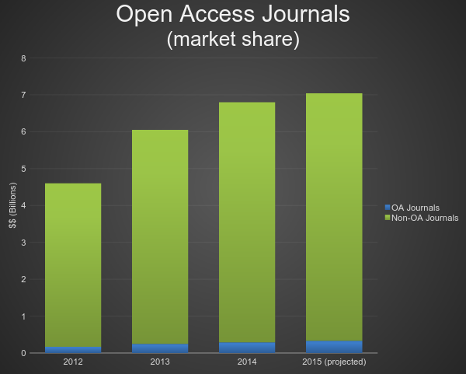

Slide 40
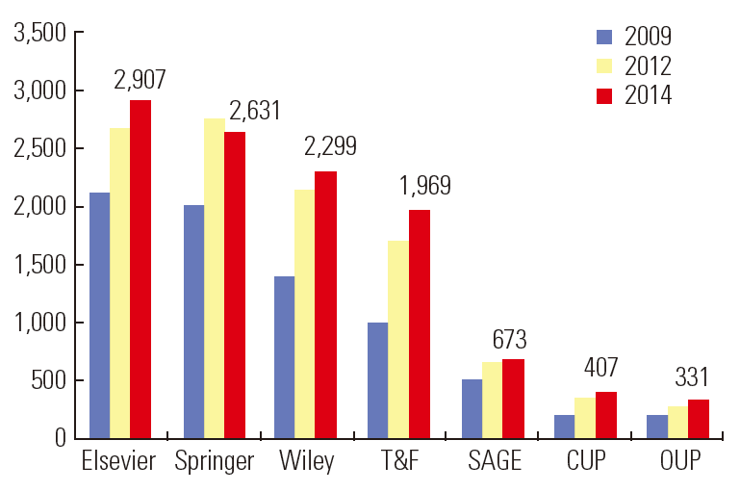
Scholarly Journals
Number of journals published by the Largest Publishers
Source: “The Big Picture: Scholarly Publishing Trends 2014,” by Pippa Smart (Sci Ed 2014; 1(2): 52-57. http://dx.doi.org/10.6087/kcse.2014.1.52)

Slide 41



eBooks in the Academy
Textbooks going digital
Monographs struggling to gain a foothold
  Often challenging to read on a hand-held device
  Competing/conflicting technologies
  Digital rights management (DRM)

Slide 42

Scholarly Publishing Today:
What Hasn’t Changed?
Submission process
Peer review
Contract
Copy editing
Publication

Slide 43
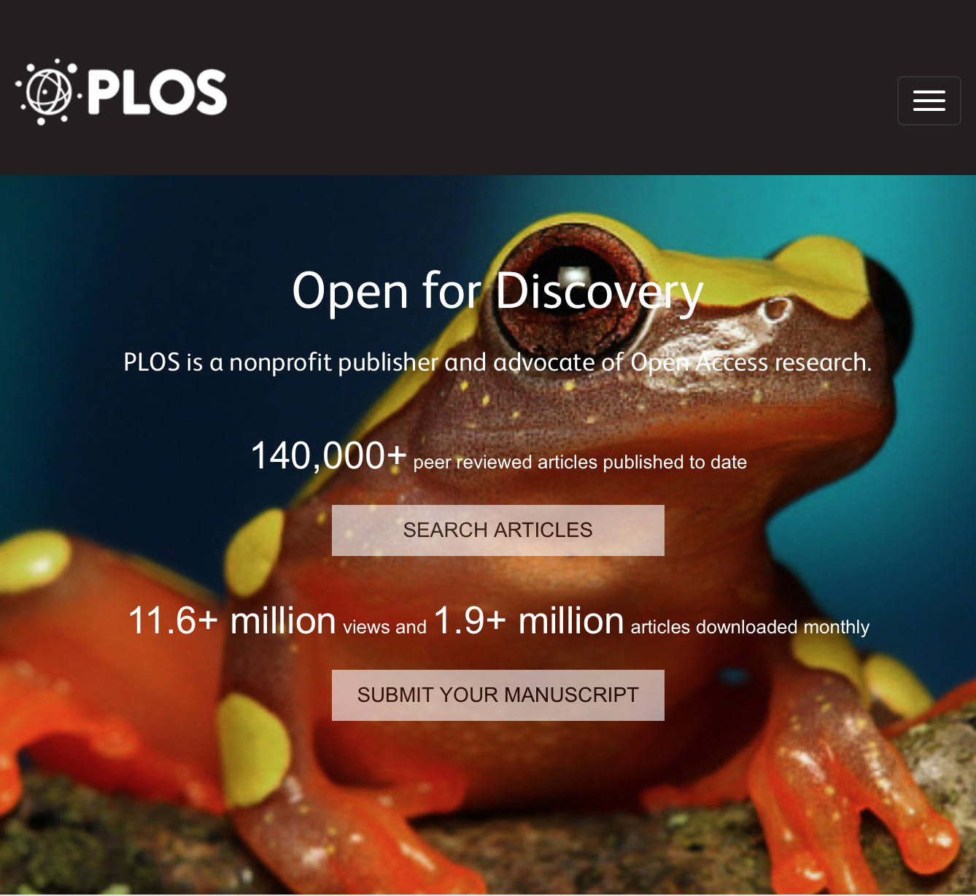
Scholarly Publishing Today:
What Has Changed?
Printing optional
OA options
  PLoS
  BioMed Central
Self publishing (Who needs a publisher?)
  Preprints, Postprints
  Repositories
  ArXiv, PubMed Central
Notes:
Photo: PLoS website

Slide 44

What to Expect When You’re Expecting
(to publish an article or a book)
More Choices/More Risks
More publishers (traditional & OA)
New forms of peer review
New formats
Contracts, copyright, & licensing
Editing, design, production
Marketing
Self publishing

Slide 45
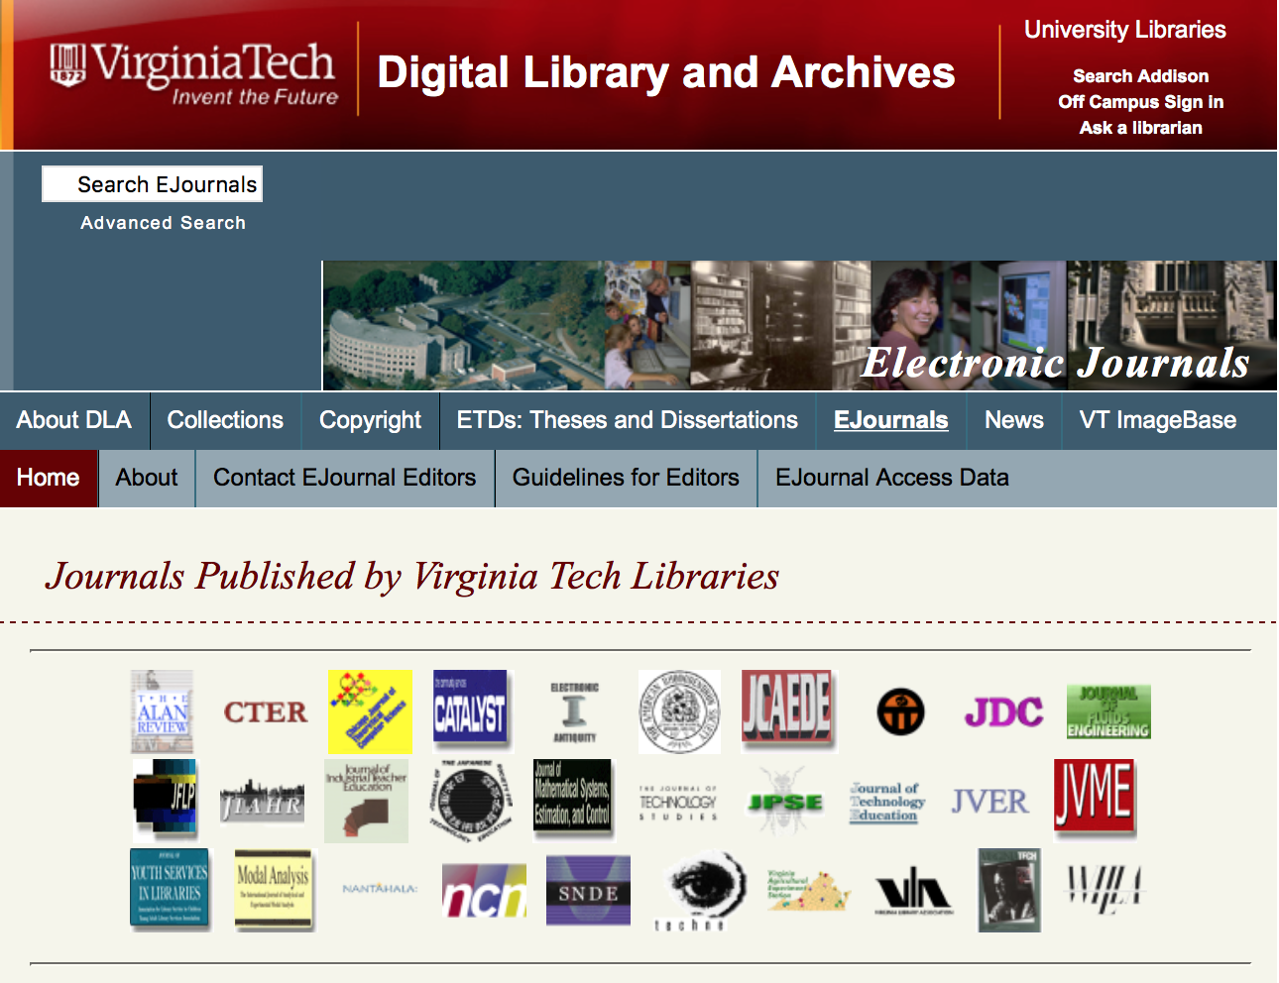
Library Publishing at Virginia Tech
40+ journals hosted since 1989
12 active journals today
  3 student journals
Open Textbooks
Conferences
Support for OA Publishing
  Article subventions
  Monograph subventions

Slide 46
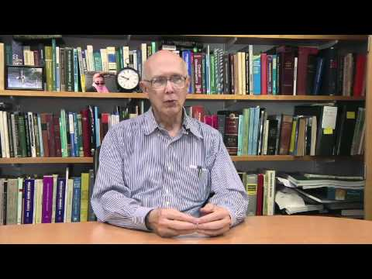
George Whitesides. “Impact of technology on scientific articles.” American Chemical Society. April 29, 2011. Available on YouTube.

Slide 47
Discussion: What is Open Access?
“Open Access (OA) Literature is digital, online, free of charge, and free of most copyright and licensing restrictions.”
—Peter Suber, Open Access (2012)
Notes:
Anita - OA is a small (but relatively new) option ...but we want to talk about this. What do you think “open access” means? Why might or might it not be valuable to you? How has it impacted your field? What do you think about OA?

Slide 48


Open licenses
Creative Commons Licenses
about attributing cc-licensed works finding cc-licensed images brochure
More information

Slide 49

Do you want a break?

Slide 50
Open access
Definition
Who’s excluded
Two paths
Advantages
Misunderstandings
Uncertainties
Library services

Slide 51
Open Access Defined
Definition
  “Open-access (OA) literature is digital, online, free of charge, and free of most copyright and licensing restrictions” (Suber, 2004)
Creative Commons licenses

Slide 52
Who doesn’t have access?
Researchers at other institutions
Researchers in the global south/developing countries
Taxpayers
Government policymakers
Non-governmental organizations
Alumni
Citizen scientists
Us

Slide 53
Two paths to open access
Archiving - Open Access Repositories (“Green OA”)
Publishing - Open Access Journals (“Gold OA”)

Slide 54
Advantages
Citations
Attention
Openness is aligned with research integrity
Text and data mining
Use in teaching and research
Efficient knowledge building and transfer

Slide 55
Misunderstandings
Open access is a way to bypass peer review
Open access will prevent me from receiving royalties
Open access means publishing (1) in a journal (2) for a fee (3) that I have to pay out of pocket
Open access will hurt my society
Open access advocates think everything should be free

Slide 56
Common uncertainties
Which journals are legitimate?
Think Check Submit
Ulrich’s Periodical Directory (limit to OA, peer review)
Directory of Open Access Journals
Ask us
Do I have the right to post my article?
Check your contract
Check Sherpa/Romeo
Negotiate or add an addendum
Learn about a potential faculty open access policy at VT

Slide 57
Library services
Open access guide, subvention fund, and discounts
Open access publishing - journals, conference proceedings, & books
VTechWorks and VTechData
Data consultations / data management plans, NIH, NSF
Copyright consultations
Tell Your Story: Impact & Engagement consultations and resources
Open educational resources guide, consultations & publishing
Overleaf
perma.cc
Stay informed: blog, twitter, email list

Slide 58

BREAK
TIME!

Slide 59

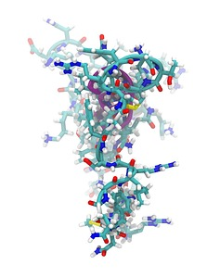


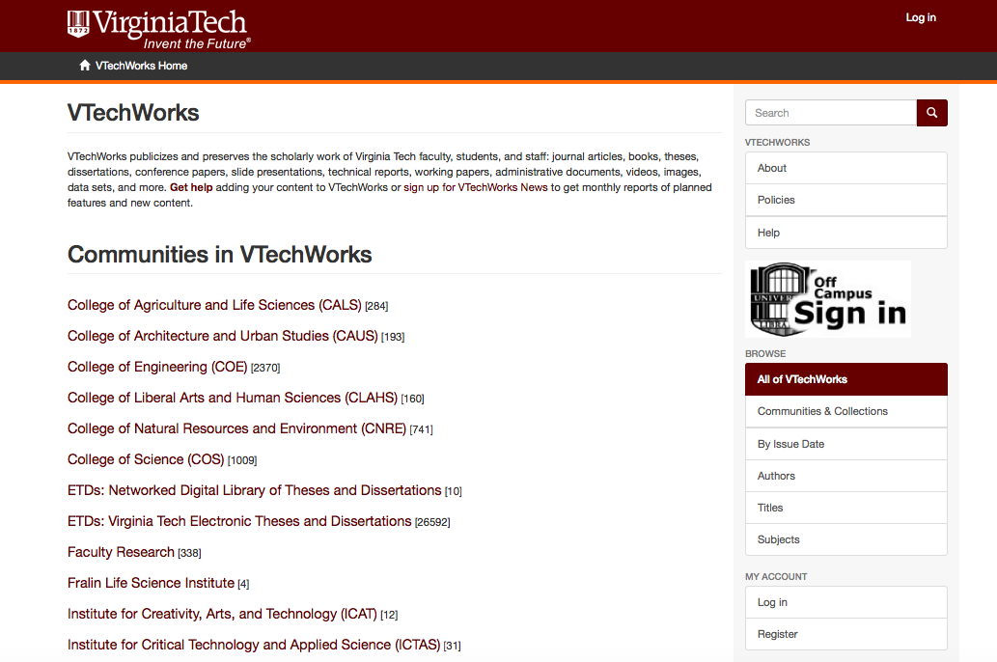

Share Your Work & Get Noticed
Images are: a screenshot of VTechWorks page, and (all others) CC0 public domain sourced from Pixabay

Slide 60
Share Your Work & Get Noticed
What do you want others to know about, find, and access?
Works (publications, creative works, …)?
Teaching (course syllabi, educational materials)?
Service and Association involvement?
What else?
How are you sharing these now, if you are?

Slide 61
Sharing Your Work - Benefits
& Considerations (Copyrights)
Access
Scholars, Developing world, Alumni, Taxpayers….. You?
Outreach
Networking, Blogging, Social media
Metrics
Open access citation advantage & altmetrics advantage
Image of point-line network by geralt via Pixabay (CC0 public domain release).
Image of folder-manuscripts by ClikerFreeVectorImages via Pixabay (CC0 public domain release).

Slide 62

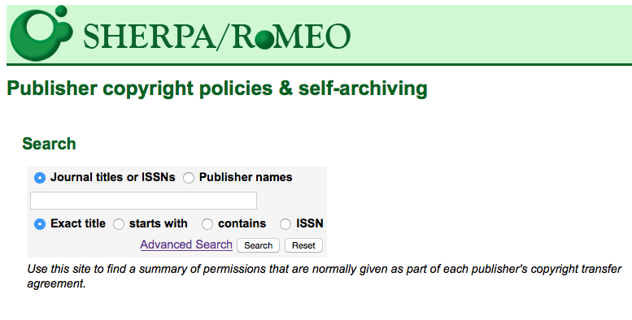
How do I know:
what, where, and when I am permitted to post my work?
Your copyright agreement / contract
Transfer or license?
Terms of use - archiving, posting, sharing, etc.
Sherpa romeo
95% accuracy with general publisher guidelines
Publisher guidelines
Check their website
Image of copyright icon by openicons via Pixabay (CC0 public domain release).
http://www.sherpa.ac.uk/romeo/index.php

Slide 63
Publication posting
terminology
From SHERPA Open Access Glossary:
Submitted Manuscript (‘Preprint’)
“...a draft of an academic article or other publication before it has been submitted for peer-review or other quality assurance procedure as part of the publication process. Preprints cover initial and successive drafts of articles, working papers or draft conference papers.”
Accepted and Revised Manuscript (‘Postprint’)
“The final version of an academic article or other publication - after it has been peer-reviewed and revised into its final form by the author.”
Repository (Institutional / Disciplinary)
“A website that aims to collect, preserve and proffer electronically the intellectual output of a subject or organisation [institution] without charge to the World”
VTechWorks is VT’s Institutional repository
http://www.sherpa.ac.uk/romeo/index.php
Image of copyright icon by openicons via Pixabay (CC0 public domain release).

Slide 64
Journal’s archiving/posting policies
Go to your Elements eFAR, or direct to SHERPA/RoMEO to look up the posting guidelines for one of your articles:
http://www.sherpa.ac.uk/romeo
Or, search one of these example journal titles:
New England Journal of Medicine
Contemporary Sociology
Language and Literature
vtechworks@vt.edu

Slide 65


Share Your Work & Get Noticed
Online Identity Inventory (handout)
Search for yourself on Google/Yahoo/Other: What do you find in the top 10 results?
What profiles do you already have?

Slide 66
Share Your Work & Get Noticed
Online Identity Inventory
Share your results and notes with a partner
  What recommendations do you have for each other?

Slide 67
Share Your Work & Get Noticed
Goals Check-In
Tomorrow we’ll have hands-on time to work on your goals
Check-in on what you have written down - would you like to adjust or add anything?

Slide 68
See you on Tuesday!
Lighting talk sign up
8am Breakfast (Torgerson 1100)
8:30am Session (Torgerson 3080)
Done by 12noon

Slide 69
Get Noticed
Managing your scholarly career in an age of metrics, social media, and open research
NLI Summer Session
June 12-13, 2017
This presentation is licensed CC BY 4.0 for reuse.
Notes:
Anita
OUTLINE is available here https://docs.google.com/a/vt.edu/document/d/1hZvNHgdIXiJRctIADdLe1Uqpb4cofthqI9NYsT2ECnQ/edit?usp=sharing

Slide 70
Tuesday:
Welcome back!
Loose ends & planning for today
Lightning round talks
Influencing what people find
Your role in promoting your work
Group and individual breakout sessions
Reflection exercise
Notes:
Anita

Slide 71
Services We Offer
Open Access Subvention Fund - Get financial help to publish your articles in OA journals
Data Consultations: Data Management Plans | dataservices@vt.edu
  Quick List: Data Services & Resources at VT Libraries
VTechWorks - Share your work publicly in the Library’s Institutional Repository
Open Access Publishing - Publish your journals & conference proceedings with us
Publishing Consultations - Get help in publishing your work elsewhere
Copyright Consultations - Understand your rights and responsibilities as authors
Open Education/Open Educational Resource Consultations & Publishing - Create, adapt, or customize openly licensed content to fit your courses
Tell Your Story: Impact & Engagement consultations and resources - Discuss what you’re using and additional methods to optimize engagement with your work

Slide 72
Potential break out group topics?
High impact, low effort tweeting
Overleaf (or other specific platforms)
Brainstorm: Showing the impact of teaching
Helping others (or yourself) to navigate P&T
What’s my impact workflow? What do I do next?
Notes:
Ginny

Slide 73
Recap of Monday’s session
Goals?
Questions?
Notes:
Anita

Slide 74
Lightning Round Talks!
Notes:
Anita
https://pixabay.com/en/lightning-storm-weather-sky-399853/

Slide 75

Professional Identity Management
Influencing What People Can Find and
Promoting Your Work
Share your background, work, and interests
Connect with researchers, potential collaborators, and potential postdocs
Image by PeteLinforth via Pixabay, CC0, public domain
Resources folder with Tip Sheets: https://tinyurl.com/NLI-GetNoticed
Notes:
Ginny
→ at end will transition to Peter - Promoting your work

Slide 76
Managing Your Identity
✔ Investigate your online identity
✔ Identify goals to improve your personal brand and your professional identity
Select, develop, and maintain your identity using: website/portfolio page, social media, researcher profiles, professional association profiles
  Professional association memberships → network with your professional community
Image by PeteLinforth via Pixabay, CC0, public domain
Notes:
Ginny

Slide 77
Researcher Profiles and
Professional Identity Management
When you Googled yourself yesterday:
What came up?
Anyone with the same or similar name?
Image by ChristianHoppe via Pixabay, CC0, public domain
Notes:
Ginny

Slide 78
About Twitter. . .
Examples of Handles: @VTSandsman @NSF
Examples of Hashtag: #VirginiaTech #BeyondBoundaries
Schedule Tweets in advance (Twimmer, Twuffer)
100 ways to use Twitter in Education (by degree of difficulty)
IHE article: Using Twitter to discuss your work\
Chronicle article: If you want to be an active Twitter user

Slide 79
Developing Your Professional Identity
Consistency will improve the cohesiveness of your online personal identity. Develop a set of standard files and/or list of links for these pieces that you can keep on hand for setting up new tools or profiles:
Your username
Your photo
Your bio
Your work / CV → Copyright questions? Ask us!
Handouts with tips and readings on developing your professional identity are in this workshop’s resources folder.
Notes:
Ginny

Slide 80
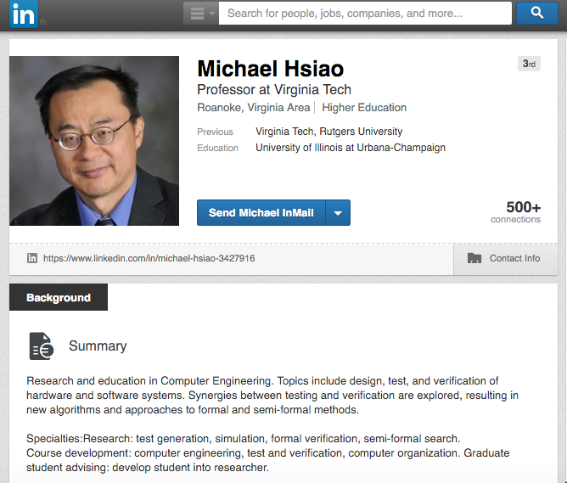
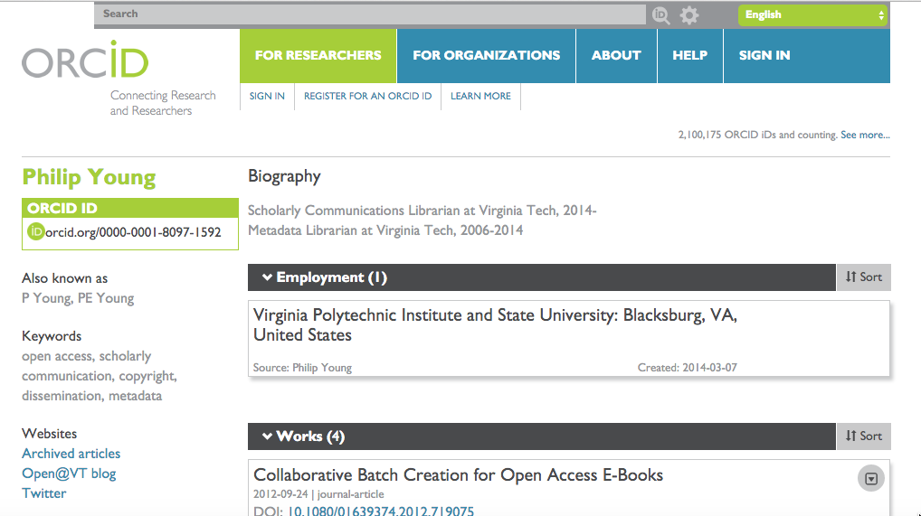
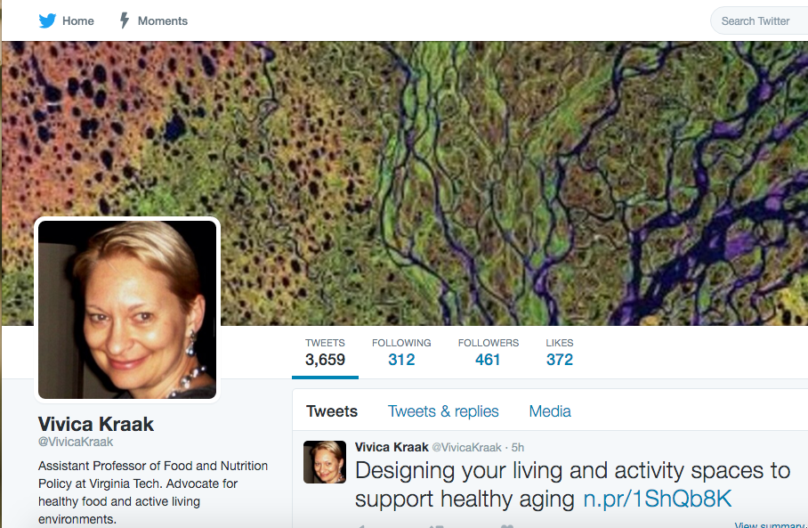
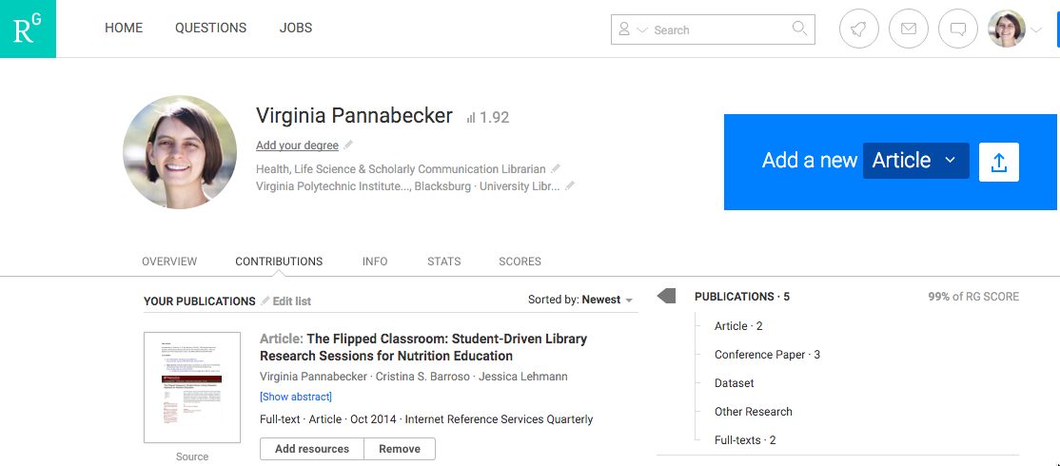
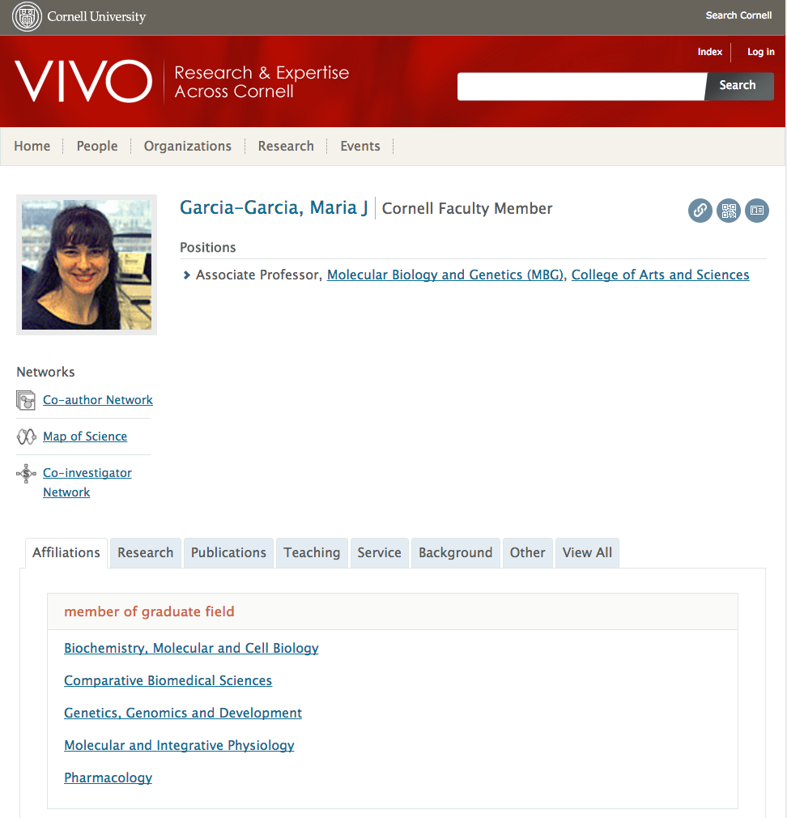
Notes:
Ginny

Slide 81





Researcher Profiles & Identifiers
Elements eFARs system
Internal VT profile and documentation system linked to outside data sources; ORCID, VTechWorks - will link to CollabVT
Unique Researcher Identifier, list of works and CV information
*Non-profit | *Publisher- and funder-recognized | *You have control over content and links.
Researcher Profile, list of works, citation metrics
*For profit | *You have *some* control over content and links
Impactstory is an open-source website that helps researchers explore and share the the online impact of their research with data-driven stories.
[CollabVT]
Researcher Profile, list of works, platform-specific metrics
*Non-profit | *Open community | *You have control over content and links
Researcher Profile, list of works, citation metrics
*For profit | *You have *some* control over content and links
Researcher Profile, list of works, platform-specific metrics
*For profit | *You have *some* control over content and links
Notes:
Ginny

Slide 82
Researcher Profiles & Identifiers → Connections
Elements eFARs system
Export: BibTex, Reference Manager, Excel, Word, and PDF; Will push to: CollabVT
Pulls from: ORCID, research databases, +; Imports: Bibtex, Reference manager files; manual entry
Pushes to: Elements, ImpactStory, +; Export: BibTex, Reference Manager, Excel, Word, and PDF
Pulls from: Crossref, Scopus, ResearcherID, +; Imports: BibTeX; manual entry
Pulls from: secret source method (info)
Exports: BibTex, Reference Manager, CSV
Pulls from: ORCID / Scopus
Exports: JSON structured data
Pulls from: Elements eFAR
[CollabVT]
Pushes to: options managed by institution
Imports: BibTeX; manual entry
Exports: CSV
Pulls from: secret source method; Imports: Bibtex, Reference manager files, MODS, XML; manual entry
None
Notes:
Ginny

Slide 83
Case study -
Anthropology graduate student who went into industry discusses Open Access

Slide 84
Get more ideas!
Google a colleague:
What comes up?
What profiles do they have?
Image by ChristianHoppe via Pixabay, CC0, public domain
Notes:
Ginny

Slide 85
Interested in break out groups?
Overleaf (or other specific platforms)
Brainstorm how to show impact of your teaching
Helping others (or yourself) to navigate the P&T process
What’s my impact workflow and what do I do next?
Notes:
Ginny

Slide 86
Wrap Up - and Thanks for attending!
Feedback: http://bit.ly/NLI-June13
Resources folder: https://tinyurl.com/NLI-GetNoticed
Keep in touch! blog, twitter, email list

