Slide 1
FreeSpeechApp4VT
Andy Cho, Chaitanya Gupta, Samuel Oh
CS 4624 Multimedia, Hypertext, and Information Access Capstone, Dr. Fox
Virginia Tech, Blacksburg VA 24061
05/8/22

Slide 2
Outline
Project Overview
Project Timeline
Application Walkthrough
Challenges
Lessons Learned
Future Work
Acknowledgements
References

Slide 3
Project Overview
A free iOS application that serves as a medium for non-verbal communication
Selectable tiles representing words to create sentences that will be spoken through the Apple Text-to-Speech engine
Customizability to allow the user to communicate in their own way
  Tile formation
  Custom images
  Personal audio recordings

Slide 4
Project Timeline
Design planning, wireframing, define basic specifications
Minimum expectations complete, customizability features introduced based on priority
March
May
February
April
Begin implementation with a focus on design and ergonomics with basic TTS implemented
Customizability features implemented, final report and presentations

Slide 5
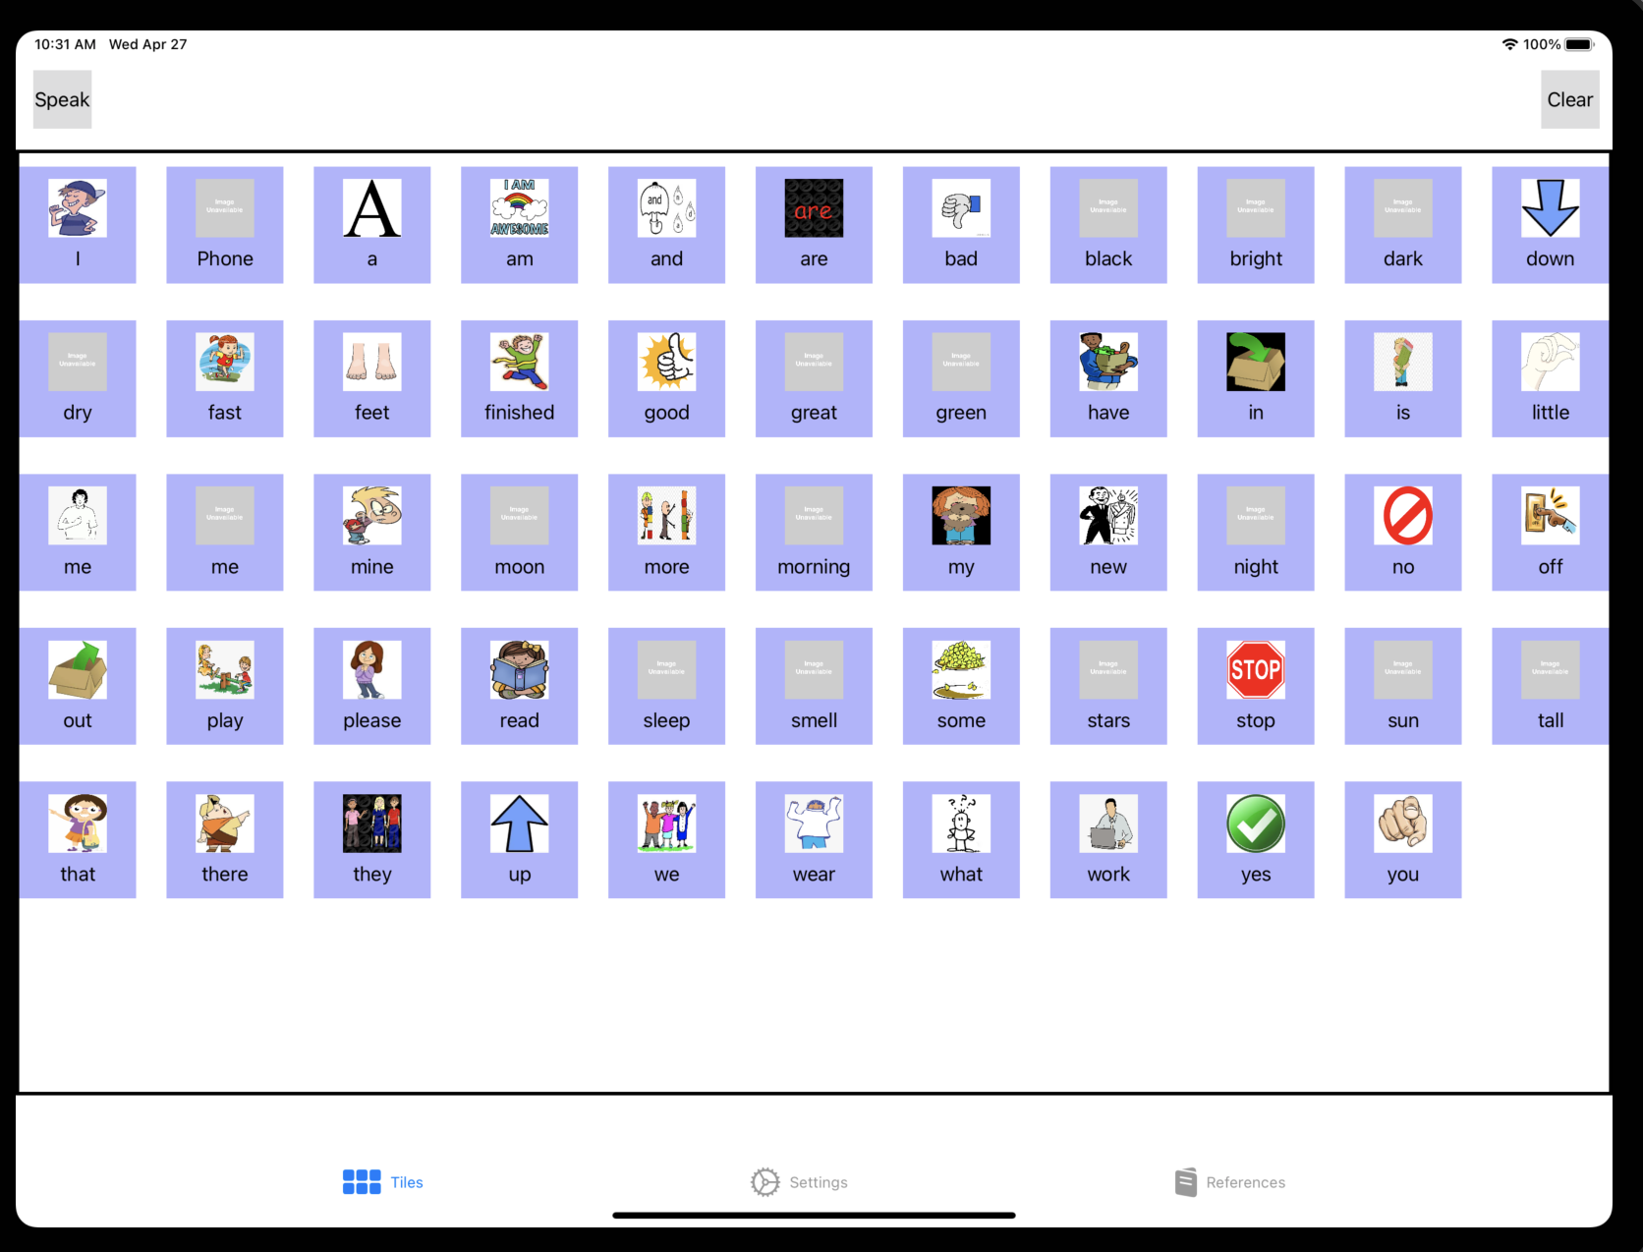
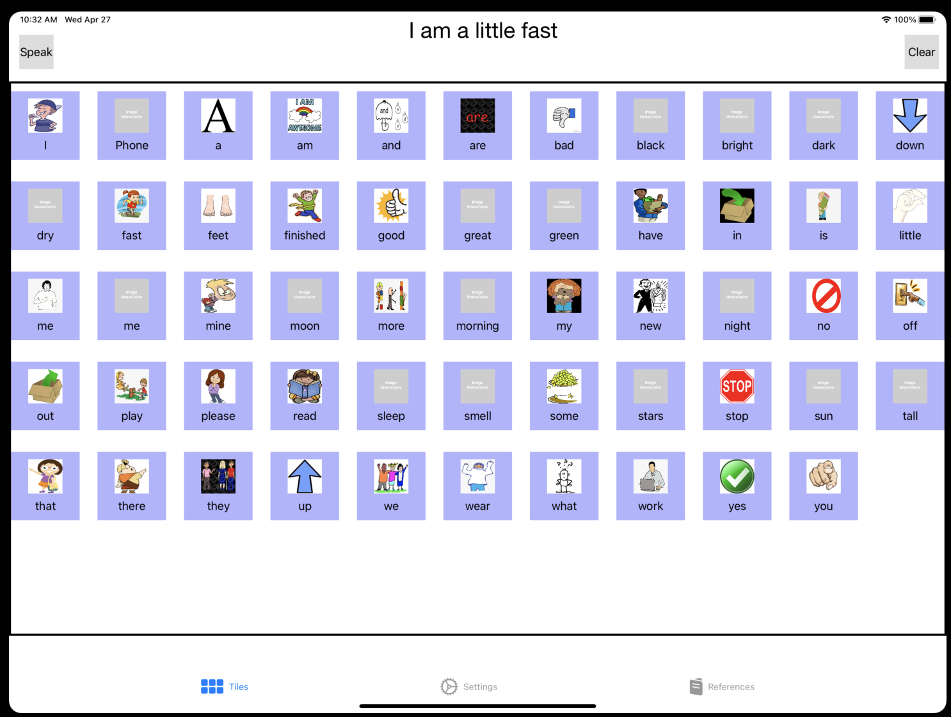
Application Walkthrough

Slide 6
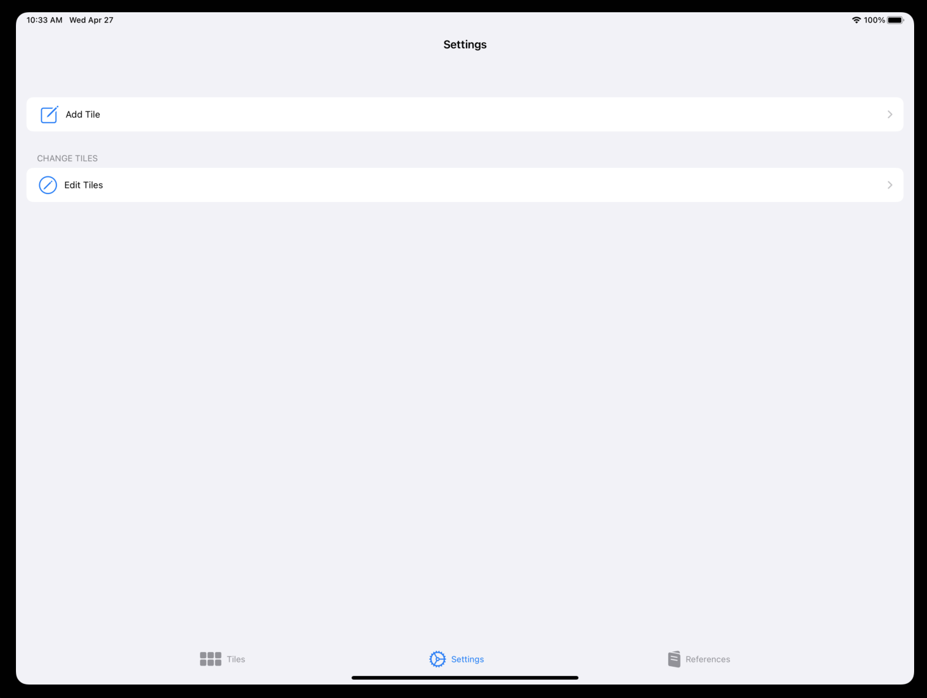
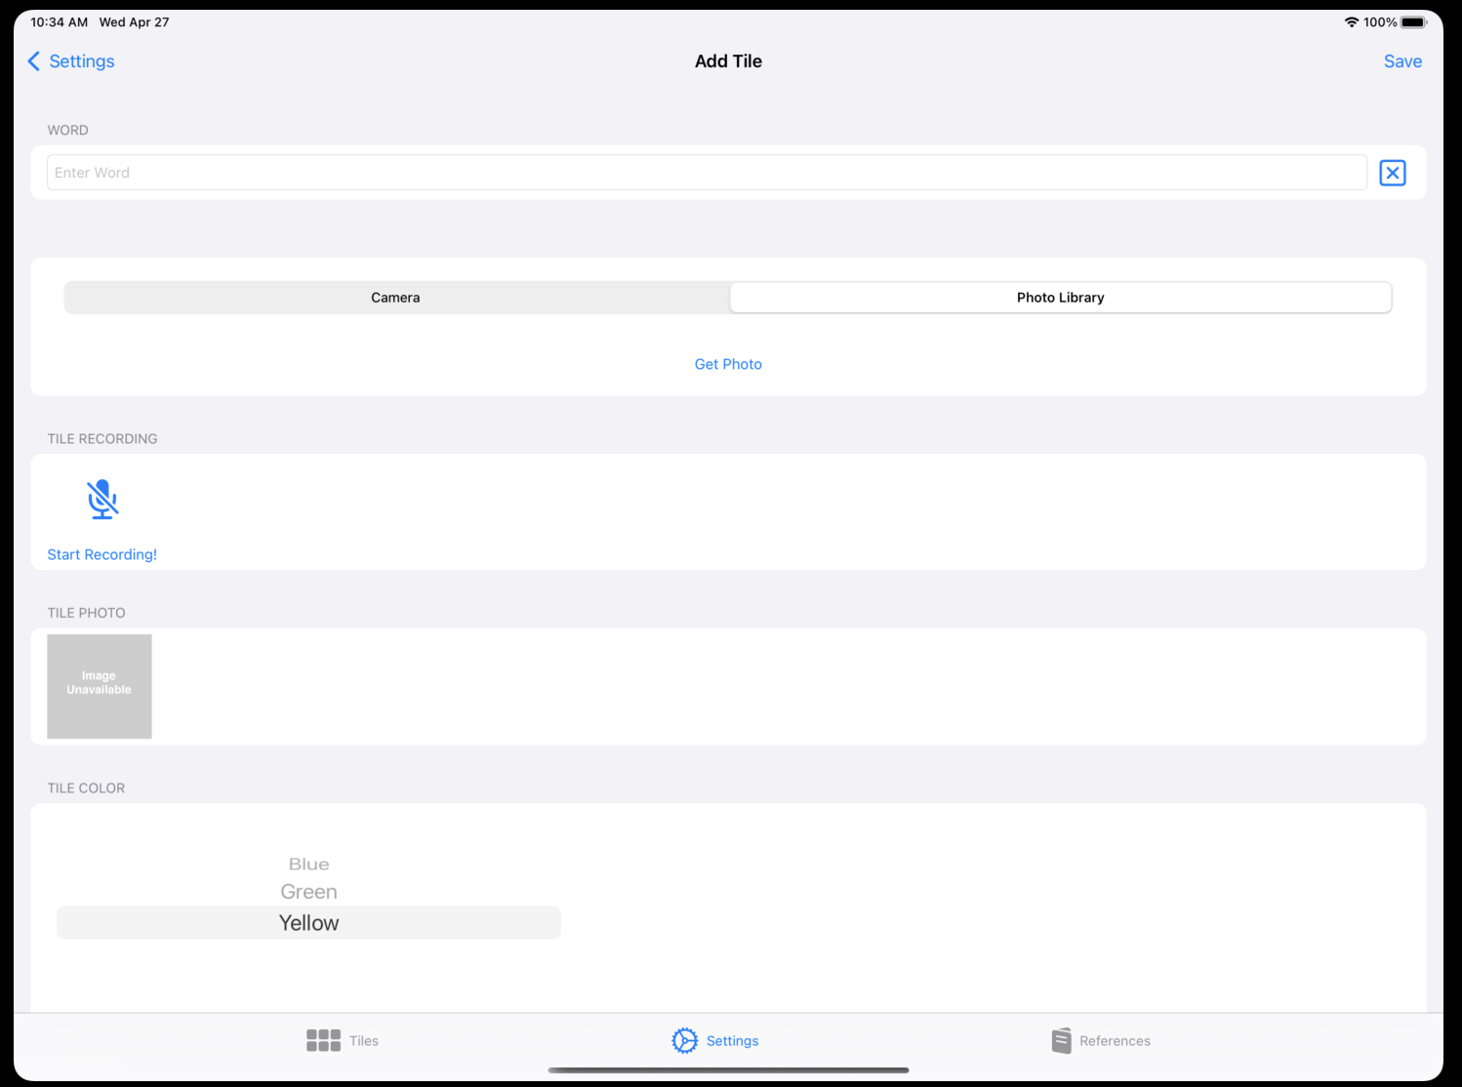
Application Walkthrough - Add Tile

Slide 7
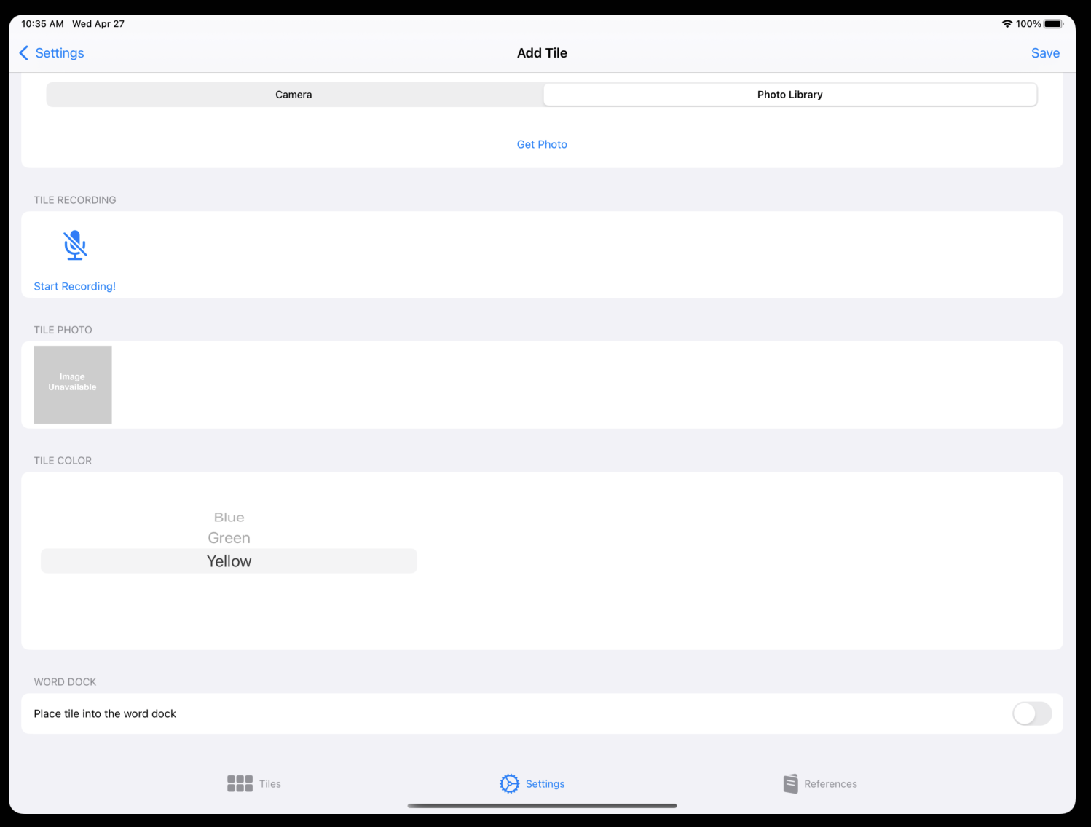
Application Walkthrough - Add to Edit Tile

Slide 8
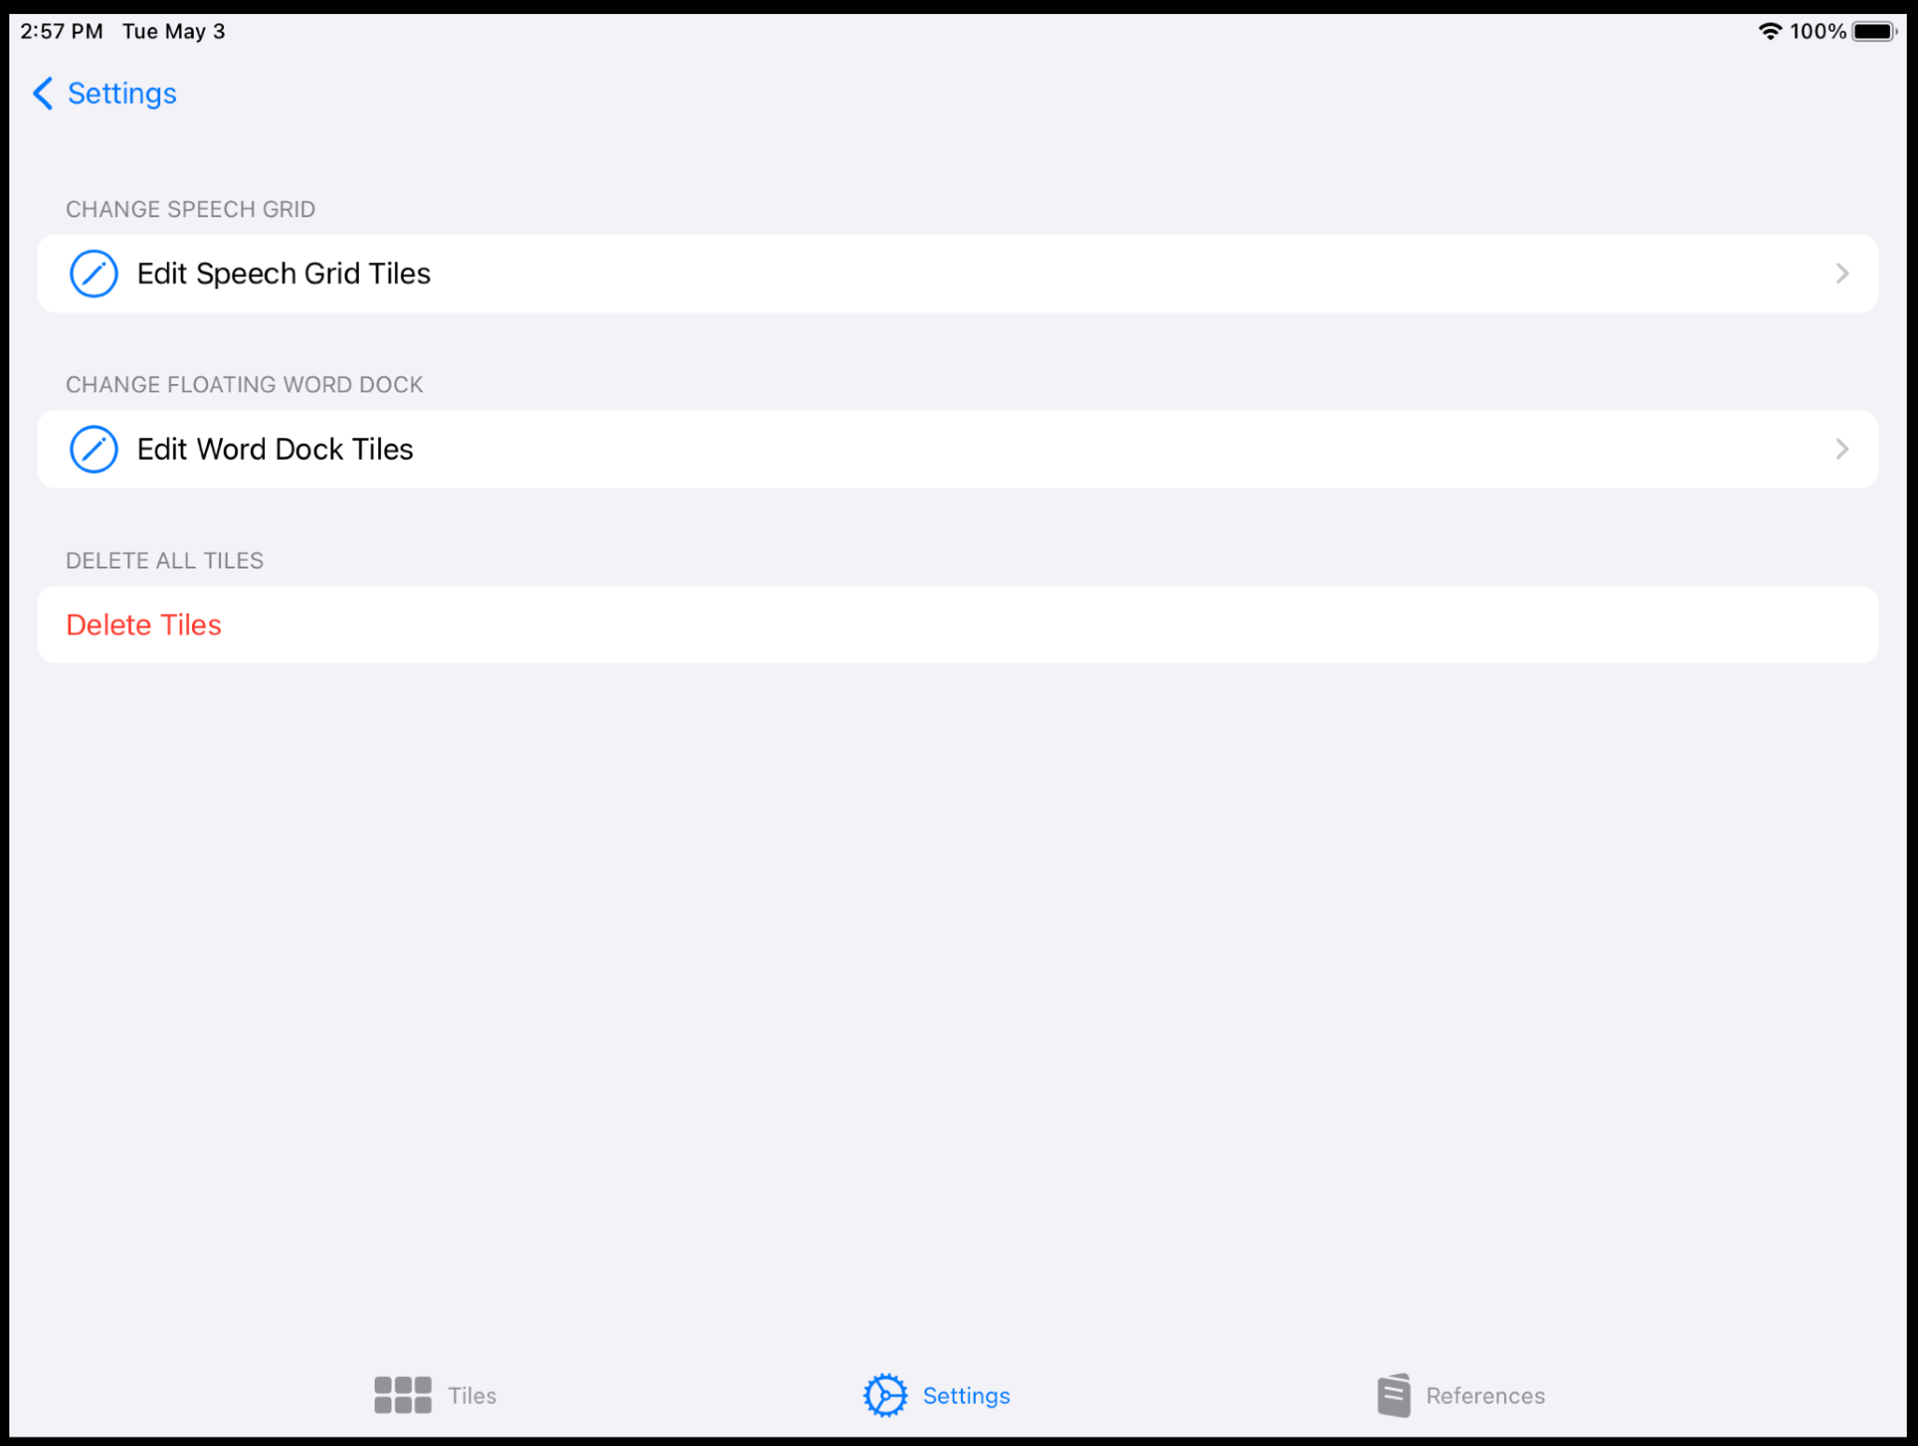
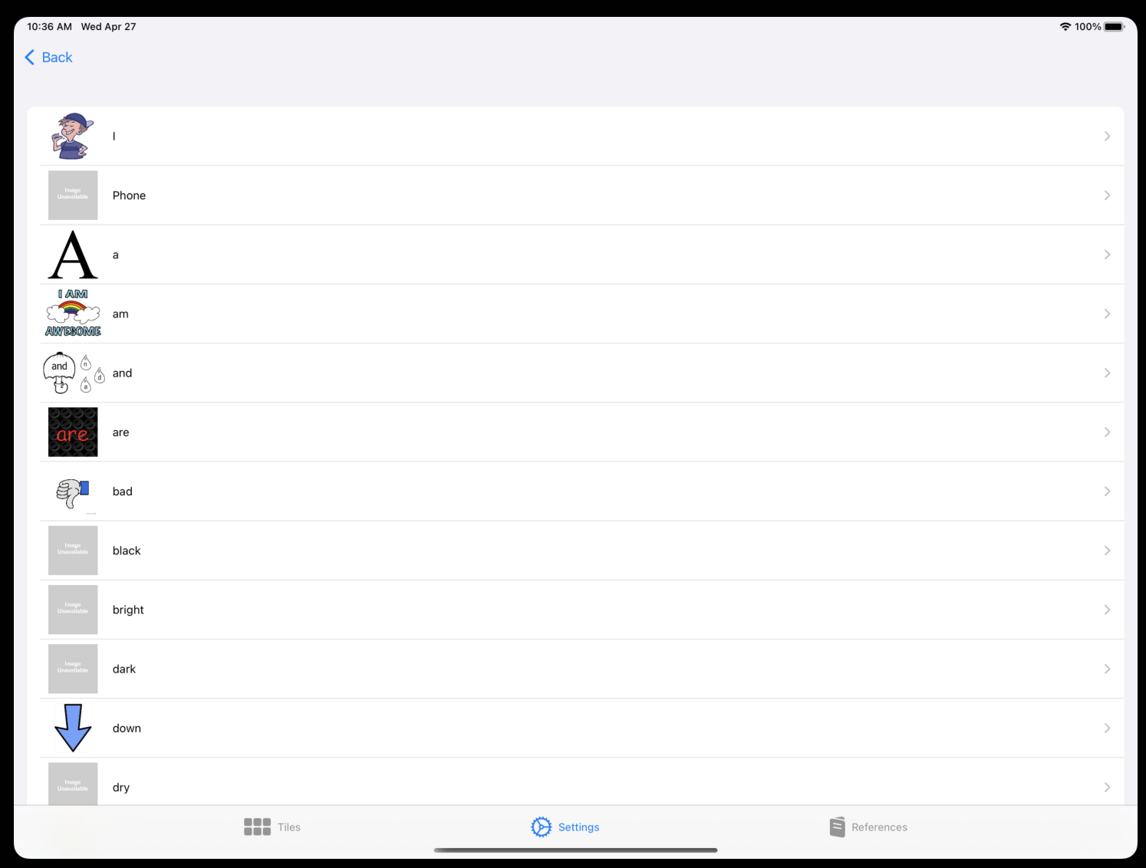
Application Walkthrough - Edit Tile

Slide 9
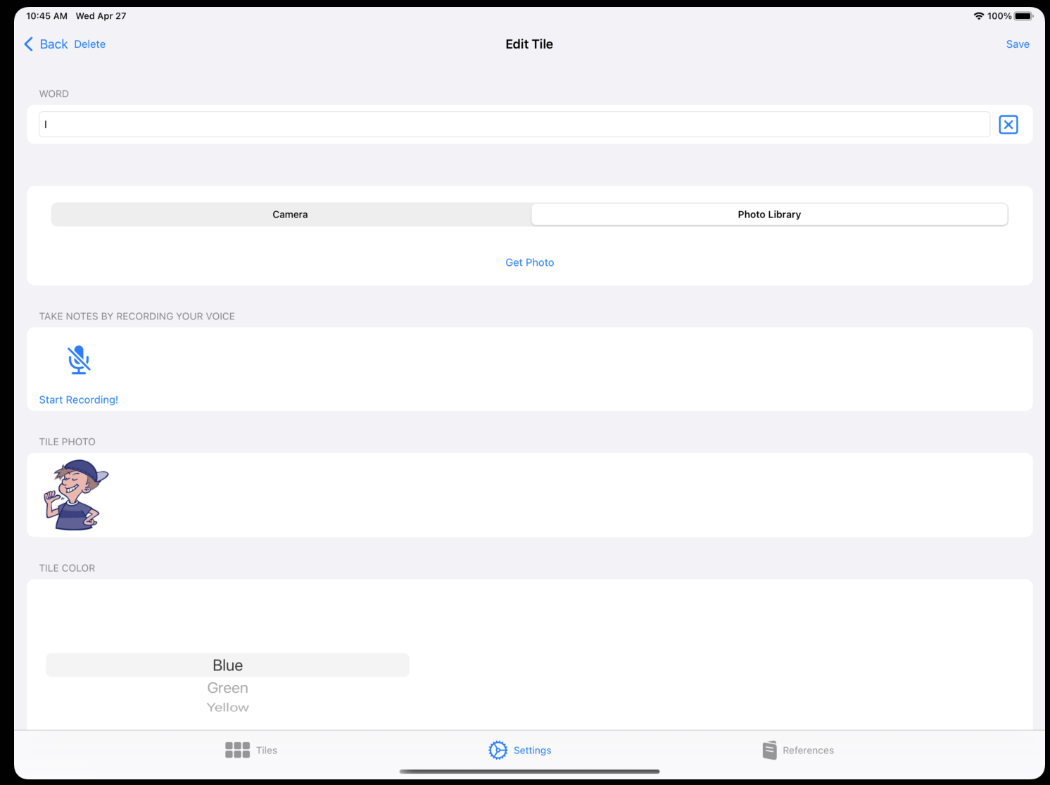
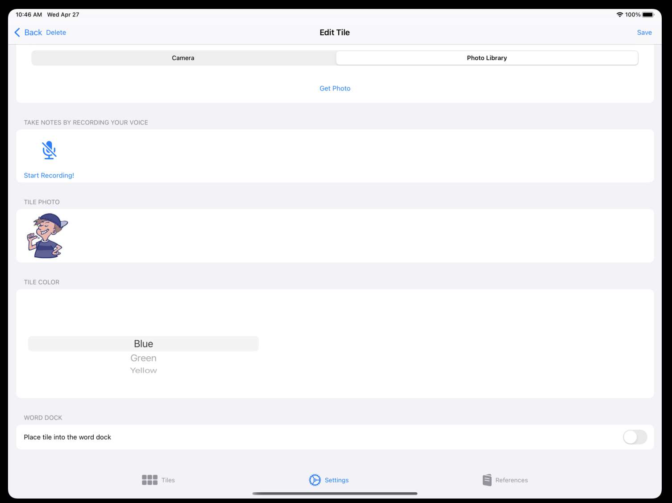
Application Walkthrough - Edit Tile

Slide 10
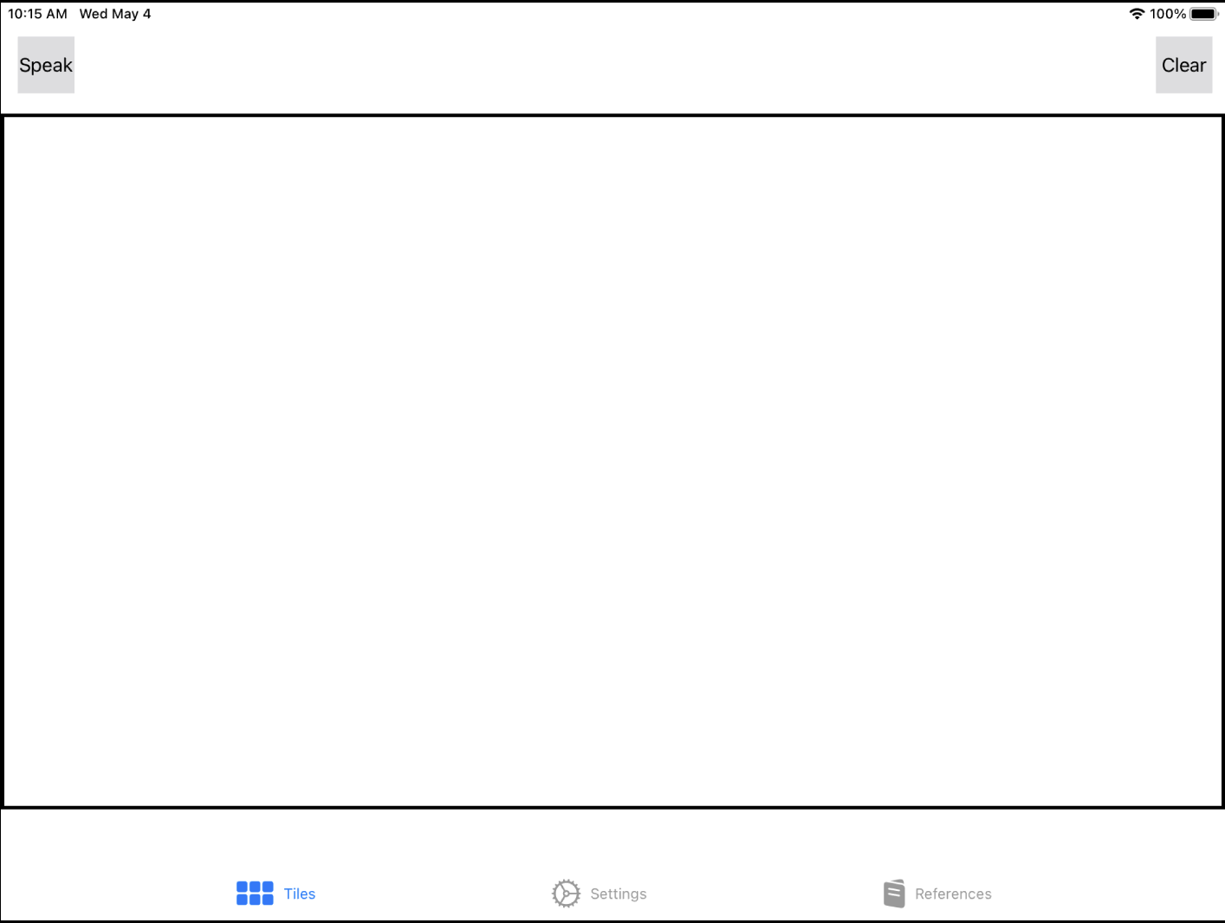
Application Walkthrough - Delete Tiles

Slide 11
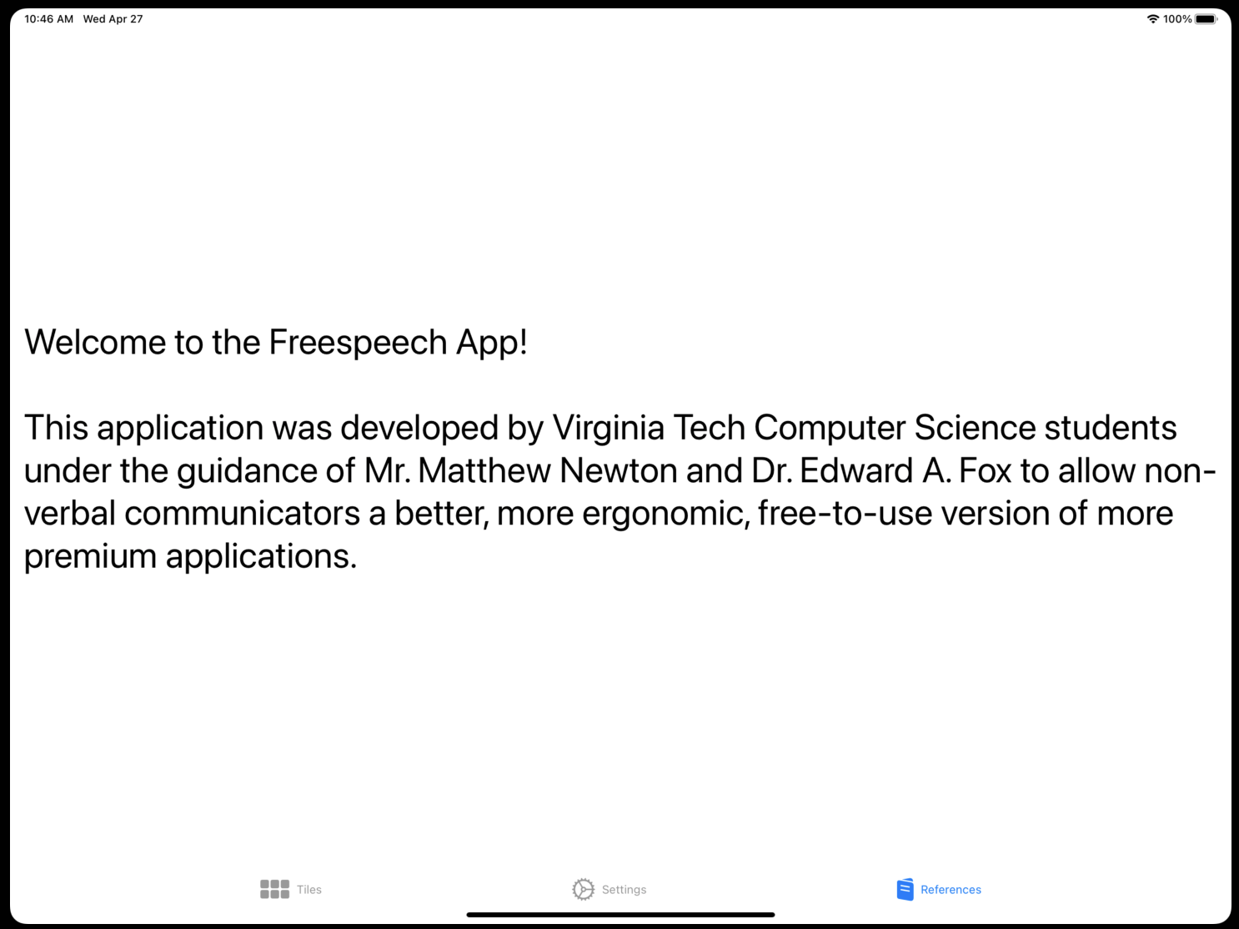
Application Walkthrough - References Tab

Slide 12
Challenges
Data management
  How can we store data in a way that would be easily accessible for our speech grid, while being able to support the desired functionalities?
Design
  How can we create a design that fits the desires of our client, while also maintaining support for our target audience?

Slide 13
Lessons Learned
Communication with client is essential for proper direction
Make design choices with users in mind
Need to allocate more time to debug programs in a timeline
Constantly learn

Slide 14
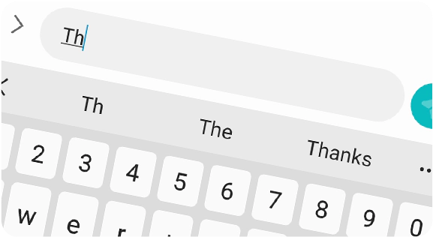
Future Work
Predictive Tiles
  Prediction of next inputs for tiles
Additional Settings
  Custom voices
  Different profiles

Slide 15
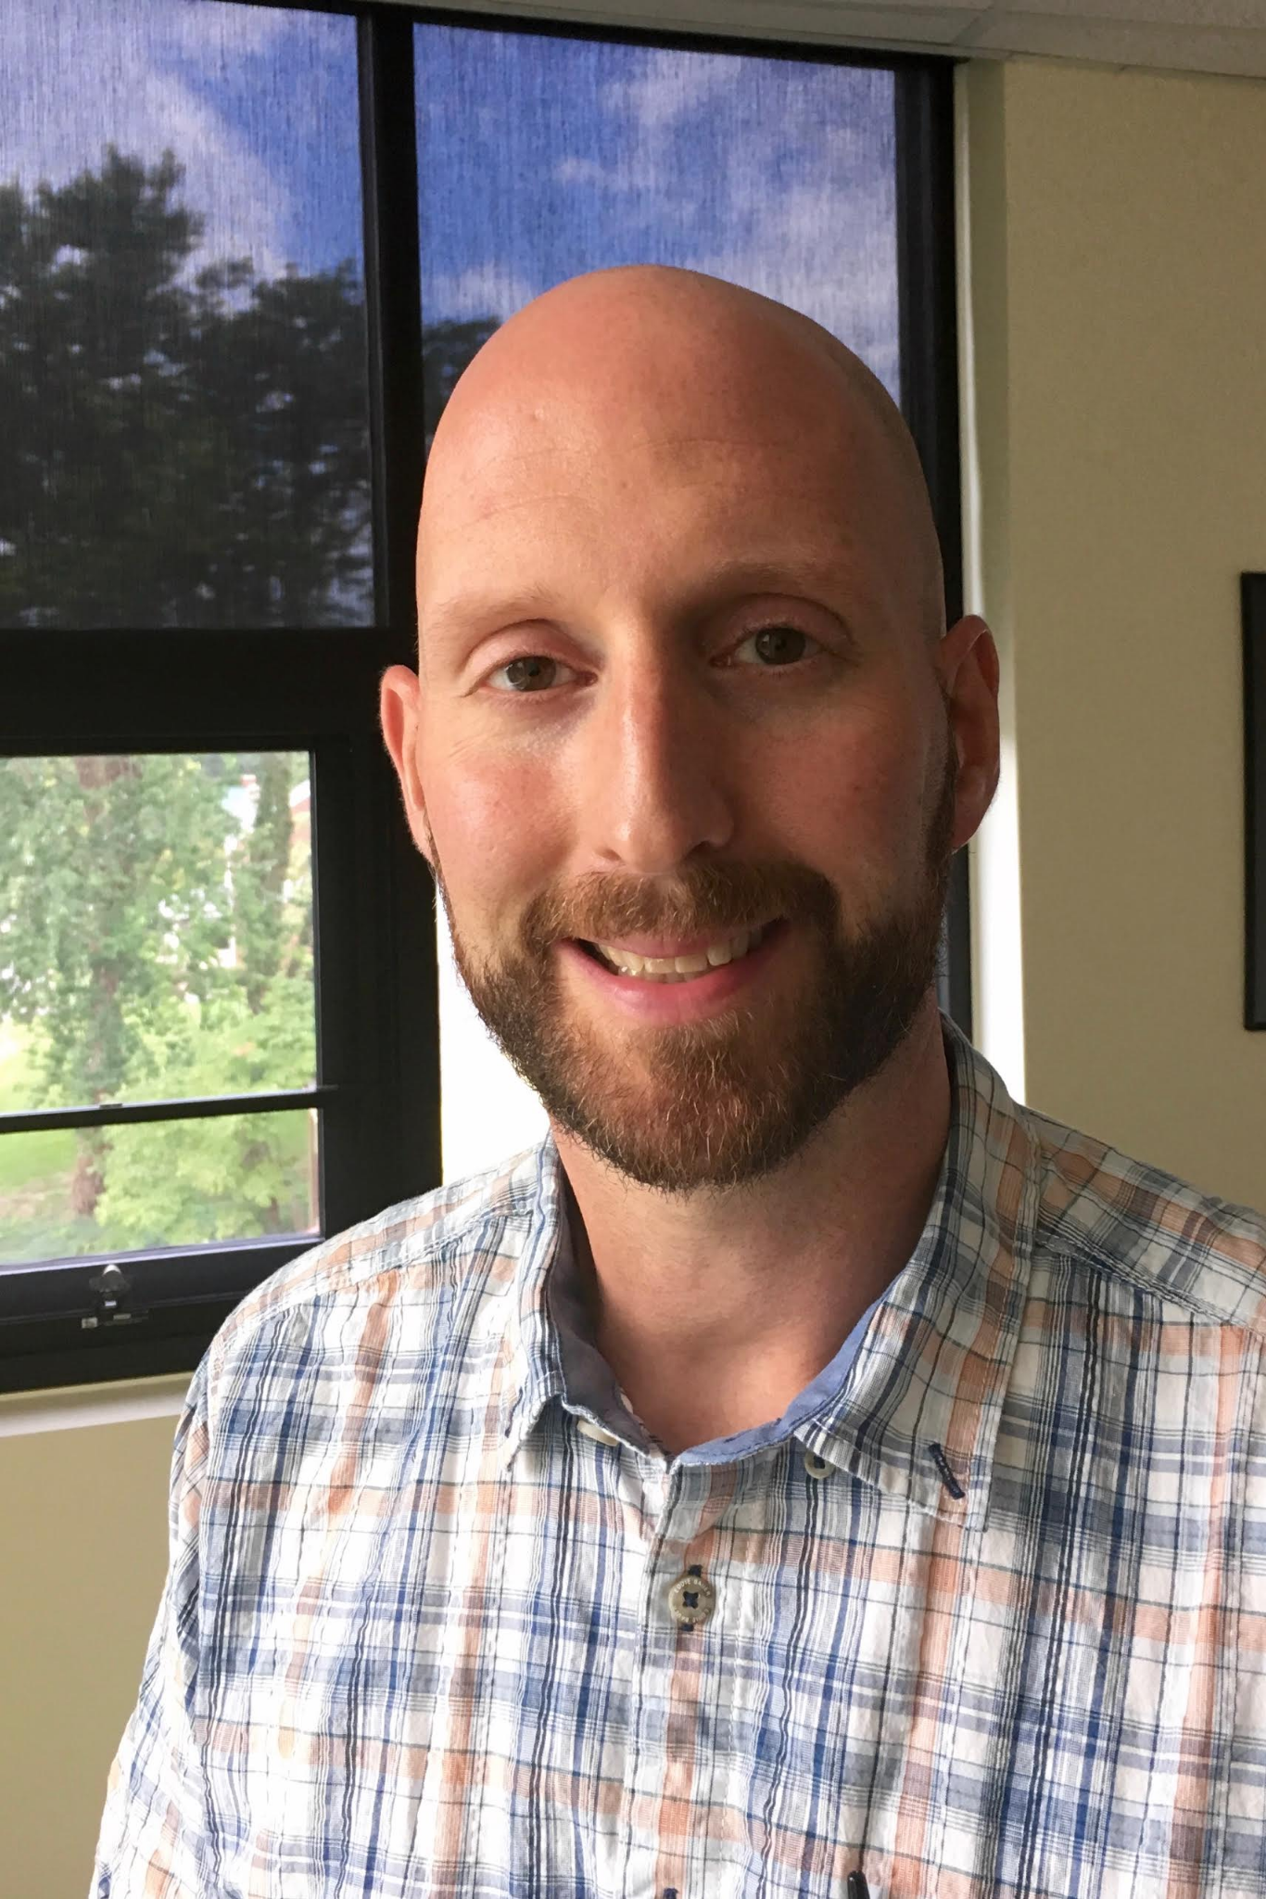
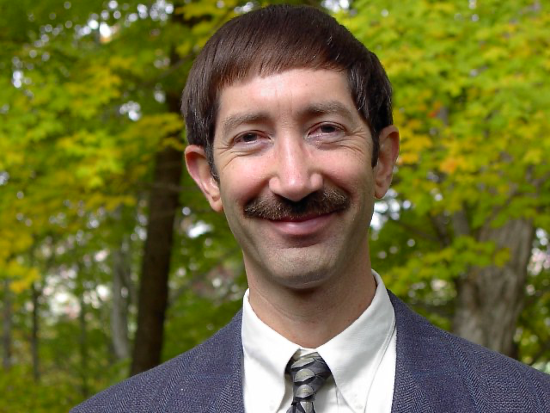
Acknowledgements
Mr. Matthew Newton
  Coordinator of Assistive and Educational Technology at Virginia Tech
Dr. Edward A. Fox
  Professor of CS 4624
  Mentor and advisor

Slide 16
References
U.S. Department of Justice. (2020, February). A Guide to Disability Rights Laws. ADA.gov. Retrieved April 12, 2022, from https://www.ada.gov/cguide.htm#anchor62335
U.S. Department of Health and Human Services. (2016, May 19). Quick statistics about voice, speech, language. National Institute of Deafness and Other Communication Disorders. Retrieved April 12, 2022, from https://www.nidcd.nih.gov/health/statistics/quick-statistics-voice-speech-language
Disability Impacts All of Us. Centers for Disease Control and Prevention. (2020, September 16). Retrieved April 12, 2022, from https://www.cdc.gov/ncbddd/disabilityandhealth/infographic-disability-impacts-all.html
Calder, A., & Townsend, B. (2021, December 24). Freespeech. Retrieved April 25, 2022, from https://app.freespeechaac.com/
Proloquo2Go - AAC app with symbols. AssistiveWare. (2022). Retrieved April 25, 2022, from https://www.assistiveware.com/products/proloquo2go

