Slide 1


Strategic Management
Chapter 11
Corporate Goverance and Business Ethics
Unless otherwise noted, this slide deck is (c) Virginia Polytechnic Institute and State University. It is released under a Creative Commons Attribution NonCommercial ShareAlike 3.0 license (CC BY NC-SA 3.0)
Instructor Name | Name of Institution
http://hdl.handle.net/10919/102735
Photo by Jon Sailer on Unsplash

Slide 2
How can a Top Management Team Lower the Chances that Key Managers will Pursue Their own Self-interests at the Expense of?
Stockholders?
Employees?
Other Key Stakeholders?
What about YOU?
http://hdl.handle.net/10919/102735

Slide 3
The Public Stock Company
Hierarchy of Authority
State Charter
Shareholders
Board of Directors
Management
Employees
Notes:
An hierarchy of authority exists in a public stock company. A state charter has authority over shareholders which have authority of the board of directors which have authority over management which has authority over employees.

Slide 4
Corporate Governance Mechanisms?
How can the Board of Directors help lower the chances that key managers will pursue their own self-interests
Monitor (Board of Directors)
Auditors (internal & external)
Control Procedures (Limit Power using Board)
Code of Conduct (must enforce)
http://hdl.handle.net/10919/102735

Slide 5
The Business Roundtable has Recommended that the CEO Should not also Serve as the Chairman of the Board
If the two positions are held by one person, what are the disadvantages for building a sustainable competitive advantage?
If the two positions are held by one person, what are the disadvantages for stakeholder management?
Are there situations where it would be advantageous to have one person in both positions?
http://hdl.handle.net/10919/102735
Notes:
If the two positions are held by one person, what are the disadvantages for building a sustainable competitive advantage?
If the two positions are held by one person, what are the disadvantages for stakeholder management?
Are there situations where it would be advantageous to have one person in both positions?

Slide 6
Ethics – Organizational Context
Is unethical behavior just a few “bad apples”?
Research – some organizations have unethical climate
  Ethical decision making depends on the organization
    Enron executives used accounting loopholes to create shell companies to hide billions in debt from failed deals and projects. Although these smug executives thought they were always “the smartest guys in the room,” the loss of $11 billion in stock value and the prison time served by many of them proves otherwise.
      Employees observed and followed the behavior set by leaders.
Ethical leadership is critical.
  CEOs at large public firms face increasing scrutiny.
    The Madoff investment scandal that broke in 2008 provided a modern twist on the classic Ponzi scheme. NASDAQ chairman Bernard Madoff pled guilty to eleven federal crimes that constituted the largest investor fraud ever committed by an individual. Madoff was sentenced to 150 years in prison.
  Formal and informal cultures
    Must be aligned with executive behavior
http://hdl.handle.net/10919/102735

Slide 7
Opposing Views on CSR
MILTON FRIEDMAN VS. MICHAEL PORTER
Traditional View: (Friedman)
  Shareholder capitalism: shareholders – the providers of the necessary risk capital and the legal owners of public companies – have the most legitimate claim on profits.
“Enlightened” View: (Porter)
  Corporate social responsibility (CSR): obligations extend beyond the economic responsibility and include legal, ethical, and philanthropic societal expectations
http://hdl.handle.net/10919/102735
Notes:
INSTRUCTOR: An Interactive video activity is available online through McGraw-Hill Connect on this section of the text. The video is a talk on Africa’s business future. It covers learning objective 12.3.
Small Group exercise 1 ties in here and may be a good option for some deeper thinking around these important topics.
Discuss in your group the contrasting perspectives of “shareholder versus stakeholder” governance. What benefits and drawbacks can you find in each view?
Students need to understand the difference between shareholders and stakeholders. Shareholders focus on self-interest and profitability, while stakeholders emphasize responsibilities and all the parties involved. They must also realize that national and cultural differences play a role when designing the governance structure.
Next, go online to find two sets of examples: (a) firms in the U.S. or Britain saving jobs by offering reduced hours to workers rather than having layoffs, and (b) large firms in Germany or Japan laying off employees or closing plants. What do the results of your search say about the impact of governance structure on corporate decisions?
German firms are more debt-financed than equity. Thus, large national banks are a major stakeholder and encourage
maintaining a high level of employment. The closure of a plant in Germany is seen as the very last resort, whereas in the UK or U.S., layoffs and plant closures are more common.

Slide 8
Viewpoints
“The capitalist system is under siege. In recent years business increasingly has been viewed as a major cause of social, environmental, and economic problems. Companies are widely perceived to be prospering at the expense of the broader community.”
~Michael Porter in HBR, Jan/Feb 2011
http://hdl.handle.net/10919/102735

Slide 9
Viewpoints (Cont.)
Traditional View: (Friedman – 1970s-2000s)
  Shareholder capitalism: shareholders – the providers of the necessary risk capital and the legal owners of public companies – have the most legitimate claim on profits. Paraphrased – the business of business is business within the bounds of the law
Corporate Social Responsibility: (Carroll)
  Corporate social responsibility (CSR): obligations extend beyond the economic responsibility and include legal, ethical, and philanthropic societal expectations.
Shared Value View: (Porter)
  Creating Shared Value (CSV): pursuit of economic value and attaining competitive advantage by repositioning the role of the firm in its relationship with society - generating economic value in a way that also produces value for society.
http://hdl.handle.net/10919/102735

Slide 10
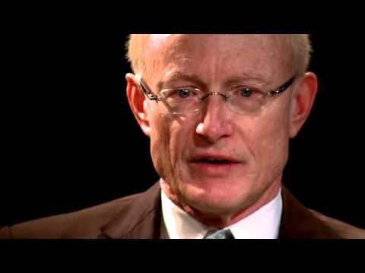
CSR vs CSV According to Michael Porter
© World Economic Forum. Insight: Ideas for Change - Michael Porter - Creating Shared Value. CC BY. Retrieved from https://youtu.be/xuG-1wYHOjY
Questions from this video may be on the final exam
https://www.youtube.com/watch?v=xuG-1wYHOjY
http://hdl.handle.net/10919/102735
Notes:
Play to 5:05 ish

Slide 11
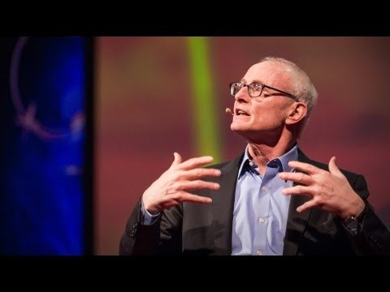
TED: Why Businesses Can be Good at Solving Social Problems (M. Porter)
© TED. Why Businesses Can be Good at Solving Social Problems - Michael Porter. CC BY NC ND. Retrieved from https://youtu.be/0iIh5YYDR2o
Questions from this video may be on the final exam
https://www.youtube.com/watch?v=0iIh5YYDR2o
http://hdl.handle.net/10919/102735
Notes:
Show until I get bored with him

Slide 12
The Shared Value Framework: Beyond CSR
Can economic and social needs create business opportunities for Whole Foods?
How might Whole Foods move beyond selling high quality footwear and apparel and utilize its expertise to serve a social need?
What actions can Whole Foods take in different geographic markets to connect economic and social needs?
https://www.wholefoodsmarket.com/mission-values
http://hdl.handle.net/10919/102735
Notes:
If the two positions are held by one person, what are the disadvantages for building a sustainable competitive advantage?
If the two positions are held by one person, what are the disadvantages for stakeholder management?
Are there situations where it would be advantageous to have one person in both positions?

Slide 13
Global Survey of Attitudes of Trust Toward Their Governments and Businesses
Data source: Edelman. (2019) Edelman Trust Barometer Executive Summary. Page 5. Retrieved from https://www.edelman.com/sites/g/files/aatuss191/files/2019-02/2019_Edelman_Trust_Barometer_Executive_Summary.pdf
http://hdl.handle.net/10919/102735
Notes:
Above 60, USA and above, there is a sense of trust
50 – 59, sense of trust is neutral, Australia > Brazil
49 and below, Ireland and below, there is an overall sense of distrust

Slide 14
Triple Bottom Line
Profit
Planet
People
http://hdl.handle.net/10919/102735

Slide 15
Personal Ethical Dilemmas
How do you know if you might be crossing the line?
Actions become public; can you explain and defend it?
Your mother would disapprove; falls outside normal professional behavior
Golden Rule; don’t do to someone what you don’t want done to you.
http://hdl.handle.net/10919/102735

