Slide 1

AI Aided Annotation
Jonah Bishop, Isaac David, & Ishaan Lubana
CS 4624 Multimedia, Hypertext, and Information Access
Dr. Fox
Virginia Tech, Blacksburg VA, 24061
May 4, 2022
Notes:
Jonah Bishop

Slide 2
Outline
Requirements
Required JSON Format
Completed Work
Walkthrough
Testing Results
Future Work
Lessons Learned
Acknowledgements
References
Notes:
Jonah Bishop

Slide 3

Requirements
Client wants an efficient way of generating rich annotated data for ETDs
Data consists of key sentences, keywords, and questions and answers
Use MMR algorithm for gathering important sentences
Notes:
Ishaan

Slide 4
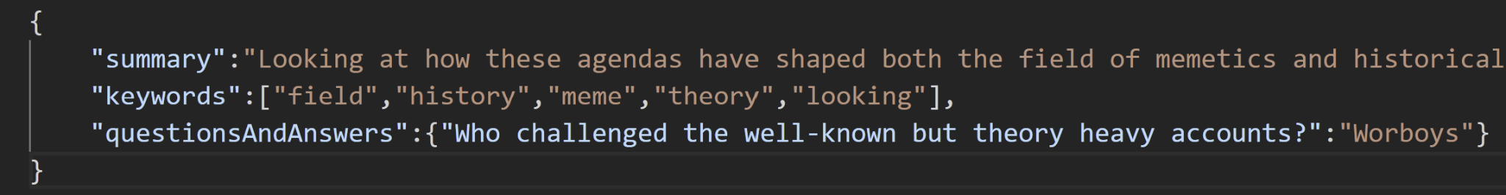
Required JSON Format
{
“summary”: <sentences>,
“keywords”: [“list”, “of”, “keywords”],
“questionsAndAnswers”: {
“Question1”: “Answer1”,
“Question2”: “Answer2”,
…
}
}
Notes:
Jonah bishop

Slide 5
Completed Work
Demo ETD selected and parsed
Similar sentences generated based on chosen diverse sentences
Keyword, question/answer inputs
Export functionality
Initial testing
Notes:
Isaac

Slide 6
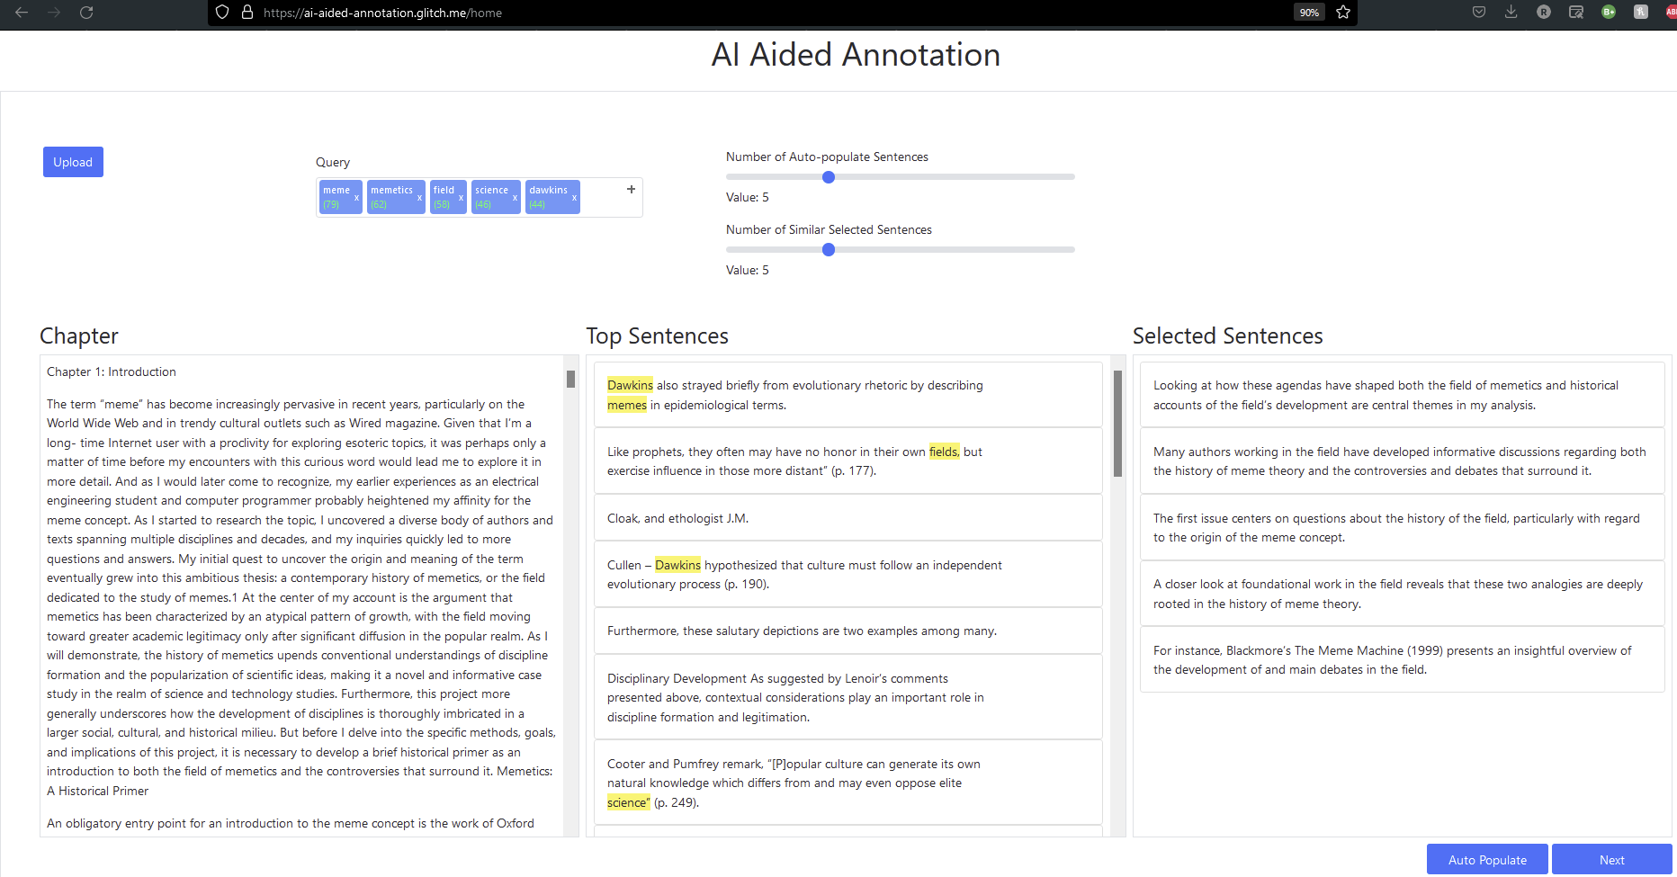
Walkthrough pt. 1
Notes:
Jonah bishop

Slide 7
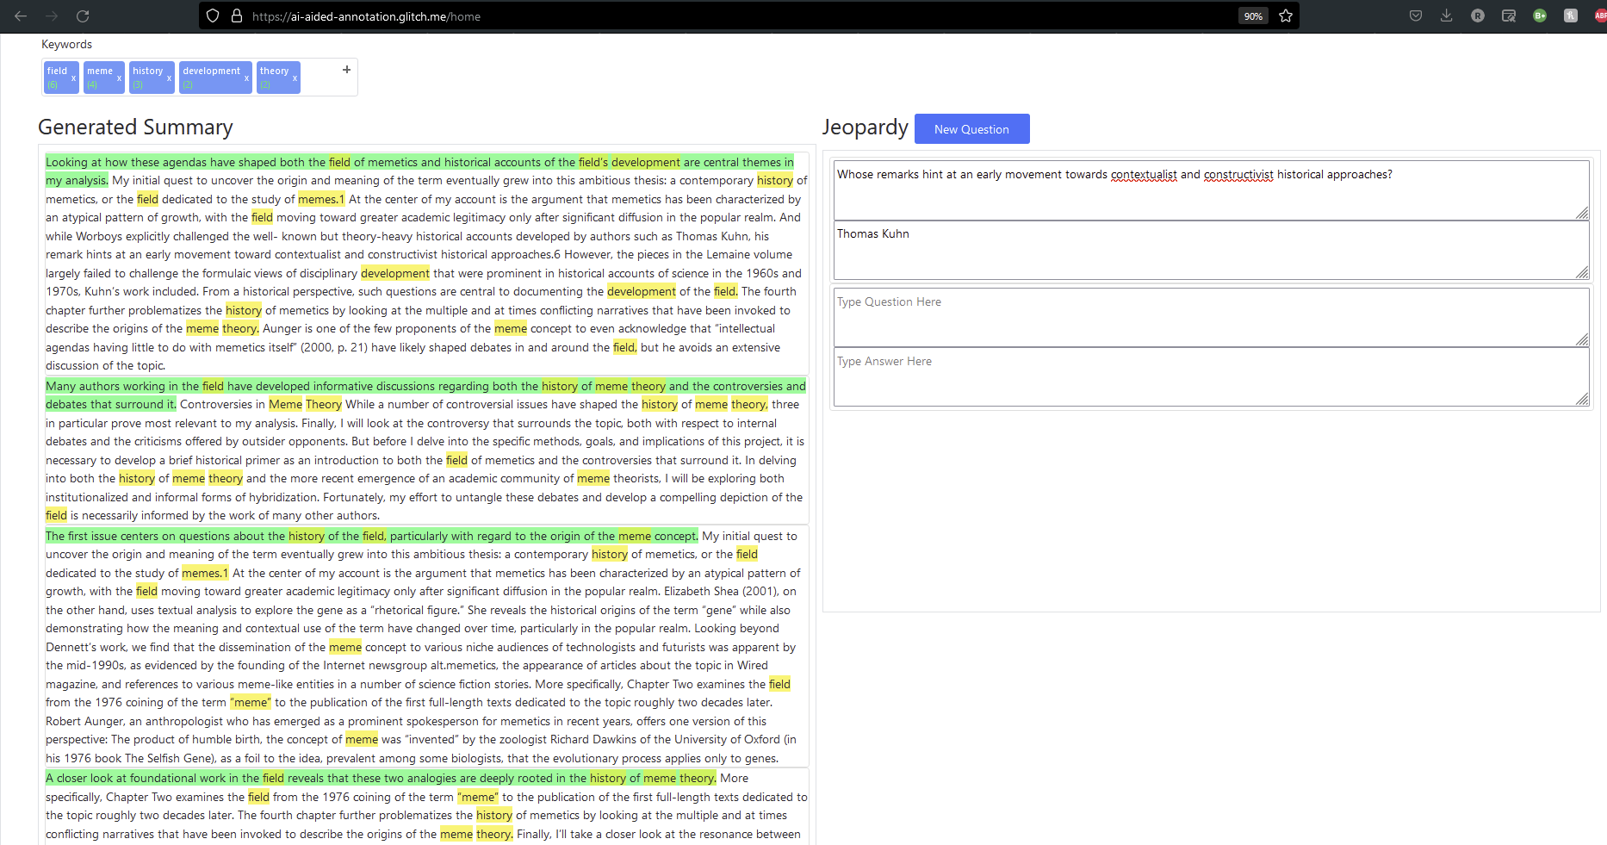
Walkthrough pt. 2
Notes:
Jonah bishop

Slide 8
Testing Results
Questions focused on UI and complete user experience:
Rate the effectiveness of the Walkthrough Video (1-10 scale)
Any questions/comments/concerns on the demo (Free Response)
Rate the overall experience with the website (1-10 scale)
Rate the Ease of Use of the service (1-10 scale)
How would you describe your overall experience with the site? (Free Response)
What did you like most about using this site? (Free Response)
What, if anything, caused you frustration/did you like least about the site? (Free Response)
Mean Score for Walkthrough Video (7.3), Ease of Use (9.5), Overall Experience (8.7) based on 20 testers
Notes:
ishaan

Slide 9

Lessons Learned
Front-end coding can be difficult. More than one team member should be familiar with it.
If something seems weird, it probably is.
Much easier to deploy on the cloud instead of your own server
Notes:
Split

Slide 10
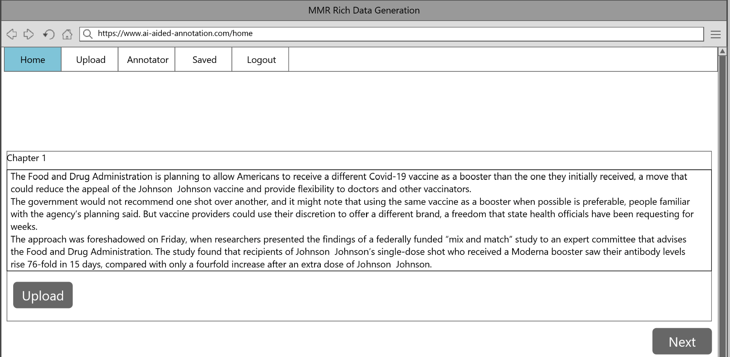
Future Work
Add user accounts
Add intake page for uploading multiple chapters
Add ability to move between multiple chapters of a single document on-the-fly
Wireframe of potential document upload page
Notes:
Isaac

Slide 11

Acknowledgements
Client - Satvik Chekuri
Instructor - Dr. Fox
GTA - Ryan Wood
StackOverflow
Notes:
Jonah Bishop

Slide 12
References
Carbonell, Jaime, and Jade Goldstein. “The Use of MMR, Diversity-Based Reranking for Reordering Documents and Producing Summaries.” Proceedings of the 21st Annual International ACM SIGIR Conference on Research and Development in Information Retrieval - SIGIR '98, 1998, pp. 335-336. Association for Computing Machinery Digital Library, https://doi.org/10.1145/290941.291025. Accessed 19 April 2022.
Chekuri, Satvik, et al. “Interactive Text Summarization using Explorable MMR.” Interactive MMR, https://interactive-mmr.glitch.me/. Accessed 19 April 2022.
Notes:
Jonah bishop

