Slide 1
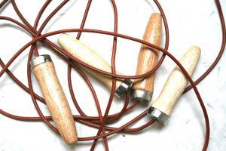

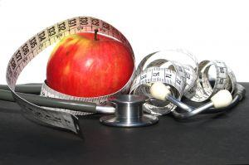
Flipping for Health: hands-on library research sessions
Virginia Pannabecker, University Libraries, Virginia Tech
Cristina Barroso, Department of Public Health, University of Tennessee
Jessica Lehmann, School of Nutrition and Health Promotion, Arizona State University

Slide 2
Do you struggle to balance enough hands-on time with enough teaching time?
Do you ever wish you could skip the demonstration and go straight to hands-on?

Slide 3
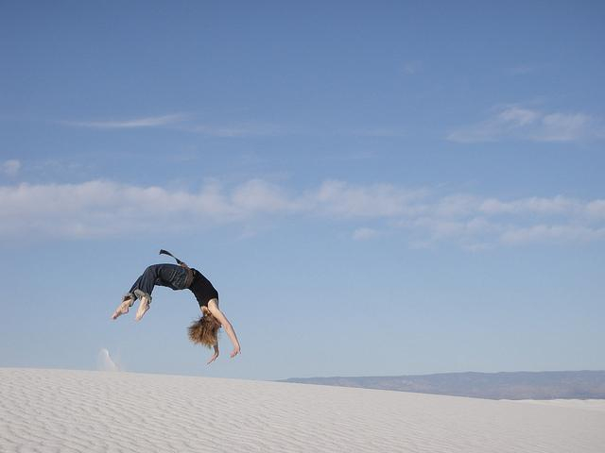
We flipped it!
We flipped it!

Slide 4



Librarian / Faculty Collaboration
Virginia Pannabecker
Health Sciences Librarian
Cristina Barroso
Asst Professor, Nutrition
Jessica Lehmann
Instructor, Nutrition

Slide 5

Overall approach
Faculty involvement
  Content planning
  Integrated with course
  Points or Extra Credit
  Assessment
Pre-assignment
  Delivered via Library Guide
  Librarian Self-Intro
  General library services
  Course-related content
  Quiz & Comments
In-class activities
  Questions / clarification
  Apply pre-learning
  New skills

Slide 6
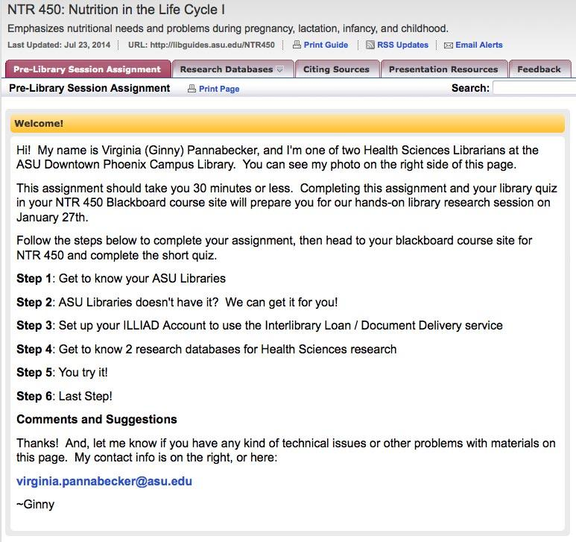
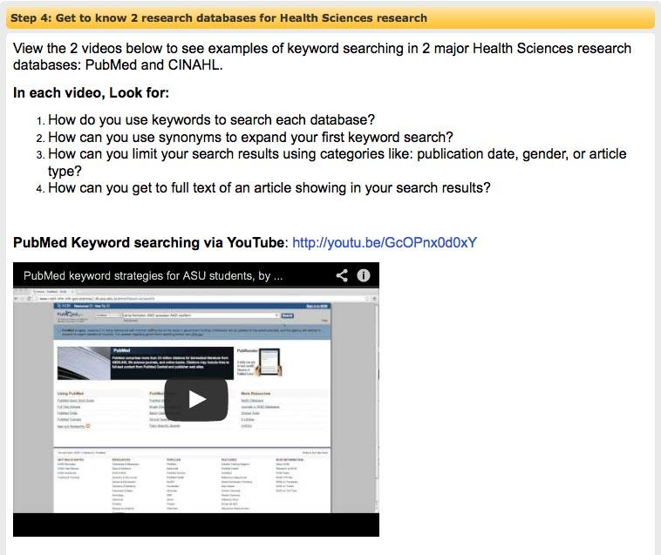
NTR 450
Nutrition in the Life Cycle
Notes:
Pre-library session library course guide activity focus
-general library accounts and services
-Basic and advanced keyword searching in PubMed and CINAHL, limiting to article types, limiting publication date

Slide 7
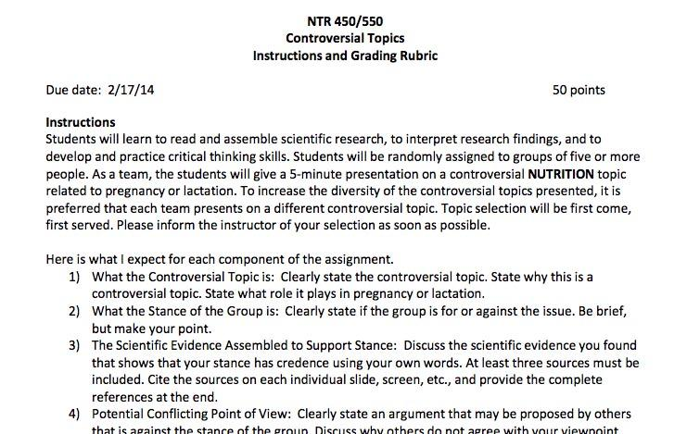
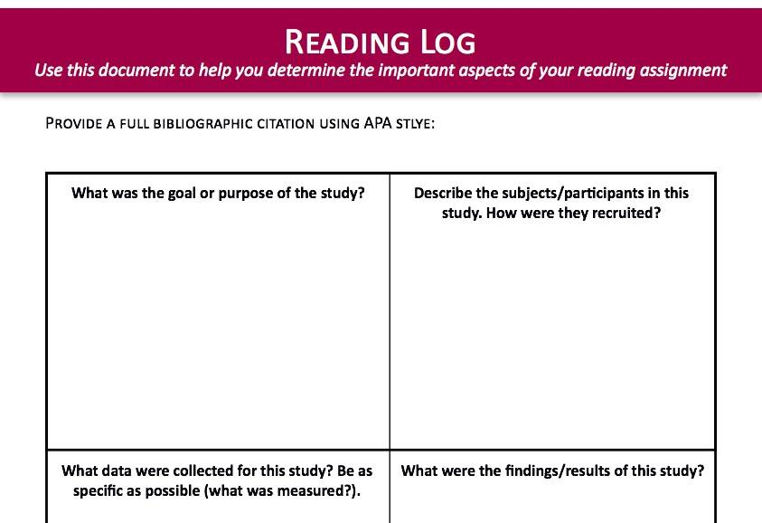
NTR 450
Nutrition in the Life Cycle
Notes:
In-class session
-Course instructor covers elements of research study articles (intro, methodology, results, discussion/conclusion)
-Q&A about pre-learning assignment
-Students get into groups for ‘controversial topics’ assignment
-In group: Students use pre-learning assignment searching skills knowledge and practice to search PubMed, CINAHL or other research databases to find relevant research studies on their group’s topic.
-In group: Students choose a high quality, relevant research study related to their topic and complete the Reading log including a citation of the study in APA style
*This session demonstrated integration of pre-learning with course-focused assignment and peer-learning through group work. Faculty and librarian had opportunities to work with each group as needed at their group’s step in the research process, and work through any difficulties with students’ participating in resolving any issues such as refining or changing topics, developing stronger, more sophisticated research strategies, and identifying and choosing from recent research studies.

Slide 8
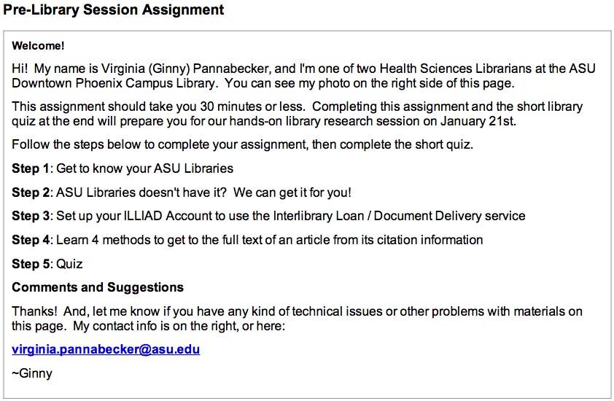
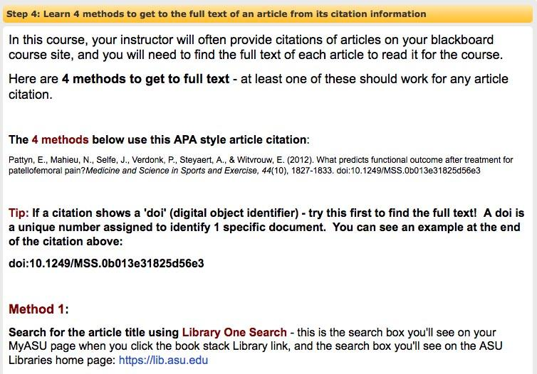
KIN 101
Introduction to Kinesiology
Notes:
Pre-library session library course guide activity focus
-general library accounts and services
-text guide to 4 methods to get to the full text of an article from its citation
In-class session
-Q&A about pre-learning assignment
-Practice getting to full text with citations
-Overview and try out basic keyword searching in PubMed

Slide 9
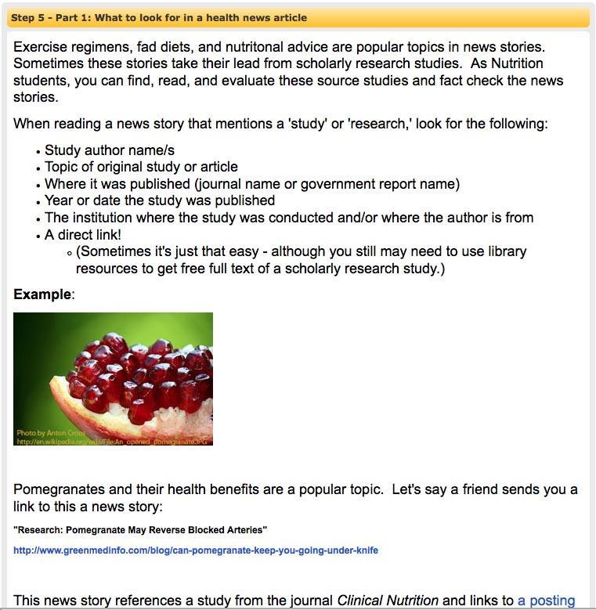
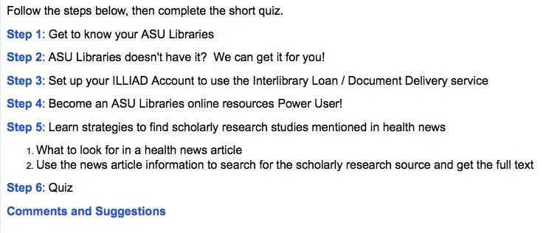
NTR 351
Nutrition and
Health Communications
Notes:
Pre-library session library course guide activity focus
-general library accounts and services
-Strategies to find a scholarly research study from a reference to the study in a health news article
In-class session
-Q&A about pre-learning assignment
-Practice finding a scholarly research study referenced in a health news article
-Review of basic keyword searching in PubMed; how to limit to article types, publication year, and see if a journal is peer-reviewed (using library full-text link resolver link to Ulrich’s periodical web database of journals)

Slide 10

Going forward
Assessment
Design
Tailored videos
Controlled study
Notes:
A little more assessment
Improve design of pre-library assignments
Example: http://libguides.asu.edu/HSC210
Further tailor video examples to course content
Plan and implement controlled study to measure effectiveness
A little more assessment
Prioritize end of in-class session feedback forms
Try out faculty and student feedback forms later in the semester
Use these experiences and design training for further improvement of pre-library assignmments
February Teaching Online Boot Camp learning to inform effective online course guide, assignment, and activity development
Example of initial starting point: HSC 210 course guide: http://libguides.asu.edu/HSC210
Goal for all course / research guides: designed to be useable as self-paced guide (from online bibliography to learning object…(?))
Create more videos with searching examples
Begin planning controlled study of effectiveness of this type of instruction, both for in-person and online (Spring or Fall 2015)
Apply testing methods (?)

Slide 11
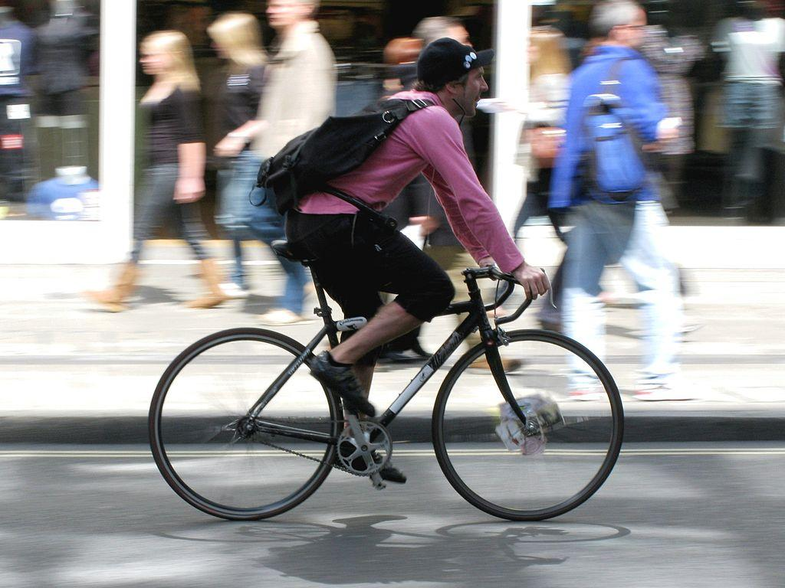
Takeaways
Notes:
-faculty/librarian collaboration is key - faculty requiring students to complete pre-learning (through ‘participation’ points, separate point assignment, extra credit, etc.), and being invested in the in-class activity is essential to making a flipped class successful.
-opportunity for common base of understanding between students themselves and with librarian
-opportunity to introduce self prior to session: recognition of who librarian is, goals of library session, how it will be valuable to them in their class/es --> noticed immediate friendliness of students at beginning of classes, more open to immediately responding and answering / asking questions
-adding intro of each service, resource ; adding 'look for' points --> provide students clear indication of goal of each pre-learning activity
-group work - absolutely a successful way to motivate engaged participation during in-class follow up session. The class that didn't have group work had much lower participation
-may be best for upper level courses; or if introductory, keep it simple for pre-session and in-class
-activity that provides work towards course assignment = also a motivator
-Longitudinal study needed to gauge retention of learning over time (garza article)

Slide 12
Tools
Screenshots
  Grab, Snippy, Snagit
Image editor
  Photoshop, Paint, Awesomescreenshot
Tutorial creation
  Guide on the Side: http://code.library.arizona.edu/
  LessonPaths: http://www.lessonpaths.com/
Surveys
  Google Forms, SurveyMonkey, LibGuides tools
Platform
  Library Guide, Course Management system, Wiki

Slide 13
References
Arizona State University. (2013). ASU Quick Facts. http://uoia.asu.edu/sites/default/files/quickfacts/Quick_Facts_Fall_2013_02-14-14.pdf
Arnold-Garza, S. (2014). The flipped classroom: Assessing an innovative teaching model for effective and engaging library instruction. C&RL News, Jan, 10-13.
Bergmann, J. & Sams, A. (2012). Flip your classroom: Reach every student in every class every day. Alexandria, VA: International Society for Technology in Education (ISTE).
Datig, I. and Ruswick, C. (2013). Four quick flips: Activities for the information literacy classroom. C&RL News, May, 249-251,257.
Head, A. (2013a). Learning the ropes: How freshmen conduct course research once they enter college [report]. Project Information Literacy. Retrieved from http://projectinfolit.org/images/pdfs/pil_2013_freshmenstudy_fullreport.pdf
McLaughlin, J. E., Roth, M. T., Glatt, D. M., Gharkholonarehe, N., Davidson, C. A., Griffin, L. M., ... & Mumper, R. J. (2014). The flipped classroom: a course redesign to foster learning and engagement in a health professions school. Academic Medicine, 89(2), 236-243. 10.1097/ACM.0000000000000086.
Pannabecker, V., Barroso, C., & Lehmann, J. (in press.) The flipped classroom: Student-driven library research sessions for nutrition education. Internet Reference Services Quarterly.

Slide 14
Images
Jump ropes: http://www.flickr.com/photos/rmgimages/4882443974/in/photostream/
Stethoscope on computer: http://www.flickr.com/photos/67272961@N03/6123892769/in/photostream/
Apple with tape measure: http://www.flickr.com/photos/rmgimages/4881836711/
ASU Downtown: http://en.wikipedia.org/wiki/File:ASU_Downtown_-_SoJ_SWC_-_2008-12-29.jpg
Sand Dune flip: https://flic.kr/p/7VnbQz
Student: https://www.flickr.com/photos/83633410@N07/7658219802/
Beach-future: https://flic.kr/p/vRWE3
Bicycle courier: http://commons.wikimedia.org/wiki/File%3ABicycle_courier_552.JPG
Questions: https://flic.kr/p/ediLaQ

Slide 15
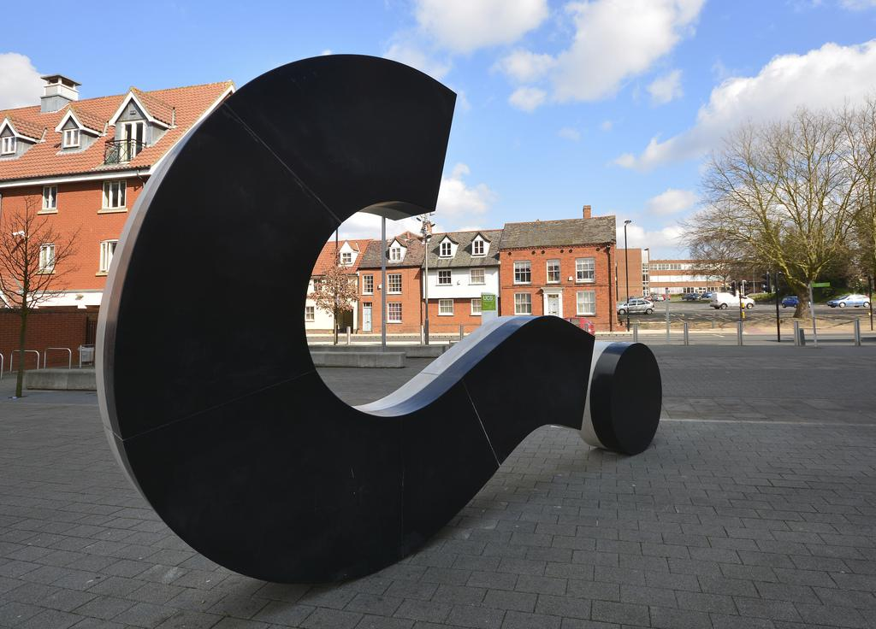
GinnyP@vt.edu

